Slide 1
MEDUSA Methane Engine Design for Unmanned Small Aircraft
Test Readiness Review
University of Colorado at Boulder
03/05/2015
Customer: Dr. Ryan Starkey Advisor: Dr. Jelliffe Jackson
Team
Daniel Frazier Nathan Genrich Abram Jorgenson
Christopher Jirucha Crawford Leeds Huikang Ma
Alexander Truskowski Carlos Torres Corey Wilson
Notes:
Good afternoon everyone, we are the MEDUSA team. Thank you for joining our pdr review

Slide 2
Outline
Overview
Schedule
Testing
Budget
Project Overview and Schedule | Corey Wilson
Mechanical | Daniel Frazier
Software and Electronic | Crawford Leeds
Budget | Crawford Leeds
Project Overview
Mechanical
Software and Electronic
Budget
Engine Integration
Notes:
I will start this presentation with the project description and baseline design. I will then pass it off to my colleagues to discuss the feasibility analysis for each of the critical element which including engine control unit, fuel delivery system and combustion can. I will then finish by providing a project summary

Slide 3
Project Statement
Project Description: Modify a JetCat P90-RXi mini turbo jet engine to run on gaseous methane fuel to address the USAF’s interest in the possible use of the methane gas as fuel.
Functional Requirements
Engine Control Unit (ECU) | Start, run, and shut down engine Maintain JetCat recommended safe operation conditions Log data
Fuel Delivery System (FDS) | Deliver up to 4.2g/s of methane to combustion can Deliver kerosene/oil mix to bearings at stock rates
Project Overview
Mechanical
Software and Electronic
Budget
Engine Integration

Slide 4
PROJECT OVERVIEW
Notes:
This is our baseline design

Slide 5
Project CONOPS and Objective
RC Signal
RC Receiver
Current Stock Engine: JetCat P90-RXI
JetCat ECU
RPM and Temperature from Engine Sensor Board
Commands to pump/solenoids
Injection point
RPM < 130,000
Shaft
Lubrication Line
Exhaust Temp < 700ºC
Kerosene
Fuel/Lubricant

Slide 6
Project CONOPS and Objective
Mass Flow Controller
Safety Valves
Pressure Regulator
Commands to Controller
Methane Tank
Student ECU
Fuel Manifold
RPM and Temperature from Engine Sensor Board
Commands to pump/solenoids
RPM < 130,000
Student Engine Board
Will use stock sensors
Six Student
injectors
Use stock lubrication hardware
Exhaust Temp < 700ºC

Slide 7
Fuel System
Key
Physical Contact
Electrical Signal
Data
Provided
Purchased
Designed
Methane Tank
Mass Flow Controller
0.9 - 4.2 g/s
RC Controller
Kerosene Tank
Fuel Pump
Throttle Command
PWM
Lubrication System
Receiver
Lubrication Solenoid
ECU
RS-232
Engine
Injectors
T₅ < 700ºC
Input Receivers
Starter
Motor
Combustion Can
Compressor
Bearings
Turbine
Nozzle
Logic Algorithms
Injectors
PWM
ESB
Command Outputs
PWM
Hall Effect Sensor
0-2500 Hz
Cold Junction Compensation & Amplification
SPI

Slide 8
Critical Project Requirements
Requirement | Subsystem | Description
CPR.1 | FDS | The FDS shall deliver 0.9-4.2g/s ± 5% of methane to the combustion chamber
CPR.2 | FDS | The FDS shall deliver lubricant to the bearings at rates equal to or greater than stock rates
CPR.3 | ESB | The ESB shall read data from the existing thermocouple and hall effect sensor
CPR.4 | ESB | The ESB shall transmit sensor data to the ECU
CPR.5 | ESB | The ESB shall drive signals to engine hardware components
CPR.6 | ECU | The ECU shall implement open loop control to control fuel flow rate
CPR.7 | ECU | The ECU shall shutdown the engine should the exhaust temperature exceed 700ºC or the RPM exceed 130,000
CPR.8 | ECU | The ECU shall detect an ignition failure, shutoff fuel flow, and drive compressor
Project Overview
Mechanical
Software and Electronic
Budget
Engine Integration
Notes:
This slide is temporary. Just for verify the critical project requirement

Slide 9
SCHEDULE
Project Overview
Mechanical
Software and Electronic
Budget
Engine Integration
Notes:
This is our baseline design

Slide 10
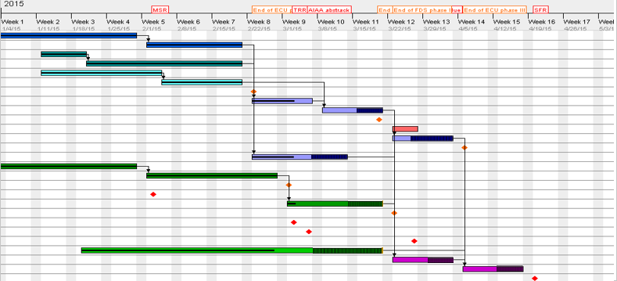
MEDUSA Current Work Plan
Where We Are
Week 10
Week 12
Week 14
FDS Phase I (Completed):
FDS components ordered, received and manufactured
FDS Phase II (In progress):
FDS seal and flow rate verification test
Lubrication flow rate date collection test
ECU Phase III:
ECU& ESB Board revision manufacturing if necessary
ECU and ESB board verified for engine integration
ECU Phase I (Completed):
ECU & ESB: Finished both prototypes, passed functional tests
Software: Individual functions complete
Simulator: LabView code complete and verified.
ECU Phase II (In progress):
ECU & ESB Board manufacturing
ECU hardware & software Integration
Engine simulator test - verify ECU requirements
Final System Test:
Integrating ECU and FDS with engine
Mock engine test with hardware
Methane engine test run – validate the project requirments
ECU phase II
ECU phase I (Completed)
Spring Break
FDS phase I (Completed)
ECU phase III
Electrical
Software
Labview
ECU Integration
Fuel Delivery
Lubrication
Engine Integration
MSR
TRR
Final system Test
FDS phase II
SFR

Slide 11
Testing Architecture & Presentation Layout
April 20
Level 3
Engine Functions With Methane
Fully integrated engine test
Spring Break
Level 2
Drive mechanical components with ECU/ESB
Mock engine test with hardware
Lubrication Flowrate Data Collection
ECU/ESB Integration
Engine simulation with Labview
TRR
Level 1
Seal & Flow
Rate Checks
ECU/ESB
Chip Tests
ECU Function Development
MSR
Mechanical
Electrical
Software
Verification Test
Project Overview
Mechanical
Software and Electronic
Budget
Engine Integration

Slide 12
Testing Architecture & Presentation Progress
April 20
Level 3
Engine Functions With Methane
Fully integrated engine test
Spring Break
Level 2
Drive mechanical components with ECU/ESB
Mock engine test with hardware
Lubrication Flowrate Data Collection
ECU/ESB Construction
Engine simulation with Labview
TRR
Level 1
Seal & Flow
Rate Checks
Seal & Flow
Rate Checks
ECU/ESB
Chip Tests
ECU Function Development
MSR
Mechanical
Electrical
Software
Verification Test
Project Overview
Mechanical
Software and Electronic
Budget
Engine Integration
Notes:
This is our baseline design

Slide 13
Methane Delivery: Flow Rate Verification
Run Engine With Methane
CPR.1
Deliver methane from
0.9 - 4.2 g/s (Idle to Full Thrust)
Must validate system and predictive models
Pressure vs Flow Rate Flow rate vs Temp
CPR.1
Meet flow rate command within 5%
Project Overview
Mechanical
Software and Electronic
Budget
Engine Integration

Slide 14
Methane Delivery: Seal Verification
Goal: Verify system has leak rate below 4% of commanded flow rate
Performed with air at Boulder Municipal with a blast tunnel
125 PSI (Maximum operational pressure)
Fuel Injectors
Air Compressor
Safety Valves
Mass Flow Controller
Check Valve
Pressure Gauge
$$\frac{∆Gauge}{Time}=Leakage<$$
5% total mass in tubes
$$Ideal Gas Law with air: 5psi/s{at 125PSI}$$
Equivalent methane leak within OSHA standards
Jan 30 8hr Remain Mar 10

Slide 15
Methane: Pressurized Delivery Verification
Goal: Verify systems delivers methane within 5% of commanded rate (CPR.1)
Performed with air at Boulder Municipal with a blast tunnel
Manual Control
0.9-4.2g/s
Flowrate Delivered
Error < 1% of Commanded Rate
Relief Valve at operational engine pressure
Fan Disperses Methane
Check Valve
Safety Valves
Mass Flow Controller
Fuel Injectors
Air Compressor
Pressure Vessel

Slide 16
Methane: Pressurized Delivery Verification
Goal: Verify systems delivers methane within 5% of commanded rate (CPR.1)
Performed with air at Boulder Municipal with a blast tunnel
Command Error
Leak Error from controller to injectors
Total Delivery Error < 5% Commanded
Manual Control
0.9-4.2g/s
Flowrate Delivered
Fan Disperses Methane
Check Valve
Safety Valves
Mass Flow Controller
Fuel Injectors
Relief Valve at operational engine pressure
Air Compressor
Pressure Vessel
Mar 4 10hr Remain Mar 15

Slide 17
Testing Architecture & Presentation Progress
April 20
Level 3
Engine Functions With Methane
Fully integrated engine test
Spring Break
Level 2
Drive mechanical components with ECU/ESB
Mock engine test with hardware
Lubrication Flowrate Data Collection
Lubrication Flowrate Data Collection
ECU/ESB Construction
Engine simulation with Labview
TRR
Level 1
Seal & Flow
Rate Checks
ECU/ESB
Chip Tests
ECU Function Development
MSR
Mechanical
Electrical
Software
Verification Test
Project Overview
Mechanical
Software and Electronic
Budget
Engine Integration
Notes:
This is our baseline design

Slide 18
Lubrication: Experimental Test
Run Engine With Methane
CPR.2
Lubricate bearings to prevent seizing
Will use stock rates, but these are unknown
No documentation, determine experimentally
Project Overview
Mechanical
Software and Electronic
Budget
Engine Integration

Slide 19
Lubrication: Experimental Test
Goal: Find flow through Lubrication Solenoid
Performed with kerosene at Boulder Municipal with a blast tunnel
Flowmeter
Flowmeter
2
1
Fuel Can
Pump
Lubrication Solenoid
Fuel
Solenoid
1
2
Bearing
Lubrication
Bearings
Injectors
On Hold because of weather
Jan 20 5hr Remain Mar 14

Slide 20
Lubrication: Calibration & Error Test Results
Goal: Calibrate flowmeters and calculate test error
Performed in Dr. Starkey’s lab with fire extinguisher
250ml Graduated Cylinder
Fuel Can
1-3V Power Supply
Flowmeters
Filter
1
2
Pump
Pulses/Quantity=Calibration Factor
 | Omega 601b | Equflow 0045
Tested | 29000 | 116000
Manufacturer | 36000 | 110000
Relative Flowmeter Error
1
2

Slide 21
Lubrication: Calibration & Error Test Results
Goal: Calibrate flowmeters and calculate test error
Performed in Dr. Starkey’s lab with fire extinguisher
250ml Graduated Cylinder
Fuel Can
1-3V Power Supply
Flowmeters
Filter
1
2
Pump
Pulses/Quantity=Calibration Factor
Relative Error
Calibration Error
 | Omega 601b | Equflow 0045
Tested | 29000 | 116000
Manufacturer | 36000 | 110000
$$\frac{σ}{\sqrt{N}}$$
1
2
Error

Slide 22
Lubrication: Calibration & Error Test Results
Goal: Calibrate flowmeters and calculate test error
Performed in Dr. Starkey’s lab with fire extinguisher
Fuel Can
1-3V Power Supply
Flowmeters
Filter
1
2
250ml Graduated Cylinder
Pump
45 Tests, 6 most refined procedures
Relative Error
Calibration Error
0.001±0.046mL/s
0.014±0.011mL/s
0.07mL/s
2% of Max Achievable Throttle
Jan 20 10hr Remain Mar 14

Slide 23
Lubrication: Remaining Work
ECU
Complete Engine Testing
Analyze data
Prove ECU can operate lubrication system (CPR.2)
Drive pump with ECU
Check flow rate produced
Test in Dr. Starkey Lab with
fire extinguisher
Predicted 30 hours, has taken 60 so far
15 hours to go
Not a scheduling problem
Filter
Pump
Lubrication Solenoid
250ml Graduated Cylinder
Engine Lubrication Tubing
$$\frac{Fuel Delivered}{Time}=Flow Rate$$

Slide 24
Testing Architecture & Presentation Progress
April 20
Level 3
Engine Functions With Methane
Fully integrated engine test
Spring Break
Level 2
Drive mechanical components with ECU/ESB
Mock engine test with hardware
Lubrication Flowrate Data Collection
ECU/ESB Construction
Engine simulation with Labview
TRR
Level 1
Seal & Flow
Rate Checks
ECU/ESB
Chip Tests
ECU Function Development
ECU Function Development
MSR
Mechanical
Electrical
Software
Verification Test
Project Overview
Mechanical
Software and Electronic
Budget
Engine Integration
Notes:
This is our baseline design

Slide 25
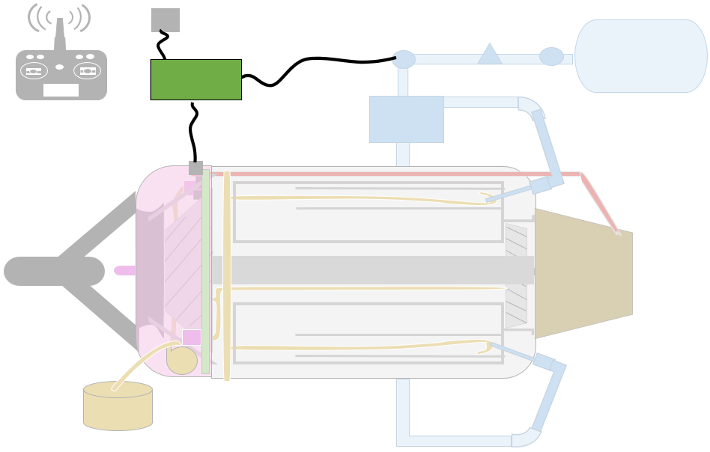
Software/Electronics: Command Testing
Run Engine With Methane
Engine Control Unit
Engine Control Unit
Engine Sensor Board
CPRs. 3-8
Control engine state
Check safety conditions
Test functionality without risking engine damage
Project Overview
Mechanical
Software and Electronic
Budget
Engine Integration

Slide 26
Electrical/Software: Command Flow
Key
Raw Data
Raw
Sensor Data
Processed
Sensor Data
Processed Data
Student Engine Sensor Board
(ESB)
Student Engine Control Unit
(ECU)
Command
Component
Stock Engine Components
Component Commands
RC Command
Methane Delivery System

Slide 27
Electrical/Software: Command Flow
Key
Signals from/to Stock Hardware
Electronic Data and Commands
Raw Data
RPM Sensor
RPM
Processed Data
Student Engine Sensor Board
(ESB)
Student Engine Control Unit
(ECU)
Command
Thermocouple
TEMP
Component
Starter Motor
Starter Motor
Pump
Pump
RC Command
Solenoid
Solenoid
Glow Plug
Glow Plug
Combustor
Methane Delivery System
Flow Control

Slide 28
Software Test & Integration Status
Electronic Data and Commands
Item | Signal Type | Individual simulated test | Individual Hardware Test | Integration and Test | Time Remaining
 | PWM
 | f Modulation
 | SPI
 | PWM
 | On/Off
 | On/Off
 | On/Off
 | RS-232
RPM
TEMP
Complete
Complete
Starter Motor
Complete
RC Command
Complete
Pump
Complete
Solenoid
Complete
Glow Plug
Complete
5 Hours Remaining
Predicted 92 Hours, Spent 60
Flow Control
Jan 1 8hr Remain Mar 7

Slide 30
Testing Architecture & Presentation Progress
April 20
Level 3
Engine Functions With Methane
Fully integrated engine test
Spring Break
Level 2
Drive mechanical components with ECU/ESB
Mock engine test with hardware
Lubrication Flowrate Data Collection
ECU/ESB Construction
ECU/ESB Construction
LabView Engine Simulator Test
Engine simulation with Labview
TRR
Level 1
Seal & Flow
Rate Checks
Complete
ECU/ESB
Chip Tests
ECU/ESB
Chip Tests
ECU Function Development
MSR
Mechanical
Electrical
Software
Verification Test
Project Overview
Mechanical
Software and Electronic
Budget
Engine Integration
Notes:
This is our baseline design

Slide 31
Electrical/Software: Command Flow
Key
Raw Data
Signals from/to Stock Hardware
Electronic Data and Commands
Processed Data
Command
RPM Sensor
RPM
Student Engine Sensor Board
(ESB)
Student Engine Control Unit
(ECU)
Component
Thermocouple
TEMP
Starter Motor
Starter Motor
Pump
Pump
RC Command
Solenoid
Solenoid
Glow Plug
Glow Plug
Injectors
Methane Delivery System
Flow Controller

Slide 32
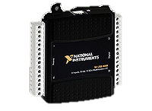
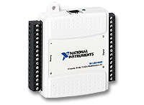
LabView Simulation Test
Key
Goal: Verify CPRs 3-8 are met in a simulated environment without danger to the engine
Performed in a computer lab
Raw Data
Signals from/to Stock Hardware
Electronic Data and Commands
Processed Data
Command
RPM Sensor
RPM
Student Engine Sensor Board
(ESB)
Student Engine Control Unit
(ECU)
Component
Thermocouple
TEMP
Starter Motor
Starter Motor
Pump
Pump
RC Command
Solenoid
Solenoid
Glow Plug
Glow Plug
Flow Controller

Slide 33
Full Engine Simulator Test
Goal: Verify CPRs 3-8 are met in a simulated environment without danger to the engine
Performed in a computer lab
RPM Sensor
Thermocouple
Starter Motor
Pump
Solenoid
Glow Plug
Flow Controller

Slide 34
Full Engine Simulator Test
Goal: Verify CPRs 3-8 are met in a simulated environment without danger to the engine
Performed in a computer lab
Signals from/to stock hardware | Expected Signal | Acceptable
 | 0-2400Hz (0-144,000 RPM) | Simulated
 | 0-41mV (0-1000ºC) | Simulated
 | 0-8V PWM, 555kHz, 39% Duty Cycle | ±0.5V, ±5kHz ±1% Duty Cycle
 | 0.5V | ±0.01V
 | 10V | ±1V
 | 10V | ±1V
 | RS-232 ASCII From ECU | <3% Baud Rate Error
Engine Run Sequence
RPM Sensor
Wait For User Command
Startup
Engine Running Control Loop
Thermocouple
Starter Motor
Shutdown
Pump
Solenoid
Glow Plug
Emergency Shutdown
Flow Controller
Mar 9 25hr Remain Mar 23

Slide 35
Testing Architecture & Presentation Progress
April 20
Level 3
Engine Functions With Methane
Integrated Engine Test
Spring Break
Level 2
Drive mechanical components with ECU/ESB
Mock Engine Test
Drive mechanical components with ECU/ESB
Mock Engine Test
Lubrication Flowrate Data Collection
ECU/ESB Construction
LabView Engine Simulator Test
TRR
Level 1
Seal & Flow
Rate Checks
ECU/ESB
Chip Tests
ECU Function Development
MSR
Mechanical
Electrical
Software
Verification Test
Project Overview
Mechanical
Software and Electronic
Budget
Engine Integration
Notes:
This is our baseline design

Slide 36
LabView Simulation Test
Key
Goal: Verify CPRs 3-8 are met in a simulated environment without danger to the engine
Performed in a computer lab
Raw Data
Signals from/to Stock Hardware
Electronic Data and Commands
Processed Data
Command
RPM Sensor
RPM
Student Engine Sensor Board
(ESB)
Student Engine Control Unit
(ECU)
Component
Thermocouple
TEMP
Starter Motor
Starter Motor
Pump
Pump
RC Command
Solenoid
Solenoid
Glow Plug
Glow Plug
Flow Controller

Slide 37
Mock Engine Test
Key
Goal: Verify CPRs 3-8 are met using engine hardware without danger to the engine
Performed with air at Boulder Municipal with a blast tunnel
Raw Data
Signals from/to Stock Hardware
Electronic Data and Commands
Processed Data
Command
RPM Sensor
RPM
Student Engine Sensor Board
(ESB)
Student Engine Control Unit
(ECU)
Component
Thermocouple
TEMP
Run as in engine operation
Not Connected to each other or the engine
Starter Motor
Starter Motor
Pump
Pump
RC Command
Solenoid
Solenoid
Glow Plug
Glow Plug
Pressure Vessel
Methane Delivery System
Flow Controller

Slide 38
Mock Engine Test
Goal: Verify CPRs 3-8 are met using engine hardware without danger to the engine
Performed with air at Boulder Municipal with a blast tunnel
RPM Sensor
Thermocouple
Starter Motor
Pump
Solenoid
Glow Plug
Flow Controller

Slide 39
Mock Engine Test
Goal: Verify CPRs 3-8 are met in a simulated environment without danger to the engine
Performed with air at Boulder Municipal with a blast tunnel
Signals from/to stock hardware | Expected Operation | Passing Operation Range
 | 0-2400Hz (0-144,000 RPM) | Simulated
 | 0-41mV (0-1000ºC) | Simulated
 | Results TBD | Results TBD
 | On/Off | On/Off
 | 0.9-4.2 g/s | ±5% commanded rate
Engine Run Sequence
RPM Sensor
Wait For User Command
Startup
Engine Running Control Loop
Thermocouple
Starter Motor
Shutdown
Pump
Solenoid
Glow Plug
Emergency Shutdown
Flow Controller
Mar 20 40hr Remain Apr 4

Slide 40
Testing Architecture & Presentation Progress
April 20
Level 3
Engine Functions With Methane
Fully integrated engine test
Engine Functions With Methane
Spring Break
Level 2
Drive mechanical components with ECU/ESB
Mock engine test with hardware
Lubrication Flowrate Data Collection
ECU/ESB Construction
Engine simulation with Labview
TRR
Level 1
Seal & Flow
Rate Checks
ECU/ESB
Chip Tests
ECU Function Development
MSR
Mechanical
Electrical
Software
Verification Test
Project Overview
Mechanical
Software and Electronic
Budget
Engine Integration
Notes:
This is our baseline design

Slide 41
Mock Engine Test
Key
Goal: Verify CPRs 3-8 are met using engine hardware without danger to the engine
Performed with air at Boulder Municipal with a blast tunnel
Raw Data
Signals from/to Stock Hardware
Electronic Data and Commands
Processed Data
Command
RPM Sensor
RPM
Student Engine Sensor Board
(ESB)
Student Engine Control Unit
(ECU)
Component
Thermocouple
TEMP
Run as in engine operation
Not Connected to each other or the engine
Starter Motor
Starter Motor
Pump
Pump
RC Command
Solenoid
Solenoid
Glow Plug
Glow Plug
Pressure Vessel
Methane Delivery System
Flow Controller

Slide 42
Integrated Engine Test
Key
Goal: Successful operate engine with methane; Verify all requirements (CPR 1-8)
Performed with methane at Boulder Municipal with a blast tunnel
Raw Data
Signals from/to Stock Hardware
Electronic Data and Commands
Processed Data
Command
RPM Sensor
RPM
Student Engine Sensor Board
(ESB)
Student Engine Control Unit
(ECU)
Component
Thermocouple
TEMP
Starter Motor
Starter Motor
Pump
Pump
RC Command
Solenoid
Solenoid
Glow Plug
Glow Plug
Combustor
Methane Delivery System
Flow Controller

Slide 43
Integrated Engine Test
Goal: Successful operate engine with methane; Verify all requirements (CPR 1-8)
Performed with methane at Boulder Municipal with a blast tunnel
 | Engine Process | Data Collected | Performance Characterization
Objective 1 | Startup | RPM | Maintain engine speed above 35kRPM?
Objective 2 | Shutdown & Emergency Shutdown | Shutdown & Emergency Shutdown | Engine shuts down safely
Objective 3 | Engine Running | RPM & Temperature | Below 130,000 RPM Temperature below 700ºC
Objective 4 | Engine Running | Temperature, & Mass Flow Rate | Flow Rate vs Temperature
Engine Run Sequence
Wait For User Command
Startup
Engine Running Control Loop
Shutdown
Emergency Shutdown
Apr 25hr Remain Apr 19

Slide 44
Critical Project Requirements
Requirement | Subsystem | Description
CPR.1 | FDS | The FDS shall deliver 0.9-4.2g/s ± 5% of methane to the combustion chamber
CPR.2 | FDS | The FDS shall deliver lubricant to the bearings at rates equal to or greater than stock rates
CPR.3 | ESB | The ESB shall read data from the existing thermocouple and hall effect sensor
CPR.4 | ESB | The ESB shall transmit sensor data to the ECU
CPR.5 | ESB | The ESB shall drive signals to engine hardware components
CPR.6 | ECU | The ECU shall implement open loop control to control fuel flow rate
CPR.7 | ECU | The ECU shall shutdown the engine should the exhaust temperature exceed 700ºC or the RPM exceed 130,000
CPR.8 | ECU | The ECU shall detect an ignition failure, shutoff fuel flow, and drive compressor
Project Overview
Mechanical
Software and Electronic
Budget
Engine Integration
Notes:
This slide is temporary. Just for verify the critical project requirement

Slide 45
BUDGET
Project Overview
Mechanical
Software and Electronic
Budget
Engine Integration
Notes:
This is our baseline design

Slide 46
Budget – MSR Recap
Total: $4,273

Slide 47
Budget – TRR Status
Total: $5,044

Slide 48
Budget – TRR Remaining

Slide 50
BACKUP SLIDES
Notes:
This is our baseline design

Slide 51
Methane: Delivery Verification (Detail)
Goal: Verify methane delivery within error bounds (CPR 3)
Relief Valve at operational engine pressure
Manual Control
Flowrate Delivered
Pressure Relief Valve
Fuel Injectors
Mass Flow Controller
Check Valve
Methane Cylinder
Shutoff Solenoid
Pressure Vessel

Slide 52
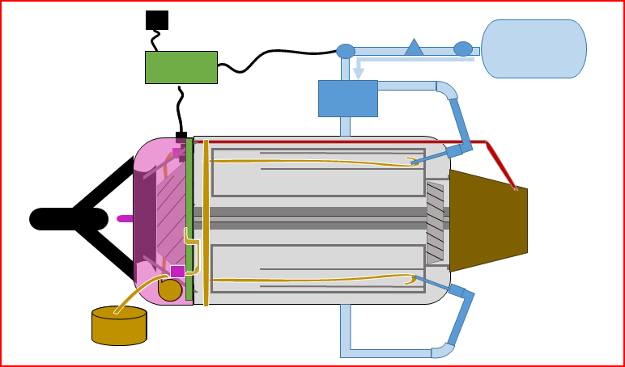
Thermocouple Input Software Test
Connect SPI interface to pins C4 throughC7
Temperature transmitted through SPI bus from ESB
Interrupt based.
Runs continuously
EGT used to regulate engine safety – 700º max
Feb 20 2 Hours Remaining Feb 28

Slide 53
Mass Flow Controller Output Software Test
Connect through RX/TX on pins C2, C3
Mass flow data transmitted via RS-232 communication protocol
Function based
Runs only when called
Mass flow used to control the engine throttle level
Feb 20 2 Hours Remaining Feb 28

Slide 54
RC Controller Software Test
Connect RC Receiver to pin D3
D3 – RC Throttle Input
Interrupt Based
Throttle input used to set the mass flow controller
Feb 20 2 Hours Remaining Feb 28

Slide 55
RPM Input Software Test
Connect RPM input to pin A6
Interrupt based
Must run continuously
RPM used to regulate engine safety – 130,000 max
RPM used to regulate the lubrication flow
Feb 20 2 Hours Remaining Feb 28

Slide 56
Starter Motor Output Software Test
Connect starter motor to pin E0
Starter motor receives PWM signal
Interrupt based
Runs continuously
Starter Motor used to start the engine, as well as safely cool engine in shut down
Feb 20 2 Hours Remaining Feb 28

Slide 57
Electrical/Software: Command Flow
RPM Sensor
RPM
Student Engine Sensor Board
(ESB)
Student Engine Control Unit
(ECU)
Thermocouple
TEMP
Starter Motor
Starter Motor
RC Command
Pump
Pump
Key
Solenoid
Solenoid
Raw Data
Glow Plug
Glow Plug
Processed Data
Injectors
Command
Methane Delivery System
Flow Controller
Component
Jan 1 5hr Remain Feb 22

Slide 58
Electrical/Software: Integrated Testing Part 1
Goal: Verify Engine Sensor Board reads and transmits engine status (CPR.8)
RPM Sensor
RPM
Student Engine Sensor Board
(ESB)
Thermocouple
TEMP
Simulated Input:
Function Generator
DC Power Supply
LabView
Recorded Output:
Oscilloscope
LabView
Key
Raw Data
Processed Data
Command
Component
Jan 1 5hr Remain Feb 22

Slide 59
Electrical/Software: Integrated Testing Part 2
Goal: Verify Engine Control Unit receives data and sends commands (CPR.X)
RPM
Student Engine Control Unit
(ECU)
TEMP
Starter Motor
RC Command
Pump
Key
Solenoid
Raw Data
Glow Plug
Processed Data
Command
Flow Controller
Component
Jan 1 5hr Remain Feb 22

Slide 60
Electrical/Software: Integrated Testing Part 3
Goal: Verify Engine Control Unit functions with Engine Sensor Board (CPR X)
RPM Sensor
RPM
Student Engine Sensor Board
(ESB)
Student Engine Control Unit
(ECU)
Thermocouple
TEMP
Starter Motor
RC Command
Pump
Key
Solenoid
Raw Data
Glow Plug
Processed Data
Command
Flow Controller
Component
Jan 1 5hr Remain Feb 22

Slide 61
Electrical/Software: Integrated Testing Part 4
Goal: Verify Engine Control Unit functions with Engine Sensor Board (CPR X)
RPM Sensor
RPM
Student Engine Sensor Board
(ESB)
Student Engine Control Unit
(ECU)
Thermocouple
TEMP
Starter Motor
Starter Motor
RC Command
Pump
Pump
Key
Solenoid
Solenoid
Raw Data
Glow Plug
Glow Plug
Processed Data
Command
Flow Controller
Component
Jan 1 5hr Remain Feb 22

