Slide 1

RAppelling Cave Exploration Rover
RACER
Team: Thomas Green, Michael Hanson, Nicole Harris, Hunter Hoopes, Dustin Larsen, Gregory McQuie, James Penrod, John Russo, Casey Zahorik
Customer: Barbara Streiffert
Advisor: James Nabity

Slide 2
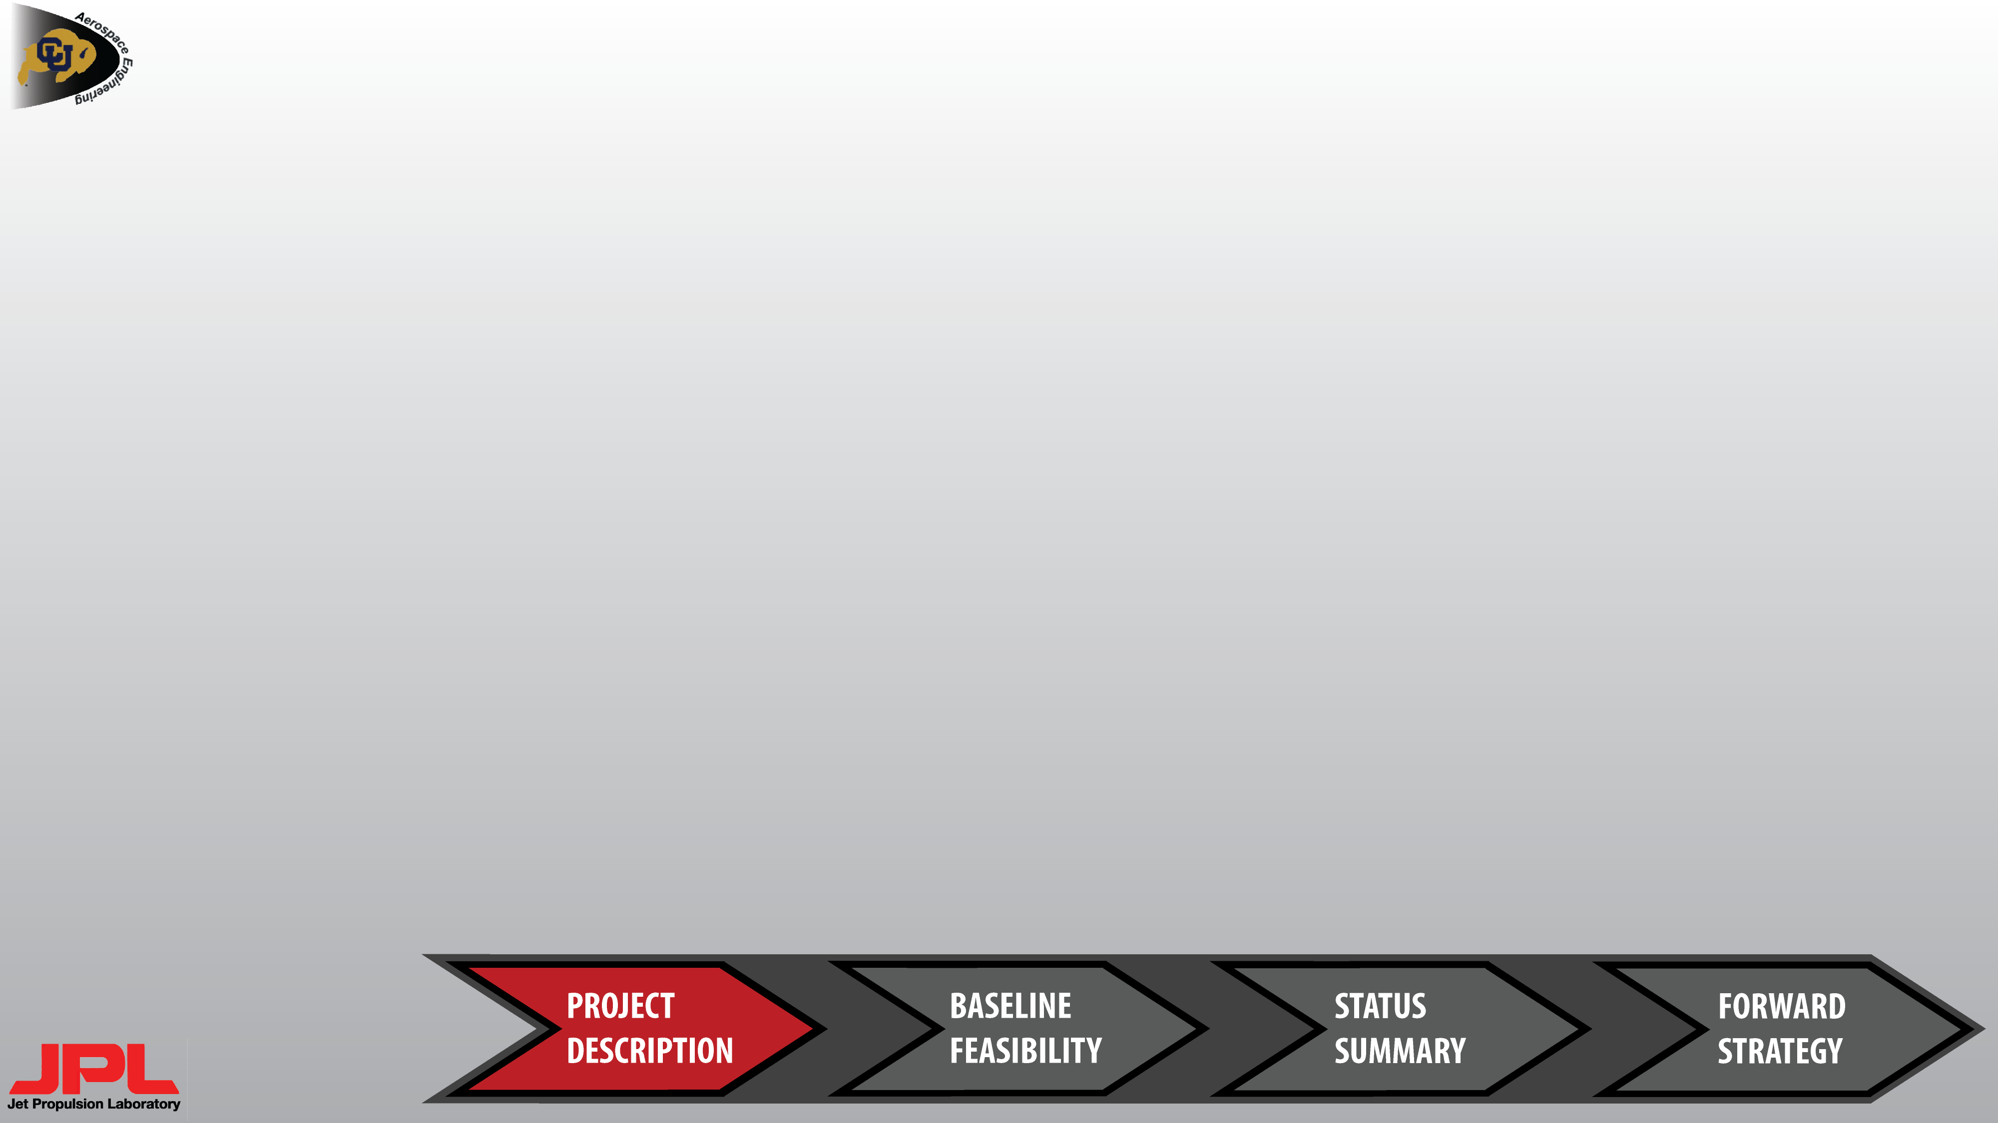
PROJECT DESCRIPTION OUTLINE
Previous Work
Definitions
Project Statement
CONOPS
Functional Block Diagram
Requirements Flow-Down
Baseline Design

Slide 3
PREVIOUS WORK
a
a
a
2008-2009
2009-2010
2010-2011
2011-2012
2012-2013
2013-2014
1st generation Mother Rover (MR)
Optical navigation system
2 COTS Child Rover (CR)
1st generation CR
2nd generation MR
2D ultrasonic “cricket” navigation system
CR imaging system
3rd generation MR
Deployable MR ramp
Enhanced relay COM system
2nd generation CR
CR rocker-bogie suspension
3rd generation CR
Sample identification based on color
CR sample collection and retrieval
4th generation CR
Ascend/descend slopes between 30$°$ and 70$°$ using suction fan
Dock with TREADS
4th generation MR
Sample storage
Multiple CR storage
Retractable ramp
LED-based automated docking system for STARR

Slide 4
DEFINITIONS
Adequate Scene Lighting – Lighting bright enough so that a 10cm diameter object 5m away from the camera is clearly resolved from the image background.
Cave/Pipe – A horizontal floor with a minimum of 5m radius area with small rocks no larger than 3cm in diameter on top of it. The MR will be fixed at the top of a 5m vertical surface above this floor. The ambient atmospheric conditions of the cave/pipe will be those of Earth.
Exploration – Descend the maximum 5m depth of the cave/pipe and traverse 5m radially from the touchdown location as commanded by the ground station (GS). The CR will take pictures for navigation that will be transmitted to the GS.
Feasibility – A project element must be shown to be achievable within project constraints such as power, mass, time and money. If a project element is shown to be feasible, it can proceed onto the next project phase without additional assessment.

Slide 5
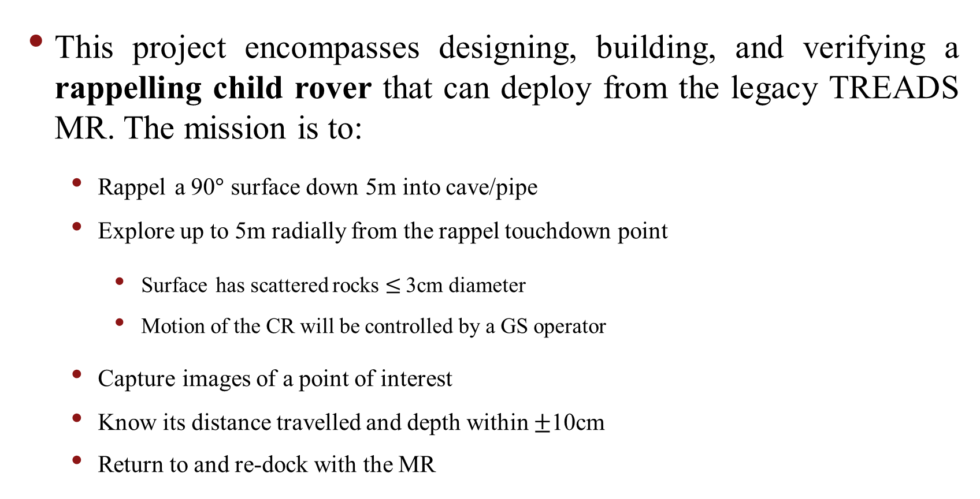
PROJECT STATEMENT
This project encompasses designing, building, and verifying a rappelling child rover that can deploy from the legacy TREADS MR. The mission is to:
  Rappel a 90$°$ surface down 5m into cave/pipe
  Explore up to 5m radially from the rappel touchdown point
    Surface has scattered rocks $≤$3cm diameter
    Motion of the CR will be controlled by a GS operator
  Capture images of a point of interest
  Know its distance travelled and depth within $±$10cm
  Return to and re-dock with the MR

Slide 6
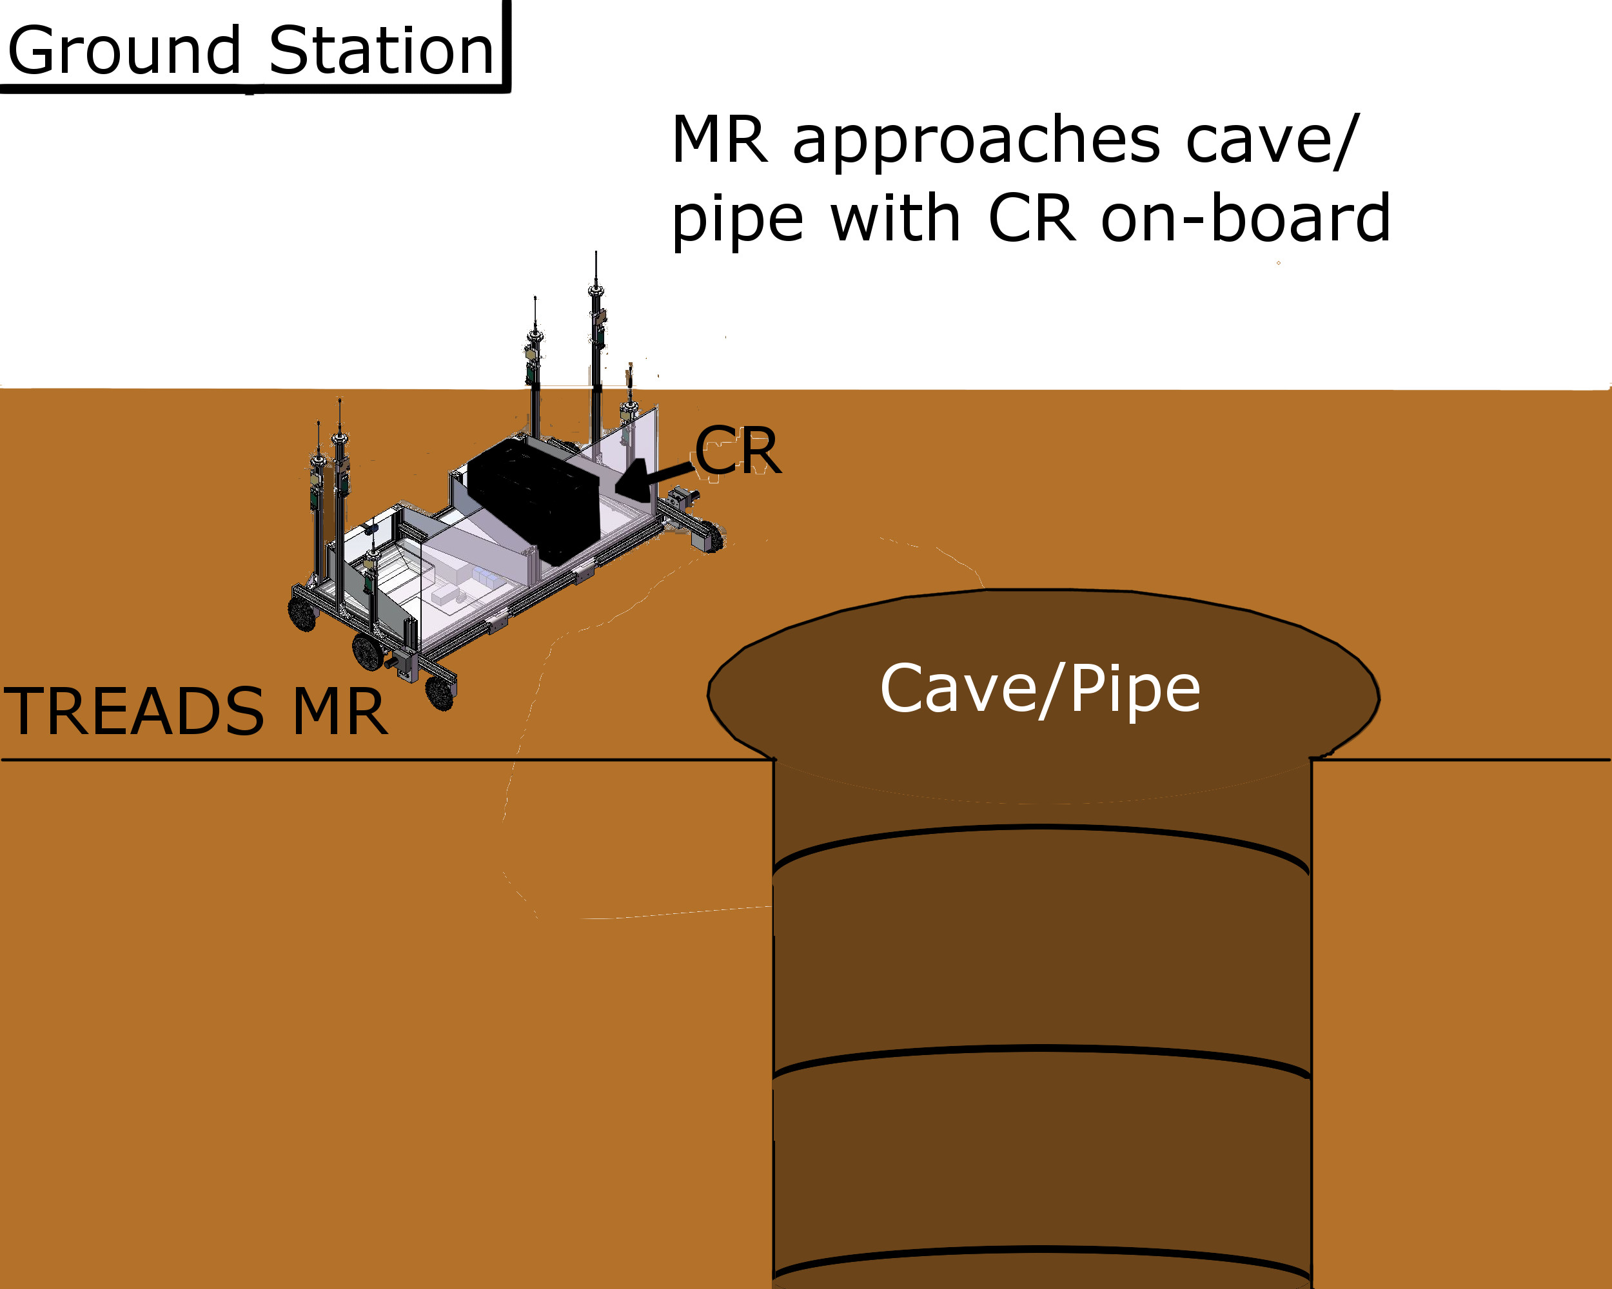
CONOPS

Slide 7
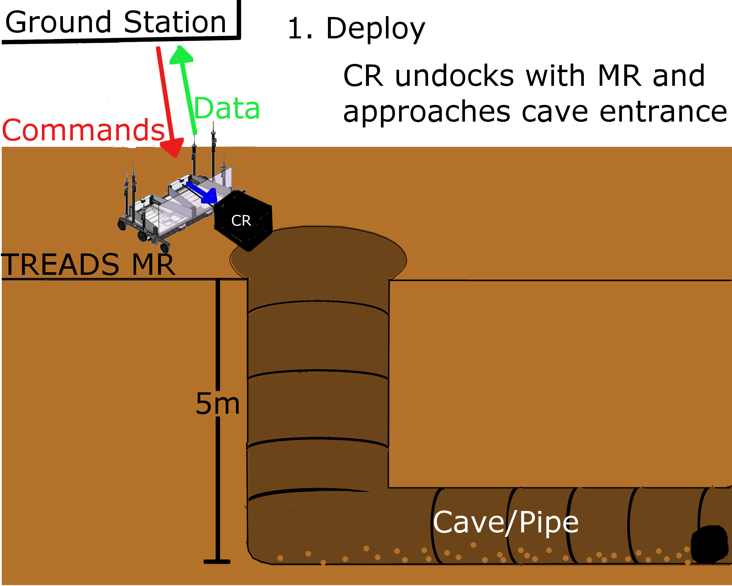
CONOPS – Deployment Stage

Slide 8
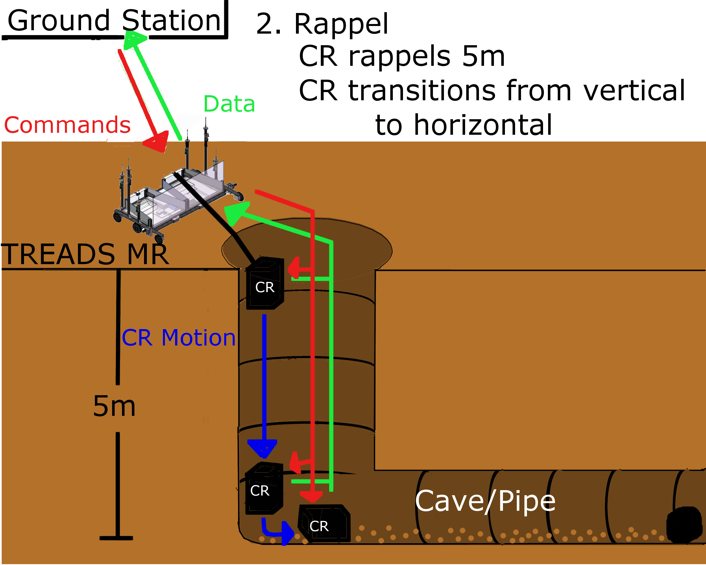
CONOPS – Rappelling Stage

Slide 9
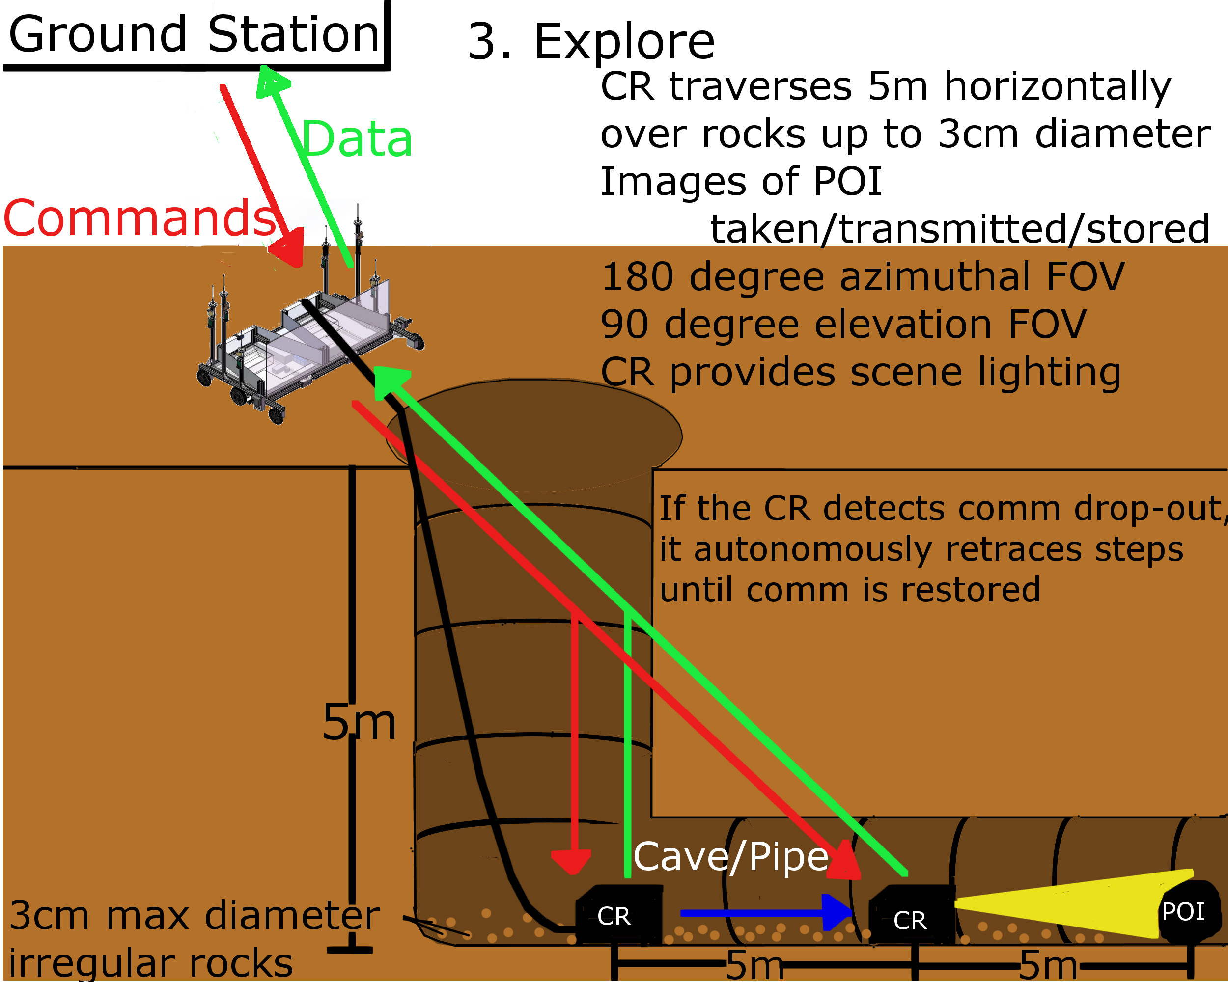
CONOPS - Exploration Stage

Slide 10
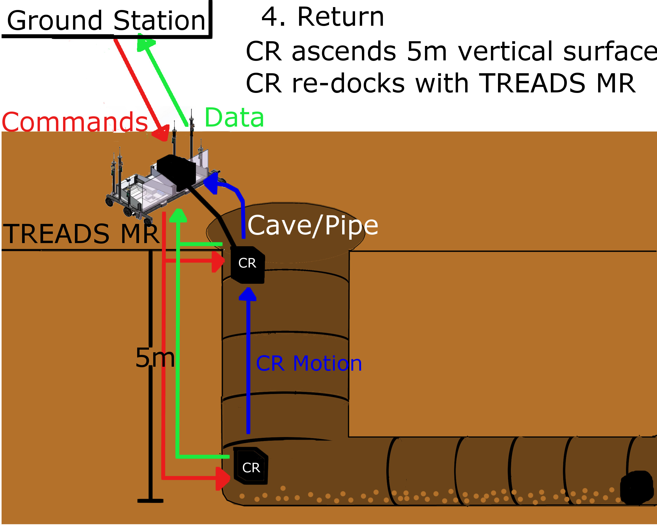
CONOPS – Return Stage

Slide 11
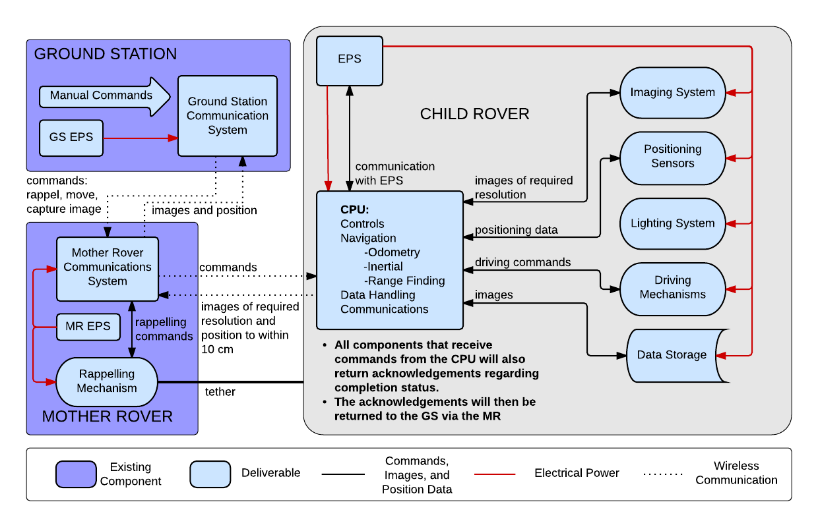
FUNCTIONAL BLOCK DIAGRAM

Slide 12
REQUIREMENTS FLOW-DOWN
Major Design Requirements from FR.1
FR.1: The CR shall use TREADS as the MR
Design Requirement Number | Description | Verification & Validation
DR.1.1 | The CR shall fit within the TREADS CR bay | Demonstration
DR.1.1.1 | The CR shall have length and width no greater than 0.483 x 0.483 m | Inspection
DR.1.1.2 | The CR shall have a mass of no more than 9.8 kg | Inspection
DR.1.2 | The CR shall un-dock and dock with the TREADS MR | Demonstration
DR.1.2.1 | The CR shall re-dock with the MR after completing is mission | Demonstration
DR.1.2.2 | The CR shall exit/enter the MR bay within a +/- 4.3 degree area | Testing – Undocking and docking
Notes:
Mention why certain requirements are bolded and some are not. Also mention the third columns purpose

Slide 13
REQUIREMENTS FLOW-DOWN
Major Design Requirements from FR.2
FR.2: The CR shall communicate with the GS via the MR
Design Requirement Number | Description | Verification & Validation
DR.2.1 | The CR shall receive commands from the GS via the MR | Testing – Comm
DR.2.1.1 | The CR shall receive rappelling commands | Testing – Comm
DR.2.1.2 | The CR shall receive commands to move a specific distance | Testing – Comm
DR.2.1.3 | The CR shall receive picture taking commands | Testing – Comm
DR.2.1.4 | The CR shall receive commands to turn on/off light source | Testing – Comm
DR.2.1.5 | The CR shall transmit data to the GS using the MR as a relay | Testing – Comm
DR.2.1.6 | The CR shall receive “transmission received” acknowledgements from the GS via the MR | Testing – Comm & Comm Drop-Outs
DR.2.2 | The CR shall be able to detect if communication with the MR is not available if “transmission received” acknowledgements are not received | Testing – Comm & Comm Drop-Outs
DR.2.2.1 | The CR shall retrace its previous driving steps until communications are reestablished | Testing – Comm Drop-Outs

Slide 14
REQUIREMENTS FLOW-DOWN
Major Design Requirements from FR.3
FR.3: The CR shall explore a cave/pipe
Design Requirement Number | Description | Verification & Validation
DR.3.1 | The CR shall be able to rappel slopes of 90$°$ inclination | Testing – Rappelling & Demonstration
DR.3.1.1 | The CR shall be able to rappel to a maximum depth of 5m | Testing – Rappelling, Inspection, Demonstration
DR.3.2 | The CR shall be able to transition from rappelling to travelling horizontally and vice versa | Testing – Rappelling & Demonstration
DR.3.3 | The CR shall be able to traverse a distance of up to 5m horizontally from the rappel touchdown point | Testing – Exploration
DR.3.3.1 | The CR shall be able to traverse a floor with small rocks no larger than 3cm in diameter | Testing – Exploration
DR.3.3.2 | The CR shall be able to go to a location of interest as commanded by the GS via the MR | Testing - Exploration
Notes:
Fade DR.3.1.1 and DR.3.3.1 - GM

Slide 15
REQUIREMENTS FLOW-DOWN
Major Design Requirements from FR.4
FR.4: The CR shall contain a positioning system
Design Requirement Number | Description | Verification & Validation
DR.4.1 | The CR shall know its depth and distance travelled from the MR | Met if DR.4.1.1 & DR.4.1.2 are met
DR.4.1.1 | The CR shall know its depth within $±$10 cm | Testing – Communication
DR.4.1.2 | The CR shall know its distance travelled within $±$10 cm | Testing – Communication
DR.4.2 | The CR shall be able to send position information to the GS via the MR | Testing - Communication

Slide 16
REQUIREMENTS FLOW-DOWN
Major Design Requirements from FR.5
FR.5: The CR shall capture photographic images
Design Requirement Number | Description | Verification & Validation
DR.5.1 | The imaging system shall record images | Testing – Low-Light Imaging
DR.5.2 | The CR shall be able to resolve objects of a 10 cm diameter at 5m distance | Testing – Low-Light Imaging
DR.5.2.1 | The imaging system shall have a minimum resolution of 200x200 pixels for a 54$°$x54$°$ FOV | Inspection
DR.5.3 | The CR shall be able to take photos within an azimuthal angular FOV of 180$°$ | Demonstration
DR.5.4 | The CR shall be able to take photos within an elevational angular FOV of 90$°$ | Demonstration
DR.5.5 | The imaging system light source shall provide a minimum 100 fc illumination of the POI | Testing – Low-Light Imaging
DR.5.6 | The CR shall be able to store at least 5 images | Inspection & Demonstration
DR.5.7 | The CR shall be able to transmit images to the GS via the MR | Testing – Communication

Slide 17
REQUIREMENTS FLOW-DOWN
Major Design Requirements from FR.6
FR.6: The CR and MR systems shall contain their own electrical power sources
Design Requirement Number | Description | Verification & Validation
DR.6.1 | The CR power system shall provide enough power for the CR to complete its mission | Testing & Analysis
DR.6.2 | The auxiliary MR power system shall provide enough power for the comm relay system as well as the rappelling system to operate as needed in the CR’s mission | Testing & Analysis

Slide 18
REQUIREMENTS FLOW-DOWN
Major Design Requirements from FR.7
FR.7: The CR, MR, and GS systems shall be controlled with software
Design Requirement Number | Description | Verification & Validation
DR.7.1 | The CR shall have functions to process commands as defined under FR.2 | Testing & Demonstration
DR.7.2 | The MR communication relay system shall have functions to relay transmissions between the CR and MR | Testing & Demonstration
DR.7.3 | The GS shall have functions to accept user inputs to control the CR using commands as defined under FR. 2 | Testing & Demonstration
Notes:
Testing - All Types should be reworded

Slide 19
BASELINE DESIGN PROCESS
Identify design driving requirements
Synthesize a system-level design
Pinpoint areas for trade studies
Perform trade studies for vital subsystems
Verify requirements

Slide 20
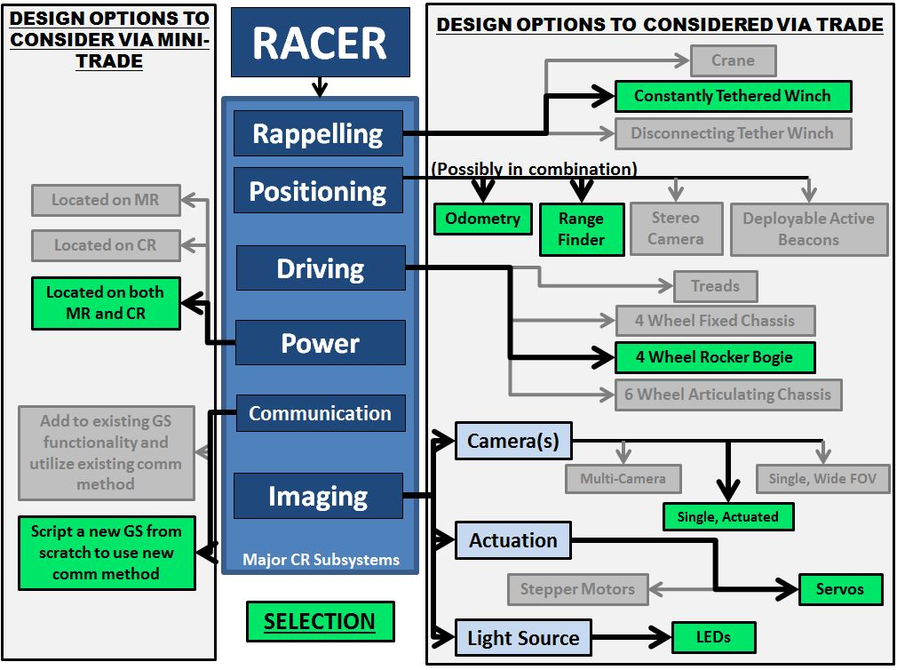
DESIGN OPTIONS CONSIDERED
TRADE METRICS
Mass
Power
Cost
Complexity
Reliability
Accuracy
Size

Slide 21
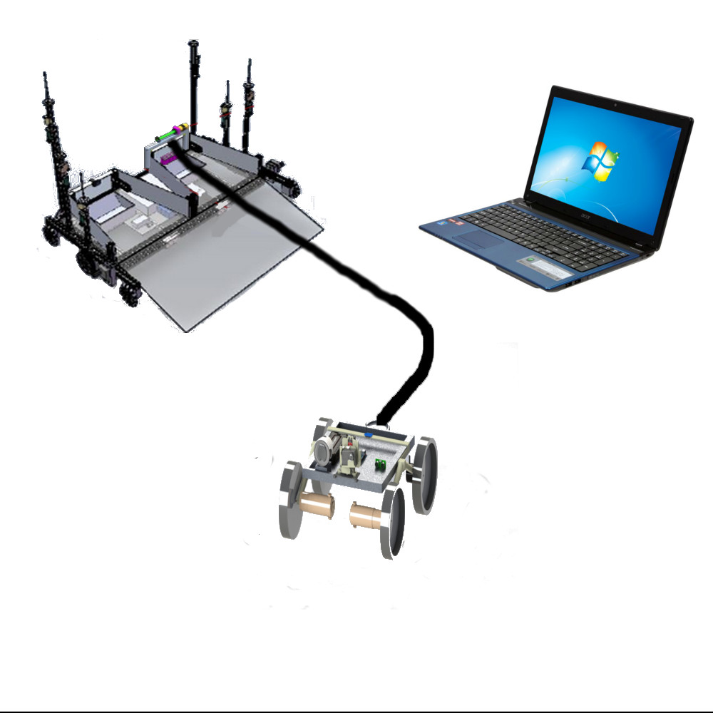
BASELINE DESIGN OVERVIEW
Rappelling Winch
Wireless Communication, 2.4 GHz radios. MR serves as relay
MR Auxiliary
Battery
GS
MR
Rappelling Tether
Fixed Tether
Attachment
Point
CR Battery
Actuated Camera & Light
Shaft Encoder
48cm
Ultrasonic Range-Finder
4-W Rocker Bogie w/ 2-W Drive
CR
48cm
$R_{wheel}$ = 10cm
Notes:
Label CR on this slide

Slide 22
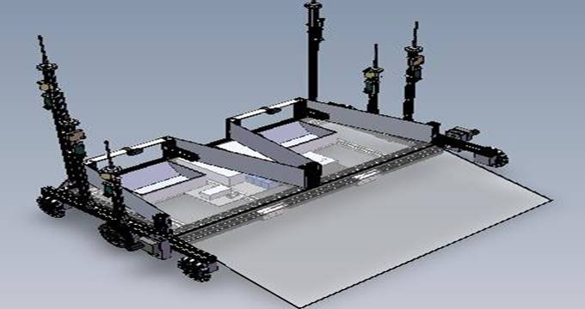
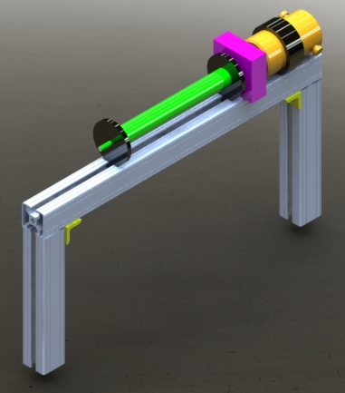


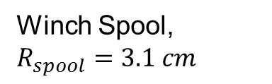
BASELINE DESIGN SELECTION:
Rappelling
Winch Spool, $R_{spool}=3.1 cm$
28 cm
Gearbox
DC Stepper Motor
48 cm
Fasteners
Braces
8020 1x1 Inch
The rappelling system is the most critical for mission success. DR.3.1, DR.3.1.1
  Winch stepper motor must supply enough torque to raise/lower CR into cave/pipe
  Winch tether must be strong enough to hold CR mass during rappelling
Tether – Multipurpose braided steel wire (7x19 core) with a breaking strength of 4,450 N and 0.238 cm diameter[1]. This allows for a winch spool radius of 3.1cm based on min. bend radius

Slide 23
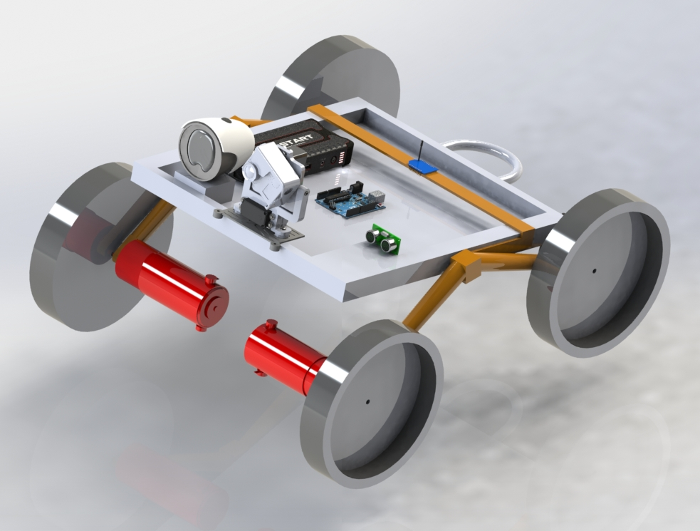
BASELINE DESIGN SELECTION:
Driving
  DR.3.3, DR.3.3.1– horizontal exploration
  4-wheel rocker-bogie (RB) suspension for traversing terrain
  Desired horizontal velocity of 0.1 m/s drives wheel size for getting over 3cm rocks ($R_{Wheel}$ must be >6cm)
DR.3.2– transitioning between horizontal and vertical surfaces
  Bottom of chassis must clear 90$°$ corner at top of cave/pipe
DR.4.2.2– CR must track distance travelled
  Un-powered rear wheels to be used for odometry
RB Pivot and Bridge connect RB to chassis
RB Bridge
RB Pivot
Driving Motors
RB Arm
$R_{Wheel}$ = 10cm

Slide 24
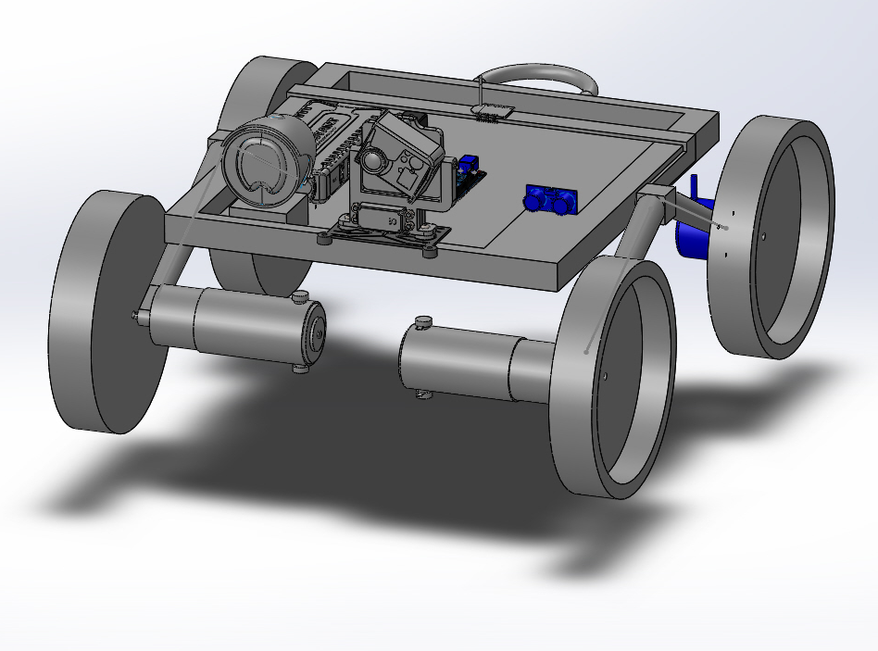
BASELINE DESIGN SELECTION:
Positioning
Microcontroller
While Rappelling:
  Ultrasonic range-finder will be used to determine CR depth. DR.4.2.1
While Exploring:
  Shaft encoders will track how much the two un-powered wheels turn.
  Odometry will be used to determine the total distance the CR has traveled. DR.4.2.2
Software in the Microcontroller will read measurements from the sensors and determine depth and distance travelled
  Position data will be sent to the GS via the MR
Shaft Encoder
Ultrasonic
Range-Finder

Slide 25
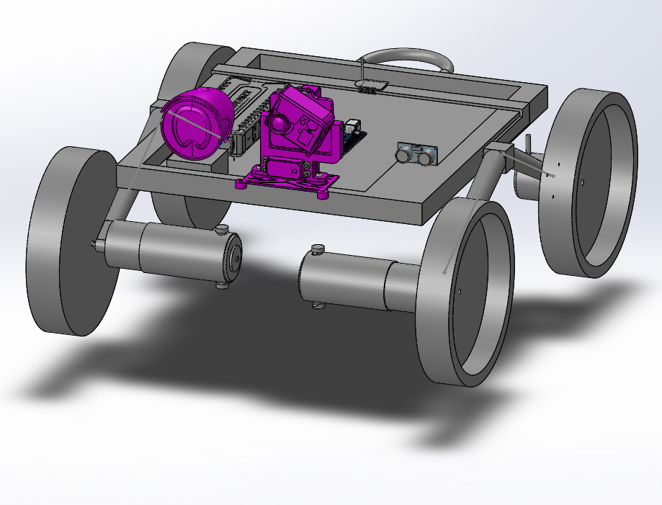
BASELINE DESIGN SELECTION:
Imaging
Microcontroller
Single digital camera with flash, mounted on a 2 axis servo gimbal
  Camera: CMOS controlled by microcontroller/single board computer. DR.5.1
  Servo: 2x180$°$ range of motion to point camera within 180$°$/90$°$ azimuth/elevation FOV.
    DR.5.3, DR.5.4
  Lighting: LED panel light mounted with camera. DR.5.5
Light Source (moves with camera)
2-axis Actuated Camera

Slide 26
BASELINE DESIGN SELECTION: Communication
Trade between reusing legacy Wi-Fi communication system or designing new system using RF
Design decision: Create new communication system
Previous system has the following drawbacks:
  Not all hardware is present for communication
  Not all commands are functional
  Requires modification to current GS to add new commands for RACER mission
  Lacks documentation and system is not currently configured properly
 |  | Legacy Comm System | Direct RF Comm System
Metric | Weight | Score | Score
Time Required | 30% | 4 | 5
Cost | 10% | 5 | 3
Complexity | 20% | 3 | 4
Robustness | 5% | 2 | 4
Reliability | 25% | 2 | 4
Speed | 10% | 5 | 3
Weighted Total | 100% | 3.4 | 4.1
Notes:
Verbally explain what the numbers mean (1 is bad, 5 is good, etc)

Slide 27
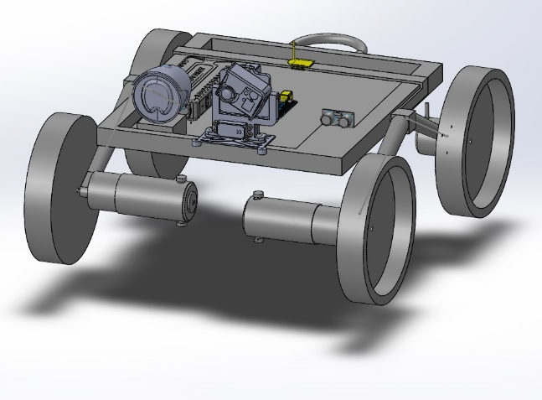
BASELINE DESIGN SELECTION: Communication
2.4 GHz Radio Transmitter/Receiver
Relayed 2.4 GHz radio system
  DR.2.1, DR.2.1.5
2-way serial communication at 250kbps
4 Radios total (1 GS, 2 MR, 1 CR)
  GS ←→ MR ←→ Microcontroller ←→ MR ←→ CR
  Microcontroller does routing and processing on MR for command/data relay
CPU
Notes:
Increase size of image

Slide 28
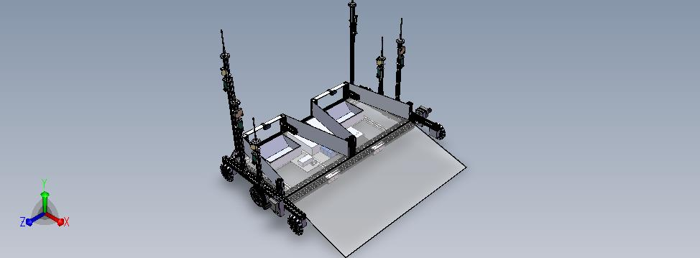

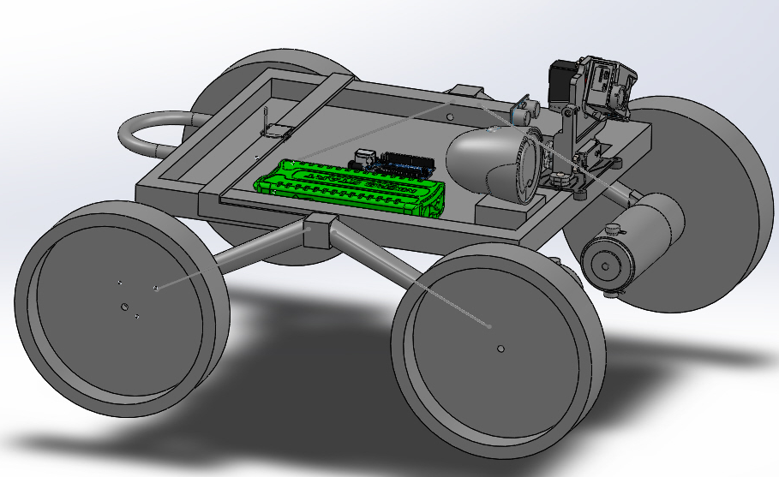
BASELINE DESIGN SELECTION:
Power
Lithium Ion/Lithium Polymer (Li-Ion/Li-Po) batteries to power necessary subsystems:
  Comms/CPU
  Driving
  Rappelling
  Positioning
  Imaging
Energy density: 110 – 265 Wh/kg
Transmitting power through tether results in voltage drop of ~5V
Batteries located on both MR and CR with enough capacity for CR to complete its mission without recharging
  DR.6.1, DR.6.2
MR
Auxiliary Battery
CR
Battery

Slide 29
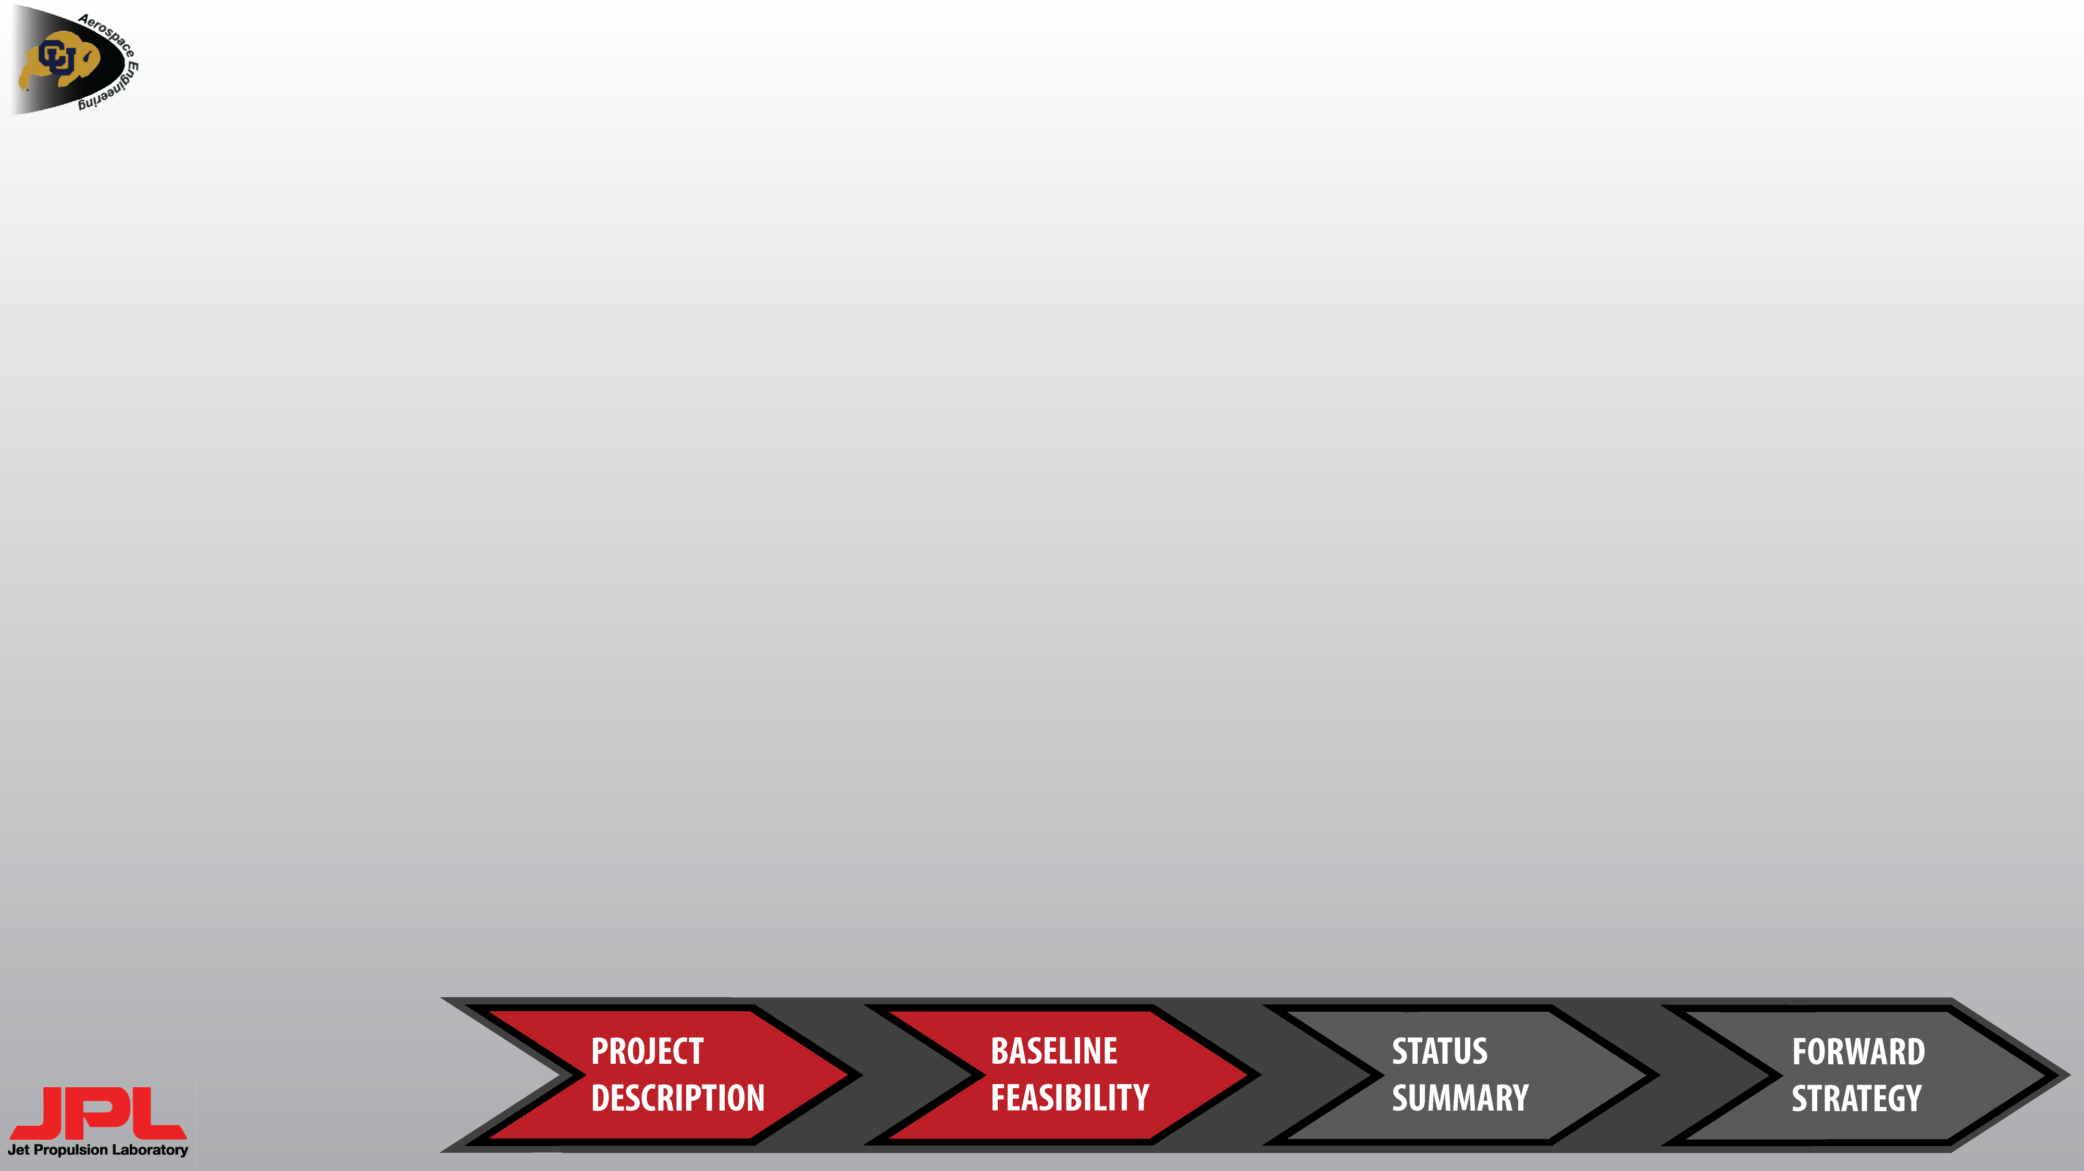
BASELINE FEASIBILITY OVERVIEW
CRITICAL PROJECT ELEMENTS
PROJECT ELEMENT | Reasoning for Feasibility Shown/Not Shown
Rappelling System | Minimum success requires rappelling
Positioning System | Accuracy requirements are high ($±$10cm over ~10m travelled)
Communications System | Proposed new system must satisfy requirements
Software | With comm system overhaul, software must be written from scratch
CR System Mass | Maximum mass budget (9.8kg) has small margin
CR System Cost | $5000 budget is non-negotiable
Power System | CR system must supply its own power otherwise mission will fail
Driving System | Rocker-bogies are proven technology and terrain is relatively benign
Imaging System | Resolution requirements are relatively low and proven COTS parts can be utilized.
All project elements are important
Not enough time to show baseline feasibility for all of them
  Systems that are critical for mission success
  Systems where baseline feasibility is not immediately obvious
Feasibility for other project elements (Driving & Imaging) was still determined
  Relatively straightforward calculations

Slide 30

Winch Motor Torque
RAPPELLING FEASIBILITY
The CR must successfully rappel up and down a 5m vertical surface for minimal mission success
The motor must provide enough torque to raise the CR from cave/pipe
  Maximum tension in tether when CR is at top of vertical surface
Assumed that the tether will properly spool and unspool during the rappel
Calculated torque drives size/weight of chosen stepper motor (3.6kg)
$$τ=T_{wire}R_{spool}$$
$$τ$$
$$T_{x}$$
DR.3.1 is met
$$T_{wire}$$
$$T_{y}$$
$h$ = .4 m
Parameter | Value
$$θ$$ | 21°
$$Tension, T_{wire}$$ | 273.5 N
$$R_{spool}$$ | 3.1 cm
$$Torque, τ$$ | 8.5 Nm
$$Safety Factor$$ | 1.4
$$T_{wire}=\frac{m_{CR}g}{\sin{θ}}$$
$$T_{wire}$$
MR
$$θ$$
CR
$$y$$
$$x$$
$$m_{CR}g$$
$l=$ 1.13 m
Notes:
Include tension force along wire from CR end

Slide 31
RAPPELLING FEASIBILITY
Gearbox Ratio Comparisons [5]
To lower the mass of the motor a gearbox is employed so a lower torque motor can be utilized at a higher rotation rate
  Gearboxes are readily available COTS and therefore do not require high tolerance machining
$τ_{1}ω_{1}=τ_{1}n\frac{ω_{1}}{n}=τ_{2}ω_{2}$ is used to find a proper gear ratio
  Max gear ratio is limited by the size and mass of the gearbox, $n_{max}=10$
$τ_{1}$ is torque on spool and $ω_{1}$is set by a 0.1m/s descent velocity
At the max gear ratio the total mass of the motor and gearbox is 1.75 kg
  This decreases the mass of the stepper motor so there is a margin for DR.1.1.2

Slide 32
RAPPELLING FEASIBILITY
Moment on MR Calculations
The rappelling system must not cause the MR to rotate over the ledge into the cave/pipe
A moment less than zero proves that the CR will not cause the MR to rotate
$\sum{M_{o}}=T_{x}h −T_{y}l −W_{MR}\frac{l}{2}=M_{MR}$
  $M_{MR}=−68 Nm$ ← MR will not flip over the ledge
Winch
Testing must be done to ensure CR will not pull MR forward
$$T_{x}$$
$$T_{y}$$
h$=$ .33 m
$$M_{MR}$$
MR
Parameter | Value
$$W_{MR}$$ | 316 N[6]
$$T_{x}$$ | 256 N
$$T_{y}$$ | 96 N
$$o$$
$l=$ 0.6 m
$$y$$
$$W_{MR}$$
$$x$$
Notes:
Change wording to "must not cause the MR to rotate over the ledge"

Slide 33
POSITIONING FEASIBILITY
Ultrasonic Range-Finder [8]
Accurate positioning ($±$10cm) is not easily accomplished
  Required for maximum mission success
An ultrasonic range finder will be used to determine CR depth only
  Encoders on the wheels will not yield useable data while rappelling
  Range-finders have both a maximum and minimum range
    Will have to offset range-finder placement back at least its minimum range from the front of the CR
Resolution within 25% of required accuracy
→ DR.4.1.1 is met
Maximum Range | Minimum Range | Resolution
6.5 m | 15 cm | 2.5 cm
7.5 m | 20 cm | 1 cm

Slide 34
POSITIONING FEASIBILITY
Shaft Encoder Odometry [9]
Two shaft encoders on the two un-powered wheels
  Un-powered wheels minimizes chance of slippage
  For wheel radius of 10 cm and 0.1 m/s horizontal velocity, can expect 30 to 160 pulses/sec
    Sampling can theoretically be done much faster to avoid missed pulses
    Need further study on hardware and software options for
  Higher frequency pulses can be filtered out as noise or slippage
Required minimum coefficient of static friction of 1.1 between un-powered wheels and surface for theoretically no slip
No slippage or missed pulses
→ DR.4.1.2 is met
Governing Equation:
$$d_{travelled}=R_{wheel}θ_{turned}$$
Encoder Resolution | Allowable Number of Net Miss-Counted Pulses
200 P/R | 31
1024 P/R | 163

Slide 35
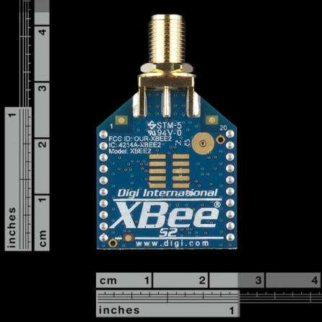
COMMUNICATION FEASIBILITY
Proposed new system: XBees operating at 2.4 GHz
  250kbps baud rate
  One at GS to transmit commands/acknowledgements and receive requested data from the CR
  Two on the MR acting as a relay
  One on the CR to receive commands from the GS, transmit images, and transmit status info (position, task completion, etc.)
Without feasible comms, entire mission is at risk
The communications subsystem will be able to meet DR.2.1 and 2.1.5 as the CR will be able to transmit data to the GS using the MR as a relay
The data rate of 250kbps will be sufficient to transmit commands and data( 100KB image in ~ 3.2 s)
Line of sight is required for max 120 m range but with high-gain antennas it’s possible to get near max range even with obstructions
  RACER’s mission will only be at maximum 1/12 of range but will have major obstructions
  Further study is needed to determine feasibility in this environment
Image credit: Sparkfun Electronics https://www.sparkfun.com/products/10416

Slide 36
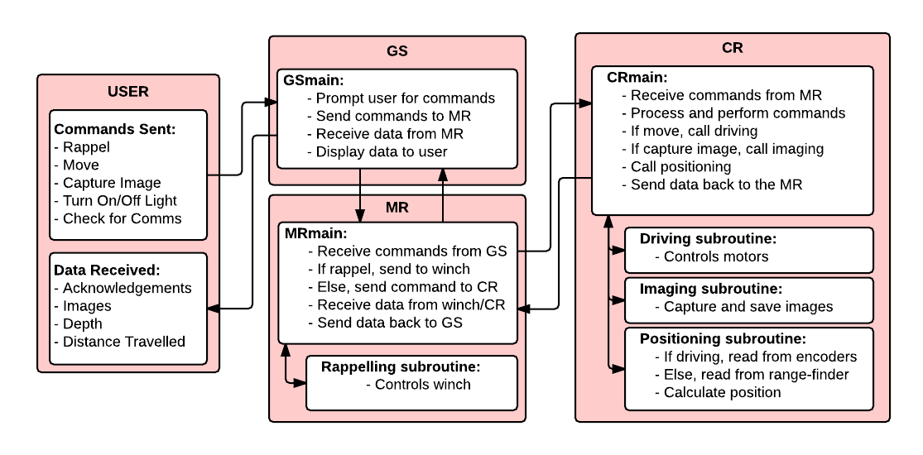
SOFTWARE FEASIBILITY
Diagram shows theoretical flow of CR, MR, and GS system software
The team has several members with an extensive software background
Entire mission success is dependent upon FR.7

Slide 37
PROJECT ENERGY BUDGET
Energy consumption break-down (44Wh = 100%)
Description
Microcontroller, receivers, and transmitters
Wheels, motors, and speed controllers
Camera, servos, lighting
Shaft encoders and ultrasonic range-finder
Winch motor, spool, tether, and gearbox
Allocating a total of 0.8kg of Li-Ion/Li-Po batteries → 88Wh total capacity, 100% margin
Leaves a total of 3% (~0.3kg ) margin for DR.1.1.2

Slide 38
EXPECTED MASS BUDGET
Percentages are based off of 9.8kg maximum CR system mass
Description
Wheels, motors, speed controllers, chassis & rocker bogie arms
Winch motor, spool, cable, and gearbox
Li-Ion/Li-Po batteries, 0.8 kg allocated total (0.5 on CR, 0.3 on MR)
Camera and servos
Shaft encoders and ultrasonic range finder
Microcontroller, receivers, and transmitters
ONLY 3% UN-ALLOCATED (~0.3kg)

Slide 39
EXPECTED PROJECT COSTS
Percentages are based off of $5000 maximum project budget
Large margin due to many COTS parts available
  Additional costs will come from building cave/pipe test environment and other miscellaneous items.
  Some system costs may have been underestimated

Slide 40
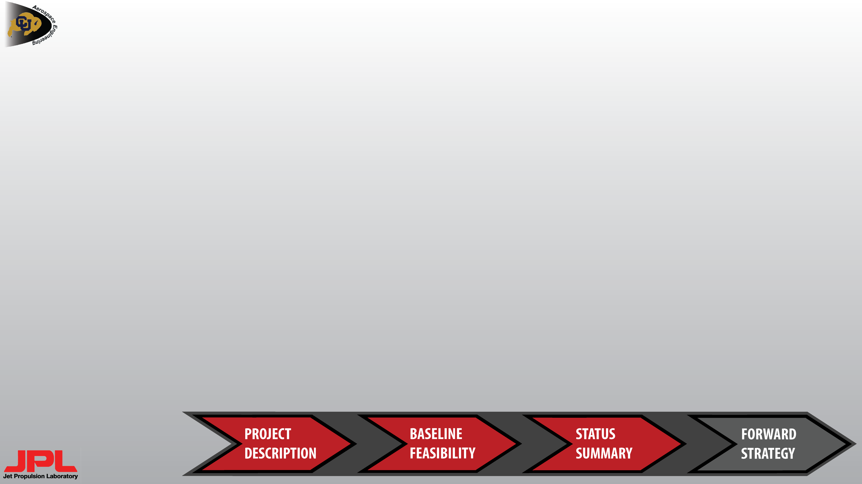
STATUS SUMMARY
Additional studies:
  Rappelling System
    Tether material & gearbox selection
  Driving System
    More refined chassis model
  Positioning System
    Determine suitable wheel material
  Imaging System
    Selection of COTS parts
  Communication System
    Requires more analysis for transmission range
  Software
    Create full code structure outline
  System Mass
    Only 3% margin calls for consideration of ways to decrease mass
  System Cost
    Large margin can be allocated
  Power System
    Create power distribution diagram
System | Feasible | Additional Analysis Required for Feasibility
Rappelling | X
Driving | X
Positioning | X
Imaging | X
Communication |  | X
Software |  | X
System Mass |  | X
System Cost | X
Power |  | X

Slide 41
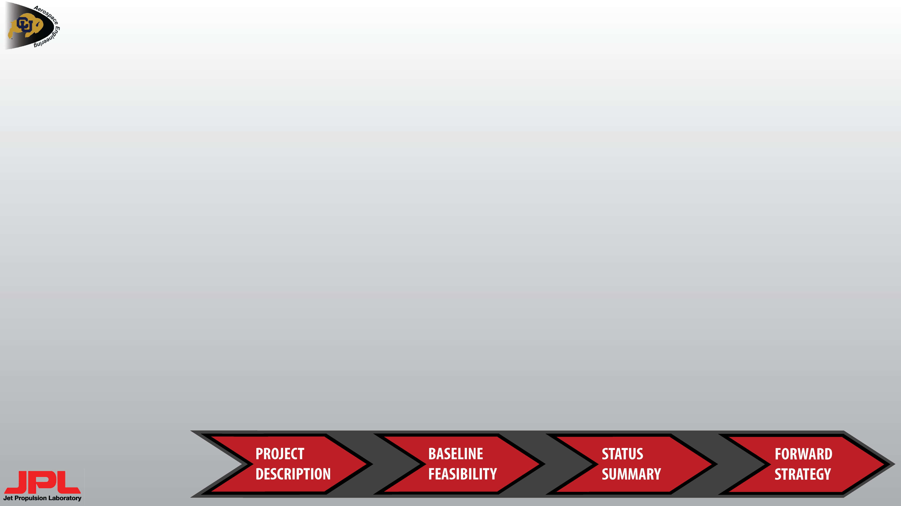
FUTURE WORK
Additional trade studies must be conducted for hardware selection
  These include:
    Selecting microcontrollers for CR data handling and MR rappelling/comm system control
    Selecting motors for driving and rappelling systems
    Selecting and sizing batteries for the CR and the MR auxiliary system
    Material selection for wheels, chassis, tether, and rappelling structure
    Selecting other COTS components such as a camera and light source
Communication analysis must be done to determine attenuation over distance from MR
Ways to decrease mass of Driving and Rappelling systems must be considered to increase mass budget margin
A more refined CAD model can be made once parts/materials are selected
Further development of power and software systems are dependent on the hardware selected.
    Power system requires a power distribution diagram to show feasibility of overall design
    Software requires a full code structure flow chart to verify hardware selection is adequate

Slide 42
REFERENCES
[1] “McMaster-Carr”,. Galvanized braided wire,. http://www.mcmaster.com/#8912tac/=u0y0i3, [October 07, 2014]
[2] “Engineering Toolbox”,. Nylon Rope,. http://www.engineeringtoolbox.com/nylon-rope-strength-d_1513.html, [October 07, 2014]
[3] “Web Rigging Supply”,. http://www.webriggingsupply.com/pages/catalog/wirerope_cable/wirerope-galvanized.html, [October 07, 2014]
[4] " Stepper Motors." - Hundreds of Stepper Motor Models on StepperOnline. Stepper Online, Motors and Electronics, 2014. [http://www.omc-stepperonline.com/stepper-motors-c-1.html. Accessed: 10/10/2014].
[5] "Gear Reducers." Gear Reducers. GAM, Mount Prospect, IL, 2012 [http://www.gamweb.com/gear-reducers-main.html. Accessed: 10/10/2014]
[6] “TREADS Preliminary Design Review” – Aerospace Engineering Sciences Senior Design Projects Archive. [http://aeroprojects.colorado.edu/archive/12_13/TREADS/TREADS_PDR_Short.pdf. Accessed: 10/10/2014].
[7] Roark, Raymond J., and Warren C. Young. Roark's Formulas for Stress and Strain. New York: McGraw-Hill, 1989. Print.
[8] “MaxBotix Inc. XL-MaxSonar – EZ Series Datasheet” – MaxBotix Inc. [http://maxbotix.com/documents/XL-MaxSonar-EZ_Datasheet.pdf. Accessed[10/10/2014].
[9] “Omron Electronics Rotary Encoder E6B2 Datasheet” – Omron Electronics. [http://www.datasheetarchive.com/dlmain/Datasheets-17/DSA-335783.pdf. Accessed[10/10/2014].
[10] "McMaster-Carr",. http://www.mcmaster.com/#2709k17/=u45eaj, [October 06, 2014]

Slide 43
Backup Slides

Slide 44
APPROXIMATE MASS AND COSTS
System | Item | Qty | Unit Mass | Unit Cost | Total Mass | Total Cost
Driving | Aluminum Chassis Plate | 1 | 1.31 kg | $100 | 1.31 kg | $100
CPU/Comms | Microcontroller/Single Board Computer | 1 | 0.04 kg | $40 | 0.04 kg | $40
CPU/Comms | Microcontroller (on MR) | 1 | 0.035 kg | $46 | 0.035 kg | $46
Positioning | Shaft Encoder | 2 | 0.10 kg | $50 | 0.20 kg | $100
Positioning | Ultrasonic Range Finder | 1 | 0.005 kg | $50 | 0.005 kg | $50
CPU/Comms | Transmitter/Receiver (1xCR, 2xMR, 1xGS) | 4 | 0.005 kg | $32 | 0.02 kg | $128
Imaging | Camera | 1 | 0.005 kg | $25 | 0.005 kg | $25
Imaging | Lighting | 1 | 0.05 kg | $50 | 0.05 kg | $50
Imaging | Servo | 2 | 0.075 kg | $15 | 0.15 kg | $30
Imaging | Gimbal | 1 | 0.1 kg | $30 | 0.1 kg | $30
 | CONT’D NEXT SLIDE

Slide 45
APPROXIMATE MASS AND COSTS
(CONTINUED)
System | Item | Qty | Unit Mass | Unit Cost | Total Mass | Total Cost
Rappelling | Winch Stepper Motor | 1 | 1.2 kg | $20 | 1.2 kg | $20
Rappelling | Winch Gear Box | 1 | 1.1 kg | Unknown | 1.1 kg | Unknown
Rappelling | Tether (~12m) | 1 | 1.0 kg | $35 | 1.0 kg | $35
Driving | Wheels | 4 | 0.25 kg | $5 | 1.0 kg | $20
Driving | Rocker Bogie Arms | 2 | 0.25 kg | $5 | 0.5 kg | $10
Driving | Driving Motors | 2 | 0.75 kg | $250 | 1.5 kg | $500
Driving | Motor Speed Controllers | 2 | 0.25 kg | $20 | 0.5 kg | $40
Communication | Xbee Explorer (1xCR, 1xGS) | 2 | 3 g | $25 | 0.006 kg | $50
Communication | Xbee Shield (2xMR) | 2 | 3 g | $15 | 0.006 kg | $30
Power | CR Battery 55 Wh | 1 | 0.5 kg | $80 | 0.5 kg | $80
Power | MR Aux. Battery 33 Wh | 1 | 0.3 kg | $50 | 0.3 kg | $50
TOTAL |  |  |  |  | 9.53 kg | $1434

Slide 46
ESTIMATED ENERGY CONSUMPTION
See Camera Energy Consumption Calculations slide for where Imaging numbers came from
Allocated 0.5kg for CR and 0.3kg for MR batteries (55 Wh and 33 Wh, respectively)
System | Item | Qty | Approx.Time Used | Voltage | Total Current Required | Approx. Energy Required
Positioning | Shaft Encoders | 2 | 30 min | 5 V | 50mA | 0.25 Wh
Positioning | Range Finders | 1 | 10 min | 5 V | 10mA | 0.01 Wh
Comms/CPU | Microcontroller | 1 | 60 min | 5 V | 60mA-1.8A | 0.3-9 Wh
Comms/CPU | Receivers (1xGS, 2x MR, 1xCR) | 4 | 60 min | 3.3 V | 160 mA | 0.528 Wh
Comms/CPU | Microcontroller | 1 | 60 min | 5 V | 25 mA | 0.125 Wh
Driving | Motors | 2 | 10 min | 12V | 5.74 A | 23 Wh
Rappelling | Winch Motor[4] | 1 | 10 min | 24 V | 2.8 A | 11.2 Wh
Imaging | Camera | 1 | 40 sec | 5 V | 80-120 mA | 0.004-0.007 Wh
Imaging | Servos | 2 | 80 sec | 4.8-6 V | 1.72-2.1 A | 0.183-0.28 Wh
Imaging | Lighting | 1 | 1 min | --- | --- | 1.0 Wh
TOTAL |  |  |  |  |  | 44.6-53.4 Wh

Slide 47
Project ENERGY FEASIBILITY
Li-Ion/Li-Po batteries provide best option with energy density ranging from: 110 – 265 $\frac{Wh}{kg}$
  Trade study must be conducted as their densities are comparable
Minimum battery mass on the MR and CR was found using:
$$Mass Needed (kg)=\frac{Projected Energy Usage (Wh)}{Energy Density (Wh/kg)}$$
Approximate mass needed (~0.4 kg) has large margin to allocated mass (0.8 kg) from Mass Budget
Projected power analysis fulfills FR.6 (The CR shall have enough power to complete mission without recharging)
Battery Location | Associated Subsystems | Percent of Required Energy | Expected Energy Usage | Minimum Battery Mass Required | Battery Mass Allocated (Margin)
MR | Rappelling, Comm | 26 % | 11.2 Wh | 0.10 kg | 0.30 kg (200%)
CR | Driving, Imaging, Positioning, Comms/CPU | 74 % | 31.3 Wh | 0.29 kg | 0.50 kg (72%)
Notes:
Change "large" to "50%"

Slide 48
COMMUNICATION TRADE STUDY DEFINITIONS
Communication Trade Metrics and Weighting:
Time Required: Time required to integrate with the system
Cost: Cost of the system
Complexity: Complexity of system design for current project
Robustness: Ease of integration for future projects
Reliability: How reliable is the communication system
Speed: Data transfer rate
Metric | Value Assigned
 | 1 | 2 | 3 | 4 | 5
Time Required | More than 500 man hours |  |  |  | Less than 25 man hours
System Cost | More than $500 | $250-500 | $100-250 | $50-$100 | Less than $50
System Complexity | More than 6 man months to develop | 5-6 man months | 4-5 man months | 3-4 man months | Less than 3 man-months to develop
Robustness | Future projects require more than 1 month to integrate |  |  |  | Future projects can integrate within one day
System Reliability | 80-100% data loss |  |  |  | 0% data loss
Speed | Transfer an image in over 5 min |  |  |  | Transfer image in less than 250ms
Metrics | Percentage | Description
Time Required | 30% | Time required to document and interface to this system
Cost | 10% | Cost required for components to interface to this system
Complexity | 20% | Complexity of the system development and integration
Robustness | 5% | Ease of use for future JPL legacy senior projects
Reliability | 25% | Reliability of data transmission
Speed | 10% | Data transmission speed

Slide 49
WINCH SPOOL CALCULATIONS
Radius of spool is chosen based on tether material
  Minimum radius of bending of Multipurpose Steel Rope (7x19 core): 2.9cm → 3.1cm $R_{spool}$
Perfect spooling where the tether never overlaps
  $n=\frac{l_{spool}}{d_{wire}}$ , $n$ is the maximum number the tether can be wrapped
  $d_{wire}=0.238 cm$
Total length of wrapped tether: $P=2πnr_{1}$ , $r1$ is the radius of the spool plus the radius of the tether
Total wrap length must be ~12m so solve for $l_{spool}$ → 28cm
$$R_{spool}$$
$$r_{1}$$
$$n$$
$$l_{spool}$$

Slide 50
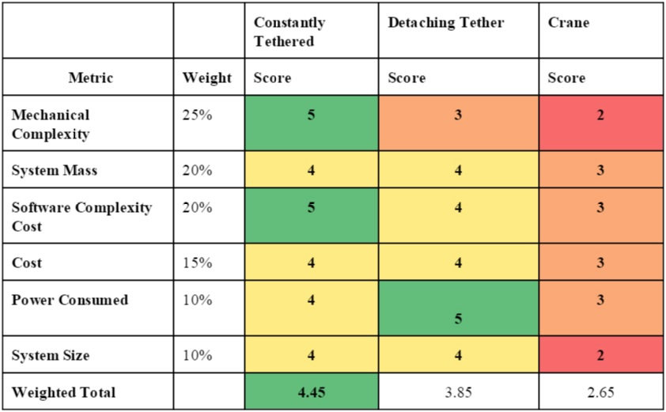
RAPPELLING TRADE STUDY
Constantly Tethered option chosen:
  Lower Mechanical and Software Complexity
  Relatively low mass, cost, size
Detaching Tether requires slightly less power, but is more complex

Slide 51
FEASIBILITY OF RAPPELLING TETHER[1]
Material | Diameter | Breaking Strength | Min Winch Spool Diameter | Min Bend Radius
Multipurpose Steel Rope (7x7 core) | 0.238 cm | 4090 N | 10.0 cm | 5.0 cm
 | 0.318 cm | 7560 N | 13.3 cm | 6.7 cm
Multipurpose Steel Rope (7x19 core) | 0.238 cm | 4450 N | 5.7 cm | 2.9 cm
Nylon-Coated Wire Rope (7x7 core) | 0.318 cm | 4090 N | 13.3 cm | 6.7 cm
Nylon-Coated Wire Rope (7x19 core) | 0.476 cm | 8900 N | 11.4 cm | 5.7 cm
Vinyl-Coated Wire Rope (7x7 core) | 0.238 cm | 2135 N | 10.0 cm | 5.0 cm

Slide 52
TRADE STUDY OF TETHER MATERIAL[2] [3]
Material | Pros | Cons | Linear Density | Cost/meter, $
Multipurpose Steel Rope | Corrosion protection | Not as strong as regular steel | >0.096 kg/m | ~0.69- 2.95
Nylon-Coated Steel Wire Rope | Better for pulley systems. Abrasion resistant, Impact handling | weight | >0.172 kg/m | ~1.05- 6.56
Vinyl-Coated Steel Wire Rope | Flexible, abrasion resistant, UV protection | Size, weight | >0.172 kg/m | ~0.95- 5.77
Nylon Rope | Strong, does not twist | Absorbs water | >0.094 kg/m | ~3.74
Kevlar Rope | Strong, low stretch, | Not abrasion resistant | >0.111 kg /m | ~3.25

Slide 53
Ramp Contact to Edge
Wire/Rope
PVC Pipe
Ramp
Attaching a PVC pipe at the end of the ramp
  Reduce abrasion on tether
  Reduces chance of rope/wire falling into a crack

Slide 54
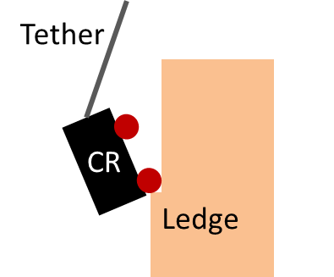
DYNAMIC RAPPELLING FORCES
A free-fall scenario can create forces on the rappelling tether that could cause it to snap or that would cause a torque on the rappelling stepper motor above its holding torque
  Increasing the diameter of the tether as well as increasing the size of the stepper motor is not a feasible design based on mass
However, the most probable falling scenario is shown in the diagram
Falling will be prevented procedurally by using the range-finder
  If the depth measurement unexpectedly stops changing: trigger an emergency stop of rappelling motor
CR wheel catches ledge
CR will fall forward and slack in the tether will not be created

Slide 55
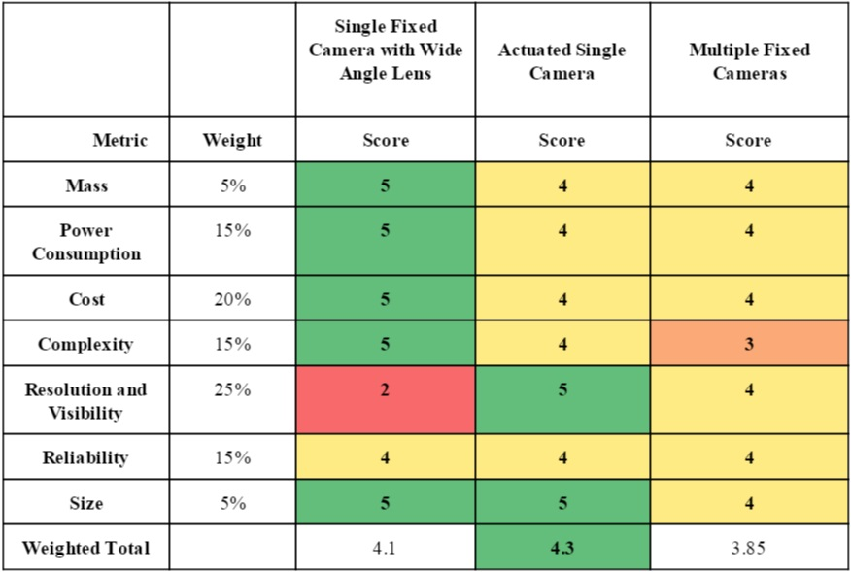
IMAGING TRADE STUDY
Actuated Single Camera option chosen:
  Excellent resolution and visibility,
  reliability, and size
  Relatively good mass, power
  consumption, cost, and complexity
Single Fixed Wide-Angle Lens Camera
not chosen because of low resolution
and visibility in accordance with DR.5.2

Slide 56
LIGHTING ANALISIS
Target foot-candles: 100
  According to Illuminating Engineers Society (IES) this is the standard level of lighting in laboratories, kitchens, etc.
Target distance: 5m
Output = 1282 candela = 1282 lumens
Typical Efficacy of LED: 50 lumen/watt
Power consumption of LED: 25.6 W (for entire camera FOV)

Slide 57
Camera Power Consumption Calculations
Power consumed to rotate and image 8 times a sweep for 10 sweeps:
For one sweep:
  Rotate 2 servos for 2 sec: $2\left(4.128W∗\left(\frac{2}{3600}\right)hours\right)$
  Camera for 1 sec: $0.6W∗\left(\frac{1}{3600}\right)hours$
  Microprocessor (Raspberry Pi) for 5 sec: $9W∗\left(\frac{5}{3600}\right)hours$
  Total: 17.25mWh
Total for 10 rotations:
  Camera FOV need 8 images to capture entire FOV required
  Will repeat 10 times (5 on the way out and 5 on the way back)
  Total overall: $17.25∗8∗10=1.38Wh$

Slide 58
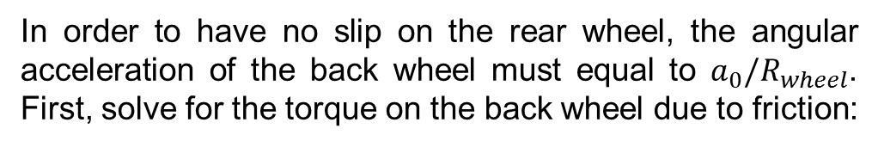





COEFFICIENT OF FRICTION REQUIRED FOR NO SLIPPAGE
$$a_{0}=α_{0}R_{wheel}=\frac{τ_{motor}R_{wheel}}{I}$$
CR
$$a_{0}$$
In order to have no slip on the rear wheel, the angular acceleration of the back wheel must equal to $a_{0}/R_{wheel}$. First, solve for the torque on the back wheel due to friction:
$$τ_{motor} , α_{0}$$
$fR_{wheel}=μ_{s}(1/4$ $W_{CR})R_{wheel}$
$$f$$
$$R_{wheel}$$
$$R_{wheel}$$
$$W_{CR}$$
Assume there is no slip on front wheel so there is maximum acceleration (most friction required). The wheel radii and moments of inertia are equal, so therefore $τ_{motor}=fR_{wheel}$. Solving for $μ_{s}$ gives:
$f$ = frictional force, $R_{wheel}$ = wheel radius, 10 cm
$W_{CR}$ = weight of CR, 96 N
$a_{0}$ = initial acceleration of CR
$τ_{motor}$ = torque from drive motor
$α_{0}$ = angular acceleration on front wheel
$$μ_{s}=\frac{4τ_{motor}}{W_{CR}R_{wheel}}=1.1$$

Slide 59
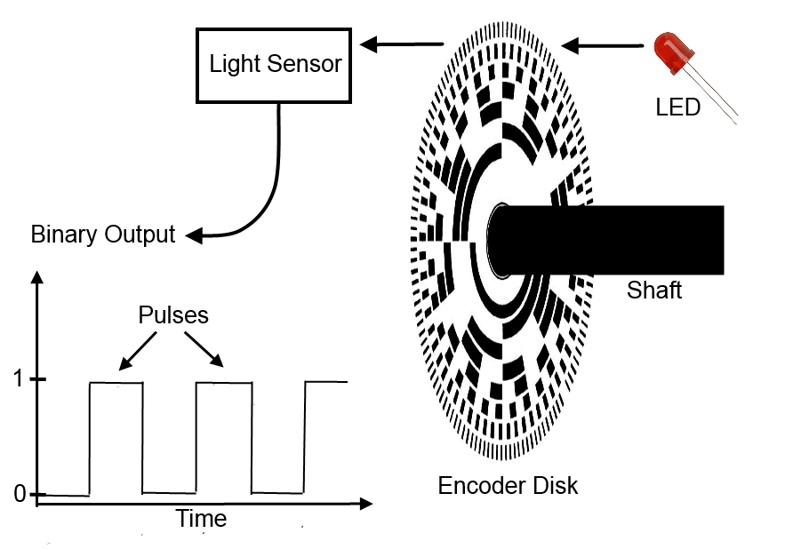
Optical Shaft Encoder Diagram

Slide 60
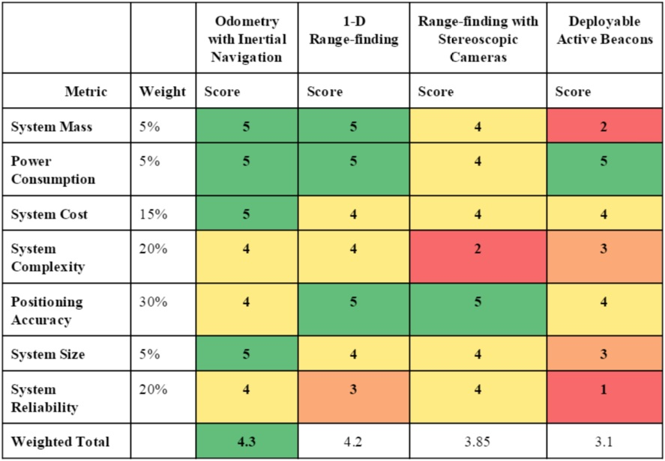
POSITIONING TRADE STUDY
Odometry with Inertial Navigation was top of trade study
  Comparable score for 1-D range-finding
Final decision was to use odometry with ultrasonic range-finder
  Low mass, power consumption, cost and size
  Relatively low complexity, with accuracy, and reliability
Other options required added complexity without a gain in accuracy

Slide 61
MINIMUM THICKNESS OF CHASSIS BASE PLATE [7]
Loaded Flat Plat Analysis:
$$a=b=0.483 m$$
$$a$$
$$m_{plate}=abtρ_{material}$$
$$P$$
$$t$$
Displacement @ center:
$$y_{m}=\frac{0.142Pb^{4}}{Et^{3}\left(2.21{\left(\frac{b}{a}\right)}^{3}+1\right)}$$
Top
view:
$$b$$
Side
view:
$$a$$
$$y$$
Edges simply supported
Assume maximum mass of CR (9.8kg) evenly distributed over plate (over-estimate) → $P=400 N/m^{2}$
Using aluminum 6061-T6, $E=68.9 GPa$ and $ρ=2700 kg/m^{3}$
For $<0.5°$ of deflection at edge, set $y_{m}=2mm$ → $t≈2mm$ →
$$m_{plate}=1.31kg$$

Slide 62
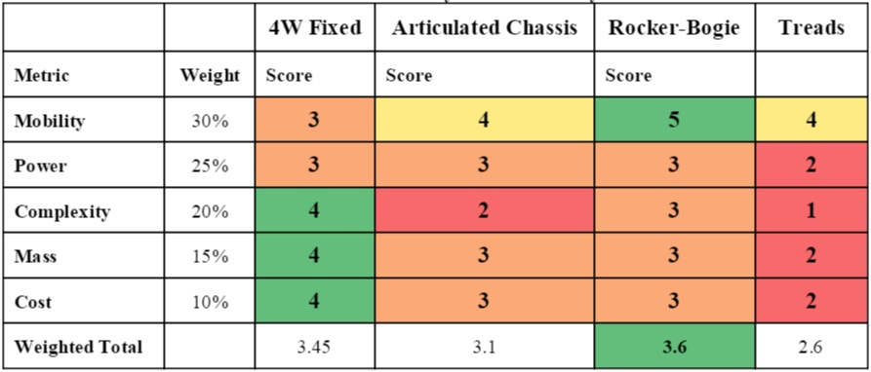
DRIVING TRADE STUDY
Final design choice:
  4W Rocker-bogie
Proven technology for traversing uneven terrain
4W Fixed option had comparable score but mobility is a key design driver that it does not fulfill

Slide 63
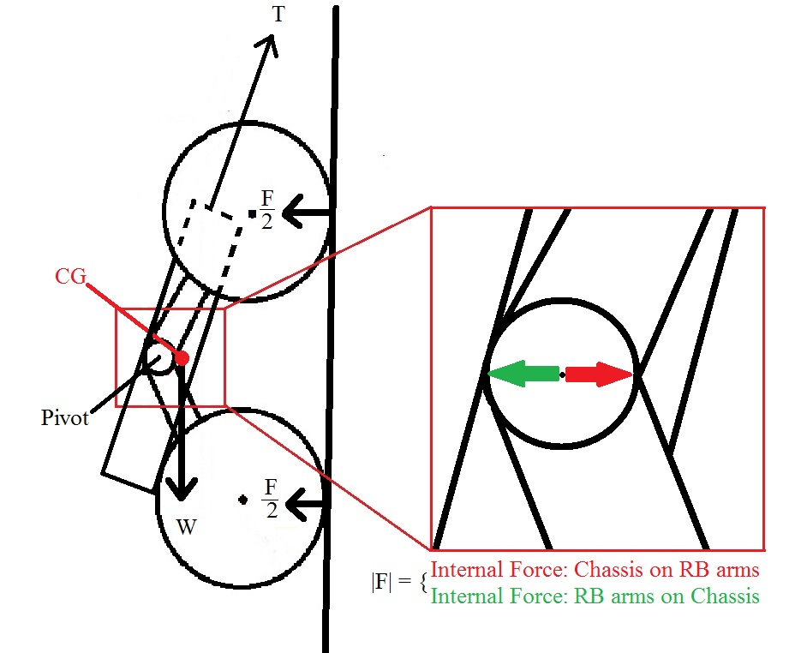
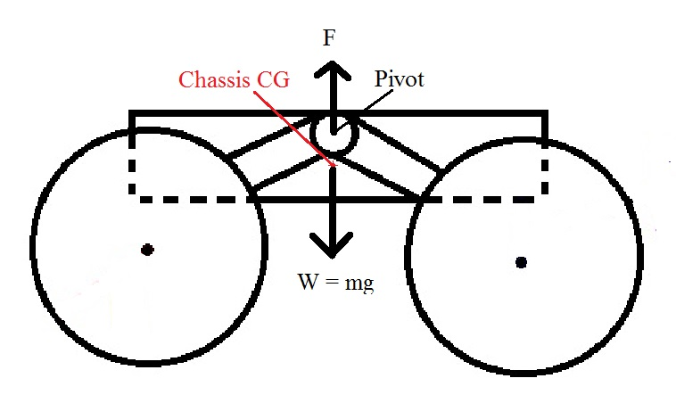
Rocker-Bogie FBD
Normal Driving Conditions
Rappelling
Sum of Moments About Pivot = 0

Slide 64
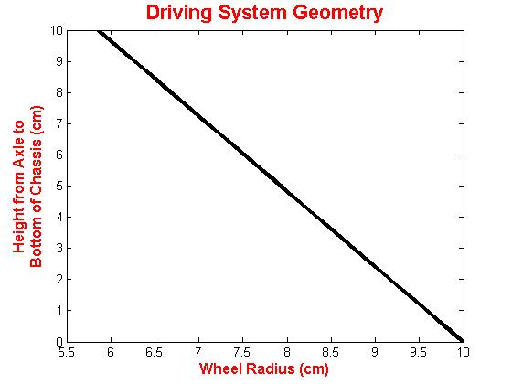
DRIVING SYSTEM FEASIBILITY
To traverse the 90 degree cave edge entrance the clearance (C) of the rover must be in the right proportion to the wheel radius (R)
R
C
Maximum Wheel Radius:
10.0 cm

Slide 65
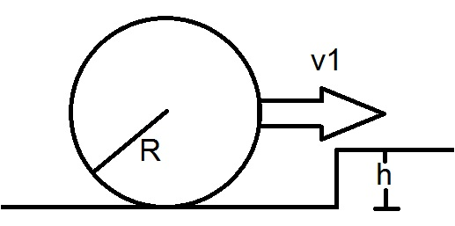
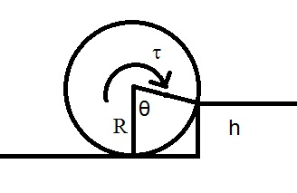
DRIVING SYSTEM FEASIBILITY
Apply conservation of energy to find minimum speed for rover to clear obstacle with no additional torque
Apply conservation of energy to find torque required for rover to clear obstacle starting from rest
$$\frac{1}{2}mv_{1}^{2}=mgh$$
$$\int_{θ_{1}}^{θ_{2}}{τdθ}=mgh$$
$$v_{1}=\sqrt{gh}$$
$$τ=\frac{mgh}{\cos\left(\frac{R−h}{R}\right)}$$
-1
If the wheel has enough velocity to traverse obstacle and enough torque to traverse the obstacle, it will always be able to traverse obstacle, satisfying Requirement 3.3.1

Slide 66
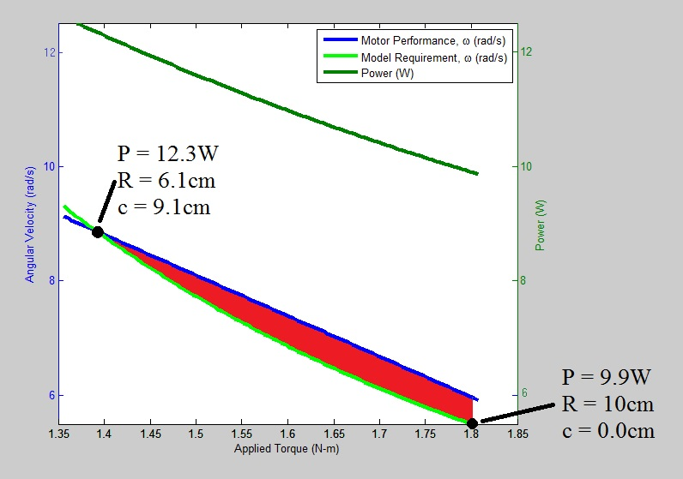
DRIVING SYSTEM FEASIBILITY [10]
The power supplied by the motor
($P=τω$) must be greater than the power required to traverse the 3cm diameter rock. this design space is shown as the red area in the plot.
The motor performance (blue line) is based on the 2709K17 Geared DC Motor
Design Space

Slide 67
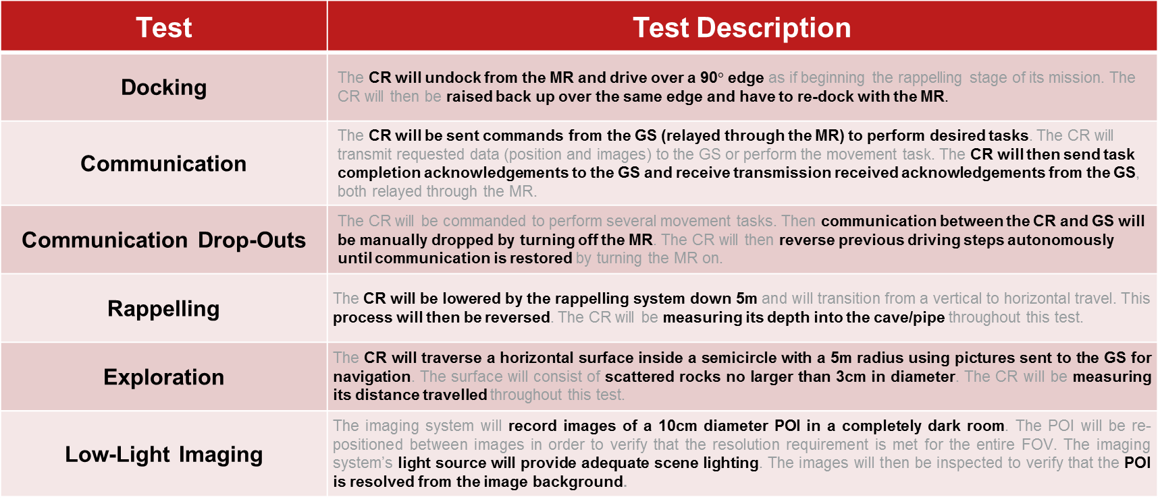
Testing Definitions

