Slide 1
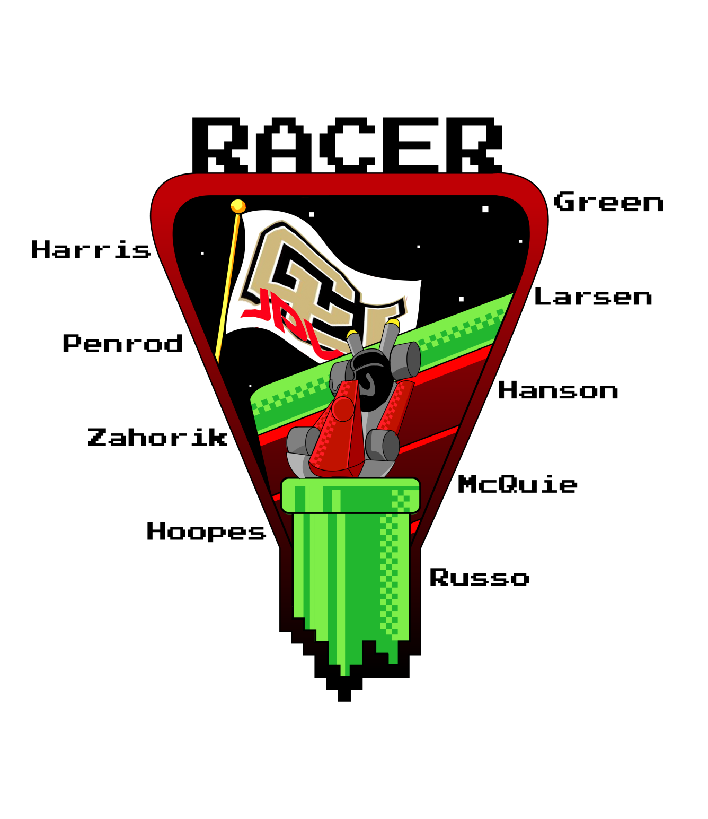
RAppelling Cave Exploration Rover
Advisor:
James Nabity
Customer:
Barbara Streiffert
Test Readiness Review
Notes:
15 seconds

Slide 2
PROJECT STATEMENT
This project encompasses designing, building and verifying a rappelling child rover (CR). The CR adds the capability of rappelling to the JPL legacy rover projects and will integrate with the TREADS Mother Rover (MR).
RACER Mission
Rappelling
Exploring
Positioning
Returning
90° Surface
To a maximum depth of 5m
Maximum distance of 5m out
Ground Station (GS) controls motion and imaging
Scattered rocks no larger than 3cm diameter
Depth within +\-10cm
Horizontal distance traveled within +\-10cm
Return to and
re-dock with MR
Overview
Test Readiness
Budget
Schedule
Notes:
30 seconds

Slide 3
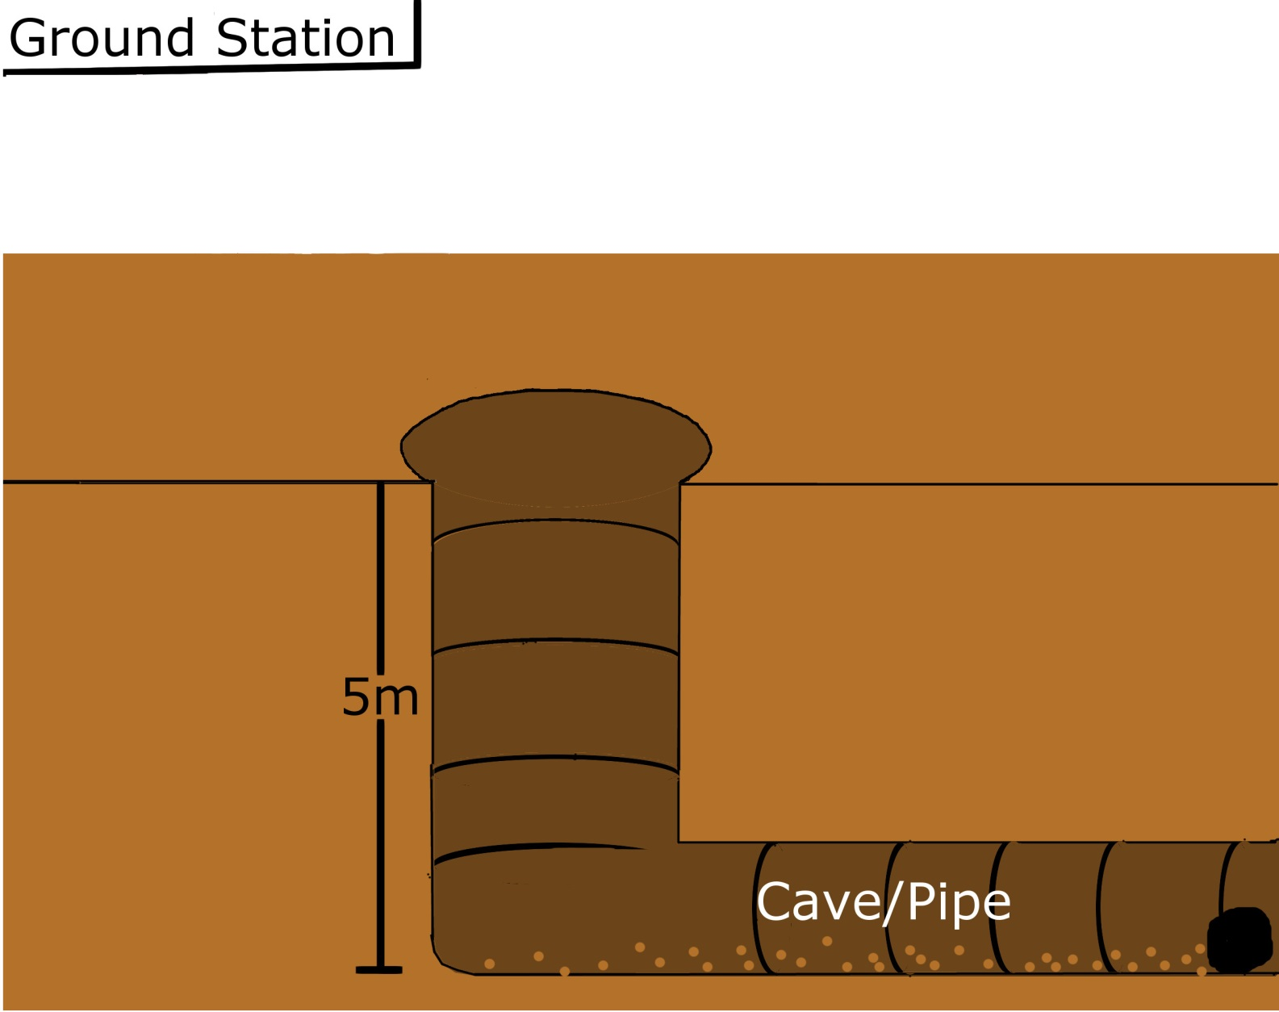
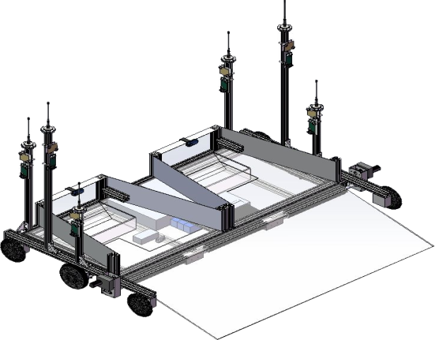
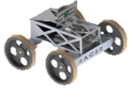
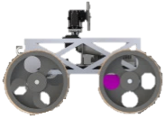
CONOPS
GS operator has direct line-of-sight view for navigation
GROUND STATION (GS)
COMMANDS
DATA
TETHER
1) Deployment (5 min)
- CR undocks
- CR enters cave/pipe
0) Arrival
- Child Rover
(CR) on MR
0) Arrival
- Child Rover
(CR) on MR
CR movement controlled by GS operator input
2) Rappelling (15 min)
- CR rappels 5m
- Transitions from
vertical → horizontal
TREADS Mother Rover (MR)
5
After command from GS, rappel is autonomous with feedback loop from CR range-finder
1
3) Exploration (120 min)
- CR traverses 5m
- CR takes/stores
image of POI
Images from CR imaging system used for navigation
NOTE: The return and comm dropout retraction will only continue to approximately the location of the start of Phase 2, based on the range-finder and winch encoder, respectively
2
4) Return (15 min)
- CR is retracted by
MR winch system
4
NOTE: If comm is dropped during exploration, the CR will be retracted by the MR winch system, after the GS operator says ‘OK’, until comm is restored or CR reaches top of cave/pipe
5) Re-docking (5 min)
- CR re-enters MR bay
3
Anticipate transmitting ~100 images in the 3hr mission
10cm diameter POI
Margin
RACER Mission Timeline:
RACER Mission Duration: 160 min Margin: 20 min TOTAL: 180 min
5
15
120
15
5
20
Overview
Test Readiness
Budget
Schedule

Slide 4
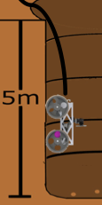
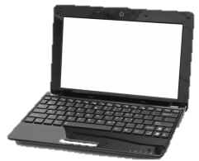



CRITICAL PROJECT ELEMENTS
Tether
Back and Forward Motion
Scattered Rocks
Rappelling
Driving
Software/Electrical
Project Element | Subsystem Breakdown | Rationale | Level of Success
Rappelling | Winch and Drivetrain | The CR shall have the capability to rappel up to 5 m into a cave/pipe | 1
Driving | Chassis, Wheels, and Motors | The CR shall have the ability to explore 5m out from the dropdown point on floor of cave/pipe | 1, 2
Software/Electrical | Microcontrollers, Range Finder, Encoders, Xbees, Imaging, PCB and Batteries | The software will integrate functionality and provide: Accurate position tracking Communication and command protocols Power analysis | 2, 3
Overview
Test Readiness
Budget
Schedule
Notes:
30 seconds

Slide 5
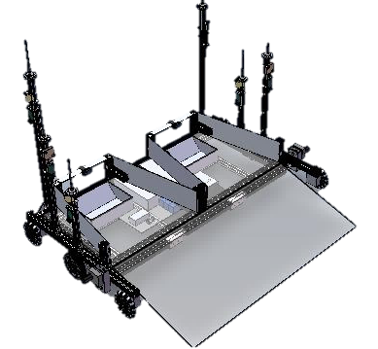
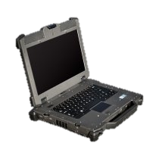
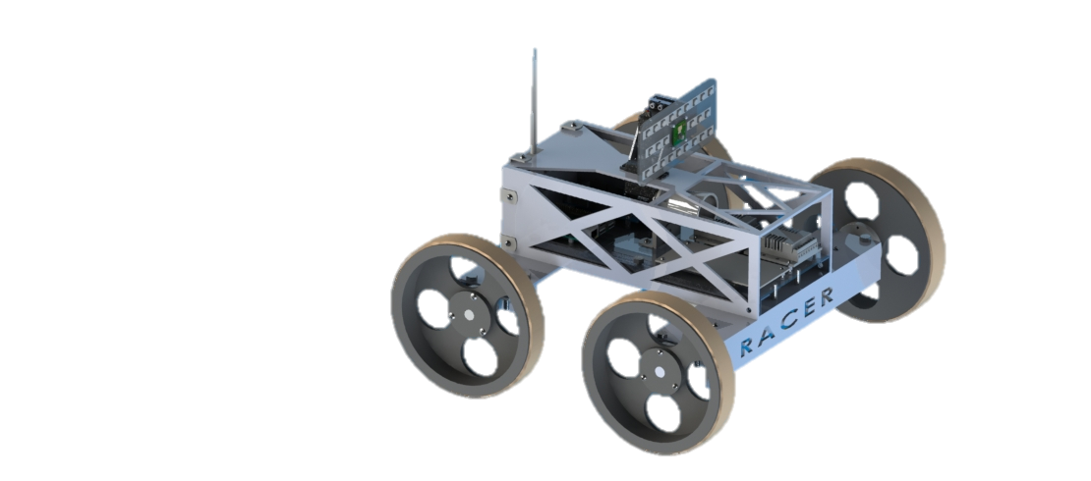
DESIGN OVERVIEW
MR Rappelling System
Custom Winch
15.1 Nm Stepper Motor
MR Comm System
2 x 2mW 2.4GHz XBee Radios
Serves as relay between GS&CR
GS
GS Comm System
2mW 2.4GHz XBee Radio
Transmits commands from user
MR
Fixed Rappelling
Attachment Point
Zinc-plated steel U-bolt
Positioning: Depth
Ultrasonic Range Finder
Rappelling Tether
7x19 Braided Steel
Only provides physical connection
Imaging System
720p Raspberry Pi Cam
Pan/tilt servos and LED light panel
CR Power System
Updated
12V CUI Inc. COTS Power Distribution
5V CUI inc. COTS Power Distribution
CR Power System
Original
Custom Power Distribution PCB
CR Comm System
2mW 2.4GHz XBee Radio
5dBi dipole antenna
Driving Motors
Updated
0.35Nm Polulu DC Motors
70:1 internal gear-box
Driving Motors
Original
0.53Nm Faulhaber DC Motors
134:1 internal gear-box
CR Wheels
18cm diam., Nitrile rubber treads
Front pair powered for driving/turning
Back pair free for odometry
Positioning: Distance Travelled
Two Optical Encoders: Back Wheels
Two Hall Effects Encoders: Front Wheels
46cm
46cm
CR Mass: 7 kg
Overview
Test Readiness
Budget
Schedule

Slide 6
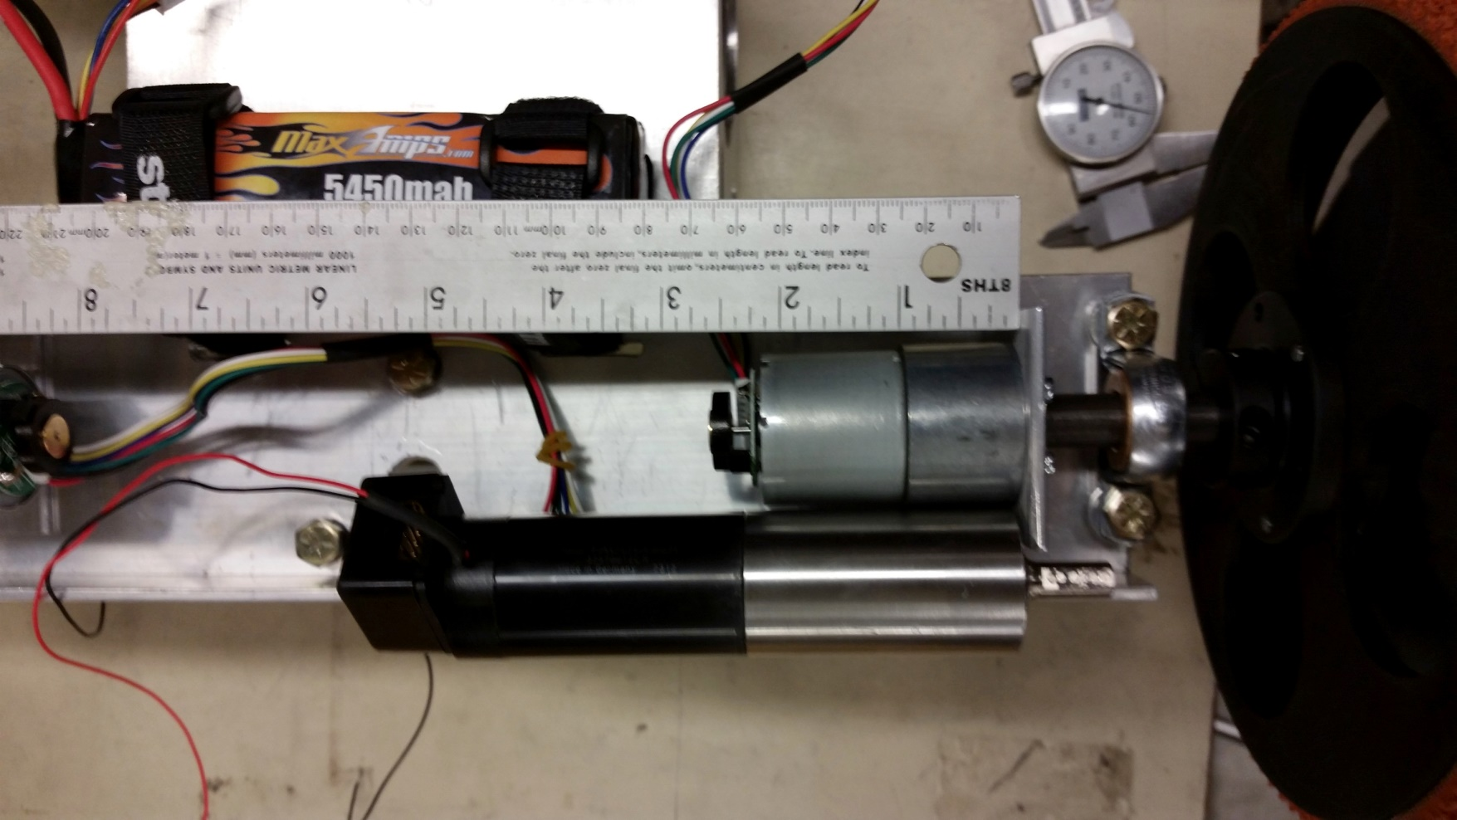
POST-MSR DRIVING MOTOR UPDATE
Faulhaber motors had too high of a detent torque
  Wheels could not free-spin during rappel or return → requires extra software complexity
Needed a cheap, readily available
1-1 replacement
  Must meet torque requirements & have low detent torque
Faulhaber
Pololu
 | OLD: Faulhaber Motor | NEW: Pololu Motor | Needed
Operational Torque | 18.4 Nm | 0.35 Nm | .33 Nm
Stall Torque | 73.7 Nm | 1.41 Nm | 1.3 Nm
Detent Torque | Unable to test (>>1.85 Nm) | 0.2 Nm | < 1.85 Nm
Software Complexity | High | None | Low
Overview
Test Readiness
Budget
Schedule

Slide 7
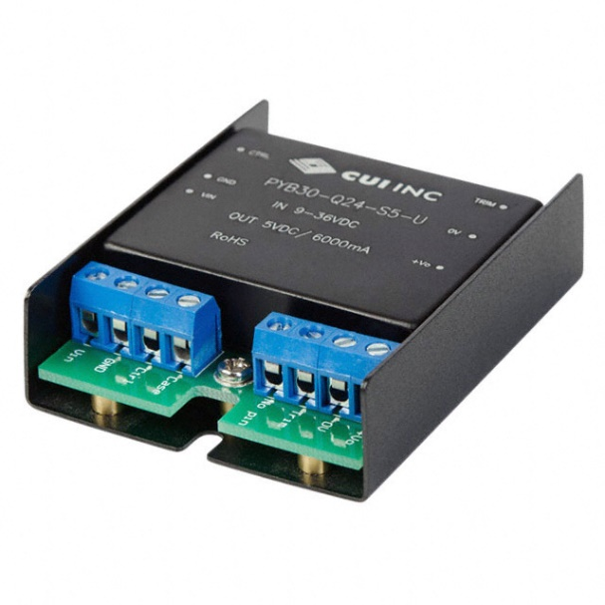
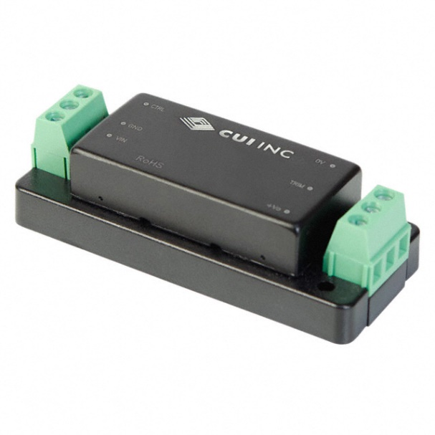
POST-MSR POWER UPDATES
Power regulation system failed Level 1 testing (DR6.1, DR6.2 – Electrical levels and loads)
  Output voltage was 40% lower than designed
  Output voltage was not constant over discharge of battery
Debugging was unsuccessful: alternate solution was needed to meet schedule constraints
SOLUTION: Purchase COTS power regulation components
12V
5V
Component | Meets Design Requirements | Level Testing | Input Sensitivity Testing | Static Load Testing | Dynamic Load Testing | EMC | Efficiency
LM25085AMY/NOPB (Prev. Design) | YES | FAIL | FAIL | FAIL | TBD | YES | PASS
TPS563209DDCT (Prev. Design) | YES | FAIL | FAIL | INCONCLUSIVE | TBD | YES | PASS
PYB30-Q24-S12-U (COTS) [12V] | YES | PASS | PASS | PASS | TBD | YES | PASS
PYB15-Q24-S5-T (COTS) [5V] | YES | PASS | PASS | PASS | TBD | YES | PASS
Overview
Manufacturing
Budget
Schedule

Slide 8
POST-MSR POSITIONING UPDATE
CR Odometry:
  By comparing pulses from 4 encoders: can track distance travelled and changes in CR orientation
    Sends this information to GS every second while driving
  Driving over rocks is also detected by comparing encoder pulses
    Forward CG causes both wheels on a side to raise which causes detectable changes in encoder readings
Calculations done on the GS:
  Integrates small changes in orientation and distance traveled to estimate and plot position.
Orientation Vector
CR
Maximum deviation allowed for return:
+/- 4.3°
Path
FUTURE WORK
Overview
Manufacturing
Budget
Schedule

Slide 9
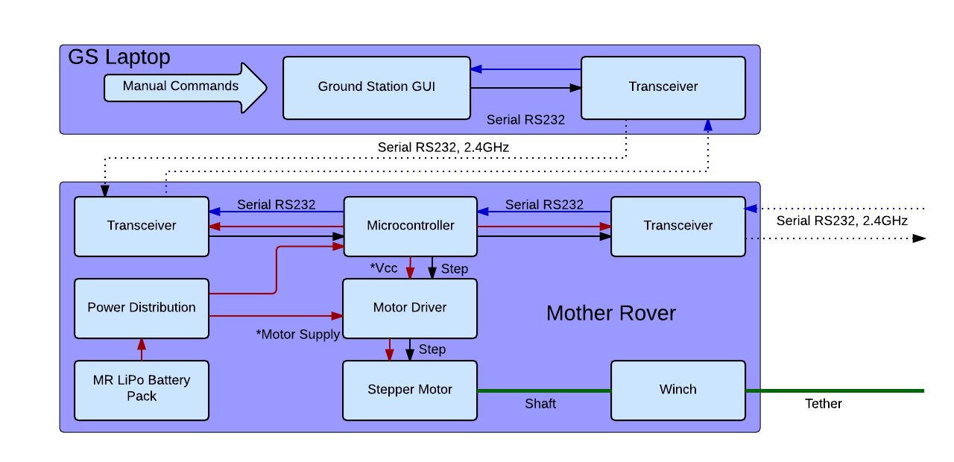
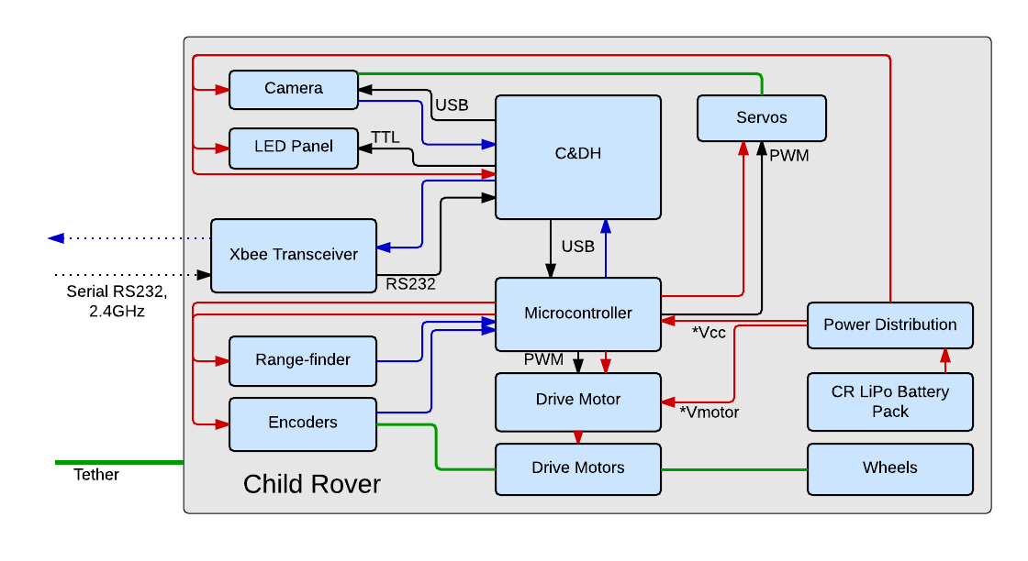
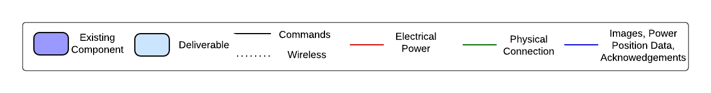
FUNCTIONAL BLOCK DIAGRAM
An Arduino Mega serves to replace the non-functional MR C&DH
A Raspberry Pi SBC performs C&DH for the CR
MR
CR
Another Arduino Mega interfaces with peripherals except for imaging
Controller
Overview
Test Readiness
Budget
Schedule
Notes:
30 seconds – 1 minute

Slide 10
LEVELS OF SUCCESS
Currently confident in achieving Levels 1 & 2 for project
  Remainder of Level 1 will be demonstrated within the next 2 weeks
Testing of Comm. dropout protocol will determine if Level 3 success can be met
Level 1
Level Criteria | Status
The CR shall be able to undock/re-dock to the TREADS CR bay | Needs to be Tested
The CR shall be able to rappel/ascend a 90 degree incline to a max depth of 5m | Needs to be Tested
The CR Shall be able to transition from traversing a vertical to horizontal surface and vice versa | Needs to be Tested
The CR shall be able to take and transmit/store at least 5 images | Demonstrated
Level 2
Level Criteria | Status
The CR shall be able to traverse up to 5m from the rappel touchdown point, controlled via the GS | IN PROGRESS
The CR shall able to resolve a 10cm diameter object from a distance of 5m using the imaging system | Demonstrated
The CR shall provide adequate scene lighting | Demonstrated
The imaging system shall have azimuthal and elevation angular coverage of 180 and 90 degrees | Demonstrated
Level 3
Level Criteria | Status
The CR shall know its depth within the cave/pipe accurate to +/- 10 cm | IN PROGRESS
The CR shall know its horizontal distance travelled accurate to +/- 10 cm | Demonstrated
The CR shall be able to return to the MR at the conclusion of a mission | Needs to be Tested
The CR shall handle communication dropouts with the MR/GS | Needs to be Tested
ACHIEVABLE
FURTHER WORK NEEDED
Overview
Test Readiness
Budget
Schedule

Slide 11
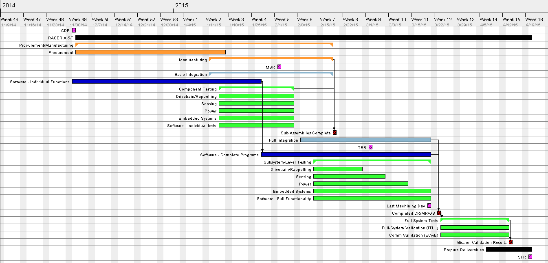

WORK PLAN AT MSR
Week 1
Week 5
Week 10
Week 15
Critical Path at MSR followed manufacturing and integration
Legend
= Manufacturing
= Integration
= Testing
= Software
= Class Milestone
= Internal Milestone
Overview
Test Readiness
Budget
Schedule
Notes:
60s

Slide 12
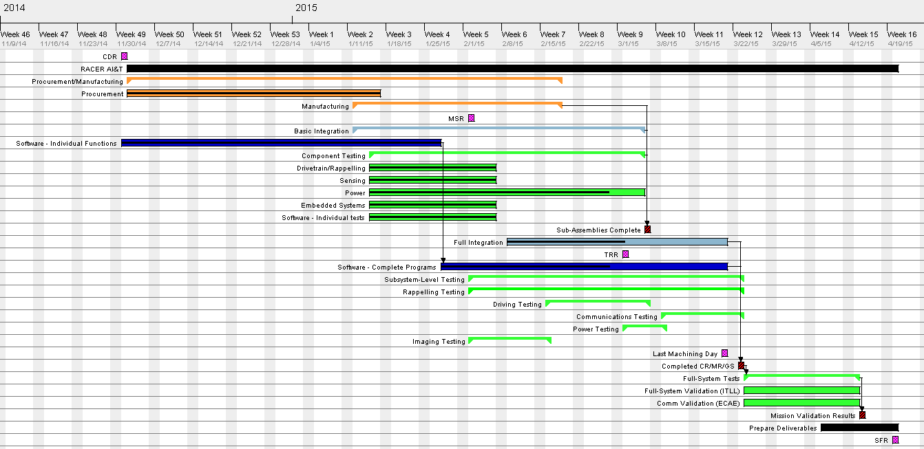
WORK PLAN POST-MSR
Week 1
Week 5
Week 10
Week 15
Basic Integration and Component Testing were extended due to further delays with PCB
NOTE: Uncertainty is included in all task lengths
Now have specific Subsystem-Level Testing tasks with their scheduling based on priority
Legend
= Manufacturing
= Integration
= Testing
= Software
= Class Milestone
Critical Path still follows integration, and testing is becoming more critical
= Internal Milestone
Overview
Test Readiness
Budget
Schedule
Notes:
60s

Slide 13
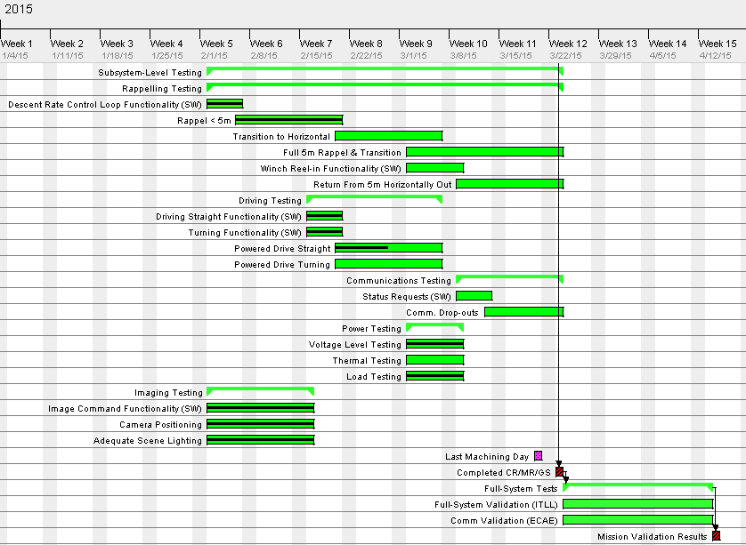
VERIFICATION AND VALIDATION SCHEDULE
Week 5
3/1/2015
Week 10
Week 15
CR driving functionality is required for all remaining subsystem testing except for power
Legend
= Testing
= Class Milestone
= Internal Milestone
Power testing with COTS modules is expected to be relatively fast
Expecting to start full-system validation within the next 3 weeks
Imaging subsystem has been fully verified
Overview
Test Readiness
Budget
Schedule
Notes:
60s

Slide 14

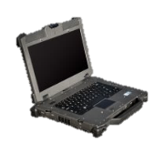


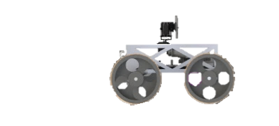
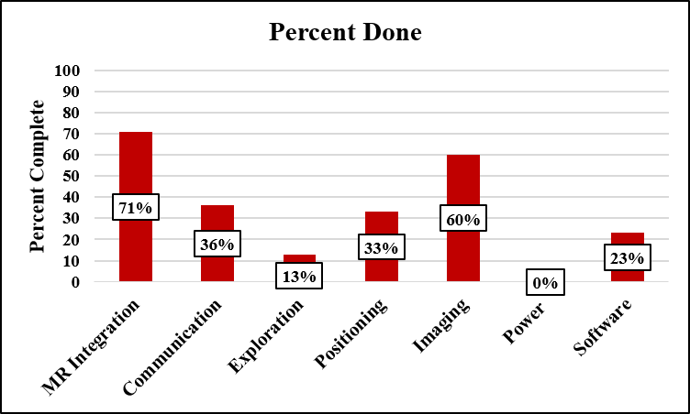
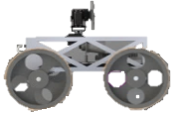
TESTING OVERVIEW
Completed Tests:
  Small-scale Rappelling Test
In Progress Tests:
  Driving Test
Future Tests:
  System Validation
  Full Scale Communication Drop-out
MR winch and electronics system mounted to platform
Rappelling
GS
CR
Most critical for minimum levels of success. Includes Rappelling and Driving
Percent of Requirements Verified
Overall: 34%
GS
Driving
CR
1m
2m
3m
4m
5m
Overview
Test Readiness
Budget
Schedule

Slide 15
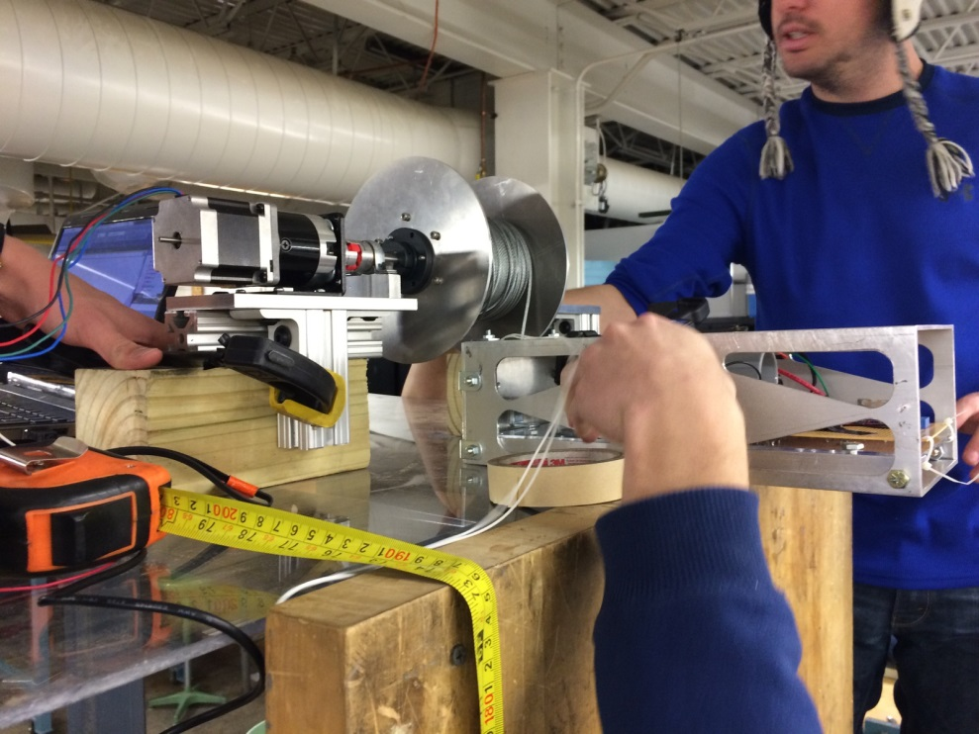

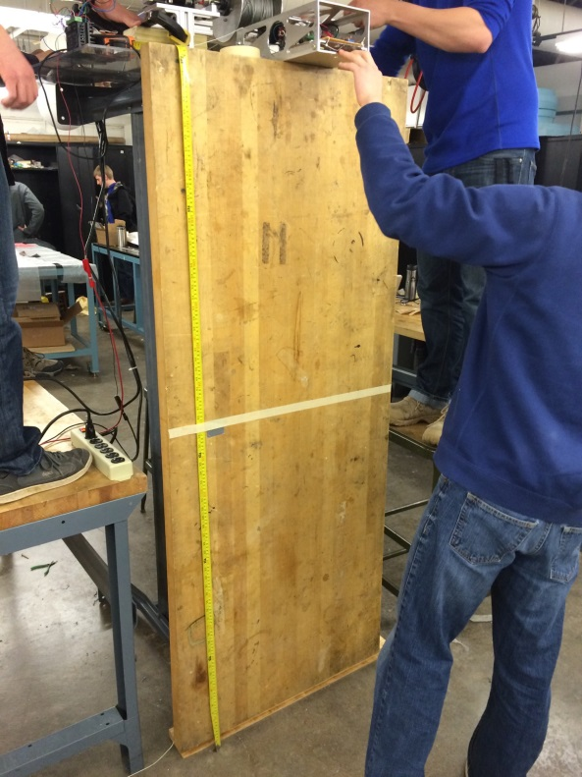
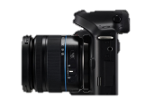
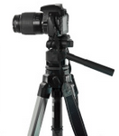
SMALL-SCALE RAPPELLING TEST OVERVIEW
Test Purpose: Verify rappelling control law model
Requirements Verified:
  DR.3.1 – The CR shall be able to rappel vertical slopes
  DR.4.1.1 - The CR shall know its depth within ± 10cm
Test Procedure: MR winch is mounted at top of the wall, the GS sends a command to rappel, track progress with camera, and measure final distance rappelled
Expected Results: Descent follows control law model and is within ± 1cm of actual distance (allowed ± 10cm)
MR WINCH SYSTEM
GS
CR CHASIS
MR winch and electronics system mounted to platform
EXPECTED RESULTS:
CR descends at ~10cm/s for most of the rappelling distance
CR descends at ~10cm/s for most of the rappelling distance
Tether
CR will stop at desired depth of
-140cm
GS
Video Camera to record descent progress
Proportional control starts 20 cm above target depth
EXPERIMENTAL SETUP:
140 cm
Rappel distance
1.8m Wall
Overview
Test Readiness
Budget
Schedule

Slide 16
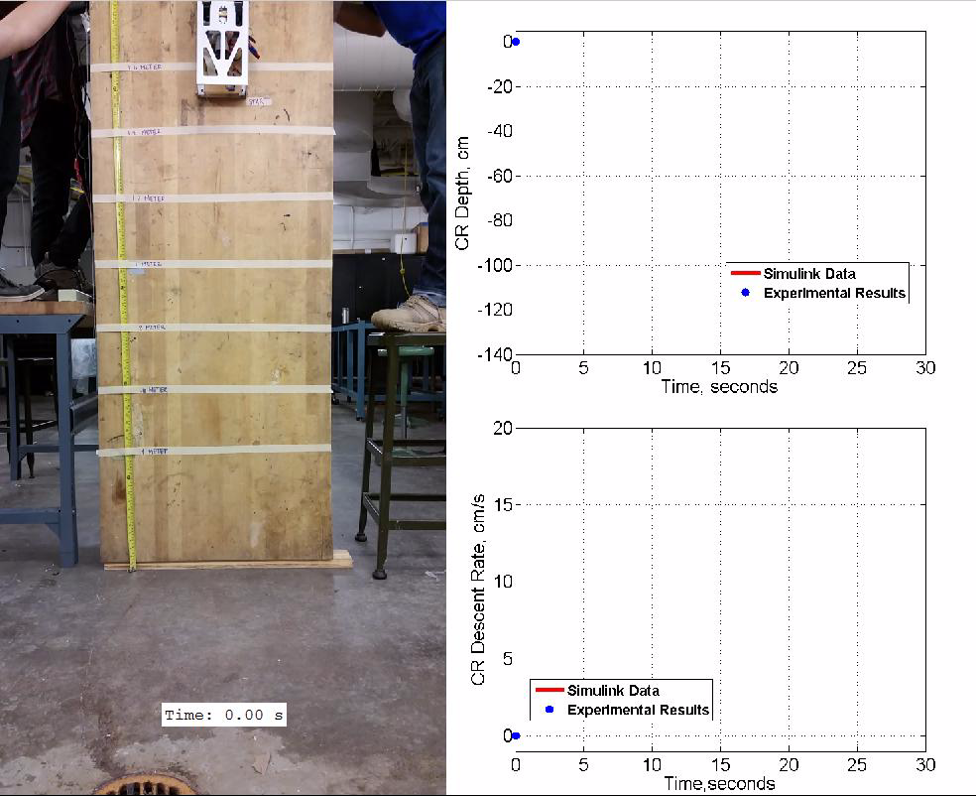
SMALL-SCALE RAPPELLING TEST: RESULTS
Proportional descent-rate control is enabled as CR approaches the target depth:
- DR.3.1: ✔
- Model Verification: ✔
Reference distances in background of video used to track CR position over time
CR rappelled to within +/-0.5cm of target and stopped:
- DR.4.1.1: ✔
CR stops at the appropriate depth for the front wheels to be touching the ground

Slide 17
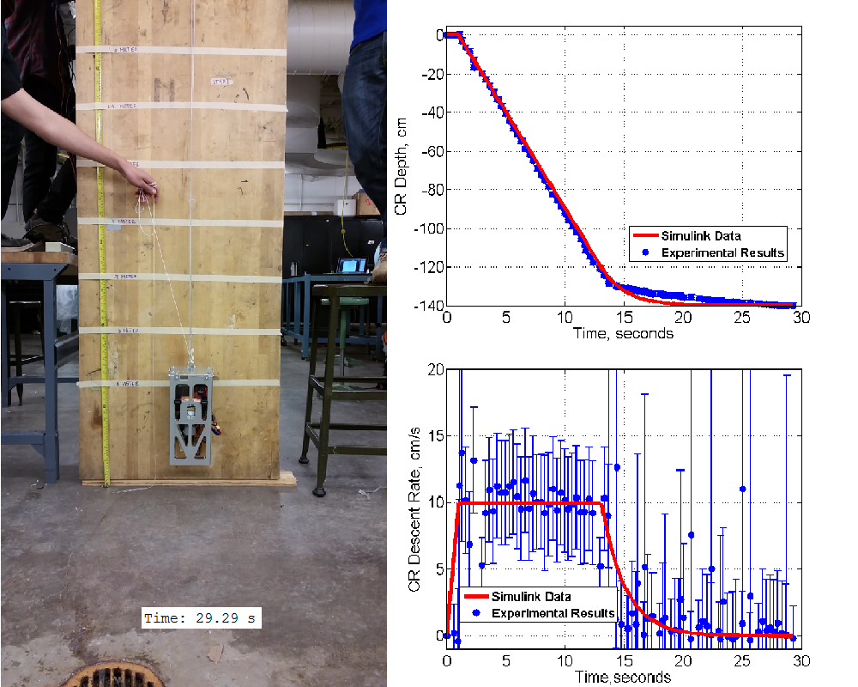
SMALL-SCALE RAPPELLING TEST: RESULTS
Proportional descent-rate control is enabled as CR approaches the target depth:
- DR.3.1: ✔
- Model Verification: ✔
Error bars for depth computed from assuming +/- 10 pixel accuracy in position tracking
Reference distances in background of video used to track CR position over time
CR rappelled to within +/-0.5cm of target and stopped:
- DR.4.1.1: ✔
- Model
Verification: ✔
CR stops at the appropriate depth for the front wheels to be touching the ground
Error bars for descent rate calculated from positional error and timing error added in quadrature

Slide 18
DRIVING TEST - OVERVIEW
Test Purpose: Verify driving performance and horizontal distance travelled positioning accuracy
Requirements Verified:
  DR.3.3 – The CR shall be able to traverse a distance of up to 5m horizontally from the rappel touchdown point
  DR.4.1.2 - The CR shall know its distance travelled within ± 10cm
Procedure: Incrementally drive forward 1m up to 5m, measure distance travelled and compare to encoders. Repeat when driving backwards to simulate full mission distance
Expected Results: <10cm of error over the mission duration (<1cm average error per meter driven)
  Maximum of 18 average miscounted pulses per meter driven allowable
Required to know distance travelled within +/- 10cm over the mission duration
GS
After each command, the distance travelled by the CR will be measured and compared with CR odometry
Positional Error Over Mission Duration, cm
Must miscount fewer than 18.1 encoder pulses per meter driven to meet requirement
1m
2m
3m
4m
5m
Overview
Test Readiness
Budget
Schedule

Slide 19
DRIVING TEST – PRELIMINARY RESULTS
Preliminary testing has demonstrated basic functionality with driving forward
  CR can be commanded to drive a distance
Current status:
  Encoder pulses are not being counted accurately
  Average error per meter driven is too high to meet requirement
Future work:
  Start removing possible sources of error:
    Wheel slip from testing on a slick surface
    Gear ratio of motors may be different from what is advertised
    The CR overshoots its target because of its momentum
  Perform additional testing with driving backwards and turning
See large positive bias between how far the CR thinks it has travelled and how far it really has
Magnitude of bias is not consistent between trials
Would result in a negative bias
Overview
Test Readiness
Budget
Schedule

Slide 20
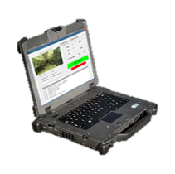
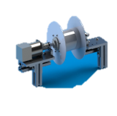
SYSTEM VALIDATION - OVERVIEW
Test Purpose: Validate the overall system as it performs the mission
Systems to be Validated:
  Driving – FR.3: The CR shall explore a cave or pipe
  Rappelling – FR.3: The CR shall explore a cave or pipe
  Positioning – FR.4: The CR shall contain a positioning system
  Imaging – FR.5: The CR shall capture photographic images
  Power – FR.6: The CR and MR systems shall contain their own electrical power systems
  Software – FR.7: The CR, MR, and GS systems shall be controlled with software
GS
MR
Test Location:
  South ITLL Patio
CR
Overview
Test Readiness
Budget
Schedule
Notes:
Can we be more specific about which ITLL patio. Like west patio possibly
And re-ordering of the systems

Slide 21
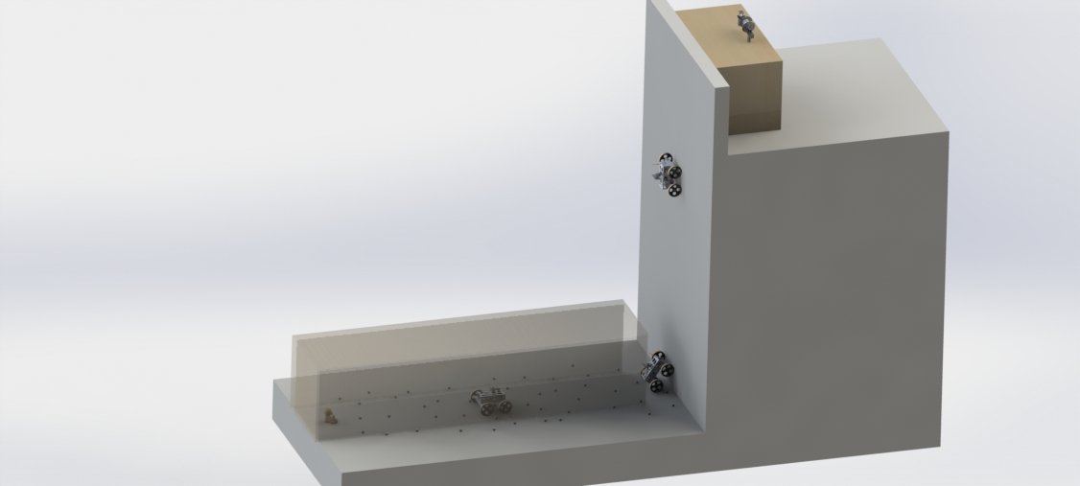
SYSTEM VALIDATION – TEST ENVIROMENT
Deployment Stage:
Pass/Fail
1
ITLL South Patio To Scale:
MR Platform
Rappelling Stage:
Positional data at end of rappel to validate model
Expected result: within 1cm of actual depth
Transition is Pass/Fail
Re-docking Stage:
Pass/Fail
5
1) Deployment (5 min)
- CR undocks
- CR enters cave/pipe
Return Stage:
Positional data recorded as before for distance travelled and depth
Expected results: within 10cm for distance, within 1cm for depth
2
2) Rappelling (15 min)
- CR rappels 5m
- Transitions from
vertical → horizontal
Exploration Stage:
Positional data throughout driving
  Recorded by test operators through openings in side of “pipe”
Expected result: within 10cm of actual distance travelled over the course of this stage
5m Vertical Surface
3) Exploration (120 min)
- CR traverses 5m
- CR takes/stores
image of POI
4
3
4) Return (15 min)
- CR is retracted by
MR winch system
1m
1m
Scattered rocks less than 3cm in diameter
5) Re-docking (5 min)
- CR re-enters MR bay
5m plywood “pipe”
Concrete
Overview
Test Readiness
Budget
Schedule
Notes:
Is this slide for the overall system validation?

Slide 22
Full Scale Comm. Drop-Out Verification
Test Purpose: Verify comm. drop-out protocol in full test environment
MR Platform
Case 1 end location
Requirements Verified:
  DR.7.2.1.1 – The CR will implement communication drop-out protocol
Test Procedure:
  Case 1 – Comm. is not restored and CR is reeled in to start of Rappel phase
  Case 2 – Comm. is restored prior to complete reel in
5m Vertical Surface
Case 2 end location
1m
1m
Concrete
Start location of CR
5m plywood “pipe”
Overview
Test Readiness
Budget
Schedule
Notes:
Is this slide for the overall system validation?

Slide 23
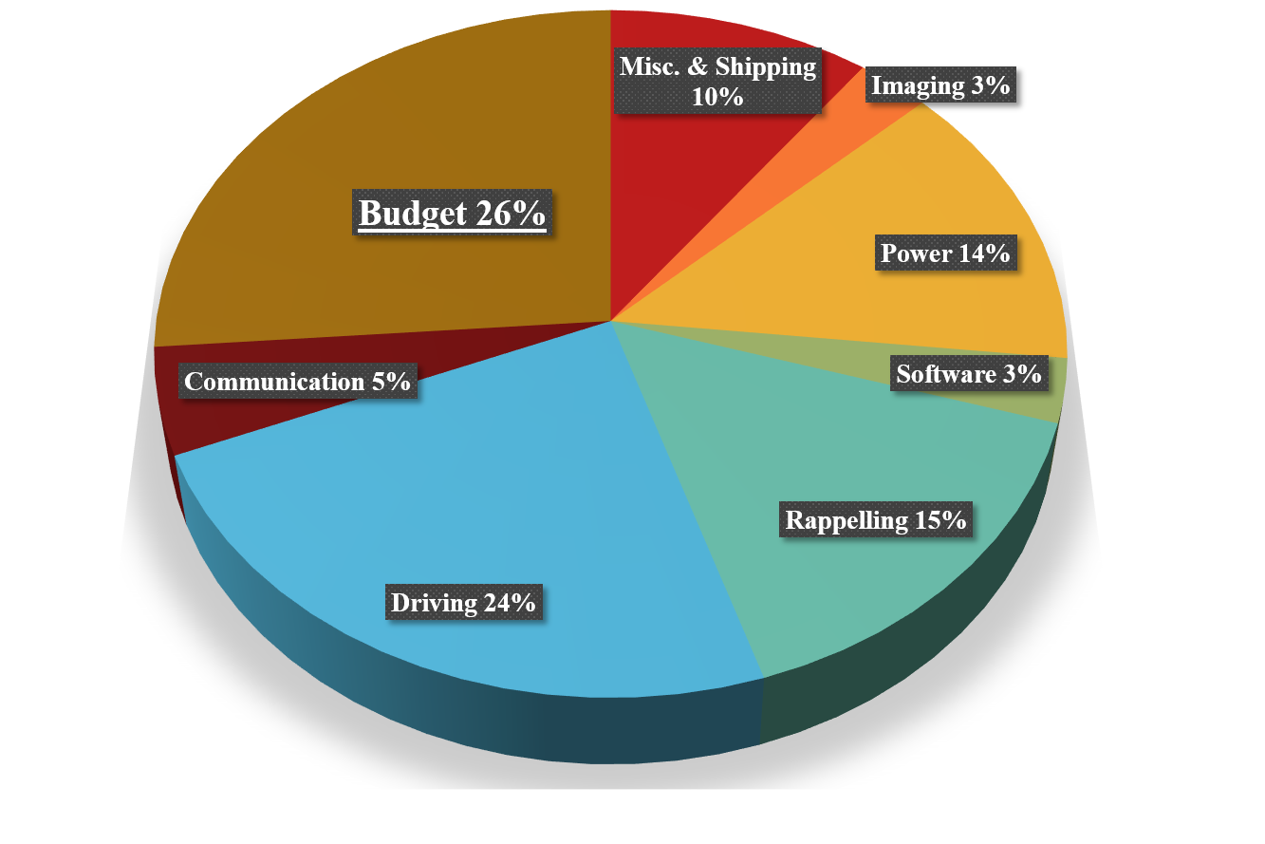
BUDGET UPDATE
Spending Category | Money Spent ($)
Miscellaneous & Shipping | 510
Imaging | 142
Power | 684
Software | 150
Rappelling | 766
Driving | 1187
Communication | 251
Money Spent | 3690
Remaining Budget | 1310
Have budget left for duplicates of any critical components
All procurements for 1 rev. of project have been purchased
Expect to spend less than CDR projected budget of $4500
Remaining expenses: report printing, test environment supplies (wood and rocks), cable management supplies, etc.
Overview
Test Readiness
Budget
Schedule

Slide 24
SUMMARY OF FUTURE WORK
Further work includes full-system validation as well as some subsystem-level verification
  Must demonstrate undocking/re-docking, full rappelling and return, and transitions
Level 1
Level Criteria | Status
The CR shall be able to undock/re-dock to the TREADS CR bay | Needs to be Tested
The CR shall be able to rappel/ascend a 90 degree incline to a max depth of 5m | Needs to be Tested
The CR Shall be able to transition from traversing a vertical to horizontal surface and vice versa | Needs to be Tested
The CR shall be able to take and transmit/store at least 5 images | Demonstrated
Level 2
Level Criteria | Status
The CR shall be able to traverse up to 5m from the rappel touchdown point, controlled via the GS | IN PROGRESS
The CR shall able to resolve a 10cm diameter object from a distance of 5m using the imaging system | Demonstrated
The CR shall provide adequate scene lighting | Demonstrated
The imaging system shall have azimuthal and elevation angular coverage of 180 and 90 degrees | Demonstrated
Level 3
Level Criteria | Status
The CR shall know its depth within the cave/pipe accurate to +/- 10 cm | IN PROGRESS
The CR shall know its horizontal distance travelled accurate to +/- 10 cm | Demonstrated
The CR shall be able to return to the MR at the conclusion of a mission | Needs to be Tested
The CR shall handle communication dropouts with the MR/GS | Needs to be Tested
By 3/23
By 3/8
By 3/8
By 3/23
By 3/8
By 3/23
By 3/23
ACHIEVABLE
FURTHER WORK NEEDED
Overview
Test Readiness
Budget
Schedule

Slide 25

QUESTIONS?

Slide 26

PRELIMINARY DRIVING TEST

Slide 27
CRDriveState Class
Encapsulates all CR state variables into a single object.
Keeps track of the previous distances on each wheel.
Introduces the “state” variable
  See Next Slide
checkEncoders() uses new encoder data and previous wheel distances to determine changes in state, distance traveled, and orientation.
  Will be used in main drive loop.
CRDriveState{
private:
depth
orientation
distanceTraveled
prevBackLeftDistance
prevBackRighttDistance
prevFrontLeftDistance
prevFrontRightDistance
state
checkEncoders()
public
getCRDriveState()
setCRDriveState()
- Other getters and setters.
}
Overview
Testing
Budget
Schedule

Slide 28
CR State
Integer variable that represents a driving condition (rocks, slip, etc..)
Assumes a forward CG
State | Name | Conditions
0 | RAPPELLING | Ignore encoder readings (disableInterrupts)
1 | DRIVING | No anomalies. Average all encoder readings.
2 | ROCK_FRONT_LEFT | FL > FR, FR ≈ BR, RL ≈ 0
3 | ROCK_FRONT_RIGHT | FR > FL, FL ≈ RL, BR ≈ 0
4 | ROCK_FRONT_ALL | FR ≈ FL, BR ≈ BL, FL > BL, FR > BR
5 | ROCK_REAR_LEFT | FL ≈ FR, BL > BR,
6 | ROCK_REAR_RIGHT | FL ≈ FR, BR > BL,
7 | ROCK_REAR_ALL | FR ≈ FL, BR ≈ BL, FL < BL, FR < BR
8 | SLIP_FRONT_LEFT | FL > FR, FR ≈ BR ≈ BL
9 | SLIP_FRONT_RIGHT | FR > FL, FL ≈ BR ≈ BL
10 | SLIP_FRONT_ALL | FR ≈ FL, BR ≈ BL ≈ 0

Slide 29
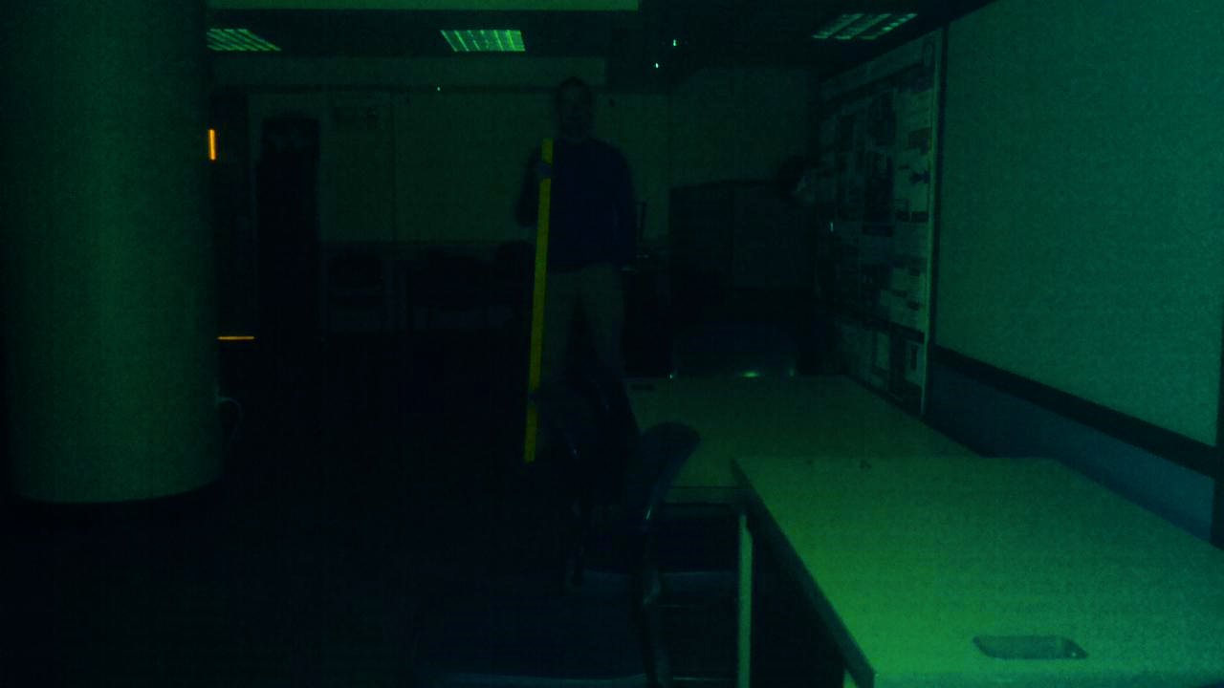
IMAGE RESOLUTION TEST
Test Purpose: Verify scene lighting and image resolution requirements
Systems Tested: Imaging, Communication, and Software
Requirements Verified:
  DR.5.1 – Imaging system shall have a minimum resolution of 3.7 pixels per degree of field of view in a single image
  DR.5.4 – The imaging system light source shall provide adequate lighting to determine a POI from background
10cm Object
Test Location: Lockheed Martin Room
Test Procedure: Room light was turned off, LED light panel was turned on, and image was captured
5m
Horizontal distance
Overview
Testing
Budget
Schedule

Slide 30
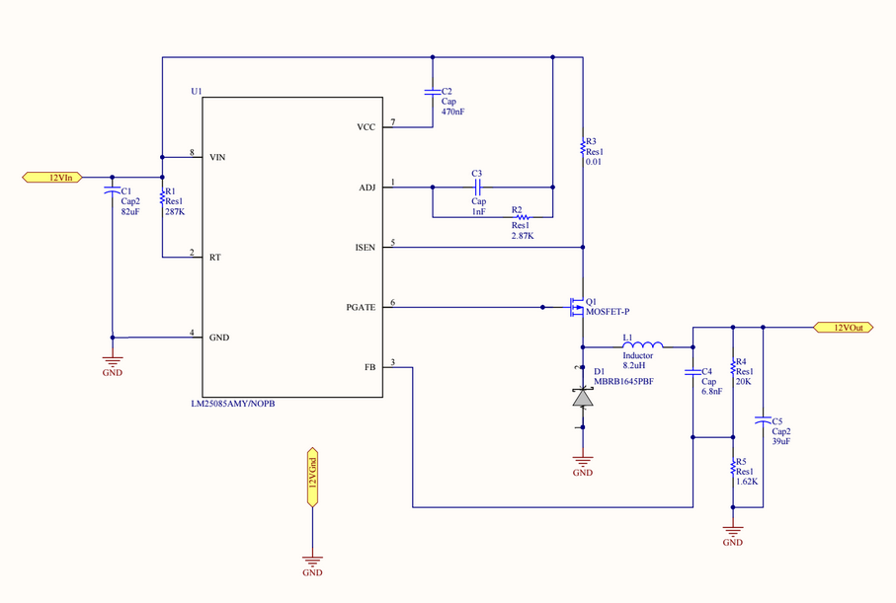
POWER SYSTEM DEBUGGING
Switches at correct frequency, but always 50% duty cycle
Any change to input voltage changes output
Changing voltage on feedback pin doesn’t change output

Slide 31
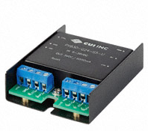
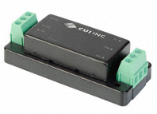
PERFORMANCE OF NEW POWER COMPONENTS
PYB30-Q24-S12-U (12V)
  This encompasses the entire discharge profile of the battery and meets our level requirements
  Line regulation of 0.1%
PYB15-Q24-S5-T (5V)
  This encompasses the entire discharge profile of the battery and meets our level requirements
  Line regulation of 0.1%
 | 12 V Regulation | 5 V Regulation
No Load | 11.941 +/- 0.002V | 5.015 +/- 0.001V
Full Load | 11.941 +/- 0.015V | 5.015 +/- 0.006V
Input voltage range (As Advertised) | 8.2V-36V | 8.2V-36V

Slide 32
MOTOR DRIVER & RESPONSE TO SMALL PWM INPUT SIGNAL
PWM duty cycle: <2%
  Motor fully powered off
PWM duty cycle: 2-3.1%
  Motor detent torque decreased
PWM duty cycle: >3.1%
  Motor freely rotating
This shows we can partially power the motors without them moving to allow the rover to be more easily pulled backward.

Slide 33
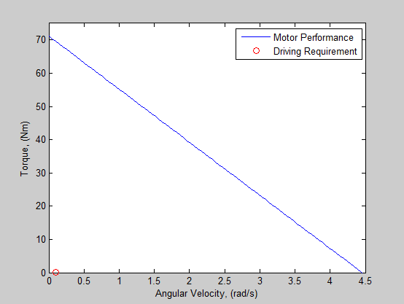
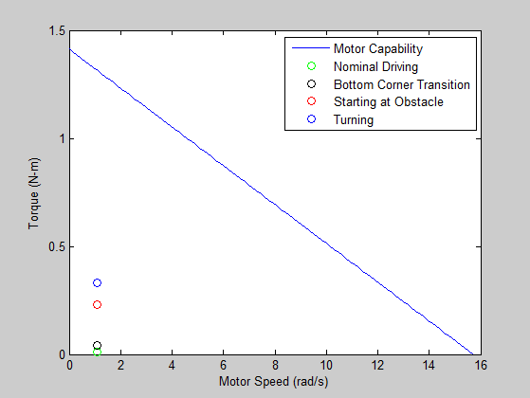
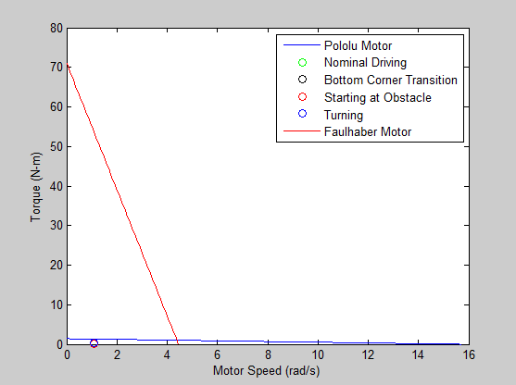
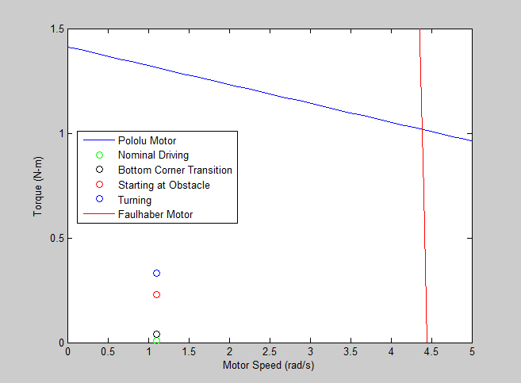
TORQUE – SPEED PLOT
Faulhaber Motor Performance
Pololu Motor Performance
Faulhaber (Red) & Pololu (Blue) Motor Performance

Slide 34
Requirements Verified
Requirement | Description | Verification method | Result
DR.1.1 | The CR shall fit within the TREADS CR bay | Child requirements met | N/A
DR.1.1.1 | The CR shall have an area footprint no greater than 0.483m x 0.483m | Inspection | Footprint – 0.46m x 0.46m
DR.1.1.2 | The CR shall have a mass of no more than 9.8 kg | Inspection | Mass – 7 kg
DR.1.3 | The winch subsystem shall fit onto the MR | Child requirements met | N/A
DR.1.3.1 | Additions to the MR structure shall not exceed 10 kg | Inspection | Mass – 6.5 kg
DR.2.1 | The CR shall receive commands from the GS via the MR relay system | Inspection | Command sent from GS was received at CR
DR.2.1.3 | The CR shall receive commands to take a picture and store the image | Testing | CR took/stored image at command of GS
DR.2.2 | The CR shall be able to transmit images to the GS via the MR | Inspection | Image taken from CR was received at GS
DR.2.2.1 | Transmission shall be a minimum of 18 bits/min baud rate per pixel in an image | Testing | Send image in 29s, required to do so in 108s

Slide 35
Requirements Verified cont.
Requirement | Description | Verification method | Result
DR.3.1 | The CR shall be able to rappel vertical slopes | Testing | As seen in main presentation
DR.4.1.1 | The CR shall know its depth within +/- 10cm | Testing | Within +/- 1cm
DR.5.1 | The imaging system shall have a minimum resolution of 3.7 pixels per degree of field of view in a single image | Testing | 1 image equals 23.9 x 17.4 pixel per degree of field of view
DR.5.4 | The imaging system light source shall provide adequate lighting to determine a POI from background | Testing | See imaging test back up slide
DR.5.5 | The CR shall be able to store at minimum of 5 images | Demonstration | 5+ images were taken and stored on SD card
DR.7.1.2 | The CR software shall command the imaging system to take an image and save onboard | Testing | See imaging test back up slide
DR.7.4 | The MR software shall be able to interpret commands from MR communication system | Testing | Commands were successfully carried out by MR software (Rappelling)
DR.7.8 | The GS software will display the image upon receiving from the MR relay and save to the GS | Testing | See imaging test back up slide

Slide 36
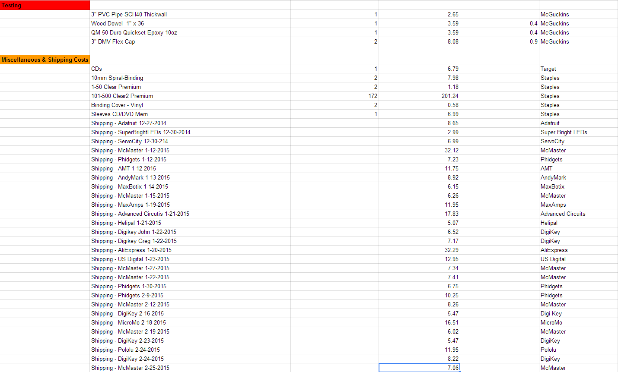
BUDGET ITEMIZATION – Test/Misc.

Slide 37
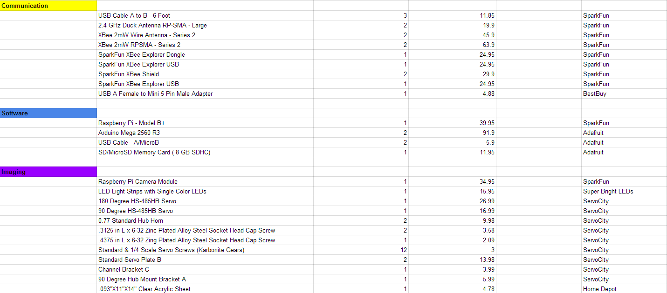
BUDGET ITEMIZATION – Comm./Power/SW

Slide 38
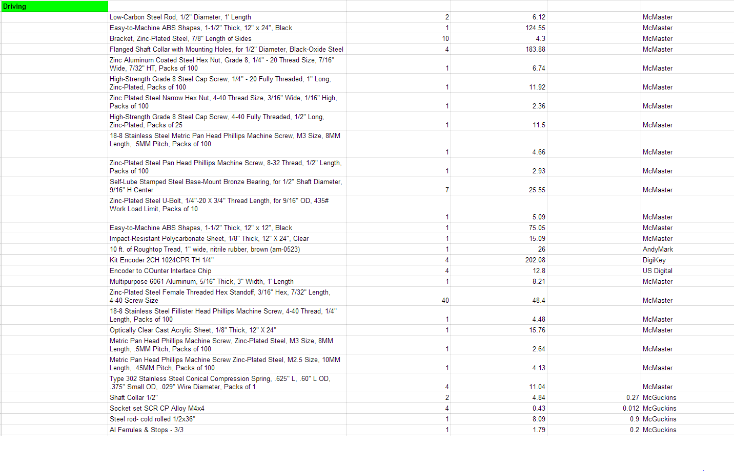
BUDGET ITEMIZATION – Driving

Slide 39
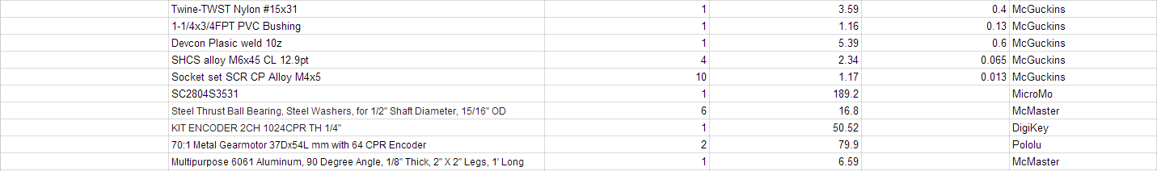
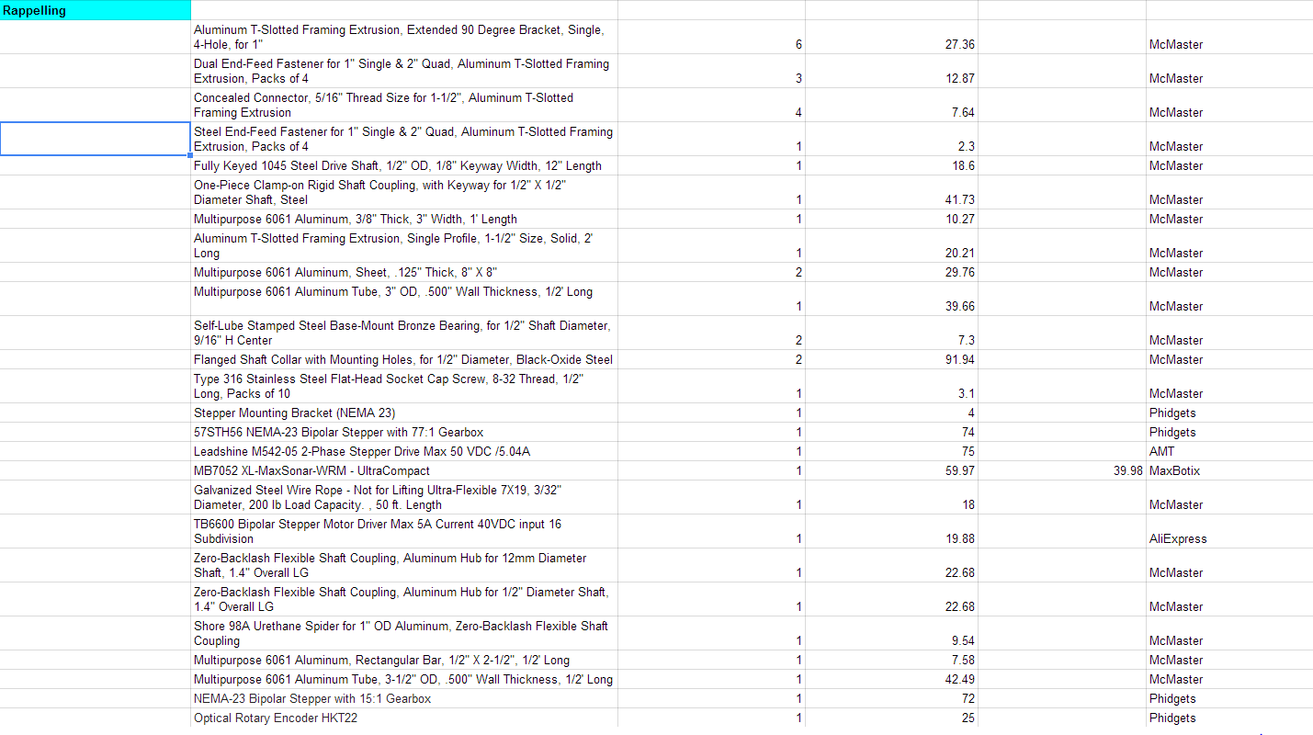
BUDGET ITEMIZATION – Driving cont./ Rappelling

Slide 40
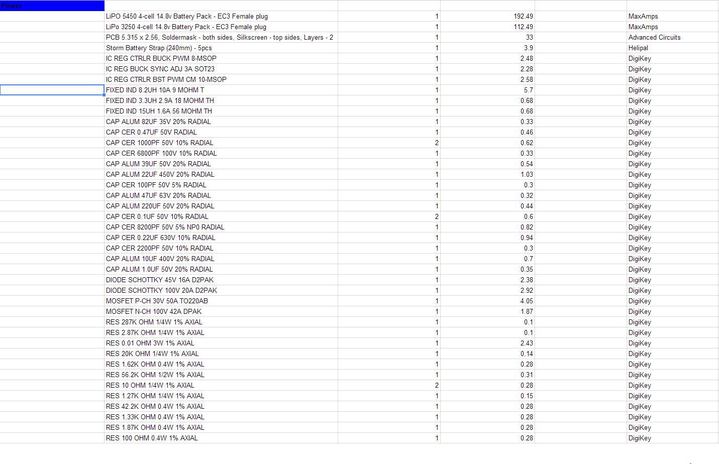
BUDGET ITEMIZATION – Power

Slide 41
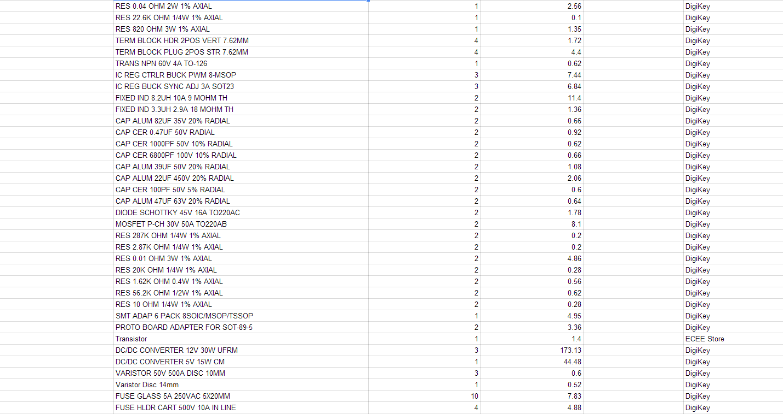
BUDGET ITEMIZATION – Power cont.

