Slide 1
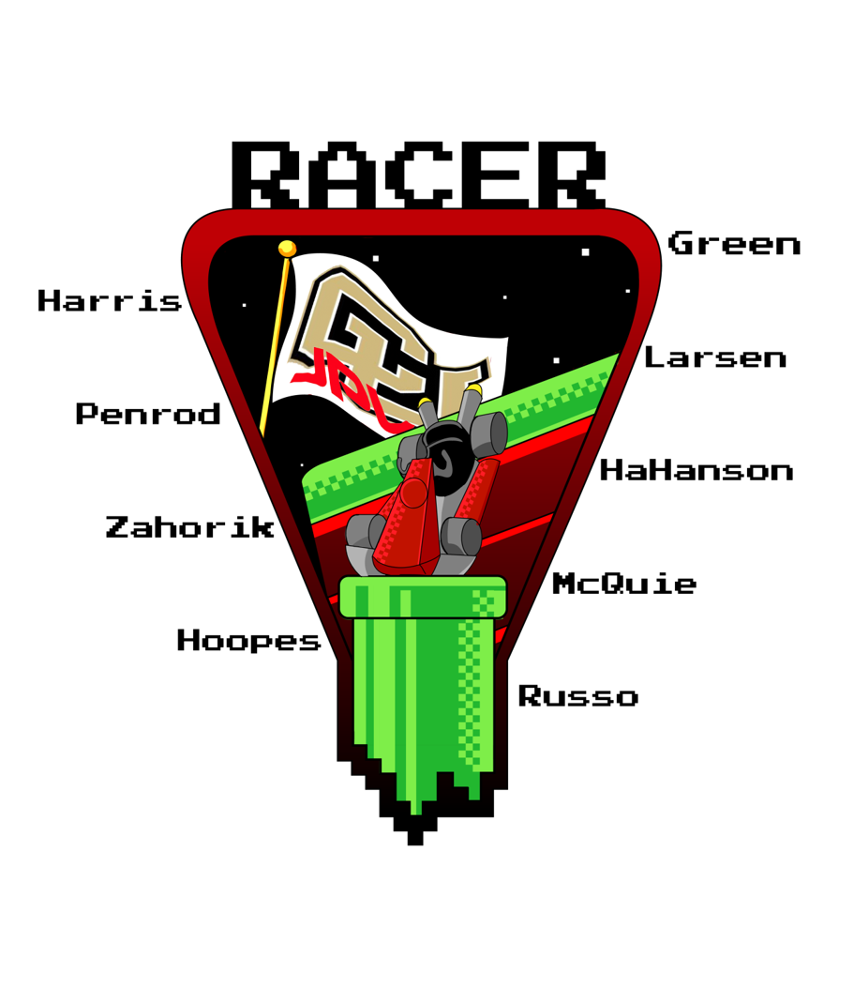
RAppelling Cave Exploration Rover
Advisor:
James Nabity
Customer:
Barbara Streiffert
Spring Final Review
Notes:
15 seconds

Slide 2
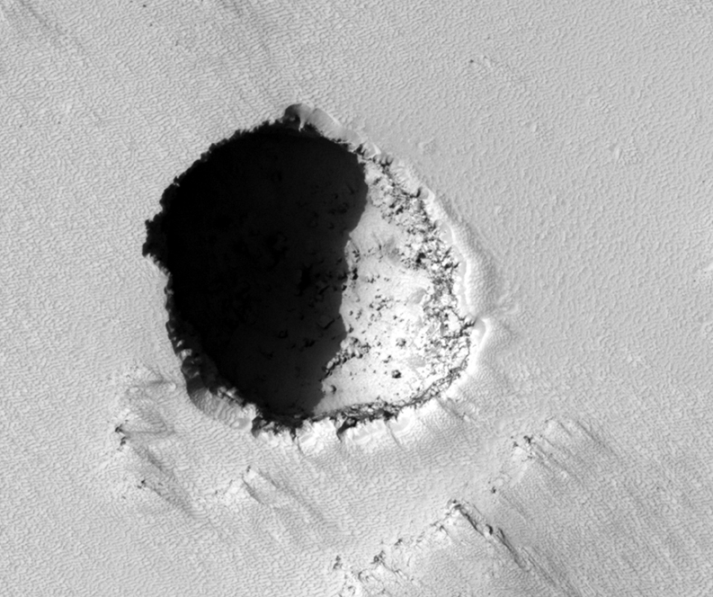
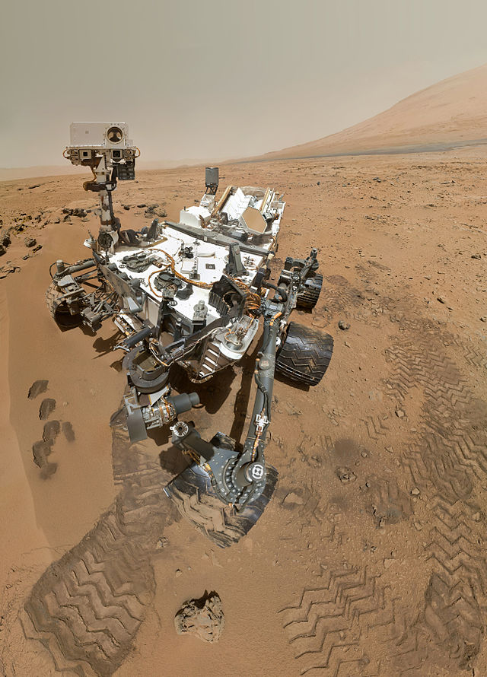
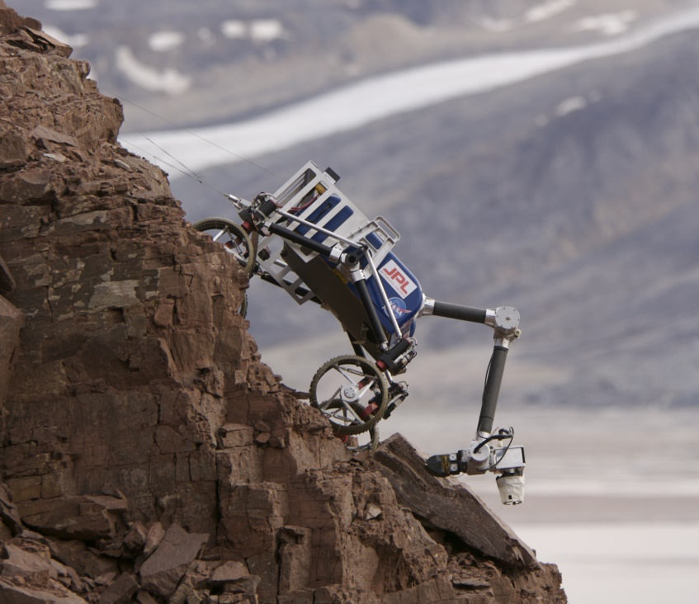
FIELD OF APPLICATION
Rovers are developed to replace high-risk human work in areas such as:
  Planetary Exploration
  Military Reconnaissance
  Disaster Relief
Steep and rocky terrain navigation is one of the largest challenges
  Cannot access environments such as collapsed buildings on Earth or skylight caves on Mars
Use of Mother Rover/Child Rover (MR/CR) configuration is advantageous
  CR can be less massive if MR transports it long distances
  MR can carry heavy support equipment such as a winch for rappelling
Image of skylight cave on Mars taken by Mars Reconnaissance Orbiter (Image Credit: NASA/JPL/University of Arizona)
JPL’s Curiosity mars rover (Image credit: NASA/JPL-Caltech/Malin Space Science Systems)
TRESSA rover scaling steep terrain in Norway (Image Credit: NASA)
Overview
Testing
Systems
Design
Management

Slide 3
PROJECT STATEMENT
This project encompasses designing, building and verifying a rappelling child rover (CR). The CR adds the capability of rappelling to the JPL legacy rover projects and will integrate with the TREADS Mother Rover (MR).
RACER Mission
Rappelling
Exploring
Positioning
Returning
90° Surface
To a maximum depth of 5m
Maximum distance of 5m out
Ground Station (GS) controls motion and imaging
Scattered rocks no larger than 3cm diameter
Depth within +\-10cm
Horizontal distance traveled within +\-10cm
Return to and
re-dock with MR
Overview
Testing
Systems
Design
Management
Notes:
30 seconds

Slide 4
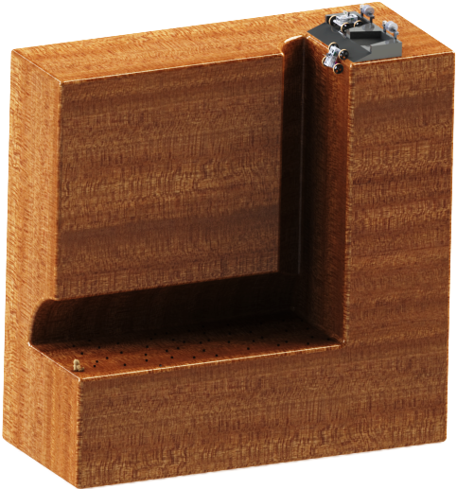

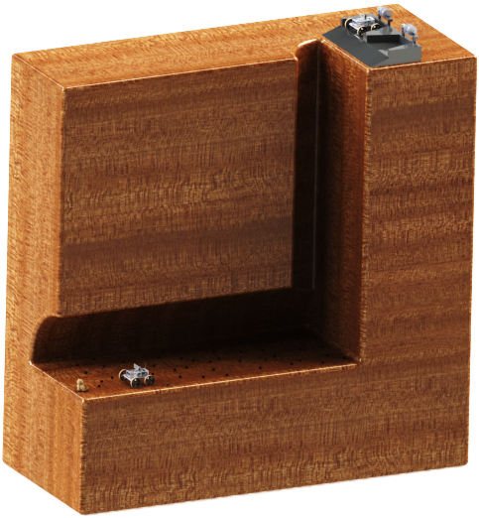
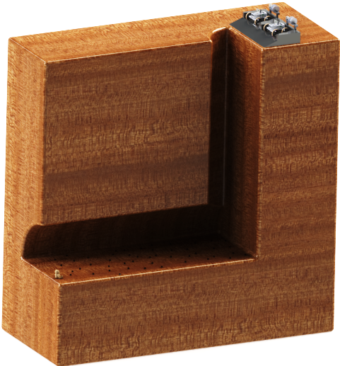
CONOPS
GROUND STATION (GS)
GS operator has direct line-of-sight view for navigation
5
1) Deployment (5 min)
- CR undocks
- CR enters cave/pipe
0) Arrival
- Child Rover
(CR) on
TREADS MR
0) Arrival
- Child Rover
(CR) on
TREADS MR
CR movement controlled by GS operator input
1
2) Rappelling (15 min)
- CR rappels 5m
- Transitions from
vertical → horizontal
After command from GS, rappel is autonomous with feedback loop from CR range-finder
→ COMMANDS
→ DATA
→TETHER
2
Images from CR imaging system used for navigation
3) Exploration (120 min)
- CR traverses 5m
- CR takes/stores
image of POI
4
NOTE: The return phase retraction will only continue to approximately the location of the start of Phase 2, based on readings from a range-finder and a winch encoder.
NOTE: There are small rocks, no larger than 3cm diameter, scattered over the horizontal surface
4) Return (15 min)
- CR is retracted by
MR winch system
3
5) Re-docking (5 min)
- CR re-enters MR bay
10cm diameter POI
Anticipate transmitting ~100 images in the 3hr mission
Margin
RACER Mission Timeline:
RACER Mission Duration: 160 min Margin: 20 min TOTAL: 180 min
5
15
120
15
5
20
Overview
Testing
Systems
Design
Management
Notes:
CHANGE THIS, SAME AS TRR – GM 6/7/15

Slide 5

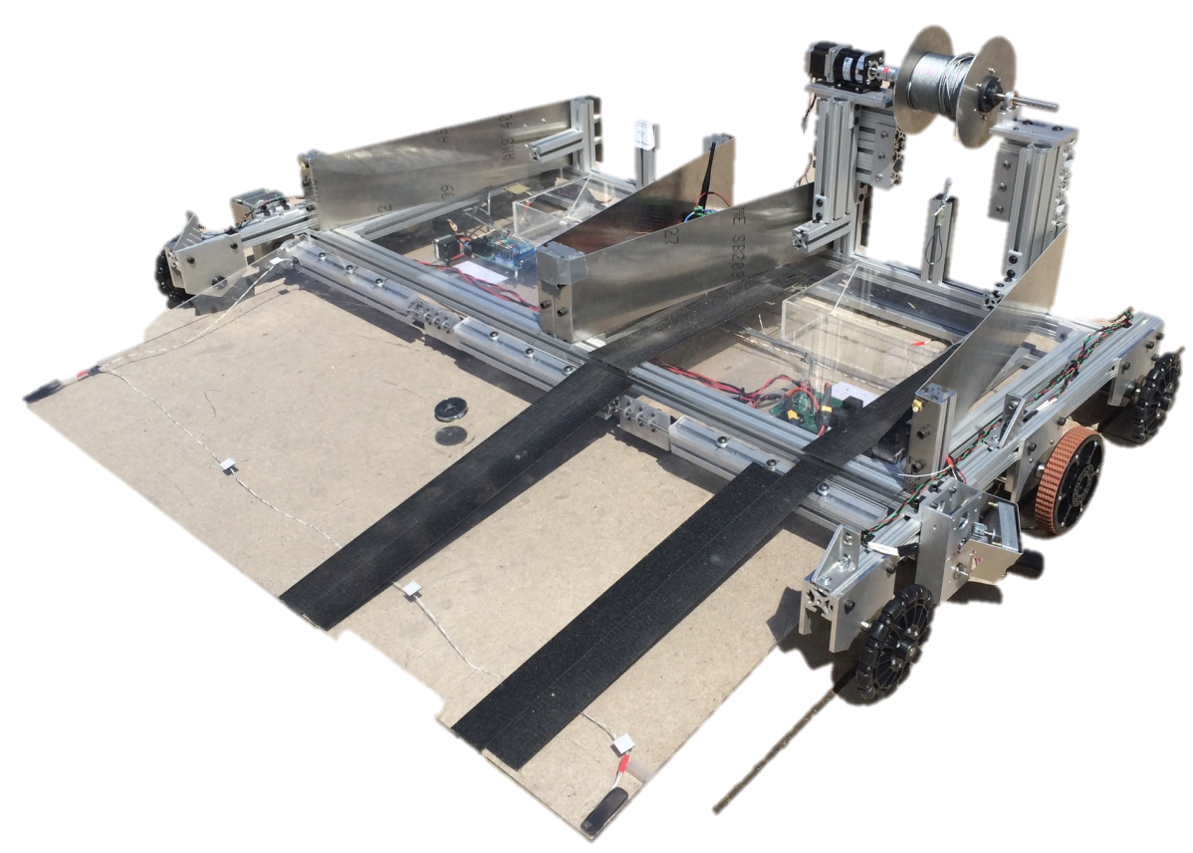
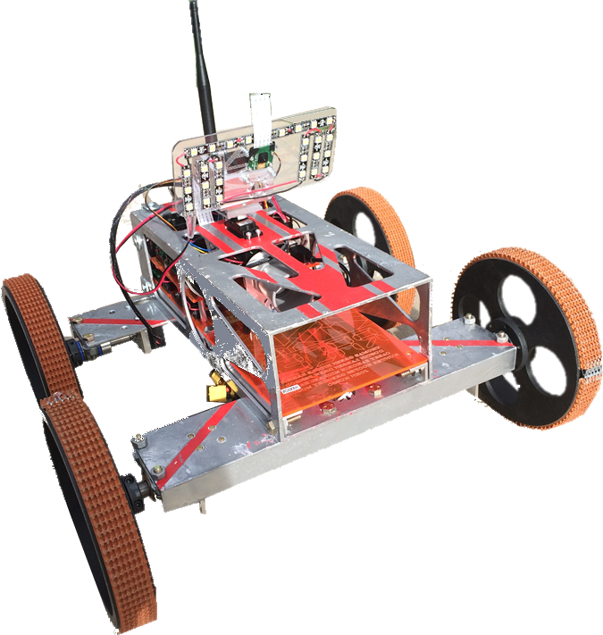
DESIGN OVERVIEW
MR Rappelling System
Custom Winch
23.5 Nm Stepper Motor
GS Comm System
2mW 2.4GHz XBee Radio
Transmits commands from user
GS
MR Comm System
2 x 2mW 2.4GHz XBee Radios
Serves as relay between GS&CR
TREADS MR
Imaging System
720p Raspberry Pi Cam
Pan/tilt servos and LED light panel
Fixed Rappelling
Attachment Point
Zinc-plated steel Eye-bolt
CR Comm System
2mW 2.4GHz XBee Radio
5dBi dipole antenna
Positioning: Depth
Ultrasonic Range Finder
CR Power System
14.8 LiPo battery w/
12V & 5V COTS Power Regulation
Rappelling Tether
7x19 Braided Steel
Only provides physical connection
CR Wheels
18cm diam., Nitrile rubber treads
Front pair powered for driving/turning
Back pair free for odometry
Driving Motors
0.35Nm Polulu DC Motors
70:1 internal gear-box
RACER CR
Positioning: Distance Travelled
Two Optical Encoders: Back Wheels
Two Hall Effects Encoders: Front Wheels
Overview
Testing
Systems
Design
Management

Slide 6
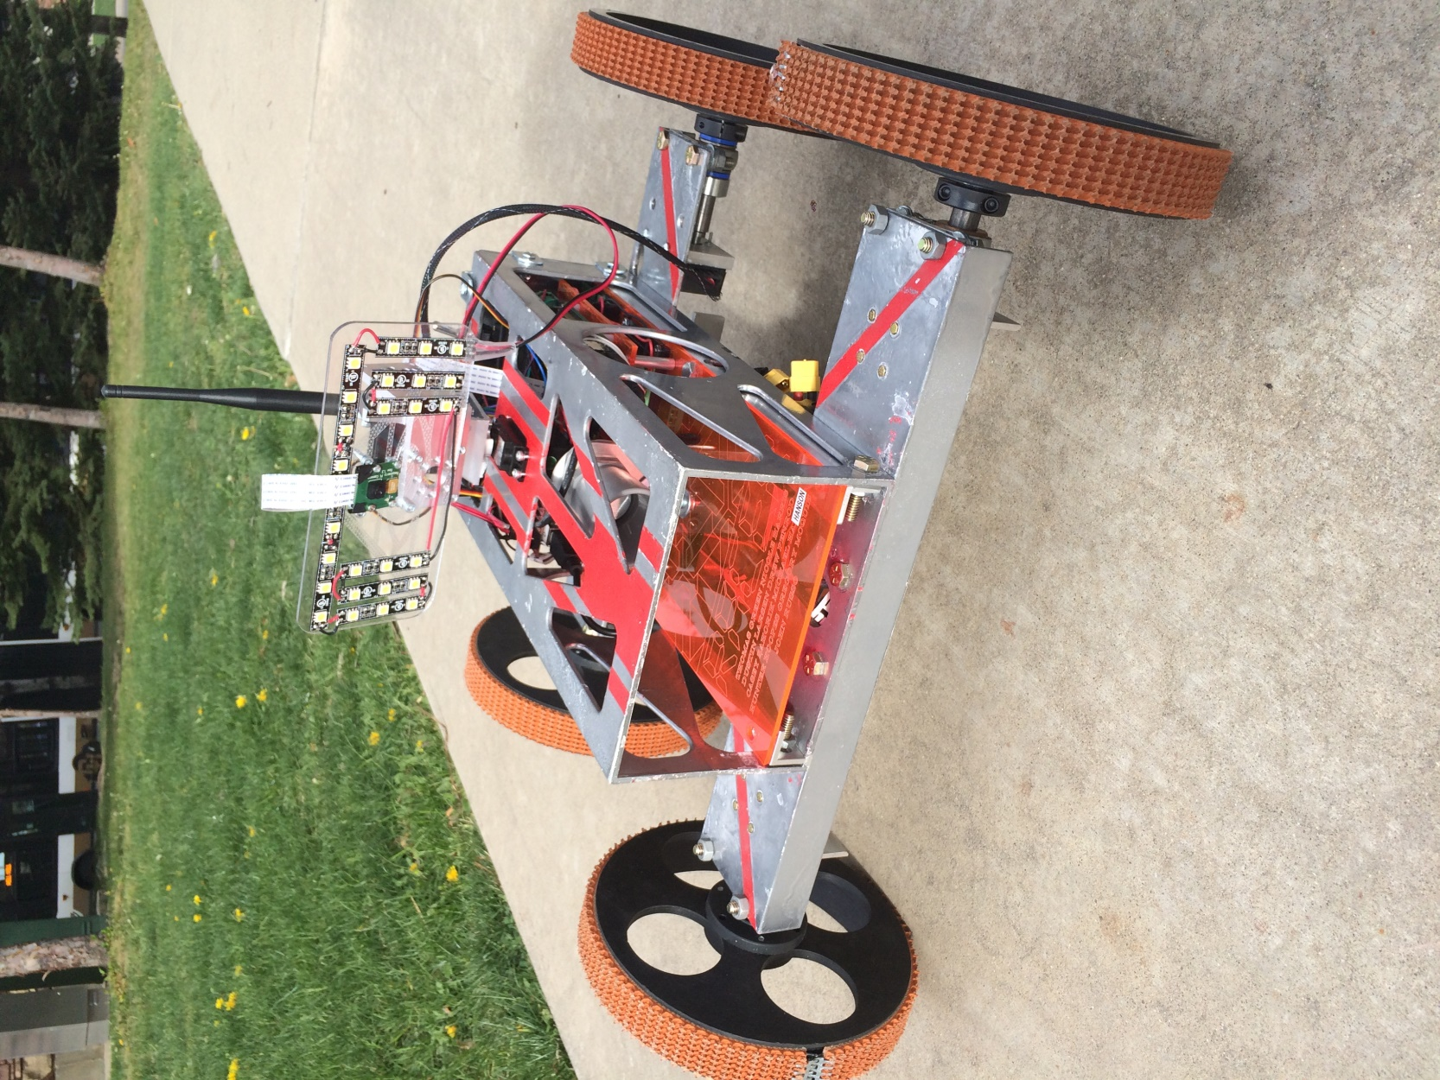
DESIGN OVERVIEW
Key Design Parameters Driven By Constraints
Child Rover Mass: | 7.5 kg
Child Rover Footprint Area: | 4646 cm
Top Driving Speed: | 30 cm/s
Top Rappelling Speed: | 2 cm/s
Max Mission Duration: | ~3 hr
Image Transmission Time: | 1-2 min
Baud Rate | 115200 bps
Overview
Testing
Systems
Design
Management

Slide 7
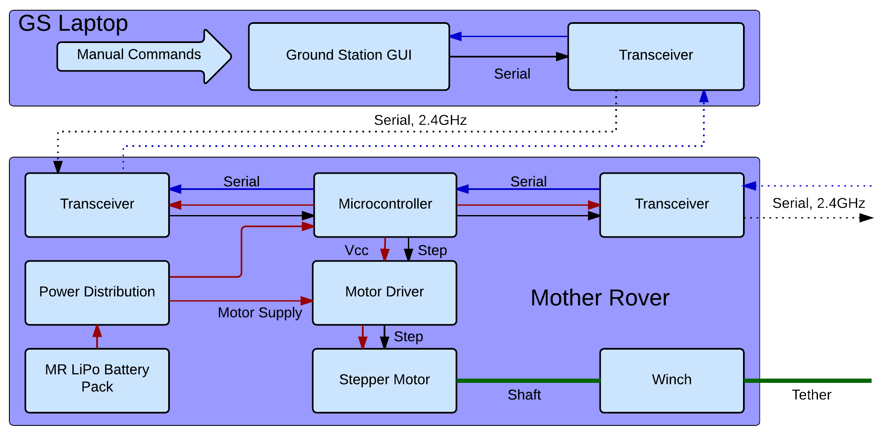
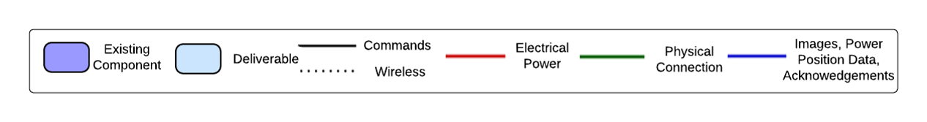
FUNCTIONAL BLOCK DIAGRAM
An Arduino Mega 2560 serves as MR C&DH
CR
A stepper motor powered winch connects the MR to the CR
Overview
Testing
Systems
Design
Management
Notes:
30 seconds – 1 minute

Slide 8
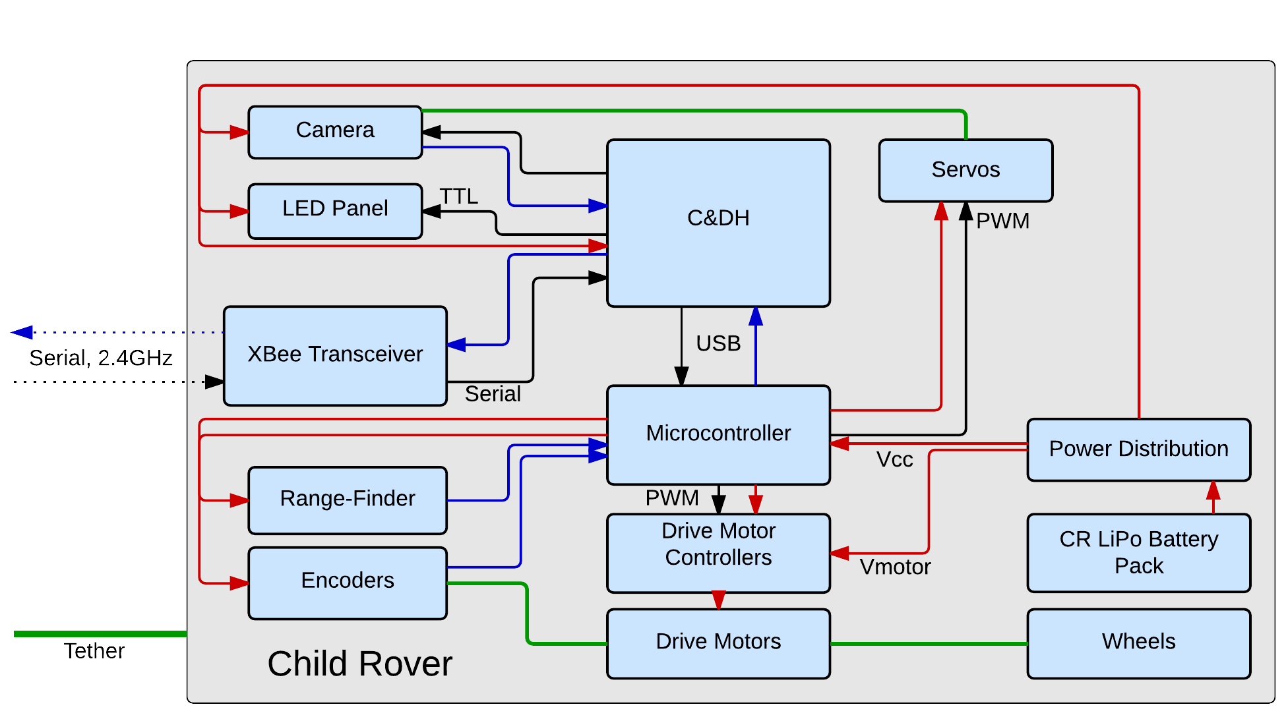
FUNCTIONAL BLOCK DIAGRAM
Measured ranges are transmitted back to MR for rappelling feedback loop
A Raspberry Pi SBC performs C&DH for the CR
MR
Another Arduino Mega interfaces with CR peripherals except for imaging
Overview
Testing
Systems
Design
Management
Notes:
30 seconds – 1 minute

Slide 9
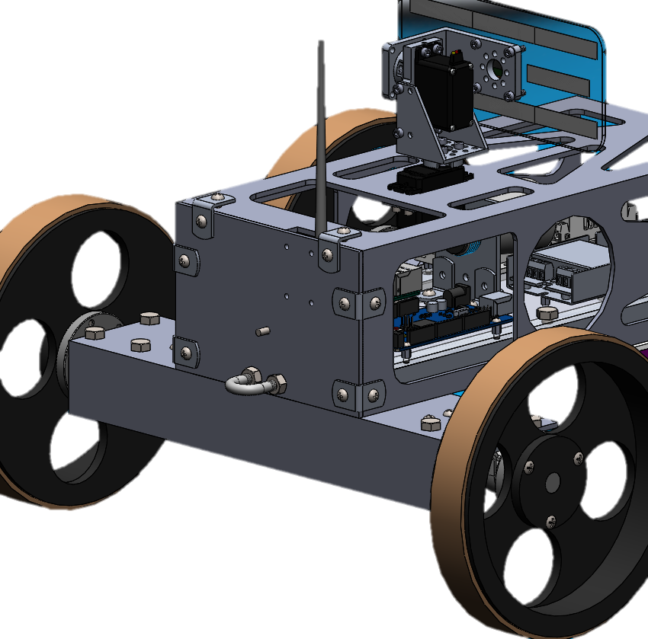
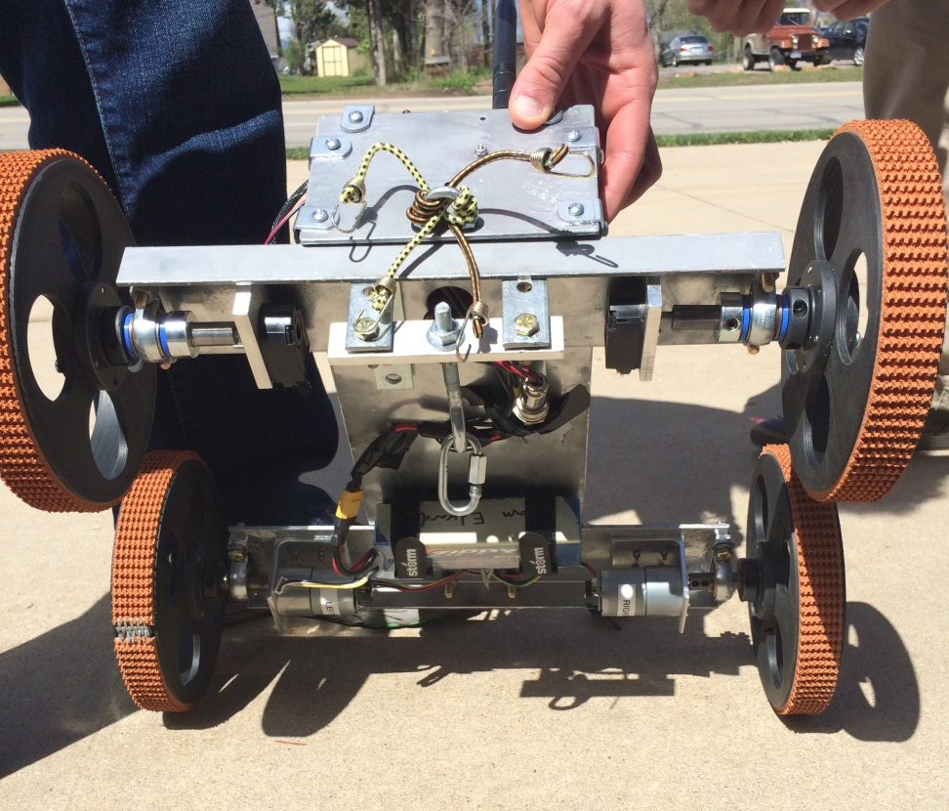
CHANGES SINCE TRR
New tether
attachment point
Bungee cords
Original tether attachment point
Tether attachment point shifted to below wheel rotation axis
  New moment allows winch to pull CR over top corner without it getting stuck
Bungee cords keep CR vertical while rappelling
  Lower attachment point caused CR to lean forward and detect the wall in range measurements
Overview
Testing
Systems
Design
Management

Slide 10
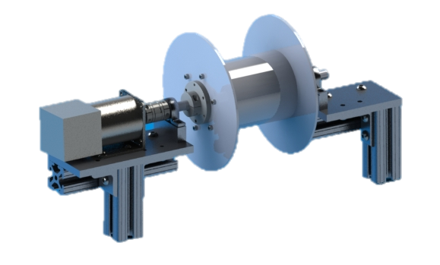
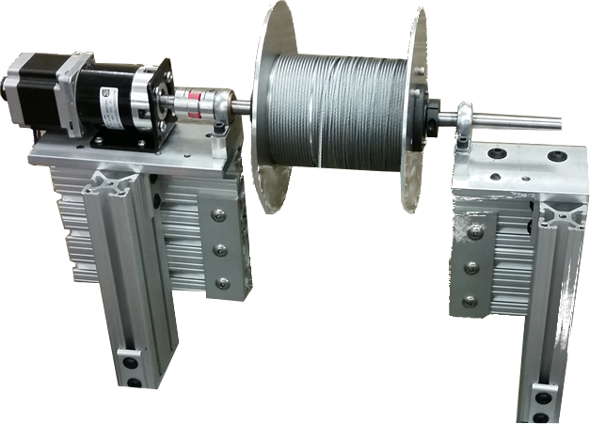
CHANGES SINCE TRR
Original design
Final design
Lessons Learned:
Early analysis must consider edge cases
Modifying design late in the process may necessitate additional unforeseen changes
(e.g. addition of bungee cords)
Winch raised 4.5 in. in MR bay
  Required a higher torque to perform top transition
  Updated free-body diagram showed 4.5 in. would prevent motor from stalling when reeling the CR in
Mass under the maximum 10 kg → DR.1.3.1
✓
Overview
Testing
Systems
Design
Management

Slide 11
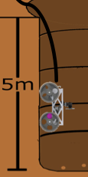
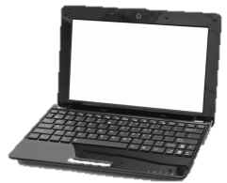


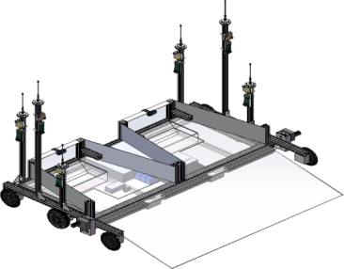
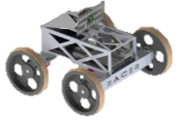
CRITICAL PROJECT ELEMENTS
Tether
Back and Forward Motion
Scattered Rocks
Rappelling
Driving
Software/Electrical
Project Element | Subsystem Breakdown | Rationale | Level of Success
Rappelling | Winch and Drivetrain | The CR shall have the capability to rappel up to 5 m into a cave/pipe | 1
Driving | Chassis, Wheels, and Motors | The CR shall have the ability to explore 5m out from the dropdown point on floor of cave/pipe | 1, 2
Software/Electrical | Microcontrollers, Range-finder, Encoders, XBees, Imaging, Power Distribution | The software will integrate functionality and provide: Accurate position tracking Communication and command protocols Power for duration of mission | 1, 2, 3
Overview
Testing
Systems
Design
Management
Notes:
UPDATE THIS. Hasn’t changed since TRR – GM 6/7/15

Slide 12
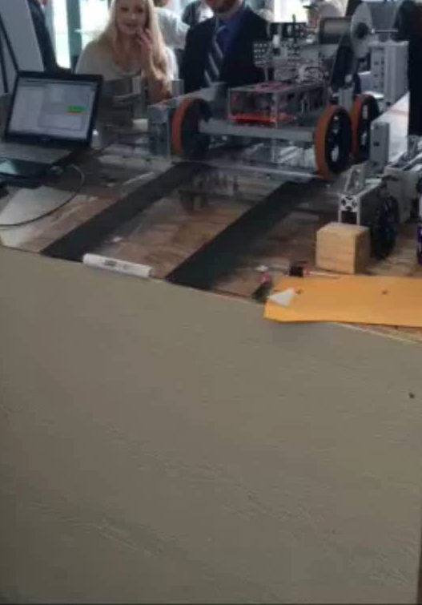
TEST OVERVIEW
Our testing followed the stages of the mission from the RACER CONOPS
Tests performed:
  Deployment
  Rappelling
    Transition
  Exploration
    Driving
    Imaging
  Returning and re-docking
  Communication (throughout all)*
* Time to build communication dropout test environment not available
Time-lapse
Overview
Testing
Systems
Design
Management

Slide 13
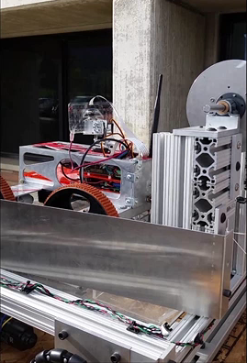
DEPLOYMENT
Deployment is required for Level 1 Success
  Requirements DR.1.2, 1.2.1: Shall undock from the MR and exit within +/- 4.3° area
The design requirements were met via demonstration → DR.1.2 DR.1.2.1
  100% success
Leaving the MR bay is an iterative process
  Winch spools out 5 cm then CR drives 5 cm
  Relies on well-defined geometry and MR orientation
Deployment requires ~1 minute
  Stage must be completed in under 5 minutes from mission definition
✓
✓
x2 Playback
Overview
Testing
Systems
Design
Management
Notes:
UPDATE THIS. Hasn’t changed since TRR – GM 6/7/15

Slide 14
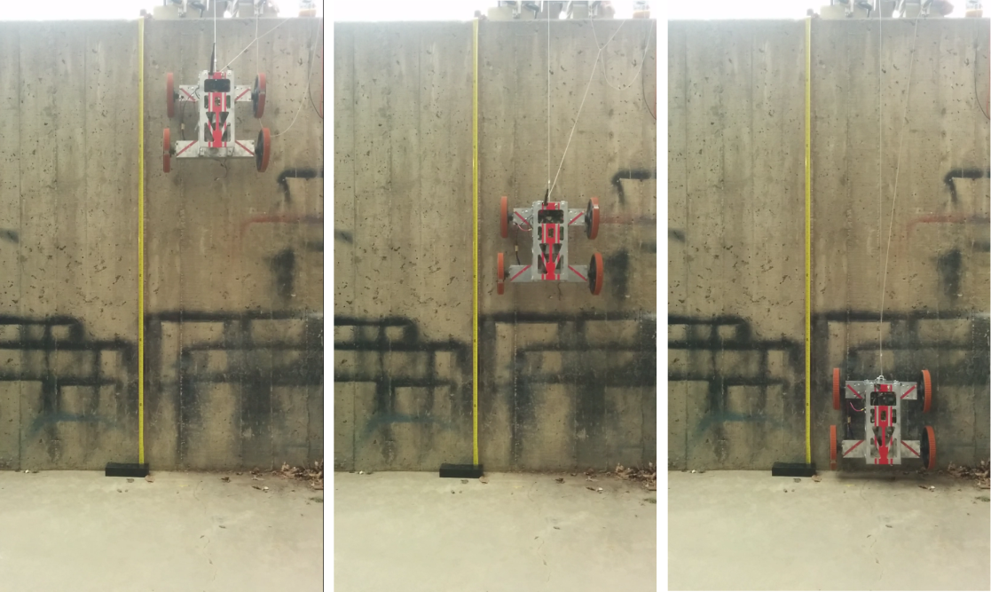
RAPPELLING: MODEL VERIFICATION
Rappelling is required for Level 1 Success
Results:
Verified rappelling functionality
  DR.3.1 − The CR shall be able to rappel vertical slopes
Verified the rappelling model in the small-scale test
  Proportional control successfully implemented for last 20cm
  Simulink diagram in back-up slides
✓
Testing results from rappelling subsystem testing. Compares range-finder readings to expected and actual depth measurements
Overview
Testing
Systems
Design
Management
Notes:
UPDATE THIS. Hasn’t changed since TRR – GM 6/7/15

Slide 15
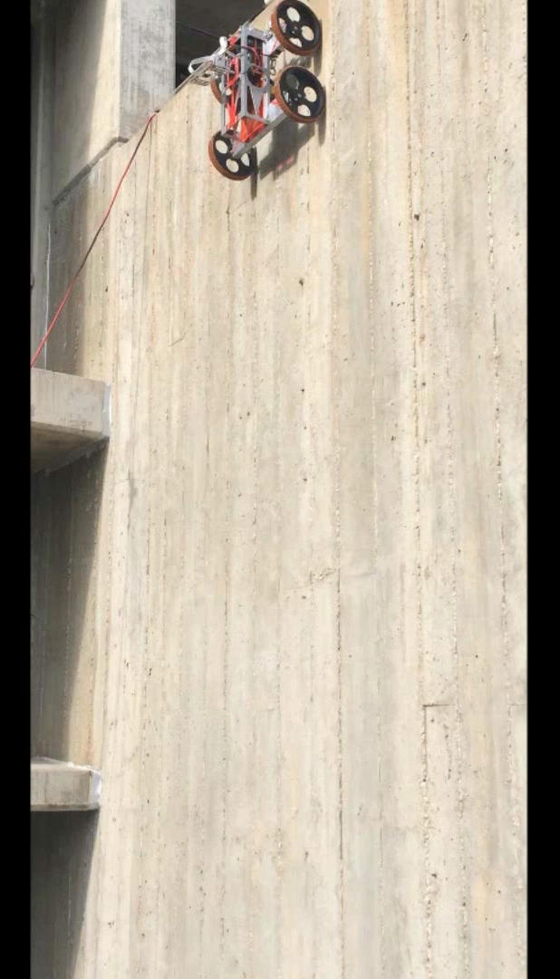
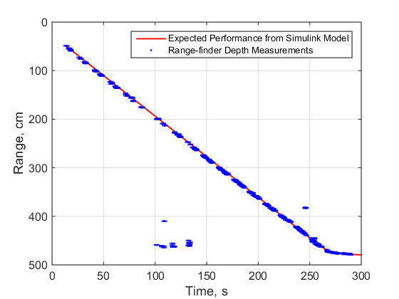
RAPPELLING: FULL SYSTEM VERIFICATION
Rappelling Requirements Not Met:
Requirement: |  | Reasons for Failure:
DR.4.1.1 | The CR shall know its depth within ± 10cm | Partial success due to intermittent incorrect readings from the range-finder Did not affect overall performance and additional bungee cords could remove this problem
Range-finder recorded a distance further than the ground.
Depth, cm
Combination of the CR tilt and rough surface.
CR must be able to rappel to a max depth of 5m while knowing its depth to ±10cm
  CR is still tilted towards the wall as it rappels
  Range-finder performance degrades when rappelling rough surfaces → DR.3.1.1 DR.4.1.1 (96% of time)
✓
○
Overview
Testing
Systems
Design
Management
Notes:
UPDATE THIS. Hasn’t changed since TRR – GM 6/7/15

Slide 16
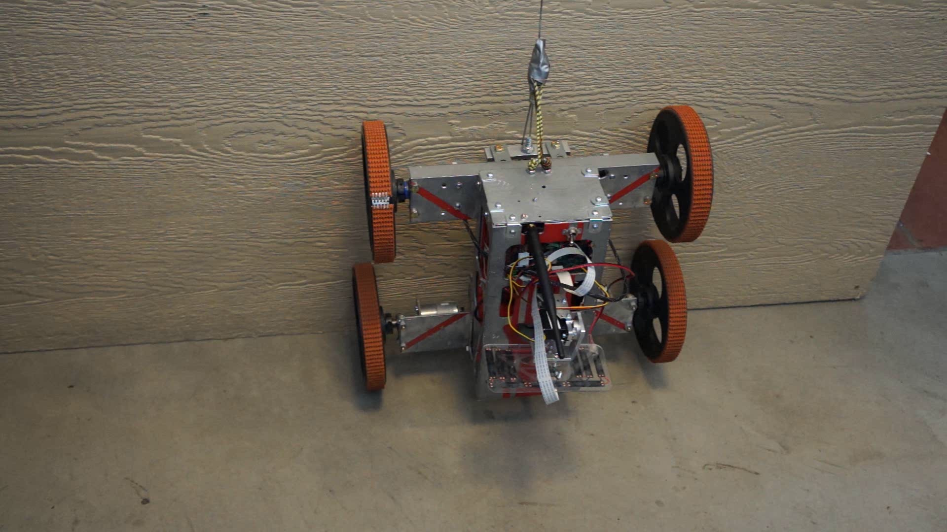
RAPPELLING: BOTTOM TRANSITION
Goal: Transition from a vertical to horizontal orientation after rappelling.
Required for Level 1 Success
100% success rate during testing
  D.R.3.2
Driving backwards stops based on a timer
  Future work: Analyze rear wheel speed and stop when wheels hit the wall
Design accommodates servo movement due to back-EMF
✓
Overview
Testing
Systems
Design
Management
Notes:
UPDATE THIS. Hasn’t changed since TRR – GM 6/7/15

Slide 17
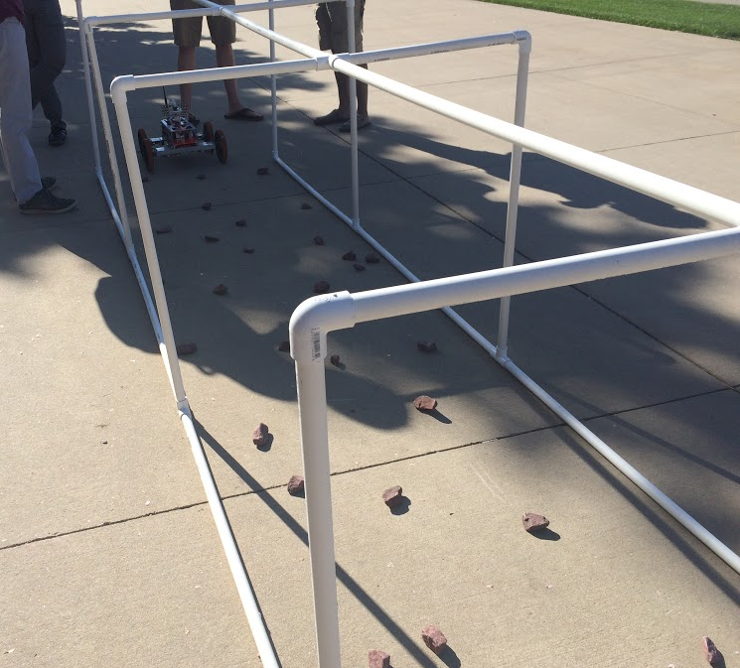
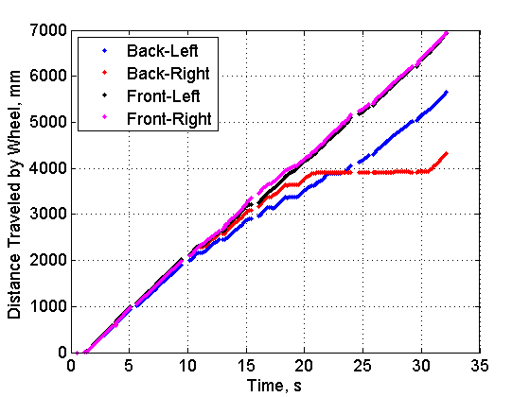
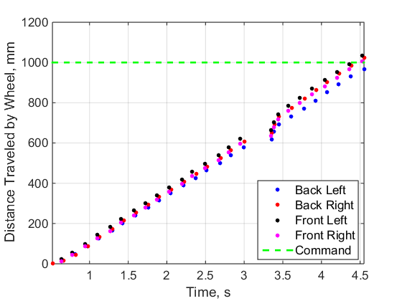
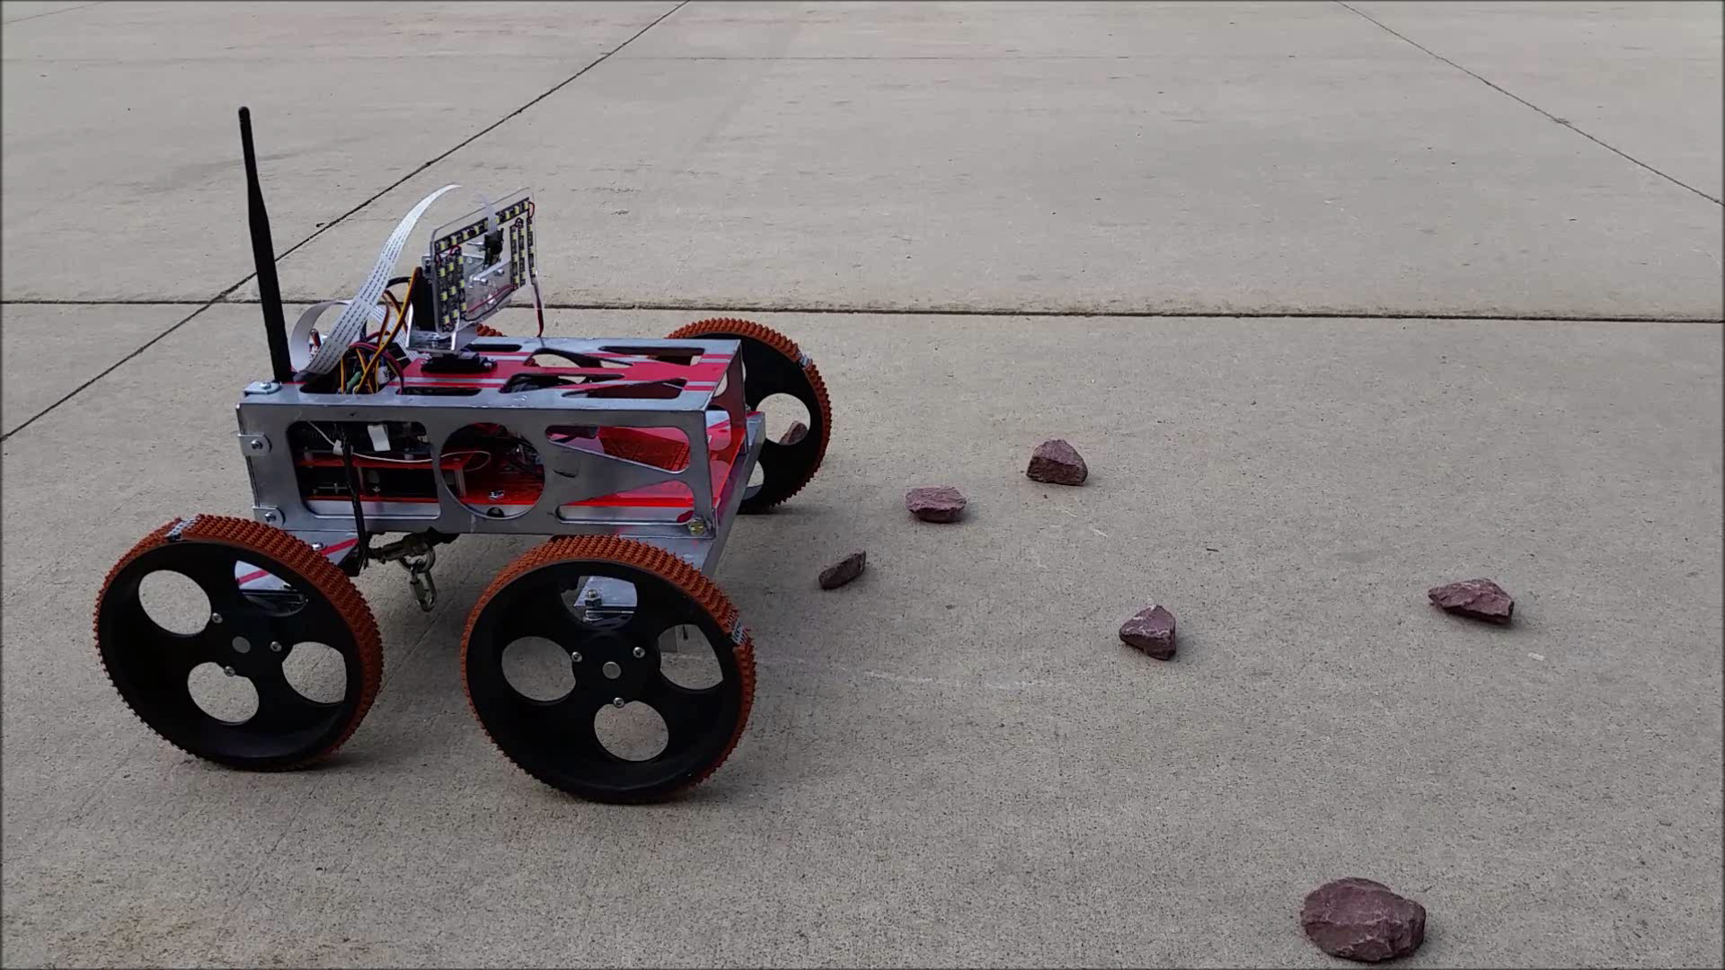
EXPLORATION: DRIVING
Driving is required for Level 2 Success
Performed ten trials of driving in test environment
  Small rocks, no larger than 3cm diameter, scattered over a concrete surface
  Tests must verify CR ability to drive, maneuver over rocks, and know position
    Smooth terrain posed no issue to odometry
    DR.3.3 DR.3.3.1 DR.3.3.2 DR.3.3.3
    DR.3.4
    DR.4.1 DR.4.1.2
    80% Success Rate
Rocky terrain often proved difficult for CR to overcome
  Front wheels could overcome rocky terrain. Occasionally rear wheels catch on rocks.
  There were up to 1m discrepancies in the odometry in this case
  Able to mostly achieve Level 2 Success
✓
✓
✓
○
✓
○
○
Back-right wheel caught on rock
x0.5 Playback
Avg. Error for Rocky Terrain: 508 mm
Avg. Error for Smooth Terrain: 38.4 mm
Overview
Testing
Systems
Design
Management

Slide 18
EXPLORATION: DRIVING
Requirement Number | Success Level | Requirement Description | Requirement Met? | Reason for Failure
DR.3.3 | 2 | The CR shall be able to traverse a distance of up to 5m horizontally from the rappel touchdown point | ✓ | N/A
DR.3.3.1 | 2 | The CR will be able to move forward and backward | ✓ | N/A
DR.3.3.2 | 2 | The CR shall be able to turn left and right | ✓ | N/A
DR.3.3.3 | 2 | The CR shall be able to traverse a concrete surface with sparse coverage of small rocks no larger than 3cm in diameter | ○ | Drive control was sometimes lost when traversing rocky surfaces (80% success rate in testing)
DR.3.4 | 2 | The rappelling mechanism shall not hinder or interfere with CR’s motion once on the cave floor | ✓ | N/A
DR.4.1 | 3 | The CR shall know its depth and distance travelled from the MR | ○ | Could not accurately measure distance travelled when going over rocky terrain (see DR 4.1.2)
DR.4.1.2 | 3 | The CR shall know its distance travelled within ± 10cm | ○ | Rocky surface caused rear wheel lock and position was lost
Future Work: Failures occurred due to wheel slippage/jamming
Modify design to be 4WD or have a suspension
Utilize an accelerometer/gyro for position-tracking to be independent of terrain
Overview
Testing
Systems
Design
Management

Slide 19
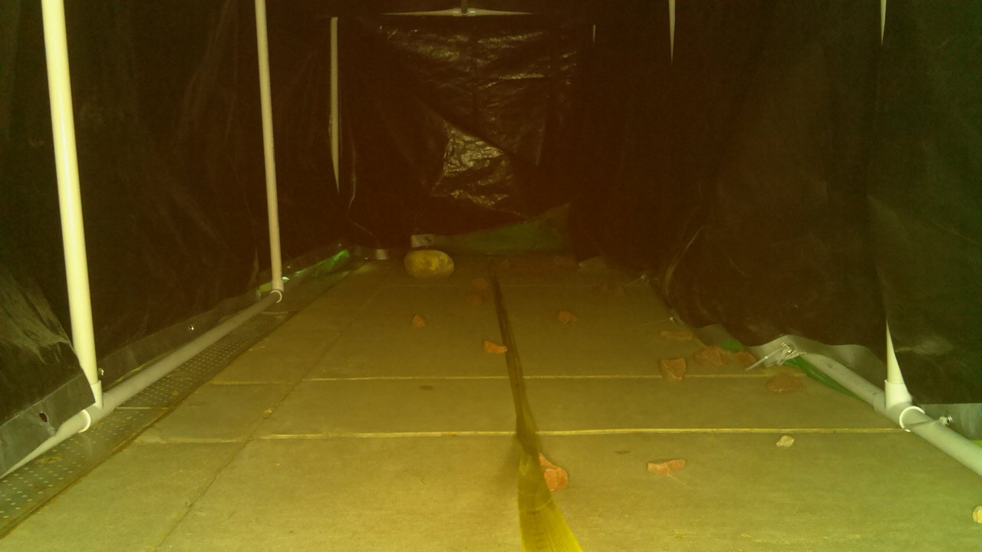
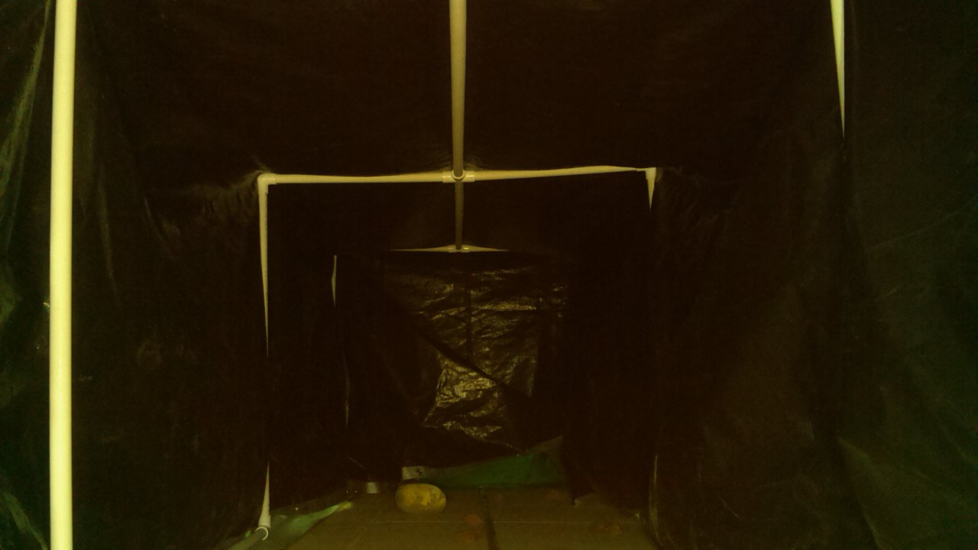


EXPLORATION: IMAGING
GS operator uses transmitted images for navigation during the exploration phase – Levels 1 & 2 of Success
  Must verify ability to process imaging commands, image transmission time, and image resolution
    DR.2.1.3 DR.2.1.3.1
    DR.2.1.4
    DR.2.2 DR.2.2.1
    DR.5.1 through DR.5.5
Can transmit and store images
CR’s FOV meets requirements and pan/tilt mechanism is controlled correctly
Transmission time depends on image composition
Imaging Requirements Not Met:
Requirement: |  | Reasons for Failure:
DR.2.2.1 | Requires a minimum baud rate of ~276480 bps for transmitting images | XBee radios cannot operate at spec-sheet baud rates
Project Customer O.K.’d a requirement de-scope as imaging transmission time is not a critical project element → DR.2.2.1
Learned datasheets are not necessarily correct
Learned to negotiate requirements with customer
✓
✓
Time: 1m43s
✓
✓
✗
✓
Pan: 0$°$, Tilt: 0$°$
✓
10cm diam. POI
Time: 1m25s
Pan: 0$°$, Tilt: 15$°$
Overview
Testing
Systems
Design
Management
Notes:
UPDATE THIS. Hasn’t changed since TRR – GM 6/7/15

Slide 20
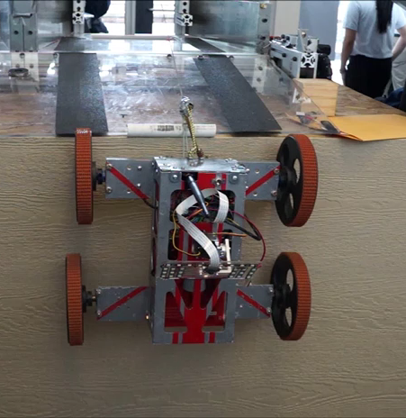
RETURN & RE-DOCK
Levels of Success:
  Return – Level 3
  Re-dock – Level 1
Requirements:
  DR.1.2, 1.2.1: Shall re-dock with the MR and enter within +/- 4.3° area
Verified the design for mission environment → DR.1.2 DR.1.2.1
Re-dock was found to be one of the most difficult stages
  Additional torque required to go over top corner
Future Work:
  Add the capability of transitioning over irregular corners (e.g. an overhang)
✓
✓
x2 Playback
*Trudy Schwartz
Overview
Testing
Systems
Design
Management
Notes:
UPDATE THIS. Hasn’t changed since TRR – GM 6/7/15

Slide 21
TESTING SUMMARY
Requirement Category | Level 1 |  |  | Level 2 |  |  | Level 3 |  |  | Total % Completed
 | Reqs. Verified | Total Reqs. | % | Reqs. Verified | Total Reqs. | % | Reqs. Verified | Total Reqs. | %
MR Integration | 7 | 7 | 100 | - | - | - | - | - | - | 100
Communication | 2 | 2 | 100 | 5 | 6 | 83 | 1 | 3 | 33 | 73
Exploration | 3 | 3 | 100 | 4 | 5 | 80 | - | - | - | 88
Positioning | - | - | - | - | - | - | 1 | 3 | 33 | 33
Imaging | 1 | 1 | 100 | 4 | 4 | 100 | - | - | - | 100
Power | - | - | - | 2 | 2 | 100 | - | - | - | 100
Software | 4 | 4 | 100 | 3 | 3 | 100 | 3 | 6 | 50 | 77
Total Completed: | 17 | 17 | 100% | 18 | 20 | 90% | 5 | 12 | 42% | 81%
  Implementation and testing of critical project elements took precedence over Level 3 Requirements
  Re-design of rappelling and driving systems required before verification
Overview
Testing
Systems
Design
Management

Slide 22
LEVELS OF SUCCESS – CURRENT
Level 1
Level Criteria | Status
The CR shall be able to undock/re-dock to the TREADS CR bay | Demonstrated
The CR shall be able to rappel/ascend a 90 degree incline to a max depth of 5m | Demonstrated
The CR Shall be able to transition from traversing a vertical to horizontal surface and vice versa | Demonstrated
The CR shall be able to take and transmit/store at least 5 images | Demonstrated
Level 2
Level Criteria | Status
The CR shall be able to traverse up to 5m from the rappel touchdown point, controlled via the GS | Mostly Demonstrated
The CR shall able to resolve a 10cm diameter object from a distance of 5m using the imaging system | Demonstrated
The CR shall provide adequate scene lighting | Demonstrated
The imaging system shall have azimuthal and elevation angular coverage of 180 and 90 degrees | Demonstrated
Level 3
Level Criteria | Status
The CR shall know its depth within the cave/pipe accurate to +/- 10 cm | Mostly Demonstrated
The CR shall know its horizontal distance travelled accurate to +/- 10 cm | Partially Demonstrated
The CR shall be able to return to the MR at the conclusion of a mission | Demonstrated
The CR shall handle communication dropouts with the MR/GS | Not Tested
ACHIEVED
90% ACHIEVED
42% ACHIEVED
Overview
Testing
Systems
Design
Management

Slide 23
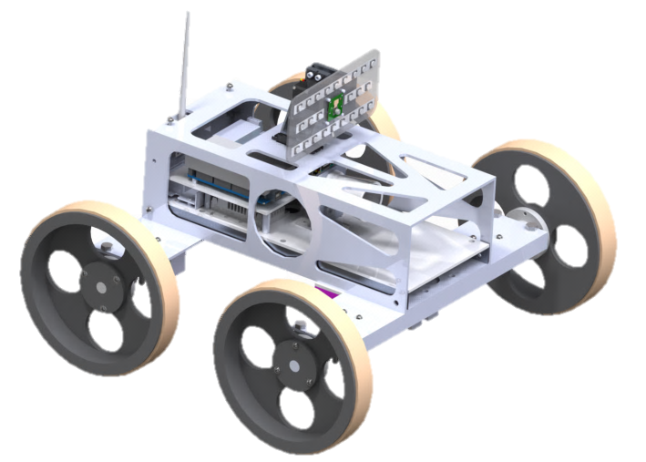
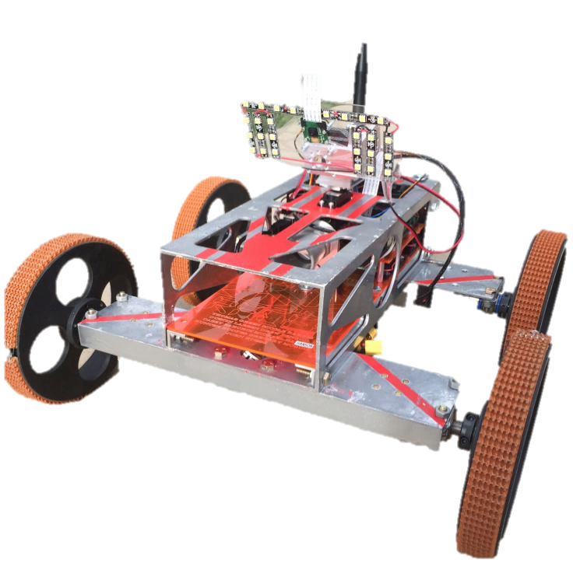
SYSTEMS ENGINEERING: APPROACH
Design Solution: Top-down
  Customer-Design Requirements
    Functional project objectives and requirements
  Concept Selection
    Trade studies to determine final design
  Risk Analysis
    Viable concept solution with off-ramps
  Full sub-system design
    CAD model
    Component selection
Assembly, Integration, and Testing: Bottom-up
  Component testing upon arrival
  Integration of various subsystems then test
  Full system integration
    Functional requirements verification
    Full system verification
Overview
Testing
Systems
Design
Management
Notes:
Summarize the systems engineering approach in the project. Identify the main systems engineering issues encountered in the project

Slide 24
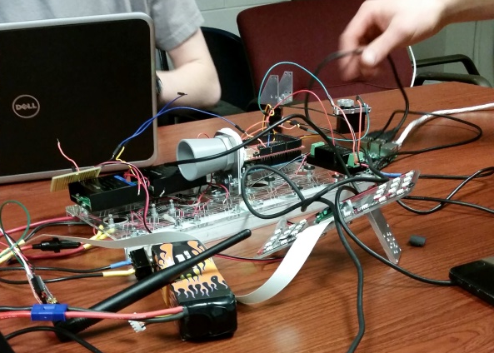
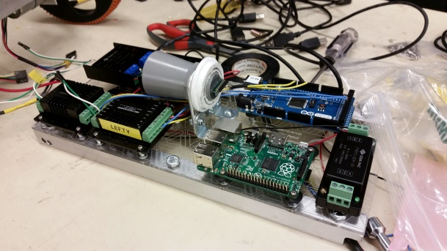
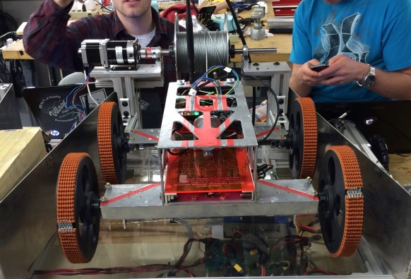
SYSTEMS ENGINEERING: LESSONS LEARNED
Consult professionals when conducting trade studies
  Initial perception of complexity was not accurate
    EX: Deciding to use DARE’s motors
Accessibility to electronics should be a design driver
  Tracking connections between individual components and sub-systems
Datasheets are not always accurate
How to negotiate with the customer over requirements
Late design changes can cause unforeseen additional issues
Overview
Testing
Systems
Design
Management
Notes:
Note the key lessons learned at the systems engineering level (as opposed to lessons from subsystem design)

Slide 25
PROJECT MANAGEMENT: APPROACH
Advisor:
Dr. Nabity
Customer:
Barbara Streiffert, JPL
Divided into 3 sub-groups:
  Mechanical
  Electrical/Software
  Managerial
Weekly meetings: subgroups update group on status and request resources
  Managerial subgroup allocates resources to allow for productivity
Group structure:
  Managerial subgroup is relay between advisor/customer and team
Managerial Subgroup
Systems:
Nicole Harris
Project Manager:
Thomas Green
Testing/Financial:
Michael Hanson
Electrical/Software Subgroup
John Russo – SW Lead
Greg McQuie
Casey Zahorik – EE Lead
Hunter Hoopes
Thomas Green
Manufacturing Subgroup
Dustin Larsen – Lead
Drew Penrod
Hunter Hoopes
Overview
Testing
Systems
Design
Management
Notes:
Summarize the project management approach, and note key management successes or difficulties encountered (lessons learned).

Slide 26
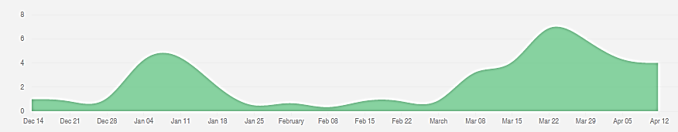
PROJECT MANAGEMENT: LESSONS LEARNED
Lessons learned based on GitHub commits to the Ground Station Repository:
Maintaining momentum is difficult
Tasks become more difficult
Performing parallel software and mechanical systems tasks is difficult
Software required to wait for integration
Starting early can pay off
Significant work needed to achieve basic functionality
Sacrifices will be made
Spring break was spent catching up
Team must be motivated
Hard work will have to happen even through the last day
→First Day of Classes
→MSR
→TRR
→Spring Break Begins
→Spring Break Ends
Commits
Date
Overview
Testing
Systems
Design
Management
Notes:
Summarize the project management approach, and note key management successes or difficulties encountered (lessons learned).

Slide 27
BUDGET
Category | CDR | Final
Rappelling | ~$750 | $843
Communication | ~$350 | $261
Imaging | ~$400 | $209
Positioning | ~$600 | $338
Driving | ~$1450 | $979
Power | ~$950 | $776
Testing | Not Accounted For | $249
Misc. & Shipping | Not Accounted For | $889
Margin | ~$500 | $366
Total Costs: | ~$4500 | $4634
Predicted budget at CDR is close to Final budget even with 2 key differences:
  CDR planned for 2 perfect revisions
  CDR did not account for any testing, miscellaneous, and shipping costs
Miscellaneous and shipping accounts for projected amount to print PFR
Categories that were projected to be most costly were correct
Main takeaways:
  Project came in under budget
  Safety Factor of 2 was approximately accurate for initial estimate
Overview
Testing
Systems
Design
Management
Notes:
Provide a comparison of the planned and actual budget. Explain any significant differences.

Slide 28
INDUSTRY COST
Assumptions:
  $65,000 annual salary of entry-level aerospace engineers
  Full Time Equivalent of 2080 hours/year (only ~34/52 weeks worked)
  Overhead rate of 200%
Average Hours of Team/Week | 175 hours
Total Hours | 5950 hours
Full Time Equivalent (FTE) | 4.38
Total Direct Labor Cost | $185,937.00
Overhead Rate | 200%
Overhead Cost | $371,875.00
Total Industry Cost | $557,812.00
Overview
Testing
Systems
Design
Management
Notes:
Calculate how much effort has been expended in the development of your project, assuming it was carried out by entry level aerospace engineers (current average yearly salary of $65,000 for 2080 hours work, exclusive of benefits). Include a typical overhead rate of 200%. What would be the resulting “industry” cost to your customer?

Slide 29
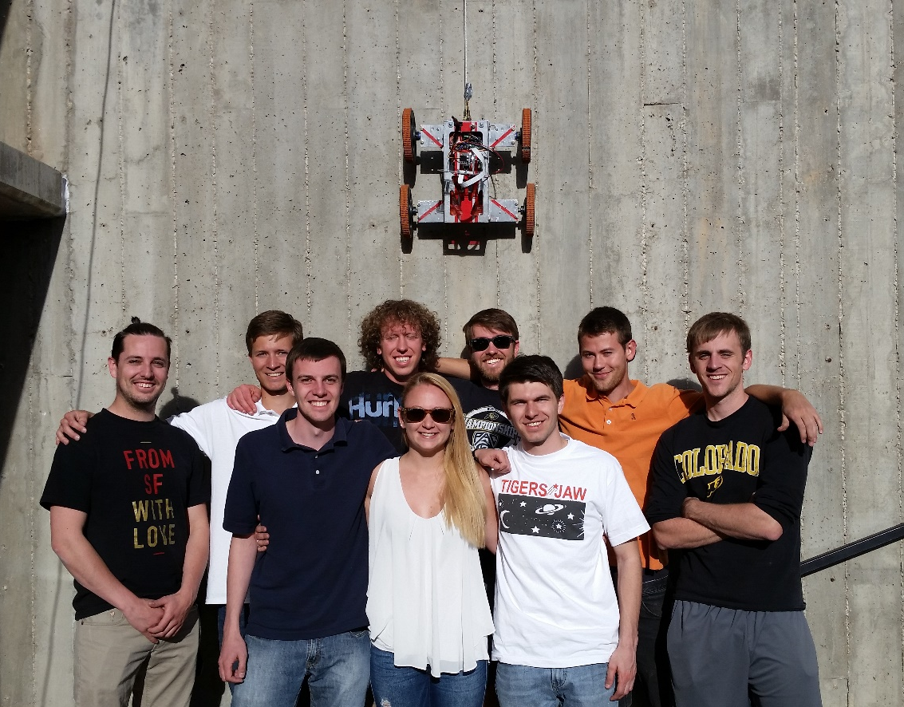
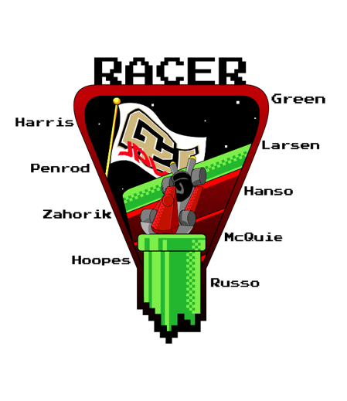
ACKNOWLEDGMENTS
Team RACER would like to thank everyone that assisted us throughout the year:
Dr. James Nabity
Barbara Streiffert
Dr. Dale Lawrence
Trudy Schwartz
Bobby Hodgkinson
Matt Rhode
Dr. John Farnsworth
Dr. Jelliffe Jackson
Dr. Xinlin Li
Dr. Donna Gerren
Ryan Slabaugh
Overview
Testing
Systems
Design
Management

Slide 30
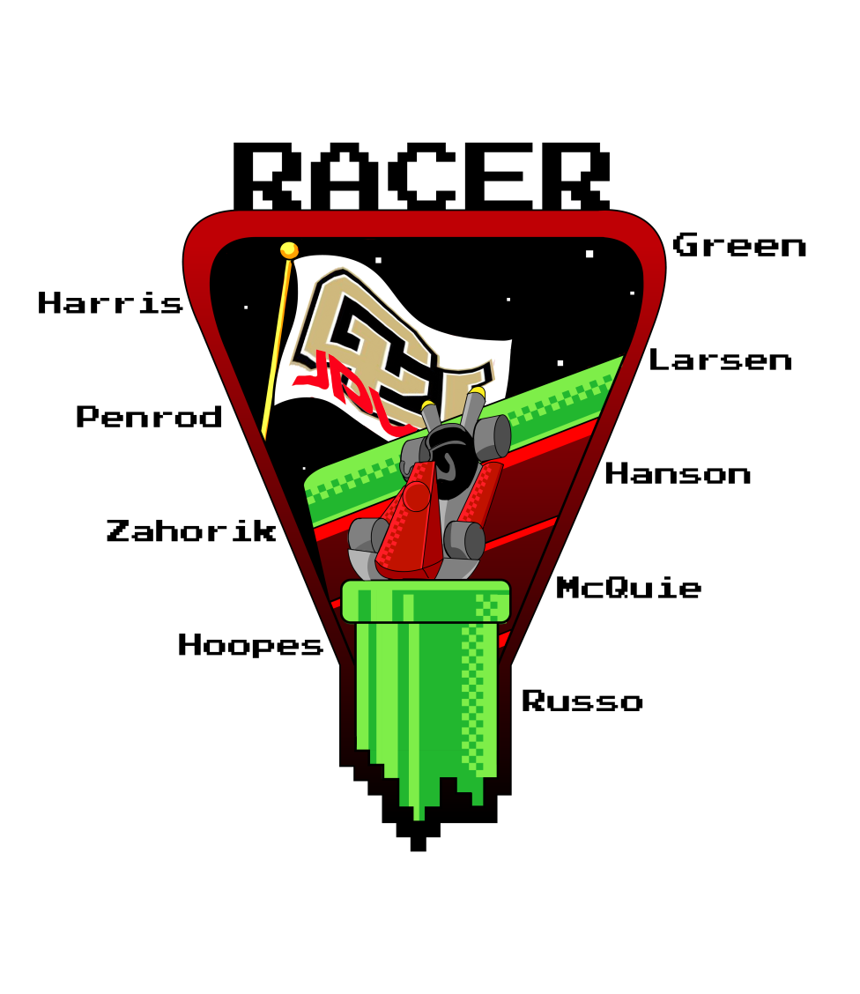
QUESTIONS?

Slide 31
PRE-TRR STATUS
Were confident in achieving Level 2 success
Testing of Comm. dropout protocol requires additional testing environment
Level 1
Level Criteria | Status
The CR shall be able to undock/re-dock to the TREADS CR bay | Needs to be Tested
The CR shall be able to rappel/ascend a 90 degree incline to a max depth of 5m | Needs to be Tested
The CR Shall be able to transition from traversing a vertical to horizontal surface and vice versa | Needs to be Tested
The CR shall be able to take and transmit/store at least 5 images | Demonstrated
Level 2
Level Criteria | Status
The CR shall be able to traverse up to 5m from the rappel touchdown point, controlled via the GS | Needs to be Tested
The CR shall able to resolve a 10cm diameter object from a distance of 5m using the imaging system | Demonstrated
The CR shall provide adequate scene lighting | In Progress
The imaging system shall have azimuthal and elevation angular coverage of 180 and 90 degrees | Demonstrated
Level 3
Level Criteria | Status
The CR shall know its depth within the cave/pipe accurate to +/- 10 cm | Needs to be Tested
The CR shall know its horizontal distance travelled accurate to +/- 10 cm | Needs to be Tested
The CR shall be able to return to the MR at the conclusion of a mission | Needs to be Tested
The CR shall handle communication dropouts with the MR/GS | Needs to be Tested
Overview
Testing
Systems
Design
Management

Slide 32

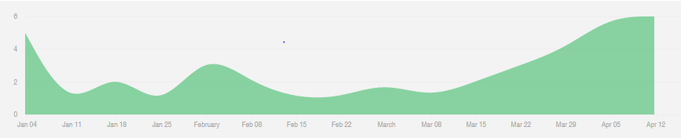
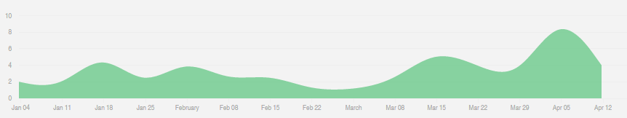
GitHub Statistics: Dec 14th – Apr 12th
Ground Station
Mother Rover
Number of code commits to GitHub per day
Child Rover
→First Day of Classes
→MSR
→TRR
→Spring Break Begins
→Spring Break Ends

Slide 33





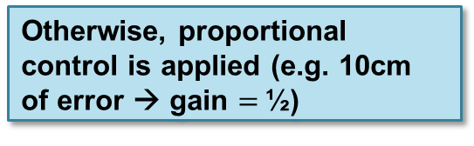







RAPPELING SYSTEM: SIMULINK MODEL
On MR:
The rappelling control loop was designed within Simulink
Later verified in testing
Goal of design: ensure the child rover would slow itself to a stop upon reaching a desired depth without overshoot using feedback from the ultrasonic range-finder.
If error, $e$, $≥20 cm,$ gain $=1$
$$d_{command}$$
$$e$$
Enable/Disable Control
Otherwise, proportional control is applied (e.g. 10cm of error → gain $=$½)
$$+$$
$$−$$
Integrator
$$d_{rangefinder}$$
$$d_{actual}$$
Set Arduino Timer Register
Rappelling
$$\frac{1}{s}$$
K_{P}
$$\frac{steps}{s}$$
$$\frac{steps}{s}$$
$$\frac{m}{s}$$
$$m$$
The model is run at the rate that ranges are transmitted to the MR by the CR to account for transmission delays
Accounts for the MR Arduino timer compare module only being able to output discrete step rates.
Convert to rappel speed using mechanical properties of the rappelling system.
View of RACER from below while rappelling
Ultrasonic Range-finder
On CR:
Models the 1cm resolution of the range-finder
Overview
Rappelling System
Conclusions
Design
Notes:
UPDATE THIS. Hasn’t changed since TRR – GM 6/7/15

Slide 34
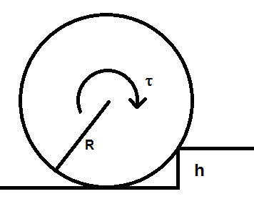
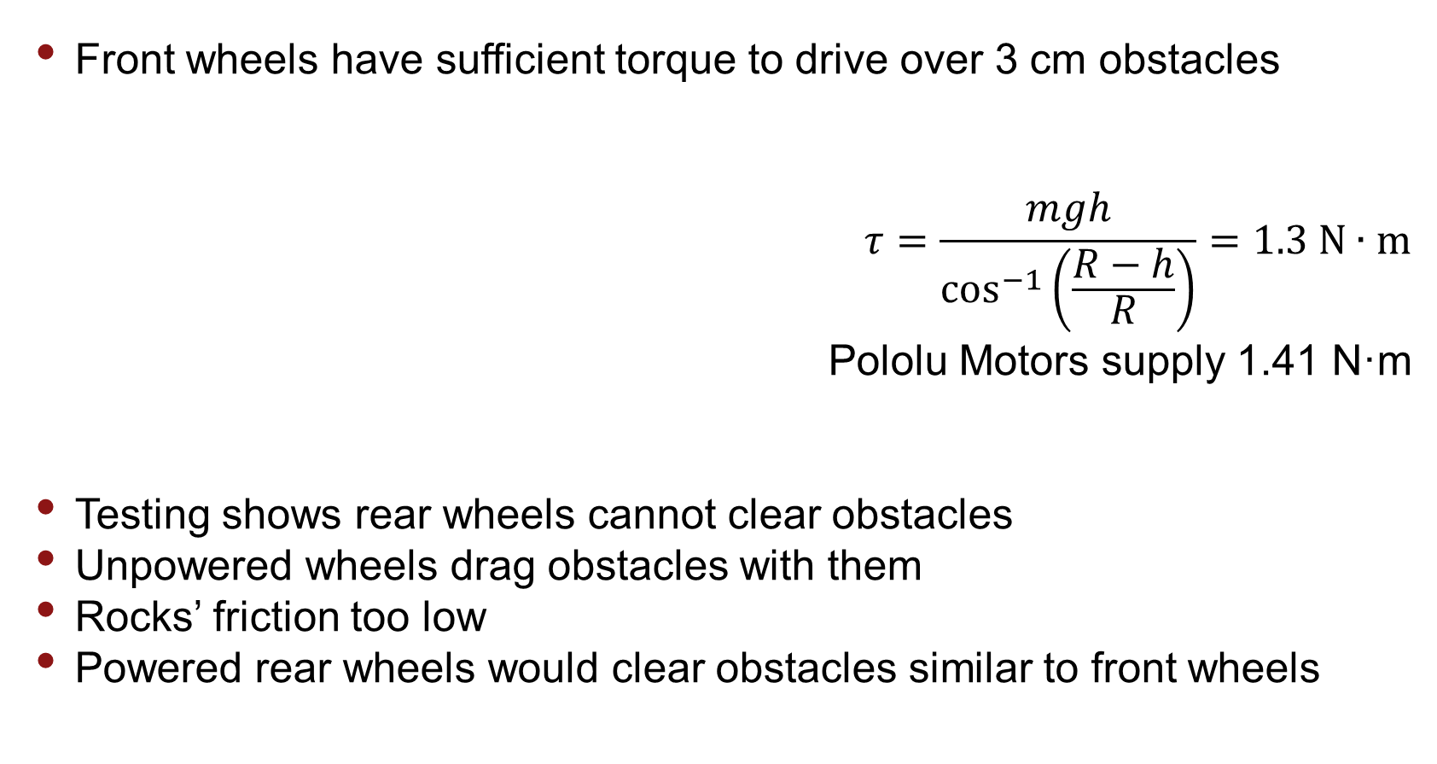
Driving Over Obstacles
Front wheels have sufficient torque to drive over 3 cm obstacles
$$τ=\frac{mgh}{\cos^{−1}\left(\frac{R−h}{R}\right)}=1.3 N∙m$$
Pololu Motors supply 1.41 N·m
Testing shows rear wheels cannot clear obstacles
Unpowered wheels drag obstacles with them
Rocks’ friction too low
Powered rear wheels would clear obstacles similar to front wheels

Slide 35
Top Corner Transition
Not initially considered a problem
Testing showed CR could not traverse top corner with original tether attachment position
CR rotates about wheel instead of being pulled over corner
Moving tether attachment point below wheel axis prevents CR from rotating about wheels
Increasing winch height increases Tension force in +y direction
Increasing winch height by 4.5 in. allows CR to traverse corner
Exact height increase required is difficult to model
  Depends on exact CR configuration relative to corner
  Angle between wall and CR chassis changes with height, motor torque

Slide 36
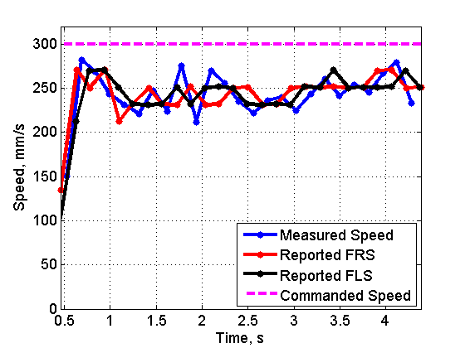
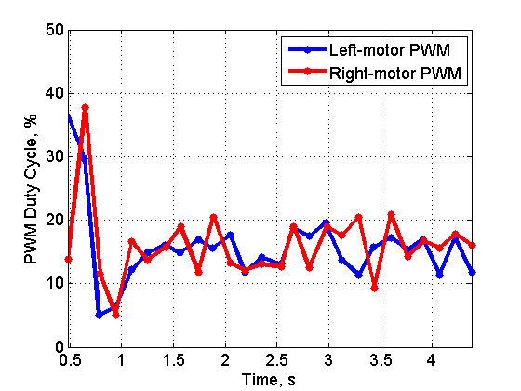
Driving: PID Controller Testing and Results
Used an open source Arduino PID control library
  http://playground.arduino.cc/Code/PIDLibrary
  Current Gains: Kp = 0.5, Kd = 0.01, and Ki = 0.1.
PWM Response
Good response for driving. Keeps wheels at similar speeds.
  Could add integral control to reduce steady state offset from commanded speed.

Slide 37

Itemization - Testing

Slide 38

Itemization – Misc. and Shipping

Slide 39

Itemization – Misc. and Shipping

Slide 40

Itemization – Comm./Software/Imaging

Slide 41

Itemization – Driving

Slide 42

Itemization – Driving

Slide 43

Itemization – Rappelling

Slide 44

Itemization – Power

Slide 45

Itemization – Power

Slide 46

Itemization – Power/Positioning

Slide 47

Budget Overall – no rounding
Does not include expected printing cost of $200 for final report

Slide 48
Requirements Verified
Requirement | Description | Verification method | Result
DR.1.1 | The CR shall fit within the TREADS CR bay | Child requirements met | Child requirements met
DR.1.1.1 | The CR shall have an area footprint no greater than 0.483m x 0.483m | Inspection | Footprint – 0.46m x 0.46m
DR.1.1.2 | The CR shall have a mass of no more than 9.8 kg | Inspection | Mass – 7.5 kg
DR.1.2 | The winch subsystem shall fit onto the MR | Child requirements met | Child requirement met
DR.1.2.1 | The CR shall un-dock and dock with the TREADS MR | Testing | Successful returned into MR bay
DR.1.3 | The winch subsystem shall fit onto the MR | Child Requirements Met | Child requirement met
DR.1.3.1 | Additions to the MR structure shall not exceed 10 kg | Inspection | Mass – 7 kg
DR.2.1 | The CR shall receive commands from the GS via the MR relay system | Child requirements met | Not all child requirements met
DR.2.1.1 | The CR shall receive commands to move forward and backward a specified distance | Testing | CR received commands to go forward and backward

Slide 49

Requirements Verified
Requirement | Description | Verification method | Result
DR.2.1.2 | The CR shall receive commands to turn left and right | Testing | CR received commands to turn left and right
DR.2.1.3 | The CR shall receive commands to take a picture and store the image | Testing | CR received commands to take an image
DR.2.1.3.1 | The GS shall be able to command the imaging system to be positioned such that the FOV will encompass a POI | Testing | CR can handle 180$°$ azimuthally and 90$°$ elevationally
DR.2.1.4 | The CR shall turn on/off the light source when taking an image | Testing | LED light panel turned on/off during a picture
DR.2.1.5 | The CR shall receive acknowledgement from MR after transmissions from CR to MR | Testing | Requirement not verified
DR.2.1.5.1 | CR shall detect if acknowledgements are not received and wait for communication to be reestablished | Testing | Requirement not verified
DR.2.2 | The CR shall be able to transmit images to the GS via the MR | Child requirements met | Requirement met even though child was not
DR.2.2.1 | Transmission shall be a minimum of 18 bits/min baud rate per pixel in an image | Testing | Was not able to meet time requirement here

Slide 50
Requirements Verified
Requirement | Description | Verification method | Result
DR.2.3 | The CR shall be able to transmit position information to the GS via the MR | Testing | Position information was received at the GS
DR.3.1 | The CR shall be able to rappel vertical slopes | Child requirements met | Child requirement met
DR.3.1.1 | The CR shall be able to rappel to a maximum depth of 5m | Testing | CR able to rappel to a max depth of 5m
DR.3.2 | The CR shall be able to transition from rappelling vertically to driving horizontally | Testing | CR is able to transition to drive at end of rappel
DR.3.3 | The CR shall be able to traverse a distance of up to 5m horizontally from the rappel touchdown point | Child requirements met | Not all child requirements met
DR.3.3.1 | The CR will be able to move forward and backward | Testing | CR is able to move forward and backward
DR.3.3.2 | The CR shall be able to turn left and right | Testing | CR is able to turn left and right
DR.3.3.3 | The CR shall be able to traverse a concrete surface with sparse coverage of small rocks no larger than 3cm in diameter | Testing | Requirement not verified – Not able to consistently go over rocks

Slide 51

Requirements Verified
Requirement | Description | Verification method | Result
DR.3.4 | The rappelling mechanism shall not hinder or interfere with CR’s motion once on the cave floor | Testing | Winch mechanism did not interfere with driving
DR.4.1 | The CR shall know its depth and distance travelled from the MR | Child requirements met | Not all child requirements met
DR.4.1.1 | The CR shall know its depth within $±$10cm | Testing | CR able to relay depth data within allowable range
DR.4.1.2 | The CR shall know its distance travelled within $±$10cm | Testing | Requirement not met
DR.5.1 | The imaging system shall have a minimum resolution of 3.7 pixels per degree of FOV in a single image | Testing | 1 image equals 23.9 x 17.4 pixels per degree of FOV
DR.5.2 | The CR shall be able to take photos within an azimuthal angular FOV of 180$°$ | Testing | Able to capture full azimuthal range
DR.5.3 | The CR shall be able to take photos with an elevation angular FOV of 90$°$ | Testing | Able to capture full elevation range
DR.5.4 | The imaging system light source shall provide adequate lighting to determine POI from background | Testing | Adequate scene lighting was provided

Slide 52
Requirements Verified
Requirement | Description | Verification method | Result
DR.5.5 | The CR shall be able to store a minimum of 5 images | Testing | CR was able to store more than 5 images
DR.6.1 | The CR power system shall provide power for the CR to complete its mission | Testing | CR battery was able to supply a full mission
DR.6.2 | The auxiliary MR power system shall provide power for the communication relay system as well as the rappelling system to complete the mission | Testing | MR battery was able to supply a full mission
DR.7.1 | The CR shall have software to interpret commands received | Child requirements met | All child requirements met
DR.7.1.1 | The CR software shall be capable of executing commands to position the rover | Testing | CR software able to execute commands to position the rover
DR.7.1.2 | The CR software shall command the imaging system to take an image and save onboard | Testing | CR software can take an image and save it
DR.7.1.3 | The CR software shall be capable of executing commands to position the imaging system | Testing | CR software can position the imaging system

Slide 53
Requirements Verified
Requirement | Description | Verification method | Result
DR.7.2 | The CR shall receive “transmission received” acknowledgements from MR | Child requirements met | Child requirements not met
DR.7.2.1 | The CR software shall detect if transmissions were not received by MR | Testing | Requirement not verified
DR.7.2.1.1 | CR will implement communication drop-out protocol | Testing | Requirement not verified
DR.7.3 | The CR software shall be able to transmit the capacity of the CR power source to the GS via MR | Testing | Requirement not verified
DR.7.4 | The MR software shall be able to interpret commands from MR communication system | Testing | MR was able to handle commands sent to it
DR.7.5 | The MR software shall implement a mechanism to determine if CR has gone to commanded heading | Testing | Requirement not met
DR.7.6 | The GS software shall allow for a user to send commands and receive acknowledgments | Testing | GS able to send commands and receive acknowledgments

Slide 54
Requirements Verified
Requirement | Description | Verification method | Result
DR.7.7 | The GS shall request and display current position and power source level of the CR every 10 seconds while idling | Testing | Requirement not met
DR.7.8 | The GS software will display the image upon receiving from the MR relay and save to the GS | Testing | GS displays image, ~2 minutes later, after taking image

