Slide 1
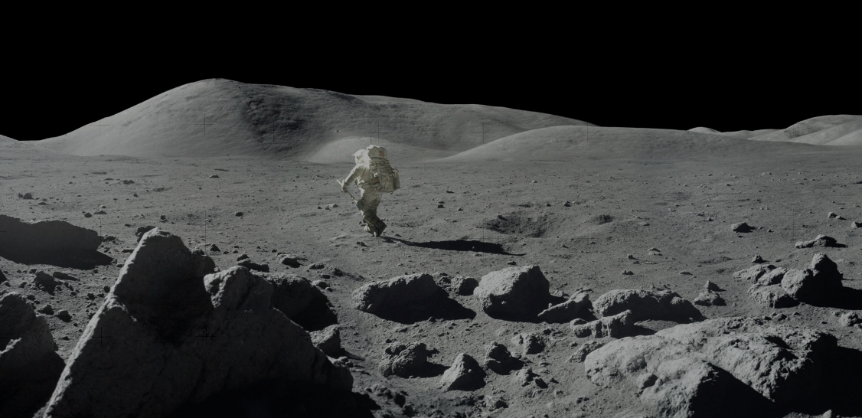
LunaSim
Test Readiness Review
University of Colorado Boulder
March 1st, 2023
Presenters: Parker Randolph, James Perkins, Chandler Jeep, Mia Lawrence, Brennan Zill, Lauren Daniels, Zoe Bloomfield
Non-Presenting Team Members: Blake Wilson, Ian Wong, Kevin Lane, Paul Flora, Max Bergman
Academic Advisor: Dr. Anderson
Sponsor: EchoStar
Notes:
Parker - list all team members

Slide 2
TRR Overview
Project Overview
Schedule
Test Readiness
Budget
Notes:
Parker

Slide 3
Project Overview
Notes:
Parker

Slide 4
Engineering Mission
Team LunaSim is designing a suspension system off-loader for astronaut lunar simulation training. The system will allow users to experience a 1/6th gravity environment here on earth while performing a series of hybrid reality mission objectives. Similar to NASA's ARGOS or reduced-gravity aircraft, astronauts will utilize LunaSim’s system to better prepare for a variety of gravity conditions to further advance the exploration of the moon and beyond.

Slide 5
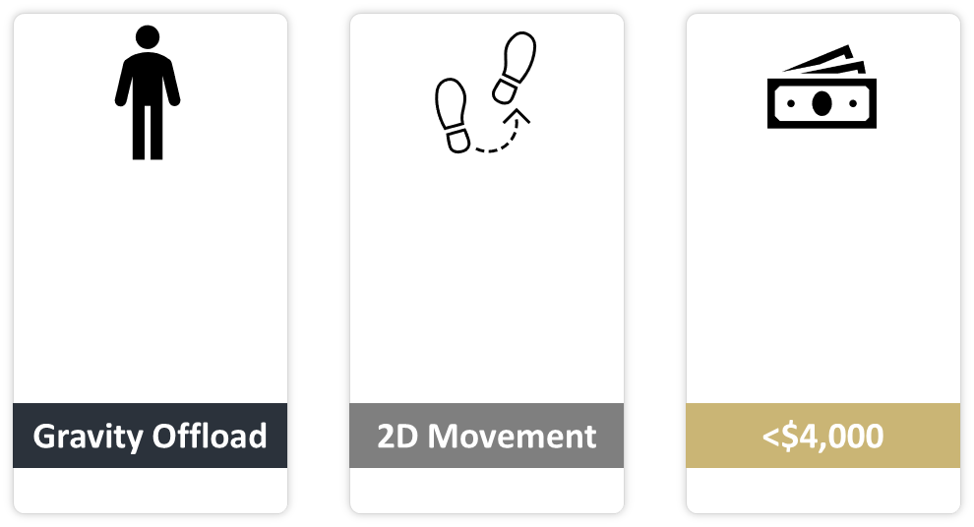
Project Purpose & Objectives
The z-offloading system shall be able to simulate an acceleration due to gravity of 1.62 [m/s/s] ±10%. (L3-13)
The translation system shall allow the user to move at 6 ft/s (1.83 m/s) along the x-axis. (L3-21)
The system shall remain at or below the total project budget of $4,000. (L0-07)
Notes:
Parker -
“With this is mind, I’d like to highlight the 3 major objectives and the specific quantitative requirements they drive… these are the nonegotiables within which our team has designed an effective, user friendly offloading system.”
< Brief top level overview of your project purpose and specific, quantitative objectives (levels of success), including a brief overview of the project CONOPS and FBD. >

Slide 6
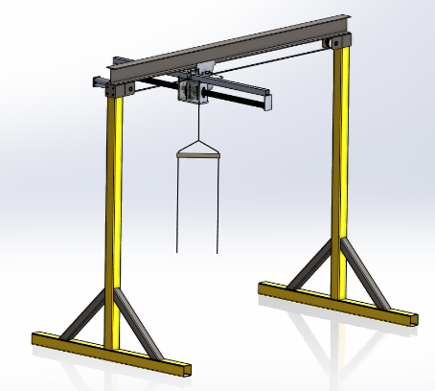
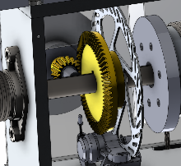
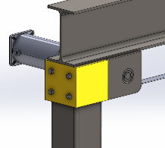
Gantry
Trolley
Offload motor
Springs
Hanger
Harness
Notes:
James
Explain movement within system, spring + motors
TA Note: Add labels with arrows (subsystems, terminology - so they know what they’re looking at)

Slide 7
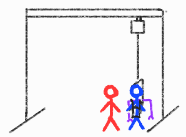
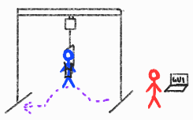
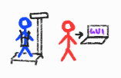
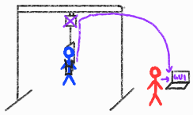
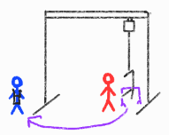
CONOPS
Operator
User
User dons harness and is weighed for software calibration
Entry: cables lowered and harness attached to cabling
Active: user performs training tasks during offloading
If E-Stop activated by operator or user: cut power to motor and start Egress.
Egress: cables lowered and harness detached from cabling
User doffs harness and operator performs checkout procedures
Notes:
More detail in backup slides

Slide 8
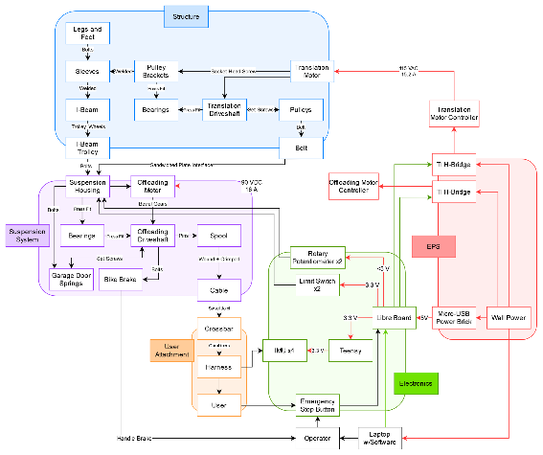
FBD
Notes:
James
Explain movement within system, spring + motors

Slide 9
Critical Project Elements
Critical Element | Rationale | Related FRs
Gravity Offloading | Most important baseline functionality of the system desired by customer | L0-01
Training Viability | Broad-view utility of the final system, justification to build in the first place | L0-02, L0-03
User Safety | Essential for best engineering practices | L0-06
Cost | Inflexible constraint critical to project success | L0-07
Notes:
Parker - < Review of the critical project elements, along with any updates on critical issues from CDR, FFR, IDR, etc.>
Should have longer descriptions of what the critical elements are - e.g. What does training viability mean

Slide 10
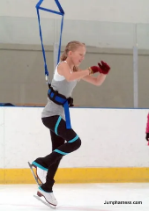
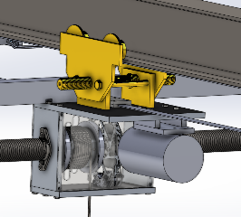
Design Adjustments
New User Attachment
Cantilever Spring Solution
Safety Cable
New Angle Detection
Enclosed Gear Box
Sand Bags
Notes:
Parker - < Brief review of the baseline design with respect to CDR. Describe major changes to the design. >
TA: Consider replacing with fewer images + bullet points, or only review a subset
(James: recommend sand bags, gearbox could be bulleted)
Replace V-Clamp with Figure-Skating Harness
Cantilever Springs
Sandbags
Safety Cable
Gear Box Closed
Hard/Soft Stop Changes?
Potentiometer redesign, software -> hardware changes for safety features

Slide 11
Schedule
Notes:
Parker

Slide 12
Testing Table
Task Name | Duration | Start Date | End Date | Driving Requirements | Assigned Team | Status
Software Code Verification | 10d | 03/09/23 | 03/18/23 |  | Testing | Not Started
Electronics Component Testing | 10d | 03/09/23 | 03/18/23 |  | Testing | Not Started
Gantry X-Direction Wobble Test | 2d | 03/15/23 | 03/16/23 |  | Testing | Not Started
Gantry Y Direction Tipping Test | 2d | 03/16/23 | 03/17/23 |  | Testing | Not Started
Gantry Free Belt Translation Test | 1d | 03/17/23 | 03/17/23 |  | Testing | Not Started
Offloading Motor Test | 4d | 03/20/23 | 03/23/23 |  | Testing | Not Started
UI Testing | 5d | 03/20/23 | 03/24/23 |  | Testing | Not Started
X-Translation Test | 5d | 03/20/23 | 03/24/23 |  | Testing | Not Started
E-Stop Testing | 1d | 03/23/23 | 03/23/23 |  | Testing | Not Started
Hard/Soft Stop Test | 3d | 03/24/23 | 03/26/23 |  | Testing | Not Started
Motor+Spring Characterization | 4d | 03/26/23 | 03/29/23 |  | Testing | Not Started
Uninstalled Offloading Test | 2d | 03/27/23 | 03/28/23 |  | Testing | Not Started
Tensioned Suspension Test | 2d | 03/28/23 | 03/29/23 |  | Testing | Not Started
Weighted Gantry Suspension Test | 2d | 04/02/23 | 04/03/23 |  | Testing | Not Started
Fireman Randy Test | 5d | 04/11/23 | 04/15/23 |  | Testing | Not Started
Human Testing | 6d | 04/15/23 | 04/20/23 |  | Testing | Not Started
Notes:
Brennan

Slide 13
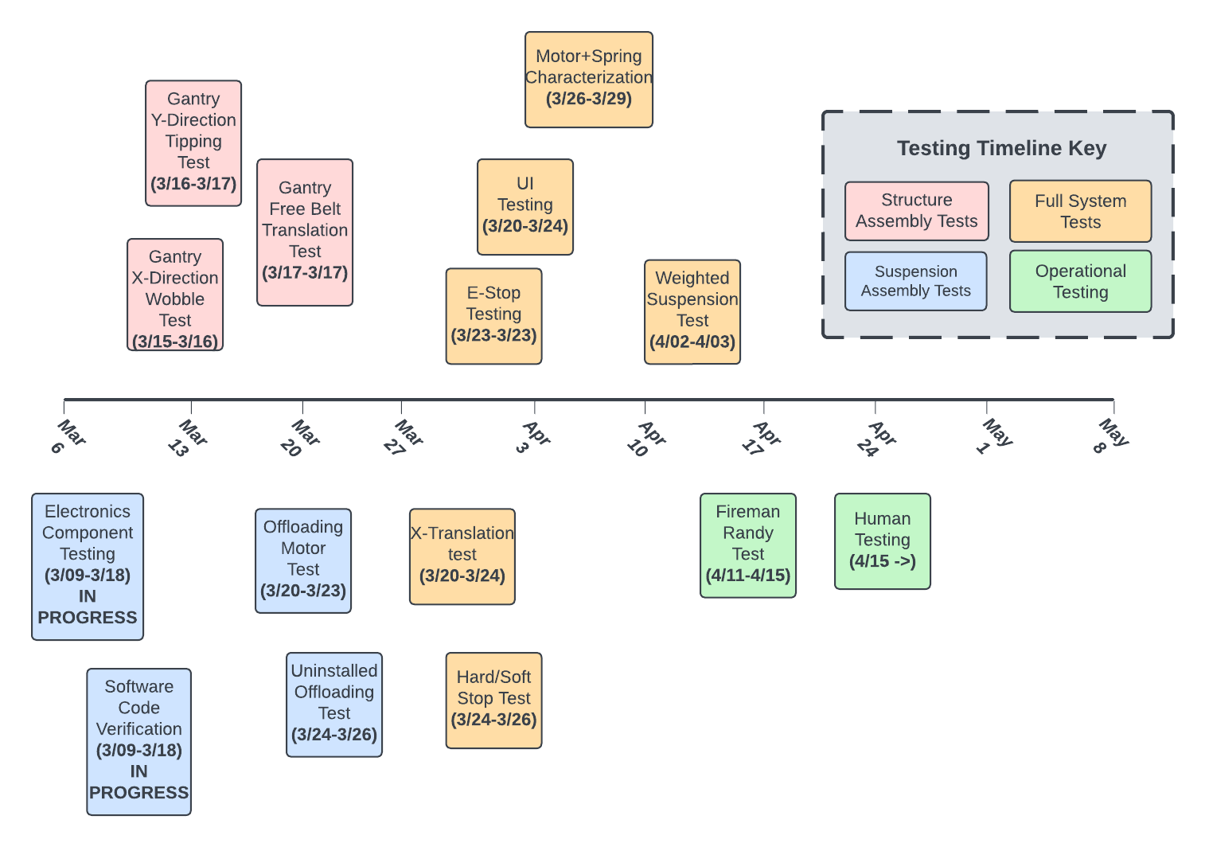
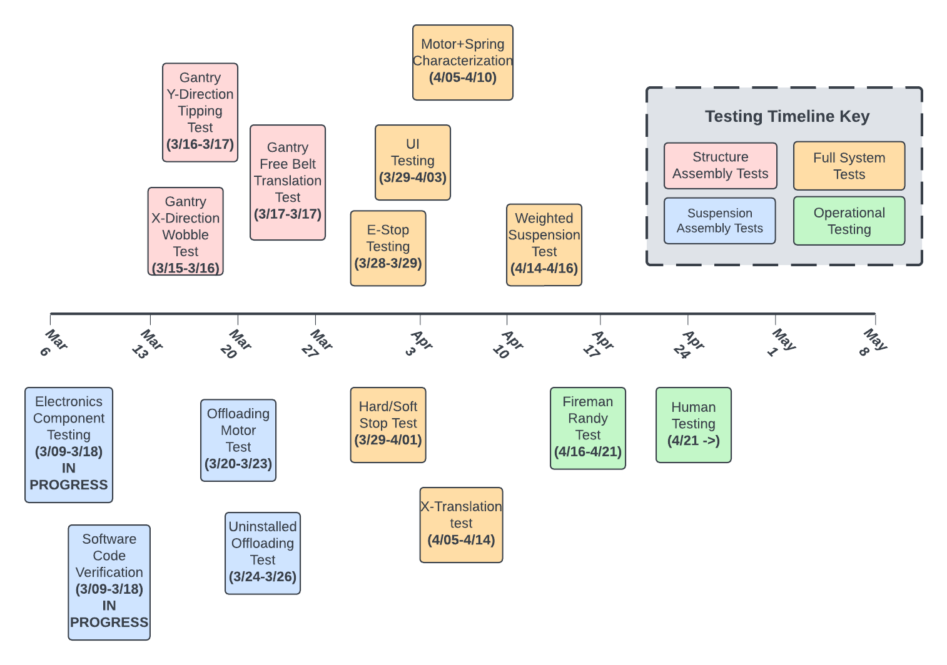
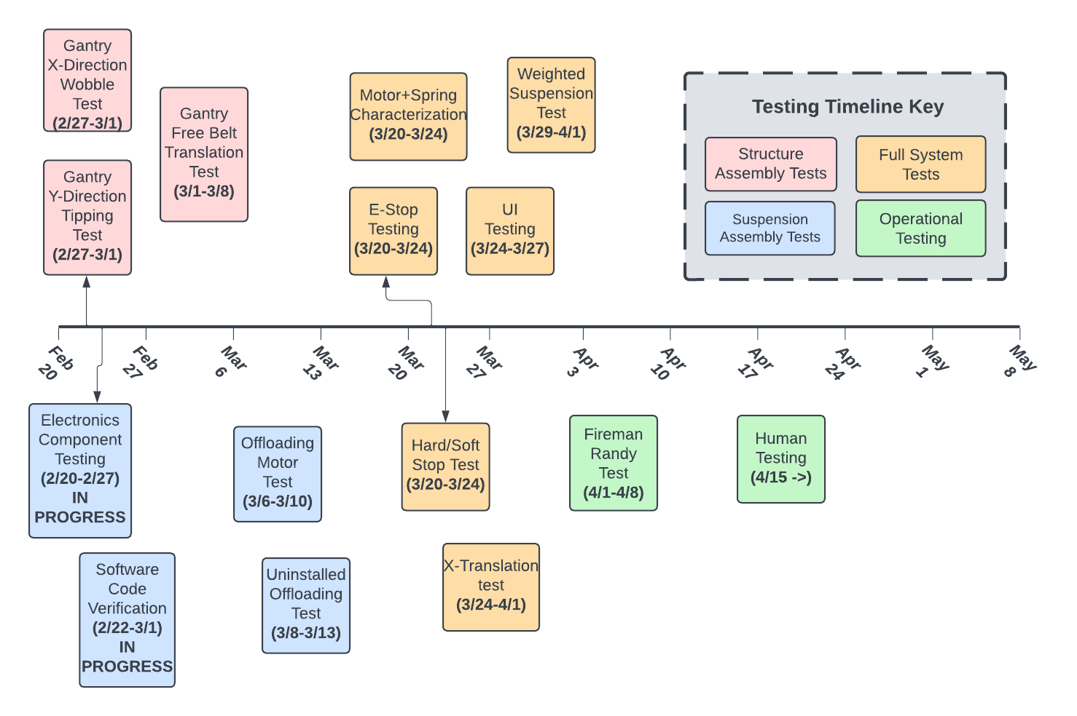
Testing Chart
4 phases of testing
Structural tests and Suspensions testing phases performed simultaneously
TRR is focused on full system tests and operational tests
Notes:
Brennan
TA: Rubric needs a table - introduce table, then move to this diagram
Feel free to edit the chart at this link: https://lucid.app/lucidchart/e4591c22-5b77-471c-80c7-39d0415a3a27/edit?viewport_loc=32%2C-77%2C1683%2C1532%2C0_0&invitationId=inv_73ade7e2-a885-456c-a229-cba8d3d2ffc0

Slide 14
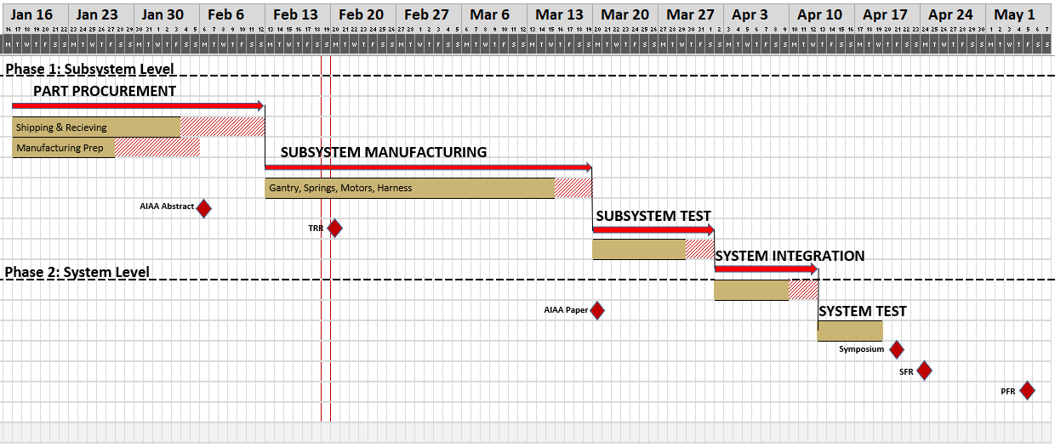
Gantt Chart - Top Level
Notes:
< Review the whole project schedule in the form of the Gantt chart, showing overall progress toward goals. In this case, the status should be described with an emphasis on testing. Highlight any major changes in the project schedule since CDR, and indicate shifts in critical path or margins. >
Parker
Dont forget to add text boxes to bars to label
Progress
Manufacturing has began
Emphasis on Testing
Component Testing in progress, subsystem level testing begins March ____
Major changes since CDR
Extended manufacturing timeline
Removed V-Clamp Design
Shifts in Critical Path or Margin
Failed to reach Procurement within margin due to Mechanical IDR Concerns
Manufacturing timeline extended due to Mechanical IDR Concerns

Slide 15
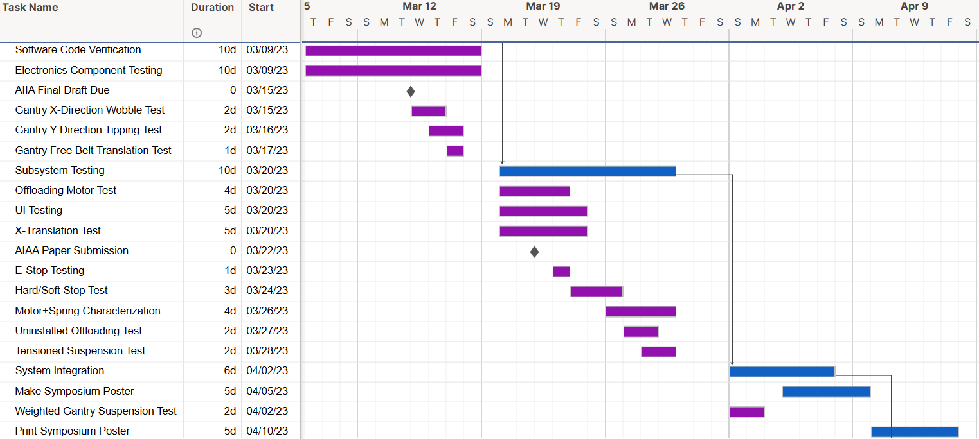
Gantt Chart - Testing
Testing
All Team
Notes:
Parker
TA: Comment on what might happen if schedule impact if delayed, but may not be necessary?

Slide 16
Test Readiness
Notes:
Parker

Slide 17
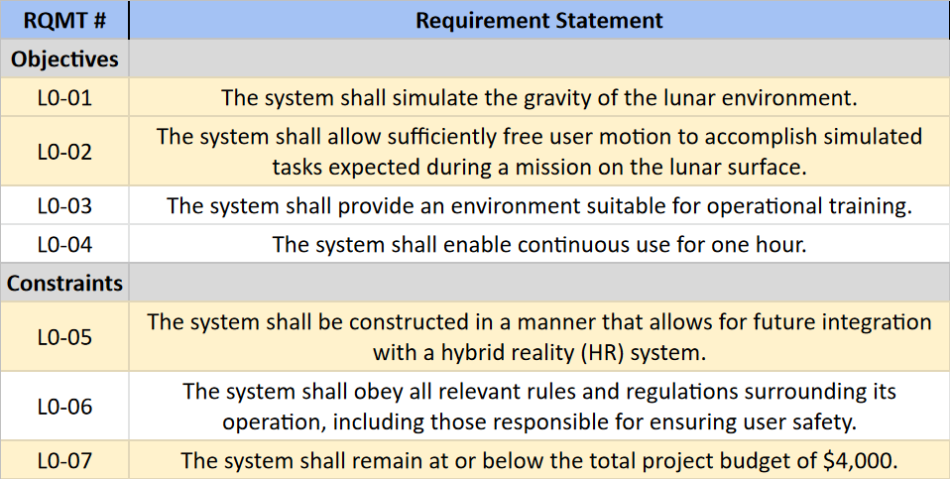
Functional Requirements

Slide 18
Overview for Today
Motor+Spring Characterization Test
X-Translation Test
Fireman Randy Test
Notes:
Parker

Slide 19
Test 1:
Spring and Motor Characterization Test
Notes:
Brennan

Slide 20
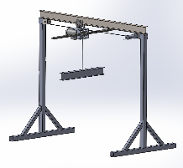
Test 1: Spring and Motor Characterization Test
The spring and motor characterization test will verify the software control laws and produce expected results when compared to previously developed EOMs.
Full Testing Procedure
Critical Prerequisite Tests
Electronics Component Tests
Software Code Verification Tests
Uninstalled Offloading Test
Emergency Stop Test
Primary Related Requirements
L3-13: Simulate gravity within 10% accuracy
L3-14: Maximum Vertical speed of 5.67 ft/s
L3-15: Cycling vertical speed of 2.68 ft/s
L3-61: Software shall accurately adjust motor power based on user movement
Notes:
Brennan

Slide 21
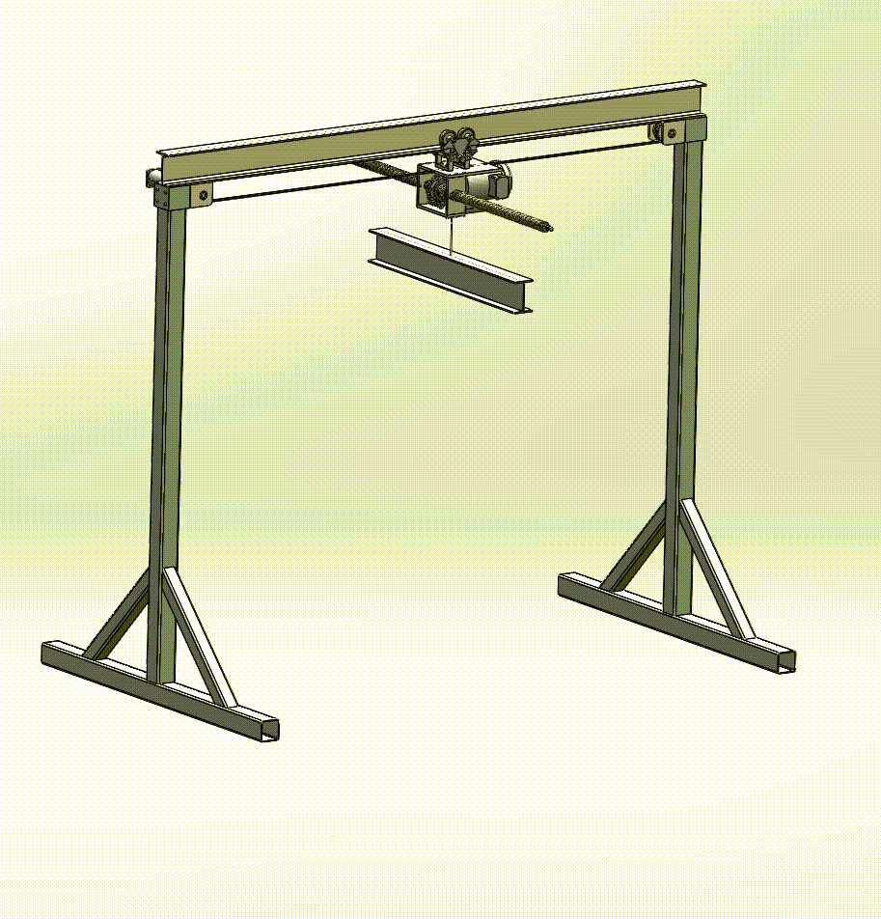
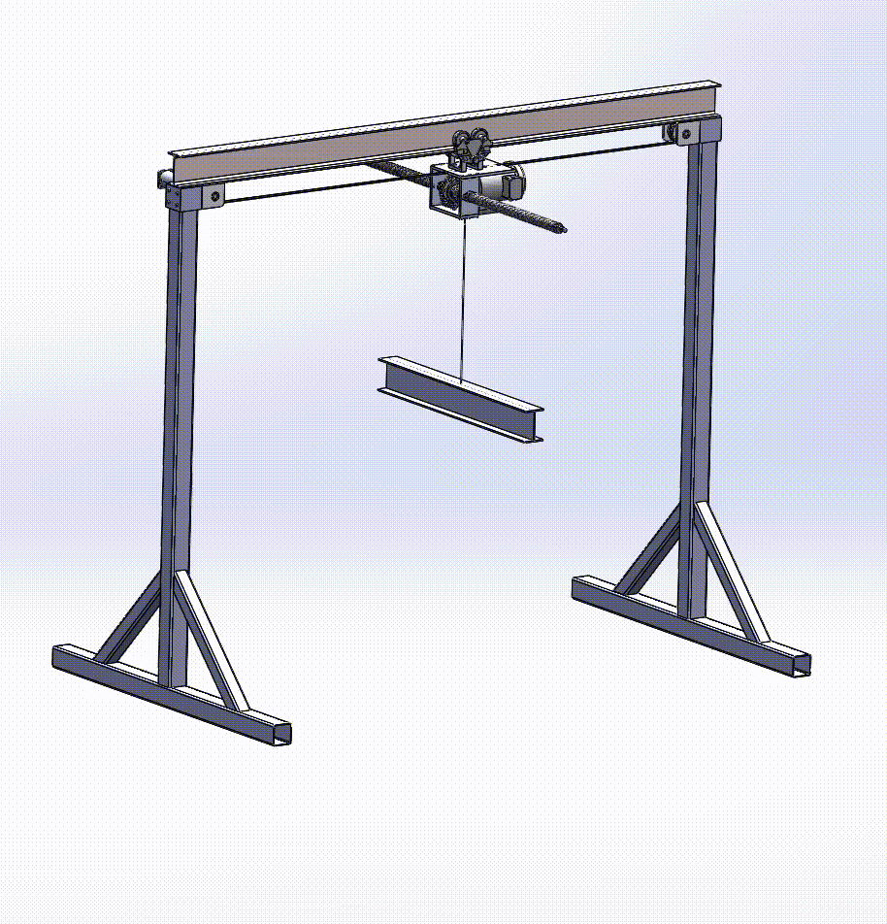
Test 1: Spring and Motor Characterization Test
Testing Procedure
Attach weight + accelerometers to system and power on
Manually manipulate weight to simulate motion requirements of L3-14, L3-15
Record Slo-mo video of test, and record accelerometer data of motion.
Analyze difference between video and accel data. Adjust accelerometer as needed.
Analyze difference between accel data and CDR model. Adjust motor control law and repeat test if needed.
L3-14: Max Vertical Speed
L3-15: Average Cycle Speed
Notes:
Chandler
TA: Condense if possible, add images! Too much text, could combine bullets, less detail (e.g. “data gathered and analyzed” could replace a few of these)

Slide 22
Test 1: Spring and Motor Characterization Test
Test Equipment
Assembled LunaSim Gantry + Suspension System
ADXL337 Accelerometer (On Weight)
50lb Weight with loop attachment
Cell Phone Camera with Slo-mo Capabilities
Floor Protection Mat
Required Personnel
Safety Officer
Testing Lead
Systems Engineer
1x Software Team Member
1x Suspension Team Member
Risk Mitigation
Verified Safety of Structure+Suspension through previous testing
Previous verification of emergency stop button
Required PPE and training
Suspension System Verification Risk Assessment
Data Acquisition Plans
Accelerometer Data will be exported to attached laptop. Will be read into MATLAB, and analyzed there.
These accelerometers will have previously been calibrated during electronics component testing.
Cell Phone video will be sent to computer, and analyzed in Video Software
Notes:
Brennan

Slide 23
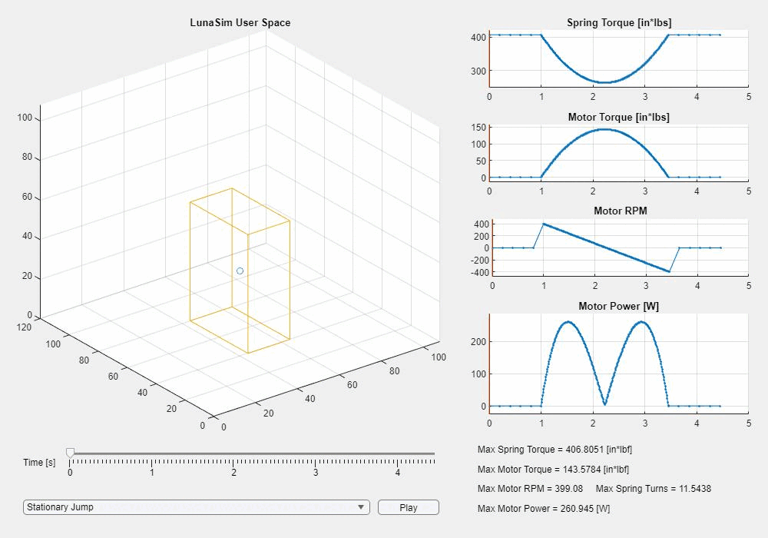
Test 1: Spring and Motor Characterization Test
Expected Results
Pass/Fail Criteria
The maximum speeds and times of requirements L3-14 and L3-15 must have been tested and achieved by the system
The accelerometers provide position data that is within 1in of recorded video of the test.
The accelerometer position data is within 10% accurate when compared to Offloading Simulator data presented at CDR with similar starting conditions
Notes:
Chandler
Condense text here as well if possible, a bit dense to read (visual is good though!)
TA: Make all success criteria related to requirements, don’t need “nice-to-haves”. Make requirements met more prominent, box with green check or similar - don’t necessarily need requirements summary, but could be nice

Slide 24
Test 2: Horizontal Translation Test
Notes:
Zoe

Slide 25
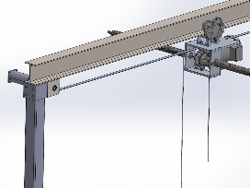
Test 2: Horizontal Translation Test
The Horizontal-Translation test ensures that the x-translation system is able to function properly while loaded with the suspension system. Under a load, the motor and belt must stay tight and secure.
Full Testing Procedure
Critical prerequisite tests
Electronics Component Tests
Software Code Verification Tests
Gantry Free Belt Translation Test
Emergency Stop Test
Primary Related Requirements
L3-21: Allow user to move up to 6ft/s
L3-22: Maximum Angle between user and offloader of 26°.
Notes:
Zoe

Slide 26
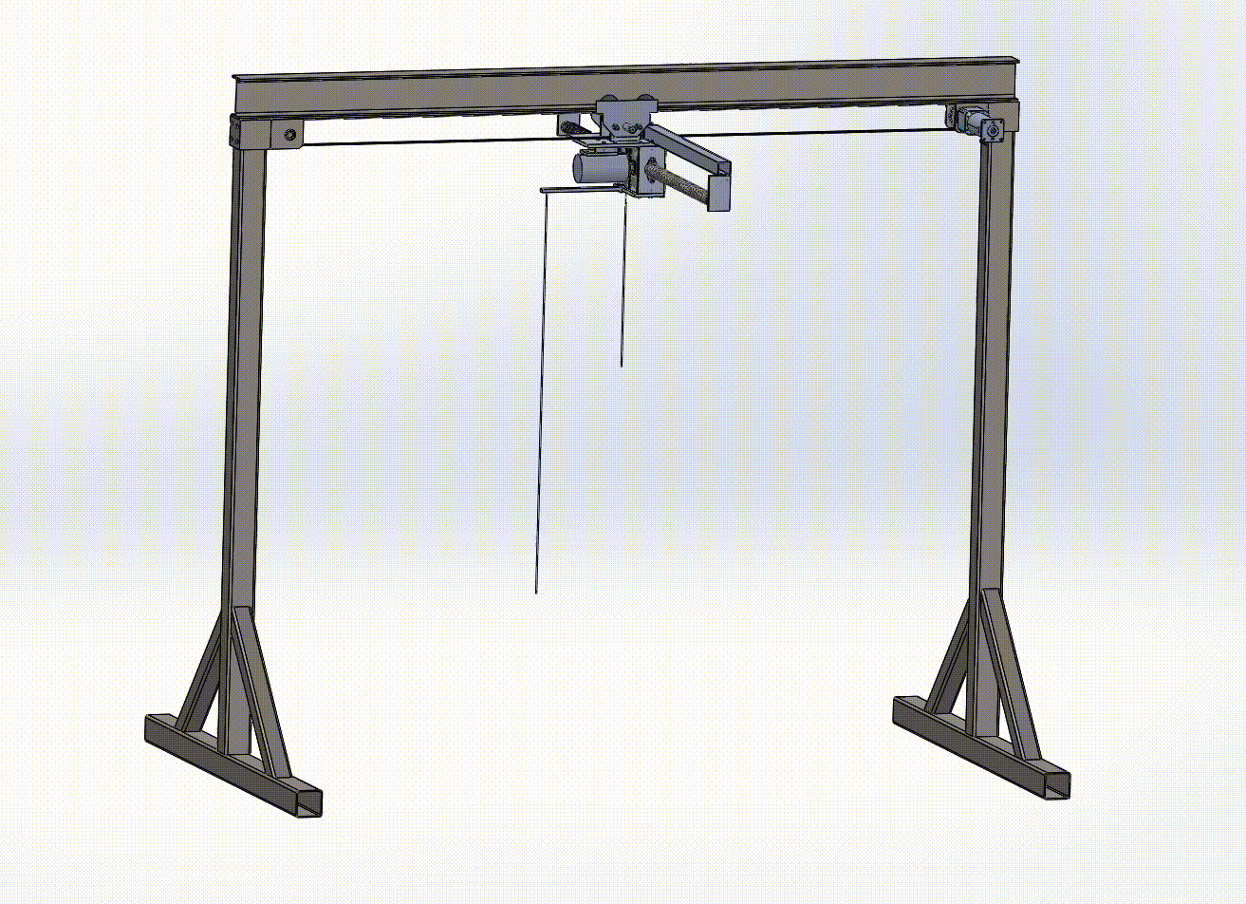
Test 2: Horizontal Translation Test
Testing Procedure
Hang cable 1ft from offloader center
Enable offloader brake, and power horizontal translation system
Displace offloading cable side to side, and record accelerometer data from overhead suspension system
Movement of cable within 26° range should result in movement. Any displacement outside of 26° range should result in max movement speed.
Notes:
Max
TA: Truncate, add visuals as in previous test

Slide 27
Test 2: Horizontal Translation Test
Test Equipment
Assembled LunaSim Gantry + Suspension System
Potentiometer Angle Detector Mechanism
10ft cable/rope to hang
System Accelerometer
Required Personnel
Safety Officer
Testing Lead
Systems Engineer
1x Structures Team Member
1x Software Team Member
Risk Mitigation
Structure Inspected and approved by PAB before testing
Verified Safety of Structure+Suspension through previous testing
Previous verification of emergency stop button
Required PPE and training
X-Translation Test Risk Assessment
Notes:
Zoe

Slide 28
Test 2: Horizontal Translation Test
Expected results
Horizontal Translation System should respond according to the magnitude of cable displacement
Timing belt and translation motor should remain tight and secure
Pass/Fail Criteria
The maximum speed specified in requirement L3-21 must be achieved
The potentiometers always detect and report an angle of over 26°
The software appropriately responds to electronic signals from potentiometers
Any angle greater than 26° results in maximum speed translation. [L3-22]
Notes:
Max
TA: Same feedback regarding requirements, make sure we can provide reasoning for repetition (probably cut 3x bullet per brennan) TA: Good just to test movement can occur, can move cycles to day-in-the-life/full system test

Slide 29
Test 3:
Fireman Randy Full System Test
Notes:
Mia

Slide 30
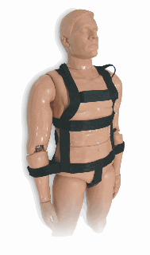
Test 3: Fireman Randy Full System Test
The Fireman Randy test exists to completely verify the functionality and safety of the complete LunaSim system before full human testing.
Full Testing Procedure
Thanks to Prof. Torin Clark for access to Randy!
Critical prerequisite tests
E-Stop Testing
Motor+Spring Characterization
UI Testing
Weighted Suspension Test
Hard/Soft Stop Test
X-Translation Test
Notes:
Mia
James: Could move 1 hour cycles/day in the life to here?
TA: Pick requirements that we think are most important, slide in backup slides with all of them (maybe). Probably won’t care about smaller requirements. Alternatively, relate to high level FR (L1s could work here)
Acknowledge Prof. Torin Clark!
James: are there any requirements that this test verifies that we definitely aren’t verifying with any other tests? could highlight those

Slide 31
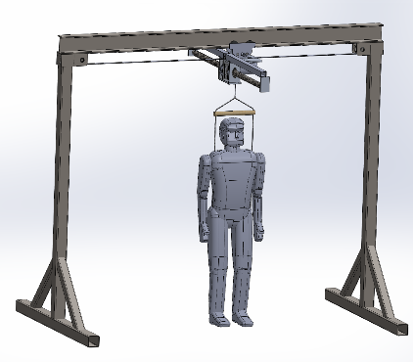
Test 3: Fireman Randy Full System Test
Testing Procedure
Attach Fireman Randy to LunaSim System
Manually Manipulate Randy to simulate expected motion
Move Randy to trigger various safety mechanisms (ie Hard/Soft Stops)
Collect and analyze accelerometer data
Remove Fireman Randy
Notes:
Mia
TA: Same feedback: cut down, add visuals
James: Have we solidified the manipulation method? They’ll probably ask
TA: Could have multiple slides detailing modes (w/images?) first, then move to procedures

Slide 32
Test 3: Fireman Randy Full System Test
Test Equipment
Assembled LunaSim System
Fireman Randy
PPE for UI operator and Randy Manipulator
Required Personnel
Safety Officer
Testing Lead
Systems Engineer
2x Team Members
Risk Mitigation
Verified Safety of Structure+Suspension through previous testing
Inspection and Verification by PAB prior to testing
Required PPE and preparation
Fireman Randy Test Risk Assessment
Data Acquisition Plans
Accelerometer Data on harness will be exported to MATLAB for analysis.
Data will be examined for each mode tested, and compared to requirements
Notes:
Mia

Slide 33
Test 3: Fireman Randy Full System Test
Expected Results
Fireman Randy should be able to simulate a user doing the following:
Walking/Running
Jumping
Crouching
Triggering Soft/Hard Stops
Rotating
Emergency Stop
Pass/Fail Criteria
Fireman Randy should be able to achieve all related requirements for each mode of movement. For example, regarding a walk test
L3-13: Cycling 2.68 ft/s every 0.5 s
L3-21: Translate up to 6 ft/s
L3-29: Z-Offloading motor shall use less than 120 V
L3-61: Software shall adjust spring tension to simulate lunar gravity with 10% error
Notes:
James
NOTE: Software no longer adjusts spring tension, instead uses motor with static spring. James correct requirements
TA: Continued from last slide, have examples and more in backup (other modes)

Slide 34
Budget
Notes:
Lauren, CFO

Slide 35
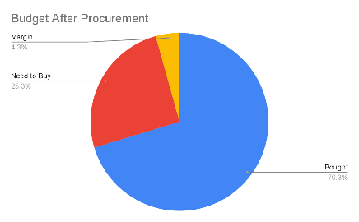
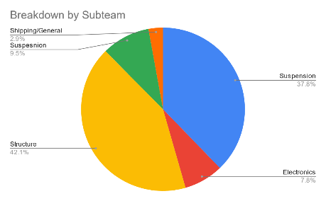
Budget
Notes:
Lauren, CFO
TA: Move pie chart to beginning, make sure formatting is consistent between tables. Also, pie chart by type of components (subsystem) would be good to see - could replace right-hand chart here

Slide 36
Budget
Metal Bevel Pinion | 2/13 | McMaster | 41.4 | 2/15 | Complete
Metal Bevel Gear | 2/13 | McMaster | 151.36 | 2/15 | Complete
Shipping | 2/13 | McMaster | 53.45 | N/a | Complete
Steel | 2/19 | Dencol | 1028.26 | 2/20 | Complete
2.5 Hp Treadmill Motor, Power Supply, and Motor Controller |  | Craiglist | 150 | 2/8 | Trial period
Carabiners | 2/13 | Amazon | 24.98 | 2/14 | Complete
Springs | 2/13 | American Door Supply | 329.98 |  | Shipping
Spring Winding Bar | 2/13 | American Door Supply | 17.78 |  | Shipping
Shipping | 2/13 | American Door Supply |  |  | Shipping
Smartsheet license | 2/13 | Smartsheet | 27 | N/a | Complete
Notes:
Lauren, CFO

Slide 37
Budget
Part | Date Purchased | Supplier | Cost | Expected Delivery | Status
Harness | 2/12 | Amazon | 45.99 | 2/14 | Complete
Libre Board | 2/12 | Amazon | 35 | 2/14 | Complete
I Beam Trolley | 2/12/2023 | Amazon | 65.98 | 2/14 | Complete
Timing Plate | 2/13 | McMaster | 296.8 | 2/15 | Complete
6.3" Long x 1.97" Wide End Plate for Trase Size L Timing Belt | 2/13 | McMaster | 84.52 | 2/15 | Complete
Zinc Yellow-Chromate Plated Hex Head Screw | 2/13 | McMaster | 31.72 | 2/15 | Complete
Ball Bearing | 2/13 | McMaster | 25.59 | 2/15 | Complete
Multipurpose Neoprene Rubber Sheet | 2/13 | McMaster | 13.18 | 2/15 | Complete
Timing Belt Pulley | 2/13 | McMaster | 118.62 | 2/15 | Complete
Rotary Shaft | 2/13 | McMaster | 58.24 | 2/15 | Complete
Ball Bearing | 2/13 | McMaster | 17.06 | 2/15 | Complete
Metal Bevel Pinion | 2/13 | McMaster | 41.4 | 2/15 | Complete
Notes:
Lauren, CFO

Slide 38
Acknowledgements
Dr. Anderson - Advisor and Customer, CU Assistant Professor
Sandor Nemethy - VP, Mission Management at EchoStar
Matt Rhode - Aerospace Mechanical Design & Manufacturing Lab Manager
Nate Coyle - Aerospace Machine Shop and Fabrication Instructional Lab Coordinator
Trudy Schwartz - Associate Teaching Professor
Bobby Hodgkinson - Assistant Teaching Professor
Dr. Wingate & Dr. Muldrow - CU Boulder Professors
Lauren Darling - ITLL Senior Engineering Projects Consultant
Viri Varela - Engineering Projects Consultant
TF Team - CU Boulder Senior Design
Notes:
Parker

Slide 39
Thank you
Notes:
Parker

Slide 40
PAB Testing Gate Inspections
Schedule Flowdown Here

Slide 41
Additional Analysis
Notes:
Lauren, CFO

Slide 42
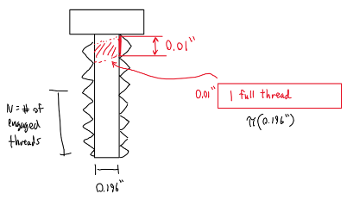
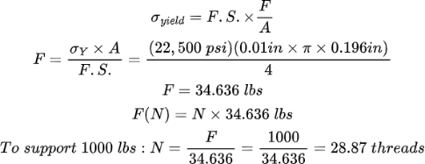
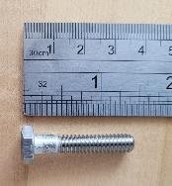
Suspension Chassis Fastener Threading Analysis
Notes:
Parker

Slide 43
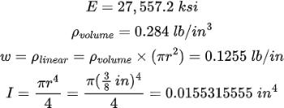
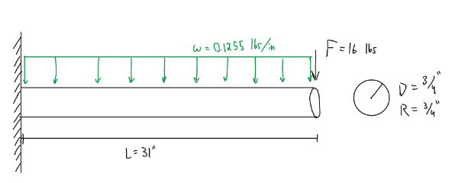
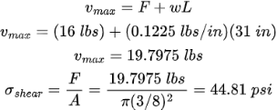
Driveshaft Bending Analysis
https://www.steelss.com/Carbon-steel/aisi-1566.html
https://www.mcmaster.com/1346K36/
Shear
Deformation
Notes:
Parker

Slide 44
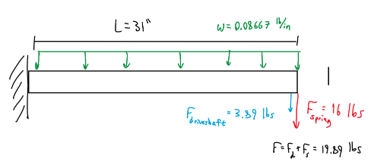
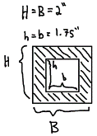
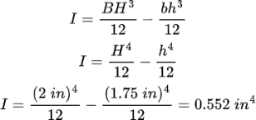
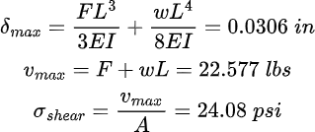
Driveshaft and Spring Support Analysis
https://www.matweb.com/search/DataSheet.aspx?MatGUID=b8d536e0b9b54bd7b69e4124d8f1d20a&ckck=1
Displacement
Shear
Notes:
Parker

Slide 45
Parts in Detail
Notes:
Lauren, CFO

Slide 46
Parts in Detail Table of Contents
Structures:
I-Beam (55)
Steel Sleeves (55)
Square Tubes (3x3) (56)
Square Tubes (4x4) (56)
Pulley Brackets (57)
Fasteners - Bolts (57)
Belt (58)
Belt Motor (58)
Electronics:
Microprocessor (Libre Board) (69)
10 G Wire (69)
IMUs (70)
Accelerometers (70)
Potentiometers (71)
Limit Switches (71)
Motor Encoder (72)
Motor Controller (72)
Suspension:
Suspension Chassis (59)
I-Beam Trolley (59)
Driveshaft (60)
Driveshaft Support (60)
Spool (61)
Ball Bearings (61)
Torsional Springs (62)
Tensioning Bars (62)
Bevel Gears (63)
Suspension Motor (64)
Fasteners (64)
Bike Brake (65)
Swivel Joint (65)
Cable (66)
Cable Thimbles and Clamps (66)
Harness (67)
Carabiners (67)
Human Attachment System (68)
Separate Safety Features:
Soft Stop (73)
Hard Stop (73)
Emergency Stop Buttons (74)
Cable Catch System for Suspension Chassis (74)
Notes:
Parker

Slide 47
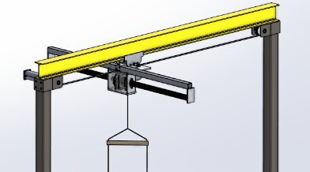
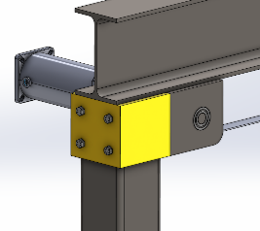
Structure Parts in Detail (pt.1)
I-Beam
Material: A992 Steel
Dimensions:
Factor of Safety:
Steel Sleeves
Material: A36 Steel
Dimensions:
Factor of Safety:
Notes:
Parker

Slide 48
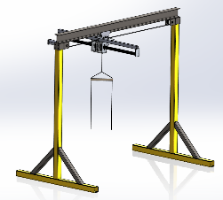
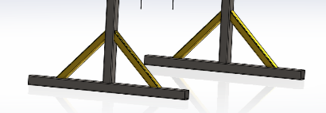
Structure Parts in Detail (pt.2)
Square Tubes (3”x3”)
Material: A500 Steel
Specification: HSS 3x3x0.1875
Purpose: Diagonal Supports for the Legs of the Structure
Factor of Safety:
Square Tubes (4”x4”)
Material: A500 Steel
Specification: HSS 4x4x0.1875
Purpose: Legs and Feet of Structure
Factor of Safety:
Notes:
Parker

Slide 49
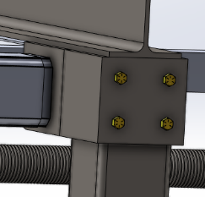
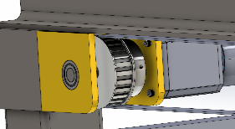
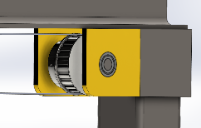
Structure Parts in Detail (pt.3)
Pulley Brackets
Material: A36 Steel
Dimensions: ⅜” Thick,
Factor of Safety:
Structural Fasteners - Bolts
Material:
Specs:
Factor of Safety:
Notes:
Parker

Slide 50
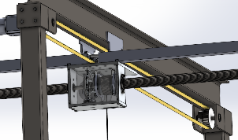
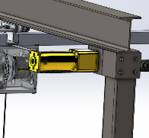
Structure Parts in Detail (pt.3)
Translation Belt
Material: Neoprene Reinforced with High-Strength Fiberglass
Specs: L-Series with Trapezoidal Teeth
Dimensions:
FOS:
Translation Belt Motor
Material:
Power: 207 W
Voltage: 90 VDC
RPM: 500 (after reducer)
Shaft Diameter: ¾”
Controlled By:
Notes:
Parker

Slide 51
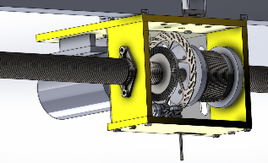
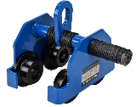
Suspension System Parts in Detail (pt.1)
Suspension Chassis
Material: 6061 Aluminum
Yield Strength: 45 [ksi]
Plate Thickness: ½”
Overall Dimensions: 8” Wide, 10” Tall
Aluminum Plate FOS: 180 (dynamic)
I-Beam Trolley
Material: Thickened Manganese Alloy Steel Plate
Working Load Limit: 2,200 [lbs]
Width Adjustability: Between 3”-6”
FOS: 6.3 (static), 1.6 (dynamic)
Height
Width
Notes:
Parker

Slide 52
Suspension System Parts in Detail (pt.2)
Driveshaft
Material: 1566 Carbon Steel
Dimensions: ¾” diameter, 72” long
Yield Strength: 75 [ksi]
FOS: 49.6 (dynamic)
Conducted Analysis: Torsional and Bending Analysis (43 & 44)
Driveshaft and Spring Support
Material: 6061 Aluminum
Dimensions: 2”x2” square tube, ⅛” thick
Yield Strength: 40,000 [psi]
Tensile Strength: 45,000 [psi]
FOS: 1246 (static, not supporting load of person)
Notes:
Parker

Slide 53
Suspension System Parts in Detail (pt.3)
Spool
Material: Aluminum
Dimensions: 3” outer diameter, ½” wall thickness
Attachment to Driveshaft: Filler ½” Aluminum Plate and ¼” Pin
FOS: Brennan
Ball Bearings
Material: High Carbon Chromium Bearing Steel (GCr15)
Bore (Inner Diameter): 0.74”
Outer Diameter: 1.61”
Thickness: 0.43”
Radial Load Cap (for 1 million revolutions): 1,750 [lbs] (dynamic), 1,000 [lbs] (static)
Notes:
Parker

Slide 54
Suspension System Parts in Detail (pt.4)
Torsional Garage Door Springs
Company: American Door Supply
Material: Steel
Dimensions:
Inner Diameter: 3.75”
Outer Diameter: 3.975”
Length: 25”
Spring Constant: 5.5704 [in-lb/rad] / 17.62 [IPPT]
Maximum Turns on Spring: 10.6
Specified Lifetime Given Maximum Turns: 50,000 cycles
Quantity: 2
Torsional Springs Tensioning Bar
Note: Commercial Winding Bar for Garage Door Springs
Overall Dimensions: 18” long, ½” diameter
Notes:
Parker

Slide 55
Suspension System Parts in Detail (pt.5)
Bevel Gears (Motor to Driveshaft)
Gear Ratio: 4:1
Material: 1144 Carbon Steel
Pinion Specs
Bevel Gear Specs
Modifications: increasing bore diameter of both bevel gears
Pinion: to ⅝”
Gear: to ¾”
Metal Bevel Gear
Metal Bevel Pinion
Notes:
Parker

Slide 56
Suspension System Parts in Detail (pt.6)
Suspension Motor
Motor Type: Johnson JM05-015
Power: 2.5 hp
Voltage: 90 VDC
RPM: 3150
Shaft Diameter: ⅝”
Controlled By: To Be Added (Specific Motor Controller)
Suspension Fasteners - Hex Bolts
General Description: ¼-20
Length: 1 ¼”
Number of Engaged Threads Per Bolt: 10
Shank Length: 0.355”
Overall FOS: 4 (dynamic)
Conducted Analysis:
Thread Strength
Analysis (42)
Notes:
Parker

Slide 57
Suspension System Parts in Detail (pt.7)
Bike Brake
160 mm diameter rotor
Swivel Joint
Materials: Stainless Steel, Magnesium Aluminum Alloy
Breaking Load: 6,613 [lbs] (30 kN)
Certification:
CE 1019 EN 566
EN 354:2011
Certified.
FOS: 6.6
(dynamic), 18.9
(static)
Notes:
Parker

Slide 58
Suspension System Parts in Detail (pt.8)
Cable
Material: Galvanized Steel
Diameter: 3/16”
Working Load Limit: 840 [lbs]
Breaking Load: 4,200 [lbs]
Cable Configuration: 7x19
FOS: 4.2 (dynamic), 12 (static)
Cable Thimbles and Clamps
Material: Zinc Plated Steel
Sizing: For 3/16” cable
Purpose: For looping the ends of the cable
Requires Testing for Strength ( )
Notes:
Parker

Slide 59
Suspension System Parts in Detail (pt.9)
Harness
Brand: KwikSafety
Certification: Meets ANSI/ASSE Z359.11-2014 Standards and is OSHA Approved
Material: Heavy-Duty Synthetic Material
Adjustability: Works for all users
Carabiners
Material: 7075 Aircraft Aluminum
Certification: UIAA Certified
Major Axis Strength: 5,621 [lbs] (25 kN)
Cross-Load Strength: 1,573 [lbs] (7 kN)
FOS (Major Axis): 5.6 (dynamic),
22.5 (static)
Notes:
Parker

Slide 60
Suspension System Parts in Detail (pt.10)
Human Attachment System (Redesigned)
Design Inspiration and Heritage: Ice Skating Harnesses
Materials:
Steel Cable (same as the rest of the suspension cable)
1.5” Wood Dowel for Cross-Bracing
Adjustability: One Size Fits All Users
Old
New
Notes:
Parker

Slide 61
Electronics Parts in Detail (pt.1)
Microprocessor (Libre Board)
Series: AML-S905X-CC-2GB
Processor Speed: 1416 [MHz]
Number of Digital Ports:
Number of Analog Ports:
10 Gauge Wire
Materials: Tinned Copper Conductor & Silicone Rubber Insulator
Voltage: 600 [V]
Specs: 1050 strand 0.08mm Conductor
Dimensions: Outside diameter 5.5mm, Tolerance +/- 0.1mm
Temperature Range: -76ºF to 395ºF
Purpose: Connect electronic components for data and power transmission
Notes:
Parker

Slide 62
Electronics Parts in Detail (pt.3)
Potentiometers
Something
Limit Switches
Something
Add Pic
Add Pic
Notes:
Parker

Slide 63
Separate Safety Feature Parts in Detail (pt.1)
Soft Stop
Hard Stop
CAD
CAD
Notes:
Parker

Slide 64
Separate Safety Feature Parts in Detail (pt.2)
Emergency Stop Buttons
Cable Catch System for Suspension Chassis
Notes:
Parker

Slide 65
Safety Documentation
Notes:
Lauren, CFO

Slide 66
Risks
Process
Associated Risks
Safety Measures
Manufacturing
Potential human harm from machinery
Machine shop trainings and standard procedures
Assembly and Integration
Potential human harm
High-energy torsional springs
Testing involving human subjects
Proper Training and Culture of Safety
Safety Documentation Including:
Emergency Plans
Method Statements
Risk Assessments
Assembly, Integration, and Test plans
Safety Guides
Testing
Notes:
Parker

Slide 67
Types of Safety Documentation
We will implement five different types safety documents, each serving their
own purpose:
Emergency Procedures for Assembly, Integration, and Testing
Method Statement
Assembly, Integration, or Test Plan
Includes:
Personnel responsibilities
Work procedure and control measures
Required training and PPE
Includes:
Embedded safety measures step-by-step
Safety verification of system
Risk Assessment
Safety Guides
Includes:
Hazard identification
People and equipment at risk
Mitigation strategies
Includes:
General guidelines that can be used for training (e.g., first aid, safety awareness, PPE use, ladder safety)
Notes:
Parker

Slide 68
Method Statement Document Example
Notes:
Parker

Slide 69
Risk Assessment Document Example
Notes:
Parker

Slide 70
Safety Guide Document Example
Notes:
Parker

Slide 71
Full System CONOPS: Entry
Operator
User
System power on
User dons harness, operator confirms
User weighed, input to software
Software set to “entry” mode
Operator lowers cabling, anchors to floor
Harness attached to cabling
Operator engages brake, removes anchor
Operator disengages brake, leaves area

Slide 72
Full System CONOPS: Active
Operator
User
If E-Stop activated by operator or user: cut power to motor and start Egress.
Otherwise, proceed to Egress when finished.
Software set to “active” mode
User performs training tasks

Slide 73
Full System CONOPS: Egress
Operator
User
Software set to “egress” mode
Operator lowers cabling, anchors to floor
Harness detached from cabling
Operator engages brake, removes anchor
User doffs harness with operator assistance
System power off

Slide 74
Gantt Chart Specifics
Notes:
Lauren, CFO

Slide 75
Structures - Manufacturing
Notes:
Parker

Slide 76
Suspension - Manufacturing
Notes:
Parker

Slide 77
Software - Manufacturing
Notes:
Parker

Slide 78
All Team 1/15-2/7
Notes:
Parker

Slide 79
All Team 1/29-2/22
Notes:
Parker

Slide 80
All Team 2/20-3/17
Notes:
Parker

Slide 81
All Team 3/5-4/1
Notes:
Parker

Slide 82
All Team 3/19-4/20
Notes:
Parker

Slide 83
All Team 4/1-5/8
Notes:
Parker

