Slide 1
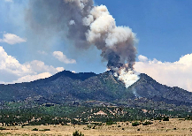
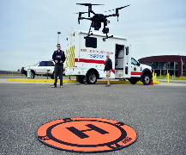
Team CARROT:
Compact Aerial Radio Relay for Obscure Terrain
Critical Design Review
November 28, 2022
Customer: Professor John Mah
Jared Seefried (Project Manager)
Elena Bauer (Systems Engineer)
Marguerite Adwan
Luis Alvidrez
Talen Fischer
Kushal Kedia
Chris Lolkema
Eric Lozano
Tyler Mckay
Abigail Moonan
Lucas Pereira
Carson Sexton

Slide 2
Presentation Outline
Purpose & Objectives
Design Solution
Critical Project Elements
Risks
Design Requirements
Verification & Validation
Project Planning

Slide 3
Purpose &
Objectives

Slide 4
Project Overview - Mission Statement
The goal of CARROT is to develop a human-portable, manufacturable, low-cost, and rapidly deployable unmanned aircraft system (UAS).
This system will be utilized to assist with multiple mission profiles, including search and rescue. The aircraft will be capable of meeting the demands of the mission including agility, low-costs, high persistence, and broad coverage capability.
Objectives
Ease of transportability
Ease of manufacturability
Cost efficient
High endurance for continuous overwatch
Purpose & Objectives
Design Solution
CPEs
Risks
Design Requirements
Verification & Validation
Project Planning

Slide 5
C O N O P S
C O N O P S
Purpose & Objectives
Design Solution
CPEs
Risks
Design Requirements
Verification & Validation
Project Planning

Slide 6
Design Solution

Slide 7
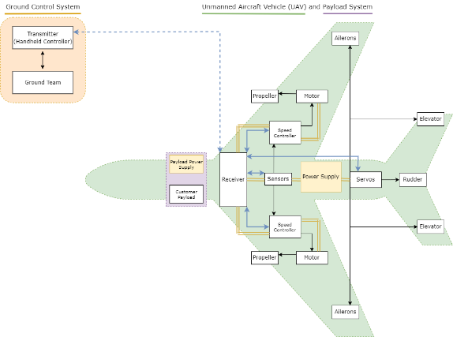
Functional Block Diagram
Key:
Physical Connections
Data Connections
Wireless Data Connections
Power Supply
Purpose & Objectives
Design Solution
CPEs
Risks
Design Requirements
Verification & Validation
Project Planning
Notes:
This is our Functional Block Diagram for the project. As seen, we have a Ground Control System, Unmanned Aircraft Vehicle (UAV), and Payload System. From the Ground System, the pilot will have a handheld controller that will communicate with the aircraft. Any inputs from the pilot will be sent to the receiver which will be connected to the speed controller as well as the servos. This will allow the pilot to direct and control the aircraft when necessary during the mission profile.

Slide 8
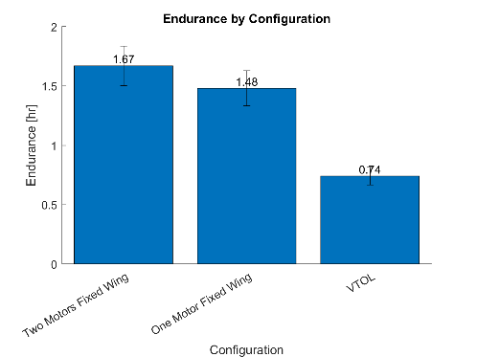
Design Solution - Changes from PDR to CDR
Propeller profile drag adds significant power draw and endurance loss
~55% loss from two motor configuration
Does not consider endurance loss from high power draw during VTOL transition
Purpose & Objectives
Design Solution
CPEs
Risks
Design Requirements
Verification & Validation
Project Planning
Notes:
High amounts of parasite drag from propellers (3x base parasite drag for 4x 9” props- we are using 22”). This model is extremely optimistic with drag characterization and still more than halves endurance
Elena

Slide 9
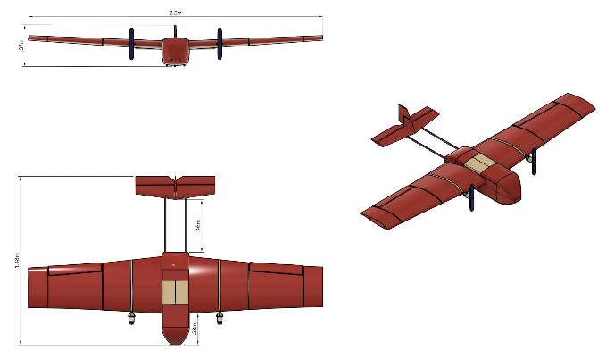
Design Solution - Fixed Wing Aircraft
Purpose & Objectives
Design Solution
CPEs
Risks
Design Requirements
Verification & Validation
Project Planning
Notes:
This is our design solution for our fixed wing aircraft. As shown, the aircraft has a wingspan of 2.6 meters (8.5 ft) and has a length of 1.48 meters from the nose to the tail. From the bottom of the fuselage to the top of the tail, the aircraft is 0.37 meters (~ 1 ft).

Slide 10
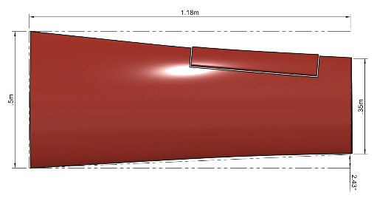
Design Solution - Wing
Half Span | 1.18 m
Wing Area | 1 m²
Aspect Ratio | 5.55
Root Airfoil | NLF(1)-0215F
Tip Airfoil | NLF(1)-0212F
Tip Twist | -3°
Incidence Angle | 3°
NLF(1)0215F
NLF(1)0212F
Purpose & Objectives
Design Solution
CPEs
Risks
Design Requirements
Verification & Validation
Project Planning
Notes:
Chris

Slide 11
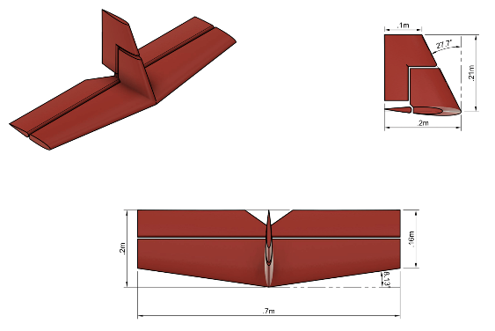
Design Solution - Empennage
Vertical Stabilizer
Airfoil | NACA 0012
Area | .03 m²
Lever Arm | .98 m
Horizontal Stabilizer
Airfoil | NACA 0012
Tail Incidence | -2°
Area | .12 m²
Lever Arm | .12 m²
Purpose & Objectives
Design Solution
CPEs
Risks
Design Requirements
Verification & Validation
Project Planning
Notes:
Chris

Slide 12
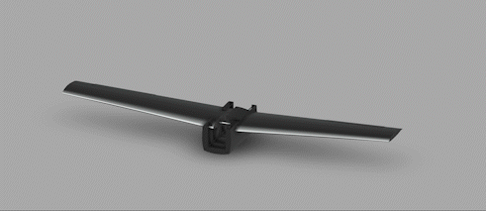
Design Solution - Fuselage
Design Solution - Fuselage
Purpose & Objectives
Design Solution
CPEs
Risks
Design Requirements
Verification & Validation
Project Planning

Slide 13
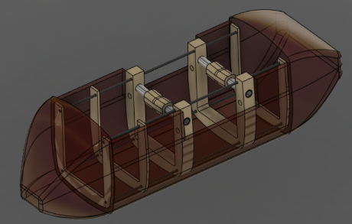
Design Solution - Fuselage
Parameter | Value | Unit
Length | 0.5 | [m]
Height | 0.2 | [m]
Width | 0.2 | [m]
Component | Material
Spars | Carbon Fiber
Ribs | PETG Plastic
Shell | Foam sheet
Fig.1 - Fuselage Interior Structure
Purpose & Objectives
Design Solution
CPEs
Risks
Design Requirements
Verification & Validation
Project Planning

Slide 14
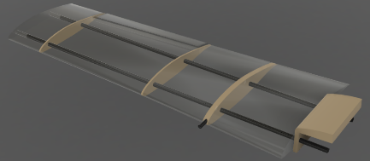
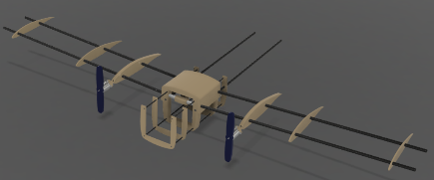
Design Solution - Wing and Tail Structure
Wing
2 main spars
Solid body airfoils
Ribs placed at force inflections
Tail
Two rear spars
Solid body airfoils
No ribs
Component | Material
Body | EPS Foam
Spar | Carbon Fiber
Rib | PETG
Purpose & Objectives
Design Solution
CPEs
Risks
Design Requirements
Verification & Validation
Project Planning
Notes:
Add spar and ribs

Slide 15
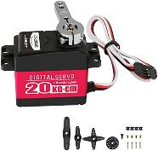
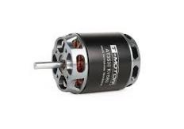
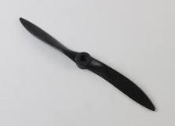
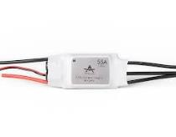
Design Solution: Drivetrain and Servos
Motor: Tmotor AT3530 | Propeller: APC 11x10 | ESC: Tmotor AT 55A | Servos: LD-20MG
Max power: 1400 W | Diameter: 11 in | Continuous current: 55A | Max torque: 20 kg-cm
Max current: 65 A | Pitch: 10 in. | Max current: 75A | Voltage: 7.4V
Input voltage: 16.8-22.2V | Max RPM: 22000 | Efficiency: 90% | No load current: 100 mA
Total configuration max thrust: 20+ N/motor
Purpose & Objectives
Design Solution
CPEs
Risks
Design Requirements
Verification & Validation
Project Planning

Slide 16
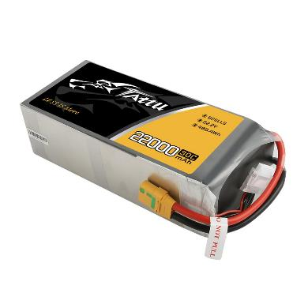
Design Solution - Battery
Tattu 6S Battery
Voltage: 22.2 V
Capacity: 488.4 Wh
Discharge rate: 30 C
Mass: 2.46 kg
Total endurance time: 1.7 ± 0.2 hrs
Purpose & Objectives
Design Solution
CPEs
Risks
Design Requirements
Verification & Validation
Project Planning
Notes:
Mention endurance doesn’t account for last 20%

Slide 17
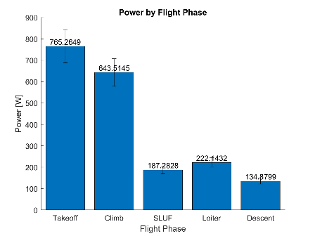
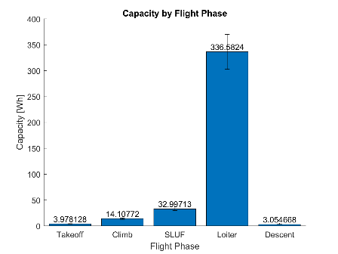
Design Solution - Power, Capacity and Endurance
Visual representation of the power and capacity in each flight regime
Assumptions for transitional flight regimes (durations extra)
All left over capacity is for loiter
Loiter composition
Purpose & Objectives
Design Solution
CPEs
Risks
Design Requirements
Verification & Validation
Project Planning
Notes:
Speaks to where power is going to and where we are optimizing towards

Slide 18
Critical Project Elements

Slide 19
Critical Project Elements
Critical Project Element | Description | Functional Requirement
CPE 1: Operability | Achieve operability by following FAA 14 CFR Part 107 and MIL-F-8785C requirements | F.R. 1
CPE 2: Design - Minimizing size and weight of aircraft | Achieve lightweight and portability features utilizing appropriate materials and modularization | F.R. 1 F.R. 2 F.R. 3
CPE 3: Manufacturing | Achieve manufacturing and repairability ease by the end user by utilizing low-cost, COTS materials and additive manufacturing methods | F.R. 4 F.R. 6
CPE 4: Design - Maximizing endurance through aerodynamics and propulsion | Meet endurance goals through extensive aerodynamic design & modeling and propulsion system design & modeling | F.R. 7
CPE 5: Design - Maintaining durability | Ensure structural integrity throughout flight profile given disturbances, weather variation, temperature, and maintaining static stability | F.R. 8
Purpose & Objectives
Design Solution
CPEs
Risks
Design Requirements
Verification & Validation
Project Planning

Slide 20
Risks

Slide 21
Possible Risk
Unique ID | Risk Description | Caused by & Consequences | Risk Owner(s) Name and Role | Probability | Impact | Risk Rating
1 | Wing Break | Crash or Landing Impact | Manufacturing Team | High | High | Critical
2 | Underestimated Drag Polar | Lowers Endurance due to increased drag | AeroStruct Team | High | Medium | Severe
3 | Battery Overheat/Combustion | Adverse chemical reaction due to battery damage or improper ventilation | ElectroMechanical | Low | Very High | Critical
4 | Battery Depletion | Overuse for given endurance time or underestimated battery calc | ElectroMechanical | Medium | Medium | Moderate
5 | Flight Controller Failure | Vibration, short circuit, software error | ElectroMechanical | Low | Medium | Moderate
Purpose & Objectives
Design Solution
CPEs
Risks
Design Requirements
Verification & Validation
Project Planning

Slide 22
Risk Matrix
Impact |  | Very Low | Low | Medium | High | Very High
Probability | Very High
Probability | High |  |  | 1 | 1
Probability | Medium |  |  | 1
Probability | Low |  |  | 1 |  | 1
Probability | Very Low
Purpose & Objectives
Design Solution
CPEs
Risks
Design Requirements
Verification & Validation
Project Planning

Slide 23
Possible Risk - Mitigation
Unique ID | Control(s) Name and Role | Residual Probability | Residual Impact | Residual Risk Rating
1 | Whiffletree Test | Medium | Medium | Moderate
2 | Live flight testing | Low | Low | Sustainable
3 | Thermal Testing for adequate ventilation and containment | Low | Medium | Moderate
4 | Full flight mission endurance test and max power testing | Low | Medium | Moderate
5 | Preflight test and redundancy in system | Low | Low | Sustainable
Purpose & Objectives
Design Solution
CPEs
Risks
Design Requirements
Verification & Validation
Project Planning

Slide 24
Risk Matrix - After Mitigation
Impact |  | Very Low | Low | Medium | High | Very High
Probability | Very High
Probability | High
Probability | Medium |  |  | 1
Probability | Low |  | 2 | 2
Probability | Very Low
Purpose & Objectives
Design Solution
CPEs
Risks
Design Requirements
Verification & Validation
Project Planning

Slide 25
Design Requirements

Slide 26
Functional Requirements
Functional Requirement | Description | Critical Project Element | Satisfied?
F.R. 1 | UAS shall adhere to FAA Part 107 and MIL-F-8785C | CPE 2
F.R. 2 | UAS shall be human portable | CPE 2
F.R. 3 | UAS shall clear short takeoff and landing areas and be able to deploy with unprepared launch surfaces and obstructed climb windows | CPE 2
F.R. 4 | UAS components shall be easily manufacturable, replaceable, or repairable | CPE 3
F.R. 7 | UAS shall provide continuous coverage for the duration of the mission profile | CPE 4
Purpose & Objectives
Design Solution
CPEs
Risks
Design Requirements
Verification & Validation
Project Planning

Slide 27
UAS Weight
D.R. 1.1: UAS shall be less than 55 lbs
Section | Weight [Kg]
Fuselage | 1.12
Wing | 1.83
Tail | 0.825
Motors | 1.36
Batteries | 2.26
Payload | 3
Margin | 10 %
Total | 11.46 kg
Weight = 25.26 lbs
Less than 55 lbs
UAS size and weight is reasonable to be carried and transported by a single person.
Purpose & Objectives
Design Solution
CPEs
Risks
Design Requirements
Verification & Validation
Project Planning
Notes:
Discuss why there is some error in this weight.
The wings are approximated as tapered linear geometry, and don’t take airfoil shape → overestimate.

Slide 28
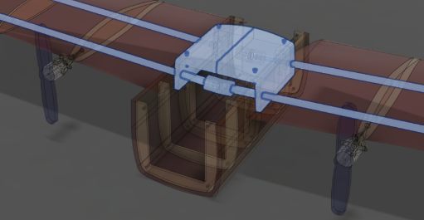
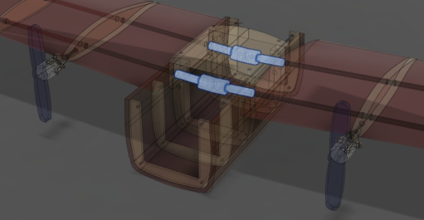
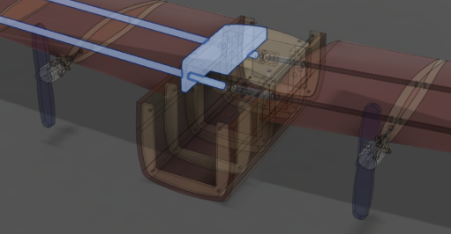
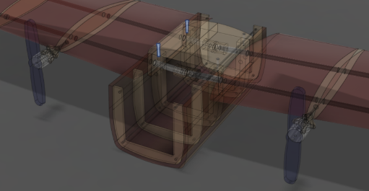
UAS Modularity
UAS Fuselage Design
Allows for easy removal of wing.
Spar Mount and Joint
Slide wing spars into aluminum mounts
Simple 2 Pin Removal gets rid of 2.6 wingspan.
D.R. 2: UAS shall be modularized to fit within rescue vehicle and be human portable
Purpose & Objectives
Design Solution
CPEs
Risks
Design Requirements
Verification & Validation
Project Planning

Slide 29
Rail Launch
D.R. 3.3: Clear a height of 30 meters (Average Blue Spruce tree height)
D.R. 3.4: Clear a takeoff runway of 244 m (Boulder Canyon Drive)
Dimensions
10 degree angle
Creates optimal angle of attack
3 m length
Requires 280 N elastic force
At Takeoff
Place aircraft and retention pin
Stretch bungee/elastic around UAS
Increase throttle to highest setting
Release retention pin
Purpose & Objectives
Design Solution
CPEs
Risks
Design Requirements
Verification & Validation
Project Planning
Notes:
Length: Due to force provided by engines. F = ma -> a = F/m — Velocity Takeoff (using constant acceleration formulas)
Angle : Optimized inclination to ease aircraft takeoff.
Make sure to:
Have full launching rail dimensions
Talk about how this will also be modular - The front will come off, and the full rail (depending on length) can probably be taken apart into sections.
Discuss bungee idea
Discuss safety release pin
Once measurements are know, discuss how there is error in them, since we know that the acceleration formulas don’t take into account surface friction or drag. For that reason, let’s provide an error for margin.

Slide 30
Model Design Benefits for User
Manufacturable
Pilot 141 3D Printer
Machine Shop EPS Foam Machinable
Student Operated or Special Build Request
Easy to teach 3D printing manufacturing process
Simplicity in Design Fast construction No laborious shapes.
Replaceable
Carbon Fiber Rods Easy to Find. Common Dimensions No Special Ordering
EPS Foam Easy to Find. Purchase at Local Home Depot
Repairable
Detachable Structural Components If single component breaks Single component could be replaced Without compromising repairing or rebuilding entire UAS
Purpose & Objectives
Design Solution
CPEs
Risks
Design Requirements
Verification & Validation
Project Planning
Notes:
Add D.R. 4

Slide 31
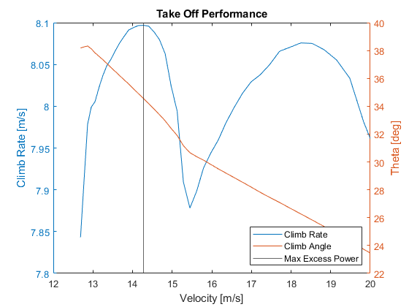
Take Off Performance
D.R. 3.3: Clear a height of 30 meters (Average Blue Spruce tree height)
D.R. 3.4: Clear a takeoff runway of 244 m (Boulder Canyon Drive)
Purpose & Objectives
Design Solution
CPEs
Risks
Design Requirements
Verification & Validation
Project Planning
Notes:
Chris
Excess Power is used to calculate the optimal take-off angle and velocity. By finding the point of max excess power we can find both the velocity and optimal take-off angle. They power available is derived from the propulsion team and power required came from the airfoil and aircraft design.

Slide 32
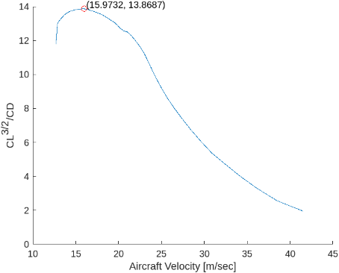
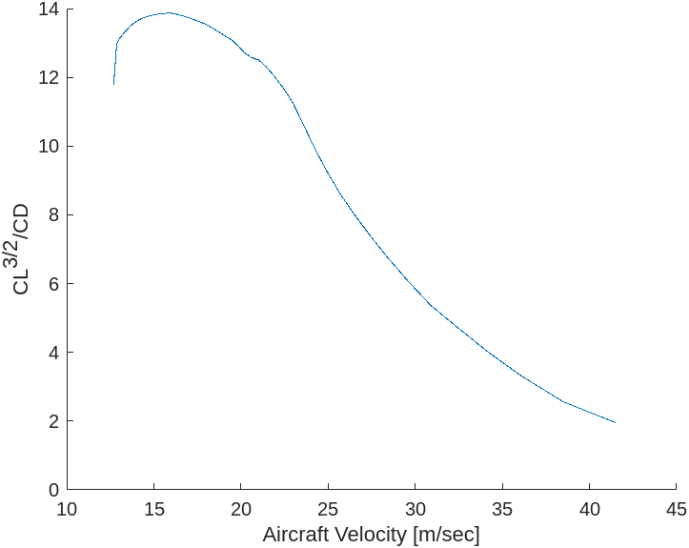
Endurance
D.R. 7.1: Maximize endurance for 4 hours flight time (without autonomous control) at 6,000 ft MSL
Maximize
SLUF Cruise Values
Velocity | 16.0 m/sec
Coefficient of Lift | .83
Angle of Attack | 4𐩑
Purpose & Objectives
Design Solution
CPEs
Risks
Design Requirements
Verification & Validation
Project Planning
Notes:
Chris

Slide 33
Two Engines: Drivetrain Analysis
D.R. 7.1: UAS shall maximize endurance for 4 hours flight time (without autonomous control) at 6,000 ft MSL
Given Aerodynamic Properties
Prop Pwr by Diameter
Diameter
selection for minimized Pwr &
size
Final
Configuration
of Motor+Prop
pitch & Dia
Thrust Per Motor
Pitch Vs Motor Pwr
Pitch Decision
# of Motors
Motor selection for max thrust condition
Motor Pwr & TQ
Purpose & Objectives
Design Solution
CPEs
Risks
Design Requirements
Verification & Validation
Project Planning

Slide 34
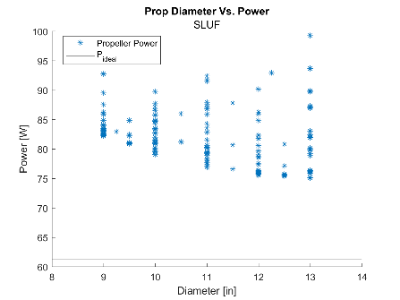
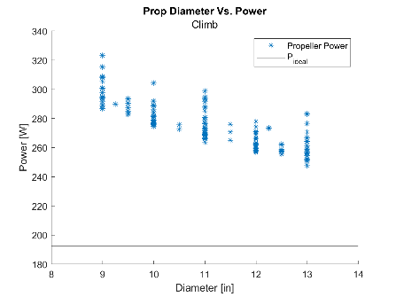
Two Engine Prop Diameter
D.R. 7.1: UAS shall maximize endurance for 4 hours flight time (without autonomous control) at 6,000 ft MSL
Purpose & Objectives
Design Solution
CPEs
Risks
Design Requirements
Verification & Validation
Project Planning
Notes:
These plots show us the prop size and power.
Our goal is to minimize the prop size and power simultaneously.
We chose an 11 in prop for the following reasons:
Power consistently decreases as prop size increases but by having the props on the wings we need to avoid props hitting ground during landing. 11 inch props gives us 2 inches of margin on the props during landing assuming the plane lands with wings level. Error bars excluded but average error for these were about 7 W

Slide 35
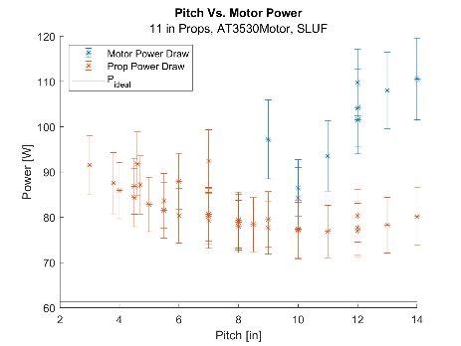
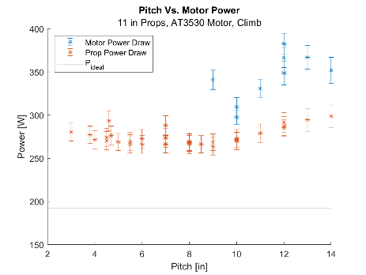
Two Engine Prop Pitch
D.R. 7.1: UAS shall maximize endurance for 4 hours flight time (without autonomous control) at 6,000 ft MSL
Purpose & Objectives
Design Solution
CPEs
Risks
Design Requirements
Verification & Validation
Project Planning
Notes:
Not all propellers have the same performance, even with the same diameter. Prop geometry (namely pitch) affects torque and therefore the motor power required. In general, lower pitch results in less torque in exchange for higher RPM’s, however the motor can only supply so many RPM’s. As a result, this plot has removed the motor power (blue dots) from propellers that require too high RPM’s to maintain thrust and velocity profile. From this, we can see that there are two possible propellers that will provide similar performance: 11x7 and 11x9 props. Since the 11x9 takes ever so slightly less power in SLUF (2 W decrease), it was selected as the prop used.

Slide 36
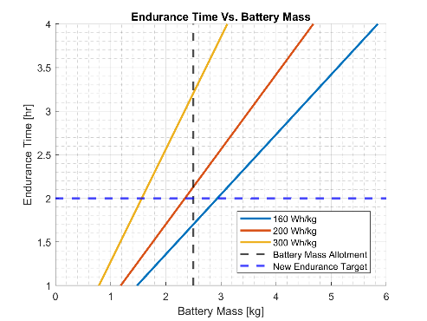
Battery Discussion
D.R. 7.1: UAS shall maximize endurance for 4 hours flight time (without autonomous control) at 6,000 ft MSL
Endurance target of 4 hrs is infeasible with design constraints
Can get close but only with a custom battery
Manufacturability and low cost/COTS was listed as higher priority by requirements
Current battery selection allows for 1.7 ± 0.2 hours of endurance
Purpose & Objectives
Design Solution
CPEs
Risks
Design Requirements
Verification & Validation
Project Planning
Notes:
Mention 80 vs 100% capacity

Slide 37
Functional Requirements
Functional Requirement | Description | Critical Project Element | Satisfied?
F.R. 1 | UAS shall adhere to FAA Part 107 and MIL-F-8785C | CPE 2 | ✔
F.R. 2 | UAS shall be human portable | CPE 2 | ✔
F.R. 3 | UAS shall clear short takeoff and landing areas and be able to deploy with unprepared launch surfaces and obstructed climb windows | CPE 2 | ✔
F.R. 4 | UAS components shall be easily manufacturable, replaceable, or repairable | CPE 3 | Needs further analysis
F.R. 7 | UAS shall provide continuous coverage for the duration of the mission profile | CPE 4 | Needs further analysis
Purpose & Objectives
Design Solution
CPEs
Risks
Design Requirements
Verification & Validation
Project Planning

Slide 38
Verification & Validation

Slide 39
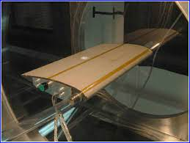
Aerostruct
Wind tunnel testing to verify stall AoA
Video Recorded Glide tests
Longitudinal and Lateral Static Stability
Full scale developmental flight tests
Accelerometer to verify flight envelope
Endurance tests with battery level
Drag profile
Rate of Climb
Turn Performance
Purpose & Objectives
Design Solution
CPEs
Risks
Design Requirements
Verification & Validation
Project Planning
Notes:
Eric

Slide 40
Flight Tests: Develop Drag Profile
Verification & Validation: Flight Tests
Stand Alone Monitors
Camera
GPS Receiver/Pitot Tube
Flight Test
Finite Time at Set Velocity in SLUF condition
Functional and Powered UAS
Flight Test at predetermined alpha and velocity
Land/Collect Data
Determine Drag Profile
Recorded Atmospheric Data
Purpose & Objectives
Design Solution
CPEs
Risks
Design Requirements
Verification & Validation
Project Planning

Slide 41
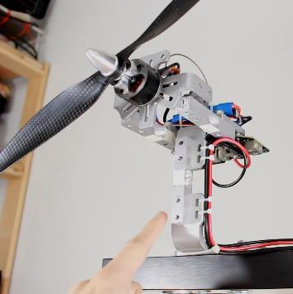
Electromechanical Summary
Verification & Validation
Verification and Validation focused on low-fidelity aspects of our models
Propeller / Motor combination and battery performance
Motor+prop static test planned
Will validate interpolation of motor and propeller data and establish confidence in endurance calculations
Battery discharge test to analyze performance during end phase of flight when battery is drained
Will validate battery capacity for last 20%
Thermal test of battery
Purpose & Objectives
Design Solution
CPEs
Risks
Design Requirements
Verification & Validation
Project Planning
Notes:
Battery discussion here is preliminary and full discussion will be in backup slides?

Slide 42
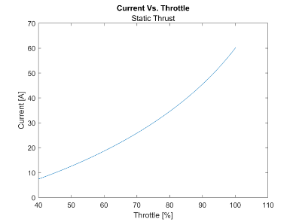
Propulsion Testing: Motor and Prop
Verification & Validation: Motor and Prop
Reason for test:
Validate prop and motor models
Verify thrust per amp model as well as max thrust prediction.
Verify predicted thrust from prop and motor efficiency.
Calibration
Verify Voltage and Amperage for static thrust, in Kg, for Flight controller.
Verification
Is Motor & Prop power draw and efficiency within 10% of model?
Does Motor & Prop test performance meet ACFT requirements?
Does Motor & Prop test meet customer requirements?
Purpose & Objectives
Design Solution
CPEs
Risks
Design Requirements
Verification & Validation
Project Planning

Slide 43
Propulsion Testing: Motor and Prop Testing diagram
Verification & Validation: Motor and Prop
Legend:
Power
Signal
Data
Test Stand
Stand Alone Monitors
Camera
Thermal
Camera
Load Cell
Micro Controller
Power Supply
ESC
Motor & Prop
Voltage & Amperage Sensor
Purpose & Objectives
Design Solution
CPEs
Risks
Design Requirements
Verification & Validation
Project Planning

Slide 44
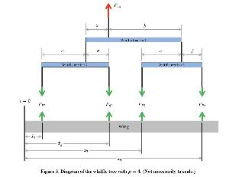
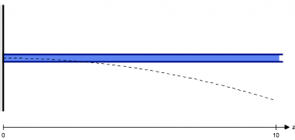
Manufacturing Testing
Whiffletree Test
Validity of Wing
Withstand predicted loadings
Tail Deflection Test
Validity of Tail
Can tail support moments and stresses produced by horizontal and vertical tails.
Strain Gauge Test
Verify Fuselage can support payload and Stresses
Drop Test
Measure Integrity of Structure
Fig a. Whiffletree Testing
Fig b. Wing and Tail Deflections
Purpose & Objectives
Design Solution
CPEs
Risks
Design Requirements
Verification & Validation
Project Planning
Notes:
Whiffletree Test
Here we will test the validity of the wing - if it will be able to withstand the loading we predict.
Tail deflection
Here we will test the validity of the tail - if it will be able to withstand the loading the horizontal and vertical tails will create wrt the Cg.
Strain Gauges
Useful test to to verify the fuselage can support payload and expected forces on it
Drop test
Potential test to test durability of airframe.

Slide 45
Project Planning

Slide 46
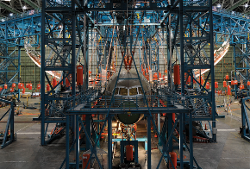
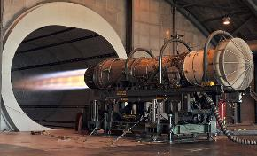
Tests to be conducted
Electromechanical
Static Tests - Pilot/Project
Endurance Testing - Pilot/Project
Aerodynamic
Test Flights: Take-Off
Test Flights:
Verify Lift and Drag Calculations
Manufacturing
Whiffletree Test - Project
Tail Deflection Test - Project/ AES Machine Shop
Purpose & Objectives
Design Solution
CPEs
Risks
Design Requirements
Verification & Validation
Project Planning
Notes:
• How the design will be verified against predictive models through characterization tests
• What model/requirements are you verifying (from design requirements and satisfaction section)
• What are you measuring- include pass/fail criteria if you can
• Key measurement issues (resolution, sampling rate, etc.)
• Describe the test setups, the facilities and equipment, and how the test works
• Show how the selected sensors, instruments, data acquisition, test fixtures, etc. provide the needed data
• How will you know you met the requirement?

Slide 47
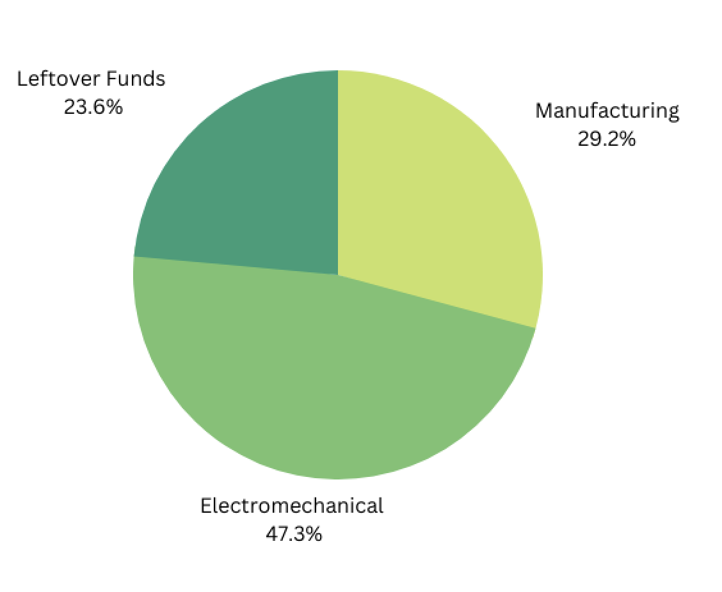
Financials
Total Cost: $3363.73
Included Margin: 10%
Leftover Funds: $636.27
Purpose & Objectives
Design Solution
CPEs
Risks
Design Requirements
Verification & Validation
Project Planning
Notes:
The total estimated cost is $3938
I’ve implemented a ten percent cost margin to account for error
Going forward there is a strong likely hood that 2 of those items, combined around 600$ will not be needed. So there is still wiggle room for unforeseen costs.

Slide 48
Work Plan - Fall
Purpose & Objectives
Design Solution
CPEs
Risks
Design Requirements
Verification & Validation
Project Planning

Slide 49
Work Plan - Spring
Purpose & Objectives
Design Solution
CPEs
Risks
Design Requirements
Verification & Validation
Project Planning

Slide 50
Questions?

Slide 51
Backup Slides

Slide 52
Sources

Slide 53
Project Management,Systems, and CFO
PM:
https://www.denverpost.com/2017/03/20/dry-weather-colorado-human-caused-wildfires/
https://bouldercolorado.gov/guide/boulder-fire-rescue-department-wildland-division
Sys:
CFO:

Slide 54
Project Management

Slide 55
Critical Project Elements - Functional Requirements
F.R. 1: UAS shall adhere to FAA 14 CFR Part 107 and MIL-F-8785C
F.R. 2: UAS shall be human portable
F.R. 3: UAS shall clear short takeoff and landing areas and be able to deploy with unprepared launch surfaces and obstructed climb windows
F.R. 4: UAS components shall be easily manufacturable, replaceable, or repairable
F.R. 5: UAS shall support a payload with a weight ranging from 1.5 - 3 kg
F.R. 6: UAS shall be low-cost with COTS electronics, materials, and machines
F.R. 7: UAS shall provide continuous coverage for the duration of the mission profile
F.R. 8: UAS shall be durable and reliable throughout the mission profile
F.R. 9: UAS shall utilize only open-source or team-developed software for mission critical components
Purpose & Objectives
Design Solution
CPEs
Risks
Design Requirements
Verification & Validation
Project Planning

Slide 56
Design Requirements - Full Table
# | Design Requirement
1 | UAV shall weigh less than 55 lbs UAV shall operate between 5,000 - 10,000 ft MSL
2 | UAS shall be able to fit a volume of 50 cm x 46 cm x 39 cm for storage
3 | UAS shall have a minimum setup time of no longer than 5 minutes UAV shall have a width of no longer than 2.6 m (8.5 ft) UAV shall clear a height of 30 m, the average Blue Spruce tree height in Colorado UAV shall clear a runway of 800 ft
4 | At least 90% of the UAS shall be fully manufacturable, replaceable, or repairable by end user via low-cost, consumer-grade COTS additive manufacturing materials and machines
6 | Utilize only consumer-grade, COTS electronics and/or components for all other required components for a fully operational system
7 | UAV shall maximize aerodynamic efficiency for high endurance with a goal of 4 hours flight time without autonomous flight control optimization of flight trajectory (constant altitude, constant speed orbit) at 6,000 ft MSL altitude.
8 | UAV shall be capable of operational use in winds up to 20 mph at surface during launch and 30 mph at cruise altitude UAV structure must withstand discrete wind gust loads for sharp-edged vertical gusts of 30 ft/s throughout flight envelope UAV shall be capable of day/night/rain/snow operational use UAV shall exhibit both static and dynamic longitudinal and lateral-directional stability naturally UAS shall be capable of sustaining an overall eighty percent (80%) Fully Mission Capable (FMC) rate under Instrument Meteorological Conditions (IMC), in temperature range from -20 degrees to 120 degrees Fahrenheit.
Purpose & Objectives
Design Solution
CPEs
Risks
Design Requirements
Verification & Validation
Project Planning

Slide 57
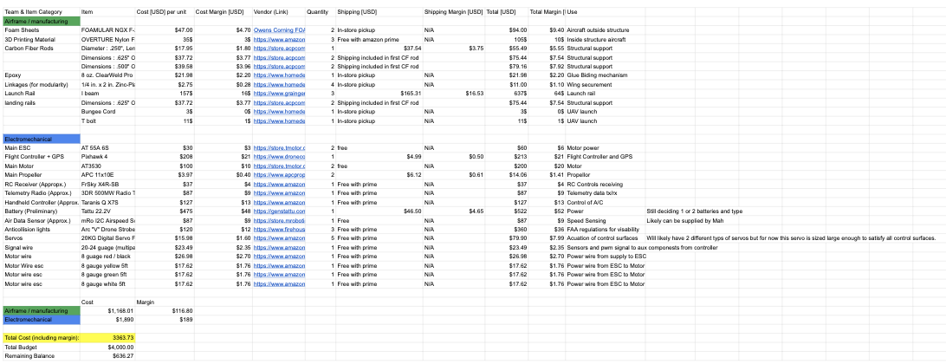
Financials
Total Cost: $3938
Link
Notes:
I’ve implemented a ten percent cost margin to account for error
The total estimated cost is $1005.19
Going forward there is a strong likely hood that 2 of those items, combined around 600$ will not be needed. So there is still wiggle room for things like connectors, hardware, glue, linkages, and unknowns.

Slide 58
Risks

Slide 59
Risk Matrix - Key
Impact |  | Very Low | Low | Medium | High | Very High
Probability | Very High | Moderate | Severe | Severe | Critical | Critical
Probability | High | Sustainable | Moderate | Severe | Critical | Critical
Probability | Medium | Sustainable | Moderate | Moderate | Severe | Critical
Probability | Low | Sustainable | Sustainable | Moderate | Severe | Critical
Probability | Very Low | Sustainable | Sustainable | Sustainable | Moderate | Severe
More Information
Purpose & Objectives
Design Solution
CPEs
Risks
Design Requirements
Verification & Validation
Project Planning

Slide 60
Possible Risk
Unique ID | Risk Description | Caused by & Consequences | Risk Owner(s) Name and Role | Probability | Impact
1 | Wing Break | Crash or Landing Impact | Manufacturing Team | High | High
2 | Landing Gear Failure | Breaking off at Landing | Manufacturing Team | Low | Medium
3 | Wing Loading Failure | Lift produced breaks wing | Manufacturing Team | Very Low | High
4 | Underestimated Drag Polar | Lowers Endurance due to increased drag | AeroStruct Team | High | Medium
5 | Overestimated Alpha Stall | Lowers available angle of attacks to generate lift | AeroStruct Team | Medium | Medium
6 | Battery Overheat/Combustion | Adverse chemical reaction due to battery damage or improper ventilation | ElectroMechanical | Low | Very High
7 | Wiring Disconnection | Forceful disconnection or user error | ElectroMechanical | Low | Low
8 | Battery Depletion | Overuse for given endurance time or underestimated battery calc | ElectroMechanical | Medium | Medium
9 | Flight Controller Failure | Vibration, short circuit, software error | ElectroMechanical | Low | Medium
Purpose & Objectives
Design Solution
CPEs
Risks
Design Requirements
Verification & Validation
Project Planning

Slide 61
Risk Matrix - Before Controls
Impact |  | Very Low | Low | Medium | High | Very High
Probability | Very High
Probability | High |  |  | 1 | 1
Probability | Medium |  |  | 2
Probability | Low |  | 1 | 2 |  | 1
Probability | Very Low |  |  |  | 1
Purpose & Objectives
Design Solution
CPEs
Risks
Design Requirements
Verification & Validation
Project Planning

Slide 62
Possible Risk
Unique ID | Control(s) Name and Role | Residual Probability | Residual Impact | Residual Risk Rating
1 | Whiffletree Test | Medium | Medium | Moderate
2 | Drop Testing to see landing legs survivability | Medium | Low | Moderate
3 | Whiffletree Test | Low | Low | Sustainable
4 | Live flight testing | Low | Low | Sustainable
5 | Wind-Tunnel and Live Flight tests | Low | Low | Sustainable
6 | Thermal Testing for adequate ventilation and containment | Low | Medium | Moderate
7 | Preflight checks, simple design, and two person verification on assembly | Very Low | Very Low | Sustainable
8 | Full flight mission endurance test and max power testing | Low | Medium | Moderate
9 | Preflight test and redunancy in system | Low | Low | Sustainable
Purpose & Objectives
Design Solution
CPEs
Risks
Design Requirements
Verification & Validation
Project Planning

Slide 63
Risk Matrix - After Controls
Impact |  | Very Low | Low | Medium | High | Very High
Probability | Very High
Probability | High
Probability | Medium |  | 1 | 1
Probability | Low |  | 4 | 2
Probability | Very Low | 1
Purpose & Objectives
Design Solution
CPEs
Risks
Design Requirements
Verification & Validation
Project Planning

Slide 64
Design Requirement

Slide 65
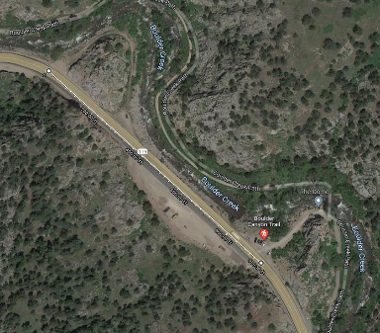
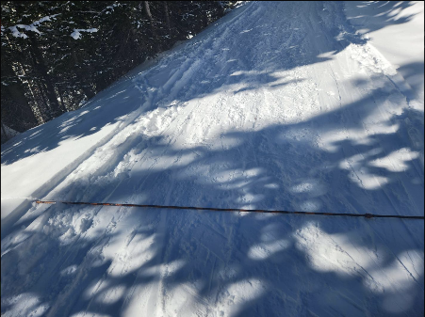
Boulder Canyon Drive and Trail Head
Notes:
Figure on right is example of forest service road on Jones Pass. Width of road tread is ~3m with ~1m of shoulder on either side. Probe length here is 270 cm

Slide 67
V and V

Slide 68
Validation Planning
CARROT Subsystem | Test | Validation | Functional Requirement FR | Scheduled time As soon as:
Aerodynamics | SMEAD Wind tunnel test | Validate 3D Wing Forces | 7 | Jan 15, 2022
Whole UAS | Preliminary Whole System Flight Test | Validate Flight Characteristics | 7 | April 15, 2022
Manufacturing | Whiffletree Test | Validate Wing Loading Criteria | 8 | Feb 7, 2022
Manufacturing | Tail Deflection Test | Validate Resistance to Deflection | 8 | Feb 7, 2022
Manufacturing | Wind Gust and Payload | Validate the UAS can withstand Payload | 5 | Feb 7, 2022
Notes:
• How the design will be validated against functional requirements and overall project success criteria (Levels of Success)
• Day in the life/demos

Slide 69
Aero

Slide 70
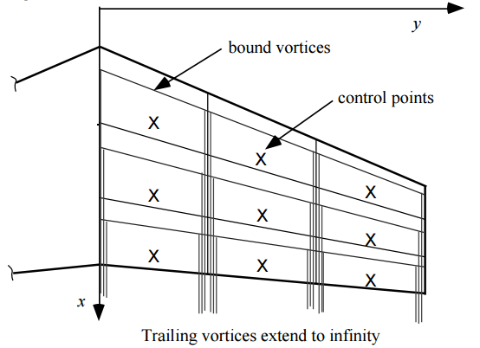
Aero Back up
Design Requirements - Endurance
Method: Potential Flow HorseShoe Vortex Panel Method at a Constant Lift
Assumptions
Incompressible
Inviscid
Irrotational
Thin Lifting Surfaces
Limitations
Cannot calculate viscous drag
Flow is steady
Purpose & Objectives
Design Solution
CPEs
Risks
Design Requirements
Verification & Validation
Project Planning

Slide 71
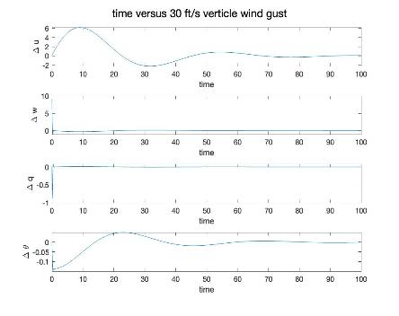
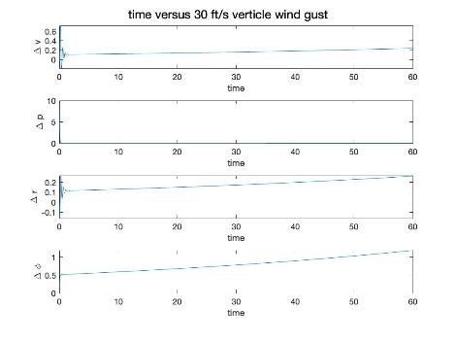
Aero Back up
Design Solution - Design Stability
Longitudinal Stability
Lateral Stability
Purpose & Objectives
Design Solution
CPEs
Risks
Design Requirements
Verification & Validation
Project Planning

Slide 72
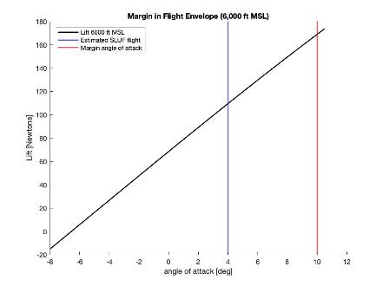
Margin in Flight
D.R. 7.1: Maximize endurance for 4 hours flight time (without autonomous control) at 6,000 ft MSL
Flight envelope designed with margin to generate more lift based on uncertainty in variables
Atmospheric temperature
Higher Aircraft weight than expected
Higher altitudes
Purpose & Objectives
Design Solution
CPEs
Risks
Design Requirements
Verification & Validation
Project Planning
Notes:
Chris

Slide 73
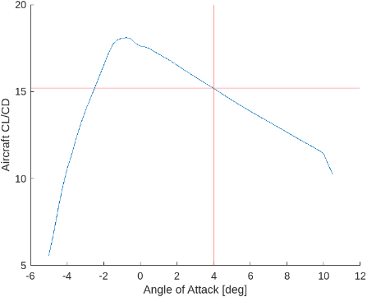
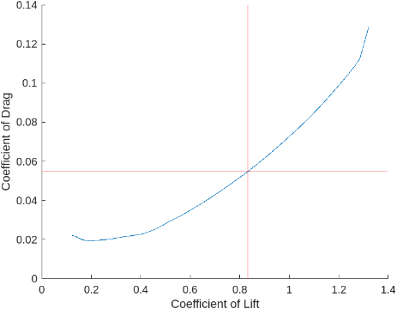
Aero Back up
Design Requirements - Performance
Purpose & Objectives
Design Solution
CPEs
Risks
Design Requirements
Verification & Validation
Project Planning

Slide 74
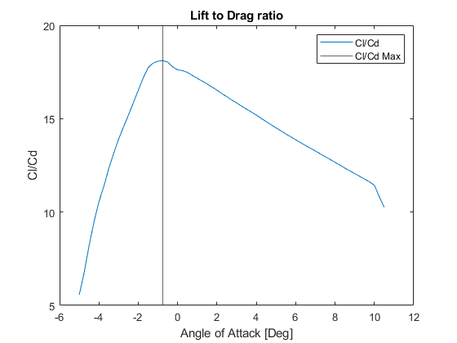
Design Requirements - Take Off Performance (FR3)
Notes:
During flight we would like to optimize the flight conditions by flying at an orientation that would minimize the required thrust. We can calculate the thrust required at each point with the Airfoild data and we can determine that point that would minimize the thrust required would be to find the ratio point where CL/CD is the largest. This point would put is at an angle of attack of -.75 degrees.

Slide 75
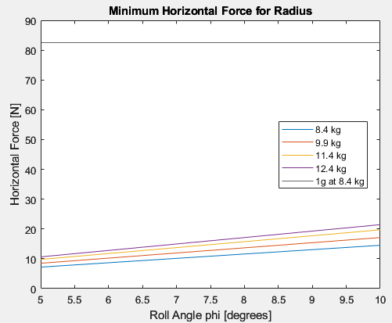
Design Requirements Aero Structure (FR5)
Loiter phase
5- 10 deg roll angle
Velocity 16 m/s
Max C_L = 1.5
Mass [kg] | Coefficient of Lift
8.4 | .6198
9.9 | .7305
11.4 | .8411
12..4 | .9149
Notes:
The airframe was originally designed with a 12.4 mass budget. As we refined our budget we were able to calculate the CL needed as we loiter at different mass configurations. At a 10 deg turn orientation the max CL we would need is .9149 out of a maximum possible 1.5. At our greatest mass configuration the maximum horizontal forces created during or circular track would only be about 20N.

Slide 76
Aero Back up
Design Requirements - Wing
NACA 4412
Thickness (12%)
Max Camber (4%)
NACA 4415
Thickness (15%)
Max Camber (4%)
NLF(1)0212 (Low Speed)
Thickness (12%)
Max Camber (4%)
NLF(1)0215 (Low Speed)
Thickness (15%)
Max Camber (4%)
Purpose & Objectives
Design Solution
CPEs
Risks
Design Requirements
Verification & Validation
Project Planning

Slide 77
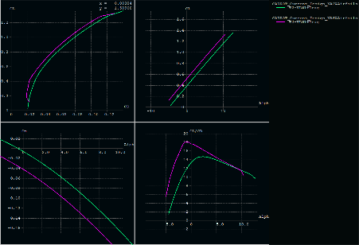
Aero Back up
Design Solution - Airfoil Wing Comparison
Vortex Lattice Method Whole Aircraft (Horseshoe Vortex)
Purpose & Objectives
Design Solution
CPEs
Risks
Design Requirements
Verification & Validation
Project Planning

Slide 78
Aero Back up
Design Solution - Control Surfaces
Aircraft Design: A Conceptual Approach Raymer
Purpose & Objectives
Design Solution
CPEs
Risks
Design Requirements
Verification & Validation
Project Planning

Slide 79
Aero Back up
Design Solution - Ailerons
Area: .032m^2
Purpose & Objectives
Design Solution
CPEs
Risks
Design Requirements
Verification & Validation
Project Planning

Slide 80
Aero Back up
Design Solution - Elevator
Area: .044m^2
Purpose & Objectives
Design Solution
CPEs
Risks
Design Requirements
Verification & Validation
Project Planning

Slide 81
Aero Back up
Design Solution - Rudder
Area: .031m^2
Purpose & Objectives
Design Solution
CPEs
Risks
Design Requirements
Verification & Validation
Project Planning

Slide 82
Aero Back up
Design Solution - Empennage
Aircraft | Horizontal Tail Volume Coef | Vertical Tail Volume Coef
CARROT | .26 | .01182
TALON | .4 | .02
Sailplanes✞ | .5 | .02
GA Twin Engine✞ | .80 | .07
✞ Typical Values Obtained from Aircraft Design: A Conceptual Approach
Purpose & Objectives
Design Solution
CPEs
Risks
Design Requirements
Verification & Validation
Project Planning

Slide 83
Manufacturing

Slide 84
Design Overview - Modularity
Purpose & Objectives
Design Solution
CPEs
Risks
Design Requirements
Verification & Validation
Project Planning

Slide 85
Material Trades
Weights and Cross-Sectional Areas

Slide 86
Material Trades - Weight
Aircraft Dimensions
Volume
Dimensions
Vary Weight
Depending on Material
Conclude Material Per Aircraft Part

Slide 87
Material Trades - Cross Section & Cost
Forces on Aircraft
Stresses
Moments
Find Cross Sectional Area
Area needed to sustain moments and forces.
Notes:
These are the required minimum cross sections in order to meet the strength cases composed. Worst case scenario

Slide 88
Interior Aircraft Dimensions
Element | Size [m]
Rib Spacing | 0.3048
Rib Thickness | 0.0127
Aluminum Shell Thickness | 0.003175
Print Shell Thickness | 0.00635
Print Infill | 0.00762
Carbon Fiber Outer Radius | 0.00635
Carbon Fiber Inner Radius | 0.003175
Number of Spars [unitless] | 2
Foam Shell Thickness | 0.0254

Slide 89
F.R. 5 and 6
Payload, Cost and COTS

Slide 90
Payload Housing Capable
UAS has a volume capacity of 0.50 ft³ surpassing the [x] payload volume, and even the heaviest payload scenario (3kg) can be supported by structure design. → Can we prove this Kushal?
Functional Requirement 5
UAS shall support a payload with a weight ranging from 1.5 - 3 kg
Fig. - Volume of Fuselage - 0.50 ft³
Purpose & Objectives
Design Solution
CPEs
Risks
Design Requirements
Verification & Validation
Project Planning
Notes:
Show CAD of payload and battery inside fuselage
Add calcs for fuselage

Slide 91
Hybrid: Carbon Fiber + Foam
Functional Requirement 6
Low Cost
Element | Inner Radius [mm] | Outer Radius [mm]
Carbon FIber Rods | 6.35 | 7.94
Purpose & Objectives
Design Solution
CPEs
Risks
Design Requirements
Verification & Validation
Project Planning
Notes:
After stress analysis, A hybrid design will satisfy flight requirements.
Hybrid deflection is similar to that of full carbon fiber.
The hybrid design solution is composed of 80% foam and 20% carbon fiber.
Hybrid materials will provide for optimal strength weight and strength cost ratios.
We Assume that both materials combine to be a homogeneous compound - therefore, transferring load equally.

Slide 92
FR6 - Cost Effective & Easy to find parts
Easy to Find Parts
Local Home Depot stores 45% of building components.
Remaining parts can be easily ordered and shipped to an address.
Best Prices.
Functional Requirement 6
COTS
Purpose & Objectives
Design Solution
CPEs
Risks
Design Requirements
Verification & Validation
Project Planning
Notes:
FR6 is satisfied by our material and manufacturing choices. Show why the CF and EPS selection is cheap and while still meeting strength and weight requirements.

Slide 93
Hybrid: Carbon Fiber + Foam
Functional Requirement 6
Low Cost
Element | Inner Radius [mm] | Outer Radius [mm]
Carbon FIber Rods | 13.08 (.515 “) | 15.88 (.625 “)
Purpose & Objectives
Design Solution
CPEs
Risks
Design Requirements
Verification & Validation
Project Planning
Notes:
After stress analysis, A hybrid design will satisfy flight requirements.
Hybrid deflection is similar to that of full carbon fiber.
The hybrid design solution is composed of 80% foam and 20% carbon fiber.
Hybrid materials will provide for optimal strength weight and strength cost ratios.
We Assume that both materials combine to be a homogeneous compound - therefore, transferring load equally. – For this reason we can present this as a source of error, since we know it could not be a perfect compound.
This also goes for any deflection or stress calculation – The materials could be weaker than the ideal formals we are using (due to lattice imperfections) for this reason we can present our results as

Slide 94
Equations
Used for Stresses and Deflections

Slide 95
FC 1: Wing Bending Deflection - Equations
Bending Deflection
Depends on Material Properties
E - Elastic Young’s Modulus
I - Area Moment of Inertia
Depends on Load
Thrust to Weight Ratio = 1.2
Dependant on Wing Length
Notes:
To find the wing benign deflection for each material, we took into account the material properties ( elastic modulus and area moment of inertia), thrust to weight ratio, and wing length

Slide 96
F1: Compressive Stress - σ
Compressive Stress
Reduce Distributed Load
Single Point Force, SPF.
Locate SPF at center of wing
Solve for Compressive Stress
Notes:
Good,
To calculate bending stresses we need to have a moment, distance away from neutral axis, Y - and the moment of inertia for the object.
Still approximating the wing as a rectangular prism beam, we can find the compressive stress.
NOTE this is the compressive stress on one wing only, at the root.
Next FC2 - SLUF

Slide 97
F.R. 8
Maintaining Durability

Slide 98
Forces and Stresses Found on UAS
Flight Phase # | Flight Phase
1 | Takeoff
2 | Steady Level Unaccelerated Flight (SLUF)
3 | SLUF with Wind/Disturbances
4 | Loiter
5 | Crash
Purpose & Objectives
Design Solution
CPEs
Risks
Design Requirements
Verification & Validation
Project Planning
Notes:
We looked into 5 flight cases to determine the stresses found on the UAV
Takeoff, SLUF, SLUF plus wind gust, loiter, and crash

Slide 99
FP 1: Takeoff - Wing Bending Deflection
Parameter
Lift Force of 214 Newtons distributed through wings.
Plot: Varying Force Location about Cg_{x} Wing
Purpose & Objectives
Design Solution
CPEs
Risks
Design Requirements
Verification & Validation
Project Planning
Notes:
These are the bending deflection results during takeoff
We considered 5 materials, aluminum, carbon fiber, EPS foam, extruded foam, and nylon.
Aluminum and Carbon Fiber rank similarly, with the least amount of deflection
Extruded foam deflects the most, this is expected, as foam possesses the lowest yield strength and elastic modulus.

Slide 100
FP 1: Takeoff - Wing Bending Deflection
Parameter
Lift Force of 214 Newtons distributed through wings.
Plot: Varying Force Location about Cg_{x} Wing
Purpose & Objectives
Design Solution
CPEs
Risks
Design Requirements
Verification & Validation
Project Planning
Notes:
These are the bending deflection results during takeoff
We considered 5 materials, aluminum, carbon fiber, EPS foam, extruded foam, and nylon.
Aluminum and Carbon Fiber rank similarly, with the least amount of deflection
Extruded foam deflects the most, this is expected, as foam possesses the lowest yield strength and elastic modulus.

Slide 101
FP 2 & 3: SLUF & SLUF + Wind Gust
SLUF
Wind
SLUF & Wind Gust
Maximum Load Type | Result | Location From Root Chord [m]
Distributed Load | 63.79 [N/m] | Through Wing
Bending Moment | 28.20 [Nm] | At Root of the wing
Shear Force | 60 [N] | At Root of the wing
Table: Maximum Forces FP 2
Plot: Varying Force Location about Wing Length
Purpose & Objectives
Design Solution
CPEs
Risks
Design Requirements
Verification & Validation
Project Planning
Notes:
In SLUF flight, we calculated the distributed load throughout the wing, as well as the bending moment and shear force.
The distributed load on wing is placed at the center of the wing
The bending moment and shear force are shown in the corresponding graphs,
With the maximum forces occuring at the root of the wing
Sluf plus wind
The wind gust case Builds off of the previous SLUF calculations
To account for the wind gust, we incorporate a 9.14 m/s wind gust on a single wing.
We calculated the bending deflection per material,
The deflection angles under wind gust stress analysis are much larger than those in take off , ranging from 0 to 44 degrees
The material trends mimic the previous sluf results, with carbon fiber deflecting the least, and extruded foam deflecting the most.

Slide 102
FP 2 & 3: SLUF & SLUF + Wind Gust
SLUF
Wind
SLUF & Wind Gust
Maximum Load Type | Result | Location From Root Chord [m]
Distributed Load | 63.79 [N/m] | Through Wing
Bending Moment | 28.20 [Nm] | At Root of the wing
Shear Force | 60 [N] | At Root of the wing
Table: Maximum Forces FP 2
Plot: Varying Force Location about Wing Length
Purpose & Objectives
Design Solution
CPEs
Risks
Design Requirements
Verification & Validation
Project Planning
Notes:
In SLUF flight, we calculated the distributed load throughout the wing, as well as the bending moment and shear force.
The distributed load on wing is placed at the center of the wing
The bending moment and shear force are shown in the corresponding graphs,
With the maximum forces occuring at the root of the wing
Sluf plus wind
The wind gust case Builds off of the previous SLUF calculations
To account for the wind gust, we incorporate a 9.14 m/s wind gust on a single wing.
We calculated the bending deflection per material,
The deflection angles under wind gust stress analysis are much larger than those in take off , ranging from 0 to 44 degrees
The material trends mimic the previous sluf results, with carbon fiber deflecting the least, and extruded foam deflecting the most.

Slide 103
FP 4: Loiter - Wing Loading on UAS
Wing | Compressive Stress [kN/m²] σ
Upper Wing | 10.67
Lower Wing | 23.48
Total | 34.15
Loiter Radius [meters] | Velocity [meters/second] | Roll Angle [degrees]
148 | 16 | 10
Plot: Loiter Radius Vs. Roll Angle
Purpose & Objectives
Design Solution
CPEs
Risks
Design Requirements
Verification & Validation
Project Planning
Notes:
In loiter conditions, the lower wing Experiences higher Wing Loading and Compressive stress
The lowest point of the lower wing will have the highest lift force, which correlates to a higher stress on the wing.
We Looked at velocity and roll angle to determine loiter radius .
This radius will allow the plane to maintain altitude at chosen velocity and roll angle values.

Slide 104
FP 5: Crash Forces
Common Tree Type in Colorado: Blue Spruce
Average Height : 30 [m]
Parameter | Value
Mass [kg] | 11.46
Vertical Velocity [m/s] | 24.24
Horizontal Velocity [m/s] | 16.00
F_{impact Vertical} [kN] | 33.69
F_{impact Horizontal} [kN] | 14.67
Table: Work and Energy relationship - Impact Force
Purpose & Objectives
Design Solution
CPEs
Risks
Design Requirements
Verification & Validation
Project Planning
Notes:
Crash forces were analyzed by utilizing the most common type of tree in the state of colorado, the blue spruce, at an average height of 30 meters
We solved for the horizontal and vertical impact forces by applying the work energy theorem with a .1 meter deflection
The maximum impact force the UAV will see is from a vertical crash, at 33.69 Kilonewtons.
Work and energy relations - assuming 0.1 m for the displacement (W = FxD)
0.1 m distance travelled after impact.

Slide 105
Stresses - All Flight Conditions
Functional Requirement 8
Flight Case | Compressive Stress [kN/m²] σ | Compressive Stress [lbf/in²] σ
Takeoff - Climb | 260.44 | 37.77
SLUF | 72.69 | 10.54
SLUF + Wing Gust | 81.06 | 11.75
Loitering - Top Wing | 10.67 | 1.55
Loitering - Bottom Wing | 23.48 | 3.40
Table: Stresses found per Flight Case
Purpose & Objectives
Design Solution
CPEs
Risks
Design Requirements
Verification & Validation
Project Planning
Notes:
This is a summary of compressive stresses the UAV will endure throughout the flight.
Takeoff experiences the highest compressive stress
Loitering experiences the lowest compressive stress
We satisfy FR 8 ( maintaining durability) by designing the UAV to withstand the maximum stress encountered.

Slide 106
Stresses - Tail
Flight Case | Compressive Stress [kN/m²] σ | Compressive Stress [lbf/in²] σ
Takeoff - Climb | 579.09 | 83.98
SLUF + Wing Gust | 16.53 | 2.39

Slide 107
Wing Strut Verification
Strut Outer Diameter (in) | 0.625in
Strut Inner Diameter (in) | 0.5in
Strut Moment Area of Inertia (in^4) | .00441
Moment Applied (in.lb) | 307
Distance from Neutral Axis (in) | 1.5
Expected Tensile Stress (PSI) | 104,000
Allowable Tensile Stress (PSI) | 240,000

Slide 108
Tail Strut Verification
Strut Outer Diameter (in) | 0.5in
Strut Inner Diameter (in) | 0.25in
Strut Moment Area of Inertia (in^4) | .00287
Moment Applied (in.lb) | 225
Distance from Neutral Axis (in) | .5
Expected Tensile Stress (PSI) | 19,600
Allowable Tensile Stress (PSI) | 240,000

Slide 109
Flight Condition 1: Takeoff - Horizontally Positioned UAS
Determine Center of Gravity (Cg) location.
For prelelimatry assumptions, Cg is placed at quarter chord of the wings.
Cg_{x} = 0.0000 m [from origin]
Cg_{y} = 0.2520 m [from origin]
Origin is at UAS nose tip
Assuming Four Engines Provide Thrust to Lift UAS.
Symmetrically positioned on each wing.
Moment = Force x Distance
Notes:
new Cg due to dimensions

Slide 110
Flight Condition 2
Steady Level Unaccelerated Flight

Slide 111
FC 2: Steady Level Unaccelerated Flight
In Steady Level Unaccelerated Flight (SLUF), the following forces have the following relations:
Lift = Weight
Drag = Thrust
Lift and Drag constitute the aerodynamics forces
Lift supports the weight
Thrust Counteracts drag
Aircraft linear and angular velocity are constant in a body-fixed reference frame
Sum of forces = 0 in two perpendicular directions
Angle of attack, α, is very small
cos(α) ~ 1
Our Results show that (for 1 UAS)
Mass of Aircraft = 11.46 [kg] ~ 25.26 lbs
Weight of Aircraft = (11.46[kg]) x (9.81 [m/s²]) = 112.44 [N]

Slide 112
FC 2: SLUF Results
Table 2: Maximum Forces FC 2
Distributed Load
Distributed load on wing can be placed to be at center of wing.
Bending Moment
Highest bending results at root of wing.
Expected
Shear Force
Highest shear force results at root of wing.
Expected
Maximum Load Type | Result | Location From Root Chord [m]
Distributed Load | 63.79 [N/m] | Through Wing
Bending Moment | 28.20 [Nm] | At Root of the wing
Shear Force | 60 [N] | At Root of the wing
Notes:
These are the new resultant Loads in SLUF conditions
GOOD

Slide 113
FC 2: SLUF Results
Notes:
Assume that lift is only produced by the wings - this is only one wing minus radis
How would these results change if there was a wind gust? Lets find out in FC3

Slide 114
Flight Condition 3
Wind Gust
Notes:
In this FC, we build off SLUF FC2 —
Next slide

Slide 115
Flight Condition 3: Wind Gust
Building off Case 2
From SLUF conditions
Add 9.14 m/s wind gust on single wing.
Find bending deflection per material, and bending moments.
Notes:
We will add a required 9.14 m/s wind gust on a single wing to see how the effects of it.
Next step

Slide 116
FC 3: Equations
Cantilever Beam: Concentrated Load P at any Point
Slope at Free End:
Where I_{x} is
Variable | Description
θ | Slope at Free end
P | External Applied Load
a | Distance to Load from Root
E | Elastic Modulus of Material
I | Area Moment of Inertia
Deflection Angle:
Notes:
These are some of the equations we will use, for finding the deflection angle.
Next slide

Slide 117
FC 3: Equations
Cantilever Beam: Concentrated Load P at any Point
To calculate the wind-loading on the wing , we use:
F = P ᐧ A ᐧ C_{D}
Where P is the wind pressure calculated as (SI Units)
P = 0.631 ᐧ V ²
A, is the area that the wind is acting upon.
A = Wing Baseᐧ Wing Width
C_{D}, is the coefficient of drag of the wing.
C_{D} = 0.2568
Notes:
Good
The most important step
Turn Wind on Area —> force

Slide 118
FC 3: Results
Results
Same trend as VTOL case 1.
Notes:
Good
These are the results – we can see the deflection engles here are much larger than those in in take off
Which ranged from 0 - 12 – here 0 - 55 deg
Lets move on to bending stress

Slide 119
Flight Condition 4:
Loitering Section
Notes:
In this section we will talk about the the loitering flight section - we will determine the loiter radius, roll angle, and velocity to sustain the turn as well.

Slide 120
FC 4: Loiter Radius in relation to Velocity and Roll Angle
Velocity and turning angle from Loiter Radius.
Begin with F.B.D. sketch.
Assumptions
Find governing equations
Solve/Solution
Notes:
To find loitering radius, velocity, and roll angle we went through this 4 steps.
Lets go through it - beginning with FBD

Slide 121
FC 4: Free Body Diagram
Top View of Airplane in level turn
Front View of Airplane in Level turn
Begin with visual representation of problem.
Notes:
FBD containing typical banked turn
we can see the forces that will result from this maneuver
The forces will help find distributed loads - but first - lets discuss the assumptions

Slide 122
FC 4: Assumptions
Steady, Unaccelerated, Level Flight (SLUF)
Constant Altitude
Constant Velocity
Circular Path
Perfect circular turn - at edges,
Optimizes Flight Endurance
No External Forces
Strong Wind
Assumptions
Notes:
We

Slide 123
FC 4: Equations
The bank angle φ and the lift L are such that the component of the lift in the vertical direction exactly equals the weight:
The resultant of L and W leads to a resultant force Fr, which acts in the horizontal plane. This resultant force is perpendicular to the flight path
Introduce “load factor” which means how many g’s act on the aircraft in any given maneuver.
From the previous equations, in a circular flight path at velocity V∞, the radius R can be equated below,
Equations
Notes:
From the FBD and assumptions
We get this equations
Lift - Forces - Radius - and Velocity
Next slide has our progress.

Slide 124
FC 4: Loiter Radius in relation to Velocity and Roll Angle
Velocity and turning angle from Loiter Radius.
Begin with F.B.D. sketch.
Assumptions
Find governing equations
Solution
Notes:
At this point we know forces, assumptions, and equations, so lets start solving.

Slide 125
FC 4: Velocity, Roll Angle, and Velocity Results
Loiter Radius of ~ 148 meters.
Velocity: 30 mph ~ 13.4 [m/s].
Roll Angle: 10 degrees.
Loiter Radius [meters] | Velocity [meters/second] | Roll Angle [degrees]
148 | 16 | 10
Solution
Notes:
Good
We know the aircraft will have to fly at 30 mph ~ 13.4 m/s

Slide 126
FC 4: Radius of Loiter Section?
Compared to ASEN Building
148 m ~ 485 feet

Slide 127
FC 4: Loitering Radius at Chautauqua Park - Conclusion
Conclusion
The selected loitering radius is achievable with the values in the table to the right.
The circular shape allows for winds/gust to be spread evenly - even though, better control system could adjust orientation of UAS for better flight endurance.
Loiter Radius [meters] | Velocity [meters/second] | Roll Angle [degrees]
148 | 16 | 10

Slide 128
Electro-Mechanical
Back up

Slide 129
Minimum Power Required
D.R. 7: UAS shall maximize endurance for 4 hours flight time (without autonomous control) at 6,000 ft MSL
EOM Thrust for SLUF
Assumptions:
Aircraft Frame
No Z-forces
Constant Velocity
Thrust Acts on A/C X-axis
SLUF Thrust: 1.51 [kg]
Notes:
Sluf thrust eff is relatively consistent across different motor and prop configurations, Therefore the deciding factor in motor selection from a thrust perspective comes from the max thrust condition in climb. Single motor configurations do not allow for any significant margin.
These are the thrust values for SLUF and CLIMB ______.

Slide 130
SLUF Thrust Calculation
EOM Thrust for SLUF
Assumptions:
Aircraft Frame
No Z-forces
Constant Velocity
Thrust Acts on A/C X-axis
SLUF Thrust: 1.51 [kg]
T = Thrust
D = Drag
L = Lift
W = Weight
Notes:
Sluf thrust eff is relatively consistent across different motor and prop configurations, Therefore the deciding factor in motor selection from a thrust perspective comes from the max thrust condition in climb. Single motor configurations do not allow for any significant margin.
These are the thrust values for SLUF and CLIMB ______.

Slide 131
Climb Thrust Calculation
EOM Thrust for Climb
Assumptions:
Aircraft Frame
No Z-forces
Constant Velocity
Climb Thrust: 2.12 [kg] (ideal climb?)
T = Thrust
D = Drag
L = Lift
W = Weight
𝛼 = Angle of Attack

Slide 132
Two Engine Motor Selection: Torque-Power Curve
D.R. 7: UAS shall maximize endurance for 4 hours flight time (without autonomous control) at 6,000 ft MSL

Slide 133
Two Engine Motor selection: motor tq power curve
Configuration Specs:
Power Draw @ max climb : 595.4 W
Power Draw @ SLUF : 168.6 W
Power Draw @ Loiter: TBD (need loiter profile)
Power Draw @ Take-Off: TBD (need takeoff profile)
Notes:
Does not include ESC efficiency

Slide 134
Endurance by Configuration
D.R. 7: UAS shall maximize endurance for 4 hours flight time (without autonomous control) at 6,000 ft MSL
Notes:
This process was repeated for 4 total configurations: one with a single 18 inch prop, and two additional single prop, 11x9 prop with different motor combinations. The result of this showed that a two motor, 11x9 prop combination allowed for the greatest endurance, with a 12.84% increase over the single motor combination.

Slide 135
Power Draw by Configuration
D.R. 7: UAS shall maximize endurance for 4 hours flight time (without autonomous control) at 6,000 ft MSL

Slide 136
Change in Power From 1 Motor
D.R. 7: UAS shall maximize endurance for 4 hours flight time (without autonomous control) at 6,000 ft MSL
Notes:
This process was repeated with 3 additional configurations: 1 single motor configuration and two additional 2 motor configurations. Here the two motor configurations are compared with the single motor configuration. All other two motor configurations use the same prop selection as it was found to be ideal in these scenarios and the single motor configuration uses an 18x8 prop. These plots show that the two motor configuration with an AT3530 motor minimizes the power required in SLUF and only adds a small amount of power in climb.

Slide 137
Power Derivation

Slide 138
Single Engine Drivetrain: Final selection
Motor: AT5220-B 20-25CC
https://store.tmotor.com/goods.php?id=949
Propellor: LP18080
https://www.apcprop.com/product/18x8/
Motor Max thrust / Power
6.7kg @1.9Nm
1680 W (Static)
Rated for 2200 @ 3min

Slide 139
Propulsion Testing Preliminary Summary of Equipment
Verification & Validation: Motor and Prop
D.R. 7: UAS shall maximize endurance for 4 hours flight time (without autonomous control) at 6,000 ft MSL
Test Stand Hardware | Motor Hardware | Software “options” | Misc
Test stand | Motor | Labview | Camera
Motor to stand Fixture (Custom Built or Printed) | Prop | Matlab (for arduino) | Thermal Camera
Attaching Hardware | ESC | Arduino IDE
Load Cell | Wires & Connectors
Power Supply
Micro Controller (Arduino)

Slide 140
Propulsion Testing: Battery Endurance
Verification & Validation: Motor and Prop
Reason for test:
Validate
Max endurance in Loiter configuration
System resistance to compute effective voltage vs Draw in all flight regimes
Calibration
Determine time till cutoff voltage
Cutoff voltage: Function of Max system Amps
Verification
Determine deviation from manufacturer's specifications
Capacity at rated C rate

