Slide 1
Group 20: Semi-Autonomous Imaging Land Rover (SAILR)
Preliminary Design Review
Robert Beddome, Krystal Horton, Sam Stewart, Luke Roberson, Skyler Schull, Trevor Reed,
Luca Barton, Chris Nylund, Aidan Jones, Caleb Bristol, Noah Freeland, Suphakan Sukwong
Project Sponsor: Barbara Streiffert
Project Advisor: Dr. Rafi
** Emphasized names correspond to presenting members

Slide 2
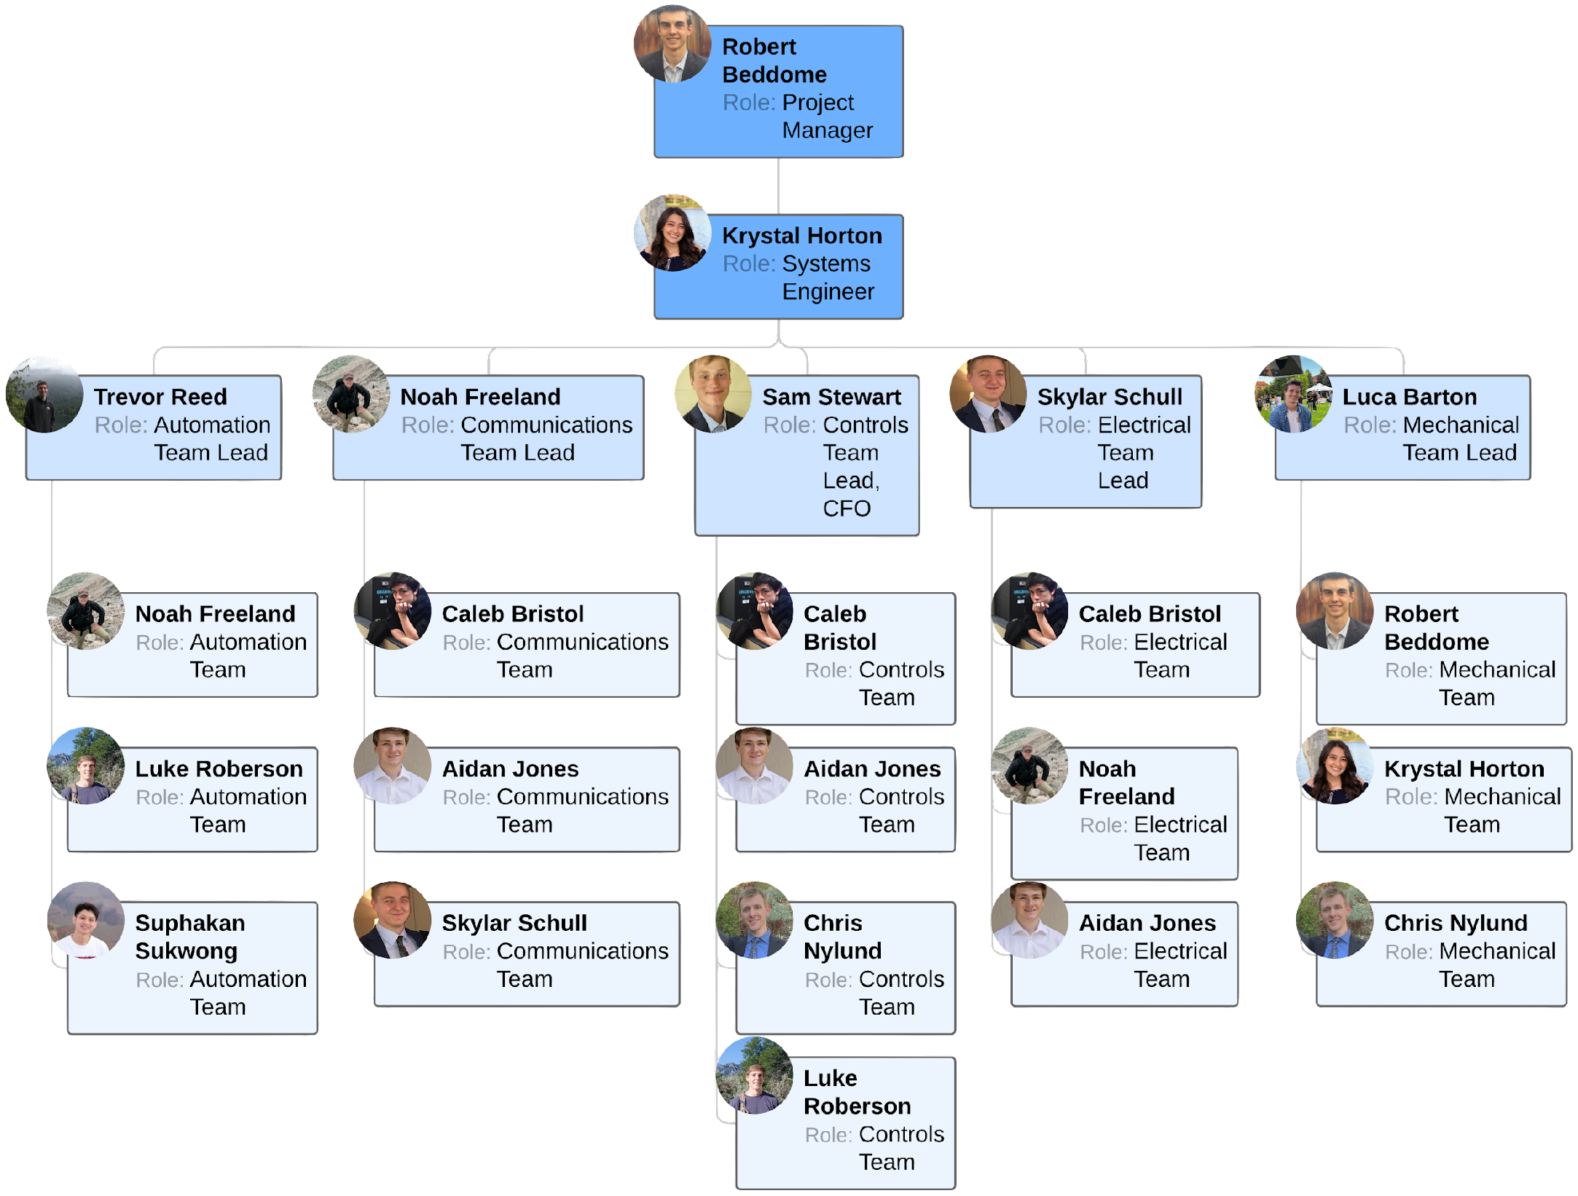

Slide 3
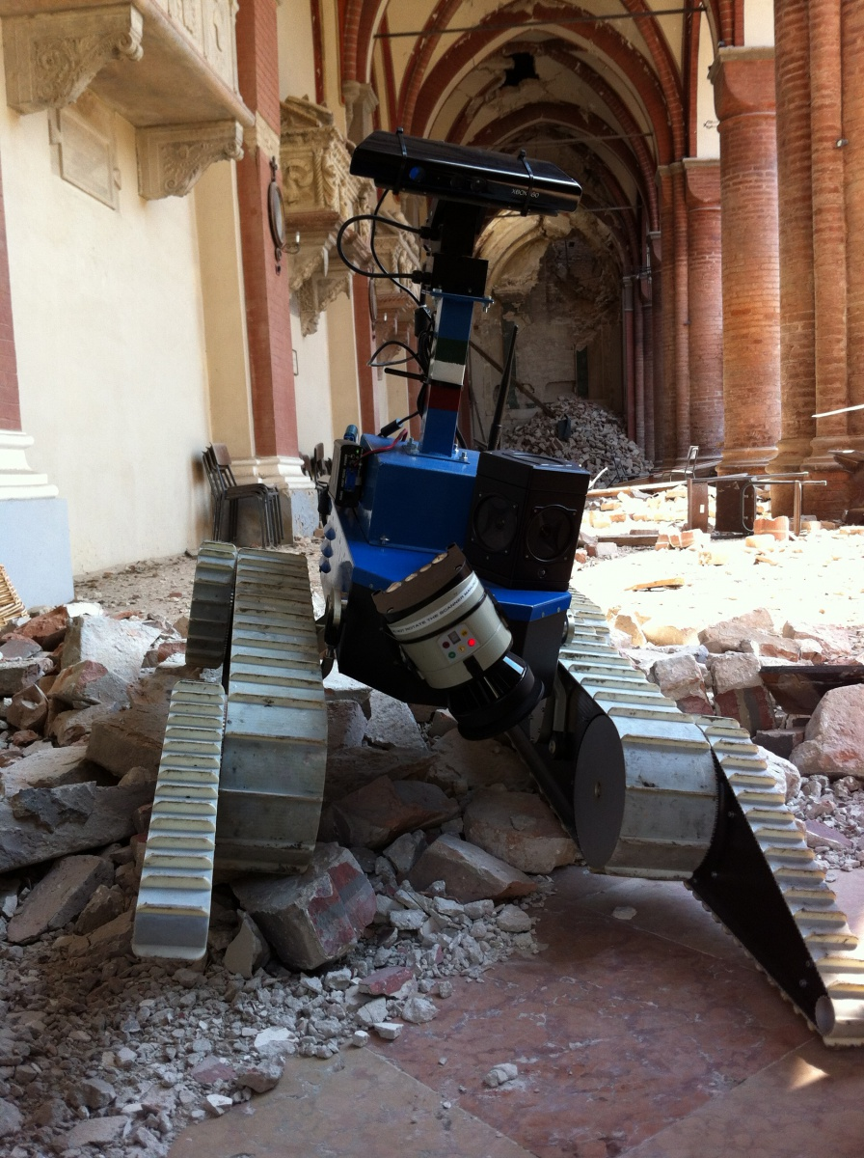
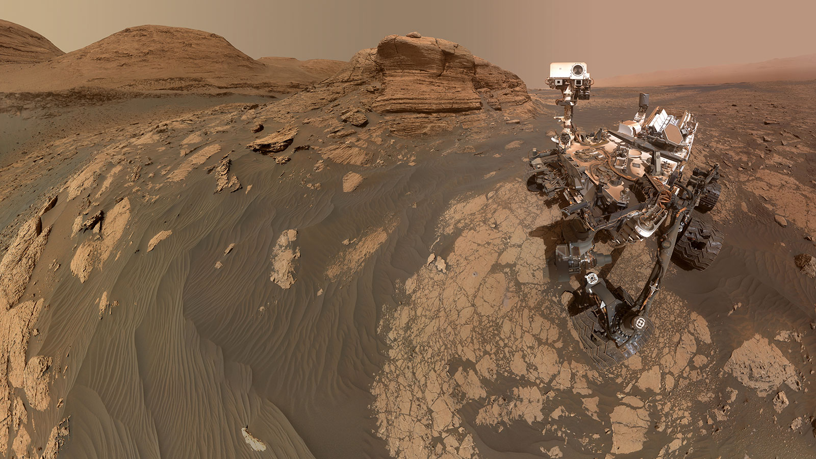
Project Motivation
Extreme environments not suitable for human exploration require the use of semi-autonomous rovers to surveil area and assess locations of interest.
Potential Applications:
Space Exploration
Natural Disaster Relief
Law Enforcement
NIFTi Unmanned Ground Vehicle (UGV)
Image Source: Advanced Robotics
Curiosity’s Selfie at Mont Mercou
Image Source: NASA JPL
Project Description
Trades Overview
Trade #1
Trade #2
Trade #3
Design Space
Modeling & Prototyping

Slide 4
Mission Statement
The Semi-Autonomous Imaging Land Rover (SAILR) team will design, integrate, and test a compact rover capable of autonomously navigating and imaging a predetermined location of interest. The rover will proceed to a secondary location if defined by the user or return to the ground station to complete the mission.
Project Description
Trades Overview
Trade #1
Trade #2
Trade #3
Design Space
Modeling & Prototyping

Slide 5
Relevant Definitions
Typical Mission Environment:
Indoor: consist of hard wood or rough carpet & will include obstructions
Outdoor: consists of flat, hard-packed ground (defined by Gmax) with natural obstacles
Underbrush: all naturally occurring, rigid objects less than 3 cm in height
Obstacles: capable of recognition by the autonomous system and avoided as necessary for navigation to the location of interest
Location of Interest: set of GPS coordinates that are provided to the rover by the operator
Ground Station: the point of contact between the rover and the operator
Project Description
Trades Overview
Trade #1
Trade #2
Trade #3
Design Space
Modeling & Prototyping
Notes:
Notes: Pick a height for underbrush and stick with it

Slide 6
CONOPS
Initiate Rover 1. Setup ground station 2. Initialize rover and ground station communication 3. User sends location of interest through ground station to rover 4. Initiate rover video streaming | Automated Navigation 5. Rover navigates over underbrush autonomously 6. Rover navigates around obstacles autonomously | Reach Location of Interest 7. Rover reaches location of interest (up to 100m away from ground station) | Image Location of Interest 8. Rover captures images of location of interest given user input 9. Rover transfers images to the ground station | Secondary Location 10. If defined, rover moves to next location of interest or if not defined, rover transitions into next phase (steps 11-12). | Return to Ground Station 11.Rover autonomously navigates to ground station 12. Rover is collected and prepared for next mission
Rover Continuously Communicating with Ground Station
Project Description
Trades Overview
Trade #1
Trade #2
Trade #3
Design Space
Modeling & Prototyping

Slide 7
Functional Requirements
Req. # | Requirements
FR.1 | The drivetrain shall enable the rover to move forwards, backwards and turn in any direction.
FR.2 | The communications subsystem shall provide a means for data transmission and reception capabilities between the on-board computer and the ground station.
FR.3 | The communications subsystem shall be able to transmit live video to the ground station.
FR.3a | The communications subsystem shall be able to transmit images to the ground station.
FR.4 | The automation subsystem shall be able to utilize remote sensing and video and imaging subsystems to path plan to a location of interest.
FR.4a | The automation subsystem shall be able to utilize the drivetrain subsystem to navigate to the specified location of interest.
FR.5 | The power delivery system shall be able to sustain the rover for the duration of the mission utilizing battery power.
FR.6 | Rover shall have a footprint no larger than 1’ x 1’.
Project Description
Trades Overview
Trade #1
Trade #2
Trade #3
Design Space
Modeling & Prototyping

Slide 8
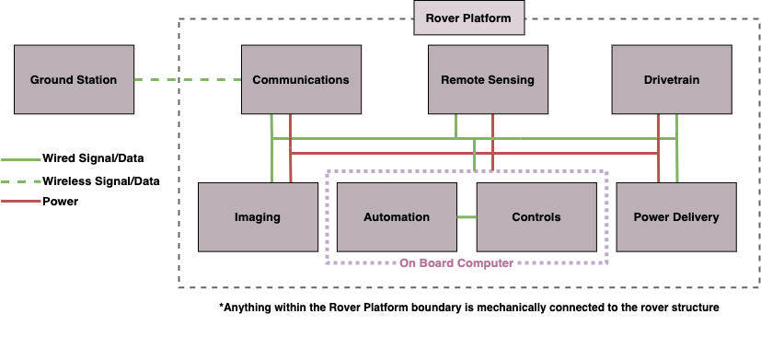
Functional Block Diagram
Project Description
Trades Overview
Trade #1
Trade #2
Trade #3
Design Space
Modeling & Prototyping

Slide 9
Critical Project Elements
CPE # | Subsystem | Critical Project Element (CPE) Description
1 | Locomotion | The rover needs a method of locomotion which allows it to successfully navigate in the typical mission environment to reach the location of interest. If the rover cannot successfully reach the location of interest, it cannot satisfy its mission.
2 | Command and Control - Manual | A backup manual control system will be implemented as a safeguard in the event that the autonomous control of the rover fails. This element of manual control is necessary in the case of automation failure or required operator interaction.
3 | Command and Control - Automated | The rover must be able to use automation to navigate itself to the location of interest. This involves sensing its environment, making path planning decisions to define its next motion, and then controlling that motion to make progress towards the location. The rover must also be able to use automated control to navigate back into range of communication.
4 | Video and Imaging | Streaming live video to the operator is essential for manual control of the rover, when the rover is not in line of sight of the operator. The rover's mission is also to collect images of a location of interest, making imaging an essential function of the rover.
5 | Ground Station | The ground station shall provide a method of communication between the operator and the rover. The ground station will allow the exchange of video, images, and manual control.
6 | Power/Endurance | The battery must be capable of powering all systems for the duration of a typical mission.
7 | Integration into Rover | Integration pertains to integrating all of the previous critical project elements into a single rover, and the successful interaction of the elements.
Project Description
Trades Overview
Trade #1
Trade #2
Trade #3
Design Space
Modeling & Prototyping

Slide 10
Trades Overview
SAILR
Automation
Controls
Communications
Electrical
Mechanical
Ground Station Computation Method
Device For Video & Imaging
Separate vs. Combined
Transceiver for Video & Imaging
Power Storage
Method of Vehicle Propulsion
Transceiver for User Commands
Mechanical Power Delivery
Project Description
Trades Overview
Trade #1
Trade #2
Trade #3
Design Space
Modeling & Prototyping

Slide 11
Trades Overview
Complete
In Progress
SAILR
Not Started
Automation
Controls
Communications
Electrical
Mechanical
Ground Station Computation Method
Device For Video & Imaging
Separate vs. Combined
Transceiver for Video & Imaging
Power Storage
Method of Vehicle Propulsion
Type of Remote Sensor
On-board Computation Method
Derivative/Integral Controls
Transceiver for User Commands
Mechanical Power Delivery
Path Planning Algorithm
On-Board Controls Processor
On-Board Comms Controller
Chassis Material
Remote Sensor Orientation
Drivetrain Stability Control
Turning Mechanism
Project Description
Trades Overview
Trade #1
Trade #2
Trade #3
Design Space
Modeling & Prototyping

Slide 12
Trades Overview
Trades Discussed Today
SAILR
Automation
Controls
Communications
Electrical
Mechanical
Ground Station Computation Method
Device For Video & Imaging
Separate vs. Combined
Transceiver for Video & Imaging
Power Storage
Method of Vehicle Propulsion
Type of Remote Sensor
On-board Computation Method
Derivative/Integral Controls
Transceiver for User Commands
Mechanical Power Delivery
Path Planning Algorithm
On-Board Controls Processor
On-Board Comms Controller
Chassis Material
Remote Sensor Orientation
Drivetrain Stability Control
Turning Mechanism
Project Description
Trades Overview
Trade #1
Trade #2
Trade #3
Design Space
Modeling & Prototyping

Slide 13
Trade Studies
Mechanical, Communications, Controls, Automation, Electrical

Slide 14
Methods of Vehicle Propulsion
Analysis of various systems for rover mobility
FR.1: The drivetrain shall enable the rover to move forwards, backwards and turn in any direction.
Project Description
Trades Overview
Trade #1
Trade #2
Trade #3
Design Space
Modeling & Prototyping

Slide 15
Methods of Vehicle Propulsion
Mechanical
Options Considered: Wheels, Tracks, Rocker Bogie
Metric Description | Weight | 1 | 2 | 3 | 4 | 5
Maneuverability | .3 | System has turning radius > 0.5m | System has turning radius from 0.3m to 0.5m | System has turning radius from 0.2m to 0.3m | System has turning radius from 0.1m to 0.2m | System has turning radius < 0.1m
Traction | .1 | System allows for movement over plain flat terrain with no underbrush | System allows for movement over plain flat terrain with underbrush | System has moderate slipping on grassy terrain with underbrush | System has rare slipping on grassy terrain with underbrush and small hills | System allows for no slipping on grassy terrain with underbrush and small hills
Simplicity | .3 | System has many possible failure points and is difficult to prototype | System has many possible failure points and is moderately difficult to prototype | System has a moderate number of failure points and is moderately difficult to prototype | System has a moderate number of failure points and can be rapidly prototyped | System has minimal failure points and can be rapidly prototyped
Weight | .2 | > 4 kg | 3 kg – 4 kg | 2 kg – 3 kg | 1 kg – 2 kg | < 1 kg
Cost | .1 | >$300 | $200-$300 | $100-$200 | $50-$100 | <$50
Project Description
Trades Overview
Trade #1
Trade #2
Trade #3
Design Space
Modeling & Prototyping

Slide 16
Methods of Vehicle Propulsion Wheels
Mechanical
A traditional wheel system consisting of an even number of wheels connected to the drivetrain
Metric Description | Weight | 1 | 2 | 3 | 4 | 5
Maneuverability | .3 | System has turning radius > 0.5m | System has turning radius from 0.3m to 0.5m | System has turning radius from 0.2m to 0.3m | System has turning radius from 0.1m to 0.2m | System has turning radius < 0.1m
Traction | .1 | System allows for movement over plain flat terrain with no underbrush | System allows for movement over plain flat terrain with underbrush | System has moderate slipping on grassy terrain with underbrush | System has rare slipping on grassy terrain with underbrush and small hills | System allows for no slipping on grassy terrain with underbrush and small hills
Simplicity | .3 | System has many possible failure points and is difficult to prototype | System has many possible failure points and is moderately difficult to prototype | System has a moderate number of failure points and is moderately difficult to prototype | System has a moderate number of failure points and can be rapidly prototyped | System has minimal failure points and can be rapidly prototyped
Weight | .2 | > 4 kg | 3 kg – 4 kg | 2 kg – 3 kg | 1 kg – 2 kg | < 1 kg
Cost | .1 | >$300 | $200-$300 | $100-$200 | $50-$100 | <$50
Project Description
Trades Overview
Trade #1
Trade #2
Trade #3
Design Space
Modeling & Prototyping

Slide 17
Methods of Vehicle Propulsion Tracks
Mechanical
A mobility system using belts that wrap around a series of wheels
Metric Description | Weight | 1 | 2 | 3 | 4 | 5
Maneuverability | .3 | System has turning radius > 0.5m | System has turning radius from 0.3m to 0.5m | System has turning radius from 0.2m to 0.3m | System has turning radius from 0.1m to 0.2m | System has turning radius < 0.1m
Traction | .1 | System allows for movement over plain flat terrain with no underbrush | System allows for movement over plain flat terrain with underbrush | System has moderate slipping on grassy terrain with underbrush | System has rare slipping on grassy terrain with underbrush and small hills | System allows for no slipping on grassy terrain with underbrush and small hills
Simplicity | .3 | System has many possible failure points and is difficult to prototype | System has many possible failure points and is moderately difficult to prototype | System has a moderate number of failure points and is moderately difficult to prototype | System has a moderate number of failure points and can be rapidly prototyped | System has minimal failure points and can be rapidly prototyped
Weight | .2 | > 4 kg | 3 kg – 4 kg | 2 kg – 3 kg | 1 kg – 2 kg | < 1 kg
Cost | .1 | >$300 | $200 - $300 | $100 - $200 | $50 - $100 | <$50
Project Description
Trades Overview
Trade #1
Trade #2
Trade #3
Design Space
Modeling & Prototyping

Slide 18
Methods of Vehicle Propulsion Rocker Bogie
Mechanical
A six-wheel suspension system commonly used in Mars rovers such as Perseverance
Metric Description | Weight | 1 | 2 | 3 | 4 | 5
Maneuverability | .3 | System has turning radius > 0.5m | System has turning radius from 0.3m to 0.5m | System has turning radius from 0.2m to 0.3m | System has turning radius from 0.1m to 0.2m | System has turning radius < 0.1m
Traction | .1 | System allows for movement over plain flat terrain with no underbrush | System allows for movement over plain flat terrain with underbrush | System has moderate slipping on grassy terrain with underbrush | System has rare slipping on grassy terrain with underbrush and small hills | System allows for no slipping on grassy terrain with underbrush and small hills
Simplicity | .3 | System has many possible failure points and is difficult to prototype | System has many possible failure points and is moderately difficult to prototype | System has a moderate number of failure points and is moderately difficult to prototype | System has a moderate number of failure points and can be rapidly prototyped | System has minimal failure points and can be rapidly prototyped
Weight | .2 | > 4 kg | 3 kg – 4 kg | 2 kg – 3 kg | 1 kg – 2 kg | < 1 kg
Cost | .1 | >$300 | $200-$300 | $100-$200 | $50-$100 | <$50
Project Description
Trades Overview
Trade #1
Trade #2
Trade #3
Design Space
Modeling & Prototyping

Slide 19
Vehicle Propulsion Trade Comparison
Mechanical
Metric Description | Weight | Wheels | Tracks | Rocker Bogie
Maneuverability | .3 | 4 | 5 | 3
Traction | .1 | 3 | 5 | 4
Simplicity | .3 | 5 | 4 | 1
Weight | .2 | 5 | 3 | 2
Cost | .1 | 4 | 3 | 2
Total Score: |  | 4.4 | 4.2 | 2.2
Project Description
Trades Overview
Trade #1
Trade #2
Trade #3
Design Space
Modeling & Prototyping

Slide 20
Communication Method
Analysis of various systems for rover
data transmission with ground station
FR.2: The communications subsystem shall provide a means for data transmission and reception capabilities between the on-board computer and the ground station.
Project Description
Trades Overview
Trade #1
Trade #2
Trade #3
Design Space
Modeling & Prototyping

Slide 21
User Commands Communication Method
Communications
Options Considered: ISM (RF), 4G Cellular, Wi-Fi, Infrared, Bluetooth 5.0
Metric Description | Weight | 1 | 2 | 3 | 4 | 5
Range | .4 | < 10 m | 10 – 49 m | 50 – 149 m | 150 – 200 m | > 200 m
Interference Susceptibility | .3 | Loss of connection from light obstacles: brush small objects | Loss of connection through medium obstacles: walls, trees | Loss of connection through large obstacles: Buildings, terrain | Obscured connection through large obstacles | Full connectivity through mission environment
Data Throughput | .2 | < 1 Mbps | 1 – 2.9 Mbps | 3 – 4.9 Mbps | 5 – 20 Mbps | > 20 Mbps
Cost | .1 | >$150 | $100-$150 | $50-$100 | $15-$50 | <$15
Project Description
Trades Overview
Trade #1
Trade #2
Trade #3
Design Space
Modeling & Prototyping

Slide 22
Comms Method
Industrial, Scientific, and Medical Radio Band (ISM)
Communications
IMS Radio band transceivers connected to ground station and on-board computer
Metric Description | Weight | 1 | 2 | 3 | 4 | 5
Range | .4 | < 10 m | 10 – 49 m | 50 – 149 m | 150 – 200 m | > 200 m
Interference Susceptibility | .3 | Loss of connection from light obstacles: brush small objects | Loss of connection through medium obstacles: walls, trees | Loss of connection through large obstacles: Buildings, terrain | Obscured connection through large obstacles | Full connectivity through mission environment
Data Throughput | .2 | < 1 Mbps | 1 – 2.9 Mbps | 3 – 4.9 Mbps | 5 – 20 Mbps | > 20 Mbps
Cost | .1 | >$150 | $100-$150 | $50-$100 | $15-$50 | <$15
Project Description
Trades Overview
Trade #1
Trade #2
Trade #3
Design Space
Modeling & Prototyping

Slide 23
Comms Method
4G Cellular
Communications
SIM card adapter connected to on-board computer communicating with ground station
Metric Description | Weight | 1 | 2 | 3 | 4 | 5
Range | .4 | < 10 m | 10 – 49 m | 50 – 149 m | 150 – 200 m | > 200 m
Interference Susceptibility | .3 | Loss of connection from light obstacles: brush small objects | Loss of connection through medium obstacles: walls, trees | Loss of connection through large obstacles: Buildings, terrain | Obscured connection through large obstacles | Full connectivity through mission environment
Data Throughput | .2 | < 1 Mbps | 1 – 2.9 Mbps | 3 – 4.9 Mbps | 5 – 20 Mbps | > 20 Mbps
Cost | .1 | >$150 | $100-$150 | $50-$100 | $15-$50 | <$15
Project Description
Trades Overview
Trade #1
Trade #2
Trade #3
Design Space
Modeling & Prototyping

Slide 24
Comms Method
Wi-Fi Network
Communications
Communications
Ad Hoc Peer to peer Wi-Fi network between ground station and on-board computer
Metric Description | Weight | 1 | 2 | 3 | 4 | 5
Range | .4 | < 10 m | 10 – 49 m | 50 – 149 m | 150 – 200 m | > 200 m
Interference Susceptibility | .3 | Loss of connection from light obstacles: brush small objects | Loss of connection through medium obstacles: walls, trees | Loss of connection through large obstacles: Buildings, terrain | Obscured connection through large obstacles | Full connectivity through mission environment
Data Throughput | .2 | < 1 Mbps | 1 – 2.9 Mbps | 3 – 4.9 Mbps | 5 – 20 Mbps | > 20 Mbps
Cost | .1 | >$150 | $100-$150 | $50-$100 | $15-$50 | <$15
Project Description
Trades Overview
Trade #1
Trade #2
Trade #3
Design Space
Modeling & Prototyping

Slide 25
Comms Method
Infrared
Communications
Infrared transceivers connected to ground station and on-board computer
Metric Description | Weight | 1 | 2 | 3 | 4 | 5
Range | .4 | < 10 m | 10 – 49 m | 50 – 149 m | 150 – 200 m | > 200 m
Interference Susceptibility | .3 | Loss of connection from light obstacles: brush small objects | Loss of connection through medium obstacles: walls, trees | Loss of connection through large obstacles: Buildings, terrain | Obscured connection through large obstacles | Full connectivity through mission environment
Data Throughput | .2 | < 1 Mbps | 1 – 2.9 Mbps | 3 – 4.9 Mbps | 5 – 20 Mbps | > 20 Mbps
Cost | .1 | >$150 | $100-$150 | $50-$100 | $15-$50 | <$15
Project Description
Trades Overview
Trade #1
Trade #2
Trade #3
Design Space
Modeling & Prototyping

Slide 26
Comms Method
Bluetooth 5.0
Communications
Bluetooth 5.0 adapters connected to ground station and on-board computer
Metric Description | Weight | 1 | 2 | 3 | 4 | 5
Range | .4 | < 10 m | 10 – 49 m | 50 – 149 m | 150 – 200 m | > 200 m
Interference Susceptibility | .3 | Loss of connection from light obstacles: brush small objects | Loss of connection through medium obstacles: walls, trees | Loss of connection through large obstacles: Buildings, terrain | Obscured connection through large obstacles | Full connectivity through mission environment
Data Throughput | .2 | < 1 Mbps | 1 – 2.9 Mbps | 3 – 4.9 Mbps | 5 – 20 Mbps | > 20 Mbps
Cost | .1 | >$150 | $100-$150 | $50-$100 | $15-$50 | <$15
Project Description
Trades Overview
Trade #1
Trade #2
Trade #3
Design Space
Modeling & Prototyping

Slide 27
Comms Method Trade Comparison
Communications
Metric Description | Weight | ISM | 4G Cellular | Wi-Fi | Infrared | Bluetooth 5.0
Range | .4 | 5 | 5 | 2 | 1 | 4
Interference Susceptibility | .3 | 4 | 3 | 5 | 1 | 3
Data Throughput | .2 | 4 | 5 | 4 | 3 | 4
Cost | .1 | 4 | 1 | 5 | 5 | 5
Total Score: |  | 4.4 | 4.0 | 3.6 | 1.8 | 3.8
Project Description
Trades Overview
Trade #1
Trade #2
Trade #3
Design Space
Modeling & Prototyping
Notes:
Fix last col

Slide 28
Video/Imaging System
Analysis of various cameras for collection of video and images
FR.3: The communications subsystem shall be able to transmit live video to the ground station.
FR.3.a: The communications subsystem shall be able to transmit images to the ground station
Project Description
Trades Overview
Trade #1
Trade #2
Trade #3
Design Space
Modeling & Prototyping
Notes:
Hi Im Aidan and im a member of the communications, controls, and electrical subteams. Our next trade study looked at the video and imaging system, as it pertains to the functional requirements that the rover should be able to transmit live video and still images to the ground station

Slide 29
Video/Imaging System
Communications
Options Considered: 360 Video/Imaging, Standard Aspect Ratio (AR) Video + 360 Imaging, Single Standard AR Camera + Composite Images, 3 Standard AR Cameras + Composite Images
Metric Description | Weight | 1 | 2 | 3 | 4 | 5
Output Usability | .4 | Severely modified camera output | Heavily modified camera output | Moderately modified camera output | Few modifications to camera output | No modifications to camera output
Physical Complexity | .1 | Significant amount of work needed | Moderate amount of work needed | Small amount of work needed | Works with some modification | No work needed
Algorithmic Complexity | .2 | Significant amount of work needed | Moderate amount of work needed | Small amount of work needed | Works with some modification | No algorithms needed to make usable output
Relative Size | .2 | Multiple large cameras and small cameras | Multiple large cameras | Single large camera | Multiple small cameras | Single small camera
Cost | .1 | > $400 | $400 | $300 | $200 | < $200
Project Description
Trades Overview
Trade #1
Trade #2
Trade #3
Design Space
Modeling & Prototyping
Notes:
Considered a variety of combinations of standard 16:9 aspect ratio cameras and 360-degree field of view cameras
Output usability entails how easy to utilize a given camera output is, which factors in general image quality.. A large contribution to this metric comes from the type of camera used, as video will be easiest to work with in std 16:9 aspect ratio, while photos will need to be panoramic and will need less modification if provided from a 360 degree camera
Physical complexity is relatively straightforward and aims to capture the difficulty in attaching and orienting the one or more cameras on the rover
Algorithmic complexity aims to capture the difficulty in processing the camera outputs

Slide 30
Video/Imaging 360 Video/Imaging
Communications
A single camera that can collect video and images in a 360-degree field of view
Metric Description | Weight | 1 | 2 | 3 | 4 | 5
Output Usability | .4 | Severely modified camera output | Heavily modified camera output | Moderately modified camera output | Few modifications to camera output | No modifications to camera output
Physical Complexity | .1 | Significant amount of work needed | Moderate amount of work needed | Small amount of work needed | Works with some modification | No work needed
Algorithmic Complexity | .2 | Significant amount of work needed | Moderate amount of work needed | Small amount of work needed | Works with some modification | No algorithms needed to make usable output
Relative Size | .2 | Multiple large cameras and small cameras | Multiple large cameras | Single large camera | Multiple small cameras | Single small camera
Cost | .1 | > $400 | $400 | $300 | $200 | < $200
Project Description
Trades Overview
Trade #1
Trade #2
Trade #3
Design Space
Modeling & Prototyping
Notes:
Note relatively low output usability and algorithmic complexity due to video format being difficult to work with in real time ,

Slide 31
Video/Imaging Standard AR Video + 360º Imaging
Communications
A standard 16:9 aspect ratio camera for video and a separate 360-degree field of view camera for imaging
Metric Description | Weight | 1 | 2 | 3 | 4 | 5
Output Usability | .4 | Severely modified camera output | Heavily modified camera output | Moderately modified camera output | Few modifications to camera output | No modifications to camera output
Physical Complexity | .1 | Significant amount of work needed | Moderate amount of work needed | Small amount of work needed | Works with some modification | No work needed
Algorithmic Complexity | .2 | Significant amount of work needed | Moderate amount of work needed | Small amount of work needed | Works with some modification | No algorithms needed to make usable output
Relative Size | .2 | Multiple large cameras and small cameras | Multiple large cameras | Single large camera | Multiple small cameras | Single small camera
Cost | .1 | > $400 | $400 | $300 | $200 | < $200
Project Description
Trades Overview
Trade #1
Trade #2
Trade #3
Design Space
Modeling & Prototyping

Slide 32
Video/Imaging Single Standard AR Camera + Composite Images
Communications
A standard 16:9 aspect ratio camera for video and images, forms a composite image by rotating the camera 360 degrees
Metric Description | Weight | 1 | 2 | 3 | 4 | 5
Output Usability | .4 | Severely modified camera output | Heavily modified camera output | Moderately modified camera output | Few modifications to camera output | No modifications to camera output
Physical Complexity | .1 | Significant amount of work needed | Moderate amount of work needed | Small amount of work needed | Works with some modification | No work needed
Algorithmic Complexity | .2 | Significant amount of work needed | Moderate amount of work needed | Small amount of work needed | Works with some modification | No algorithms needed to make usable output
Relative Size | .2 | Multiple large cameras and small cameras | Multiple large cameras | Single large camera | Multiple small cameras | Single small camera
Cost | .1 | > $400 | $400 | $300 | $200 | < $200
Project Description
Trades Overview
Trade #1
Trade #2
Trade #3
Design Space
Modeling & Prototyping
Notes:
Change rover rotates 360 to camera rotates 360

Slide 33
Video/Imaging 3 Standard AR Cameras + Composite Images
Communications
3 standard 16:9 aspect ratio cameras for video and images, each camera with 120-degree field of view and offset by 120-degrees to form a composite image
Metric Description | Weight | 1 | 2 | 3 | 4 | 5
Output Usability | .4 | Severely modified camera output | Heavily modified camera output | Moderately modified camera output | Few modifications to camera output | No modifications to camera output
Physical Complexity | .1 | Significant amount of work needed | Moderate amount of work needed | Small amount of work needed | Works with some modification | No work needed
Algorithmic Complexity | .2 | Significant amount of work needed | Moderate amount of work needed | Small amount of work needed | Works with some modification | No algorithms needed to make usable output
Relative Size | .2 | Multiple large cameras and small cameras | Multiple large cameras | Single large camera | Multiple small cameras | Single small camera
Cost | .1 | > $400 | $400 | $300 | $200 | < $200
Project Description
Trades Overview
Trade #1
Trade #2
Trade #3
Design Space
Modeling & Prototyping

Slide 34
Video/Imaging Trade Comparison
Communications
Metric Description | Weight | 360 Video/Imaging | Standard AR Video + 360 Imaging | Single Standard AR Camera + Composite images | 3 Standard AR Cameras + Composite images
Output Usability | .4 | 2 | 5 | 3 | 4
Physical Complexity | .1 | 5 | 3 | 5 | 2
Algorithmic Complexity | .2 | 1 | 5 | 2 | 4
Relative Size | .2 | 3 | 1 | 5 | 3
Cost | .1 | 3 | 1 | 5 | 2
Total Score: |  | 2.4 | 3.6 | 3.6 | 3.4
Project Description
Trades Overview
Trade #1
Trade #2
Trade #3
Design Space
Modeling & Prototyping

Slide 35
Current Design Space
Legend
Additional Research Required
Eliminated
Means of Propulsion
Wheels
Tracks
Rocker Bogie
Communication Method
ISM
4G Cellular
Wi-Fi
Infrared
Bluetooth 5.0
Video/Imaging
Standard AR + 360° Camera
Single Standard AR Camera
Three Standard AR Cameras
Single 360° Camera
Project Description
Trades Overview
Trade #1
Trade #2
Trade #3
Design Space
Modeling & Prototyping

Slide 36
Subsystem Dependencies
Physical Dependencies
1. Rover Battery
2. On Board Automation
3. Communication System
Computing / Communication Dependencies
1. Remote Sensing
2. On Board Computing
3. Video and Imaging
4. User Commands
5. Rover Controller
&
Project Description
Trades Overview
Trade #1
Trade #2
Trade #3
Design Space
Modeling & Prototyping

Slide 37
Models & Prototyping
 | Modeling
1. Communication | 2. Automation | 3. Rover Motion
Send video and images to ground station Send user control to rover | Sensing of virtual environment Response to virtual environment and commands | Rover motion given commands from user or automation
Project Description
Trades Overview
Trade #1
Trade #2
Trade #3
Design Space
Modeling & Prototyping

Slide 38
Questions?

Slide 39
Back Up
Completed trades, design space, risk matrix, G_{max} comparison, resources

Slide 40
Remote Sensing Methods
Analysis of various sensors for remote sensing and autonomous control
FR.4: The automation subsystem shall be able to utilize remote sensing and video and imaging subsystems to path plan to a location of interest.

Slide 41
Remote Sensing Methods
Automation
Options Considered: LiDAR, Ultrasonic, IR Distance, Computer Vision
Metric Description | Weight | 1 | 2 | 3 | 4 | 5
Sensing Distance | .2 | Touching | Up to 2m | Up to 5m | Up to 10m | Up to 50m
Accuracy/Overall Object detection ability | .4 | No data related to obstruction size can be inferred | Sensor can sense an object is in its sensing area but does not know its distance. | Distance to obstruction is known to +/- 0.5 m, direction +/- 10 deg | Distance to object is returned within +/- 25cm, direction to object is +/- 5 deg | Distance to object is returned within +/- 10cm, direction to object is +/- 1 deg
Ease of Implementation | .3 | Data returned and protocol would require significant research and man hours in order to implement, and/or hard to mechanically implement | Data returned would be moderately complex to interpret, but very difficult to mechanically implement | Moderate algorithmic complexity for processing data, and/or moderate difficulty in mechanical implementation | Data is easily interpreted but moderate difficulty regarding mechanical implementation | Data returned is in an easily usable format and communicates over popular protocol (UART, I2C, SPI, etc.). Easily mechanically implemented
Cost | .1 | >$150 | $100-$150 | $50-$100 | $15-$50 | <$15

Slide 42
Remote Sensing Continued LiDAR
Automation
Emits laser pulse and measures the time it takes for the laser pulse to reflect off an object and return to its receiver.
Metric Description | Weight | 1 | 2 | 3 | 4 | 5
Sensing Distance | .2 | Touching | Up to 2m | Up to 5m | Up to 10m | Up to 50m
Accuracy/Overall Object detection ability | .4 | No data related to obstruction size can be inferred | Sensor can sense an object is in its sensing area but does not know its distance. | Distance to obstruction is known to +/- 0.5 m, direction +/- 10 deg | Distance to object is returned within +/- 25cm, direction to object is +/- 5 deg | Distance to object is returned within +/- 10cm, direction to object is +/- 1 deg
Ease of Implementation | .3 | Data returned and protocol would require significant research and man hours in order to implement, and/or hard to mechanically implement | Data returned would be moderately complex to interpret, but very difficult to mechanically implement | Moderate algorithmic complexity for processing data, and/or moderate difficulty in mechanical implementation | Data is easily interpreted but moderate difficulty regarding mechanical implementation | Data returned is in an easily usable format and communicates over popular protocol (UART, I2C, SPI, etc.). Easily mechanically implemented
Cost | .1 | >$150 | $100-$150 | $50-$100 | $15-$50 | <$15

Slide 43
Remote Sensing Continued Ultrasonic
Automation
Emits a sound greater than 20kHz and measures the time it takes the sound to reflect off an object and return to the sensor.
Metric Description | Weight | 1 | 2 | 3 | 4 | 5
Sensing Distance | .2 | Touching | Up to 2m | Up to 5m | Up to 10m | Up to 50m
Accuracy/Overall Object detection ability | .4 | No data related to obstruction size can be inferred | Sensor can sense an object is in its sensing area but does not know its distance. | Distance to obstruction is known to +/- 0.5 m, direction +/- 10 deg | Distance to object is returned within +/- 25cm, direction to object is +/- 5 deg | Distance to object is returned within +/- 10cm, direction to object is +/- 1 deg
Ease of Implementation | .3 | Data returned and protocol would require significant research and man hours in order to implement, and/or hard to mechanically implement | Data returned would be moderately complex to interpret, but very difficult to mechanically implement | Moderate algorithmic complexity for processing data, and/or moderate difficulty in mechanical implementation | Data is easily interpreted but moderate difficulty regarding mechanical implementation | Data returned is in an easily usable format and communicates over popular protocol (UART, I2C, SPI, etc.). Easily mechanically implemented
Cost | .1 | >$150 | $100-$150 | $50-$100 | $15-$50 | <$15

Slide 44
Remote Sensing Continued Infrared
Automation
Emits an IR signal then measures the angle of the reflected signal to determine distance.
Metric Description | Weight | 1 | 2 | 3 | 4 | 5
Sensing Distance | .2 | Touching | Up to 2m | Up to 5m | Up to 10m | Up to 50m
Accuracy/Overall Object detection ability | .4 | No data related to obstruction size can be inferred | Sensor can sense an object is in its sensing area but does not know its distance. | Distance to obstruction is known to +/- 0.5 m, direction +/- 10 deg | Distance to object is returned within +/- 25cm, direction to object is +/- 5 deg | Distance to object is returned within +/- 10cm, direction to object is +/- 1 deg
Ease of Implementation | .3 | Data returned and protocol would require significant research and man hours in order to implement, and/or hard to mechanically implement | Data returned would be moderately complex to interpret, but very difficult to mechanically implement | Moderate algorithmic complexity for processing data, and/or moderate difficulty in mechanical implementation | Data is easily interpreted but moderate difficulty regarding mechanical implementation | Data returned is in an easily usable format and communicates over popular protocol (UART, I2C, SPI, etc.). Easily mechanically implemented
Cost | .1 | >$150 | $100-$150 | $50-$100 | $15-$50 | <$15

Slide 45
Remote Sensing Continued Computer Vision
Automation
Uses imagery from the onboard imagery to identify obstacles using various AI algorithms.
Metric Description | Weight | 1 | 2 | 3 | 4 | 5
Sensing Distance | .2 | Touching | Up to 2m | Up to 5m | Up to 10m | Up to 50m
Accuracy/Overall Object detection ability | .4 | No data related to obstruction size can be inferred | Sensor can sense an object is in its sensing area but does not know its distance. | Distance to obstruction is known to +/- 0.5 m, direction +/- 10 deg | Distance to object is returned within +/- 25cm, direction to object is +/- 5 deg | Distance to object is returned within +/- 10cm, direction to object is +/- 1 deg
Ease of Implementation | .3 | Data returned and protocol would require significant research and man hours in order to implement, and/or hard to mechanically implement | Data returned would be moderately complex to interpret, but very difficult to mechanically implement | Moderate algorithmic complexity for processing data, and/or moderate difficulty in mechanical implementation | Data is easily interpreted but moderate difficulty regarding mechanical implementation | Data returned is in an easily usable format and communicates over popular protocol (UART, I2C, SPI, etc.). Easily mechanically implemented
Cost | .1 | >$150 | $100-$150 | $50-$100 | $15-$50 | <$15
Notes:
The sensing distance is heavily dependent on the resolution of the camera being used.
This is assuming that the algorithm used would not be able to infer distance (because it is a single camera). A much more
This is the only method that would require a significant amount of processing power. A lot of the sensors return data just as some sort of number

Slide 46
Remote Sensing Trade Comparison
Automation
Metric Description | Weight | LiDAR | Ultrasonic | Infrared | Computer Vision
Sensing Distance | .2 | 5 | 3 | 2 | 3
Accuracy/Overall Object Detection Ability | .4 | 5 | 3 | 2 | 2
Ease of Implementation | .3 | 4 | 5 | 5 | 1
Cost | .1 | 1 | 4 | 4 | 4
Total Score: |  | 4.3 | 3.7 | 3.1 | 2.1

Slide 47
Rover State Determination Sensors
Analysis of various sensor combinations for determining the state of the rover in its environment such as position and orientation
FR.4: The automation subsystem shall be able to utilize remote sensing and video and imaging subsystems to path plan to a location of interest.

Slide 48
Rover State Determination Sensors
Automation
Options Considered: GNSS*+Acc+Gyro+Mag+Alt, GNSS+Acc+Gyro+Mag, GNSS+Acc+Gyro, GNSS+Mag, GNSS only
Metric Description | Weight | 1 | 2 | 3 | 4 | 5
Degrees of Freedom (Number of independent data points) | .4 | ≤1 | 2-4 | 5- 6 | 7- 9 | ≥10
Types of States That can be determined | .5 | Latitude, Longitude, Altitude. | Latitude, Longitude, Altitude. Change of state is redundantly calculated through integration. | Latitude, Longitude, Altitude. Orientation relative to Earth's magnetic field. | Latitude, Longitude, Altitude, Orientation relative to Earth's magnetic field. Change of state is redundantly calculated through integration. | Latitude, Longitude, Altitude, Orientation relative to Earth's magnetic field. Change of state is redundantly calculated through integration. Altitude is redundant.
Mass** | .05 | 20 – 25 g | 15 – 20 g | 10 –15 g | 5 – 10 g | <5g
Cost*** | .05 | $175 - $200 | $150 - $175 | $125 - $150 | $100 - $125 | < $100
*GNSS is included in every option because GNSS is a customer requirement
**Mass was estimated using 2.8E-4kg/cm^2 for FR4, Upper bound for each components weight was estimated to be ~5g (custompcb.org)
***These sensors and associated breakout boards have a wide variations in price. After looking through sparkfun.com, it was estimated that the lower bound for GNSS boards was $100 and boards for other sensors would cost around $25 each. Often accelerometers and gyros are combined onto one breakout board.

Slide 49
State Determination GNSS+Acc+Gyro+Mag+Alt
Automation
This configuration is the most complete set of sensors with the capability to directly measure acceleration, angular velocity, magnetic field direction, atmospheric pressure (altitude), as well as position using GNSS.
Metric Description | Weight | 1 | 2 | 3 | 4 | 5
Degrees of Freedom (Number of independent data points) | .4 | ≤1 | 2-4 | 5- 6 | 7- 9 | ≥10
Types of Measurable States | .5 | Latitude, Longitude, Altitude. | Latitude, Longitude, Altitude. Change of state is redundantly calculated through integration. | Latitude, Longitude, Altitude. Orientation relative to Earth's magnetic field. | Latitude, Longitude, Altitude, Orientation relative to Earth's magnetic field. Change of state is redundantly calculated through integration. | Latitude, Longitude, Altitude, Orientation relative to Earth's magnetic field. Change of state is redundantly calculated through integration. Altitude is redundant.
Mass | .05 | 20 – 25 g | 15 – 20 g | 10 –15 g | 5 – 10 g | <5g
Cost | .05 | $175 - $200 | $150 - $175 | $125 - $150 | $100 - $125 | < $100

Slide 50
State Determination GNSS+Acc+Gyro+Mag
Automation
This configuration has the capability to directly measure acceleration, angular velocity, magnetic field direction, as well as position using GNSS.
Metric Description | Weight | 1 | 2 | 3 | 4 | 5
Degrees of Freedom (Number of independent data points) | .4 | ≤1 | 2-4 | 5- 6 | 7- 9 | ≥10
Types of Measurable States | .5 | Latitude, Longitude, Altitude. | Latitude, Longitude, Altitude. Change of state is redundantly calculated through integration. | Latitude, Longitude, Altitude. Orientation relative to Earth's magnetic field. | Latitude, Longitude, Altitude, Orientation relative to Earth's magnetic field. Change of state is redundantly calculated through integration. | Latitude, Longitude, Altitude, Orientation relative to Earth's magnetic field. Change of state is redundantly calculated through integration. Altitude is redundant.
Mass | .05 | 20 – 25 g | 15 – 20 g | 10 –15 g | 5 – 10 g | <5g
Cost | .05 | $175 - $200 | $150 - $175 | $125 - $150 | $100 - $125 | < $100

Slide 51
State Determination GNSS+Acc+Gyro
Automation
This configuration has the capability to directly measure acceleration, angular velocity, as well as position using GNSS.
Metric Description | Weight | 1 | 2 | 3 | 4 | 5
Degrees of Freedom (Number of independent data points) | .4 | ≤1 | 2-4 | 5- 6 | 7- 9 | ≥10
Types of Measurable States | .5 | Latitude, Longitude, Altitude. | Latitude, Longitude, Altitude. Change of state is redundantly calculated through integration. | Latitude, Longitude, Altitude. Orientation relative to Earth's magnetic field. | Latitude, Longitude, Altitude, Orientation relative to Earth's magnetic field. Change of state is redundantly calculated through integration. | Latitude, Longitude, Altitude, Orientation relative to Earth's magnetic field. Change of state is redundantly calculated through integration. Altitude is redundant.
Mass | .05 | 20 – 25 g | 15 – 20 g | 10 –15 g | 5 – 10 g | <5g
Cost | .05 | $175 - $200 | $150 - $175 | $125 - $150 | $100 - $125 | < $100

Slide 52
State Determination GNSS+Mag
Automation
This configuration has the capability to directly measure magnetic field direction, as well as position using GNSS.
Metric Description | Weight | 1 | 2 | 3 | 4 | 5
Degrees of Freedom (Number of independent data points) | .4 | ≤1 | 2-4 | 5- 6 | 7- 9 | ≥10
Types of Measurable States | .5 | Latitude, Longitude, Altitude. | Latitude, Longitude, Altitude. Change of state is redundantly calculated through integration. | Latitude, Longitude, Altitude. Orientation relative to Earth's magnetic field. | Latitude, Longitude, Altitude, Orientation relative to Earth's magnetic field. Change of state is redundantly calculated through integration. | Latitude, Longitude, Altitude, Orientation relative to Earth's magnetic field. Change of state is redundantly calculated through integration. Altitude is redundant.
Mass | .05 | 20 – 25 g | 15 – 20 g | 10 –15 g | 5 – 10 g | <5g
Cost | .05 | $175 - $200 | $150 - $175 | $125 - $150 | $100 - $125 | < $100

Slide 53
State Determination GNSS only
Automation
This configuration is only capable of measuring position using GNSS.
Metric Description | Weight | 1 | 2 | 3 | 4 | 5
Degrees of Freedom (Number of independent data points) | .4 | ≤1 | 2-4 | 5- 6 | 7- 9 | ≥10
Types of measurable States | .5 | Latitude, Longitude, Altitude. | Latitude, Longitude, Altitude. Change of state is redundantly calculated through integration. | Latitude, Longitude, Altitude. Orientation relative to Earth's magnetic field. | Latitude, Longitude, Altitude, Orientation relative to Earth's magnetic field. Change of state is redundantly calculated through integration. | Latitude, Longitude, Altitude, Orientation relative to Earth's magnetic field. Change of state is redundantly calculated through integration. Altitude is redundant.
Mass | .05 | 20 – 25 g | 15 – 20 g | 10 –15 g | 5 – 10 g | <5g
Cost | .05 | $175 - $200 | $150 - $175 | $125 - $150 | $100 - $125 | < $100

Slide 54
Rover State Determination Comparison
Automation
Metric Description | Weight | GNSS+Acc+Gyro+Mag+Alt | GNSS+Acc+ Gyro+Mag | GNSS+Acc+ Gyro | GNSS+Mag | GNSS only
Degrees of Freedom | .4 | 5 | 5 | 4 | 2 | 2
Types of measurable States | .5 | 5 | 4 | 2 | 3 | 1
Mass | .05 | 1 | 2 | 3 | 4 | 4
Cost | .05 | 2 | 3 | 4 | 4 | 5
Total Score: |  | 4.5 | 4 | 2.6 | 2.2 | 1.3
GNSS+Acc+Gyro+Mag+Alt and GNSS+Acc+Gyro+Mag have the largest scores with GNSS+Acc+Gyro+Mag+Alt coming half a point ahead. While the altimeter would provide another data point for determining state, the rover will not have significant changes in altitude in its operational environments so the SAILR team may elect to forgo the altimeter.

Slide 55
On Board Computation Methods
Analysis of various types of microcontrollers to be used on rover
FR.4: The automation subsystem shall be able to utilize remote sensing and video and imaging subsystems to path plan to a location of interest.

Slide 56
On Board Computation Method
Automation
Options Considered: PIC, ARM, 8051, AVR, MSP
Metric Description | Weight | 1 | 2 | 3 | 4 | 5
Power Consumption | .2 | > 10mWatt | 7.5-10mWatt | 5-7.5mWatt | 2.5-5mWatt | 0-2.5mWatt
East of Use, Compatibility | .3 | Limited information, hard to understand datasheet, limited operating system, not suitable for the project | Limited information, hard to understand datasheet | Some resources available | Resources available, wide community | Multiple resources, easy to learn, compatible with most operating system
Memory | .25 | < 20 KB | 20-40 KB | 40-60 KB | 60-80 KB | > 80 KB
Processing Power | .25 | < 10 MHz | 10-20 MHz | 20-50 MHz | 50-100 MHz | > 100 MHz
Notes:
The sensing distance is heavily dependent on the resolution of the camera being used.
This is assuming that the algorithm used would not be able to infer distance (because it is a single camera). A much more
This is the only method that would require a significant amount of processing power. A lot of the sensors return data just as some sort of number

Slide 57
On Board Computation Method PIC
Automation
Metric Description | Weight | 1 | 2 | 3 | 4 | 5
Power Consumption | .2 | > 10mWatt | 7.5-10mWatt | 5-7.5mWatt | 2.5-5mWatt | 0-2.5mWatt
East of Use, Compatibility | .3 | Limited information, hard to understand datasheet, limited operating system, not suitable for the project | Limited information, hard to understand datasheet | Some resources available | Resources available, wide community | Multiple resources, easy to learn, compatible with most operating system
Memory | .25 | < 20 KB | 20-40 KB | 40-60 KB | 60-80 KB | > 80 KB
Processing Power | .25 | < 10 MHz | 10-20 MHz | 20-50 MHz | 50-100 MHz | > 100 MHz
Notes:
The sensing distance is heavily dependent on the resolution of the camera being used.
This is assuming that the algorithm used would not be able to infer distance (because it is a single camera). A much more
This is the only method that would require a significant amount of processing power. A lot of the sensors return data just as some sort of number

Slide 58
On Board Computation Method ARM
Automation
Metric Description | Weight | 1 | 2 | 3 | 4 | 5
Power Consumption | .2 | > 10mWatt | 7.5-10mWatt | 5-7.5mWatt | 2.5-5mWatt | 0-2.5mWatt
East of Use, Compatibility | .3 | Limited information, hard to understand datasheet, limited operating system, not suitable for the project | Limited information, hard to understand datasheet | Some resources available | Resources available, wide community | Multiple resources, easy to learn, compatible with most operating system
Memory | .25 | < 20 KB | 20-40 KB | 40-60 KB | 60-80 KB | > 80 KB
Processing Power | .25 | < 10 MHz | 10-20 MHz | 20-50 MHz | 50-100 MHz | > 100 MHz
Notes:
The sensing distance is heavily dependent on the resolution of the camera being used.
This is assuming that the algorithm used would not be able to infer distance (because it is a single camera). A much more
This is the only method that would require a significant amount of processing power. A lot of the sensors return data just as some sort of number

Slide 59
On Board Computation Method 8051
Automation
Metric Description | Weight | 1 | 2 | 3 | 4 | 5
Power Consumption | .2 | > 10mWatt | 7.5-10mWatt | 5-7.5mWatt | 2.5-5mWatt | 0-2.5mWatt
East of Use, Compatibility | .3 | Limited information, hard to understand datasheet, limited operating system, not suitable for the project | Limited information, hard to understand datasheet | Some resources available | Resources available, wide community | Multiple resources, easy to learn, compatible with most operating system
Memory | .25 | < 20 KB | 20-40 KB | 40-60 KB | 60-80 KB | > 80 KB
Processing Power | .25 | < 10 MHz | 10-20 MHz | 20-50 MHz | 50-100 MHz | > 100 MHz
Notes:
The sensing distance is heavily dependent on the resolution of the camera being used.
This is assuming that the algorithm used would not be able to infer distance (because it is a single camera). A much more
This is the only method that would require a significant amount of processing power. A lot of the sensors return data just as some sort of number

Slide 60
On Board Computation Method AVR
Automation
Metric Description | Weight | 1 | 2 | 3 | 4 | 5
Power Consumption | .2 | > 10mWatt | 7.5-10mWatt | 5-7.5mWatt | 2.5-5mWatt | 0-2.5mWatt
East of Use, Compatibility | .3 | Limited information, hard to understand datasheet, limited operating system, not suitable for the project | Limited information, hard to understand datasheet | Some resources available | Resources available, wide community | Multiple resources, easy to learn, compatible with most operating system
Memory | .25 | < 20 KB | 20-40 KB | 40-60 KB | 60-80 KB | > 80 KB
Processing Power | .25 | < 10 MHz | 10-20 MHz | 20-50 MHz | 50-100 MHz | > 100 MHz
Notes:
The sensing distance is heavily dependent on the resolution of the camera being used.
This is assuming that the algorithm used would not be able to infer distance (because it is a single camera). A much more
This is the only method that would require a significant amount of processing power. A lot of the sensors return data just as some sort of number

Slide 61
On Board Computation Method MSP
Automation
Metric Description | Weight | 1 | 2 | 3 | 4 | 5
Power Consumption | .2 | > 10mWatt | 7.5-10mWatt | 5-7.5mWatt | 2.5-5mWatt | 0-2.5mWatt
East of Use, Compatibility | .3 | Limited information, hard to understand datasheet, limited operating system, not suitable for the project | Limited information, hard to understand datasheet | Some resources available | Resources available, wide community | Multiple resources, easy to learn, compatible with most operating system
Memory | .25 | < 20 KB | 20-40 KB | 40-60 KB | 60-80 KB | > 80 KB
Processing Power | .25 | < 10 MHz | 10-20 MHz | 20-50 MHz | 50-100 MHz | > 100 MHz
Notes:
The sensing distance is heavily dependent on the resolution of the camera being used.
This is assuming that the algorithm used would not be able to infer distance (because it is a single camera). A much more
This is the only method that would require a significant amount of processing power. A lot of the sensors return data just as some sort of number

Slide 62
On Board Computation Method Trade Comparison
Automation
Metric Description | Weight | PIC | ARM | 8051 | AVR | MSP
Power Consumption | .2 | 2 | 3 | 1 | 4 | 1
Ease of Use, Compatibility | .3 | 5 | 4 | 3 | 5 | 3
Memory | .25 | 4 | 5 | 4 | 3 | 1
Processing Power | .25 | 1 | 5 | 2 | 3 | 2
Total Score: |  | 3.15 | 4.3 | 2.6 | 3.8 | 1.85

Slide 63
Power Storage
Analysis of various types of batteries to be used on rover
FR.5: The power delivery system shall be able to sustain the rover for the duration of the mission utilizing battery power.

Slide 64
Power Storage NiMH - Nickel Metal Hydride
Electrical
Metric Description | Weight | 1 | 2 | 3 | 4 | 5
C- Rate | 0.35 | Charge: 0C-0.7C Discharge: 0C-0.7C | Charge: >0.7C Discharge: 0.7C-1C | Charge: >0.7C Discharge: 1C-2C | Charge: >0.7C Discharge: 2C-5C | Charge: >0.7C Discharge: >5C
Specific Energy | 0.25 | < 50Wh/kg | 50-100 Wh/kg | 100-150 Wh/kg | 150-200 Wh/kg | > 200Wh/kg
Durability | 0.3 | < 700 cycles, prone to explode | 700-1000 cycles | 1000-1500 cycles Faily stable and safe under normal operating conditions | 1500-2000 cycles | 2000+ cycles Very stable and resistant to temperature/ charging variables
Availability | 0.15 | Cannot find used, not manufactured | Able to find new/used with reasonable shipping (<1 month) | Can find many specs online (highly manufactured) | Custom orderable for reasonable price/ time (>1.5 months) | Highly manufactured and able to order custom specs

Slide 65
Power Storage LCO - Lithium Cobalt Oxide
Electrical
Metric Description | Weight | 1 | 2 | 3 | 4 | 5
C- Rate | 0.35 | Charge: 0C-0.7C Discharge: 0C-0.7C | Charge: >0.7C Discharge: 0.7C-1C | Charge: >0.7C Discharge: 1C-2C | Charge: >0.7C Discharge: 2C-5C | Charge: >0.7C Discharge: >5C
Specific Energy | 0.25 | < 50Wh/kg | 50-100 Wh/kg | 100-150 Wh/kg | 150-200 Wh/kg | > 200Wh/kg
Durability | 0.3 | < 700 cycles, prone to explode | 700-1000 cycles | 1000-1500 cycles Faily stable and safe under normal operating conditions | 1500-2000 cycles | 2000+ cycles Very stable and resistant to temperature/ charging variables
Availability | 0.15 | Cannot find used, not manufactured | Able to find new/used with reasonable shipping (<1 month) | Can find many specs online (highly manufactured) | Custom orderable for reasonable price/ time (>1.5 months) | Highly manufactured and able to order custom specs

Slide 66
Power Storage LMO - Lithium Manganese Oxide
Electrical
Metric Description | Weight | 1 | 2 | 3 | 4 | 5
C- Rate | 0.35 | Charge: 0C-0.7C Discharge: 0C-0.7C | Charge: >0.7C Discharge: 0.7C-1C | Charge: >0.7C Discharge: 1C-2C | Charge: >0.7C Discharge: 2C-5C | Charge: >0.7C Discharge: >5C
Specific Energy | 0.25 | < 50Wh/kg | 50-100 Wh/kg | 100-150 Wh/kg | 150-200 Wh/kg | > 200Wh/kg
Durability | 0.3 | < 700 cycles, prone to explode | 700-1000 cycles | 1000-1500 cycles Faily stable and safe under normal operating conditions | 1500-2000 cycles | 2000+ cycles Very stable and resistant to temperature/ charging variables
Availability | 0.15 | Cannot find used, not manufactured | Able to find new/used with reasonable shipping (<1 month) | Can find many specs online (highly manufactured) | Custom orderable for reasonable price/ time (>1.5 months) | Highly manufactured and able to order custom specs

Slide 67
Power Storage NMC - Lithium Nickel Manganese Cobalt Oxide
Electrical
Metric Description | Weight | 1 | 2 | 3 | 4 | 5
C- Rate | 0.35 | Charge: 0C-0.7C Discharge: 0C-0.7C | Charge: >0.7C Discharge: 0.7C-1C | Charge: >0.7C Discharge: 1C-2C | Charge: >0.7C Discharge: 2C-5C | Charge: >0.7C Discharge: >5C
Specific Energy | 0.25 | < 50Wh/kg | 50-100 Wh/kg | 100-150 Wh/kg | 150-200 Wh/kg | > 200Wh/kg
Durability | 0.3 | < 700 cycles, prone to explode | 700-1000 cycles | 1000-1500 cycles Faily stable and safe under normal operating conditions | 1500-2000 cycles | 2000+ cycles Very stable and resistant to temperature/ charging variables
Availability | 0.15 | Cannot find used, not manufactured | Able to find new/used with reasonable shipping (<1 month) | Can find many specs online (highly manufactured) | Custom orderable for reasonable price/ time (>1.5 months) | Highly manufactured and able to order custom specs

Slide 68
Power Storage LFP - Lithium Iron Phosphate
Electrical
Metric Description | Weight | 1 | 2 | 3 | 4 | 5
C- Rate | 0.35 | Charge: 0C-0.7C Discharge: 0C-0.7C | Charge: >0.7C Discharge: 0.7C-1C | Charge: >0.7C Discharge: 1C-2C | Charge: >0.7C Discharge: 2C-5C | Charge: >0.7C Discharge: >5C
Specific Energy | 0.25 | < 50Wh/kg | 50-100 Wh/kg | 100-150 Wh/kg | 150-200 Wh/kg | > 200Wh/kg
Durability | 0.3 | < 700 cycles, prone to explode | 700-1000 cycles | 1000-1500 cycles Faily stable and safe under normal operating conditions | 1500-2000 cycles | 2000+ cycles Very stable and resistant to temperature/ charging variables
Availability | 0.15 | Cannot find used, not manufactured | Able to find new/used with reasonable shipping (<1 month) | Can find many specs online (highly manufactured) | Custom orderable for reasonable price/ time (>1.5 months) | Highly manufactured and able to order custom specs

Slide 69
Power Storage Comparison
Electrical
Metric Description | Weight | NiMH | LCO | LMO | NMC | LFP
C-Rate | 0.35 | 1 | 2 | 5 | 4 | 5
Specific Energy | 0.25 | 2 | 4 | 4 | 4 | 3
Durability | .3 | 2 | 2 | 1 | 4 | 5
Availability | .15 | 4 | 5 | 3 | 4 | 4
Total Score: |  | 2.04 | 3.03 | 3.45 | 4.16 | 4.55

Slide 70
Control System Architecture
Feasibility of separate vs combined control systems
FR.1: The drivetrain shall enable the rover to move forwards, backwards and turn in any direction.

Slide 71
Control System Separate Control Systems for Manual and Automated Inputs
Metric Description | Weight | 1 | 2 | 3 | 4 | 5
Ease of Implementation | .3 | Control system design is physically impossible or cannot be completed by year end | Control system development can be completed by year end, but will require an excessive amount of research and development | Control system development can be completed by year end and has some design heritage to reference | Control system can be developed rapidly with assistance of software programs, and has design heritage to reference | Control system can be developed rapidly with high level software programs available to CU students, and has ample design heritage
Performance | .5 | Control system is unable to manipulate drivetrain | Control system is capable of manipulating drivetrain, but not to an acceptable extent | Control system can fully manipulate drivetrain, but may not meet all performance requirements | Control system can fully manipulate drivetrain to extent specified by performance requirements | Control system can fully manipulate drivetrain to extent specified by requirements and beyond
Power | .2 | Control system requires too much computing and electrical power for rover OBC/battery to handle | Control system can be implemented onto OBC, but may require a separate microcontroller to process commands | Control system can be implemented onto OBC alone, but may draw processing power away from other tasks | Control system can be implemented onto OBC with little to no processing performance loss | Control system requires negligible computing and electrical power relative to other subsystems

Slide 72
Control System Combined Control System for Manual and Automatic Inputs
Metric Description | Weight | 1 | 2 | 3 | 4 | 5
Ease of Implementation | .3 | Control system design is physically impossible or cannot be completed by year end | Control system development can be completed by year end, but will require an excessive amount of research and development | Control system development can be completed by year end and has some design heritage to reference | Control system can be developed rapidly with assistance of software programs, and has design heritage to reference | Control system can be developed rapidly with high level software programs available to CU students, and has ample design heritage
Performance | .5 | Control system is unable to manipulate drivetrain | Control system is capable of manipulating drivetrain, but not to an acceptable extent | Control system can fully manipulate drivetrain, but may not meet all performance requirements | Control system can fully manipulate drivetrain to extent specified by performance requirements | Control system can fully manipulate drivetrain to extent specified by requirements and beyond
Power | .2 | Control system requires too much computing and electrical power for rover OBC/battery to handle | Control system can be implemented onto OBC, but may require a separate microcontroller to process commands | Control system can be implemented onto OBC alone, but may draw processing power away from other tasks | Control system can be implemented onto OBC with little to no processing performance loss | Control system requires negligible computing and electrical power relative to other subsystems

Slide 73
Control System Architecture Trade Comparison
Metric Description | Weight | Separate Systems | Combined System
Ease of Implementation | .3 | 4 | 2
Performance | .5 | 4 | 3
Power | .2 | 3 | 4
Total Score: |  | 3.8 | 2.9

Slide 74
Current Design Space
Remote Sensing​​
LiDar​​
Ultrasonic​​
Infrared​​
Computer Vision Object Identification​​
Rover State Determination Sensors
GNSS+Acc+Gyro+Mag+Alt
GNSS+Acc+Gyro+Mag
GNSS*+Acc+Gyro
GNSS+Mag
GNSS only
On Board Computation Method
​ARM
​AVR
​8052
​MSP
Power Storage
​NiMH
​LCO
​LMO
​NMC
LFP

Slide 75
Risk Matrix
Very Likely |  |  | -Rover loses communication behind obstacle
Likely |  |  |  | -Insufficient Rover Sensing Capability | -Rover gets stuck in environment
Possible |  | -Rover automation failure
Unlikely |  |  | -Rover battery insufficient for mission time | - Rover can't navigate around obstacles | -Rover size greater than 1ft by 1ft
Very Unlikely |  |  | -Communication failure causes loss of rover control |  | -Rover video/imaging failure
 | Negligible | Minor | Moderate | Significant | Severe
Probability
Impact
Risk Level: | Acceptable | Watch | Unacceptable
Notes:
List of Risks:
Rover doesnt fit in 1'x1'
Rover can not navigate around obstacles
Rover battery not enough to supply for mission time
Rover will not take most efficient automated path
Rover will not be able to sense obstacles versus underbrush
The rover cannot move in typical mission environments
Communication failure causes loss of control of rover
Rover loses communication in the presence of obstacles

Slide 76
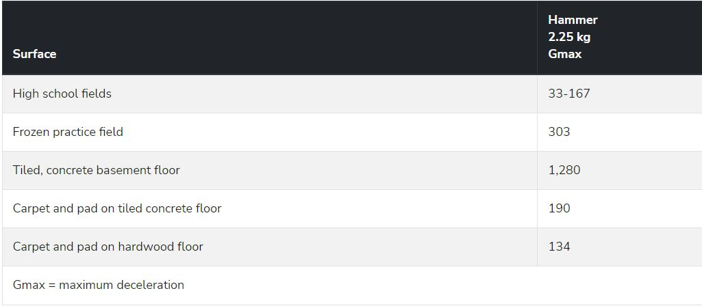
Typical G_{max}
Surface Hardness (G_{Max}) For Various Surfaces
Image Source: Penn State College of Agricultural Sciences

Slide 77
Resources
https://www.nasa.gov/image-feature/jpl/curiosity-s-selfie-at-mont-mercou
Kruijff, G. J. M., Kruijff-Korbayová, I., Keshavdas, S., Larochelle, B., Janíček, M., Colas, F., Liu, M., Pomerleau, F., Siegwart, R., Neerincx, M. A., Looije, R., Smets, N. J. J. M., Mioch, T., van Diggelen, J., Pirri, F., Gianni, M., Ferri, F., Menna, M., Worst, R., … Hlaváč, V. (2014). Designing, developing, and deploying systems to support human–robot teams in disaster response. Advanced Robotics, 28(23), 1547–1570. https://doi.org/10.1080/01691864.2014.985335
(Vehicle Propulsion) https://www.intorobotics.com/wheels-vs-continuous-tracks-advantages-disadvantages/​
(Vehicle Propulsion) https://www.macallisterrentals.com/track-vs-wheeled-equipment-type-machine-rent/​
(Vehicle Propulsion) https://en.wikipedia.org/wiki/Sojourner_(rover)
(Vehicle Propulsion) https://www.intorobotics.com/wheels-vs-continuous-tracks-advantages-disadvantages/​
(Vehicle Propulsion) https://www.macallisterrentals.com/track-vs-wheeled-equipment-type-machine-rent/
(Vehicle Propulsion) https://ijisrt.com/wp-content/uploads/2017/05/Design-of-Rocker-Bogie-Mechanism-1.pdf​
(Vehicle Propulsion) https://en.wikipedia.org/wiki/Rocker-bogie​
(Vehicle Propulsion) https://medium.com/@haikalfouzi/rocker-bogie-robot-autonomous-search-and-rescue-robot-8e049e5c47c4
(Method of Comms) https://mars.nasa.gov/msl/mission/communications/#:~:text=The%20rover%20communicates%20with%20the,waves%20used%20for%20FM%20stations.​

Slide 78
Resources
(Method of Comms) https://www.britannica.com/science/electromagnetic-radiation/Radio-waves​
(Method of Comms) https://support.huawei.com/enterprise/en/doc/EDOC1000113315/b4231b86/signal-attenuation-and-interference​
(Method of Comms) https://ourpastimes.com/disadvantages-radio-communication-6181295.html
(Method of Comms) https://www.amazon.com/GPRS-GSM-Shield-Arduino-GPS/dp/B01HNV3ZXC​
(Method of Comms) https://www.lifewire.com/how-fast-are-4g-and-3g-internet-speeds-3974470#:~:text=3G%20networks%20have%20speeds%20of,similar%20to%20cable%20modem%20speeds.​
(Method of Comms) https://www.dacast.com/blog/video-bandwidth/
(Method of Comms) https://www.sciencedirect.com/science/article/abs/pii/S2214209619302323​
(Method of Comms) https://wonderfulengineering.com/10-best-raspberry-pi-wifi-adapters/​
(Method of Comms) https://raspberrypihq.com/how-to-add-wifi-to-the-raspberry-pi/​
(Method of Comms) https://www.lifewire.com/what-is-an-ad-hoc-wireless-network-2377409​
(Method of Comms) https://www.techtarget.com/searchmobilecomputing/definition/ad-hoc-network​
(Method of Comms) https://www.fastmetrics.com/blog/wifi/factors-affecting-wifi-performance/
(Method of Controls) https://cds.cern.ch/record/1100534/files/p73.pdf

Slide 79
Resources
(Method of Comms) https://linuxhint.com/interface-infrared-ir-sensor-raspberry-pi/​
(Method of Comms) https://www.amazon.com/Gikfun-Digital-Receiver-Transmitter-Arduino/dp/B0816P2545/ref=sr_1_6?keywords=infrared+transmitter+and+receiver&qid=1663972073&sr=8-6​
(Method of Comms) https://t4tutorials.com/bluetooth-vs-infrared-comparison-of-range-and-transmission-speed/
(Method of Comms) https://www.headphonesty.com/2021/01/bluetooth-versions/#:~:text=Bluetooth%204%20has%20a%20range,and%20with%20fewer%20audio%20dropouts. ​
(Method of Comms) https://www.digikey.com/en/products/filter/rf-transceiver-ics/879 ​
(Method of Comms) https://vinnter.se/whats-new-with-ble5-and-how-does-it-compare-to-ble4/#:~:text=Bluetooth%205.0%20has%20a%20bandwidth,you%20ignore%20overheads%20like%20addressing. ​
(Method of Comms) https://www.audio-technica.com/en-us/support/audio-solutions-question-of-the-week-what-causes-bluetooth-interference/
(Video & Imaging) https://www.amazon.com/Ricoh-Theta-SC2-White-Camera/dp/B0815KT8WC/ref=sr_1_4?gclid=Cj0KCQjwj7CZBhDHARIsAPPWv3f6ULq-jlhHZ5vl1GGgnaRNDpqckqwSRt_mEXNd-MmVyuZzef68iTIaAq0cEALw_wcB&hvadid=224064081276&hvdev=c&hvlocphy=1014448&hvnetw=g&hvqmt=b&hvrand=12658977248659934215&hvtargid=kwd-319986051544&hydadcr=18503_9834403&keywords=ricoh+theta+s+360+degree+camera&qid=1663872932&sr=8-4&ufe=app_do%3Aamzn1.fos.ac2169a1-b668-44b9-8bd0-5ec63b24bcb5

Slide 80
Resources
(Video & Imaging) https://www.amazon.com/GoPro-Session-CHDHS-101-Waterproof-Camera/dp/B010H05JMQ
(Video & Imaging) https://gopro.com/en/us/shop/cameras/max/CHDHZ-202-master.html?clickId=4109675502&utm_campaign=101987&utm_content=8-12501&utm_medium=affiliate&utm_source=pepperjam
(Video & Imaging) https://www.amazon.com/GoPro-Session-CHDHS-101-Waterproof-Camera/dp/B010H05JMQ
(Video & Imaging) https://www.amazon.com/GoPro-Session-CHDHS-101-Waterproof-Camera/dp/B010H05JMQ
(Remote Sensing) https://www.ibm.com/topics/computer-vision
(Remote Sensing) https://www.seeedstudio.com/blog/2019/12/23/distance-sensors-types-and-selection-guide/
(State Determination) https://www.engineersgarage.com/what-are-inertial-sensors/
(State Determination) https://www.sciencedirect.com/topics/engineering/magnetometer
(Method of Comp) https://www.pjrc.com/store/teensy41.html#power
https://plantscience.psu.edu/research/centers/ssrc/research/infill/surface-hardness-gmax
(Method of Controls) https://www.electronics-tutorials.ws/systems/open-loop-system.html​
(Method of Controls) https://www.electronics-tutorials.ws/systems/closed-loop-system.html​
(Method of Controls) https://cds.cern.ch/record/1100534/files/p73.pdf

