Slide 1
Preliminary Design Review
ASEN 4018 – Team 5
Notes:
Presented by ESTHER
1) Consistent language choices

Slide 2
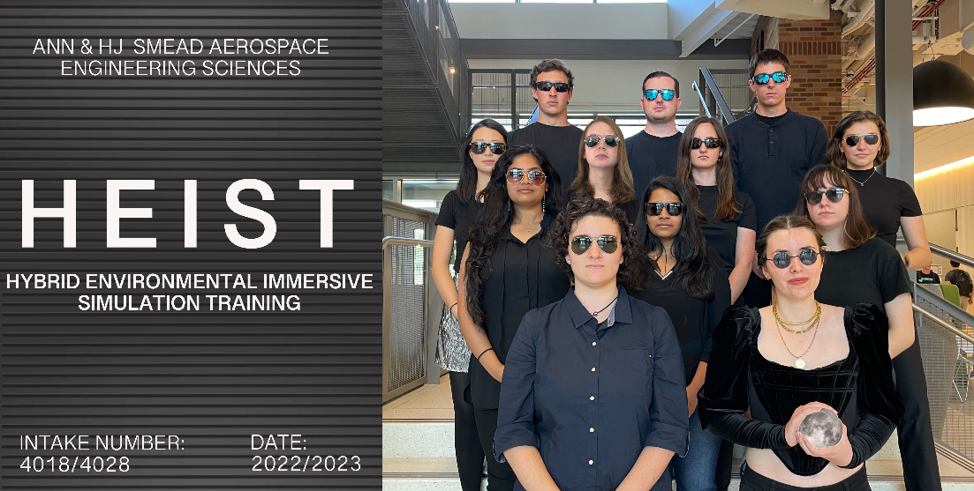
Notes:
Presented by ESTHER
Introduce each team member.
Describe what we want to do: Provide the capability to train astronauts for lunar missions using HR.

Slide 3
Agenda
Introduction (1 min)
Project Description (6 min)
Trade Studies (9 min)
Current Design Space (7 min)
Modeling & Prototyping Plans (7 min)
Notes:
Presented by ESTHER

Slide 4
Project Description
Notes:
Presented by JULIA
Clear what project is about and what it must accomplish to be successful. (18-20 pts)

Slide 5
Main Acronyms and Definitions
VR
Virtual Reality
PR
Physical Reality
HR
Hybrid Reality
Computer-generated environment
The world we live in
PCs
Physical Constraints
VR and PR combined. Interaction with PR has consequences in VR
Real world body constraints to limit motion
EVA
Extravehicular Activity
Astronaut activity outside of a spacecraft/habitat
Notes:
Presented by JULIA

Slide 6
Mission Statement
The Hybrid Environmental Immersive Simulation Training (HEIST) system will develop the capability to train humans for lunar extravehicular operations using hybrid reality.
Notes:
Presented by JULIA

Slide 7
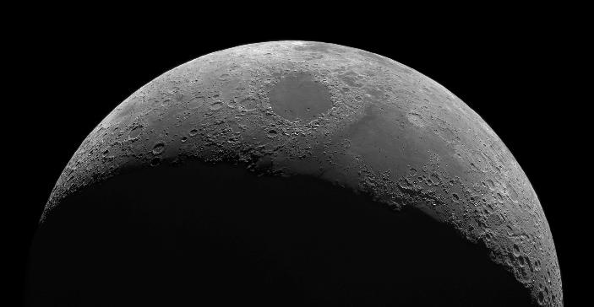
Objectives
VR Environment
Movement Constraints
Allows for some user interaction and resemble a lunar environment
Range-of-motion arm constraints to simulate wearing an EVA spacesuit
Environmental Conditions
Integrate PR Objects
Simulate lunar lighting, temperature OR auditory inputs
At least one tool/panel must be integrated from PR to VR
Notes:
Presented by JULIA
I can take it, it would flow well from the mission statement then I can pass it off to alicia for the systems stuff (CONOPS reqs etc) -- Julia C
VR Environment: example of user interaction → moving around, turning

Slide 8
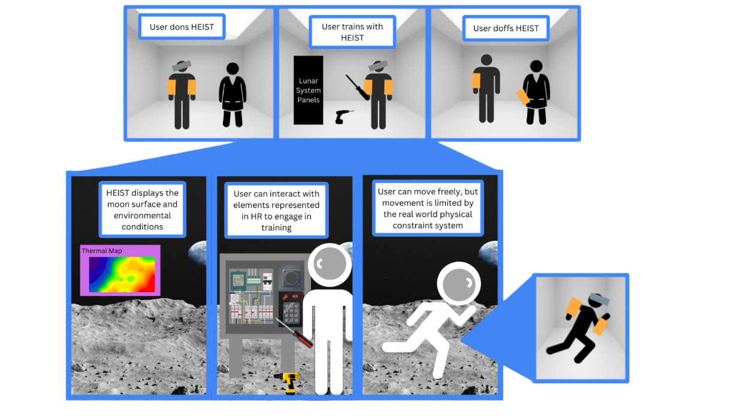
CONOPS
Notes:
Allie’s Feedback: Top was cut off. You may want to go ahead and jump down to the 3 inset things before going to the doffing. Some of the ways in which you spoke through this was actually a little confusing.
Addressed – Julia C
________________________________________________________
Presented by ALICIA
Hattie Thoughts on CONOPS Slide:
- First row shows baseline what running it will look like and the safety in place with having a scientist present
- Second row shows the functionality:
+
Don relevant items
1st two boxes, then bottom boxes, then doff

Slide 9
Functional Requirements (FRs)
1- HEIST shall be an immersive HR system where the user can enter a VR environment and interact with it though PR elements.
2- The PCs shall inhibit movement of at least one part of the body.
3- The user shall be in no danger while operating in the HR environment.
4- The customer shall be able to implement their own training scenarios within the HR environment.
Requirements Breakdown
Notes:
Allie’s Feedback: It’s fine to read through these.
No Action Needed
____________________________________
Presented by ALICIA
Add some details so it runs smoother

Slide 10
Critical Project Elements (CPEs)
Number | Critical Project Element | Description
CPE 1 | Human Safety | Minimum level of safety is required. No injury to user will be tolerated.
CPE 2 | Data Transfer Between PR and VR | Communicate position and attitude data from PR objects to the system for translation into the VR.
CPE 3 | Hand Tracking | User’s hands must be tracked accurately to ensure effectiveness in training and immersion.
CPE 4 | Motion Restriction | Simulate EVA spacesuit lack of mobility via PCs to increase immersion and fidelity.
CPE 5 | Training Versatility | Customer should be able to design their own training scenario and implement into the system.
Notes:
Allie’s Feedback: Highlight why you have elevated them to a CPE level
___________________________________________________
Presented by ALICIA
Need to show why we have elevated them to CPE level

Slide 11
Constraints
C1 - The cost of the project shall not exceed 4000 USD.
C2 - The system shall have a life span of no less than 3 years.
C3 - Unity shall be used as the VR development engine.
Requirements Breakdown
Notes:
Presented by ALICIA
C1 – Project imposed constraint
C2 & C3 – Customer imposed constraint

Slide 12
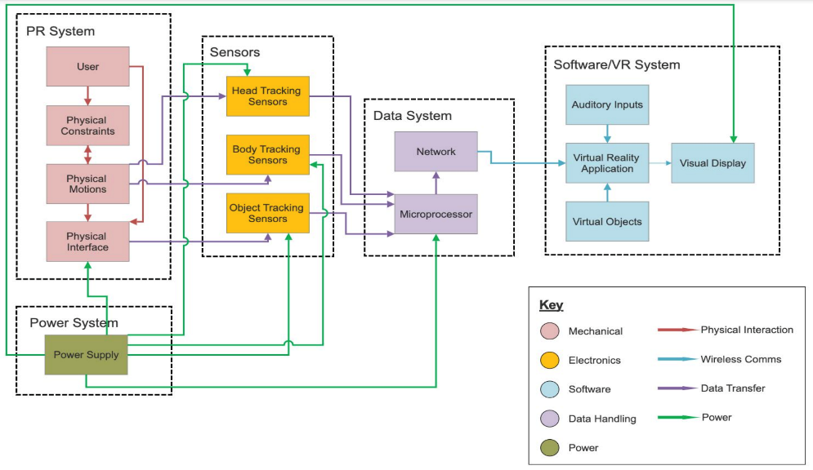
Functional Block Diagram (FBD)
Notes:
Define how systems are dissected which helps lead into trades...
Presented by ALICIA

Slide 13
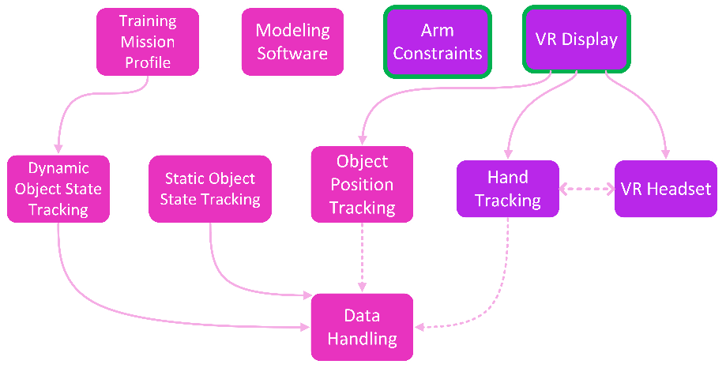
Trade Study Interdependencies
Legend:
Complete
HEIST System
Presented Today
Not Complete
Notes:
Presented by ALICIA
I added the legend, feel free to mess with it – julia c
Purple = Trade Studies that have been done
Green outline = Trades presented today
Pink (rest) = in process or not started yet
Convince them that we know how to dissect the system

Slide 14
Trade Studies
VR Display
Arm Constraints
Notes:
Presented by JULIA?
Trades covered are most critical to design. Requirements clearly tie to trade matrices. Engineering analyses utilized in trade matrices. Design space well explored. Selections are well reasoned. (27-30 pts)

Slide 15
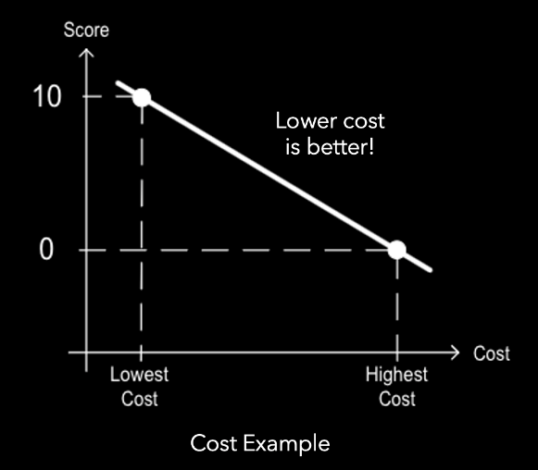
Trade Study Method
 |  | Trade Option 1
Criteria | Weights | Real Value | Interp | Wtd
Hand Tracking | 20.00% | 8 | 10.00 | 2.000
Cost | 20.00% | $1,000 | 10.00 | 2.000
Safety/Comfort | 5.00% | 9 | 0.00 | 0.000
Software | 10.00% | 10 | 10.00 | 1.000
Integration w/ outside electronics | 15.00% | 7 | 5.00 | 0.750
Outside tracking | 20.00% | 7 | 5.00 | 1.000
Resolution (width Pixels) | 5.00% | 1920 | 0.00 | 0.000
Sound | 5.00% | 8 | 0.00 | 0.000
Total | 100.00% |  |  | 6.750
Notes:
Presented by JULIA?

Slide 16
VR Display System Trade Study
Notes:
Presented by TRAYANA

Slide 17
VR Display System
Relevant Requirements
Trade Options Analyzed
# | Requirement
FR 1 | The user shall view a functional VR simulation of a lunar EVA.
FR 3 | The user's actions in PR shall correlate to effects in VR.
FR 4 | The user shall be in no danger while operating in the HR environment.
VR Headset
AR Headset
Projection Room
Notes:
Presented by TRAYANA
Specify main criteria for this trade study! So that's easier to know what to look for when you're going over pros and cons
Instead of showing trade study dependency, show different options

Slide 18
Criteria Explanation
Criteria | Weight | Explanation
Hand Tracking | 20.0 % | Ability to track user’s hands with native hand tracking (preferred) or to integrate with external methods.
Outside Tracking | 20.0 % | Ability to track objects with native software or sensors.
Cost | 20.0 % | Reasonably below max budget to allow for other purchases.
Integration with Outside Electronics | 15.0 % | Ability to interface with external sensors and electronics.
Software | 10.0 % | Compatible with C# and Unity.
Safety / Comfort | 5.0 % | Safety is required, comfort would be nice to have.
Sound | 5.0 % | Ability of the display to output sound for auditory immersion.
Resolution | 5.0 % | Number of pixels used to display the virtual environment.
Notes:
Presented by TRAYANA

Slide 19
VR Headset
Criteria | Score
Hand Tracking | 8
Outside Tracking | 7
Cost | $1,000
Integration with Outside Electronics | 7
Software | 10
Safety / Comfort | 9
Sound | 8
Resolution (Pixel Width) | 1920
Notes:
Presented by TRAYANA
Allie’s Feedback: The AR headset is usable with C# and Unity btw
_______________________________________
Pros:
Easy to use with C# and Unity
Comfortable and safe with years of testing
Easy to integrate with outside sources via Bluetooth
Diverse ability to track hands and outside objects
Built in headphones allowing further integration
Cons:
Built in software may block any changes we try to make

Slide 20
Augmented Reality (AR) Headset
Criteria | Score
Hand Tracking | 3
Outside Tracking | 8
Cost | $3,500
Integration with Outside Electronics | 4
Software | 5
Safety / Comfort | 9
Sound | 8
Resolution (Pixel Width) | 2048
Notes:
Presented by TRAYANA
From Matthew’s comment: “The main reason that I gave it an 8 is based on the description of augmented reality. In essence, the objects that we would need to “track” would not be tracked as they would be the real-world object and the AR wouldn’t put anything on to it. Therefore, it is super accurate (because its not actually doing anything just not overlaying an image) but its not perfect in that we would have to make the model much higher fidelity ”
Pros:
Safe and comfortable
Cons:
Difficult to integrate with Unity and C#
Do not typically track hands or outside objects
Less immersive and more focused on certain virtual objects

Slide 21
Projection Room
Criteria | Score
Hand Tracking | 7
Outside Tracking | 6
Cost | $10,000
Integration with Outside Electronics | 10
Software | 7
Safety / Comfort | 10
Sound | 10
Resolution (Pixel Width) | 1920
21
Notes:
Presented by TRAYANA
Pros:
Allows for free motion of user within simulated environment
Cons:
Requires a large amount of space
Would need exterior sound systems for a full immersion

Slide 22
TRADE TREE: Display Method
Display Methods
AR Headset
VR Headset
Projection Room
Score: 3.944
Expensive, high threshold for visual immersion
Score: 6.750
Low cost, highly immersive, many existing development tools
Score: 4.500
Prohibitively expensive, large space requirement
Notes:
Presented by JULIA

Slide 23
TRADE TREE: Display & Hand Tracking
Display Methods
AR Headset
VR Headset
Projection Room
Hand Tracking
In-house build
Gloves
Headset Native
Headset Software
Native Trackers
External Software
Notes:
Presented by JULIA

Slide 24
Arm Constraints Trade Study
Notes:
Presented by RACHAEL

Slide 25
Arm Constraints
Relevant Requirements
Trade Options Analyzed
# | Requirement
FR 2 | The PCs shall inhibit movement of at least one part of the body.
DR 2.1 | The PCs shall simulate the impacts of physical constraints of a lunar EVA spacesuit on arm movement.
DR 2.1.1 | The PCs shall constrain the user's arm rotation by 180-340 degrees.
DR 2.1.2 | The PCs shall constrain the user's arm movement by TBD.
DR 2.1.4 | The user shall be able to perform gross motor skills to pull, pick up, and set down PR objects.
Foam Sleeve
Wire Arm Harness
Ball and Socket (Octopus)
Clothing
Air-Pressurized Sleeve
Braces
Splints
Notes:
Presented by RACHAEL
Allie’s Feedback: For the “dependent trade studies” I wonder if this is most effective to have at the beginning. You’re giving the summary of ‘protype and model” but we haven’t seen the trade yet.
________________________________
Dependent trades/prototyping → explain WHY we need to do this trade study now (so early). Is there a lot of dependent trades that come after this decision? Does it require feasibility analysis / prototyping to happen relatively soon?
COTS = Commercial off-the-shelf (can buy from somewhere)
The hand restraint system and object tracking directly overlap, so we need to know what the arm constraints will be first
We mainly need a top 3 design choices for the pcs for this exact reason. With respect to prototyping and modeling, yes it needs to be prototyped fairly soon to make sure the restraints for feasible.
NOTES FROM TF MEETING:
Specify main criteria for this trade study! So that's easier to know what to look for when you're going over pros and cons
CHANGE RW for PR!!!!!!

Slide 26
TRADE TREE: Arm Constraints
Only Shoulder
Arm Constraints
Foam Sleeve
Wire Arm Harness
Ball and Socket (Octopus)
Clothing
Air-Pressurized Sleeve
Braces
Splints
Only Elbow
Shoulder and Elbow
Notes:
Presented by RACHAEL
Arm constraints: We chose to focus to constrain the arm for the astronaut suit mockup. We found that the main constraint astronauts have are their arms. From there, we decided to focus in on the three parts of the arm: shoulder and elbow

Slide 27
Criteria Explanation
Criteria | Weight | Definitions
Resistivity | 20.0 % | Ability for suit mockup to restrict joints and movement to mimic an EVA suit for realism.
Mechanical Adaptability | 15.0 % | Ability to modify product without damaging and changing the products ideal capability.
Adjustability | 15.0 % | Ability for constraint to be adjusted to fit different individuals.
Material Availability | 15.0 % | Availability of material required to develop mechanism.
Manufacturability | 7.5 % | Ability to buy mechanism online or difficulty of time allotment required for build.
Cost | 7.5 % | Cost of fully assembled mechanism: material, tools, and workshops.
Durability | 7.5 % | Number of cycles a mechanism can go through before maintenance.
User Comfort | 7.5 % | How comfortable the user feels wearing the constraint system.
Maintainability | 5.0 % | Ability to go in and quickly repair mechanism.
Notes:
Presented by RACHAEL

Slide 28
TRADE TREE: Arm Constraints
Only Shoulder
Arm Constraints
Foam Sleeve
Wire Arm Harness
Ball and Socket (Octopus)
Clothing
Air-Pressurized Sleeve
Braces
Splints
Only Elbow
Shoulder and Elbow
Does not fulfill requirements
Score: 3.475
Costly and not very adaptable
Score: 4.125
Prototype to further determine feasibility
Score: 3.938
Prototype to further determine feasibility
Score: 4.313
Removed due to low resistance
Removed due to minimal adaptability
Score: 4.025
Prototype to further determine feasibility
Score: 4.250
Score: 3.788
Not easily adjustable
Does not fulfill requirements
Notes:
Presented by RACHAEL
Clothing was the best option based on the trade study, however due to its very poor resistivity, it was not a valid choice to move forward with.
Have a previous table outlining criteria: simple definitions
Adaptability: being able to adjust and apply across the board.
Likewise, the compression support also had low resistivity making it an invalid choice moving forward
Removed Air-pressurized sleeve due to its inability to be very adaptable
Braces and Splints were some of the best options

Slide 29
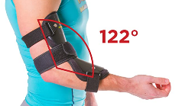
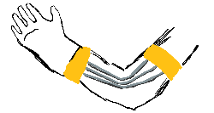
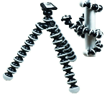
Arm Constraints Top Options
Arm Constraints | Reason | Criteria It Matches
Braces | The best option of all the trades for those that traded most favorably in the most important criteria. | Resistivity, Mechanical Adaptability, Adjustability, Manufacturability, Durability, User Comfort, Maintainability
Wire Arm Harness | The second best option of all the trades for those that traded most favorably in the most important criteria. | Resistivity, Mechanical Adaptability, Adjustability, Material Availability, Manufacturability, Cost, Maintainability
Ball and Socket (Octopus) | The third best option of all the trades for those that traded most favorably in the most important criteria. | Resistivity, Material Availability, Durability, Cost, User Comfort
Notes:
Presented by RACHAEL
Our top three arm constraints after our trade study were splints, braces, and the wire arm harness. We found that the splint, brace, and wire arm harness had high resisitivity, durability, and adaptability which aligns well with our top expectations for the mockup suit.
Options traded most fa vourably for the most important criteria

Slide 30
Current Design Space
Design Limitations
Next Trade Studies
Notes:
Presented by STEVEN

Slide 31
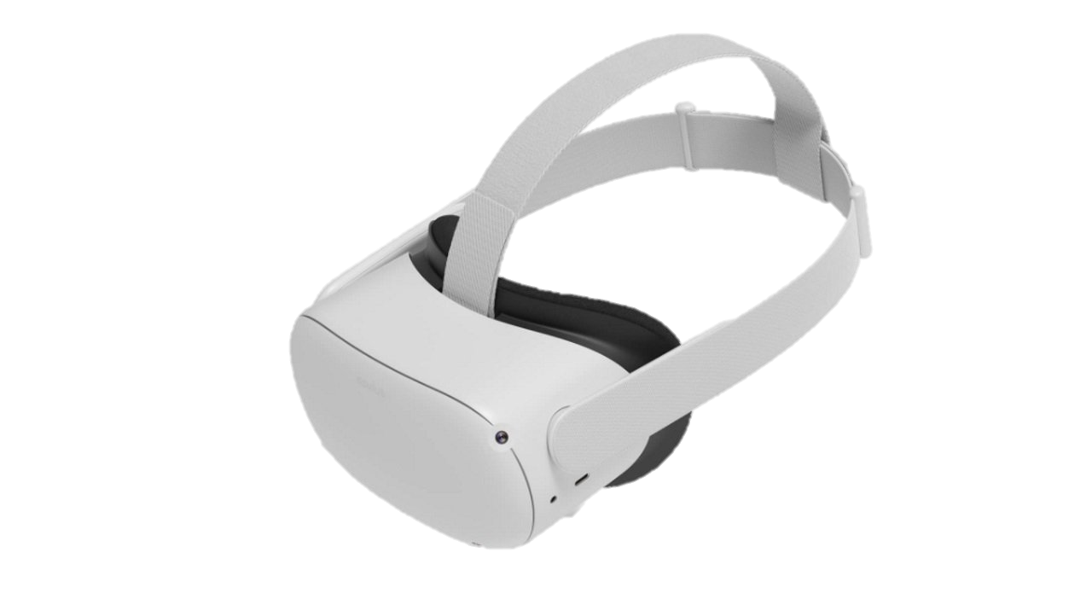
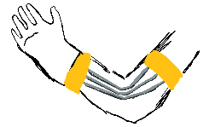
Design Limitations
A VR headset is the most favorable solution
Only solution with a reasonable price for our budget
Most practical for creating a fully immersive experience
Braces, wire arm harnesses, and ball and socket joints are all viable options that need to be explored further through prototyping before a final design is chosen
Notes:
Presented by STEVEN
Allie’s Feedback: Design limitations an AR headset is within the budget btw. Magic Leap. (The reason the AR headset is not within the budget is because we would still have to have money for hand tracking and arm constraints and would not leave enough money for either of those)
(magic leap is $3200 at the cheapest it seems so, yeah, no AR – julia c)
__________________________
“As we highlighted previously in the trade studies, blah blah blah”
need to be explored further through prototyping

Slide 32
Next Trade Studies
Future Trade Studies
Current Trade Studies
Environmental Conditions Display Method
PR Interactions
Panels, Buttons, Switches, Tools
Replacement of Objects
Hand Tracking – Finished
VR Headset – Finished
Object Tracking – In Progress
VR Modeling Software – In Progress
VR Computer - In Progress
Training Profile – In Progress
Notes:
Presented by STEVEN

Slide 33
Modeling & Prototyping Plans
Compatibility & Feasibility Analysis
Interaction PR-VR
Arm Constraints Prototyping
Notes:
Presented by STEVEN

Slide 34
Compatibility & Feasibility Analysis of VR
VR Build Demo
Design a basic virtual environment that allows motion
Will require training with Unity and C# to design the environment
Test with demo headset
Already started
Notes:
Presented by STEVEN
Allie’s Feedback: there is a lot of stuff on this slide with two. To do this prototyping, you will have to buy a lot of stuff. How will you do this? The key thing to emphasize here is what will the prototyping tell you and how does it help you narrow down the design space.
__________________________________
Explain: test with available headset (Oculus Quest 2 from Electronics Shop – Bobby Hodgkinson) to show that we can send a VR environment to headset and move around.
Requires training but has already started (by the time we present)

Slide 35
Compatibility & Feasibility Analysis of VR
VR Headset + Hand Tracking
Experiment with different hand tracking methods to check compatibility
Test VR headset along with its hand tracking abilities
Notes:
Presented by STEVEN
Allie’s Feedback: To do this prototyping, you will have to buy a lot of stuff. How will you do this? The key thing to emphasize here is what will the prototyping tell you and how does it help you narrow down the design space.
________________________________
Explain: test hand tracking w/ headset → Goal: test with Oculus Quest 2 (best ranked VR headset for hand tracking in our trade study) to see how good is the best option (help inform the trade study and adjust if necessary). If it turns out to be bad, we can discard all VR headsets hand tracking since they would be worse.
Hand tracking gloves would be the best quality we could realistically achieve. Only reason to eliminate this option would be budget. IF gloves are over budget, then Plan C: prototype our own hand trackers

Slide 36
Physical Interaction with VR Environment
PR Interaction Proof of Concept
Create a flip switch on a physical board where VR environment reflects real-world interaction.
Object Tracking Testing
Plan A: Test headset-specific tracking sensors for tool interaction.
Plan B: Prototype in-house custom sensors to track tool interaction (trade study).
Notes:
Presented by STEVEN
Allie’s Feedback: this is great and it makes it clear why you need to do this. That said, you have these options here, I’m not clear what these options are? Is this not something you can do a trade on?
___________________________
Have a software architecture tree or FBD for how the software will interact or how it’s going to work/what we’re expecting (In appendix)
Explain: we want to demonstrate that we can create a PR-VR interaction (we will do this no matter what)
For object tracking: will test available tracking sensors to see how good they are → inform our object tracking trade study
It depends on which VR headset we choose, may or may not have outside trackers and/or may be over budget → need to trade study object tracking
If they are overbudget: then prototype our own object trackers

Slide 37
Arm Constraint Prototyping
Existing Mechanisms
In-House Development
Continue our trade study on top options for arm and shoulder constraint systems by prototyping.
Examine those constraint systems by having mobility tests with the prototypes.
Compare results against astronaut suit restraint data.
Prototype our top options for arm and shoulder and modify to decrease movement.
Examine durability and resistivity of modified constraints.
Compare durability, resistivity, cost, and user comfort.
Notes:
Presented by RACHAEL
Allie’s Feedback: This is clear from the trade why you need to do this, and I like how you will state your metrics for how you will assess and feed the decision.
__________________________
* We need to start prototyping ASAP, so we must buy things soon (preferably begin prototyping/testing after PDR)
Interaction PR-VR right before
Mention we need P-card to buy prototype materials: materials, needed mechanisms, etc.

Slide 38
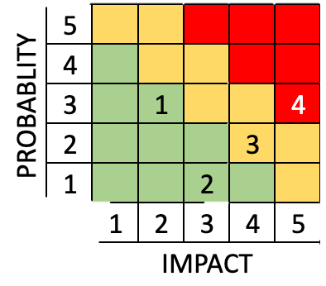
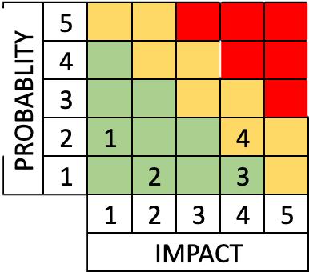
Risk Management Plan
# | Risk Description | Probability | Impact
1 | Motion Sickness | 3 | 2
User feels unwell after/during VR simulation due to higher susceptibility to motion sickness. Probability: common occurrence Impact to the user: dizziness, disorientation, nausea, etc.
2 | User is Physically Harmed | 1 | 3
User is harmed due to the lack of spatial awareness of their PR surrounds. Probability: rare occurrence Impact: user might fall, bump into objects, etc.
3 | Lost/Reduced Synchronization Between PR/VR | 2 | 4
Delay or total disconnection between user's actions in PR and what the user sees in VR. Probability: semi-rare occurrence Impact: increased difficulty of interacting with system
4 | Hardware/Sensor Malfunction | 3 | 5
Malfunction of the PCs or tracking sensors (depending on tracking method chosen). Possible cause may be hardware damage during operation. Probability: common occurrence Impact: inability to operate the simulation or to simulate PCs of EVA spacesuit
Mitigation
Risk Management Plan
Notes:
Presented by ESTHER

Slide 39
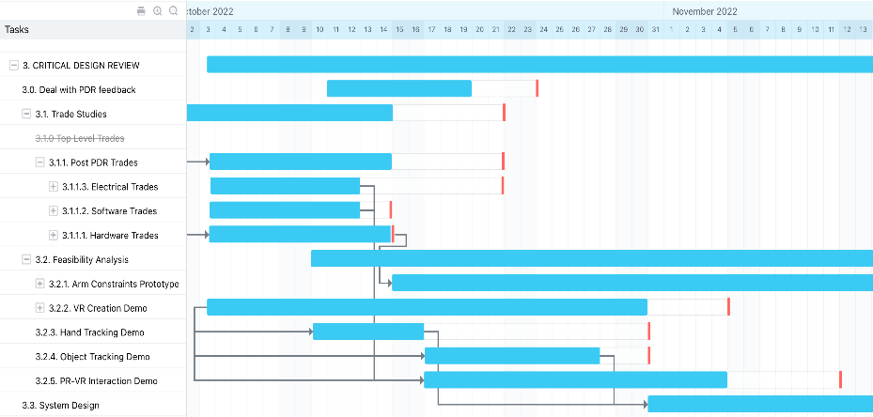
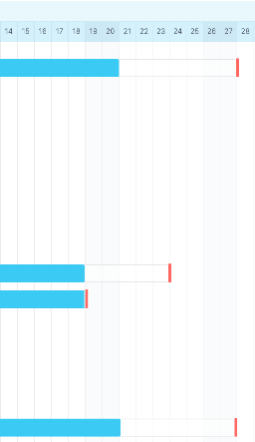
Schedule Moving Forward
CDR
Notes:
Presented by ESTHER
Allie’s Feedback: Please annotate with your critical path, current date on the slides. Can you color code so the gantt chart is tied to the system components

Slide 40
Presenters
Credits
Faculty Advisor
Additional Team Members
Dr. Allison Anderson
Esther Revenga Villagra
Trayana Athannassova
Rachael Carreras
Julia Claxton
Steven Young
Alicia Wu
Akanksha Nelacanti
Matthew Grewe
Sruthi Bandla
Sebastian Boysen
Lucy Davis
Hattie Rice
Mentor Company
Blue Origin
PDR Reviewers
Team CTHREEPIO
Andreas Brecl
Notes:
Presented by ESTHER

Slide 41
Thank you! Q&A Time (20 min)
Notes:
Presented by ESTHER

Slide 42
Appendix
Backup Slides
Notes:
Need to add FBD for software implementation. Kind of a hybrid between trades and block diagram.

Slide 43
Appendix Index
Full List of Acronyms
Object Tracking Trade Options
Requirements
Training Profile Trade Tree
VR Display Trade Study
VR Computer & Dev Software
Hand Tracking Trade Study
Risk Management Plan
Arm Constraint Trade Study
Resources

Slide 44
Full List of Acronyms
A = Analysis (V&V)
AR = Augmented Reality
CDR = Critical Design Review
CFO = Chief Financial Officer
COTS = Commercial Off The Shelf
CPE = Critical Project Element
D = Demonstration (V&V)
DH = Data Handling
DoF = Degree of Freedom
DR = Design Requirement
Elect = Electrical
EVA = Extravehicular Activity
FBD = Functional Block Diagram
FFBD = Functional Flow Block Diagram
FR = Functional Requirement
HEIST = Hybrid Environmental Immersive Simulation Training
HT = Hand Tracking
HR = Hybrid Reality
I = Inspection (V&V)
Mech = Mechanical
Mgmt = Management
PC = Physical Constraint
PDD = Preliminary Design Document
PDR = Preliminary Design Review
PM = Project Manager
PR = Physical Reality
SE = Systems Engineer
SME = Subject Matter Expert
SW = Software
T = Test (V&V)
TBD = To Be Determined
TBR = To Be Refined
TPM = Technical Performance Measure
UI = User Interface
UX = User Experience
VR = Virtual Reality
Back to Index

Slide 45
Requirements
Mission Objectives
FRs
Constraints
VR Trade
Arm Trade
Back to…
Back to Index

Slide 46
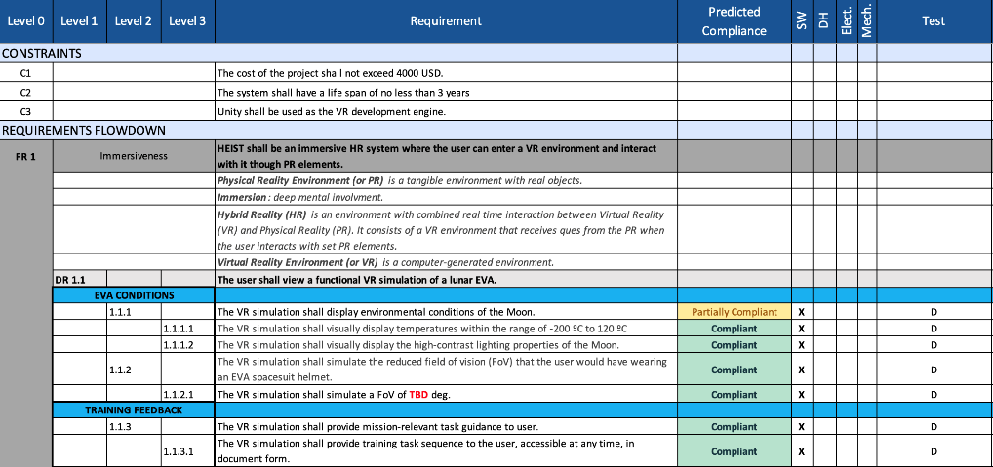
Requirements – FR1
Back to Index
Notes:
TOO SMALL TO READ

Slide 47
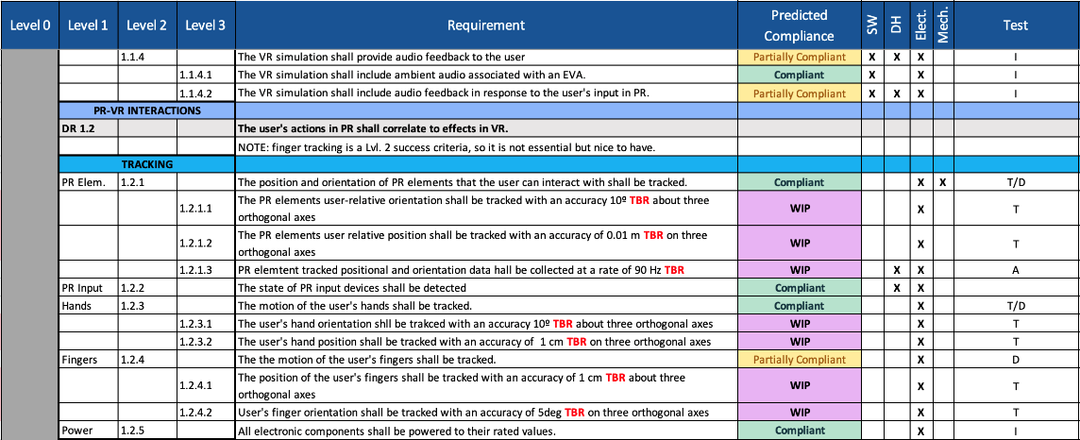
Requirements – FR1
D
Back to Index
Notes:
TOO SMALL TO READ

Slide 48
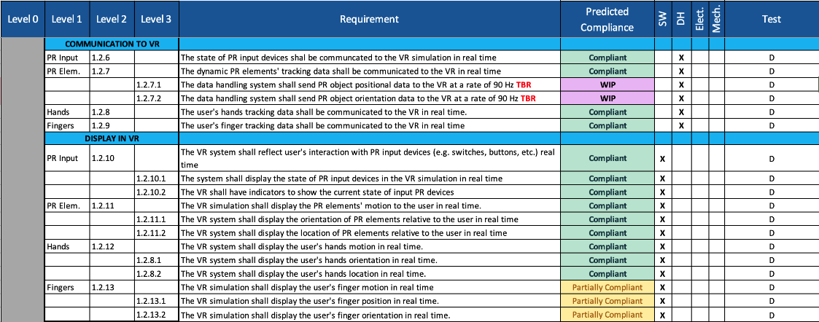
Requirements – FR1
Back to Index
Notes:
TOO SMALL TO READ

Slide 49
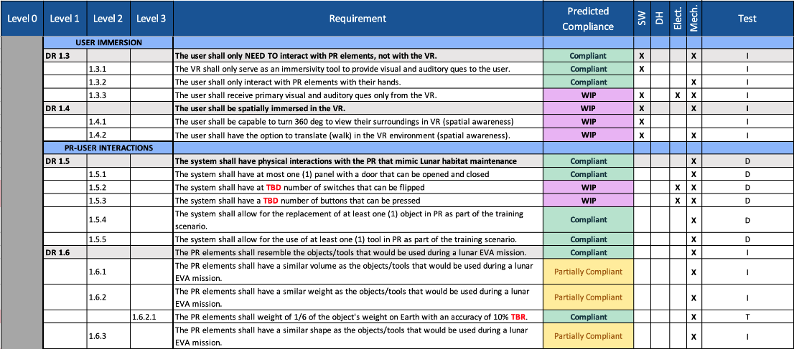
Requirements – FR1
Back to Index
Notes:
TOO SMALL TO READ

Slide 50
Requirements – FR3, FR4
Back to Index

Slide 51
VR Display Method Trade Study
Trade Options
Results
Trade Tree
Back to VR Display…
Back to Index

Slide 52
Grading Values for VR System
 | 0-1 | 2-3 | 4-5 | 6-8 | 9-10
Hand Tracking | No method for hand tracking | Very difficult to add in custom hand tracking | Easy to add in house hand tracking | Hand tracking is there but may not be great | Hand tracking is very accurate
Cost | Was done based on interpolation with cheapest option getting 10 pts and most expensive getting 0pts
Safety/Comfort | User will be seriously injured, or system is extremely uncomfortable | User may be injured, or system is highly uncomfortable | Slight chance of injury. System may be uncomfortable to be in for long periods of time | No realistic injury but slightly uncomfortable | No realistic injury and user could wear it for many hours with no discomfort
Software | Cannot use software to modify anything | Uses a different type of software but is difficult to modify | Uses a different type of software but can be modified easily | Compatible with Unity or C# | Compatible with Unity and C#
Integration w/ outside electronics | No ability of connect with outside electronics | VR system would need modifications to be able to connect via wires to other electronics | VR system can connect via wires to other electronics | VR system can connect via Bluetooth to other electronics | No need for special communication between outside electronics and VR system
Outside tracking | No ability to track objects not directly connected to VR | Tracking of objects requires both hardware and software | Tracking of objects can be added with exclusively hardware | Tracking of objects can be easily added to VR system with software | Tracking of outside objects built into VR systems
Resolution (width Pixels) | Was done based on interpolation of the number of pixels the system has along its width (systems were assumed to have a constant ratio of pixels in width and height directions) with the least number of pixels getting 0 pts and most number getting 10 pts
Sound | No ability to add sound | Sound with wired headphones | Sound with wireless headphones | Immersive surround sound with wireless headphones | Immersive surround sound without headphones
Back to Index
Notes:
Organize criteria from max weight to min

Slide 53
VR Display Trade Study Grading
Criteria | VR Headset | AR Headset | Projectors
Hand Tracking | Built-in capabilities. Easy to integrate other technologies | Minimal built-in hand tracking methods | Cannot always see hands/full body
Safety/Comfort | Comfortable headset that has been tested | Comfortable headset that has been tested | Nothing touching the body
Software | Easy to integrate with C# and Unity | Cannot easily integrate with C# and Unity | Does not require Unity. Interaction will not deal with software
Integration w/ outside electronics | Easy to send data via Bluetooth | No data on Bluetooth interactions | No need for connection with outside electronics
Outside Tracking | Historical data showing how to do outside tracking. Ability to buy trackers or make our own | No data showing how to track outside objects or how it works | Outside tracking will be difficult and will not always be able to be seen based on where cameras are pointed
Sound | Built in headphones that integrate with VR environment | No built-in sound system | Sound would be a sperate entity
Back to Index
Notes:
Maybe move to Appendix if going to explain each case individually in their respective slide

Slide 54
VR Display Trade Study Results
 |  | VR Headset |  |  | AR Headset |  |  | Projection System
Criteria | Weights | Real Value | Interp | Wtd | Real Value | Interp | Wtd | Real Value | Interp | Wtd
Hand Tracking | 20.00% | 8 | 10.00 | 2.000 | 3 | 0.00 | 0.000 | 7 | 8.00 | 1.600
Cost | 20.00% | $1,000 | 10.00 | 2.000 | $ 3,500 | 7.22 | 1.444 | $ 10,000 | 0.00 | 0.000
Safety/Comfort | 5.00% | 9 | 0.00 | 0.000 | 9 | 0.00 | 0.000 | 10 | 10.00 | 0.500
Software | 10.00% | 10 | 10.00 | 1.000 | 5 | 0.00 | 0.000 | 7 | 4.00 | 0.400
Integration w/ outside electronics | 15.00% | 7 | 5.00 | 0.750 | 4 | 0.00 | 0.000 | 10 | 10.00 | 1.500
Outside tracking | 20.00% | 7 | 5.00 | 1.000 | 8 | 10.00 | 2.000 | 6 | 0.00 | 0.000
Resolution (width Pixels) | 5.00% | 1920 | 0.00 | 0.000 | 2048 | 10.00 | 0.500 | 1920 | 0.00 | 0.000
Sound | 5.00% | 8 | 0.00 | 0.000 | 8 | 0.00 | 0.000 | 10 | 10.00 | 0.500
Total | 100.00% |  |  | 6.750 |  |  | 3.944 |  |  | 4.500
0 = worst 10 = best
Back to Index
Notes:
Allie’s Feedback: Organize criteria from max weight to min weight
_________________________________
Presented by …
DESCRIBE CRITERIA NUMBERING: WHAT IS EACH NUMBER? MAYBE EASIER TO MAKE INTO ‘WHAT IS 0-3 POINTS VS 4-7 VS 8-10? ← Backup slides

Slide 55
VR Headset Trade Study

Slide 56
VR Headset Trade Study Grading
Criteria | HTC Vive Pro 2 | HTC Vive Focus 3 | HTC Vive Cosmos Elite | Oculus Quest 2
Hand Tracking | Accurate hand tracking requires more advanced components but very accurate | Controller free hand tracking | 6 exterior cameras to advance hand and object tracking | High quality hand tracking that has been tested to be accurate within a few cm
Safety / Comfort | Safe. Comfortable design | Most comfortable design. Safe | Safe. Comfortable design | Safe. Comfortable design
Software | Easy to integrate with Unity using C# | Easy to integrate with Unity using C# | Easy to integrate with Unity using C# | Easy to integrate with Unity using C#
Integration w/ outside electronics | Integration using Bluetooth | Integration using Bluetooth | Integration using Bluetooth | Requires the use of additional Bluetooth receiver
Outside Tracking | Commercial trackers available or could build in house | Commercial trackers available or could build in house | Commercial trackers available or could build in house | Trackers would have to be built in house
Sound | Built in headphones | Spatial audio out of headset (no headphones – worse sound) | Built in gaming headphones | Headphone jack available (but would be taken over by Bluetooth receiver. Must add wireless headphones)
Back to Index
Notes:
No close cases, no need for sensitivity analysis
Organize criteria from max to min weight

Slide 57
HTC Vive Pro 2
Accurate hand tracking requires more advanced components but very accurate
Safe. Comfortable design
Easy to integrate with Unity using C#
Outside electronics integration using Bluetooth
Commercial trackers available or could build in house
Built in headphones
Back to Index

Slide 58
HTC Vive Focus 3
Controller free hand tracking
Most comfortable design. Safe.
Easy to integrate with Unity using C#
Outside electronics integration using Bluetooth
Commercial trackers available
Spatial audio out of headset (no headphones)
Back to Index

Slide 59
HTC Vive Cosmos Elite
6 exterior cameras to advance hand and object tracking
Safe. Comfortable design
Easy to integrate with Unity using C#
Outside electronics integration using Bluetooth
Commercial trackers available
Built in gaming headphones
Back to Index

Slide 60
Oculus Quest 2
High quality hand tracking that has been tested to be accurate within a few cm
Safe. Comfortable design
Easy to integrate with Unity using C#
Requires the use of additional Bluetooth receiver
Trackers would have to be built in house
Headphone jack available (but would be taken over by Bluetooth receiver. Must add wireless headphones)
Back to Index

Slide 61
VR Headset Trade Study Results
 |  | Vive Pro 2 |  |  | Focus 3 |  |  | Cosmos Elite |  |  | Oculus Quest 2
Criteria | Weights | Real Value | Interp | Wtd | Real Value | Interp | Wtd | Real Value | Interp | Wtd | Real Value | Interp | Wtd
Hand Tracking | 20.00% | 6 | 4.29 | 0.857 | 4 | 1.43 | 0.286 | 8 | 7.14 | 1.429 | 10 | 10.00 | 2.000
Cost | 20.00% | $ 1,400.00 | 8.96 | 1.792 | $ 1,300.00 | 9.06 | 1.813 | $ 1,300.00 | 9.06 | 1.813 | $ 400.00 | 10.00 | 2.000
Safety/Comfort | 5.00% | 9 | 8.89 | 0.444 | 10 | 10.00 | 0.500 | 9 | 8.89 | 0.444 | 9 | 8.89 | 0.444
Software | 10.00% | 10 | 10.00 | 1.000 | 10 | 10.00 | 1.000 | 10 | 10.00 | 1.000 | 10 | 10.00 | 1.000
Integration w/ outside electronics | 15.00% | 8 | 0.00 | 0.000 | 8 | 10.00 | 1.500 | 8 | 10.00 | 1.500 | 4 | 3.33 | 0.500
Outside tracking | 20.00% | 8 | 10.00 | 2.000 | 8 | 10.00 | 2.000 | 8 | 10.00 | 2.000 | 4 | 2.00 | 0.400
Resolution (Pixels Width) | 5.00% | 5000 | 10.00 | 0.500 | 5000 | 10.00 | 0.500 | 2880 | 3.12 | 0.156 | 1920 | 0.00 | 0.000
Sound | 5.00% | 7 | 10.00 | 0.500 | 5 | 6.00 | 0.300 | 7 | 10.00 | 0.500 | 5 | 6.00 | 0.300
Total | 100.00% |  |  | 7.093 |  |  | 7.898 |  |  | 8.841 |  |  | 6.644
Back to Index
Notes:
No close cases, no need for sensitivity analysis
Organize criteria from max to min weight

Slide 62
Hand Tracking Trade Study
Back to Index

Slide 63
Hand Tracking Trade Study Grading
 | VR Headset Native Hand Tracking | Hand Tracking Gloves | In House Hand Tracking with IMUs, Accelerometers, etc | Pixy Cam Hand Tracking
Position | Some models may track position to mild (~0.25m) accuracy | Can track hand position to within 0.05m | Can track orientation relative to other things based on acceleration. Errors build | Hands would have to be colored for cams to track within a few cm
Orientation | Various models can track changes in orientation | Can track hand orientation to within 1˚ orientation | Can track accuracy to within a few degrees but errors build on each other | Can track orientation to within degrees IF the surfaces are colored
Cost | Included in the cost of the headset | $1,000 for gloves | IMUs ~$30, Arduino ~$25, would need ~10 IMUs | Pixy cams ~ $20, Arduino ~$25, may need 5
Ease of Use | Would need minimal modification to work with VR headset | Designed for VR. May need slight algorithmic modification | IMUs can be difficult to send power to and get data from | Lots of opensource software to use. May need to modify algos slightly
Compatibility with VR System | VR system is compatible with itself | Designed for VR. Compatible | Would have to do extra work to send data to VR | Would have to do extra work to send data to VR
Compatibility with PR Objects | VR Headsets lack good object tracking for the most part unless they use exterior cameras that are not particularly accurate | May affect how the user picks up or holds objects but only minimally | Could get bulky depending on design. May interfere with how user interacts with PR objects | Very easy to track PR objects and would not get in the way of anything. PR objects would have to be colored
Back to Index
Notes:
Organize criteria from max to min weight

Slide 64
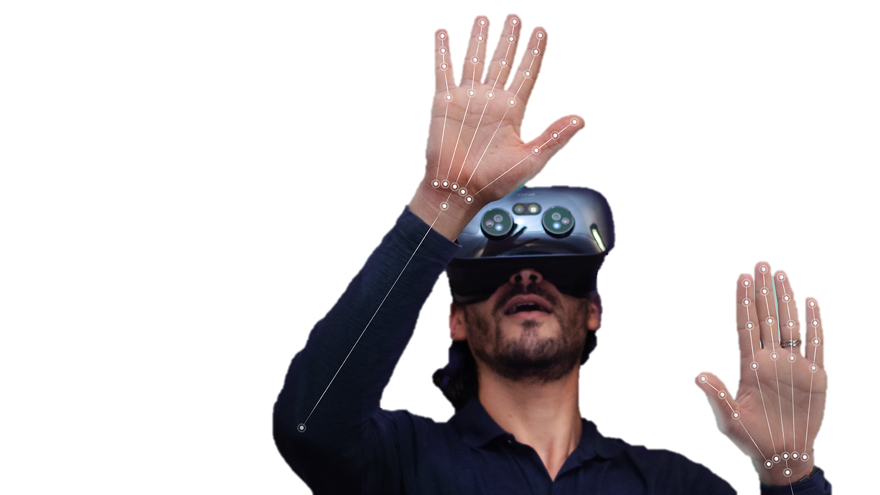
VR Headset Native Hand Tracking
Pros
Already included in VR headset
Varying levels of accuracy but could be calibrated for increased accuracy
No need to use exclusively exterior electronics
Cons
Not always the most accurate
Orientation may be difficult to track
Back to Index

Slide 65
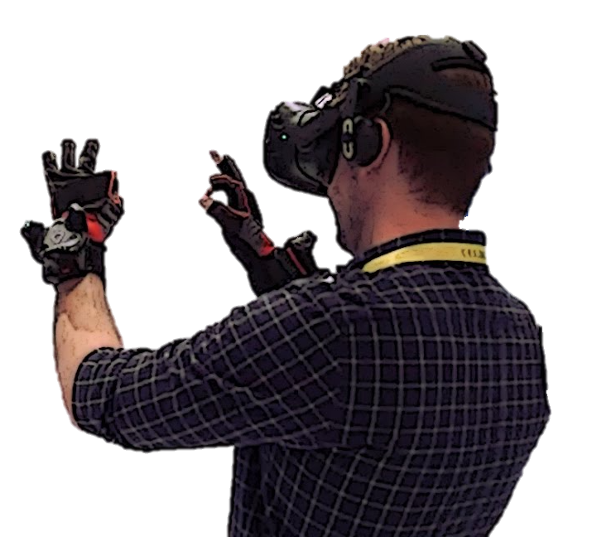
VR Hand Tracking Gloves
Pros
Very accurate (cm and single ˚ accuracy)
Integrate well with VR systems
Cons
Expensive
Neutral
May make holding PR objects a little weird as the glove will be in between the hand and object
Back to Index

Slide 66
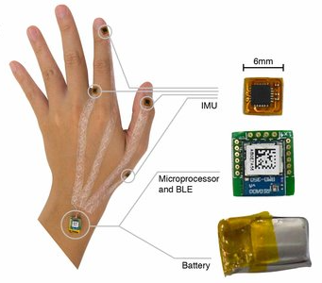
In-House Hand Trackers with Accelerometers/IMUs/etc
Pros
Would be designed specifically for our task
Inexpensive components (~$20 each)
Cons
Accuracy will be dependent on our skill/fabrication level and budget
Requires complicated integration algorithms that are highly sensitive to error
May become bulky and interfere with user
Back to Index
Notes:
https://www.researchgate.net/figure/a-Hardware-implementation-of-the-IMU-hand-tracking-system-b-Application-example_fig12_327758775

Slide 67
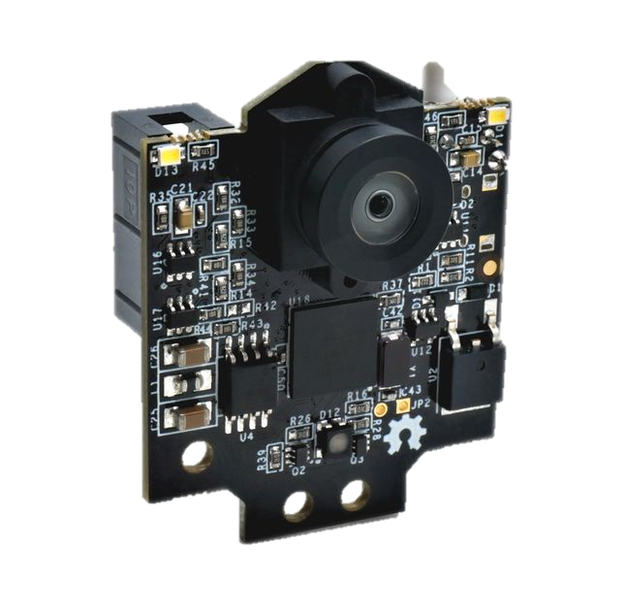
Pixy Cams
Pros
Inexpensive components (~$20 each)
Decent accuracy (makes a box around object that is accurate)
Cons
Would need extra work to integrate with the VR headset
Occlusion of object disables all tracking
Tracks in 2 dimensions only
Back to Index

Slide 68
Hand Tracking Trade Study Results
 |  |  |  | VR Native Hand Tracking |  |  | Hand Tracking Gloves |  |  | In House Hand Tracking with Accelerometers/IMU/other |  |  | Tracking with Pixy Cams
Criteria | Weights | WORST | BEST | Real Value | Interp | Wtd | Real Value | Interp | Wtd | Real Value | Interp | Wtd | Real Value | Interp | Wtd
Position | 20.00% | 4 | 8 | 6 | 5.00 | 1.000 | 8 | 10.00 | 2.000 | 5 | 2.50 | 0.500 | 4 | 0.00 | 0.000
Orientation | 15.00% | 5 | 9 | 5 | 0.00 | 0.000 | 9 | 10.00 | 1.500 | 7 | 5.00 | 0.750 | 5 | 0.00 | 0.000
Cost | 20.00% | 6 | 10 | 10 | 10.00 | 2.000 | 6 | 0.00 | 0.000 | 8 | 5.00 | 1.000 | 9 | 7.50 | 1.500
Ease of Use | 20.00% | 4 | 8 | 8 | 10.00 | 2.000 | 8 | 10.00 | 2.000 | 4 | 0.00 | 0.000 | 8 | 10.00 | 2.000
Compatability with VR system | 20.00% | 4 | 10 | 10 | 10.00 | 2.000 | 8 | 6.67 | 1.333 | 4 | 0.00 | 0.000 | 4 | 0.00 | 0.000
Compatability with PR objects | 5.00% | 3 | 10 | 3 | 0.00 | 0.000 | 7 | 5.71 | 0.286 | 10 | 10.00 | 0.500 | 10 | 10.00 | 0.500
Total | 100.00% |  |  |  |  | 7.000 |  |  | 7.119 |  |  | 2.750 |  |  | 4.000
Back to Index
Notes:
Organize criteria from max to min weight

Slide 69
TRADE TREE: Hand Tracking
Hand Tracking
In-house build
Gloves
Headset Native
Software
Hardware (native sensors)
External Software
Back to Index

Slide 70
Physical Constraints (PCs) Trade Study
Trade Tree
Top Options
Back to Arm Constraints…
Back to Index

Slide 71
Levels of Evaluation For Physical Constraints
Levels | 1(WORST) | 2 | 3 | 4 | 5(BEST)
Manufacturability | Can get product from one site OR manufacturing of constraint takes longer than 8 hours and very difficult to manufacture | Can get product from 1-2 sites OR manufacturing time is still 6-8 hours and difficult to manufacture | Can get product from multiple sites OR manufacturing is 5-6 hours and maybe some difficulty in manufacturing | Can get product from multiple sites OR manufacturing 3-5 hours and with ease in manufacturing | Can get product from multiple sites OR 2 hours or less and with ease in manufacturing
Resistivity | Product has no resistance, user can move all degrees of motion OR product has complete resistance, no moment possible | Product has a noticeable lack of resistance, user can move in most degrees of motion OR product has way too large resistance, very difficult to move | Product has noticeable resistance; user is restricted in only one degree of motion but otherwise unrestrained, OR product has quite a bit larger resistance than desired, very difficult to move | Product has noticeable resistance; user is restricted in two degrees of motion but otherwise unrestrained, OR product has larger resistance than desired, very difficult to move | Product restricts the joints properly; all important joints are restrained properly
Durability | Object is fragile | Fragile, can handle being tossed to the ground | Not brittle, can go through multiple cycles before maintenance | Not fragile, able to go through 50% of system life cycle before maintenance | Not fragile, able to go through 100% of system life cycle before maintenance
Adaptability | Modifying compromises its resistivity and durability, able to be used by only one certain individual | Modifying product compromise durability, able to be used by some individuals | Modifying product has little effect on resistivity, able to be used by most individuals | Modifying product doesn't compromise resistivity, able to be used by general standard of individuals | Modifying product has little to no impact on product well-being, able to be used by any individual
Maintainability | Not able to maintain system, must make significant adjustments after every use. | Can go 2-3 test runs before adjustments | 4-5 test runs before adjustments | 5-6 test runs before adjustments | 6-10 test runs before adjustments
Material Availability | Material is rare | Material available yet rare | Material available | Material easily available | Material readily available
Cost | $100+ | $75-$100 | $50-$75 | $25-$50 | $0-$25
User Comfort | Digs into user's skin, causes significant pain to move, | Mildly uncomfortable straps and slightly hurts to move | Fairly comfortable straps but uncomfortable to use, lining required but not enough | Comfortable straps and equipment, doesn't hurt to move, lining may be required | Comfortable as straps and equipment move with arm movement
*For options that fall in two ranges, can be given a value halfway between the two ranges
Back to Index
Notes:
Organize criteria from max to min weight

Slide 72
Arm Constraint Trade Study Results
 |  |  |  | Air-Pressurized Sleeve |  |  | Braces |  |  | Splints |  |  | Clothing/Clothing Material Sleeves
Criteria | Weights | WORST | BEST | Real Value | Interp | Wtd | Real Value | Interp | Wtd | Real Value | Interp | Wtd | Real Value | Interp | Wtd
Resistivity | 20.00% | 0 | 5 | 4 | 4.00 | 0.800 | 5 | 5.00 | 1.000 | 4 | 4.00 | 0.800 | 2.5 | 2.50 | 0.500
Mechanical Adaptability | 15.00% | 0 | 5 | 1 | 1.00 | 0.150 | 4 | 4.00 | 0.600 | 4 | 4.00 | 0.600 | 5 | 5.00 | 0.750
Adjustability | 15.00% | 0 | 5 | 5 | 5.00 | 0.750 | 5 | 5.00 | 0.750 | 3 | 3.00 | 0.450 | 4.5 | 4.50 | 0.675
Material Availability | 15.00% | 0 | 5 | 5 | 5.00 | 0.750 | 3 | 3.00 | 0.450 | 3 | 3.00 | 0.450 | 5 | 5.00 | 0.750
Manufacturability | 7.50% | 0 | 5 | 5 | 5.00 | 0.375 | 4 | 4.00 | 0.300 | 5 | 5.00 | 0.375 | 5 | 5.00 | 0.375
Durability | 7.50% | 0 | 5 | 2 | 4.00 | 0.300 | 5 | 5.00 | 0.375 | 4 | 4.00 | 0.300 | 5 | 5.00 | 0.375
Cost | 7.50% | 0 | 5 | 5 | 5.00 | 0.375 | 3 | 3.00 | 0.225 | 3.5 | 3.50 | 0.263 | 4.5 | 4.50 | 0.338
User Comfort | 7.50% | 0 | 5 | 5 | 5.00 | 0.375 | 4 | 4.00 | 0.300 | 4 | 4.00 | 0.300 | 4 | 4.00 | 0.300
Maintainability | 5.00% | 0 | 5 | 3 | 3.00 | 0.150 | 5 | 5.00 | 0.250 | 5 | 5.00 | 0.250 | 5 | 5.00 | 0.250
Total | 100.00% |  |  |  |  | 4.025 |  |  | 4.250 |  |  | 3.788 |  |  | 4.313
…
Shoulder Compression Support |  |  | Ball and Socket Joints - OCTOPUS |  |  | Foam Sleeve |  |  | Wire Harness |  |  | Cast
Real Value | Interp | Wtd | Real Value | Interp | Wtd | Real Value | Interp | Wtd | Real Value | Interp | Wtd | Real Value | Interp | Wtd
3 | 3.00 | 0.600 | 4 | 4.00 | 0.800 | 4 | 4.00 | 0.800 | 4 | 4.00 | 0.800 | 1 | 1.00 | 0.200
5 | 5.00 | 0.750 | 3 | 3.00 | 0.450 | 2 | 2.00 | 0.300 | 4 | 4.00 | 0.600 | 1 | 1.00 | 0.150
5 | 5.00 | 0.750 | 3.5 | 3.50 | 0.525 | 3 | 3.00 | 0.450 | 4 | 4.00 | 0.600 | 2 | 2.00 | 0.300
5 | 5.00 | 0.750 | 5 | 5.00 | 0.750 | 5 | 5.00 | 0.750 | 5 | 5.00 | 0.750 | 3 | 3.00 | 0.450
5 | 5.00 | 0.375 | 3.5 | 3.50 | 0.263 | 3 | 3.00 | 0.225 | 4 | 4.00 | 0.300 | 3 | 3.00 | 0.225
4.5 | 4.50 | 0.338 | 5 | 5.00 | 0.375 | 4 | 4.00 | 0.300 | 3.5 | 3.50 | 0.263 | 5 | 5.00 | 0.375
2 | 2.00 | 0.150 | 4 | 4.00 | 0.300 | 2 | 2.00 | 0.150 | 4.5 | 4.50 | 0.338 | 2 | 2.00 | 0.150
3.5 | 3.50 | 0.263 | 4 | 4.00 | 0.300 | 4 | 4.00 | 0.300 | 3 | 3.00 | 0.225 | 2 | 2.00 | 0.150
4.5 | 4.50 | 0.225 | 3.5 | 3.50 | 0.175 | 4 | 4.00 | 0.200 | 5 | 5.00 | 0.250 | 5 | 5.00 | 0.250
 |  | 4.200 |  |  | 3.938 |  |  | 3.475 |  |  | 4.125 |  |  | 2.250
…
Back to Index
Notes:
Organize criteria from max to min weight

Slide 73
Air-Pressurized Sleeve
Design Idea
Reason for Ranking
Criteria | Reasoning
Manufacturability | Can be easily bought online or at a store
Resistivity | Limited joint movement from bulky material
Durability | Soft, not as durable due to inflation if there is a hole in the sleeve
Adaptability | Not as adaptable to modifications, one-size-fits-all
Maintainability | Can be worn several times
Material Availability | N/A - already assembled
Cost | Extremely cheap ~$7
User Comfort | Very comfortable (users are children – adults)
Back to Index
Notes:
Organize criteria from max to min weight

Slide 74
Braces
Design Idea
Reason for Ranking
Criteria | Reasoning
Manufacturability | Can be easily bought online or at a store
Resistivity | Limited joint movement
Durability | Rigid but high durability due to material
Adaptability | Not as adaptable to modifications, different sizes depending on the user
Maintainability | Can be worn several times
Material Availability | Already assembled
Cost | Fairly expensive ~$50 for a high-end brace
User Comfort | Mixed customer reviews on comfort
Back to Index
Notes:
Organize criteria from max to min weight

Slide 75
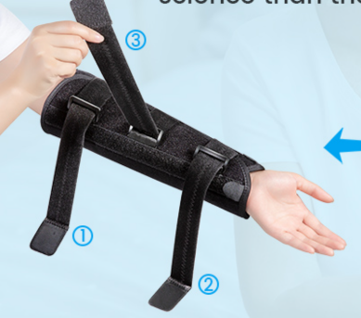
Splints
Design Idea
Reason for Ranking
Criteria | Reasoning
Manufacturability | Can be easily bought online or at a store
Resistivity | Plates keep the elbow from moving
Durability | Rigid but high durability due to material
Adaptability | Not as adaptable to modifications, one-size-fits-all
Maintainability | Can be worn very often
Material Availability | Readily available
Cost | ~$25
User Comfort | Relatively comfortable around the arm
Back to Index
Notes:
Organize criteria from max to min weight

Slide 76
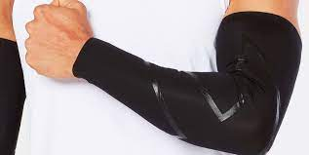
Clothing/Clothing Material Sleeves
Design Idea
Reason for Ranking
Criteria | Reasoning
Manufacturability | Can be easily bought online or at a store
Resistivity | Not very limiting in mobility, but adds the extra pressure similar to spacesuit
Durability | Fairly durable due to the material
Adaptability | Adaptable to different body types
Maintainability | Can be worn for a long period of time
Material Availability | N/A - already assembled
Cost | Not very expensive, but depends on material type ($5-$50)
User Comfort | Mostly comfortable
Back to Index
Notes:
Organize criteria from max to min weight

Slide 77
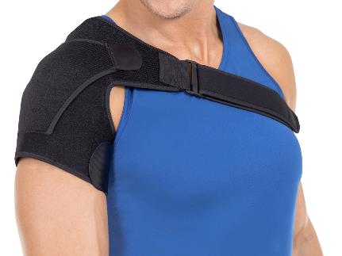
Shoulder Compression Support
Reason for Ranking
Design Idea
Criteria | Reasoning
Manufacturability | Can be easily bought online or at a store
Resistivity | Limited joint movement from the resistance of the straps and wraps.
Durability | Fairly durable due to the material
Adaptability | Adaptable to different body types due to straps and wraps
Maintainability | Can be worn for a long period of time. Until velcro stops sticking.
Material Availability | N/A - already assembled
Cost | For a good brace, it will need to be a higher cost ($25-$150)
User Comfort | Mostly comfortable, but the straps can be uncomfortable. Will probably need lining
Back to Index
Notes:
Organize criteria from max to min weight

Slide 78
OCTOPUS – Ball and Socket Joint
Design Idea
Reason for Ranking
Criteria | Reasoning
Manufacturability | May be able to purchase, in house design may be more difficult
Resistivity | Unknown level or resistance, but presumed some resistance based on purpose of design
Durability | Relatively durable
Adaptability | Very adaptable
Maintainability | Pretty maintainable
Material Availability | Pre-made forms can be bought, materials are also available for in house manufacturing
Cost | Some cost, more expensive for in house (3D print?)
User Comfort | Not very comfortable, would require lining of some sort
Back to Index
Notes:
Organize criteria from max to min weight

Slide 79
Foam Sleeve
Reason for Ranking
Design Idea
Criteria | Reasoning
Manufacturability | May be able to purchase. In house manufacturing would require some work
Resistivity | Some resistance, depends on material and thickness
Durability | Limited durability, multiple uses can star to wear and provide creases in the foam
Adaptability | In house foam sleeve would allow for Velcro adjustability
Maintainability | Would be relatively easy to maintain
Material Availability | Depending on the foam used, material is readily available
Cost | Depending on the material, the cost can range, but on the more expensive side (> $50)
User Comfort | Many foams my be less comfortable, would probably require a lining
Back to Index
Notes:
Organize criteria from max to min weight

Slide 80
Wire Arm Harness
Reason for Ranking
Design Idea
Criteria | Reasoning
Manufacturability | Some difficulty in manufacturing
Resistivity | Depending on material and thickness of wire, can be quite resistive or too resistive
Durability | Depending in material, can be quite durable
Adaptability | Can be adaptable with adjustable arm bands, wire length not adaptable
Maintainability | Relatively easy to maintain
Material Availability | Depending on material, material is readily available
Cost | Somewhat pricey if more expensive materials are used (≥ $25)
User Comfort | Not very comfortable
Back to Index
Notes:
Organize criteria from max to min weight

Slide 81
Cast
Design Idea
Reason for Ranking
Criteria | Reasoning
Manufacturability | Difficult to manufacture
Resistivity | Too much resistance, no movement
Durability | Very durable
Adaptability | Not adaptable
Maintainability | Easily maintainable
Material Availability | Material not readily available
Cost | Can be costly ($25-$2000)
User Comfort | Not comfortable
Back to Index
Notes:
Organize criteria from max to min weight

Slide 82
Object Tracking Trade Options
Back to Index

Slide 83
TRADE TREE: Object Tracking
Object Tracking
In-house build
Headset Native Tracking
Cameras
Sensors
Back to Index

Slide 84
Training Profile Trade Tree
Back to Index

Slide 85
TRADE TREE: Training Profile
Training Profile
Airlocks
Indoor Operation + Exit
Power
Exterior
CO2 Filter
Rover
Indoor Operation + Exit + Reentry
Interior
Solar Panels Maintenance
Battery Replacement
Full Habitat Power Reboot
Exterior
Interior
Rover Filter Replacement
Outside Panel Habitat Filter Replacement
Repair Rover
Use Rover for other tasks
Panel Access
Exit
No Exit
SCOPE
NOT VERSATILE
SCOPE
Back to Index

Slide 86
VR Computer Trade Options
Back to Index

Slide 87
TRADE TREE: VR Computer
VR Computer
Personal Desktop
Check out from Electronics Shop
Build Dedicated Computer
Availability, might not meet required specifications
Expensive, not easily portable, could take months for parts to ship
Back to Index
Notes:
MAKE CHANGES ALLIE TALKED ABOUT → POTENTIAL COMBO BETWEEN THIS AND HAND TRACKING

Slide 88
VR Computer Trade Study Grading
Criteria | Personal Computer | Electronic Shop Computer | Newly Built Computer
Availabilty | Would need to coordinate whose computer and availability wouldn’t exist after projects class ends | Available to anyone in CU to rent a computer when needed | Fully available and dedicated to the project
Cost | Varies | Free | $830 for recommended specifications
Software | Would need access/licensing for required programs | Has required programs pre-installed | Would need access/licensing for required programs
Integration w/ outside electronics | Might need to buy extra components to integrate | Might need to buy extra components to integrate | Components required accounted for in cost
Hardware Requirements | Might not meet minimum or recommended requirements | Meets minimum requirements | Meets recommended requirements
Back to Index
Notes:
Not sure about the specs of the computers we can check out from electronics shop
Organize criteria from max to min weight

Slide 89
Development Software Trade Options
Back to Index

Slide 90
IN PROGRESS: Software Process Flow
Modeling
Unity
VR Headset
Download or purchase premade models
Import 3D models from modeling software
User runs the program on VR headset
Make 3D assets and models
Generate lunar terrain asset
User interacts with VR program
Combine assets and model into full lunar environment
Export to Unity
Implement functionality
Create user interface
Back to Index

Slide 91
Development Engine - Constrained
Unity is a cross platform 3D-2D development software based in C#
Unity has extensive usage history in VR development
The use of Unity as the development software for HEIST was given by the project customer, Dr. Allison Anderson.
The team determined they will be moving forward with a VR headset after it traded favorably.
Unity is ideal for both the customer constraint and Unity lends itself to the development of HEIST in a VR headset.
Back to Index

Slide 92
IN PROGRESS – Modeling Software Trade Study Results
Blender | 3D modeling, Rendering, “3D CG technology in the hands of artists as free/open-source software.” | Runs on Linux, macOS, Windows. Unity uses Blender files | Open-source, websites with free assets available specifically for blender. Also .obj | Free
Mudbox | Computer-based 3D sculpting and painting tool. | Runs on Linux, macOS, Windows. Can export to .fbx, .obj | There are websites with .obj files available (some free) | $10/month
Maya | It is used to create assets for interactive 3D applications, animated films, TV series, and visual effects | Runs on Linux, macOS, Windows. Can export to .obj | There are websites with .obj files available (some free) | $225/month
Cinema 4D | Cinema 4D is a 3D software suite | Runs on Linux, macOS, Windows. Can export to .obj | There are websites with .obj files available (some free) | $75/year for school plan
Zbrush | A digital sculpting tool that combines 3D/2.5D modeling, texturing, and painting. | Runs on Linux, macOS, Windows. Can export to .obj | There are websites with .obj files available (some free) | $30/month
3DS Max | 3D computer graphics program for making 3D animations, models, games, and images. | Runs on Linux, macOS, Windows. Can export to .obj | There are websites with .obj files available (some free) | $225/month
Back to Index
Notes:
Can you please put in a table rather than taking a screen shot? It will look a lot better

Slide 93
DEFINITIONS: Audio Software
Mono/Monophonic: one channel of audio information.
Stereo/Stereophonic: two channels of audio information; usually implies listener can perceive sound images along a line (between loudspeakers or headphone transducers).
Surround Sound: encompasses variety of audio systems that utilize four or more channels of audio information; usually implies listener can perceive sound images between the sources.
Binaural: two-channel audio system that utilizes everyday live spatial hearing cues and provides listener with the perception of three dimensions.
Spatial audio: broader, more inclusive in scope (than 3D audio) and includes the possibility of environmental sound
3D audio: implies perception of point sources in 3D space (could also be 2D plane)
Back to Index

Slide 94
TRADE TREE: Audio Software
VR Audio
Channel-based
Sound-field
Object-based
Mono
Stereo
Surround
Binaural
Spatial
3D audio
Too limited, breaks user immersion and experience
Too limited, breaks user immersion and experience
Better allocation along x-y plane but no height distinction
360-audio around user, no tangible point source
Combines environmental noise and point/object source cues
Point-source audio in three-dimensional space, limited environmental background noise

Slide 95
Risk Management Plan
Back to Index

Slide 96
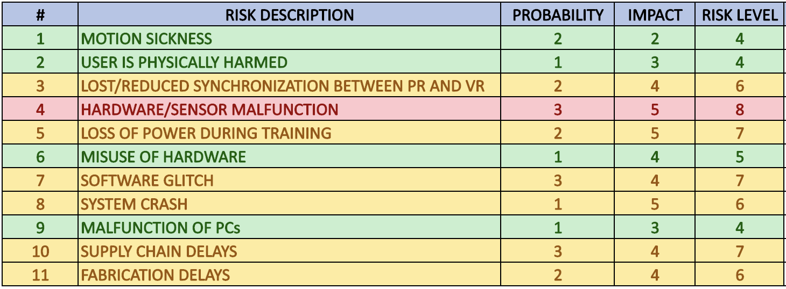
Identified Risks
Back to Index

Slide 97
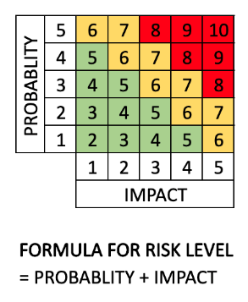
Risk Matrix
Back to Index

Slide 98
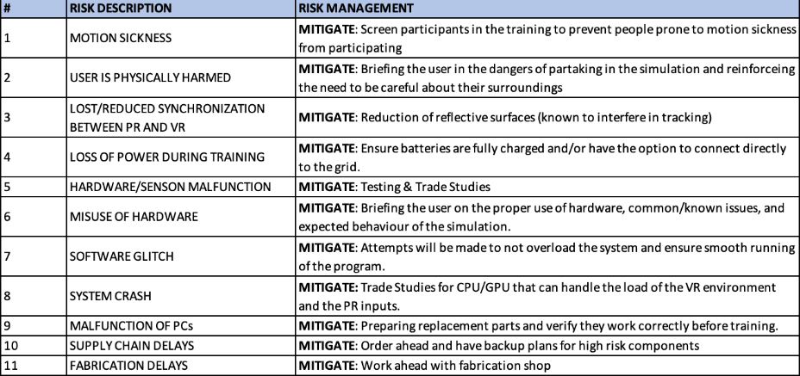
Risk Management Plan
Back to Index

Slide 99
Resources
Back to Index

Slide 100
VR/HT Resources 1/2
https://www.pcmag.com/news/htcs-vr-hand-tracking-system-just-got-a-lot-better
https://www.raywenderlich.com/9189-htc-vive-tutorial-for-unity
https://www.vive.com/us/
https://soundgearlab.com/how-use-bluetooth-headphones-oculus-quest-2/#:~:text=Although%20Oculus%20quest%202%20has,headphones%20to%20the%20headset%20with https://www.biorxiv.org/content/10.1101/2022.02.18.481001v1.full
https://learn.microsoft.com/en-us/hololens/hololens-core-components
https://www.breezecreative.com/dynamic-floor?gclid=CjwKCAjwg5uZBhATEiwAhhRLHv7BDOQdIQ6NFyaNNPwlXDQECx_ZjURp68v1mIBcf_zOKrb3PoV6sRoCnFQQAvD_BwE
https://hi5vrglove.com/store/hi5glove
https://www.manus-meta.com/software/polygon
https://www.ceva-dsp.com/ourblog/what-is-an-imu-sensor/#:~:text=An%20IMU%20is%20a%20specific,considered%20a%209%2Daxis%20IMU.
https://pixycam.com/pixy-cmucam5/
Back to Index

Slide 101
PCs Resources 2/2
https://www.worldbrace.com/custom-best-shoulder-brace-support-manufacturer/
https://dunbarmedical.com/wearing-shoulder-brace/
https://www.braceability.com/products/shoulder-support-brace
https://www.menshealth.com/fitness/g25803874/best-compression-sleeves/
https://www.bauerfeind-sports.com/us/compression-sleeves-arm/
https://www.compressionstore.com/products/circaid-profile-foam-arm-sleeve
https://www.verywellhealth.com/what-is-a-cast-for-broken-bones-made-out-of-2549317
https://www.hiltonphoto.co.uk/joby-gorillapod-3k-tripod-with-ball-socket/
Back to Index

