Slide 1
Preliminary Design Review
Team CARROT
October 12, 2022
Jared Seefried (Project Manager) Elena Bauer (Systems Engineer)
Tyler Mckay
Lucas Pereira
Eric Lozano
Luis Alvidrez
Kushal Kedia
Talen Fischer
Chris Lolkema
Abigail Moonan
Carson Sexton
Marguerite Adwan

Slide 2
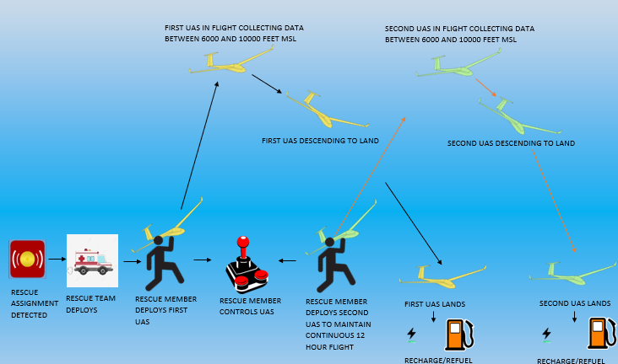
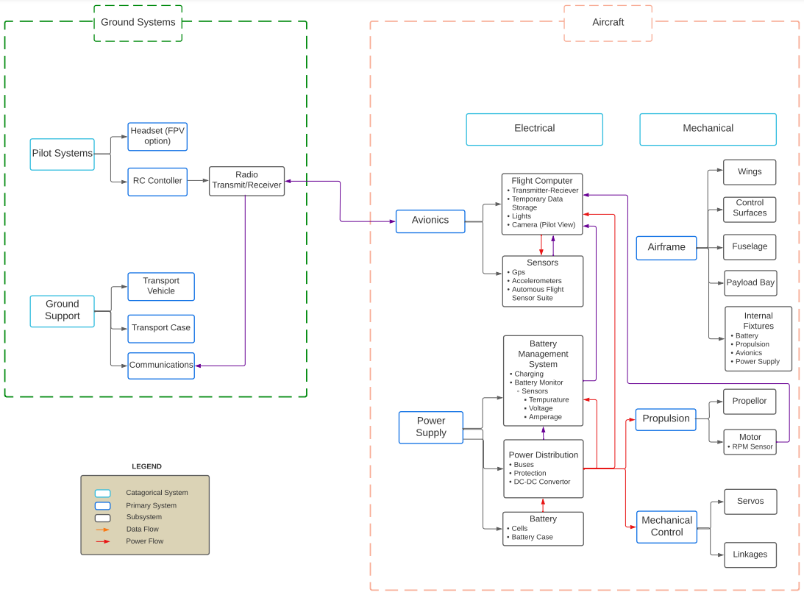
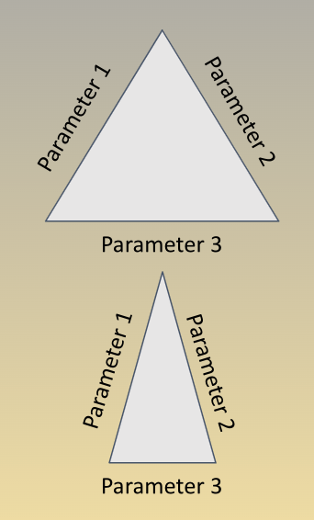
T a b l e o f C o n t e n t s
1. Project Overview
Project definition, Concept of Operations (CONOPS), Functional Block Diagram
Critical project feasibility elements (CPEs)
Trades to be performed
2. Trades
Aerodynamics/Structure
Manufacturing
Electromechanical
3. Current Design Space
4. Modeling and Prototyping Plans

Slide 3
Purpose of Phase 1C - Design for Low-Cost Digital Manufacturing & Sustainment
Objectives
Ease of Use
Long term Sustainability for the Customer
Easily Manufacturable
Cost Efficient
The goal of our project is to develop a UAS (Uncrewed Aircraft Systems) that allows for continuous coverage over difficult terrain.
This UAS should be portable for the user and should be manufacturable by the user.
Overview
Trades
Design Space
Modeling & Prototyping Plans

Slide 4
C O N O P S

Slide 5
R E Q U I R E M E N T S
Requirement 1: UAS will not weigh more than 55 lbs, and shall have short takeoff and landing capabilities to deploy in areas with unprepared launch surfaces and obstructed climb windows
Requirement 2: UAS will be able to fit within the Boulder Emergency Service Vehicle for transport
Requirement 3: UAS shall adhere to FAA 14 CFR Part 107, SMALL UNMANNED AIRCRAFT SYSTEMS, contingent on waivers.
Requirement 4: UAS total flyaway cost shall not exceed 4,000 USD for 2 amount of air vehicles
Requirement 5: UAS shall operate in the altitude range of 6,000 ft - 10,000 ft. MSL.
Requirement 6: UAS shall house a payload with a weight ranging from 1.5-3 kg.
Requirement 7: 90% of UAS airframe structural components shall be easily manufacturable, replaceable, or repairable by the end user.
Requirement 8: Over the course of a single deployment, UAS shall provide continuous coverage of an area for TBD consecutive hours, and two drones must be able to provide coverage of an area for TBD consecutive hours without any interruption
Overview
Trades
Design Space
Modeling & Prototyping Plans

Slide 6
Critical Project Elements
Critical Element | Rationale | Functional Requirement (FR)
Design | The UAS must be designed such that it meets overwatch goals, is lightweight enough to be carried, and be stored in the emergency response vehicle | FR 1, FR 2, FR 5, FR 6, FR 7, FR 8
Manufacturing | The UAS must be manufactured such that at least 90% of the airframe structural components can be maintained & sustained by the end user | FR 1, FR 2, FR 7
Operability | The UAS must be operable under FAA 14 CFR Part 107, be able to take off on unprepared land/obstructed launch windows, and provide overwatch for TBD hours | FR 1, FR 3, FR 8
Overview
Trades
Design Space
Modeling & Prototyping Plans

Slide 7
Functional
Block
Diagram

Slide 8
Trades to be Conducted
Looking at what Airframes will help us achieve our requirements
Feasibility
Types of electrical systems and propulsion systems
What manufacturing processes will be feasible for our design
Single or combination of processes
What materials will we look at for our aircraft
Overview
Trades
Design Space
Modeling & Prototyping Plans

Slide 9
Airframe Trades
Sub-Team | Team Leader | Team Member | Team Member | Team Member
Aero/struc | Eric Lozano | Elena Bauer | Chris Lolkema | Carson Sexton
Overview
Trades
Design Space
Modeling & Prototyping Plans

Slide 10
Graded Airframes
Airframes Compared
Fixed Wing
Fixed Wing Hybrid -Vertical Take Off and Landing (VTOL)
Multi-rotor
Single rotor
5 Models of each were chosen and parameters averaged
Several styles of UAS were evaluated based on several criteria from requirements
Endurance
Weight
Payload capacity
Distance required for take off
Longest dimension
Overview
Trades
Design Space
Modeling & Prototyping Plans

Slide 11
Graded Airframes
 | Endurance | Weight | Payload Capacity | TakeOff Distance | Longest Dimension
Endurance | 1.00 | 0.20 | 0.25 | 0.33 | 0.25
Weight | 5.00 | 1.00 | 2.00 | 7.00 | 2.00
Payload Capacity | 4.00 | 0.50 | 1.00 | 7.00 | 3.00
TakeOff Distance | 3.00 | 0.14 | 0.14 | 1.00 | 3.00
Longest Dimension | 4.00 | 0.50 | 0.33 | 0.33 | 1.00
Overview
Trades
Design Space
Modeling & Prototyping Plans

Slide 12
Graded Airframes
Criteria [units] (requirement) | Criteria Weight | Fixed Wing | Hybrid Fixed Wing | Single Rotor | Multirotor
Endurance [min] (3) (5) (8) | 0.05 | 210 | 120 | 64 | 41.6
Weight [kg] (1) (2) (5) | 0.41 | 13.3 | 11.3 | 21.6 | 9.3
Payload Capacity [kg] (5) (6) | 0.32 | 4.1 | 3.8 | 16 | 11.2
TakeOff Area [m^2] Approximate Value (1) | 0.11 | 30 | 5.6 | 4.088 | 2.68
Longest Dimension [m] (2) (3) | 0.11 | 3.28 | 2.8 | 2.044 | 1.34
 | Weighted Total | 0.19 | 0.22 | 0.28 | 0.31
 | Normalized Total | 0.19 | 0.22 | 0.28 | 0.31
 | Final Score | 59.63 | 70.65 | 87.99 | 100.00
‹#›
Overview
Trades
Design Space
Modeling & Prototyping Plans

Slide 13
Graded Airframes - Results
While endurance was prioritized less, a multi-rotor was determined to be undesirable for two reasons
Multi-rotor already in use by Boulder ES
The loss in endurance was deemed to great to pursue (40 min max)
A sensitivity analysis was conducted to see how prioritizing various elements would change the grading
Overview
Trades
Design Space
Modeling & Prototyping Plans

Slide 14
Graded Airframes - Results
Results of Sensitivity analysis
Endurance: Fixed Wing
Weight: Multi-rotor
Payload Capacity: Single Rotor
TakeOff Area: Multi-rotor
Dimension: Multi-rotor
Lack of significant endurance a concern for Multi-rotor
Lack of collective single-rotor knowledge a concern for next highest graded airframe
Sensitivity Analysis Results for Fixed-Wing hybrid (Percent of Max)
Standard - 70.6%
Endurance - 68.2 %
Weight - 80 %
Payload Capacity - 44.7 % (Still capable of 3kg payload)
TakeOff Area - 83.7 %
Largest Dimension - 61.9 %
Analysis of CONOPS determined that airframe not only improved current endurance capabilities by 3x-6x but also would provide VTOL capability
Overview
Trades
Design Space
Modeling & Prototyping Plans

Slide 15
Manufacturing Trades
Sub-Team | Team Leader | Team Member | Team Member | Team Member
Manufacturing | Luis Alvidrez | Marguerite Adwan | Kushal Kedia | Abigail Moonan
Overview
Trades
Design Space
Modeling & Prototyping Plans

Slide 16
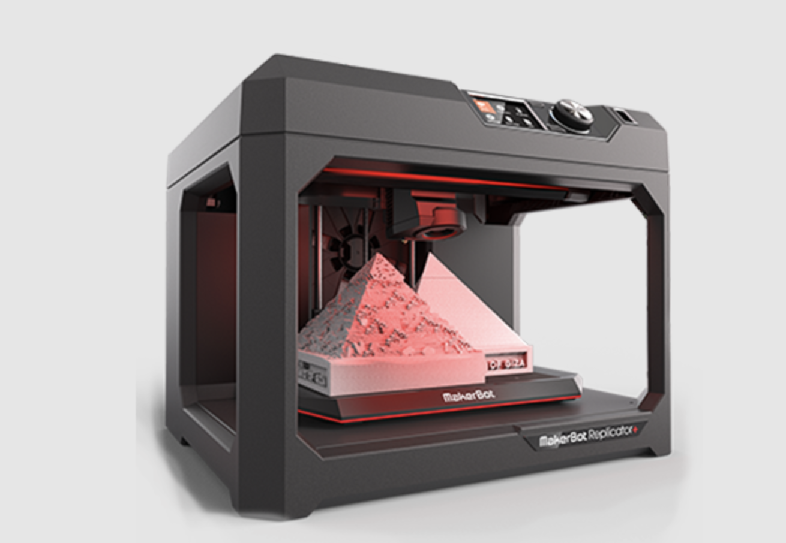
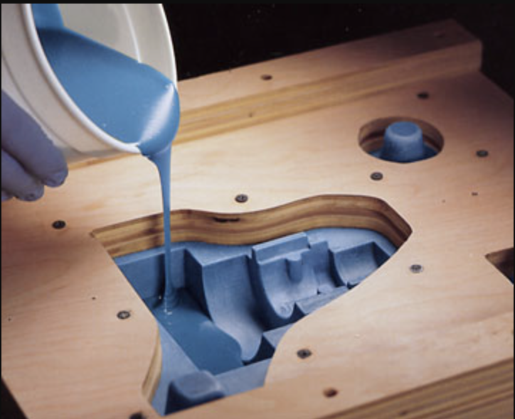
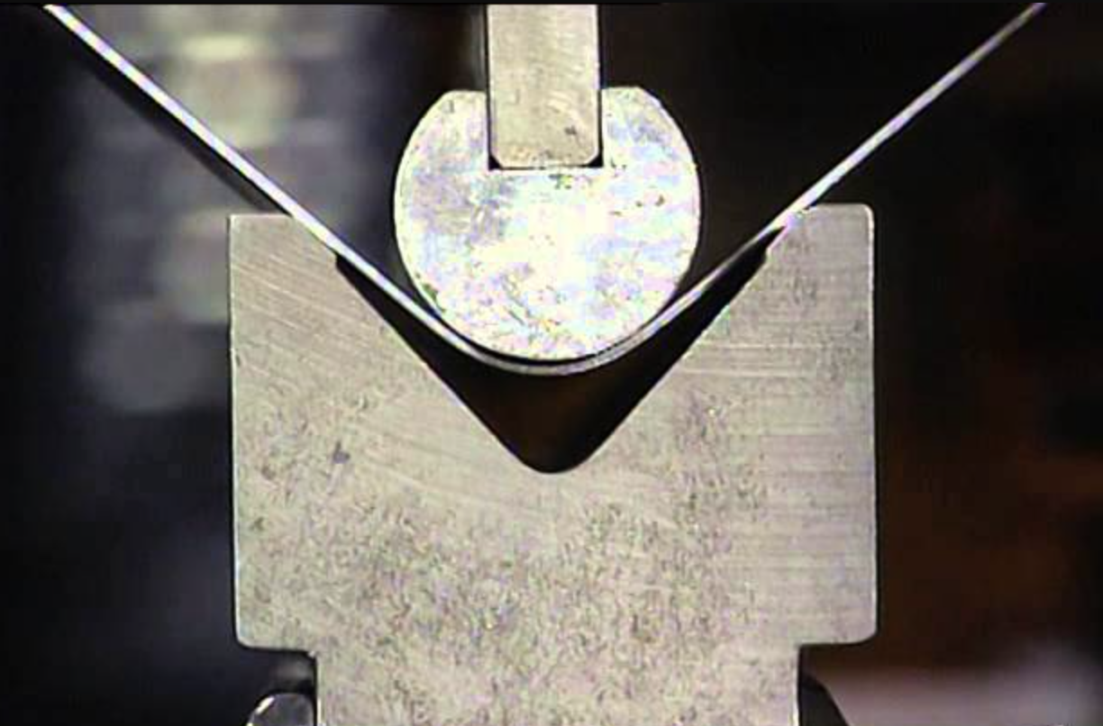
Most Common Manufacturing Processes
3D Printing
2. Casting and Molding
3. Joining
4. Machining
5. Shearing and Forming
Overview
Trades
Design Space
Modeling & Prototyping Plans

Slide 17
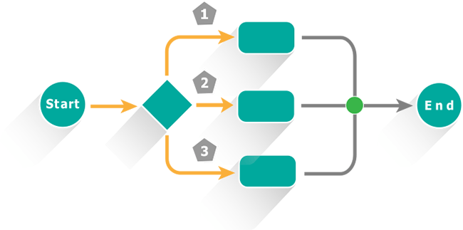
How can we Rank These Processes?
1. Define and understand your mission’s requirements. What is most important?
2. Define criteria in which the manufacturing processes can be given points depending on how well each process meets the requirements and budgets of your design.
3. Analyze, grade, and determine which process or processes are best suited for your needs based on the total scoring.
Overview
Trades
Design Space
Modeling & Prototyping Plans

Slide 18
Mission Main Objectives
Requirement 1: UAS will not weigh more than 55 lbs, and shall have short takeoff and landing capabilities to deploy in areas with unprepared launch surfaces and obstructed climb windows
Requirement 4: UAS total flyaway cost shall not exceed 4,000 USD for 2 amount of air vehicles
Requirement 7: 90% of UAS airframe structural components shall be easily manufacturable, replaceable, or repairable by the end user.
Requirement 1: UAS will not weigh more than 55 lbs, and shall have short takeoff and landing capabilities to deploy in areas with unprepared launch surfaces and obstructed climb windows
Requirement 2: UAS will be able to fit within the Boulder Emergency Service Vehicle for transport
Requirement 3: UAS shall adhere to FAA 14 CFR Part 107, SMALL UNMANNED AIRCRAFT SYSTEMS, contingent on waivers.
Requirement 4: UAS total flyaway cost shall not exceed 4,000 USD for 2 amount of air vehicles
Requirement 5: UAS shall operate in the altitude range of 6,000 ft - 10,000 ft. MSL.
Requirement 6: UAS shall house a payload with a weight ranging from 1.5-3 kg.
Requirement 7: 90% of UAS airframe structural components shall be easily manufacturable, replaceable, or repairable by the end user.
Requirement 8: Over the course of a single deployment, UAS shall provide continuous coverage of an area for TBD consecutive hours, and two drones must be able to provide coverage of an area for TBD consecutive hours without any interruption
Legend:
Materials Trade Overlap Trade Process trade
Overview
Trades
Design Space
Modeling & Prototyping Plans

Slide 19
Criteria - Based on Mission Requirements
Step 1 - Understand Requirements
Accessibility
Step 2 - Define Criteria
2. Cost
3. Skill to Operate
Step 3 - Grade, Analyze, and determine best process.
4. Precision
Create a Table to reduce subjectivity
5. Processing Time
Plug scores into Trade Matrix
6. Safety
Determine Best Candidate(s)
Overview
Trades
Design Space
Modeling & Prototyping Plans

Slide 20
Manufacturing Trade Studies
Overview
Trades
Design Space
Modeling & Prototyping Plans

Slide 21
Final Rankings
Manufacturing Process | Final Score [%]
3D Printing | 93
Casting and Molding | 46
Joining | 100
Machining | 56
Shearing and Forming | 69
For complete algorithm click here.
Overview
Trades
Design Space
Modeling & Prototyping Plans

Slide 22
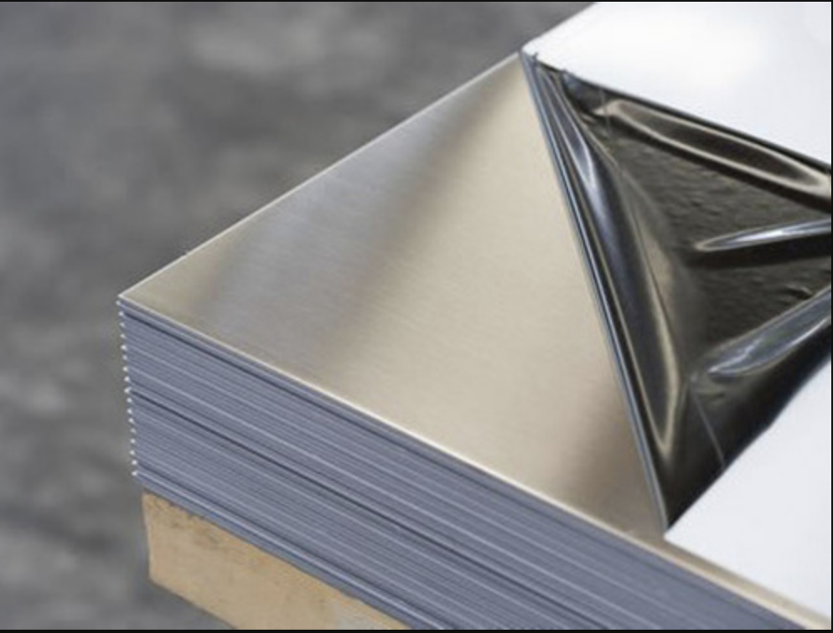
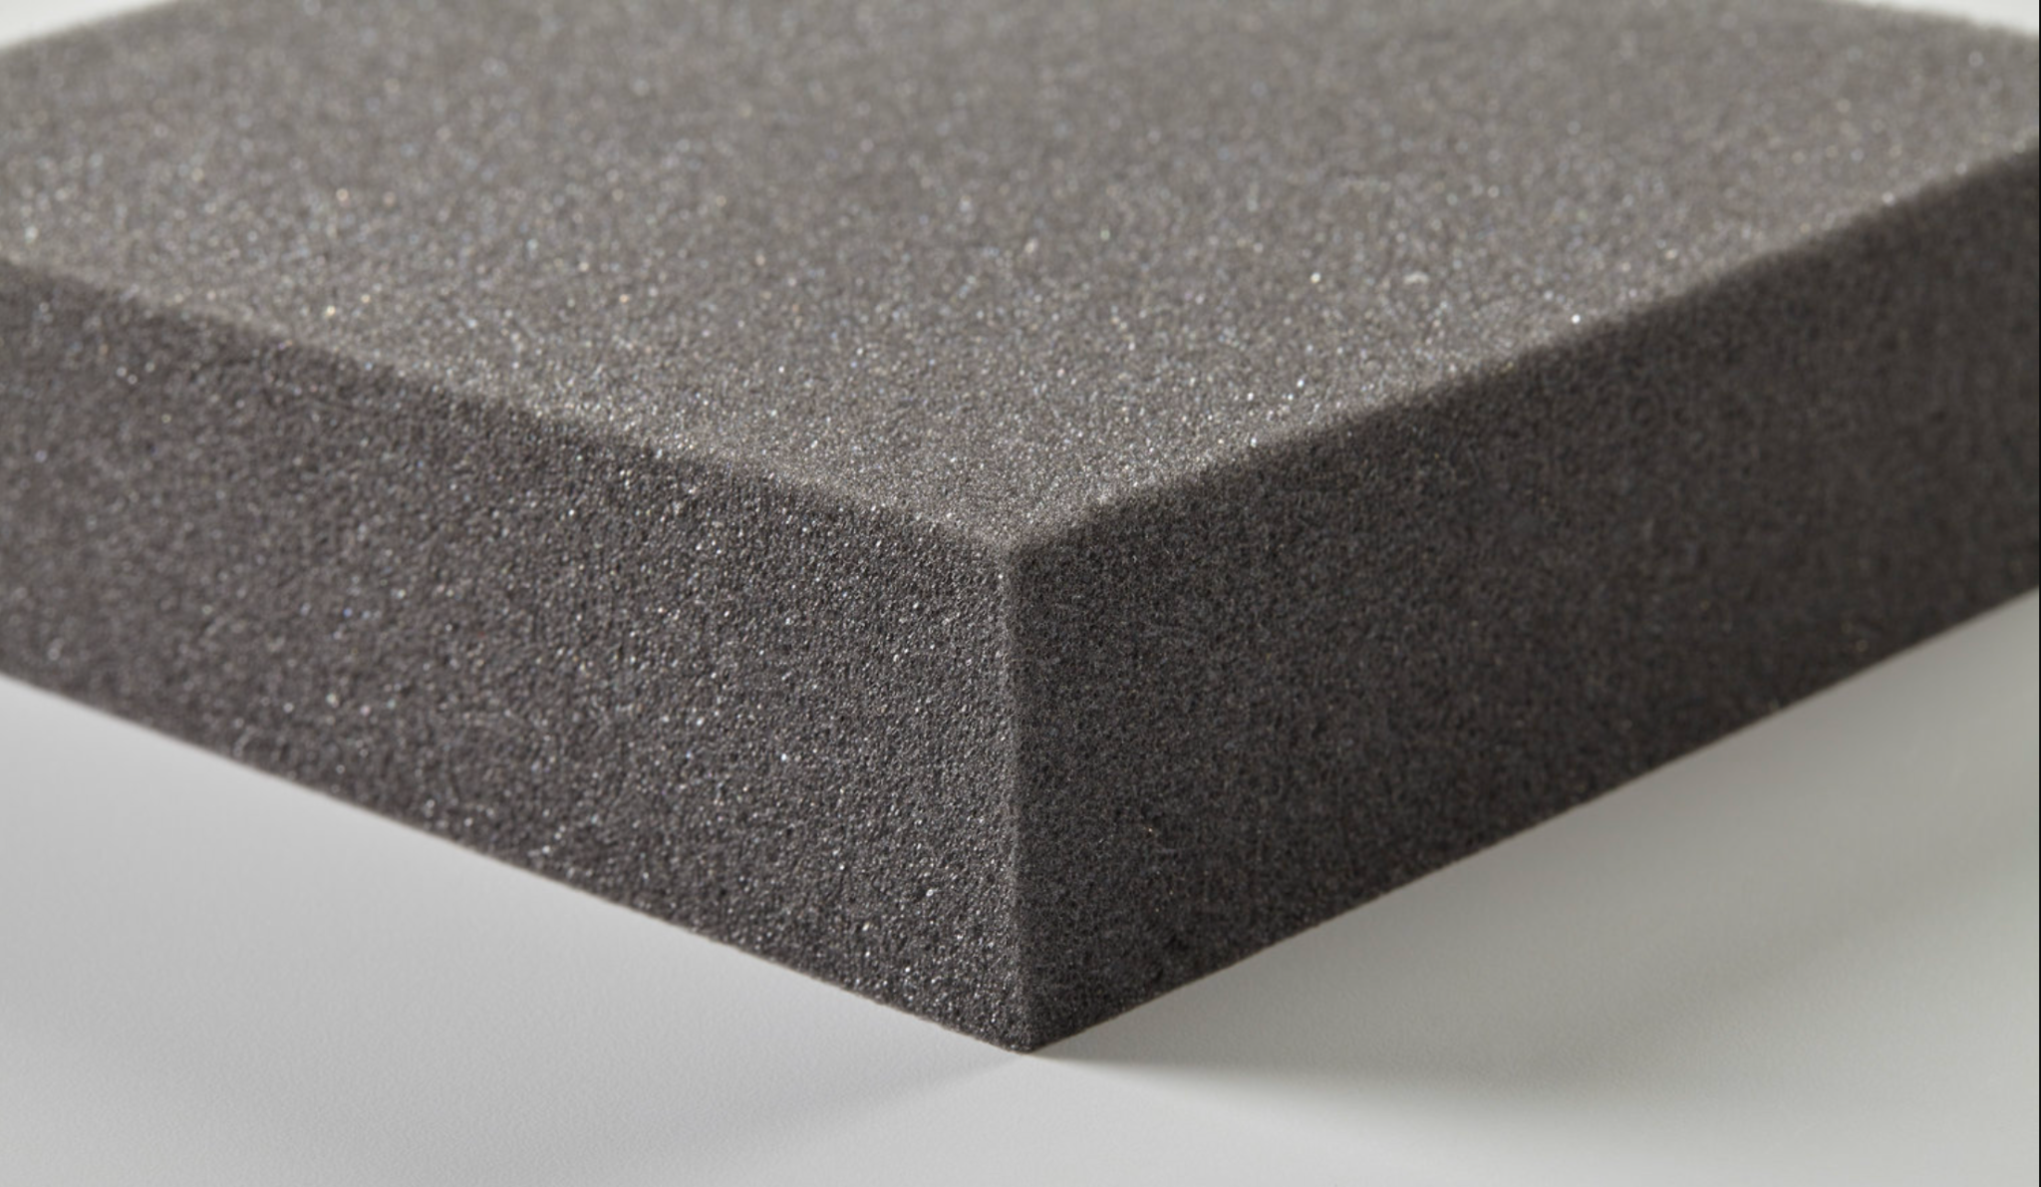
Transitioning from Manufacturing Process to Materials
The manufacturing processes scorings pave the way for new trade studies, this time the previous method is implemented, but now for materials.
1. Aluminium Alloy 6061
2. Born Fiber
3. Carbon Fiber
4. Thermoplastics
Polystyrene
Polyester
Nylon
5. Foam
Overview
Trades
Design Space
Modeling & Prototyping Plans
Notes:
Aluminum Alloy 6061
Boron Fiber
Carbon Fiber
Foam
Thermoplastics

Slide 23
Material Trade Studies
To determine the ranking for each material the following facts about each material were used.
Overview
Trades
Design Space
Modeling & Prototyping Plans

Slide 24
Final Rankings
Material | Final Score [%]
Aluminium Alloy 6061 | 77
Boron Fiber | 53
Carbon Fiber | 67
Foam | 95
Thermoplastics | 100
For complete algorithm click here.
Overview
Trades
Design Space
Modeling & Prototyping Plans

Slide 25
Propulsion Trades
Sub-Team | Team Leader | Team Member | Team Member | Team Member
Electronics | Lucas Pereira | Talen Fischer | Tyler McKay | Jared Seefried
Overview
Trades
Design Space
Modeling & Prototyping Plans

Slide 26
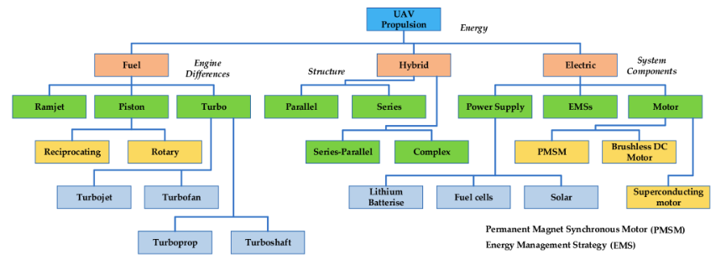
Propulsion Trade Tree
Overview
Trades
Design Space
Modeling & Prototyping Plans

Slide 27
Propulsion Trade Study
Overview
Trades
Design Space
Modeling & Prototyping Plans

Slide 28
Propulsion: Electric Pros and Cons
Electric/Battery Propulsion Systems | Pros | Cons
Lightweight | x
Energy Density |  | x
Cost | x
Thrust Generation | x
Power Consumption |  | x
Low Internal Temperatures | x
Performance Due to Weather Effects |  | x
Average Endurance |  | x
Hazard during Emergencies | x
Maintenance | x
Key features:
High torque values while maintaining lightweight construction
Less maintenance due to simplicity
Very scalable system allowing for flexibility in aircraft design
Lower average endurance due to large current draw to provide necessary thrust
Highly susceptible to weather conditions
Overview
Trades
Design Space
Modeling & Prototyping Plans

Slide 29
Aircraft Design Space
Size
Weight
Endurance
Parameter 1
Parameter 2
Ideal Design Space
Parameter 1 = Parameter 2 = Parameter 3
Parameter 3
Parameter 1
Competing Design Space
Parameter 1 = Parameter 2 > Parameter 3
Parameter 1 = Parameter 3 > Parameter 2
Parameter 1 < Parameter 2 = Parameter 3
Parameter 2
Parameter 3
Overview
Trades
Design Space
Modeling & Prototyping Plans

Slide 30
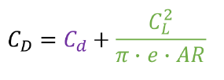
Aircraft Design Space
Size - Weight -Endurance conflicting requirements
Wing Design is critical for overall performance
Complicated interdependence
Overview
Trades
Design Space
Modeling & Prototyping Plans

Slide 31
Fixed Wing VTOL design: Where to go?
Size-Weight-Endurance
Fixed Wing airframe design trade*
Conventional
Wing-body
Bi-plane
VTOL design trade/analysis
Horizontal propellers (0 degree pitch launch)
Vertical propeller (90 degree pitch launch)
Servo-motor Propellers
Wing Design Analysis (following airframe decision)
Modelling
*Normalized results of the Level two trade study on fixed wing airframe design: See Here
Overview
Trades
Design Space
Modeling & Prototyping Plans

Slide 32
Current Manufacturing Workspace
Type | Highest Scorer
Manufacturing Processes | Joining
Materials | Thermoplastics
How do these impact the design’s future?
Design can be a combination of processes and materials.
Manufacturing Alternatives: 3D Printing, Shearing and Forming
Materials Alternatives: Foam and Carbon Fiber
Overview
Trades
Design Space
Modeling & Prototyping Plans

Slide 33
Electromechanical Future Considerations
Design Space involves three major components
Propulsion
Brushed vs. Brushless Motors*
Shrouded vs Unshrouded Propellers
Energy Consumption
Thrust Provided
Energy Capacity/Storage
Total Voltage
Power provided
Size and Weight
Safety Considerations
Flight Controls
Power efficiency/distribution
Effective Control Over Aircraft
Ease of Use
Overview
Trades
Design Space
Modeling & Prototyping Plans

Slide 34
Aircraft Modeling (Aero/STRUCT)
L = C_{L}*⍴*V²*S
D = C_{D}*⍴*V²*S
C_{D,0}= C_{D}-C_{D,i}
C_{D,i} = C_{L}²/(𝝅*e*AR)
Estimate AR, Chord
Target C_{L}/C_{D}
Determine NACA airfoil
Target C_{L}/C_{D}
Open source airfoil models
Estimate Lift
Structural analysis
Assume magnitudes of Forces/Torques applied as Lift
𝜎=M*(t/2)/I
J_{𝛼}=𝛼*b*t³
𝛕_{MAX}=T*t/J_{𝛼}
Initial estimations
Weight (FR 1)
Span (FR 2)
Velocity
Density (FR 5)
Assumptions for Unknowns
Lift=Weight
Thrust=Drag
L-Lift ⍴-Air density C_{D,0}-profile drag M-Moment
C_{L}-lift coefficient V-Velocity C_{D,i}-induced drag t-thickness
D-Drag S-Wing Area AR-Aspect Ratio I-MOI about the c.g.
C_{D}-Drag coefficient e-efficiency factor 𝜎-bending stress b-wing length
Overview
Trades
Design Space
Modeling & Prototyping Plans

Slide 35
Future Design
Future trade studies?
Joint trade study with structure design to analyze best selection of materials and processes per aircraft part.
Design companies/professionals versus self-constructed/operated.
Overview
Trades
Design Space
Modeling & Prototyping Plans

Slide 36
Electromechanical Modeling: Propulsion / Battery
Estimate Baseline Aircraft Mass
Estimate thrust required
Select Motor / Prop combination
Select Battery
Estimate flight regimes power requirements
Select ESC’s
Does solution meet requirements?
Overview
Trades
Design Space
Modeling & Prototyping Plans

Slide 37
Electromechanical Modeling: Avionics / Servos
Create a mass budget
Base weight (Aircraft structure)
Mechanical weight
Propulsion and Battery weight
Equations
Determine Equations for Thrust Req
Within each flight regime
Determine Equations for Power Req to sustain Req Levels of Thrust
Determine Equations to compute battery specifications
Determine Flight regime parameters
Take off
Landing
In-route
Max cruise velocity
Loitering
Max endurance velocity
Configuration analysis
Iterative parameter simulation
Sensitivity Analysis
Overview
Trades
Design Space
Modeling & Prototyping Plans

Slide 38
Backup Slides

Slide 39
References
Airframes:
Hybrid
https://www.elevonx.com/
https://censystech.com/sentaerobvlos/?utm_term=&utm_campaign=Censys+Website+Industry+Traffic&utm_source=adwords&utm_medium=ppc&hsa_acc=7383768994&hsa_cam=12470352944&hsa_grp=120477520446&hsa_ad=518426425868&hsa_src=g&hsa_tgt=dsa-1245958251531&hsa_kw=&hsa_mt=&hsa_net=adwords&hsa_ver=3&gclid=CjwKCAjw7eSZBhB8EiwA60kCW8uWrgTjfMrojGg3pMfPcLyKZdWt9FUt4WGzNVLJfnX4wy7913Vb5xoCLPAQAvD_BwE
https://www.unmannedsystemstechnology.com/company/elevonx/
https://www.avfoil.com/drones/eagle-vtol-uas-system/
Fixed Wing
https://www.uavos.com/products/fixed-wing-uavs/borey-10/
https://a-techsyn.com/uavs/cng-v-uav/
https://volatusaerospace.com/vedette/
https://www.c-astral.com/
Multi Rotor
https://uavsystemsinternational.com/products/aurelia-x6-standard
https://inspiredflight.com/if-1200-heavy-lift-drone/
https://www.aerosystemswest.com/product-page/heavy-lift-multirotor-hexacopter

Slide 40
References
Airframes (continued:
Single Rotor
https://www.avinc.com/uas/vapor
https://www.velosuav.com/velosv3/
https://www.unmannedsystemstechnology.com/company/swissdrones/
https://www.uavos.com/products/vtols/uvh-25el-helicopter/
https://www.unmannedsystemstechnology.com/company/missiongo-unmanned-systems/
Zeppelin
https://www.rc-zeppelin.com/indoor-rc-blimps.html
https://www.instructables.com/Miniature-Autonomous-Blimp/
https://challengeraerospace.com/innovations/unmanned-airship-systems-uas-2/
Anderson, J., 2016. Introduction to flight. 8th ed. New York: McGraw-Hill Education.
Etkin, B.,Reid, L.D, Dynamics of Flight. 3rd ed. Danvers: John Wiley & Sons.

Slide 41
References
Materials Trade:
[1] “6061 T6 aluminium plate,” Navstar Steel Corporation Available: https://www.navstarsteel.com/6061-t6-aluminium-plate.html.
[2] “Aramid Fibers ,” Aramid fibers Available: https://www.chem.uwec.edu/chem405_s01/malenirf/project.html.
[3] “Boron fiber,” Boron Fiber - an overview | ScienceDirect Topics Available: https://www.sciencedirect.com/topics/engineering/boron-fiber.
[4] “Boron fiber,” Specialty Materials Available: https://www.specmaterials.com/boron-fiber-test-page.
[4] coderman, N. J.-, “What are drones made of? - materials and engineering resources,” Matmatch Available: https://matmatch.com/resources/blog/what-are-drones-made-of/.
[5] “Overview of materials for Expanded Polystyrene (EPS)” MatWeb Available: https://www.matweb.com/search/datasheet.aspx?matguid=5f099f2b5eeb41cba804ca0bc64fa62f&ckck=1
[6] Neptuneweb, “6061 aluminium alloy,” Ferguson Perforating Available: https://www.fergusonperf.com/the-perforating-process/material-information/specialized-aluminum/6061-aluminium-alloy/.
[7] Reanod International Network Technology Co., L.---www.reanod.com, “Whats the price of Carbon Fiber Sheet,” What's the price of carbon fiber sheet Available: https://www.jinjiuyi.net/news/whats-the-price-of-carbon-fiber-sheet.html.
[8] “Thermoplastics,” Hexcel Available: https://www.hexcel.com/Products/Interference-Control/Thermoplastics.
[9] “Unmanned Aerial Vehicles (uavs),” Hexcel Available: https://www.hexcel.com/Resources/UAV#:~:text=Today%2C%20almost%20all%20UAV%20structures,addition%20to%20carbon%20fiber%20composites.
[10] “What Are Thermoplastics,” Thermoplastic Available: https://www.scottstool.com/thermoplastic.htm#:~:text=Thermoplastics%20are%20light%20weight%2C%20with,known%20solvents%20at%20room%20temperature.
Manufacturing Process Trade:
[1] Dwamena, M., “Are 3D printers easy or hard to use? learning how to use them,” 3D Printerly Available: https://3dprinterly.com/are-3d-printers-easy-or-hard-to-use-5-easy-steps-to-get-setup/.
[2]“How to select an appropriate joining method,” Matmatch Available: https://matmatch.com/learn/engineering/how-to-select-an-appropriate-joining-method.
[3] K.G. Swift, J.D. Booker, “Casting process,” Casting Process - an overview | ScienceDirect Topics Available: https://www.sciencedirect.com/topics/engineering/casting-process.
[4] Maziar Ramezani, Zaidi M., “Metal forming process,” Metal Forming Process - an overview | ScienceDirect Topics Available: https://www.sciencedirect.com/topics/materials-science/metal-forming-process.
[5] Ph.D., J. J., “Metal shearing process pros & cons,” Metal Cutting Corporation Available: https://metalcutting.com/knowledge-center/metal-shearing-process-pros-cons/.
[6] Svv, “What are the 4 types of manufacturing process?,” Product development services in Shenzhen Available: https://svv.io/what-are-the-4-types-of-manufacturing-process/.
[7] Vincent, L., “Is it hard to learn CNC machining?,” Geomiq Available: https://geomiq.com/2021/08/30/is-it-hard-to-learn-cnc-machining/.

Slide 42
References
Electromechanical:
Avionics:
Ardupilot.org. 2022. Choosing an Autopilot — Plane documentation. [online] Available at: <https://ardupilot.org/plane/docs/common-choosing-a-flight-controller.html> [Accessed 2 October 2022].
Beagleboard.org. 2022. BeagleBoard.org - blue. [online] Available at: <https://beagleboard.org/blue> [Accessed 2 October 2022].
Mini, P., 2022. Pixhawk4 mini. [online] Shop.holybro.com. Available at: <https://shop.holybro.com/pixhawk4-mini_p1120.html> [Accessed 2 October 2022]
Batteries:
notes, e., 2022. Battery Definitions, Terms & Terminology » Electronics Notes. [online] Electronics-notes.com. Available at: <https://www.electronics-notes.com/articles/electronic_components/battery-technology/terms-terminology-definitions.php> [Accessed 2 October 2022].
En.wikipedia.org. 2022. Lithium iron phosphate battery - Wikipedia. [online] Available at: <https://en.wikipedia.org/wiki/Lithium_iron_phosphate_battery> [Accessed 2 October 2022].
Mannn, K., Cruz, M., Jeyakumar, M., Domun, A. and Catsro, F., 2022. BU-205: Types of Lithium-ion. [online] Battery University. Available at: <https://batteryuniversity.com/article/bu-205-types-of-lithium-ion#:~:text=For%20example%2C%20NMC%20in%20an,continuous%20discharge%20current%20of%2020A.> [Accessed 2 October 2022].
Frost, J., 2022. BU-203: Nickel-based Batteries. [online] Battery University. Available at: <https://batteryuniversity.com/article/bu-203-nickel-based-batteries#:~:text=According%20to%20RWTH%2C%20Aachen%2C%20Germany,is%20about%20%24400%20per%20kWh.> [Accessed 2 October 2022].
2022. [online] Available at: <https://www.batterystuff.com/kb/articles/battery-articles/what-the-heck-is-a-nicd-battery.html> [Accessed 2 October 2022].
Propulsion:
Zhang, B.; Song, Z.; Zhao, F.; Liu, C. Overview of Propulsion Systems for Unmanned Aerial Vehicles. Energies 2022, 15, 455. https://doi.org/10.3390/en15020455
Griffis, C., Wilson, T., Schneider, J., & Pierpont, P. (2009). Unmanned Aircraft System Propulsion Systems Technology Survey. Retrieved from https://commons.erau.edu/publication/72
Wu, S., Xiong, R., Li, H., Nian, V., and Ma, S., “The state of the art on preheating lithium-ion batteries in cold weather,” Journal of Energy Storage, vol. 27, 2020, p. 101059.
Balicki, W., Głowacki, P., Szczecinski, S., Chachurski, R., and Szczeciński, J., “Effect of the atmosphere on the performances of Aviation Turbine Engines,” Acta Mechanica et Automatica, vol. 8, 2014, pp. 70–73.
Friedrich, C., and Robertson, P. A., “Hybrid-electric propulsion for aircraft,” Journal of Aircraft, vol. 52, 2015, pp. 176–189.
Preliminary Equations research for Battery and Propulsion systems Estimations
Journal of Aircraft. 2022. Range and Endurance Estimates for Battery-Powered Aircraft | Journal of Aircraft. [online] Available at: <https://arc.aiaa.org/doi/10.2514/1.C031027> [Accessed 2 October 2022].
Gur, O. and Rosen, A., 2009. Optimizing Electric Propulsion Systems for Unmanned Aerial Vehicles. Journal of Aircraft, 46(4), pp.1340-1353.

Slide 43
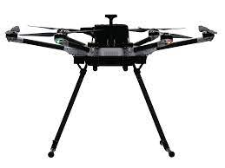
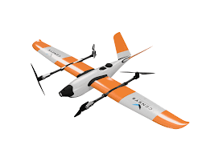
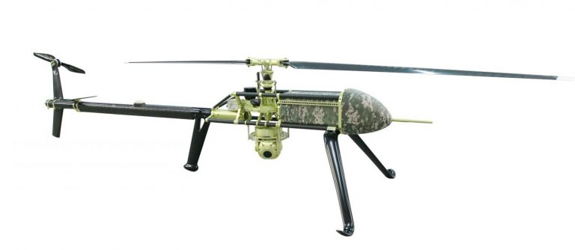
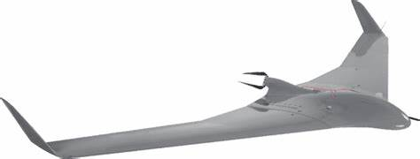
Current Designs out there

Slide 44
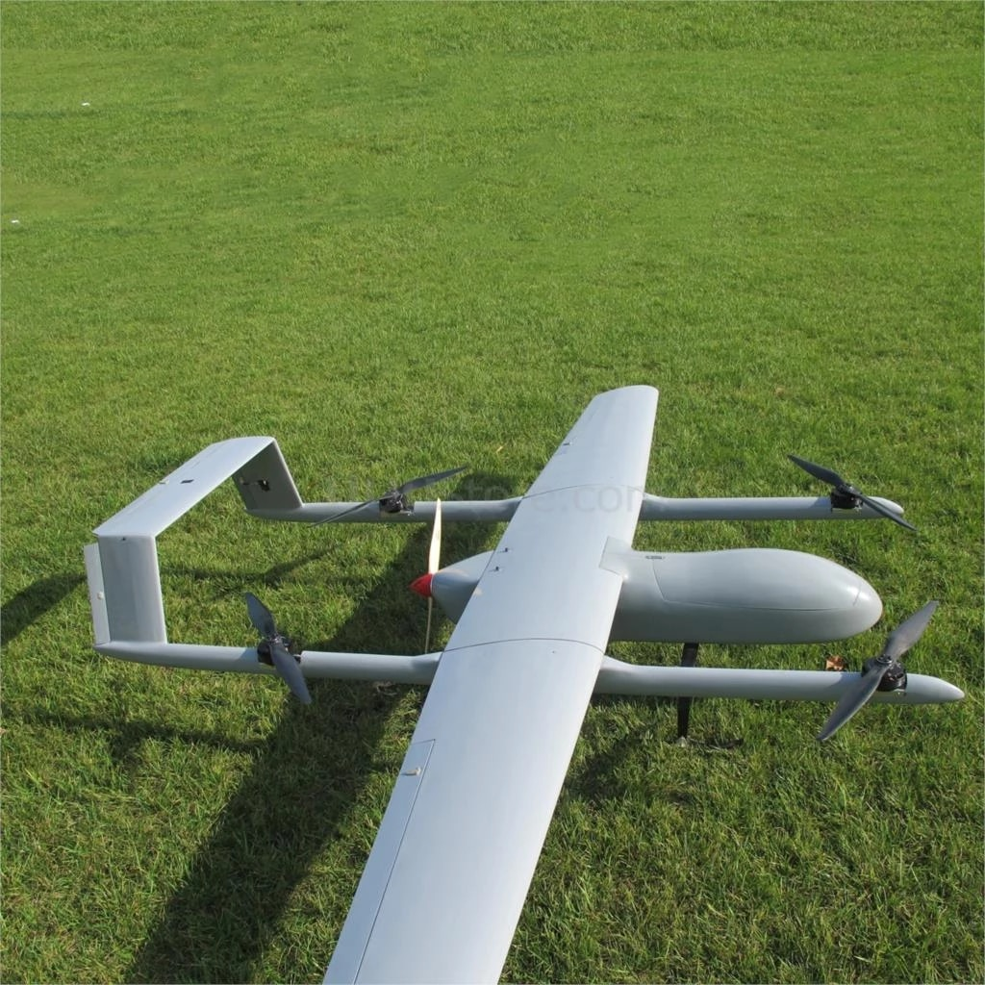
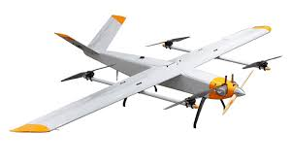
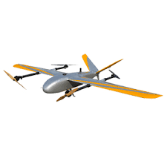
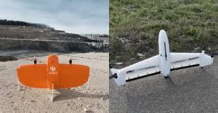
Current Hybrid systems

Slide 45
Graded Airframes - Results
Sensitivity Analysis Results for Fixed-Wing hybrid (Percent of Max)
Standard - 70.6%
Endurance - 68.2 %
Weight - 80 %
Payload Capacity - 44.7 % (Still capable of 3kg payload)
TakeOff Area - 83.7 %
Largest Dimension - 61.9 %
Analysis of CONOPS determined that airframe not only improved current endurance capabilities by 3x-6x but also would provide VTOL capability

Slide 46
Manufacturing Criteria Trade Matrix

Slide 47
Subject Trade Versus Criteria
A trade-study algorithm was used to weigh each subject trade.
The algorithm output depends on the performance scoring of each analyzed trade on criteria.
There are two matrices:
First Matrix: Score range 1 through 5; 1 is terrible and 5 is excellent.
Second Matrix: Score range 1 through 9; 1 is of equal importance and 9 is extreme of importance.
Important final scores are subjectivity free.
Compare values for each criteria and use that to score from the average reference.
Trade Study information mechanicalc.com.
Overview
Trades
Design Space
Modeling & Prototyping Plans

Slide 48
Manufacturing Trades Error
Scores assigned to each option for a certain criteria are ranked subjectively based off researched data, with low error
Weighting for criteria is more subjective, as they are determined by the team based off design requirements, with higher error
Error was determined by changing relative weighting for a criteria by plus or minus 1 points, and analyzing the resulting scores
The closer two criteria are, a larger error is present in ranking
Materials: Up to 44% error in the final weighting of criteria
Availability and cost are very closely ranked, so a small change in the importance matrix has a significant effect on their relative ranking
Methods: Up to 33% error in the final weighting criteria
Rankings are not as close together as with materials, so there is less uncertainty due to importance ranking

Slide 49
Aero/Struct Level 1 extra trades

Slide 50
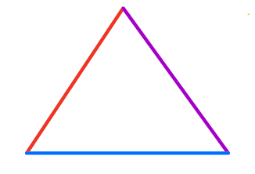
Design Space
Size
Weight
Endurance
Notes:
On slide - Ideal design space would equally be able to satisfy each of endurance, weight, and size.
On click - However, Airframe design mechanics made it so each of these aspects was in direct conflict with the other two and we could not get a good design space to satisfy all 3
On click - The reason for this is due to the Aspect Ratio. As you can see from the endurance calculation, there is a Factor of CL over CD. Each of these parameters is in part calculated by the Aspect Ratio. This parameter of the span^2 over the planform area makes the endurance very sensitive to it’s changes as it is directly correlated.

Slide 51
Zeppelin FDB
Buoyant Force
Payload mass assumed 3kg
Balloon mass assumed 5kg
Designed to settle at 6000ft or 1800 m MSL
Volume calculated at 9.4 m^3
Industrial costs of He was at least $464 to fill
Weight Balloon
Weight Balloon
Weight Helium

Slide 52
Zeppelin Costs
V = 9.4 M^3
helium | Price | Volume m^3 | $ Cost per m^3 | $ cost per fill | This is all assuming we could keep the zepplin to roughly 3kg mass carring 5kg payload
wallmat | 33.98 | 0.25 | 135.92 | 1277.648
Larger tank | 67.99 | 0.42 | 161.8809524 | 1521.680952
Industrial | 408 | 8.242 | 49.50254793 | 465.3239505 | tank is $410

Slide 53
Graded Airframes
Factors for comparisons
Endurance:
Ensuring the system can stay flying for tbd amount of time
Weight:
Wanting something lighter rather than heavier for transport
Payload Capacity:
Ensuring the system can carry the maximum possible of the desired payload
Take Off distance:
Comparing short takeoff and landing capabilities
Longest dimension:
Light weight, the smaller the better
Weighed System
1 - The two properties are determined to be of equal importance
9 - Property A is deemed to be of the utmost important over property B.

Slide 54
Graded Airframes
Endurance
< Weight (5)
< Payload (4)
< Take Off distance (3)
< Longest Dimension (4)
In order for a smaller and lighter airframe to have the same payload capacity something had to be compromised.
Endurance is determined to have the largest design space to cut into in order to make the airframe fit the operational needs

Slide 55
Graded Airframes
Weight
(5) > Endurance
(2) > Payload
(7) > Take Off distance
(2) > Longest Dimension
Determined to be highest priority. System must be light enough to be carried with all supporting equipment
Payload Capacity
(4) > Endurance
< Weight (2)
(7) > Take Off Distance
(2) > Longest Dimension

Slide 56
Graded Airframes
Take Off Distance
(3) > Endurance
< Weight (7)
< Payload (7)
(3) > Longest Dimension
Manufacturing was determined to limit Dimensions against distance required. Weight and payload capacity were considered most important.
Longest Dimension
(4) > Endurance
< Weight(2)
< Payload Capacity (3)
< Take Off Distance (3)
We plan to make the design such that it can be easily packed. But it must be light, carry the payload and make it in the air

Slide 57
Graded Airframes - Endurance Prioritized
Criteria [units] (requirement) | Criteria Weight | Fixed Wing | Hybrid Fixed Wing | Single Rotor | Multirotor
Endurance [min] (3) (5) (8) | 0.6578614692 | 210 | 120 | 64 | 41.6
Weight [kg] (1) (2) (5) | 0.1423388811 | 13.3 | 11.3 | 21.6 | 9.3
Payload Capacity [kg] (5) (6) | 0.1169848981 | 4.1 | 3.8 | 16 | 11.2
TakeOff Area [m^2] Approximate Value (1) | 0.04180969276 | 30 | 5.6 | 4.088 | 2.68
Longest Dimension [m] (2) (3) | 0.04100505891 | 3.28 | 2.8 | 2.044 | 1.34
 | Weighted Total | 0.3749648879 | 0.255953073 | 0.1946662541 | 0.174415785
 | Normalized Total | 0.3749648879 | 0.255953073 | 0.1946662541 | 0.174415785
 | Final Score | 100 | 68.2605442 | 51.91586208 | 46.51523134

Slide 58
Graded Airframes - Weight Prioritized
Criteria [units] (requirement) | Criteria Weight | Fixed Wing | Hybrid Fixed Wing | Single Rotor | Multirotor
Endurance [min] (3) (5) (8) | 0.03343711256 | 210 | 120 | 64 | 41.6
Weight [kg] (1) (2) (5) | 0.6527088843 | 13.3 | 11.3 | 21.6 | 9.3
Payload Capacity [kg] (5) (6) | 0.1759271519 | 4.1 | 3.8 | 16 | 11.2
TakeOff Area [m^2] Approximate Value (1) | 0.07626159926 | 30 | 5.6 | 4.088 | 2.68
Longest Dimension [m] (2) (3) | 0.06166525206 | 3.28 | 2.8 | 2.044 | 1.34
 | Weighted Total | 0.2168362982 | 0.2519372778 | 0.2165418886 | 0.3146845354
 | Normalized Total | 0.2168362982 | 0.2519372778 | 0.2165418886 | 0.3146845354
 | Final Score | 68.90592763 | 80.06026655 | 68.81237057 | 100

Slide 59
Graded Airframes - Payload Capacity Prioritized
Criteria [units] (requirement) | Criteria Weight | Fixed Wing | Hybrid Fixed Wing | Single Rotor | Multirotor
Endurance [min] (3) (5) (8) | 0.03205941719 | 210 | 120 | 64 | 41.6
Weight [kg] (1) (2) (5) | 0.1700612947 | 13.3 | 11.3 | 21.6 | 9.3
Payload Capacity [kg] (5) (6) | 0.6543775366 | 4.1 | 3.8 | 16 | 11.2
TakeOff Area [m^2] Approximate Value (1) | 0.07645656228 | 30 | 5.6 | 4.088 | 2.68
Longest Dimension [m] (2) (3) | 0.06704518928 | 3.28 | 2.8 | 2.044 | 1.34
 | Weighted Total | 0.1481278765 | 0.1655897755 | 0.3701245058 | 0.3161578423
 | Normalized Total | 0.1481278765 | 0.1655897755 | 0.3701245058 | 0.3161578423
 | Final Score | 40.02109402 | 44.73893862 | 100 | 85.41932172

Slide 60
Graded Airframes - Req Take Off Area Prioritized
Criteria [units] (requirement) | Criteria Weight | Fixed Wing | Hybrid Fixed Wing | Single Rotor | Multirotor
Endurance [min] (3) (5) (8) | 0.03063128194 | 210 | 120 | 64 | 41.6
Weight [kg] (1) (2) (5) | 0.1339643278 | 13.3 | 11.3 | 21.6 | 9.3
Payload Capacity [kg] (5) (6) | 0.105296375 | 4.1 | 3.8 | 16 | 11.2
TakeOff Area [m^2] Approximate Value (1) | 0.6622556614 | 30 | 5.6 | 4.088 | 2.68
Longest Dimension [m] (2) (3) | 0.06785235386 | 3.28 | 2.8 | 2.044 | 1.34
 | Weighted Total | 0.09186180393 | 0.2750736273 | 0.3044955086 | 0.3285690602
 | Normalized Total | 0.09186180393 | 0.2750736273 | 0.3044955086 | 0.3285690602
 | Final Score | 27.95814185 | 83.71866394 | 92.67321408 | 100

Slide 61
Graded Airframes - Longest Dimension Prioritized
Criteria [units] (requirement) | Criteria Weight | Fixed Wing | Hybrid Fixed Wing | Single Rotor | Multirotor
Endurance [min] (3) (5) (8) | 0.03138945659 | 210 | 120 | 64 | 41.6
Weight [kg] (1) (2) (5) | 0.1665074445 | 13.3 | 11.3 | 21.6 | 9.3
Payload Capacity [kg] (5) (6) | 0.1206812096 | 4.1 | 3.8 | 16 | 11.2
TakeOff Area [m^2] Approximate Value (1) | 0.0407191855 | 30 | 5.6 | 4.088 | 2.68
Longest Dimension [m] (2) (3) | 0.6407027039 | 3.28 | 2.8 | 2.044 | 1.34
 | Weighted Total | 0.1687214545 | 0.2114501616 | 0.2785973771 | 0.3412310069
 | Normalized Total | 0.1687214545 | 0.2114501616 | 0.2785973771 | 0.3412310069
 | Final Score | 49.44493645 | 61.96686623 | 81.64480116 | 100

Slide 62
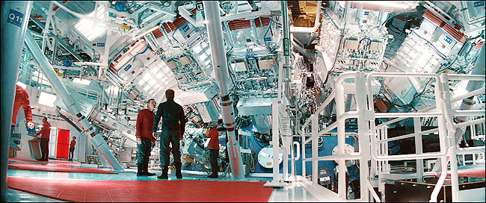
Batteries

Slide 63
Custom Built Batteries
Key features:
We can highly customize the battery to our needs.
The size, weight and power of the battery can be optimized.
The overall Capacity vs Cost ratio is not as high as something off the shelf
The safety may be a concern if not properly constructed
Custom Built | Pro | Con | Neutral
Level of Customization
Manufacturability By User
Capacity vs Cost Ratio
Safety
SWaP
Probability of Success

Slide 64
Off the Shelf Batteries
Key features:
The Manufacturability for end user is simplified
The size, weight and power of the battery now may be out of the users control
The level of customization for the battery
The safety of the battery is maximized due to regulatory requirements for battery pack sales
COTS | Pro | Con | Neutral
Level of Customization
Manufacturability By end User
Capacity vs Cost Ratio
Safety
SWaP
Probability of Success

Slide 65
Custom vs COTS Qualitative Trade
Criteria | Criteria Weight | Custom | Cots
Level of Customization | 0.025 | 5 | 1
Manufacturability By end User | 0.3 | 1 | 5
Capacity vs Cost Ratio | 0.075 | 5 | 3
Safety | 0.3 | 1 | 5
SWaP | 0.2 | 5 | 1
Probability of Success | 0.1 | 3 | 3
 | Weighted Total | 0.5875 | 0.615625
 | Normalized Total | 0.4883116883 | 0.5116883117
 | Final Score | 95.43147208 | 100
Notes:
The key Take aways from this trade study show that either route is a good fit for a prototype. However given that the customer will have to assemble and a custom battery this adds complexity and requires specialized training of the end user. Therefore, given power and energy requirements of the airframe design COTS will be prioritzed. If there is not a suitable COTS option a design study will be done to create a custom battery pack with work instructions that minimize the level of training required of the end user.

Slide 66
Battery Chemistry First Look
 | Lithium Chemistry
Chemistry | LiFePo4 | NMC | LTO | Nickle Cadmium
Specific Energy | 90-160 Wh/Kg | 150-220 Wh/Kg | 50-90 Wh/kg | 40-60 Wh/kg
Specific Power | ~200 W/Kg | 175* - 300* W/Kg | ~1400 W/Kg | 150 W/kg
Energy Density | 240-325 Wh/L | 300- 508 Wh/L | 200 Wh/L | 50-75 W/kg
Cost | 1-4 Wh/$USD | 2.4 Wh/$USD | 1.5 Wh/$USD | $0.4 Wh/$USD
Lifespan | > 10 Yrs | 3-6 Yrs | 10-30 Yrs | 20 Yrs
Safety | HIGH | Medium HIGH | HIGH | TBD
Charging Temperature Range | -20 - 55 C | -0 - 55 C | -20 - 55 C | -20 - 45 C
Discharging Temperature Range | -30 - 55 C | -20 - 55 C | -30 - 55 C | 0 - 45 C
Cycle Life | 2750-12000 | 1000-2000 | 3000-7000 | 2000-2500
Depth of Discharge | 100% | 80-100% | 100% | 100% **
1 | 2 | 3 | 4 | 5
NMC specific pwer batteries were estimated from example battery specifications*
Ni-C has memory effects **
Notes:
The Primary criteria for batteries that are likely to meet the customers design requirements is Specific Energy and Specific power, Measured in Wh/Kg and W/Kg Respectively. Secondary to these are Energy density and and Cost. As the other criteria meet and exceed the operational requirements set by the customer theses criteria are of secondary concern.

Slide 67
Battery Chemistry Qualitative Trade
Criteria | Criteria Weight | LiFePo4 | NMC | LTO | Nickle Cadmium
Specific Energy | 0.2 | 3 | 4 | 2 | 1
Specific Power | 0.2 | 4 | 3 | 5 | 1
Energy Density | 0.15 | 3 | 4 | 2 | 1
Cost | 0.1 | 3 | 1 | 4 | 5
Lifespan | 0.0475 | 3 | 1 | 4 | 4
Safety | 0.1 | 4 | 3 | 4 | 2
Charging Temperature Range | 0.05 | 4 | 2 | 4 | 3
Discharging Temperature Range | 0.05 | 4 | 3 | 4 | 1
Cycle Life | 0.0475 | 4 | 1 | 4 | 2
Depth of Discharge | 0.055 | 4 | 4 | 4 | 2
 | Weighted Total | 0.1999519231 | 0.1978044872 | 0.193525641 | 0.1046794872
1 | Normalized Total | 0.2873031224 | 0.2842175555 | 0.2780694483 | 0.1504098738
 | Final Score | 100 | 98.92602388 | 96.7860864 | 52.35232828
Notes:
The key take away from this qualitative trade study are that the 3 lithium ion battery chemestris chosen are relatively matched. When conducting energy studies and modeling based off predicted flight regime power requirements these 3 chemistries will be consider in a flow done manor. Ultimately cost and availability constraints will likely be a deciding factor.

Slide 68
Propulsion

Slide 69
Propulsion: High Level Trade Research
Extremely large propulsion trade space needs to be refined before analysis can begin
Research conducted on existing propulsion systems, focusing on scaling down to fit size requirements for small UAS
Notes:
Three main categories: Fuel, Hybrid, and Electric

Slide 70
Propulsion: Gas Pros and Cons
Gas Propulsion Systems | Pros | Cons
Lightweight (Fuel included) |  | x
Energy Density | x
Cost |  | x
Thrust Generation | x
Power-to-Weight Ratio | x
High Internal Temperatures |  | x
Performance Due to Weather Effects | x
Average Endurance | x
Hazard during Emergencies |  | x
Maintenance |  | x
Key features:
3 primary categories: piston, rotary and turbine engines
High energy density leads to small engine size for amount of thrust provided
Reliable for wide range of flight conditions
High internal temperatures and increased risk of fire
Significantly more routine maintenance necessary

Slide 71
Propulsion: Gas/Electric Hybrid Pros and Cons
Hybrid Gas/Electric Propulsion Systems | Pros | Cons
Lightweight (Fuel included) | x
Energy Density | x
Cost |  | x
Thrust Generation | x
Efficiency | x
High Internal Temperatures |  | x
Performance Due to Weather Effects | - | -
Average Endurance | x
Hazard during Emergencies |  | x
Maintenance | x
Key features:
4 main configurations: Series, Parallel, Series-Parallel, Complex Hybrid engines
Potential for high endurance and efficiency
High cost due to added complexity, especially for small systems
Scalability and reliance on fuel are primary drawbacks

Slide 72
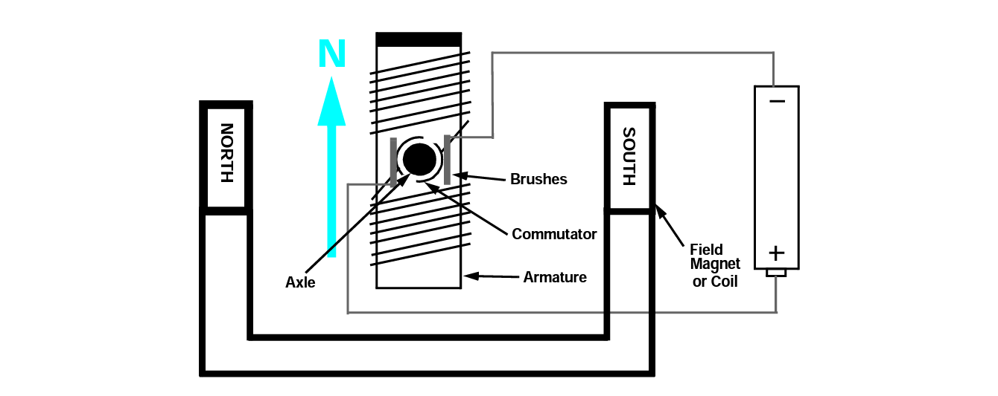
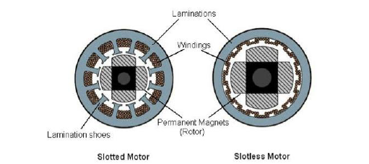
Brushed vs. Brushless
Brushed
4 Major Components:
Stator
Rotor
Brushes and Commutator
Highly Efficient
Brushes physically interact with commutator
This causes excess wear and tear
Brushless
3 Major Components:
Stator
Rotor (with teeth)
Commutator
Similar Efficiency
Less wear and tear therefore lower cost in long run
Key Difference
Brushed commutation occurs through physically touching the commutator
Brushless commutation occurs with transistors during motor winding

Slide 73
Avionics

Slide 74
Avionics: Peripheral Hardware List
Basic Peripherals (Required for flight) | Desired Peripherals (Ideal for ease of use/autopilot) | Expansion Peripherals (Could potentially be integrated later by customer)
RC Controls | RC Controls | RC Controls
Airspeed Sensing and Barometer | Airspeed Sensing and Barometer | Airspeed Sensing and Barometer
Radio Transmit/Receive | Radio Transmit/Receive | Radio Transmit/Receive
Main motor and ESC | Main motor and ESC | Main motor and ESC
4 Servos | 4 Servos | 4 Servos
 | GPS/Compass | GPS/Compass
 | Telemetry | Telemetry
 |  | First Person Video
 |  | ADS-B Receiver
Notes:
Before avionics trade studies can be done, need to outline what avionics will be necessary. Separated into 3 Levels of peripheral hardware options: one for basic (no autopilot) flight, one for adding autopilot options, and one for potential/discussed customer additions.

Slide 75
Avionics: Flight Controller Software Trade Study Key
Metric | Score
 | 1 | 2 | 3 | 4 | 5
Ease of Use/Complexity | Difficult process to alter flight control laws and troubleshooting, no way of creating flight plans |  | Ability to add flight plans, simple way of altering control laws and troubleshooting |  | Simple UI for altering flight plans and control laws, easily programmable and simple installation/troubleshoot
Documentation | Little to no centralized or detailed documentation for setup or troubleshooting |  | Centralized and detailed documentation for troubleshooting and setup |  | High degree of centralized, detailed documentation explaining troubleshooting, setup, alteration, and addition of new features with regular updates and community support
Peripheral Hardware** | Basic flight peripherals supported only |  | All desired peripherals supported |  | All expansion peripherals supported
Controller Hardware Compatibility | Limited controller hardware compatibility or cost/performance restrictions |  | Compatible with reasonable range of controller hardware |  | Compatible with wide range of controller hardware with many cost and performance options
Notes:
Software study conducted first- staying solution agnostic for as long as possible. 4 main criteria developed after research into autopilot software and differences between them.

Slide 76
Avionics: Flight Controller Software Trade Study
Criteria | Criteria Weight | Ardupilot | INAV | PX4
Ease of Use/Complexity (Req 7) | 0.35 | 3 | 3 | 4
Documentation (Req 7) | 0.35 | 5 | 2 | 4
Peripheral Hardware | 0.20 | 5 | 4 | 5
Controller Hardware Compatibility | 0.10 | 5 | 1 | 2
Final Score | 100 | 61.23998665 | 93.47463284
Notes:
Weighting developed with requirements in mind: two criteria with direct relation to functional requirements are weighted the highest. Most autopilot software has similar capabilities, so the main difference is how easy it is for us and the customer to interact with-hence high weighting on Ease of use and documentation. Ardupilot and PX4 are very similar systems and could potentially be interchangeable. Main limiting factor for PX4 is being specific to Pixhawk hardware and lack of mode switching through RC hand controller, allowing different autopilot rules for different phases of flight without creating a mission plan. Specific notes on each system is in the avionics trade study sheet

Slide 77
Avionics: Flight Controller Hardware Trade Study Key
Metric | Score
 | 1 | 2 | 3 | 4 | 5
Cost | >$325 | $250-324 | $175-249 | $100-174 | <$100
SWaP (Size, Weight and Power) | Relatively large size and weight, relatively high board power draw |  | Relatively average size and weight and board power draw |  | Relatively small size and weight, relatively high board power draw
Peripheral Hardware** | Basic flight peripherals supported only |  | All desired peripherals supported |  | All expansion peripherals supported or all desired peripherals supported with room for expansion
Ease of Use/Complexity | Difficult to install, high degree of knowledge needed to install or configure, specialized hardware required to install | Somewhat difficult to install (complicated to configure or setup) | Easy to configure and install (easy wiring, first time setup) | Easy to configure and install (easy wiring and first time setup), easily able to connect new hardware to expand scope | Very easy to configure and install (wiring redundant to incorrect connections, easy first time setup), easily able to connect new hardware to expand scope
Documentation | Little to no centralized or detailed documentation for setup or troubleshooting |  | Centralized and detailed documentation for troubleshooting and setup |  | High degree of centralized, detailed documentation explaining troubleshooting, setup, alteration, and addition of new features with regular updates and community support

Slide 78
Avionics: Flight Controller Hardware Trade Study
Criteria | Criteria Weight | Pixhawk 4 | Cube Orange | BeagleBone Blue
Cost (Req 4) | 0.30 | 3 | 1 | 5
SWaP (Req 1) | 0.10 | 5 | 4 | 3
Peripheral Hardware | 0.30 | 5 | 5 | 3
Ease of Use/Complexity (Req 7) | 0.15 | 4 | 4 | 2
Documentation (Req 7) | 0.15 | 4 | 4 | 2
Final Score | 100 | 61.23998665 | 93.47463284
Final Score | 100 | 89.71820259 | 95.31607007
Notes:
Two main driving criteria are cost and peripheral hardware. Costs can easily exceed $500 for a highly capable flight controller, but some cheaper options are not capable of supporting complex systems (high numbers of servos, multiple serial inputs/outputs for GPS and airspeed sensing). SWaP listed as lowest due to small size of systems relative to total size of A/C- limited power draw and weight expected. All three controllers are compatible with each of the softwares in the trade space in order to remain solution-agnostic until both trades completed. Systems are somewhat comparable based on trade study, but cost is limiting factor to Cube and ease of use/documentation for BeagleBone. Further breakdown of each criteria in trade study sheet.

Slide 79
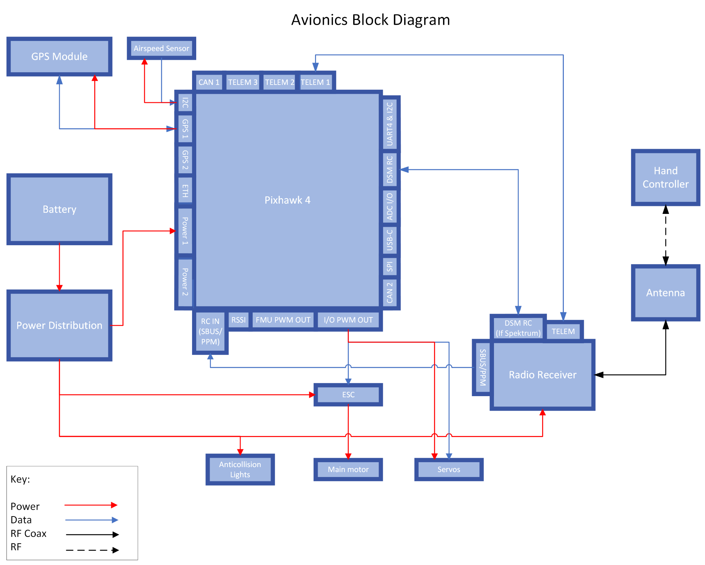

Slide 80
Level 2 trade: Fixed-Wing Airframe design

Slide 81
Level two trade: Fixed wing aircraft designs
 | Manufacturing ability | Launch capability | Aerodynamic efficiency | Stability | Team knowledge
Manufacturing ability | 1 | 7.000350018 | 5 | 9.0000009 | 4
Launch capability | 0.14285 | 1 | 1 | 4 | 2
Aerodynamic efficiency | 0.2 | 1 | 1 | 7.000350018 | 5
Stability | 0.1111111 | 0.25 | 0.14285 | 1 | 1
Team knowledge | 0.25 | 0.5 | 0.2 | 1 | 1

Slide 82
Level two trade: Fixed wing aircraft designs
Criteria | Criteria Weight | Conventional | Flying Wing | Bi-Plane
Manufacturing ability | 0.09176689682 | 5 | 3 | 5
Launch capability | 0.1325202868 | 4 | 5 | 3
Aerodynamic efficiency | 0.263111979 | 4 | 5 | 3
Stability | 0.0351331383 | 5 | 1 | 5
Team knowledge | 0.4774676991 | 5 | 2 | 2
 | 0 | 0 | 0 | 0
 | Weighted Total | 0.4484018234 | 0.2953216084 | 0.2562765682
 | Normalized Total | 0.4484018234 | 0.2953216084 | 0.2562765682
 | Final Score | 100 | 65.86092942 | 57.15332874

