Slide 1
Additively Manufactured Aerial Drone for Emergency Unmanned Surveillance (HERD-CU)
Preliminary Design Review
Customer & Faculty Mentor: Prof. John Mah
Aziz Alwatban
Mikaela Felix
Alex Fitzgerald
Ben Gattis
Godwin Gladison
Brady Hogoboom (Systems Engineer)
Amanda Marlow
Ella Mumolo
Devon Paris
Adam Pillari
Jake Ramsey
Linus Schmitz (Program Manager)
Overview
Trades
Design
Next Steps
Notes:
Hi everyone and welcome to the PDR for team AMADEUS. Thank you to everyone for coming out today, in particular to Brandon Yonko and Michael Fillman from AeroVironment who have provided us invaluable feedback. My name is Linus Schmitz and I am the Program manager for the team and I'll let everyone else introduce themselves.

Slide 2
Team Org Chart
Overview
Trades
Design
Next Steps
Notes:
Our team structure is set up such that I provide a point of contact for the industry and faculty mentors and then with the technical help from Brady, lead the team.

Slide 3
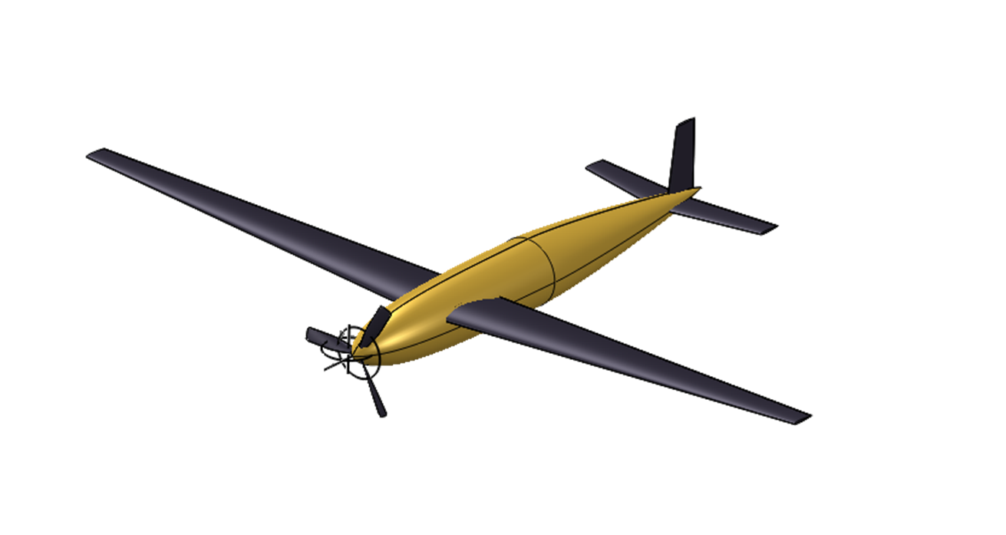
Project Description
The purpose of AMADEUS is to provide a low cost, high endurance, human portable, and rapidly deployable UAS capable of various missions in austere environments.
Overview
Trades
Design
Next Steps
Notes:
The mission statement for Team AMADEUS was to provide a low cost, high endurance, UAV capable of operating in austere environments under a variety of missions.
It must be transported, launched and flown by a single operator.
Additionally, it must be constructed out of additively manufactured materials and consumer off the shelf components.
The final deliverable, will be design documentation for organizations, to reproduce and operate the aircraft with minimal additional work.

Slide 4
Functional Requirements
FR.1: The UAS shall be human portable.
FR.2: The UAS shall support 12 hours of continuous coverage/operation.
FR.3: The UAS shall be durable to support structural loading and environmental conditions.
FR.4: The UAS shall support a modular payload.
FR.5: The UAS shall be low cost to produce and repair for user.
FR.6: The UAS shall be rapidly deployable.
FR.7: The UAS shall obey guidelines and regulations set forth by FAA and MIL-F-8785C.
FR.8: The total costs for development and technology shall not exceed $4000.
FR.9: The UAS shall be controllable by remote user.
Overview
Trades
Design
Next Steps
Notes:
Our functional requirements, flow down from the mission statement
where our top three are human portability, endurance and operability in austere environments. Next we have the customer focused requirements
which include the modular payload, low maintenance cost and rapid deployment. Finally the last three requirements are geared towards design and manufacturing
which include legal restrictions, design cost requirements and remote operation.

Slide 5
CONOPS
Overview
Trades
Design
Next Steps
Notes:
Our CONOPS highlights the key attributes of our project including the documentation, fabrication, mission use and continued maintenance and upkeep of the UAV throughout it's lifecycle.

Slide 6
Critical Project Elements
Element Number | Element | Associated Functional Requirements | Interdependent with
1 | Aerodynamic Efficiency | FR.2 FR.6 IRON Triangle --> Requirements/Scope | -Materials -Portability
2 | Structural Support | FR.1 FR.3 FR.4 FR.5 FR.6 FR.7 FR.8 IRON Triangle --> Requirements/Scope + Cost + Schedule | -Materials -Portability
Overview
Trades
Design
Next Steps
Notes:
We have identified four Critical project elements, without which the design will not be successful.
First and foremost is the aerodynamics which ties into the requirements for endurance and deployment.
Next is structural design which touches on ALL the requirements except endurance and remote operation.
1: The UAS must have a high aerodynamic efficiency that ensures natural stability, long endurance for minimal orbit swaps, and little energy losses at operation altitudes. Optimizing lift to drag ratio will ensure performance in all mission stages (launch, orbits, landing).
2: UAS structure must support its own weight in addition to modular payload. Structures will accommodate the aerodynamic loading and any other environmental loading without significant yielding or deformation.

Slide 7
Critical Project Elements
Element Number | Element | Associated Functional Requirements | Interdependent with
3 | Materials | FR.3 FR.5 FR.8 IRON Triangle --> Cost and requirements/scope | -Aerodynamic Efficiency -Structural Support -Portability
4 | Portability | FR.1 FR.6 FR.9 IRON Triangle --> Requirements | -Aerodynamic Efficiency -Structural Support -Materials
Overview
Trades
Design
Next Steps
Notes:
Materials and material choice is one of our most important elements as it plays a roll in every CPE.
It is based on the austere operations, low maintenance cost and total development cost requirements for the project.
Finally portability stems from the very first functional requirement specifying that it must be transportable by a single user.
It is additionally influenced by the rapid deployment and remote control requirements.
Similar to material choice it is has interdependencies with all three other CPEs.
3: Design must incorporate additive manufacturing or off the shelf materials while maintaining the lightest possible airframe. Poses challenges for aerodynamics as materials used influence efficiency and structures as these materials have stress/strength limitations.
4: For use in austere environments, UAS must be lightweight to be carried by user to launch site. If feasible, design to be modular and assembled in field or before use.

Slide 8
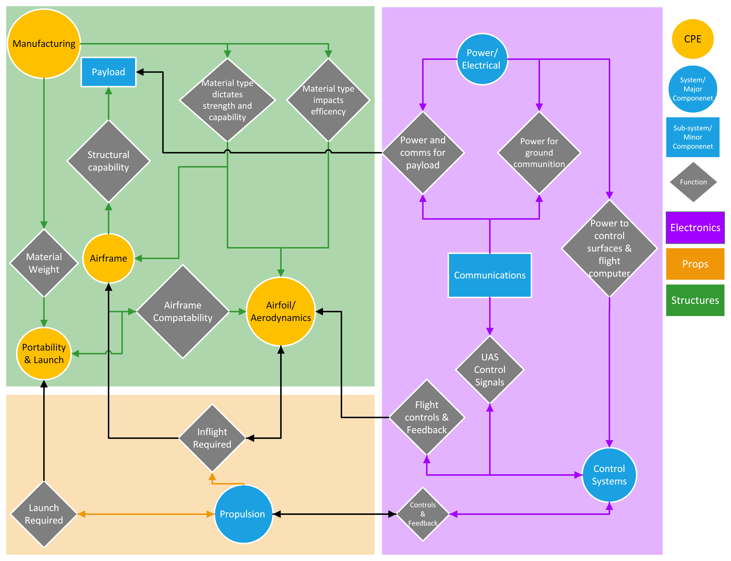
Functional Block Diagram
Overview
Trades
Design
Next Steps
Notes:
The functional block diagram provides a high level systematic overview of the entire project.
In particular it outlines the physical dependency of all systems with the structural design.
Furthermore, it outlines the connection of communications and control with nearly every system to provide a single coherent aircraft.
Starting with the structures section, material choice plays a key roll in designing the airfoil and airframe, by ensuring strength and stability.
The propulsion system communicates with the control system during flight, however is a key determinant in the design process as it will dictate the climb rate at launch and the cruise performance once at altitude.

Slide 9
Trades List
Structures | Manufacturing Methods | Materials
Propulsion | Endurance Power and Energy | Climbing Power and Energy | Motor Type | Number of Motors | Motor Placement
Aerodynamics | Aircraft Configuration | Parasite Drag | Induced Drag | PLLT Finite Wing Selection
Overview
Trades
Design
Next Steps
Notes:
For our trades we will be covering the material selection from the structures team which is dependent on both the propulsion and aerodynamics team. Propulsion team covered motor type which again was dependent on the design solutions from the aerodynamics and structures teams. Aero team looked into aircraft configuration and Prandtl lifting line theory for a finite wing selection. To ensure that we did not have any delays with subteams waiting for results, baseline assumptions were coordinated across all teams prior to trades being completed. I'll now hand it over to Amanda who will cover the structural trade studies and design space.

Slide 10
Structures/Material Selection Space
Purpose:
Explore options to meet
FR.3 - durable
FR.4 - modular payload (up to 3 kg)
FR.5 - low cost to produce and repair
DR.5.1 - 90% COTS or additively manufactured by user
Refine the design space by modeling worst case loading scenarios on the most critical structural elements
Choose an ideal manufacturing method and identify top candidate materials for each critical structural element
Overview
Trades
Design
Next Steps
Notes:
The driving factors behind our structures and materials research were our functional requirements for durability, supporting a 3 kg payload, and keeping costs low – specifically by using primarily COTS and 3D printed parts.
We wanted to refine the design space by modeling worst case loading conditions on the most critical structural elements. We also looked into the best material and manufacturing methods for each of these elements.

Slide 11
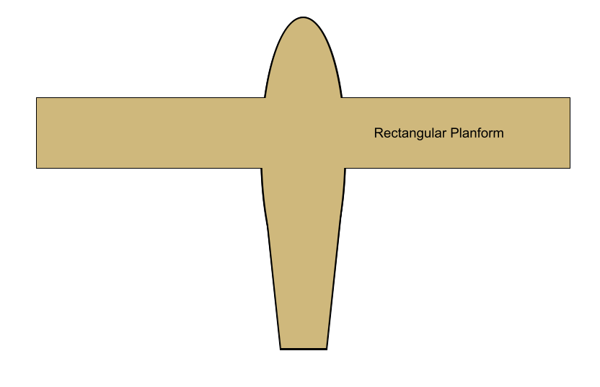
Wing Loading Assumptions
Mass = 15 kg (Mass budget in appendix)
L = Lift = Weight = 147.15 N
F = Force applied at wing tips to overestimate worst case scenario without relying on specific lift distribution and keeping the model simple
Overview
Trades
Design
Next Steps
Notes:
The first element we looked at were the wings.
We had to start with some assumptions to do this analysis. First of all, we decided to use a total lifting force equal to the weight of the plane. We also assumed loads were applied at the tips, so that we did not have to rely on a certain lift distribution from the aerodynamics team. When looking at torsion over the wing, we assumed a pretty long chord length for this sized plane and a rectangular wing so the chord length is uniform. We chose to apply the lifting force at the quarter chord to get the moment arm as this is about where the aerodynamic center is on most fixed wings.

Slide 12
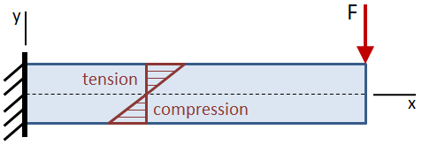
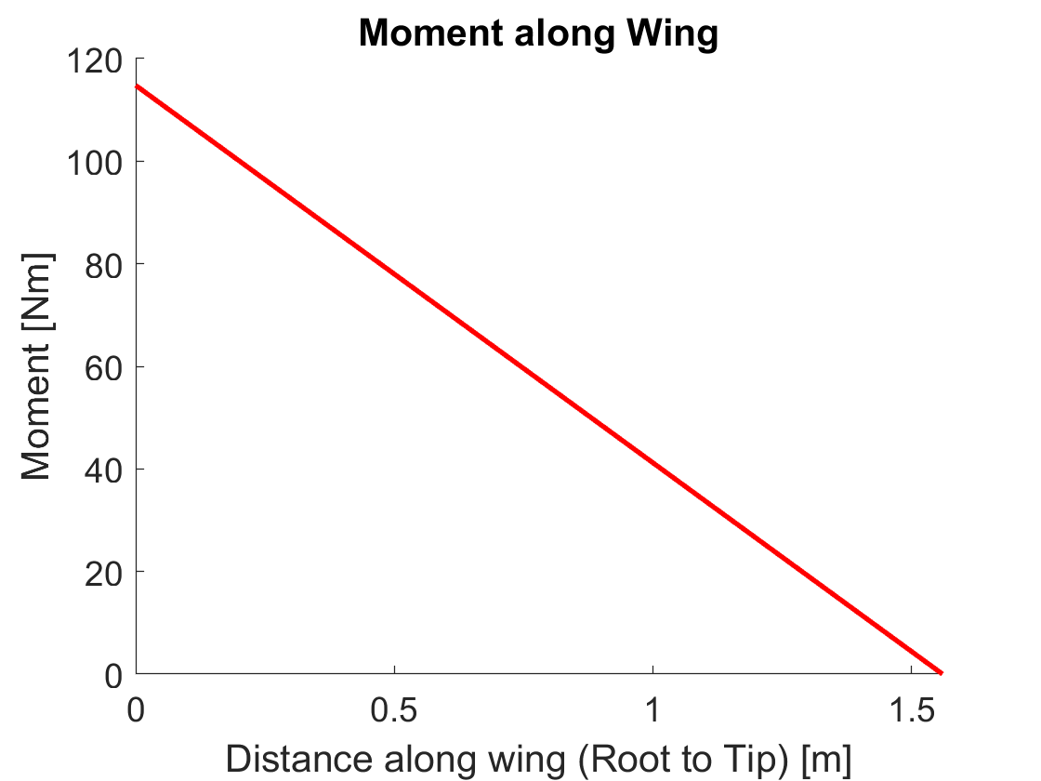
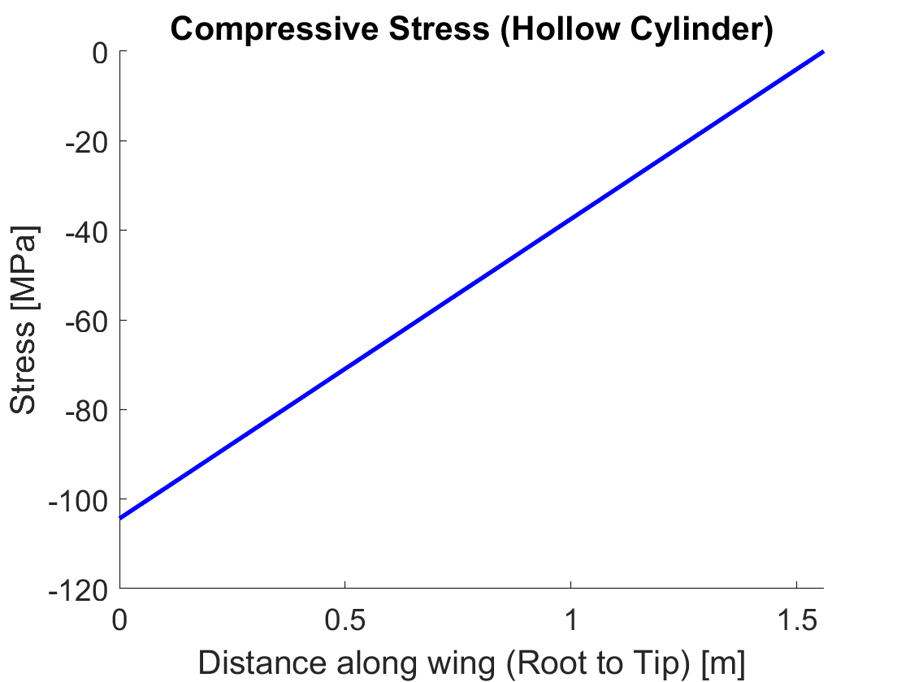
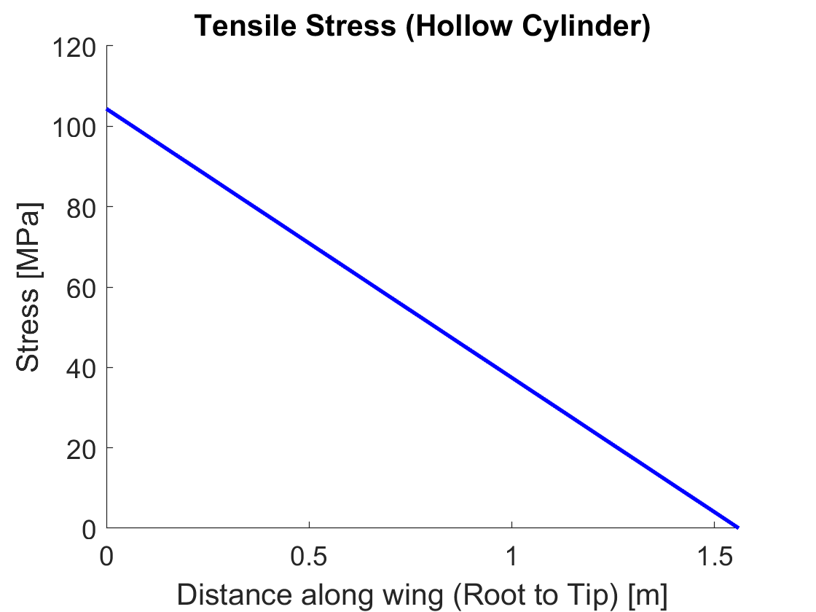
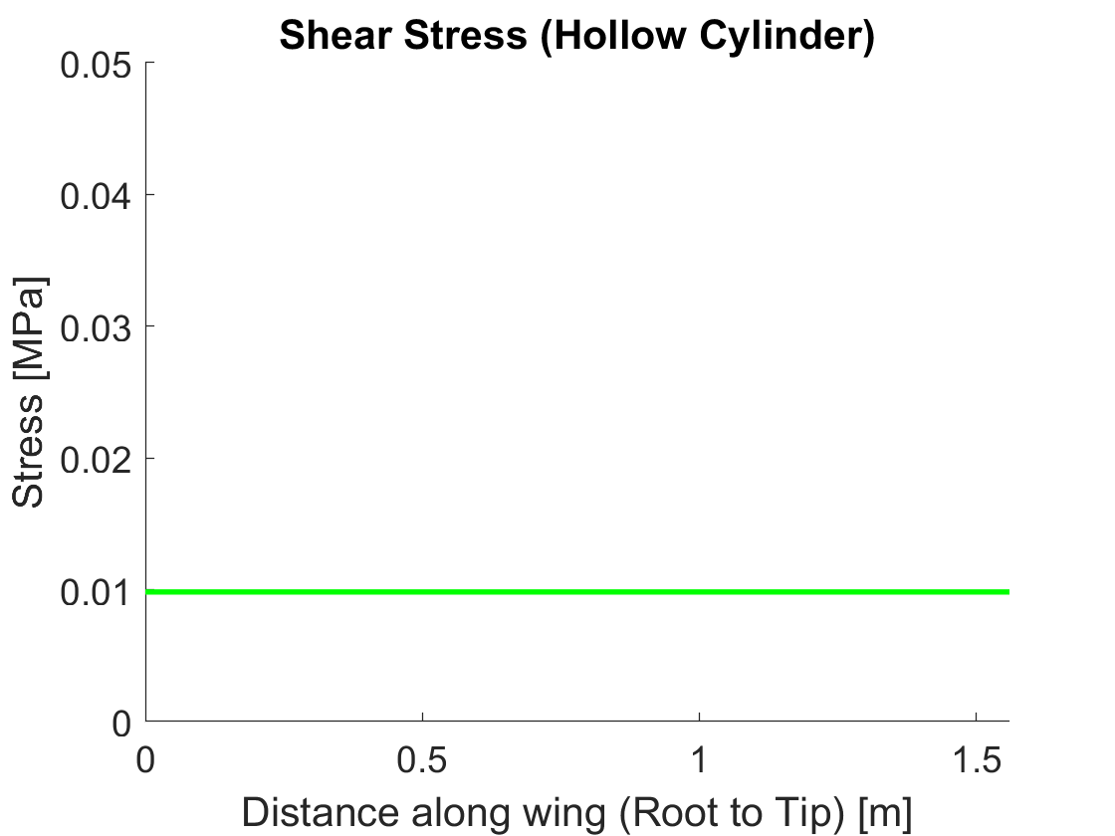
Wing Bending
Cantilever Beam Analysis
Trends along the wing stay the same for all cross sections but max and min stress differ
Max Shear
Overview
Trades
Design
Next Steps
Notes:
We modeled the bending moment on the wing with a cantilever beam meaning it is completely fixed at the fusilage. The top of the wing will be in compression and the bottom in tension with a plane of shear stress that transitions between the two.
You can see the trends along the wing in these plots with the most extreme tensile stress at the root and uniform shear stress over the span.

Slide 13
Wing Bending
Hollow Cylinder
Approximates a structural spar beam
Easily constructed with COTS components
Hollow Rectangular Cross Section
Approximates a wing shell with no other structural elements
Best with additive manufacturing
Tensile Stress:
Max σ = 104.4 MPa
Tensile Stress: Max σ = 2.701 MPa
Shear Stress: Max τ = 0.27 MPa
Shear Stress:
Max τ = 0.0098 MPa
Overview
Trades
Design
Next Steps
Notes:
For wing bending we primarily looked at two cross section shapes. The hollow cylinder is meant to approximate a spar beam. The hollow rectangle is meant to be close to the shape of an airfoil with a representative length and thickness. The tensile stress was pretty high on the hollow cylinder, but a spar beam would be pretty easy to make with COTS components that have higher strengths. The tensile stress on the rectangle was lower, and shear stress was higher. The increased shear stress here is something to keep an eye on, since this is meant to approximate an airfoil shape we would want to 3D print and shear strength is highly dependent on printing techniques.

Slide 14
Wing Torsion
Hollow Thick-Walled Cylinder
Approximates a structural spar beam
Max τ = 2.22 MPa
Best with OTS Components
Aluminum
Steel
Carbon Fiber
Open Thin-Walled Ellipse
Approximates a wing shell with no other structural elements
Max τ = 0.987 MPa
Best with Additive Manufacturing
Extruded Filaments
SLS Plastics
Overview
Trades
Design
Next Steps
Notes:
Similar to our bending calculations, we looked at two cross sections. A hollow cylinder is still used to approximate the spar beam, but this time we used an open thin wall ellipse to approximate an airfoil shell. We used these results as the max shear stress a material must withstand.

Slide 15
Wing Conclusions
Manufacturability [FR.5]
Wing Surface should be additively manufactured to get ideal airfoil shape
Spar beam can utilize COTS components
Strength/Durability [FR.3]
Stress, particularly shear, is high enough that a spar beam made of a stronger material is recommended to ensure the additively manufactured wings do not fail
3D printed materials have largely unknown shear strengths because it is so dependent on printing technique and other outside factors
*Elaborated on in materials trade study
Overview
Trades
Design
Next Steps
Notes:
Overall, we concluded that the shear stress could be of great enough concern to combine a spar beam made of a strong, material and a 3D printed outer airfoil shape in order to meet our requirements for manufacturing and durability.

Slide 16
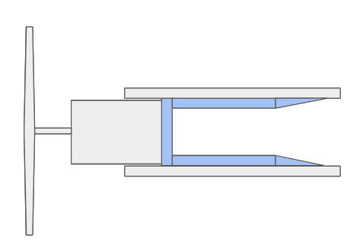
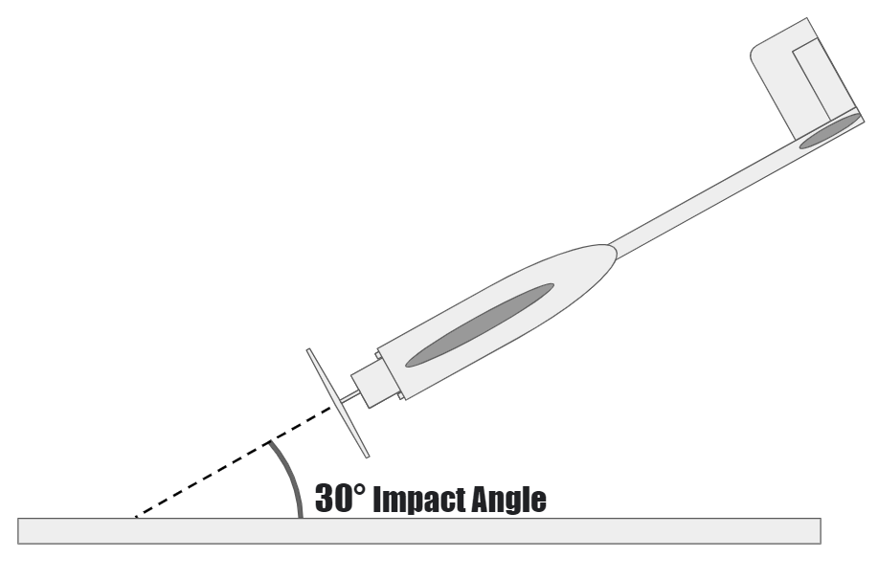
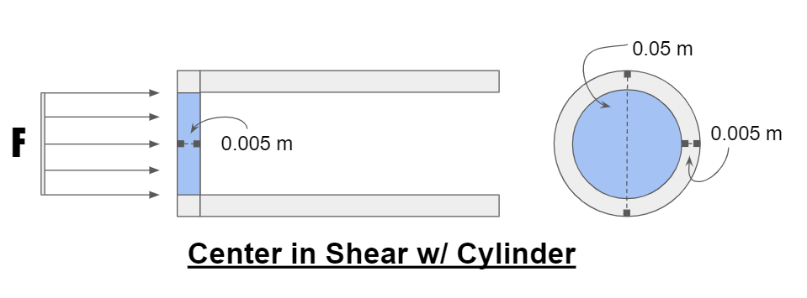
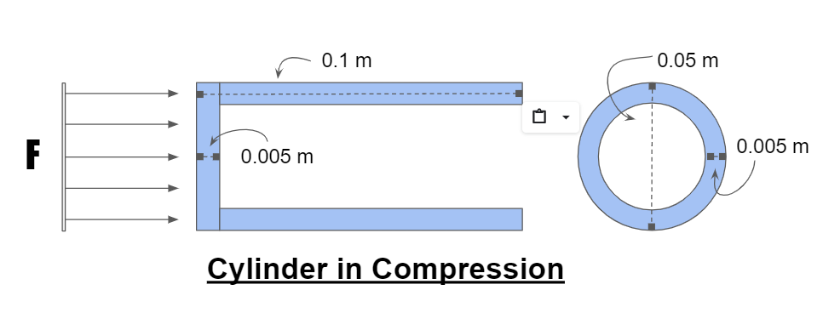
Firewall - Assumptions
Generic firewall geometry where motor transfers impact force axially onto firewall.
Primarily Shear Stress
Distributed load acting on center only.
High stresses compared to material strength
Primarily Compressive Stress
Distributed load acting on outside cylinder only.
Lower stresses compared to material strength
F is force due to impact
Overview
Trades
Design
Next Steps
Notes:
The next critical structural element we looked at was a firewall. A firewall is what the engine is mounted to and it is the primary structure that absorbs forces due to impact. We looked at various impact angles using an upper bound on the expected airspeed of 18 m/s. In our first model, we assumed the firewall was constructed in a way that the force of the impact was primarily transferred into shear stress. There were really no materials that could withstand this. So instead, we changes how me were envisioning the configuration so the major force is compression as shown in the top and bottom figures. We found that this is actually how most firewalls are constructed.
Alex's Notes: The firewall is an important airframe component that supports the motor. Due to its placement directly behind the motor it will experience large stresses during any hard landings. The firewall was analyzed in order to determine the best possible material to use in its manufacturing in order to improve the durability of the aircraft. The firewall was first analyzed as a disk attached to a hollow cylinder where the primary forces act on the disk. In this geometry the most severe stresses are shear stresses at the connection between the disk and the cylinder. Upon the completion of this analysis it was determined that few or no materials had the necessary shear strength to survive impacts at relatively low impact angles given reasonable geometry. Further research was done into firewalls in order to find out how other similarly sized uav's solved this issue. It was found that most firewalls actually have additional supports behind the motor mount generally taking the form of a L-bracket or cylinder. For simplicity the firewall was then modeled as a cylinder shown in the top image where the major stress is compression in the cylinder.

Slide 17
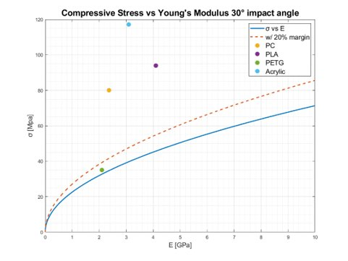
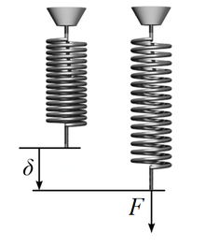
Firewall Feasibility
Compressive Stress (sigma) in the firewall cylinder calculation using work-energy principle:
Equation can be rewritten to solve for a relationship between material properties sigma (Compressive Stress) and E (Young's Modulus):
Assumptions: v = 18 m/s, m = 15 kg, geometry given in previous slide
IMAGE: https://en.wikipedia.org/wiki/Stiffness
http://hyperphysics.phy-astr.gsu.edu/hbase/impulse.html
Overview
Trades
Design
Next Steps
Notes:
Using the geometry given in the last slide compressive stress was determined using the work-energy principle. The spring constant, k, is determined using the young's modulus of the material. The stiffer the material, the more force will act upon the firewall since the impact is taking place over a shorter time period. This equation can be rearranged to isolate the material properties on one side resullting in the useful ratio between the compressive strength and the square root of the young's modulus of the material. The plot on the right shows the maximum compressive stress vs the young's modulus of the material.
Alex's Notes: Using the geometry given in the last slide where the force of an impact, F, is transfered onto the firewall as a distributed load on the hollow cylinder the maximum compressive stress and therefore necessary material compressive strength was determined. The impact force was determined using the work-energy principle where k, spring constant, is determined using the young's modulus of the firewall material. The stiffer the material, the more force will act upon the firewall since the impact is taking place over a shorter time period. The force is then divided by the cross-sectional area of the firewall cylinder in order to get the maximum compressive stress. This equation can be rearranged to isolate the material properties on one side resullting in the useful ratio between the compressive strength and the square root of the young's modulus of the material. For a specific velocity and impact angle an angle can be determined This ratio will be used to determine if a material is feasible for the firewall. A plot of the maximum compressive stress vs the young's modulus of the material is shown to the right.

Slide 18
Firewall Conclusions
Minimum material ratio required w/ 20% margin
Takeaway:
Reasonable impact angle must be assumed for firewall to survive crash.
Firewall should use material with high sigma/sqrt(E) value such as Acrylic. [FR.3]
Firewall should be additively manufactured to accommodate potentially complex geometry. [FR.5]
Compressive Strength vs. sqrt(E)
Impact Angle θ​ | sigma/sqrt(E)​
90°​ | 2853.4​
60°​ | 2140.1​
45°​ | 1426.7​
30°​ | 856.0​
15°​ | 191.1​
5°​ | 21.7​
Material | sigma/sqrt(E)
PC | 1646.77
PLA | 1468.03
ABS | 1300.00
PETG | 763.76
Acrylic | 2105.15
Nylon | 2173.52
316L SS | 386.96
Carbon Fiber | 1819.92
Al. 6061 T-6 | 952.42
Assumptions: v = 18 m/s, m = 15 kg, geometry given in previous slide
Overview
Trades
Design
Next Steps
Notes:
The conclusions we can draw from the firewall analysis is that the material should have a high strength to youngs modulus ratio to meet our durability requirement. We also determined that the shape needed to would be best to 3D print to meet our manufacturability requirement. On the right you can see tables of the strength ratios, but I'm going to hand it over to Mikaela to go more in-depth on materials.
Alex's notes: The table in the center shows the minimum required compressive strength per square root of young's modulus depending on the impact angle. These values were determined using an assumed aircraft mass of 15kg and velocity of 18 m/s. A list of prospective materials is tabulated to the right including their ratio of sigma over sqrt of E. As shown, given reasonable geometry no material is able to survive a 90 degree impact however given a more reasonable impact angle the list of feasible materials increases.

Slide 19
Material Trade Study Weighting
Metric | Description | Weight | Rationale
Density | Affects overall weight of structure | 0.35 | Most critical aspect Affects flight characteristics Must be lightweight to be human portable
Strength | Maintain structure from applied loads | 0.15 | Handle strong loads Wind gusts at least 30 ft/s
Durability | Resistance to damage from forces over time | 0.1 | Endure flight forces 12 hour duration
Overview
Trades
Design
Next Steps
Notes:
Density is the most vital for ensuring the aircraft is lightweight enough to be human portable
Strength and durability so the aircraft can endure high wind gusts and complete a long duration flight without losing structure

Slide 20
Material Trade Study Weighting
Metric | Description | Weight | Rationale
Cost | Cost per kg of filament | 0.1 | Affordable Additive manufacturing generally cheaper – smaller weight
Manufacturability | Ease of manufacturing | 0.2 | Minimal to no expertise Materials easy to use Minimal errors during construction
Heritage | Material usage in related applications | 0.1 | Lower weight Take into consideration other aircraft using this material
Overview
Trades
Design
Next Steps
Notes:
Cost was given lower weight due to additive manufacturing generally being cheaper
Manufacturability had a higher weight since another big aspect was requiring little expertise for manufacturing so anybody could build it
Heritage - using examples of other applications

Slide 21
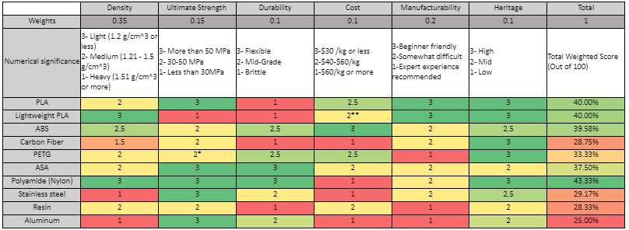
Material Trade Study
*Varies by type
**Low density offsets cost/kg
Overview
Trades
Design
Next Steps
Notes:
Broke down into further selections since each structure has different ideal metrics than others

Slide 22
Material Comparison – Spar Beam
Materials | Carbon Fiber | Stainless Steel | Aluminum
Density (g/cm^3) | 1.3 | 7.91 | 1.54
Tensile Strength (MPa) [Worst Case 104.4 MPa] | 1035 | 590 | 460
Heritage | High | Mid | Mid
Cost ($/kg) | 30-80 | 100 - Varies | 100 - Varies
Overview
Trades
Design
Next Steps
Notes:
Use COTS components and all would support the hollow cylinder as a spar beam
Carbon fiber most ideal due to high heritage and high strength while being much lighter than other materials and much more affordable

Slide 23
Material Comparison – Wing Surface
Materials | Lightweight PLA | PLA | ABS | Nylon
Density (g/cm^3) | 0.8 | 1.24 | 1.04 | 1.06-1.14
Tensile Strength (MPa) [Worst Case 2.7 MPa) | 23 (To be tested) | 65 | 40 | 40-85
Manufacturability | (FDM) Easy | (FDM) Easy | (FDM) Medium | (FDM) Medium
Cost ($/kg) | 37* | 15-20 | 21 | 40-60
Overview
Trades
Design
Next Steps
Notes:
Most important here was choosing a light material that still would have a strength that could be support
Lightweight PLA appeared to be great due to having a low density but will need to be tested strength wise

Slide 24
Material Comparison – Firewall
Materials | Carbon Fiber | PLA | PC | Nylon | Acrylic
Density (g/cm^3) | 1.3 | 1.24 | 1.20 | 1.06-1.14 | 1.24
Compressive Strength ratio (sigma/sqrt(E)) | 1819.92 | 1468.03 | 1646.77 | 2173.52 | 2105.15
Manufacturability | (COTS or FDM) Medium | (FDM) Easy | (FDM) Medium | (FDM) Medium | (FDM or COTS) Medium
Cost ($/kg) | 30-80 | 15-20 | 95 | 40-60 | 50
Overview
Trades
Design
Next Steps
Notes:
Compressive strength ended up being most vital so those with higher ratios like nylon and acrylic tended to be more
Higher the strength rating the larger the impact angle that the firewall can survive. Nylon appears to be the obvious choice however, due to its low weatherability it should be avoided for extended outdoor use. The next two options are Acrylic and Polycarbonate (PC) which both have good strength to young's modulus ratios. Acrylic beats PC due to its lower cost.

Slide 25
Materials Summary
Aerodynamic Surfaces
PLA or LW-PLA
Mostly favorable characteristics of light weight and ease of use
Disadvantages in strength can be compensated for via internal structure.
Internal Structure
Carbon fiber
High strength-to-weight ratio compared to steel and aluminum, strong heritage
Firewall
PC, Nylon, or Acrylic
High strength ratio
Performs well in harsh environment (weatherability)
Overview
Trades
Design
Next Steps

Slide 26
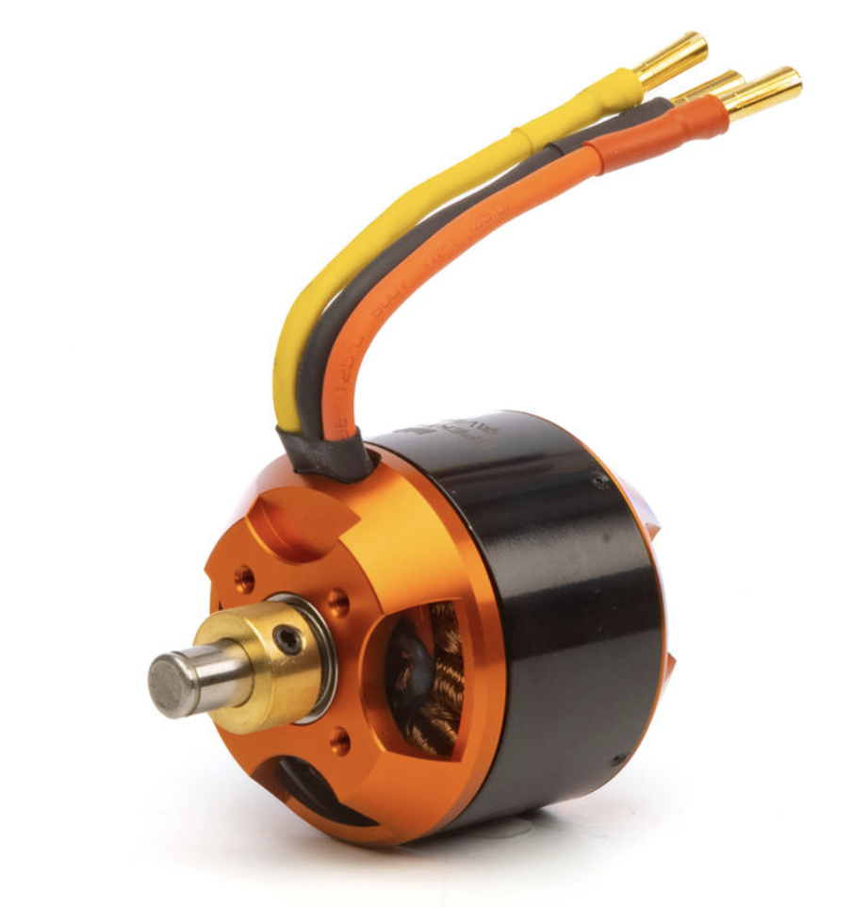
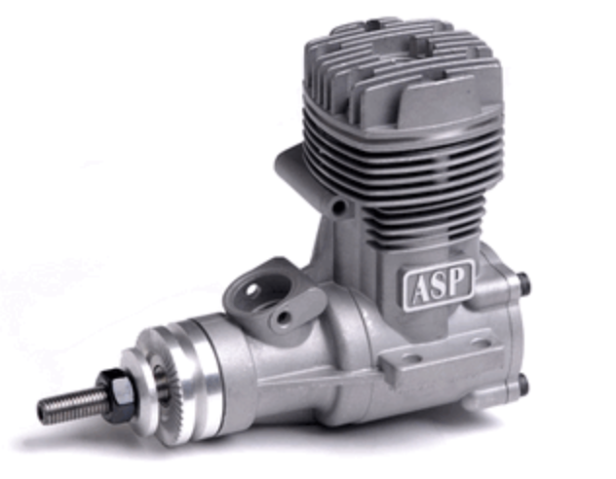
Propulsion – Motor Selection Space
Purpose:
Identify power and energy needs to satisfy [FR.2] (endurance) while also satisfying performance characteristics (climb + headwind)
Motor choices:
What type? Electric or gas?
Overview
Trades
Design
Next Steps

Slide 27
Propulsion – Power Requirements
Assumptions
Propeller Efficiency ƞ = 50% (40%-90% range)
Steady Level Unaccelerated Flight (SLUF)
Velocity = 12m/s
AR = 10
Wing Area = 0.8 m²
Span Efficiency = 0.85
Weight = 15 kg = 147.15 N
Altitude = 7500ft
Power Requirements
Drag = 10.5 N
10.5 N = Thrust Needed for SLUF
Takeaways
Drag = Required Thrust = 10.5N
Power = 252 W
1008 Wh Energy needs
7kg of batteries for 15kg plane
$$P= \frac{T}{\text{ƞ}}×V=\frac{10.5}{0.5}×12=252 W$$
$$252 W×4 hours=1008 Wh Battery$$
Common Battery COTS: 4S Lithium
14.8 V
5000 mAh
0.5 kg
= 74 Wh
Need 14 batteries in parallel = 7kg of batteries
Feasible for 15kg plane -> scalable to smaller, lighter plane
Overview
Trades
Design
Next Steps

Slide 28
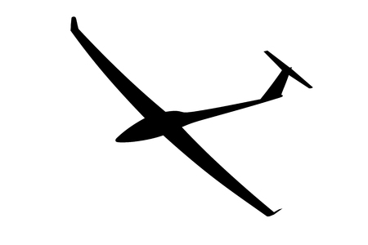
Propulsion – Power Requirements
Takeaways
Required Thrust = 31 N, 44 N
Power = 921, 1300 W
35, 25 Wh Energy needs
0.25kg of batteries for 15kg plane
Assumptions:
V = 15 m/s (Faster speed for faster climb)
ROC = 1.3 m/s, 2.6 m/s
Angle of attack = 2°
Climb 600ft = 183m
Power Requirements
$$T=D+W×\sin\left(θ\right)$$
$$T=12.8N+147N×sin⁡(7°, 12°)$$
T =30.7N, 43.4N
$$P= \frac{T}{\text{ƞ}}×V$$
P = 921W, 1302W
Time = 183m/ROC
Time = 140s, 70s
wH = 35wH, 25wH
Battery = 0.25 kg for climb
Faster climb uses less energy, but requires a greater max power and therefore larger engine
15m
1.3m, 2.6m
𝛾 = 5°, 10°
$$θ= γ+α=7°, 12°$$
Overview
Trades
Design
Next Steps

Slide 29
Motor Type – Electric vs Gas
Metric | Description | Weight | Rationale
Safety | How safe is it to operate in environment? | 35% | Motor/engine must not cause unnecessary risks
Endurance | Weight of motor and fuel energy density | 25% | Must have energy density to meet FR.2
Reliability | How simple is it to maintain and fly | 20% | Engine should require minimal maintenance between flights
Prep Time | How much prep time is needed to be flight ready | 20% | Plane should be flyable in minimal time upon arrival
Totals |  | 100%
Overview
Trades
Design
Next Steps

Slide 30
Motor Type – Electric vs Gas
Materials | Electric | Gas
Usable Energy Density (Wh/kg) | 150 Wh/kg | 400 Wh/kg
Safety | Hazards Unlikely | Hazards Possible
Reliability | Minimal Maintenance | High Maintenance
Prep Time | <5 Minutes | 5-20 Minutes
Electric is preferred: Not as energy dense, but much safer and far easier to maintain and operate
Overview
Trades
Design
Next Steps

Slide 31
Propulsion – Summary
Optimal Design: One electric motor in a pull configuration
Motor Selection Space and Next Steps:
To maximize weight and energy efficiency, the motor should have little thrust overhead
4-hour endurance goal is feasible
More battery research is necessary
Next step is to establish a better power model
Testing may be needed to establish propeller efficiency
Overview
Trades
Design
Next Steps

Slide 32
Aerodynamic Efficiency Study
Overall Purpose
Maximizing the aerodynamic efficiency will allow for longer endurance missions [FR.2]
Analyze characteristics at SLUF (Steady Level Unaccelerated Flight)
Important Quantities
Lift to Drag ratio is generally considered as the standard measure for aircraft efficiency
Maximize Lift
Minimize Drag (Parasitic and Lift Induced)
Overview
Trades
Design
Next Steps
Notes:
Within the aerodynamics team, we have been investigating how to maximize the aerodynamic efficiency of the vehicle design to meet the long endurance standards of the mission referenced in functional requirement 2. A standard measure for efficiency is the lift to drag ratio. This quantity can be improved by increasing the lift while decreasing the drag. In our case, there will be two main sources of drag, parasitic associated with the form of the aircraft and lift induced from three dimensional effects. At low speeds, induced drag is usually the main contributor.

Slide 33
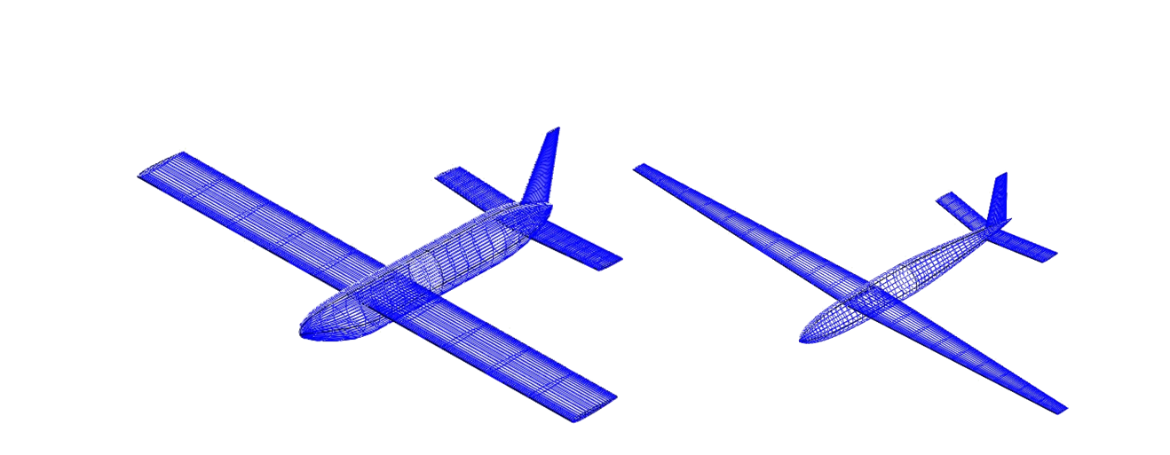
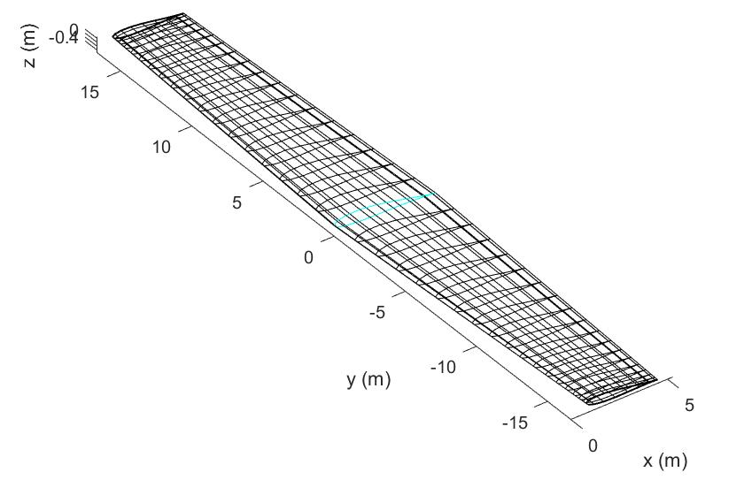
Evaluation of Aerodynamic Efficiency
Evaluation Methods
Risk Matrix Evaluations
Ranking options with quantified metrics
OpenVSP
Parasite drag on wing shape, placement, and tail configurations
Prandtl Lifting Line Theory
Span efficiency on simple wings
XFLR5
Span efficiency on complex wings
OpenVSP test configurations
Prandtl Lifting Line Theory Finite Wing
Overview
Trades
Design
Next Steps
Notes:
Within the trade studies, we used these four methods to quantify and assess our options. The risk matrices were the main factor in making final decisions by ranking a list of options in different categories with higher priority placed on important categories like endurance and manufacturability. OpenVSP was used to evaluate the parasite drag of different configurations. Prandtl Lifting Line Theory and XFLR5 were used to investigate the span efficiency factor, a direct measure of how large the effects of induced drag will be. PLLT was used for simpler finite wing planforms to narrow the airfoil selection space with XFLR5 being used for higher complexity geometries such as the use of winglets to lower induced drag.

Slide 34
Study Methodology
Designing for aerodynamic efficiency requires insight into multiple design parameters
UAV Configuration
Wing Planform Shape and Location
Tail and Stability Configuration
Airfoil Design Selection
These trade studies reveal defining factors of the early design space
Parasitic (zero lift), Induced, and Total Drag [FR.2]
Control Configuration [FR.9]
Approximate Sizing [FR.1]
Overview
Trades
Design
Next Steps
Notes:
In order to characterize the efficiency of the aerodynamic design, we had to investigate a multitude of design parameters, the UAV configuration, the shape and location of the main wing planform, the configuration of the stabilizing tail and control surfaces, and the airfoil selection of the main wing. Investigating these fields revealed some important baseline quantities in the preliminary design space. First, an estimate for the total amount of drag on the vehicle broken into its components which allowed for an early estimate of required power at trim and total endurance tying back to FR2. Next, the control scheme for the UAV which allows for the fulfillment of the controllability of FR9. And finally, the approximate sizing of the aircraft so that it remains human portable as specified by FR1.

Slide 35
UAV Configuration
General Purpose
Classify vehicle configuration to suite the requested mission profile
Overview
Trades
Design
Next Steps
Notes:
The UAV configuration study aimed to select which platform type would be best suited to the mission profile. The risk matrix is shown and considers the manufacturability, endurance, payload capacity, weight, stability, and take off characteristics for our design candidates. Emphasis was placed on the manufacturing and endurance capability of the system to satisfy the customer needs

Slide 36
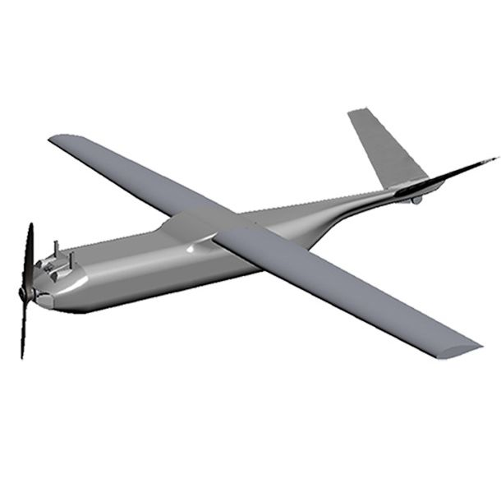
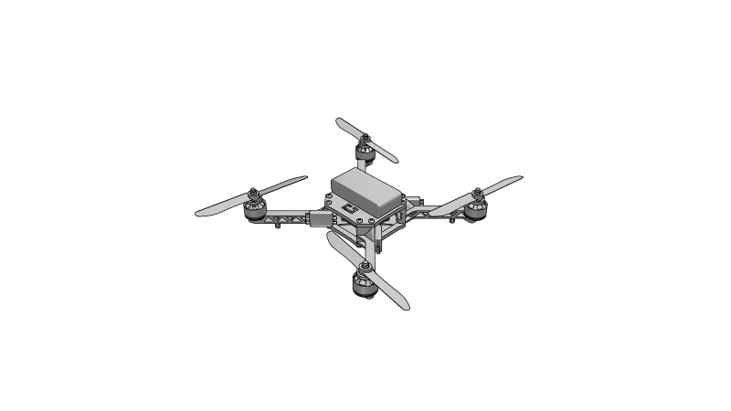
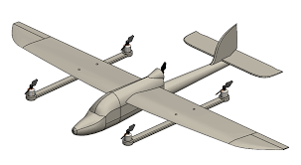
UAV Configuration Results
Selection
Fixed Wing UAV
Proven flight heritage in similar missions
Provides high efficiency [FR.2] and stability [FR.1]
Supports wide variety of payload options [FR.4]
Other Considerations
Multi-rotor, Single-rotor, and Hybrid VTOL
Fixed Wing Configuration
Hybrid VTOL Configuration
Quad-rotor Drone Configuration
Overview
Trades
Design
Next Steps
Notes:
The result of this study narrowed our design space to a fixed wing UAV. This was chosen because of its proven flight heritage in closely related missions, a high potential for long endurance, natural aircraft stability, and an easy implementation of varying payloads. Considerations were made for multi and single rotor drone and a hybrid VTOL system. These fell short in their capabilities for endurance when compared to the fixed wing UAV and did not provide enough meaningful advantage to be worth the loss.

Slide 37
Wing Planform
General Purpose
Greatly influences all aerodynamic forces and natural stability
Overview
Trades
Design
Next Steps
Notes:
The wing planform study aimed to set the general shaping of the main aircraft wing which will provide most of the lift needed for the aircraft to remain aloft. This decision has a large influence over the baseline performance of the aircraft. The included risk matrix investigates 8 unique planform shapes and ranks them in categories of stability, parasite drag, induced drag, mission fitness, strength, weight, and manufacturability. The most important were the mission fitness, and both sources of drag.

Slide 38
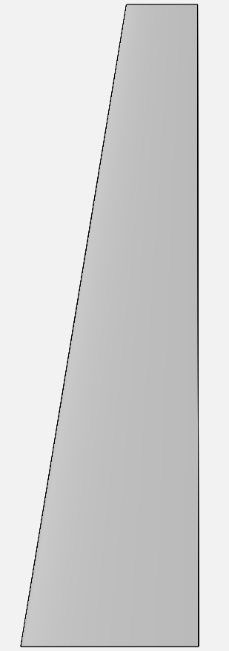
Wing Planform Results
Top Choices
Straight Tapered Wing or Delta Tapered Wing
Near elliptical lifting distribution [FR.2]
Lower parasite drag than elliptical wing [FR.2]
Easy to manufacture [FR.5], low weight [FR.1], high strength [FR.3]
Other Considerations
High AR Glider Wing: Better induced drag, worse parasite drag and strength
Blended Wing Body: Excellent parasite drag, not fit to mission profile
Straight vs Delta Tapered Wing
Overview
Trades
Design
Next Steps
Notes:
The top choices for the wing planform are between the straight tapered and delta tapered wing style shown on the right. The shape of these wings provide a very similar performance and clear advantages over others. They can closely approximate an elliptical lifting distribution which is ideal for lowering induced drag without the larger parasite drag associated with a true elliptical wing. They also provide an easy customer manufacturing and implementation process, have a lower weight than other options, and a relatively high strength compared to other designs. Other close considerations were made for a high aspect ratio glider wing which is commonly used for long endurance nonpowered vehicles. While providing excellent lift induced drag characteristics, the baseline parasite drag would be much higher and they may lack the strength to support a fully loaded vehicle. The blended wing body is becoming more popular in modern aircraft design for its greatly reduced parasite drag characteristics, but it does not support the profile of our mission and lacks the flight heritage in any similar missions.

Slide 39
Tail and Stability
General Purpose
Provide natural stability and control without significant efficiency loss
Overview
Trades
Design
Next Steps
Notes:
The selection of the tail configuration is mostly related to the stability and control design for the aircraft; however, it can still have significant effects on the overall endurance of the aircraft. An unnecessarily large or poorly configured tail can greatly increase the drag on the vehicle. The risk matrix shown evaluates 8 tail configurations for their stability, drag, weight, manufacturability, strength, and compatibility to the controls team. The most highly weighted is drag, followed by the stability and manufacturability

Slide 40
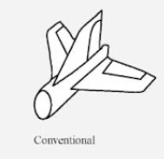
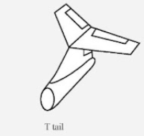
Tail and Stability Results
Selection
Conventional Tail
Naturally stable, highly controllable, suits basic flight controllers [FR.9]
Relatively high strength with low weight [FR.1,3]
Other Considerations
T-Tail: Better drag profile, requires higher weight due to low strength
Canards and Vertical Tail: Best drag characteristics, naturally unstable
Overview
Trades
Design
Next Steps
Notes:
This study yielded the choice of a conventional aircraft tail. This is an incredibly common choice for UAV and piloted systems because of its natural stability, high controllability and ability to implement into most basic flight controllers. It also has very high strength, low weight, and would be the easiest to manufacture. While it may not have the best drag characteristics, its excellence in all other categories makes this the best option. The T-Tail was not chosen despite having a reduced drag profile due to the possibility of breakage in flight and the extra weight needed to support its more complex loading. Canards and a vertical tail provided the best drag characteristics, but this configuration is not naturally stable and requires specially written, high complexity flight controllers to make constant adjustments to control surface deflections.

Slide 41
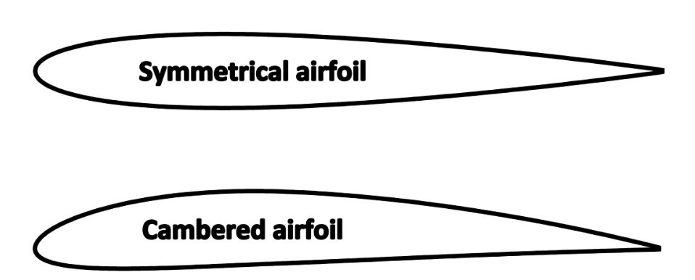
Airfoil Design Selection
Design Selection
NACA XXXX series airfoils considered. Highly dependable with sufficient subsonic performance
Minimal Induced Drag [FR.2], with sufficient Lift for SLUF
Configuration
Tapered wing with b = 3.05 (m), c_{r} = 0.457 (m), & c_{t} = 0.152 (m)
Cambered at root, reducing to symmetrical at tips (aerodynamic twist)
Geometric twist of 1º at root to zero at tips. AoA = 0
Variance of 1-8% camber and 1-24% thickness with p = 40%
Theory and Analysis Parameters
Vortex Panel Method used for 2-dimensional airfoil characteristics
Prandtl Lifting Line Theory used for Lift and Induced Drag Coefficient calculations
Overview
Trades
Design
Next Steps

Slide 42
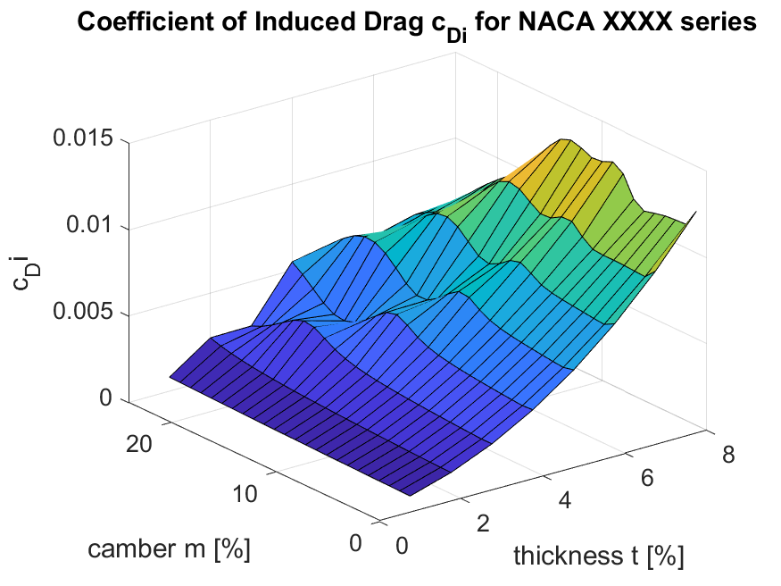
Airfoil Design Selection
Coefficients of Lift and Induced Drag
Required Lift L = 147.15 (N) for SLUF. Estimated required Lift Coefficient C_{L} = 0.353
Desired Induced Drag D < 4.46 (N). Estimated Induced Drag Coefficient C_{D,i} < 0.0107
Assessment
Acceptable Induced Drag Coefficient for camber at 1-8% with thickness from 1-24%, varying by camber
Coefficient of Lift is a limiting factor. Acceptable camber at 4-8% with thickness from 1-19% and 22-24%, varying by camber
Overview
Trades
Design
Next Steps

Slide 43
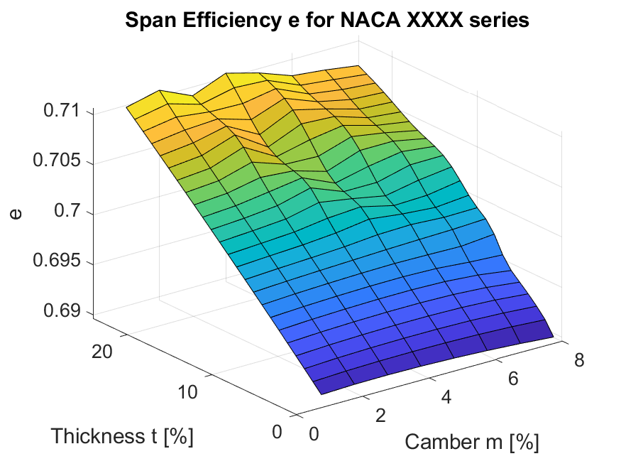
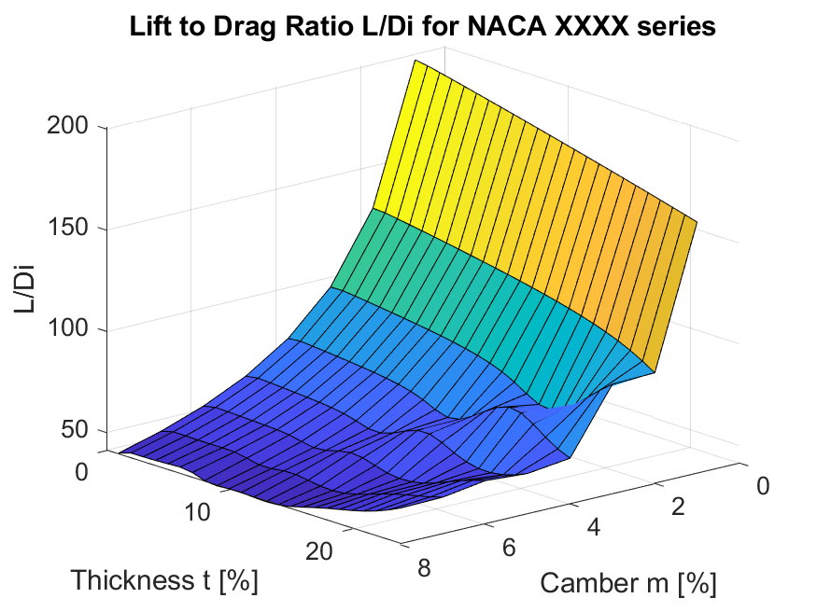
Airfoil Design Selection
Span Efficiency and Lift to Induced Drag Ratio
Increasing Span efficiency e reduces Induced Drag
Lift to Induced Drag ratio L/D_{i} is a measure of the overall aerodynamic efficiency of the wing.
Assessment
Design space bounded by Lift and Induced Drag requirements at e = 0.69-0.71.
Potential configurations with highest L/D_{i} values will have the highest aerodynamic efficiency.
Overview
Trades
Design
Next Steps

Slide 44
Airfoil Design Selection
Airfoil Design Space
35 candidate configurations with C_{L} = 0.353 ± 10% & C_{D,i} < 0.0107
7 configurations of NACA 44XX
21 configurations of NACA 54XX
4 configurations of NACA 64XX
2 configurations of NACA 74XX
1 configuration of NACA 84XX
Conclusion
5 highest L/Di values for NACA 44XX series airfoils. Most aerodynamically efficient wing root airfoil is NACA 4412 with L/D_{i} = 69.34
Increasing camber decreases the AoA at which stall occurs. Lowest possible camber is preferable to decrease the risk of stall during ascent
Overview
Trades
Design
Next Steps

Slide 45
Aerodynamic Efficiency Summary
Fixed-wing Aircraft
Straight or delta tapered wing
Conventional aircraft tail
NACA 4-series Airfoil
Aerodynamic twist reducing to zero at tips
4-8% camber to symmetrical
Geometric twist reducing to zero at tips
10-24% airfoil thickness
Top candidates NACA 44XX
Thickness t = 12,13,14,15,&23
All top candidates with L/D_{i} > 66
Overview
Trades
Design
Next Steps

Slide 46
Structures Design Space
Highest loading at wing root and firewall highest risk
Recommended design:
3D Printed wing shell
Best option to keep ideal aerodynamic shape and skin friction while balancing manufacturability requirements (FR.5)
Spar Beam is needed to support wing loading
Could be made stronger with COTS components like carbon fiber tubing rather than weaker plastics for 3D printing (FR.3)
Firewall should be built to transfer force in compression primarily to best absorb impact (FR.3)
Best materials are acrylic and PC
Overview
Trades
Design
Next Steps

Slide 47
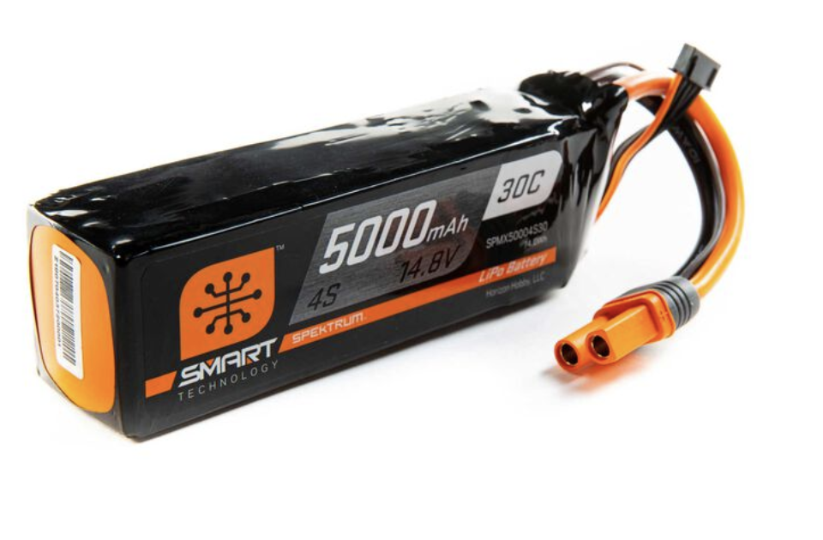
Propulsion Design Space
Recommended Motor Configuration:
One electric motor at the front of the fuselage “pulling” the aircraft
Pull configuration provides natural stability
One motor can provide the needed thrust
Motor needs approximately 1300 W of max power
Batteries required will make up roughly half of total aircraft weight
Overview
Trades
Design
Next Steps

Slide 48
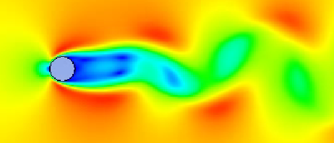
Aerodynamics Design Space
Configuration
Fixed-wing Aircraft
Straight or delta tapered wing
Conventional aircraft tail
NACA 4 series Airfoil
Aerodynamic twist reducing to zero at tips
4-8% camber to symmetrical
Geometric twist reducing to zero at tips
10-24% airfoil thickness
ANSYS Fluent Cylinder Vortex Shedding
Overview
Trades
Design
Next Steps

Slide 49
Next Steps - Structures
Modeling
Implement loading conditions more accurate to what the aerodynamics team results.
More structural elements than the 3 critical ones we started with.
Prototype scaled down wings
Get a better idea of how 3D printing method affects material properties
Most filament materials don't list shear strengths, so we need to verify these numbers
Think about interfaces between COTS and additively manufactured components, engines, electronics, and payload
Overview
Trades
Design
Next Steps

Slide 50
Next Steps - Propulsion
Modeling:
Refine assumptions with entire team so models reflect aircraft better.
Refine models to include more real-world flight conditions.
Find optimal battery now that energy needs are defined
Prototyping:
Test propellers on motors to get better efficiency numbers.
Overview
Trades
Design
Next Steps

Slide 51
Next Steps - Aerodynamics
Communicate with sub teams to refine ideal space
Discuss trade study results
Assess how decisions narrow other aspects of space
Materials and structures decisions influence feasibility of aerodynamic designs.
Follow up trade studies
Wing planform sizing (aspect ratio, taper ratio)
Finite wing geometric twist
SLUF characteristics
Fuselage shaping
Tail location and control surfaces
Material characterization (skin friction)
Overview
Trades
Design
Next Steps

Slide 52
Thank you
Any Questions?

Slide 53
Backup Slides After This

Slide 54
System Risk Analysis --> CPEs
5
4
3 |  |  |  | Detachable Wings | Efficiency
2 |  | Motor |  | Modular Build + Manufacturing
1 |  | Control Communications | Endurance Time | Loading | Engine Placement
 | 1 | 2 | 3 | 4 | 5
Probability of Occurrence
Consequence

Slide 55
System Risk Analysis
Element | Risk Statement | Notes
Endurance Time | If user must swap the orbiting aircraft more than [TBD] times in the 12-hour mission, the risk of failed launch due to fatigue and increased number of launches (that each have a risk of failing) | Swapping between launches will be a well-documented process, and fatigue will be limited by replaceable parts.
Detachable Wings | If detachable wings are implemented, those connections pose risks for aerodynamic abnormalities and stress concentrations | Any additional stress on the aircraft comes with a high consequence in terms of failure.
Engine Placement | If engine is not secure, aircraft could fail in flight and potentially crash. | A structural concern, associated with design and loading. If engine cannot function or hold, mission fails.

Slide 56
System Risk Analysis
Element | Risk Statement | Notes
Motor | If motor(s) fail(s) for any reason (loss of power, damage, etc.) aircraft could fail and crash. | Motor failure has a low probability, and if so, aircraft should still achieve some glide.
Modular Build | If the UAV is modular, connections between elements pose risks for stress concentrations throughout the airframe. | Structural concerns from design and manufacturing.
Control Communications | If the UAV cannot receive signals from operator, aircraft may fail without control and crash. | Should not be a concern as UAV must remain in line of sight.

Slide 57
System Risk Analysis
Element | Risk Statement | Notes
Manufacturing | If the UAS cannot be manufactured with the prescribed materials and design, then models and predictions could be off, resulting in failure in flight. | If necessary, materials are unavailable for manufacturing, design needs to be rethought from the ground up as the focus is on additive manufacturing.
Loading | If UAS cannot support the weight of payload + system itself, then structural integrity could fail. | Design and trade studies are using worst case weight scenarios such that this risk is low.
Efficiency | If the UAV is not aerodynamically efficient the endurance of the system will be minimal, climb will be difficult, and risks posed by engine failure will be compounded. | System needs to be aerodynamically efficient to succeed in mission objectives.

Slide 58
Mass Budget
Subsystem | Item | Mass | Rational
NA | Modular Payload | 3 kg | Max payload mass
Structures | All Structures | 6.6 kg | Mass of Talon * 1.5 for margin
Propulsion | Engine | 0.347 kg | Sample typical small UAS engine
Electronics | Batteries | 4 kg | Most research points to ~3 kg needed but overestimated for margin
 | Total | =13.947 | *Use 15 kg as an easy number to start from that is a worst case / overestimate

Slide 59
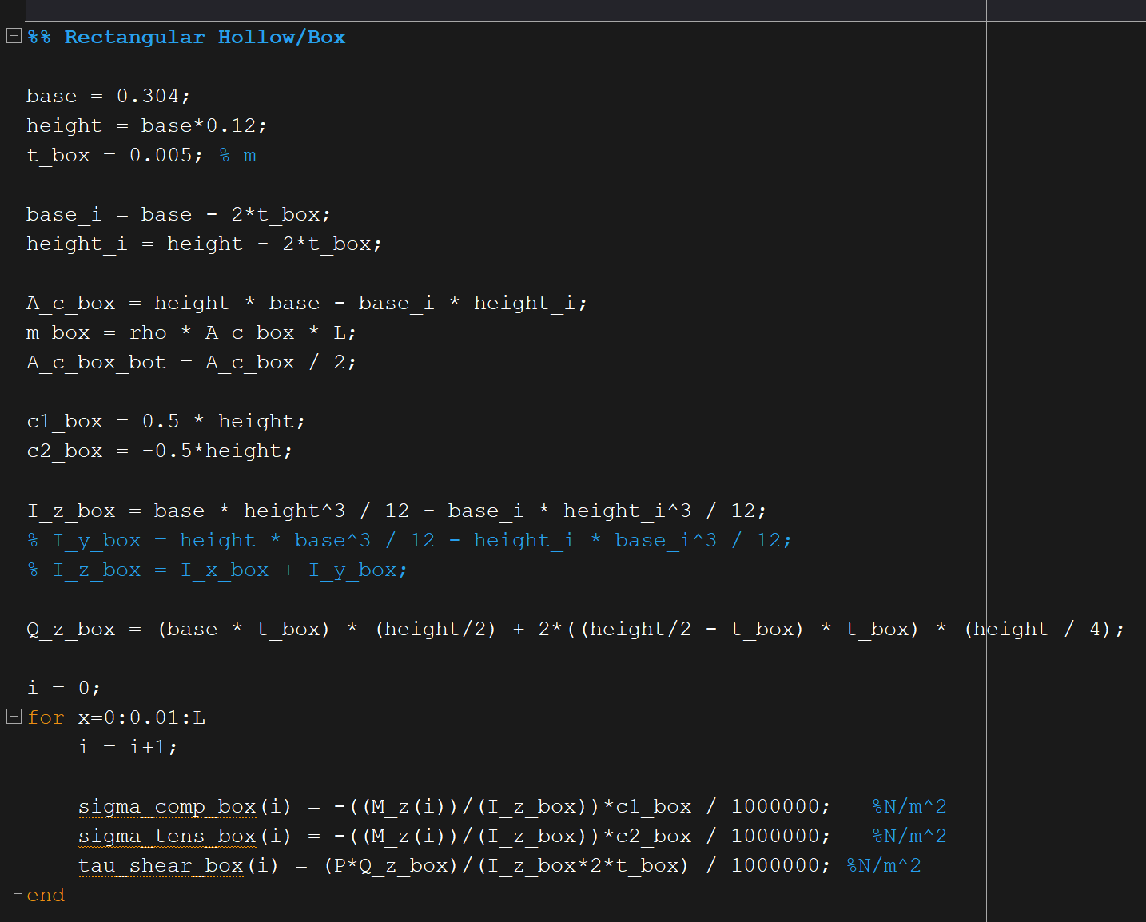
Cantilever Beam Calculations

Slide 60
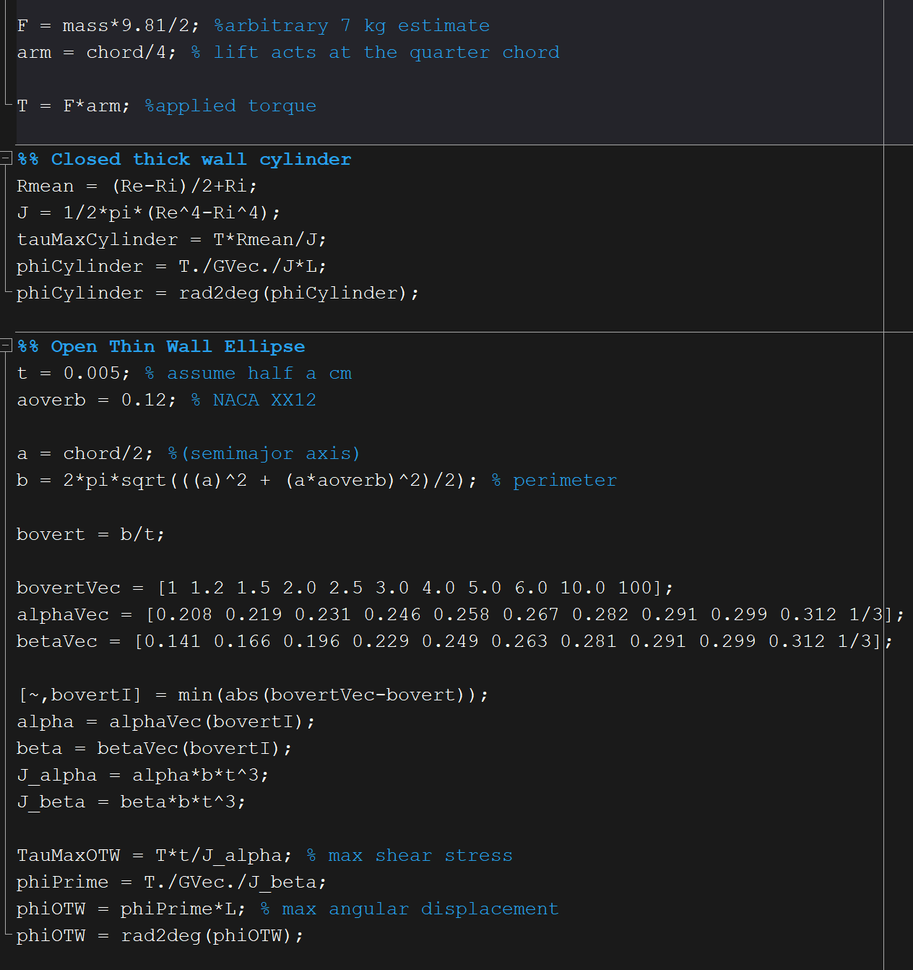
Torsion Calculations

Slide 61
3D Printed Material Qualities
Materials | Lightweight PLA | PLA | ABS
Advantages | Very lightweight Easy to work with | Easy to work with Readily available Strong heritage | Lightweight
Disadvantages | Less strength than normal PLA Can be sensitive to UV exposure | Somewhat heavy Can be sensitive to UV exposure | Difficult for inexperienced users Needs careful temperature control Prone to layer separation
Possible use | Control and Aerodynamic thin wall surfaces | Outer structures | Control and aerodynamic thin wall structures
Overview
Trades
Design
Next Steps

Slide 62
3D Printed Material Qualities
Materials | Carbon Fiber | PETG | ASA
Advantages | Very strong | Flexible More impact resistance | Lightweight Impact, heat, and UV resistant
Disadvantages | Expensive Wears out printer nozzles quickly Heavy Can become brittle | Somewhat heavy Can shrink, leading to layer separation | Difficult for inexperienced users Fumes during printing Somewhat Expensive
Possible use | Fire wall or other internal structures | Engine mounts or landing gear struts | Control surfaces and aerodynamic thin wall parts
Overview
Trades
Design
Next Steps

Slide 63
3D Printed Material Qualities
Materials | Nylon | Resin | Metal Filament
Advantages | lightweight Good impact resistance | Strong impact resistance | Very strong
Disadvantages | Prone to warping Sensitive to humidity Wide variety of characteristics; may be difficult to substitute | Can be brittle Many are not compatible with FDM | Difficult for inexperienced users Heavy
Possible use | Control and Aerodynamic thin wall surfaces | Not a good material candidate | Not a good material candidate
Overview
Trades
Design
Next Steps

Slide 64
Trade Study Rationale (Quantitative)
Materials | LW PLA | PLA | ABS | Carbon Fiber | PETG | ASA | Nylon | Resin | Aluminum | Stainless Steel
Ultimate Strength (MPa) | 23 | 65 | 40 | 45 | 40-53 (Dependent on type) | 55 | 60 | 45 | Unknown | Unknown
Density (g/cm^3) | <0.8 | 1.24 | 1.04 | 1.3 | 1.23 | 1.07 | 1.06-1.14 | Varies | 1.48 | 3.5
Cost ($/kg) | 37 | 15-20 | 21 | 40-60 | 20-60 | 40 | 25-65 | 40-75 | 148 | ~300

Slide 65
Propulsion – Number of Motors
Metric | Description | Weight | 1 | 3 | 1 Motor | 2 Motors
Thrust | How much total thrust available? | 30% | Less Thrust | More Thrust | 1 | 3
Mounting Simplicity | How easy is it to build and maintain? | 20% | Motors will require intricate placement | Motors will be simple to install | 3 | 1
Reliability | Will loss of a motor result in loss of flight? | 10% | Failure results in Loss of thrust | Motor failure doesn't result in loss of thrust | 1 | 3
Efficiency | How heavy and power efficient? | 40% | Heavier, power hungrier | Less heavy, less power required | 3 | 1
Totals |  | 100% |  |  | 2.2 | 1.8

Slide 66
Propulsion – Push vs Pull Configuration
Metric | Description | Weight | 1 | 2 | Pull | Push
Efficiency | Aerodynamic efficiency | 55% | Less aerodynamic | More aerodynamic | 2 | 1
Stability | Does the motor placement encourage stable flight? | 20% | Plane is naturally less stable | Plane is naturally stable | 2 | 1
Durability | How easily will motor/propeller break? | 25% | More likely to break | Less likely to break | 1 | 2
Totals |  | 100% |  |  | 1.75 | 1.25

Slide 67
UAV Configuration
General Purpose
Choosing the correct UAV configuration that suits the customer mission
Categories
Manufacturability (30%): Is the configuration easy to build and supports additive manufacturing?
Endurance (30%): Is the configuration able to meet the endurance requirements?
Payload capacity (10%): Does the configuration allow enough space for our payload?
Stability/Safety (10%): Does the configuration cause any stability issues?
Weight (5%): Is the configuration heavy for the customer’s use?
Take off/Landing (5%): Is it easy to land and take off the UAV?
Overview
Trades
Design
Next Steps

Slide 68
UAV Configuration Trade Studies Results
Overview
Trades
Design
Next Steps

Slide 69
UAV Configuration Choice Rationale
Top Choices
Fixed Wing
Have great flight heritage compared to single-rotor and the hybrid
Provides the best endurance
Stable in high winds
Unlike single rotor and hybrid, it does not have complex structure and supports additive manufacturing
Hybrid Wing VTOL
Similar advantages as the traditional fixed wing but is better in takeoff and landing
Structure is complex due to motor placement so it is difficult to manufacture
Additional weight of motors and structure will make the UAV heavy and less convenient
Other Consideration
Multi Rotor
Easy manufacturing without complex geometry such as airfoil
Simple takeoff and landing
Suffers from low endurance
Unstable in high winds compared to fixed wing design, which is the environment it will be tested in
Overview
Trades
Design
Next Steps

Slide 70
Wing Planform Shape
General Purpose
Wing planform shape greatly influences the properties of an aircraft and depends heavily on the goals of the mission
Categories
Stability (10%): Does the wing planform cause any stability issues?
Parasite Drag (15%): Will there be avoidable form drag added due to the planform shape?
Induced Drag (15%): How efficiently does the wing planform create lift?
Mission Fitness (20%): Has this planform been used in similar missions? Will there be any sacrifices of mission requirements due to the subsequent design choices?
Strength (10%): Does the planform shape make it more fragile during operation?
Weight (10%): Does the wing add excess weight to the vehicle?
Manufacturability (20%): Is the wing planform easy for the user to build and implement?
Overview
Trades
Design
Next Steps

Slide 71
Wing Planform Shape Results
Overview
Trades
Design
Next Steps

Slide 72
Wing Planform Shape Design Space Rationale
Top Choices
Straight Tapered Wing
Provides advantages of near elliptical lift distribution for lifting efficiency
Slightly lower parasite drag compared to rectangular, greatly decreased from elliptical
Easy manufacture, relatively lower weight, and high stability
Delta Tapered Wing
Provides the same advantages as the straight tapered wing
Both types of taper provide a compromise between the high parasite drag of a true elliptical wing and lower lifting efficiency of a rectangular wing
Other Considerations
High AR Glider Wing
Generally used for endurance missions due to high lift efficiency with low weight
Parasite drag and strength become major limiting factors in the design
Blended Wing Body
Provides incredible parasite drag numbers due to less need for a large wing
Disrupts mission requirements with complex payload integration and difficult manufacturing process
Overview
Trades
Design
Next Steps

Slide 73
Tail Type
General Purpose
Define common tail configurations and determine which type best fits the mission parameters
Categories
Stability (20%): Will the tail provide naturally stable flight?
Drag (30%): Does the tail significantly affect the endurance with added drag?
Weight (10%): Will the tail weight require higher lifting and hence higher drag forces?
Manufacturability (20%): Is the tail easy to manufacture and add working control surfaces?
Strength (10%): What is the probability of failure during flight operations?
Control Compatibility (10%): Does the tail add unnecessary complexity to the flight controller design?
Overview
Trades
Design
Next Steps

Slide 74
Tail Type Results
Overview
Trades
Design
Next Steps

Slide 75
Tail Type Design Space Rationale
Best Choice
Conventional Aircraft Tail
Provides great stability with natural implementation of flight controller
Easy to manufacture and link surface actuators
Reliably strong with low structural weight
Optimizes overall performance and customer implementation while only trading slightly increased drag profile
Other Considerations
T-Tail
Provides better drag characteristics due to horizontal tail in clean air
Lower stability and higher weight to to horizontal tail balancing
Compatible with controller, but tougher to actuate control surfaces
Canards and Vertical Tail
Best drag characteristics of all tail types considered
Inherently unstable requiring active controls
Overview
Trades
Design
Next Steps
Notes:
Why did you end up with the your top choice?
What other considerations are there to make outside of this study?

Slide 76
Parasite Drag
General Purpose
Quantifying predictions of parasite drag on UAS vehicle configurations
First order estimations of drag force on the vehicle
Required thrust force for SLUF and battery endurance
Considerations
HIstorical data of similar UAS vehicles
Calculations of parasite drag on arbitrary geometries in OpenVSP
Usage
First order estimation of vehicle drag at zero lift
Using drag polar equations and SLUF assumptions (Lift = Weight, Thrust = Drag) to find the drag coefficient at trim
Data to be communicated to the propulsion and power team for investigations of required thrust and battery endurance
Overview
Trades
Design
Next Steps

Slide 77
Parasite Drag: OpenVSP
Surface Material: Lightweight PLA
Approximate Sizing:
Fuselage: Length 1.2-2.5 meters
Wing: NACA 0010, Chord 0.25-0.5 meters, Span 2-4 meters
Horizontal Tail: NACA 0010, Chord 0.15-0.3 meters, Span 0.75-3 meters
Vertical Tail: NACA 0010, Chord 0.1-0.2 meters, Height 0.4-0.75 meters
Approximate Flight Scenarios:
Trim Velocity: 5, 10, 15, 20 m/s
Flight Altitude: 7500 ft
OpenVSP Results:
Initial sizing has a large effect on parasite drag
Higher trim speeds have a lower coefficient, but overall higher drag force
5 m/s CD0 = 0.03 – 10 m/s CD0 = 0.026 – 15 m/s CD0 = 0.0235 – 20 m/s CD0 = 0.0226
Overview
Trades
Design
Next Steps

Slide 78
Parasite Drag: OpenVSP Findings
Important Remarks
Thicker airfoils quickly increase parasite drag
Adding more complex features will increase parasite drag
Wings above CG
Dihedral Angle
Twist Angle
Tapered Wings
Winglets
Aircraft Evolution through OpenVSP Runs
Overview
Trades
Design
Next Steps

Slide 79
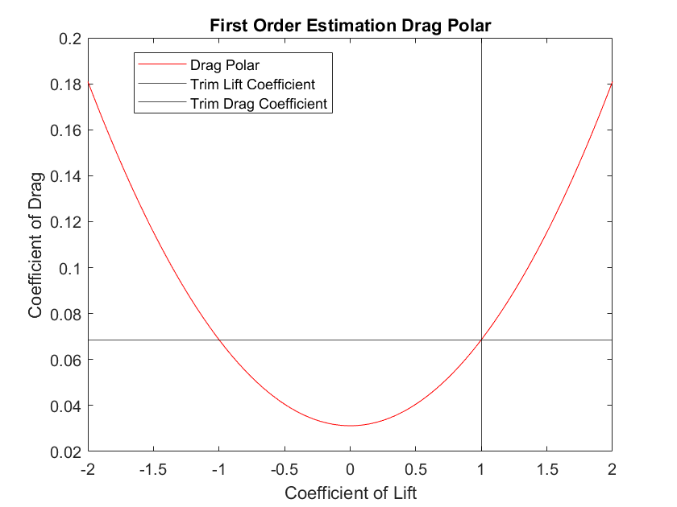
Parasite Drag OpenVSP to Drag Polar
To form a first estimate drag polar, assumptions will be
Trim speed of 10 m/s
Parasite drag of 0.0312
Increased 20% from OpenVSP model to account for material imperfections, modular connections, and other outer surface design choices such as control servo locations
Zero lift angle of attack at zero degrees
Aspect ratio of 10
Span Efficiency Factor of 0.85
To find lift and drag required at trim
SLUF (Steady Level Unaccelerated Flight)
Operating at 7500 ft
Weight of 20 kg
Overview
Trades
Design
Next Steps

Slide 80
STOL Strategy
General Purpose
Provide a strategy so that the aircraft can quickly climb to clear obstacles in an unknown environment
Categories
Time to Operation (10%): How long is the time from deployment to operation?
Drag (25%): Does the STOL system add increased drag?
Required Power (25%): Will the STOL require large amounts of power to succeed?
Weight (10%): How much weight is needed to accommodate the STOL system?
TOL Clearance (20%): Can the STOL clear objects in a short vicinity?
Manufacturability (10%): Is the STOL system easy to build and implement?
Overview
Trades
Design
Next Steps

Slide 81
STOL Strategy Results
Overview
Trades
Design
Next Steps

Slide 82
STOL Strategy Design Space Rationale
Best Choices
No Special Additions
Best drag and weight characteristics which translates directly into endurance
Normal fixed wing climb is not highly power intensive
Tough to clear obstacles with stall characteristics determining the max climb
Vortex Generators
Delayed stall on wings allows for higher climbs for obstacle clearance
No additional manufacturing complications
Small amount of additional form drag from less smooth wing surfaces
Worst Choices
Slat and Flap Control Surfaces
Provides high lift for fast, stable climb
Added complexity, weight, and power consumption for additional control surfaces
No delay of stall characteristics
VTOL Propeller
Provides best obstacle clearance and time to operational altitude
Consumes a large amount of power
Adds a large amount of weight, drag, and manufacturing complexity
Overview
Trades
Design
Next Steps

Slide 83
Wing Dihedral
General Purpose
Some aircraft use a wing dihedral/anhedral to natural roll stability
Can save power by natural restoration of trim from roll perturbations
Categories
Stability (20%): Will the dihedral angle enhance or detract from the aircraft’s natural stability?
Lift to Drag Ratio (40%): Does the dihedral angle affect the aerodynamic efficiency?
Weight (20%): Is there any added weight due to the dihedral angle?
Manufacturability (10%): Does implementation of the angle complicate the build process?
Strength (10%): Is failure more likely to occur due to the dihedral angle?
Overview
Trades
Design
Next Steps

Slide 84
Wing Dihedral Results
Best Choice
No Dihedral/Straight Wings
No increase of parasitic drag profile
No complex additions to customer manufacture process
Other Considerations
Positive Dihedral Angle
Increased natural roll stability of the aircraft
Slight decrease in lift and ~1% increase in parasite drag
Overview
Trades
Design
Next Steps

Slide 85
Wing Placement
General Purpose
The placement height of the wings relative to the z-axis center of gravity can affect the aircraft’s natural roll and pitch stability
Categories
Stability (20%): Will the wing placement enhance or detract from the aircraft’s natural stability?
Lift to Drag Ratio (40%): Does the wing placement affect the aerodynamic efficiency?
Weight (20%): Is there any added weight due to the wing placement?
Manufacturability (10%): Does implementation of the wing placement complicate the build process?
Strength (10%): Is failure more likely to occur due to the wing placement?
Overview
Trades
Design
Next Steps

Slide 86
Wing Placement Results
Above Z-Axis CG
Provides additional stability to roll and pitch
No losses of efficiency or strength
At Z-Axis CG
No natural stability increases
Complex to manufacture due to payload and power systems near mounting point
Below Z-Axis CG​
Not as much added roll and pitch control​
Slightly decreased lift to drag ratio due to dirtier flow at tail section​
Overview
Trades
Design
Next Steps

Slide 87
Induced Drag
General Purpose
See the effects of varying AR, TR, twist angle, and adding a winglet on the induced drag of the UAV’s wing
Considerations
No tail or body for simplicity
Use fixed-lift analysis when estimating the effect of Aspect Ratio and Taper Ratio for fair comparison (since lift contributes to induced drag)
XFLR5 Analysis
Airfoil: NACA 0012, Chord 0.3 meters, Span 2-4 meters
Flight Altitude: 9800 ft
Velocity: 18 m/s
Overview
Trades
Design
Next Steps

Slide 88
Airfoil Selection
NACA XXXX series airfoils analyzed
Airfoil selection based on minimizing Induced Drag with sufficient lift implied
Cambered at root with linear regression to symmetric at wing tips
Geometric twist of AoA = 1 [deg] at wing root reducing linearly to AoA = 0 [deg] at wing tip
Variance of 1-8 % camber
Variance of 1-24 % thickness
Analysis Parameters
Lift Slope and Zero Lift Angle of Attack calculated with Vortex Panel Method
Coefficients of Lift and Induced Drag calculated with Prandtl Lifting Line Theory
Lift and Drag considered for b = 10 [ft], c_{root}= 1.5 [ft], c_{tip}= 0.5 [ft]
Velocity V = 100 [ft/s] for all calculations at 8,000 [ft] Standard Atmosphere (slightly greater than half maximum altitude for desired flight regime)
Overview
Trades
Design
Next Steps

Slide 89
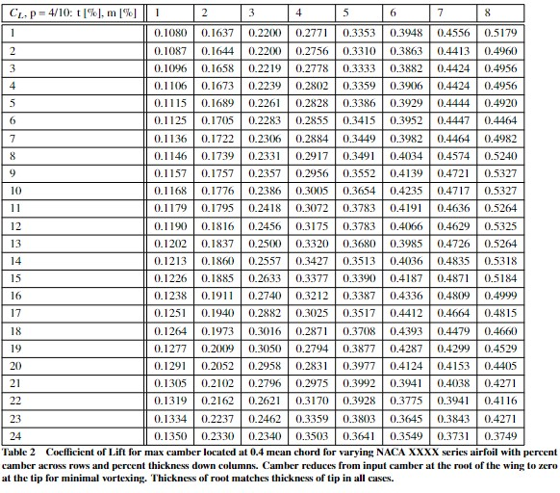
Coefficient of Lift
Non-dimensionalized lift applicable to multiple configurations and flight regimes
Strength of Lift must be considered in conjunction with minimal Induced Drag values
Optimal values from 6 % camber and up
Overview
Trades
Design
Next Steps

Slide 90
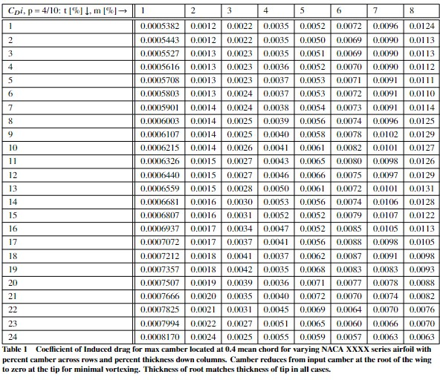
Coefficient of Induced Drag
Considerations
Non-dimensionalized Induced Drag applicable to multiple configurations and flight conditions
Drag must be considered for values coinciding with sufficient lift
Optimal values between 6-7%
Overview
Trades
Design
Next Steps

Slide 91
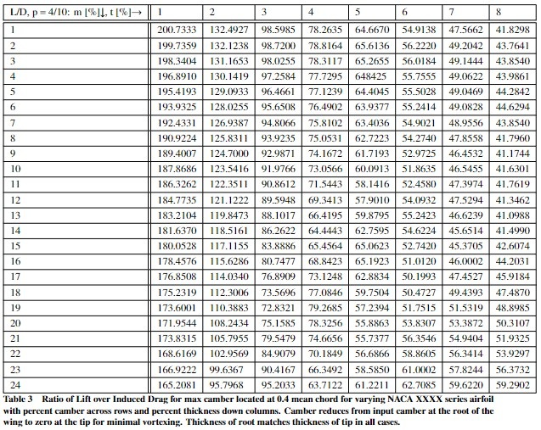
Lift over Induced Drag Ratio
Considerations
Highest values of lift over drag not realistic for design requirements
Optimal range of L/D between 45 and 60
Trend suggest camber between 6-7%
Overview
Trades
Design
Next Steps

Slide 92
Airfoil Preliminary Design Space
Results
NACA XXXX series airfoil
Maximum camber m = 6-7%
Maximum thickness t = 12-18%
Immediate modeling with NACA 7414
Overview
Trades
Design
Next Steps

Slide 93
Aspect Ratio and Taper Ratio Influence on Induced Drag
Analysis parameters
For this analysis, we are using constant lift and assuming a 20 kg aircraft
For TR analysis, we are using a chord of 0.3 m
Results
AR: as we increase the aspect ratio, it decreases induced drag
TR: as we decrease the taper ratio, it decreases the overall induced drag, although it becomes higher at the wing root
Overview
Trades
Design
Next Steps

Slide 94
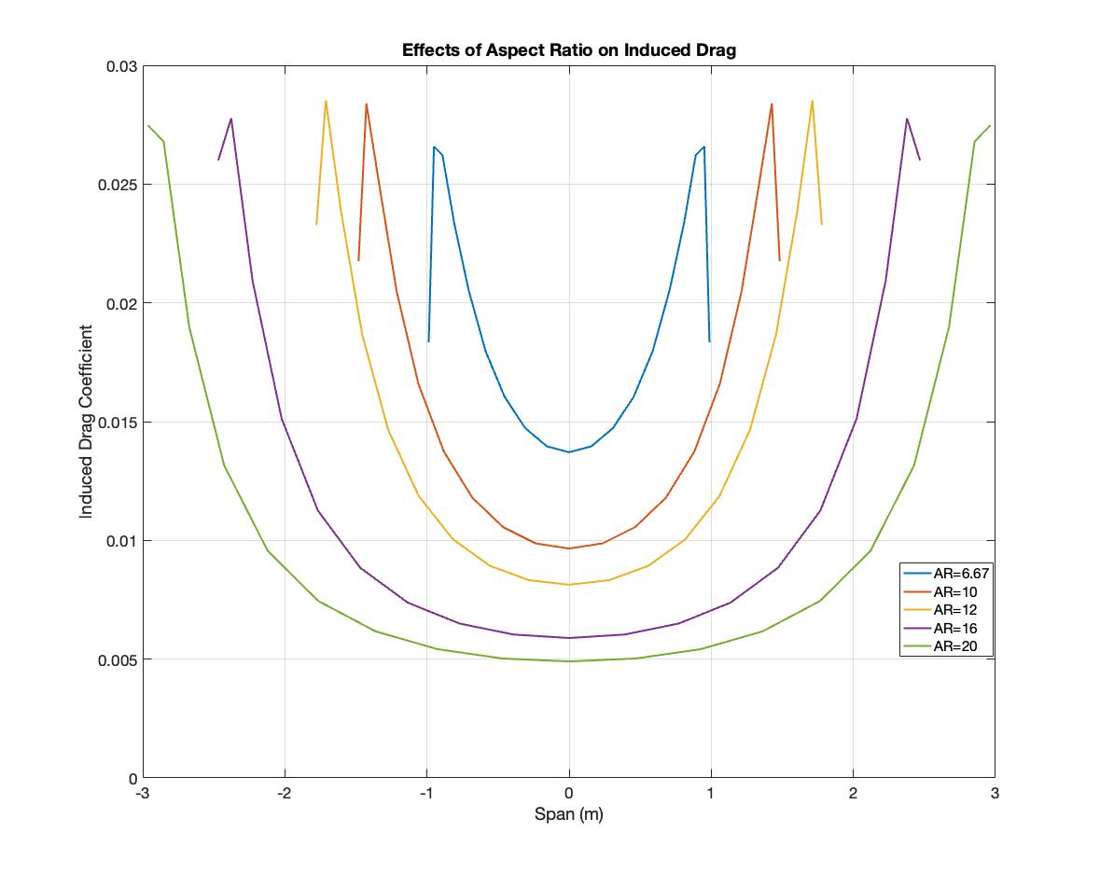
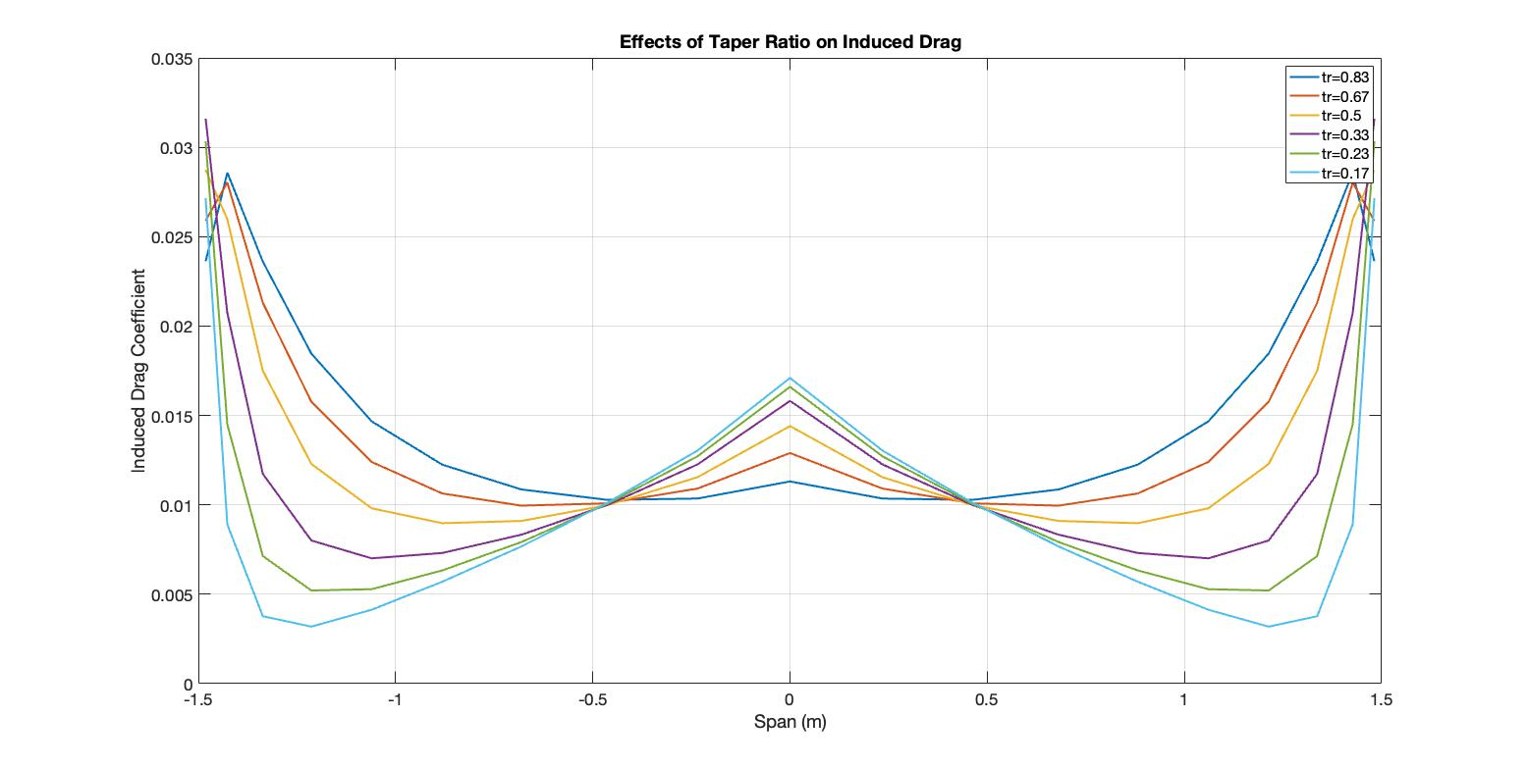
Aspect Ratio and Taper Ratio Influence on Induced Drag Figures
Overview
Trades
Design
Next Steps

Slide 95
Sources
https://www.simplify3d.com/support/materials-guide/properties-table/
https://www.matterhackers.com/
https://www.eclipson-airplanes.com/optimized-design
https://colorfabb.com/rc-planes
https://3dlabprint.com/faq/materials-for-3d-printing-planes/#lwasa
https://www.cnckitchen.com/blog/colorfabb-lw-pla-testing-foaming-pla
https://www.eclipson-airplanes.com/plavspetg
ASEN 3112 PDFs (Prof. Carlos Felippa & Prof. Kurt Maute)
http://www.epi-eng.com/propeller_technology/selecting_a_propeller.htm#:~:text=Propeller%20efficiency%20is%20defined%20as,power%20applied%20(engine%20power).&text=In%20case%20you%20are%20wondering,equation%20(8th%20grade%20algebra).

Slide 96
Sources
https://www.simplify3d.com/support/materials-guide/properties-table/?highlight=nylon
https://formlabs.com/blog/3d-printing-materials/
https://markforged.com/resources/learn/design-for-additive-manufacturing-metals/metal-additive-manufacturing-introduction/3d-printing-metal-filaments-powders
https://4dfiltration.com/resources/3d/resin-vs-filament-strength-quality-cost.html
https://all3dp.com/2/3d-printer-metal-filament-for-real-metal-parts/
https://imaterialise.helpjuice.com/materials/density

