Slide 1




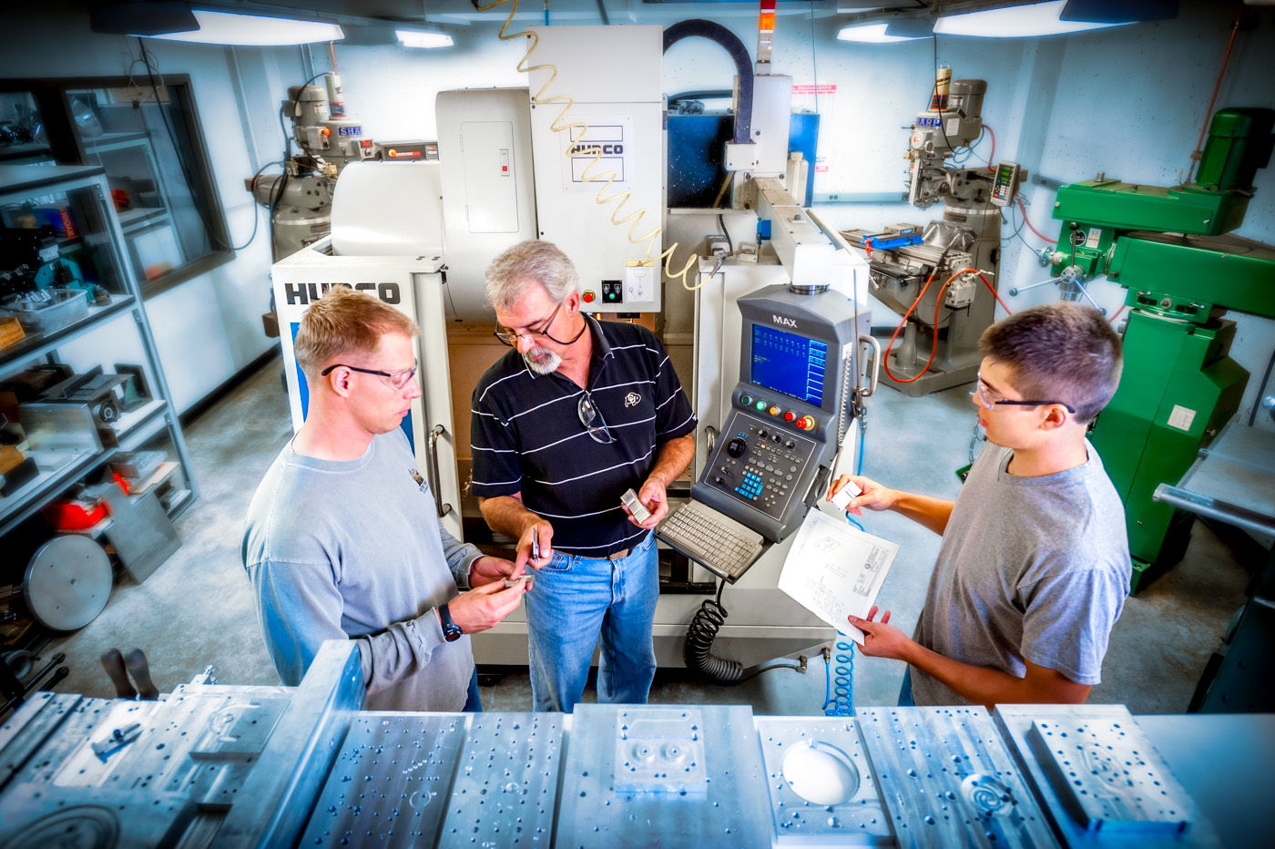
Mechanical Engineering
Design Center Colorado
Senior Design Program
Dr. Daria Kotys-Schwartz
DC – Director Undergraduate Programs Senior Design – Instructor
Dr. Mark Rentschler
DC – Director Graduate Programs
Dr. Julie Steinbrenner
Senior Design – Instructor

Slide 2

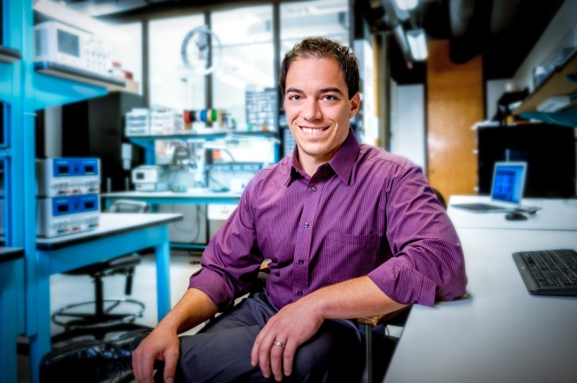
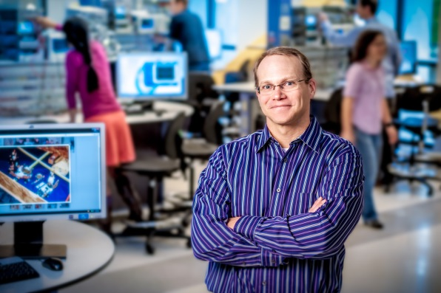

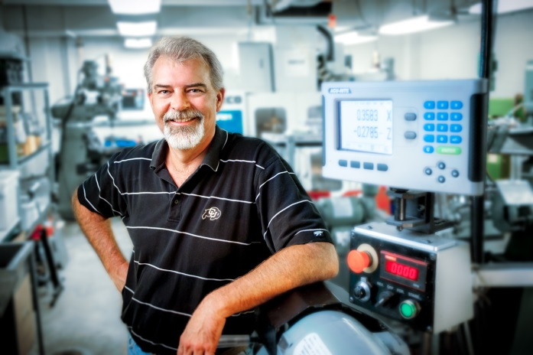
Who Are We?
BY THE NUMBERS
Over 1600 student participants
290 projects from 66 organizations since 2000
100% ME student participation in sponsored projects
1500 student hours per project
34 sponsored projects for 2015-2016
29 Faculty Directors for 2015-2016

Slide 3
The Role of Senior Design
A Transitional Experience
  Connecting the chasm between their engineering education and their career as a engineer
Objectives
  Develop an understanding of the necessary professional skills needed to succeed in industry (life!)
  Understand how to collaboratively work in a team toward a common design
  Become proficient at written technical communications
  Become proficient at oral technical communications
  Become proficient at managing long term projects
  Become proficient at integrating technical skills to successfully complete a project

Slide 4
The Role of Senior Design
Objectives
  Develop the knowledge and ability to use skills in heat transfer, fluid mechanics, circuits, etc. to perform engineering analysis
  Generate alternative design concepts and evaluate using design requirements
  Apply engineering design skills to create CAD models and drawings to build professional prototypes
  Use results of engineering analysis to make decisions (engineering and business) in a methodical manner
  Fabricate and test physical prototypes to help make decisions

Slide 5
Senior Design Course Overview
Two-Course Sequence
  ME Design Project 1: Professional skills, team formation, project selection and matching, project scoping, preliminary design review, critical design review, and hardware specification/ordering
  ME Design Project 2: Fabrication, assembly, testing, and design iteration
Course Instructors
  Oversee project solicitation, course lectures/workshops, student design facilities, faculty directors, and all academic aspects of the course
Faculty Director
  Primary point of contact for academic topics (schedule, deliverables, etc.)
Industry Client
  Primary point of contact for project goals and decisions
Project Funding
  $1500/team
2015-2016 Course Statistics
  Students: 186 (6 per team, generally)
  Projects: 28 industry/non-profit and 2 competition teams

Slide 6
Senior Design Organizational Chart
Executive Officers
Dr. Daria Kotys-Schwartz (Teams 1 – 15)
Dr. Julie Steinbrenner (Teams 16 – 30)
Client
Sponsoring Company/ or Individual
Director
Faculty Member
Project Manager
Student 1
Communication Director
Student 2
Financial Manager
Student 3
Manufacturing Engineer
Student 4
Test Engineer
Student 5
CAD Engineer
Student 6
System Engineer
Student 7
Teams meet weekly with Director and Client (sometimes in joint meeting,
sometimes in two separate meetings)
Teams check-in with Executive Officers once per semester and as needed

Slide 7
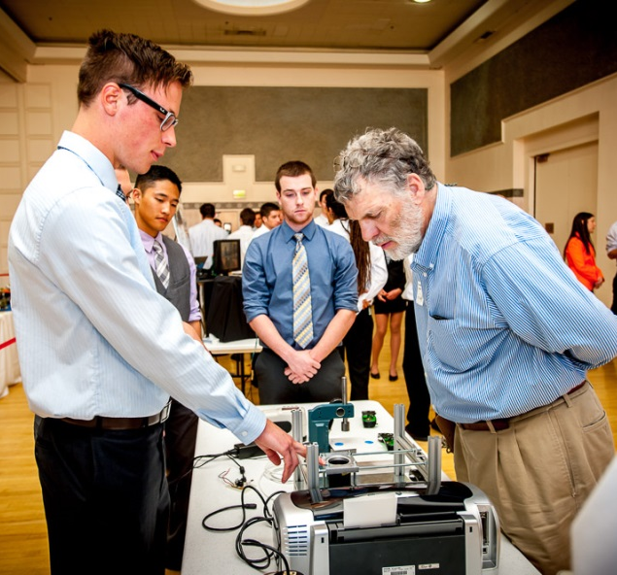
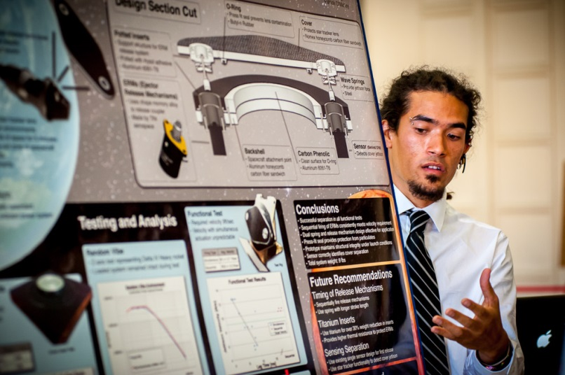
Senior Design Deliverables
ME Design Project 1 – Fall Course Deliverables
  Individual Project Preferences
  Project Bid Proposals
  Team Role Proposals
  Specification and Planning Report/Presentation
  Preliminary Design Review Presentation
  Comprehensive Design Report/Presentation
  End of Term Report/Presentation
  Manufacturing Review
ME Design Project 2 – Spring Course Deliverables
  Spring Semester Planning Report
  Analysis, Tolerance and Test Plan
  Prototype Test Results
  Redesign and Redesign Test Results
  Final Project Report Outline
  Final Report/Presentation
  Mechanical Engineering Design Expo

Slide 8
Morning Meeting & Training Topics
Fall: Resources
Communication
Technical Writing
Professional Expectations
Intellectual Property
Customer Needs, Product Specifications
Project Management
Concept Generation
Prototyping
Conflict Resolution, Social Styles
Bystander Training
Negotiations
Spring: Transition to Industry
Elevator Pitches
Job Search Tips

Slide 9
Grading and Performance Evaluations
Grades are assigned according to Individual Performance Evaluations.
Students are be required to fill out a self-assessment (Four goals style) and send it to their Director.
Students meet individually with Director to discuss their performance
Performance is translated into grades by Director
  Grading Guidelines: (Fall – Intern, Spring – Entry-level)
    A Exceeds expectations
    B Meets expectations
    C/D Fails to meet expectations
    F Fired

Slide 10
Company Client Role
Primary point of contact for project goals and decisions
Models and establishes professional and company standards
Monitors team’s execution of the design process
Responsible for ensuring engineering team meets:
  company’s project goals
Provides feedback on performance review

Slide 11
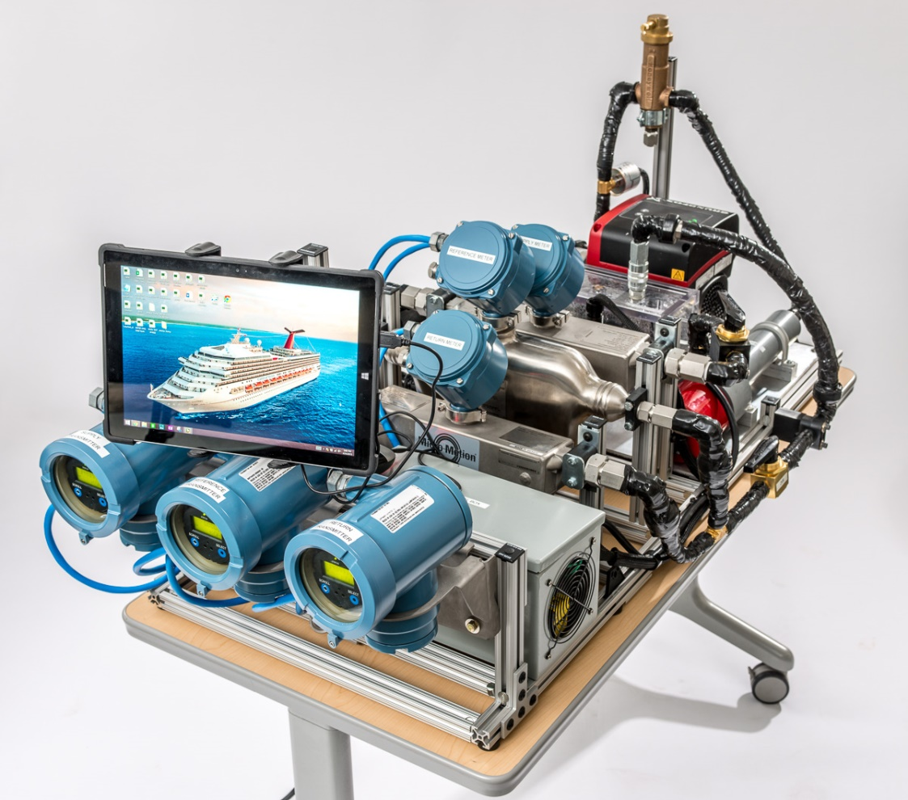
Previous Projects – Micro Motion
Project Overview
Cruise Ship Fuel Efficiency Simulator
Design and build a test stand that can demonstrate the effectiveness of the Micro Motion Fuel Consumption Solution software. Team must operate the test stand and measure the effectiveness
Project Requirements
Compares the differential measurement of two meters with the proprietary software against a highly accurate reference meter
Display the % error with and without the software
Must be able to heat the fluid to 80C to simulate conditions onboard the vessel
Compact enough (with some disassembly) to travel to customer locations

Slide 12
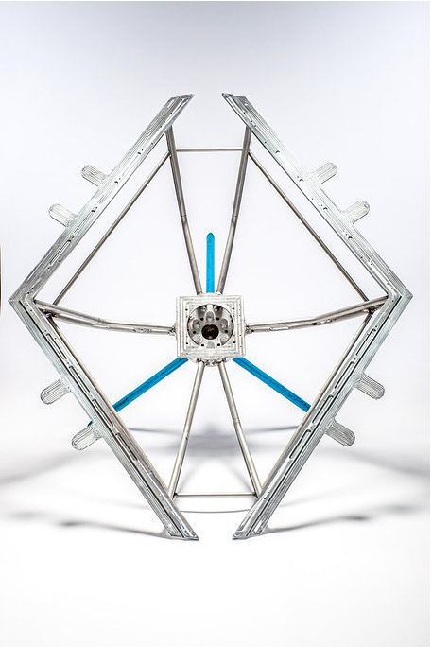
Previous Projects – Ball Aerospace
Project Overview
Multiuse Ground Plane
Redesign Ball’s current ground plane to create a new model with decreased weight, set-up time, and technician involvement, while increasing the ground plane’s ability to interact with various antennas
Selection of Project Requirements
Electrical Conductivity: Surface of the ground plane must be continuously conductive with a sheet resistance of 3-4 ohms/square
Testing: Must survive 260 3’ drops onto a concrete floor
Setup: completed setup < 30 minutes by a single technician, each component must weigh < 35 lbs
Cost: Out of house < $5000

Slide 13

Thank you! Questions?

Slide 14
Team Roles
Project Manager
Communications Director
Financial Manager
Manufacturing Engineer
Systems Engineer
CAD Design Engineer or Controls Engineer
All team members will have technical design responsibilities beyond what is listed on the following pages!

Slide 15


Purpose of Team Roles
Time
Management
Scope
Management
Cost
Management
Procurement
Management
Quality
Management
Integration
Management
!
Risk
Management
Human Resource Management
Communication
Management

Slide 16
Project Manager
Scope
Management
Time
Management
Human Resource Management
Responsible for the overall project scheduling and deliverables
Dual roles
  Managing tasks
  Leading people - nurturing the emotional or people component of the team
Responsibilities
  Makes and sends a meeting agenda out at least one business day in advance to team members, Client, and the Project Director
  Ensuring that all meetings remain focused on the agenda
  Reviews and determines progress on previous “Action Items”
  Develops team schedule for the design project
  Evaluates schedule status during team and Client/Director meetings
  Establishing an environment that fosters creativity where team members are respected, take risks and feel safe expressing their ideas
  Ensures that all team members opinions are expressed and evaluated
  Encouraging participation by all team members

Slide 17
Communications Director
Communication
Management
Provides coordination for all internal and external team interactions
Responsibilities
  Working with the Project Manger to determine who will locate and reserve a meeting room each week
  Sending an e-mail reminder out 1-2 business days in advance of the next meeting stating the meeting date/time/location
  Team and Director Meetings
    Record minutes during the meeting
    Documents decisions made
    Documents action items assigned - Who is going to do What by When
  Emailing meeting minutes within 24 hours to teammates, Client and Director (even if Client or Director did not attend)
  Sending questions to Director & Client
  Taking a lead role in establishing contact, following up on commitments, obtaining information
  Communicating with organizations outside of the team

Slide 18
Financial Manager
Procurement
Management
Cost
Management
The financial manager is responsible for providing financial advice and support to the team and mentors/advisors
Responsibilities
  Researching/benchmarking technical purchases and acquisitions
  Providing and interpreting team financial information
    Maintaining detailed Microsoft Excel spreadsheet
  Monitoring team budget
  Conducting pricing analysis on proposed purchases
  Overseeing team Design Center Colorado reimbursements
  Ensuring all team members understand and follow State of Colorado purchasing requirements
  Carrying out team purchases using department assigned Pcard
    Complete all Pcard training
    Complete all Pcard paperwork within designated timeframe
Specific PCard responsibilities covered in “Purchasing” presentation

Slide 19
Manufacturing Engineer
!
Quality
Management
Risk
Management
The Manufacturing Engineer is responsible for coordinating all fabrication required to meet final prototype requirements
Responsibilities
  Overseeing that all engineering prints meet the requirement and expectations of machine shop or vendor
  Reviewing designs with machine shop supervisors, or machine shop owner to ensure design for manufacturing (DFM)
    Coordinating meetings with machine shop supervisor, or alternative expert to review DFM
    Determine realistic timing for fabrication and assembly
  Taking the lead in prototype development and quality
    Identify risks associated with prototype fabrication and assembly
    Working with Project Manager to determine critical path items for on time prototype development
  Taking the lead on planning and coordinating the Manufacturing Review

Slide 20
Systems Engineer
!
Quality
Management
Risk
Management
The Systems Engineer is responsible for establishing product specifications, as well as monitoring, coordinating and managing integrated sub-systems in the prototype.
Responsibilities
  Analyzing clients initial design specifications and leading the team in development of product specifications
  Developing and recommending the system architecture and interfaces of the product – guiding the seamless integration of electrical and mechanical systems
  Taking the lead in testing and making recommendations for redesign based on test results
    Drafting test plans and overseeing implementation of testing plan
  Working with the Project Manager to coordinate and integrate technical presentations
  Working with the Project Manager to coordinate and integrate technical reports

Slide 21
CAD Engineer or Controls Engineer
!
Quality
Management
Risk
Management
The CAD Engineer is responsible for coordinating, managing and integrating all CAD work for the prototype design. They will work closely with the Manufacturing Engineer and Systems Engineer to integrate revisions and DFM principles.
The Controls Engineer will be responsible for coordinating, managing and integrating microcontrollers, LabView programing, data acquisition and any mechanical systems that require controls.
Responsibilities
  Specific responsibilities will be discussed once the projects are announced

Slide 22
Social Styles
19.3%
16.1%
42.9%
21.7%
Notes:
2012-2013
Analytical 17.27%
Driving 14.55%
Amiable 21.82%
Expressive 46.36%

Slide 23
Analytical: Planning the project Critiquing the plan Troubleshooting problems | Driving: Setting goals Meeting deadlines Dividing up the workload
Amiable: Working cohesively Ensuring equal participation Resolving conflict | Expressive: Brainstorming Communicating with team members; clients Assigning roles
Where does conflict typically arise?
Conflict: Occurs most often between Diagonally Opposite Social Styles

Slide 24
Expressives
Are sociable, stimulating, enthusiastic and
are good at involving and motivating others.
Ideas oriented.
Have little concern for routine and are future oriented.
Focused on people rather than on tasks.
Use opinions and stories rather than facts and data.
Can be perceived by others as excitable, impulsive, undisciplined, dramatic, manipulative, ambitious, overly reactive and egotistical.
Under stressful conditions, Expressives tend to resort to personal attack.

Slide 25
Amiables
Value personal relationships, helping others, and
being liked.
Prefer to work with other people in a team effort, rather than individually.
Some Amiables will sacrifice their own desires to win approval from others.
Friendly, supportive, respectful, willing, dependable, and agreeable.
Use opinions rather than facts and data.
Uncomfortable with and will avoid conflict.
Can be perceived by other styles as conforming, unsure, pliable, dependent and awkward.
An Amiable’s reactions to stress are to comply with
others.

Slide 26
Analyticals
Concerned with being organized, having all the facts and being careful before taking action.
Need is to be accurate and to be right.
Precise, orderly, methodical and conform to standard operating procedures, organizational rules and historical ways of doing things.
Perceived as serious, industrious, persistent, and exacting.
Are task oriented. Use facts and data.
Comfortable in positions in which they can check facts and figures and be sure they are right.
Others may see them as stuffy, indecisive, critical, picky and moralistic.
In times of stress, Analyticals tend to avoid
conflict.

Slide 27
Drivers
Action and goal oriented. Need to see results.
Speak and act quickly.
Decisive, independent, disciplined, practical and efficient.
* Use facts and data.
Do not want to waste time on personal talk or preliminaries
Comfortable in positions of power and control.
Can be perceived by other styles as dominating or harsh and severe in pursuit of a goal.
In times of stress, drivers may become autocratic.

