Slide 1
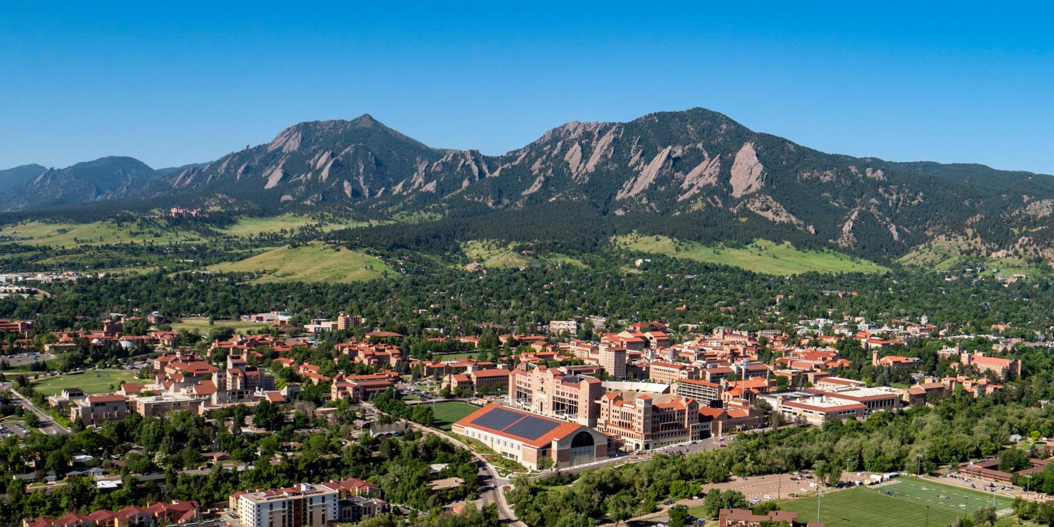
Program in Exploratory Studies
Academic Opportunities Session
Lelei Finau-Starkey
Program in Exploratory Studies
Embedded Career Team
Career Services
Admissions Ambassadors
Office of Admissions
colorado.edu/exploratorystudies/admissions
exploratorystudies@colorado.edu

Slide 2
Welcome!
What you can expect to learn from today's session:
What is the Program in Exploratory Studies
How Career Services helps you explore outside the classroom
What the student experience is like
What does the process look like to transfer out of PES
Explore the campus with our ambassadors

Slide 3
What is the Program in
Exploratory Studies?
Currently home to over 2000 students
Admission to PES
  Direct
  Alternative based on original application
PES students transfer into one of 7 different colleges/schools, typically after 1st year
Notes:
40% of those with a declared major change their major after arriving on campus. Most students at CU are exploring but PES students actually get support as they do so!

Slide 4
Transferring into colleges/schools at CU Boulder
Intra-University Transfer (IUT)
Every college/school sets their own requirements
Most require:
  Successful completion of certain courses
  Meet minimum grade, GPA and credit hours
Usually takes at least two semesters to complete IUT requirements
IUT website
Specific information if you originally applied for business or engineering (including success rate dashboard)
Notes:
We’ve mentioned that Program in Exploratory Studies students transition into the various Colleges, Programs, or Schools at CU. This process is called Intra-University Transfer. Every school/college has different requirements. The more competitive the school/college, the more strenuous the requirements. Most course requirements are sequential in nature so it typically takes about two semesters to transfer.

Slide 5
How We Support Students
Specialized, cross-campus Academic Advising
  Personalize academic path with majors, minors, certificates + co-curricular experiences
  Preparation for transition to all colleges/schools on campus
  Academic coaching support for time management, study skills, exam preparation
Notes:
We’ve talked about what our approach is going to be, now let’s talk about our services. CU is great, and it’s also big. Finding classes you like, clubs of interest, or even themes for your education connects you with like-minded people. Staff in the UEAC can help you do all of this, and more!

Slide 6

Design Your Path LLC
Craft your own journey and campus experiences through an innovation and exploration lens
How?
  Exposure to entrepreneurial and traditional career options to identify your best fit major
  Get the support you need from mentors
  Put your plan into practice through internship opportunities, campus programs & events
Design Your Path LLC students live in Farrand Hall and take a Design Thinking Seminar (FYXP 2200) together
B
Notes:
Another thing we’re excited about is our Design Your Path program. All incoming first-year students are required to live on campus. PES students have many options with regard to residence halls, from the Honors hall to the Health Professions RAP. But the Design Your Path LLC is a living and learning community hosted by PES, for PES students. Our LLC is partnered with the campus Research and Innovation Office because innovation IS exploration and the skills you need to explore are the same you need to start a company or engage in research. You'll also get the chance to connect with area entrepreneurs to see that many of them are working in fields far outside those they majored in. Visit them at the fair for more information.

Slide 7
PES Passport Program
Transition program designed for first generation and/or underserved students in the PES as they navigate their first year of college
Benefits
  Guaranteed housing in the Design Your Path LLC if you apply by May 1
  Learn together in FYXP course cohorts
  Scholarship opportunities
  Community-building programming
  Supplemental advising support, registration labs
Apply at https://www.colorado.edu/exploratorystudies/passport-program

Slide 8
Exploratory Studies Timeline
Summer
Fall
Spring and beyond
Complete Online Experience, Placement Tests (mid-May to early June)
Connect with academic advising (mid-May to mid-July)
Register for your first semester (mid-July to mid-August)
Explore your interests:
  Classes
  Student groups
  Community-building
  Office hours
  Rec Center
  Career Services
Apply for Intra-University Transfer (if applicable)
Continue connecting with campus:
  Career Services
  Research opportunities
  And so much more!
Notes:
We know students are more than a major, they are a whole person and in Exploratory Studies we honor that by connecting students to those opportunities that make college worthwhile.
Exploration helps students to build their resume. Internships, Leadership in clubs, Foreign Language, etc., all show employers that a student is more than just successful in their major.

Slide 9
"Typical Schedule"
First Year Success Seminar (FYXP 1500)
  Support first-year students with their transition to CU Boulder
2-3 Exploration Courses
  IUT class(es)
  Intro course for a major of interest
1-2 General Education Courses/Electives of Interest
  All majors have General Education requirements

Slide 10
Why is exploration important?
You are more than just a major - PES supports you as a whole person
Exploring your interests, goals, and strengths opens up the opportunities that make college worthwhile:
  90+ majors
  60+ minors
  30+ certificates
  550+ student organizations
  1000+ internships, and more!
Notes:
We know students are more than a major, they are a whole person and in Exploratory Studies we honor that by connecting students to those opportunities that make college worthwhile.
Exploration helps students to build their resume. Internships, Leadership in clubs, Foreign Language, etc., all show employers that a student is more than just successful in their major.

Slide 11
Multiple Pathways
Interested in technology?
  How about a major, minor, or certificate in:
    Information Science in Media, Communication and Information
    Computer Science in Engineering
    Environmental Product Design in Environmental Design
    Creative Technology & Design in Engineering
    Statistics and Data Science in Arts & Sciences
Notes:
PES is all about helping you tie all the pieces together - both curricular and co-curricular - starting with what interest you have and showing you the many options for pursuing that interest. There are multiple academic options that align with career interests and they can be found in multiple programs, which is where starting in PES is helpful.

Slide 12
Prepare today for a world of opportunity tomorrow
Major ≠ Career
  <30% of college graduates work in field related to major (Federal Reserve Bank of New York)
  Graduates can expect to have 17 jobs over 5 different fields (FYA)
  Start strong with Career Services' Skills for Success
Start exploring today

Slide 13
Connect
with
Career Services!

Slide 14
The
Student
Experience

Slide 15
Time to Split!
Interested in exploring the campus? Admissions Ambassadors will guide you!
Interested in learning more about the IUT process into the Leeds School of Business or College of Engineering & Applied Science? Stay put!
Questions after today?
  exploratorystudies@colorado.edu
  colorado.edu/exploratorystudies/admissions
Notes:
We’ve mentioned that Program in Exploratory Studies students transition into the various Colleges, Programs, or Schools at CU. This process is called Intra-University Transfer. Every school/college has different requirements. The more competitive the school/college, the more strenuous the requirements. Most course requirements are sequential in nature so it typically takes about two semesters to transfer.

Slide 16
Transferring into the Leeds School of Business
Students must complete four courses with B- grades
  2 math courses (statistics and MATH 1112)
  2 economics courses (ECON 2010 and ECON 2020)
Cumulative CU GPA of 3.000 required
AP/IB/approved transfer credit for economics courses can be used, transfer credit for statistics must be approved by Leeds
24 credit hours completed (12 at CU Boulder)
Admission on a space-available basis, historical admission for students who met criteria and applied by deadline

Slide 17
Let's talk about business
Can a student graduate in four years with a business degree if they start in PES?
  Almost 50% of business curriculum comprised of non-business coursework
  Cannot take business core classes until admitted to Leeds, core curriculum requires 2-3 years to complete
What are the odds of successfully completing an IUT?
  ECON 2010: <50% of PES students earned a B- on first attempt
  MATH 2510: About 50% of PES students earned a B- on first attempt
Approximately 25% of students who originally applied to business end up there
Notes:
ECON 2010: Fewer than half of XXES students who have taken ECON 2010 earned the B- on the first attempt.
About one-third of all ECON 2010 takers who didn’t meet the B- threshold retook the course, and about one-third of them were successful.
Those who were most likely to earn the B- or higher on the second attempt, earned a C- or higher on the first attempt.
Students who earned F, I, or W grades on the first attempt were not likely to meet the threshold on the 2nd attempt…a higher portion of them try and a lower portion of them succeed (~1% of those who did not earn the B- on the first try successfully met the threshold after having earned a F, I, or W).
Course Alerts: Only one-quarter of students who have received a course alert in ECON 2010 subsequently earned a B-
13% DFW rate, 2.72 average grade
MATH 2510: About half of XXES students who have taken MATH 2510 earned the B- on the first attempt.
About one-quarter of all MATH 2510 takers who didn’t meet the B- threshold retook the course, and about half of them were successful.
Those who were most likely to earn the B- or higher on the second attempt, earned a C- or higher on the first attempt.
Students who earned F grades on the first attempt were not likely to meet the threshold on the 2nd attempt…a higher portion of them try and a lower portion of them succeed (less than 1% of those who did not earn the B- on the first try successfully met the threshold after having earned a F).
Course Alerts: only 30% of students who have received a course alert in MATH 2510 subsequently earned a B-
16% DFW, 2.83 average grade

Slide 18
Transferring into the College of Engineering &
Applied Science
Students must complete three courses with C grades at CU Boulder
  2 approved math courses (Calculus 1 & Calculus 2 at a minimum)
  1 approved science course (CHEM 1113, PHYS 1110, CSCI 1300)
All grades in "technical" coursework must average to a 2.700 technical GPA (B- average)
  This includes all College of Engineering courses and all courses in PHYS, CHEM, MCDB, EBIO, APPM, MATH - some preparatory courses exempted
IUT admission is guaranteed if criteria met and apply by deadline
B

Slide 19
Let's talk about engineering
Can a student graduate in four years with an engineering degree if they start in PES?
  Important to take the best schedule for you, not to match four year engineering degree plan
  Starting in calculus and getting admitted in timely fashion are key
    All incoming PES and engineering students take a calculus placement - about 50% of students who originally applied to engineering place into calculus
What are the odds of getting in?
  Approximately 20% of students who originally applied to engineering end up there
Notes:
Of the 640 students from last fall who started in PES but had initially applied to engineering, about half placed into calculus. Students who took calculus in high school don’t necessarily place into calculus at CU Boulder. Of those who placed into pre-calculus or neither, half had calculus in high school. If students test into pre-calculus or neither (or don’t take the placement test), they will not be able to take calculus or physics.
APPM 1350: 25% DFW, average grade 2.37
MATH 1300: Almost 30% DFW, average grade 2.34
PHYS 1110: Less than 20% DFW, average grade 2.56
CHEM 1113: Almost 25% DFW, average grade 2.48
CSCI 1300: 25% DFW, average grade 2.95

Slide 20
Be curious. Be ambitious. Explore what’s possible.
Questions?
colorado.edu/exploratorystudies/admissions
exploratorystudies@colorado.edu

