Slide 1
2023-2024 University Staff Final Evaluation
Notes:
We will talk through these slides to show some upcoming changes we have made in Cornerstone based on some of the feedback we've received. We will send out the slide deck after the meeting—the last slide has a link send us a ticket if you have any additional feedback. Vidushi will also do a demo of the updated and now embedded self-evaluation option in the University Staff evaluation task.

Slide 2
Agenda
Introduce Direction Sections in University Staff Final Evaluation
Walk Through of University Staff Evaluation Task
Goals will be pulled out of the Planning Task

Slide 3
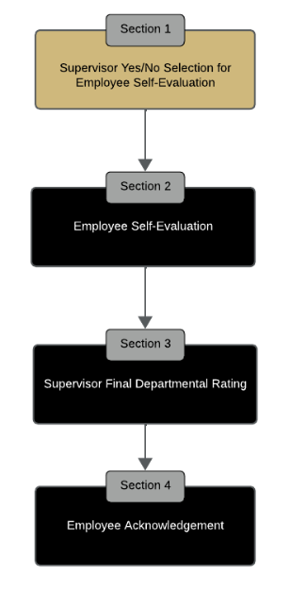
Direction Sections in University Staff Final Evaluation
Feedback from last year revealed confusion surrounding Self-Evaluation within task
Created direction section before each step to clarify instructions for supervisors and employees to follow
The section highlighted in gold helps the user keep track of the workflow step they are currently on
Notes:
Both user interface updates are NOT live, are still in the testing and feedback stages

Slide 4
University Staff Final Evaluation Screenshots
Definition of Slide Titles
Supervisor 3.5
Supervisor or Employee
Holistic Step of the Evaluation Process
Specific Page/ Section

Slide 5
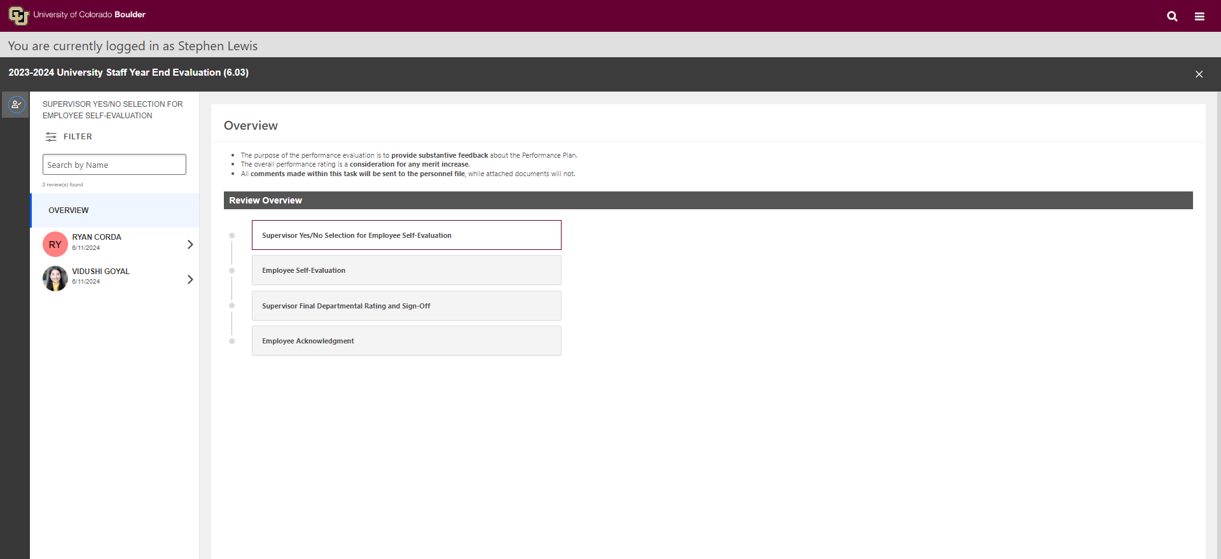
Supervisor 1.1

Slide 6
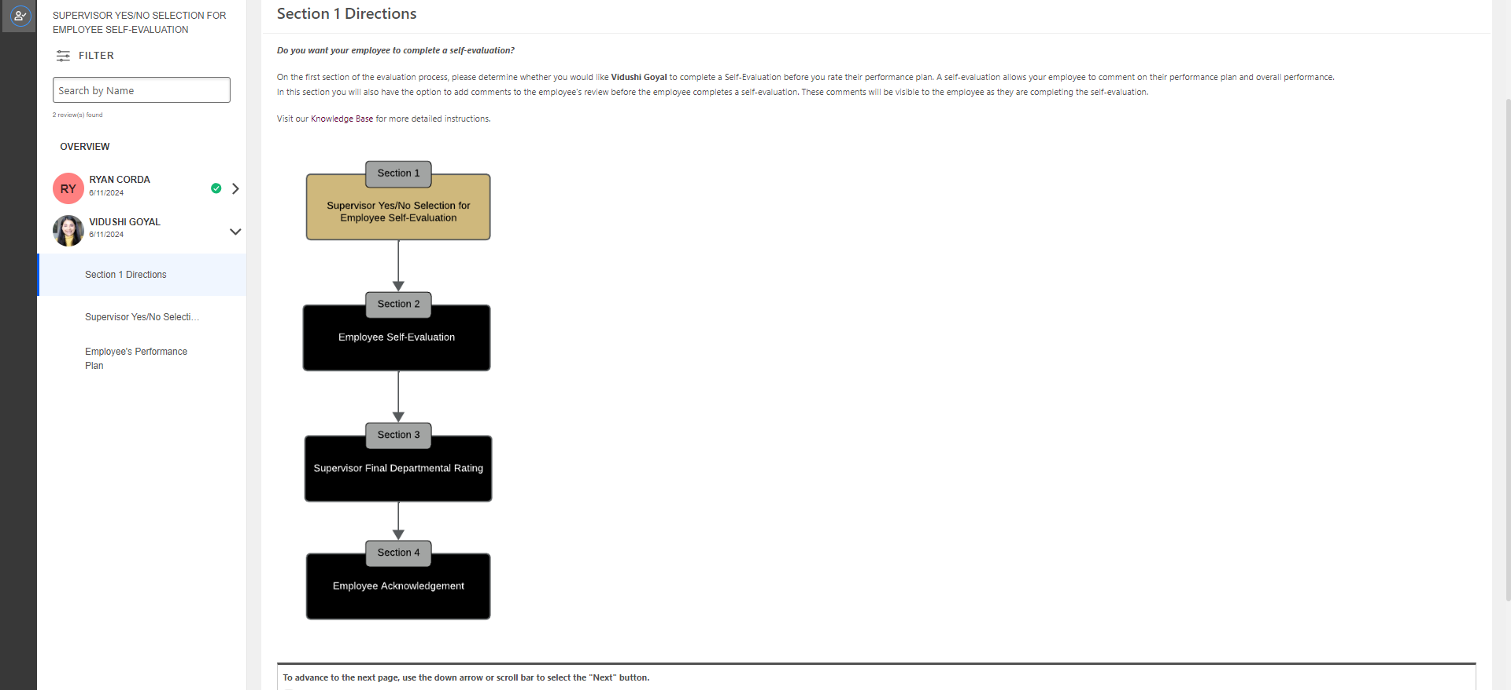
Supervisor 1.2

Slide 7
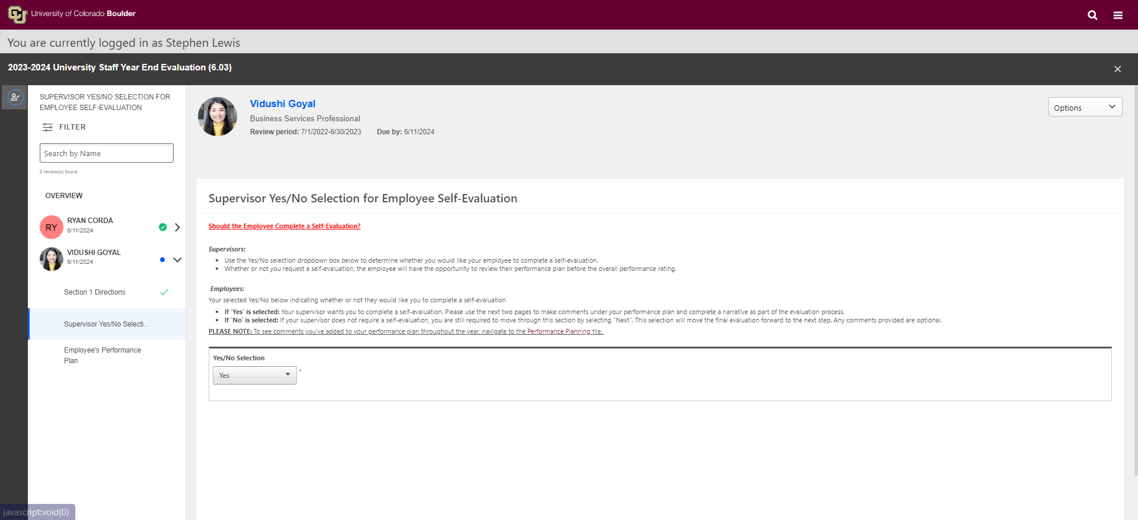
Supervisor 1.3

Slide 8
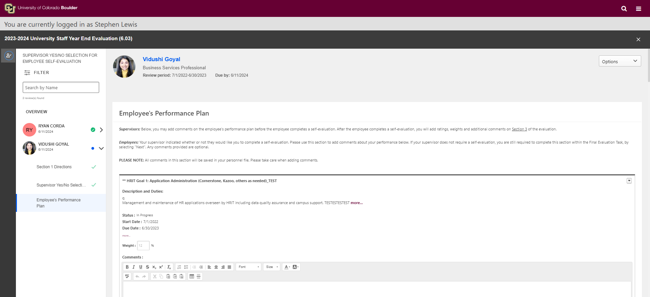
Supervisor 1.4

Slide 9
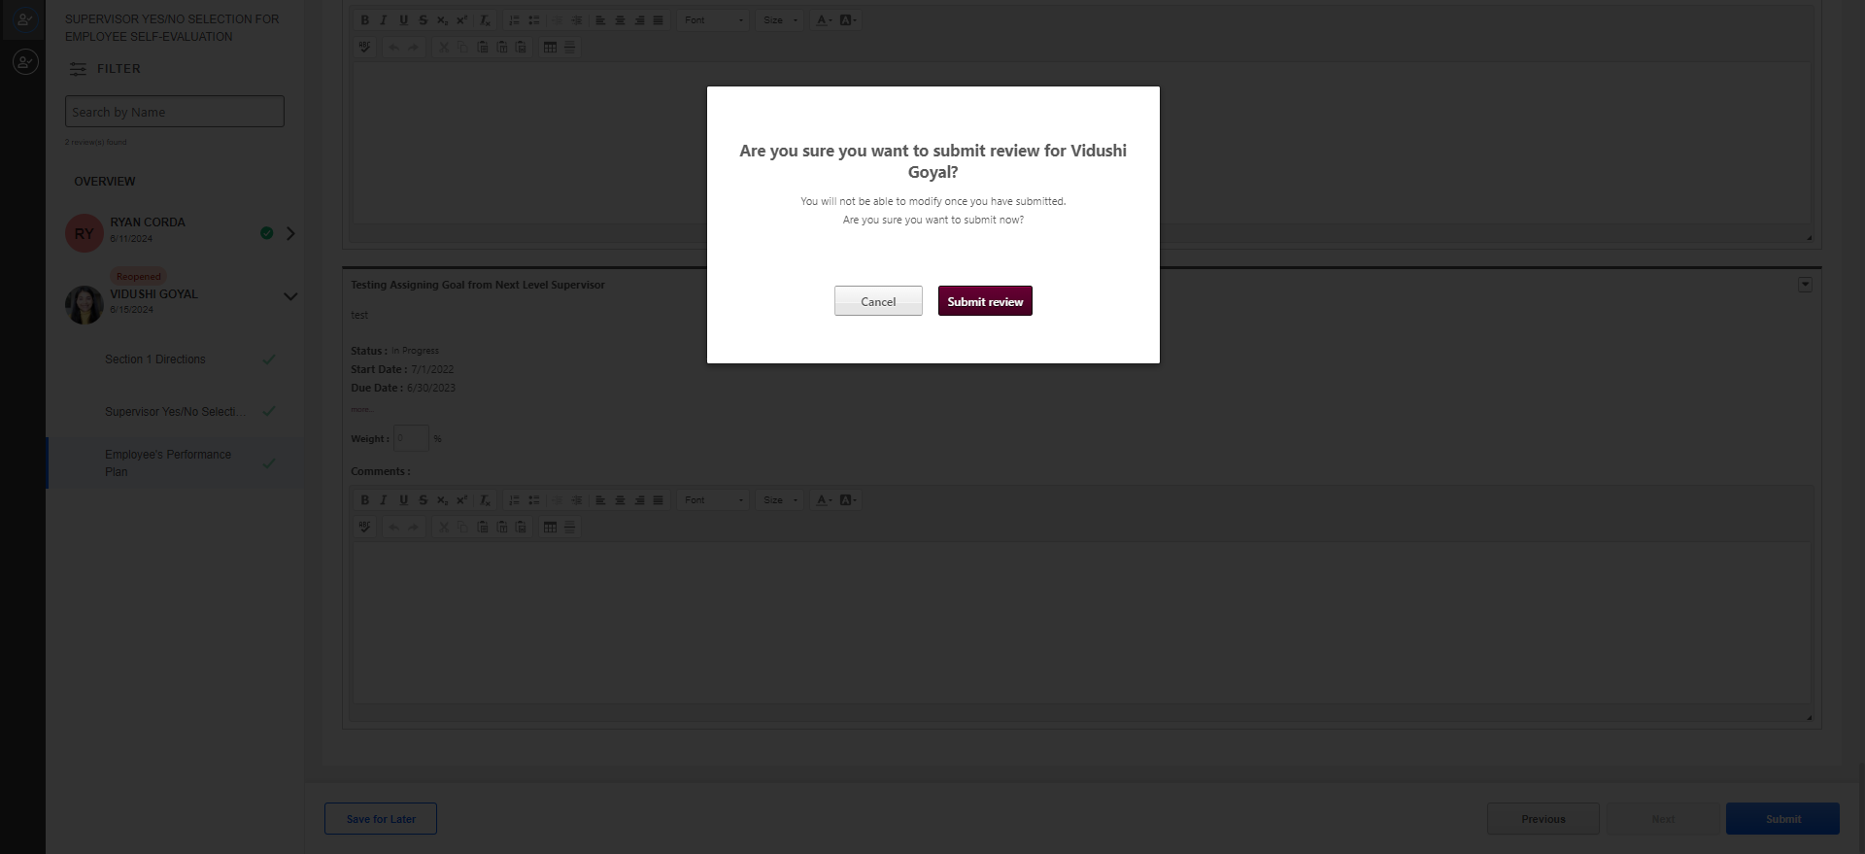
Supervisor 1.5

Slide 10
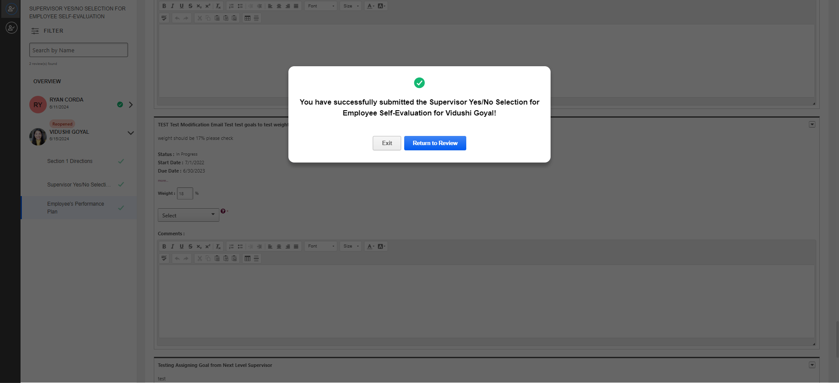
Supervisor 1.6

Slide 11
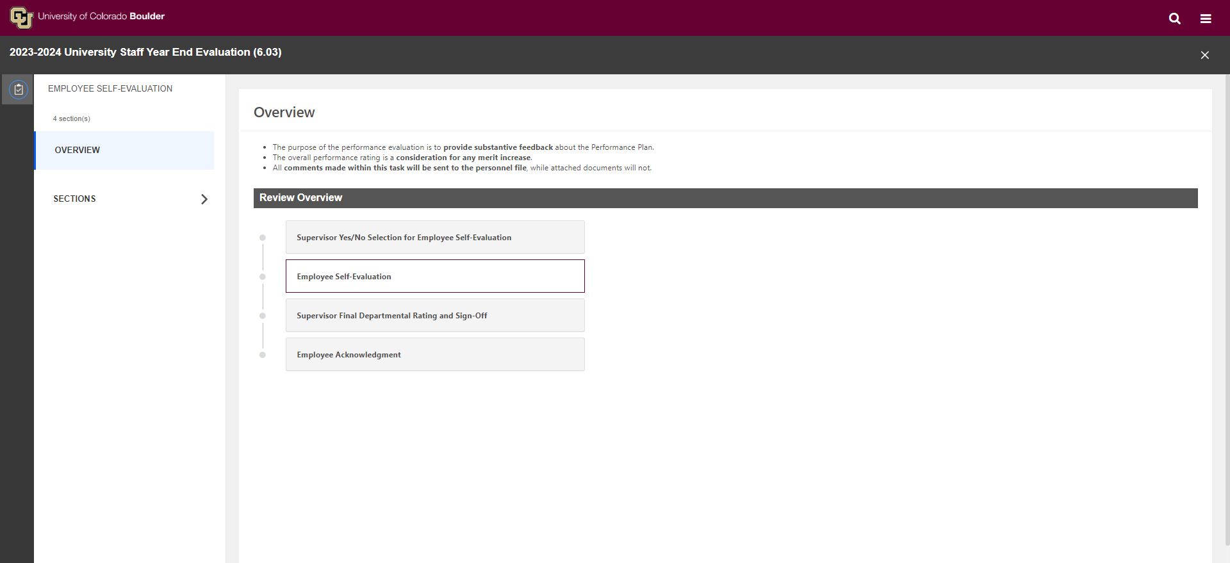
Employee 2.1

Slide 12
Employee 2.2

Slide 13
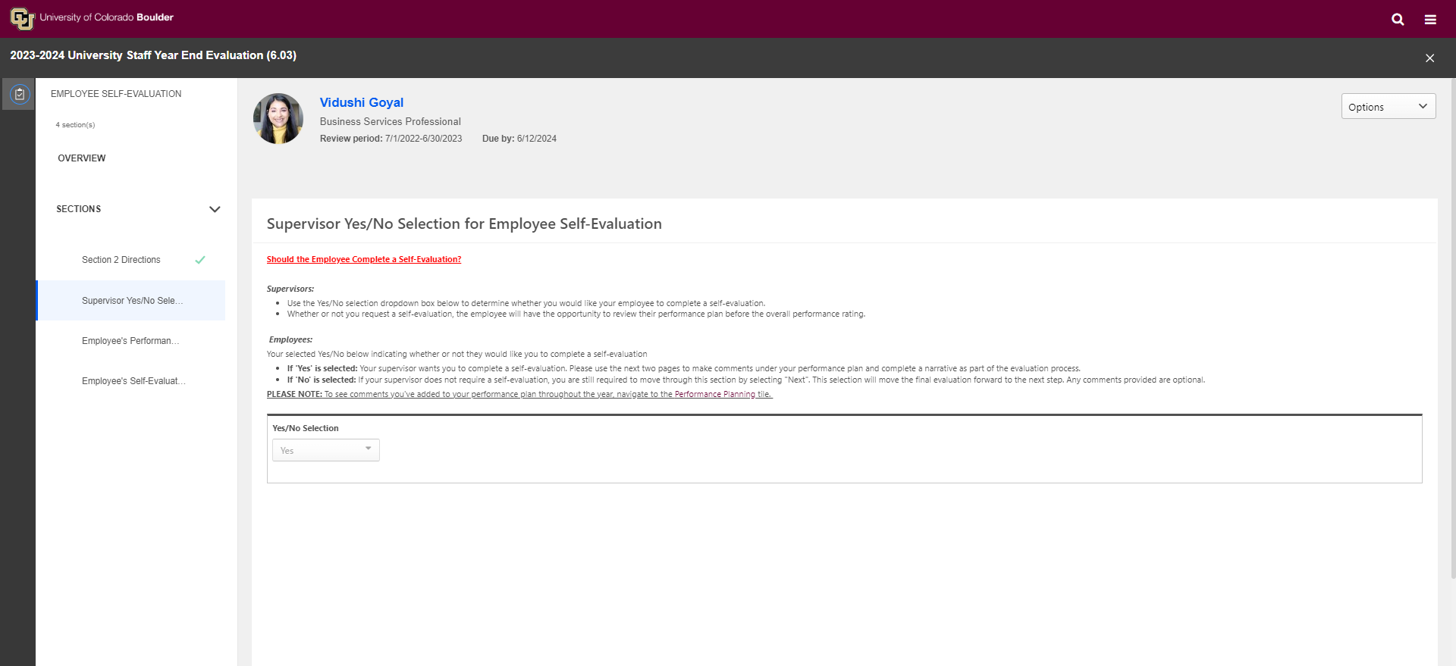
Employee 2.3

Slide 14
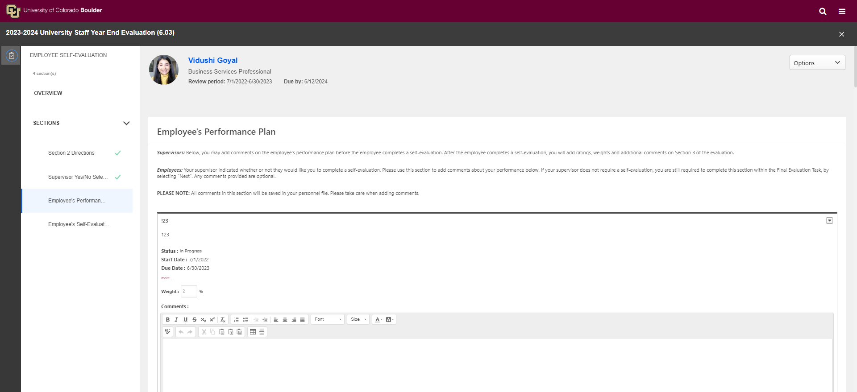
Employee 2.4

Slide 15
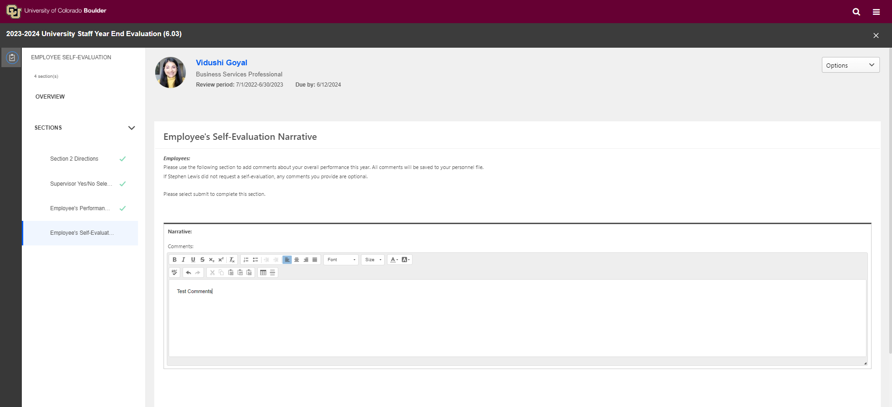
Employee 2.5

Slide 16
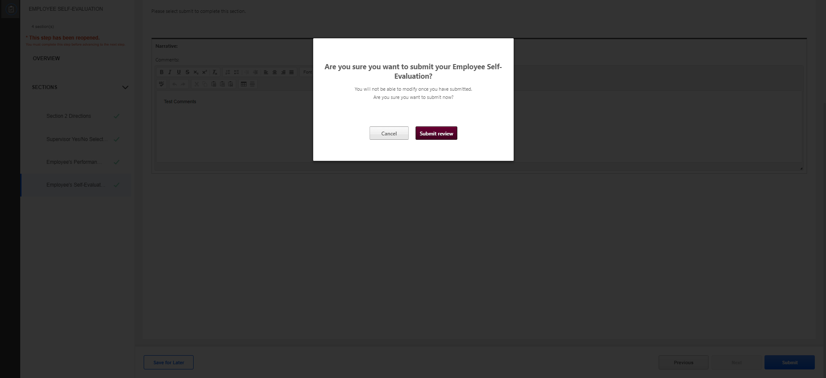
Employee 2.6

Slide 17
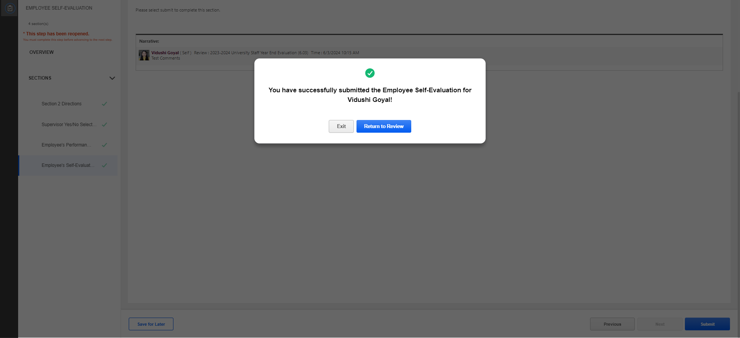
Employee 2.7

Slide 18
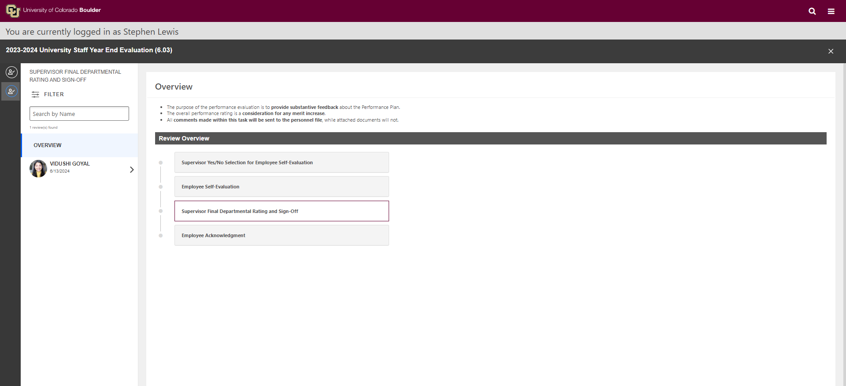
Supervisor 3.1

Slide 19
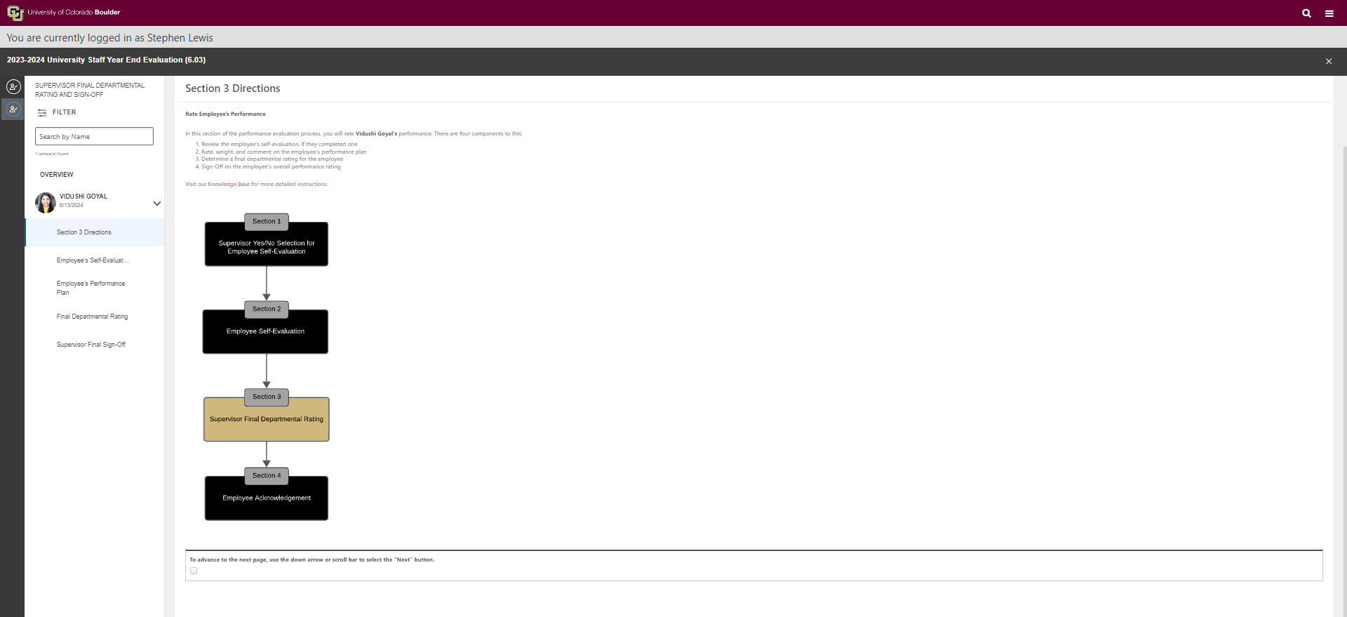
Supervisor 3.2

Slide 20
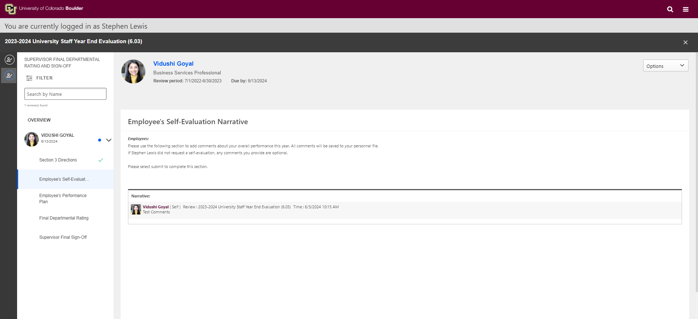
Supervisor 3.3

Slide 21
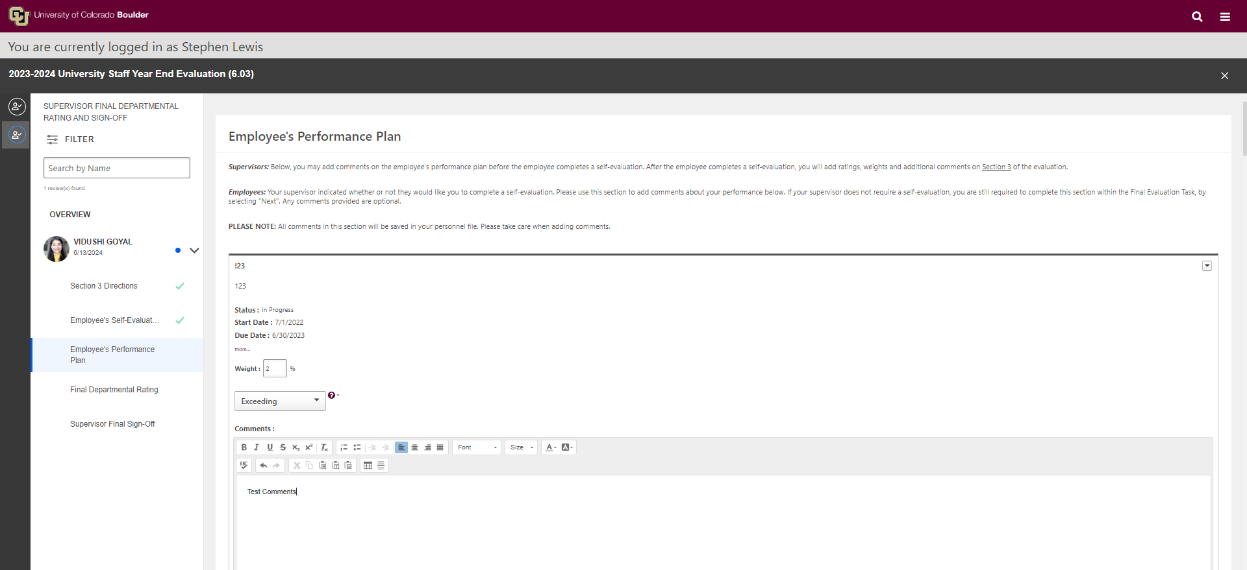
Supervisor 3.4

Slide 22
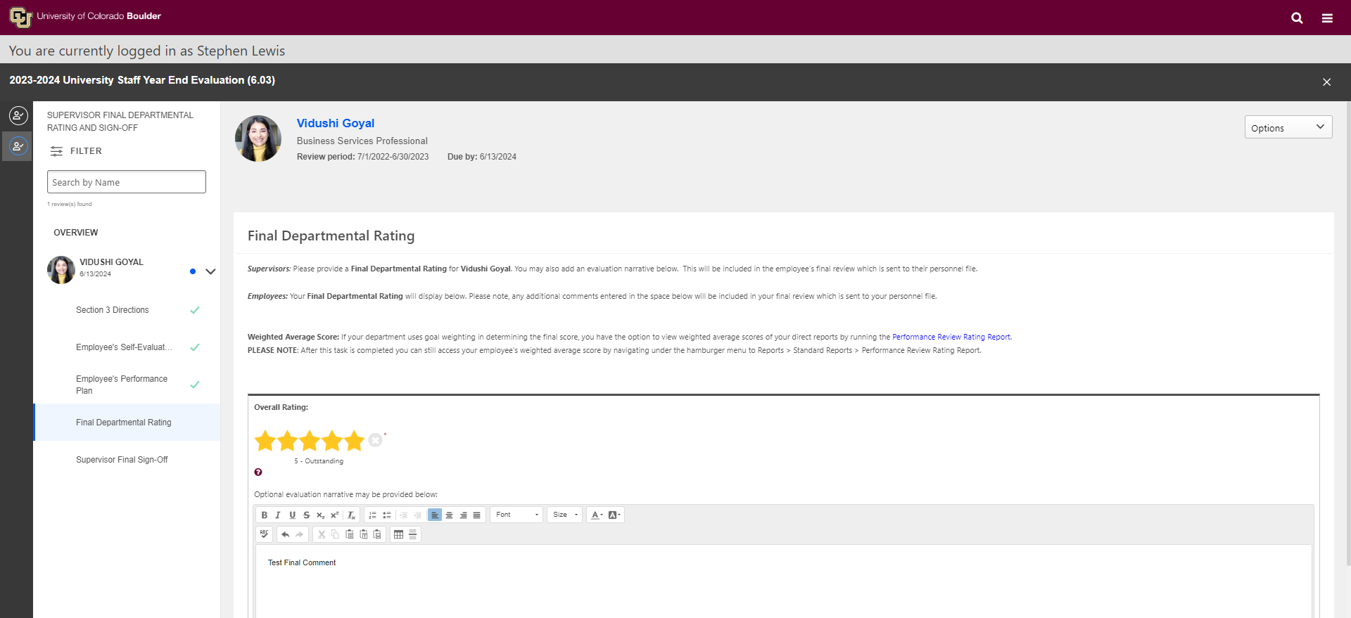
Supervisor 3.5

Slide 23
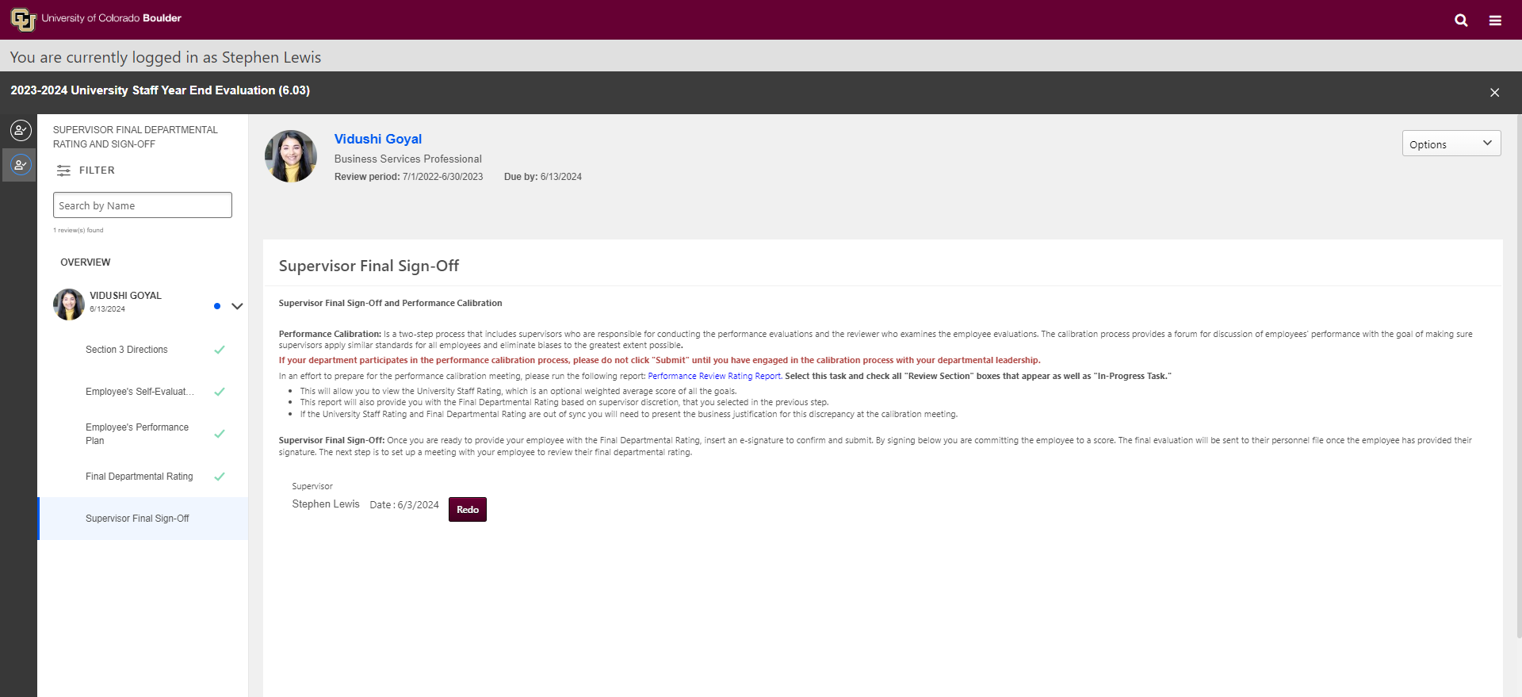
Supervisor 3.6

Slide 24
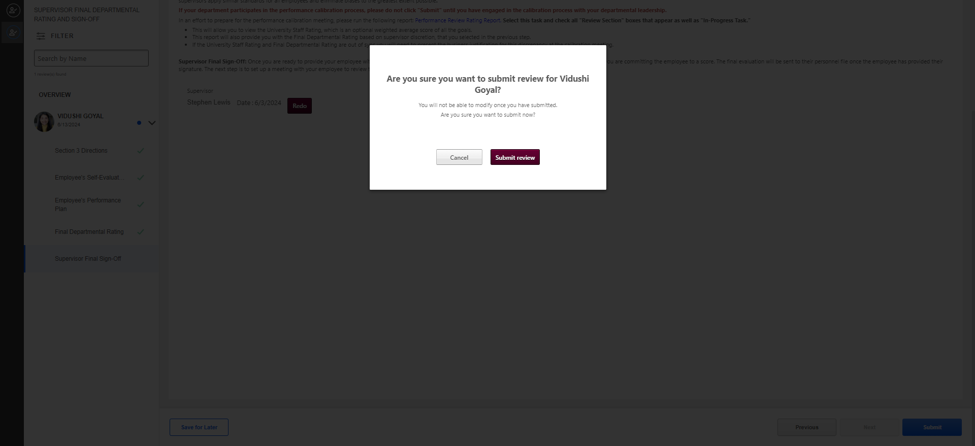
Supervisor 3.7

Slide 25
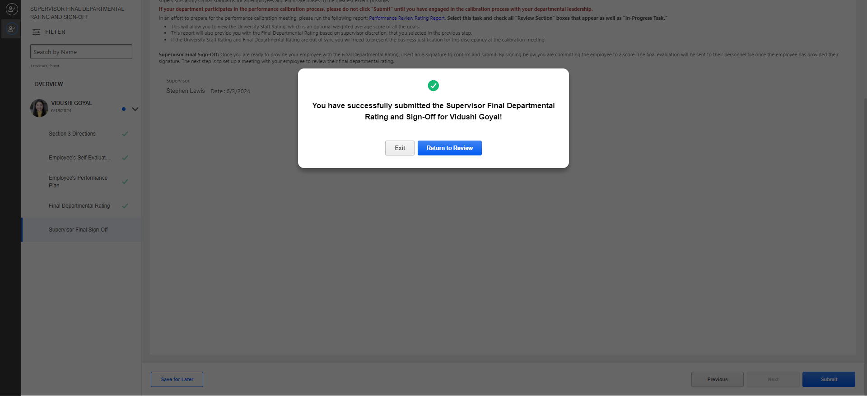
Supervisor 3.8

Slide 26
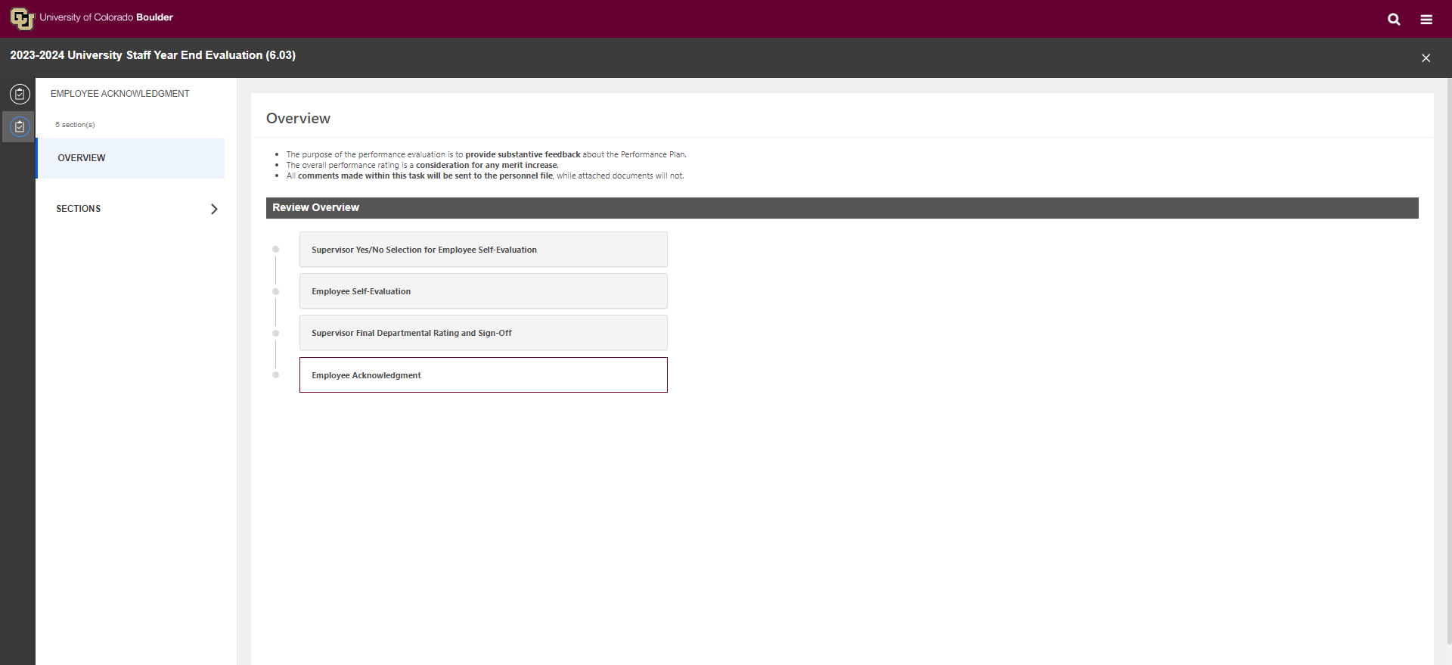
Employee 4.1

Slide 27
Employee 4.2

Slide 28
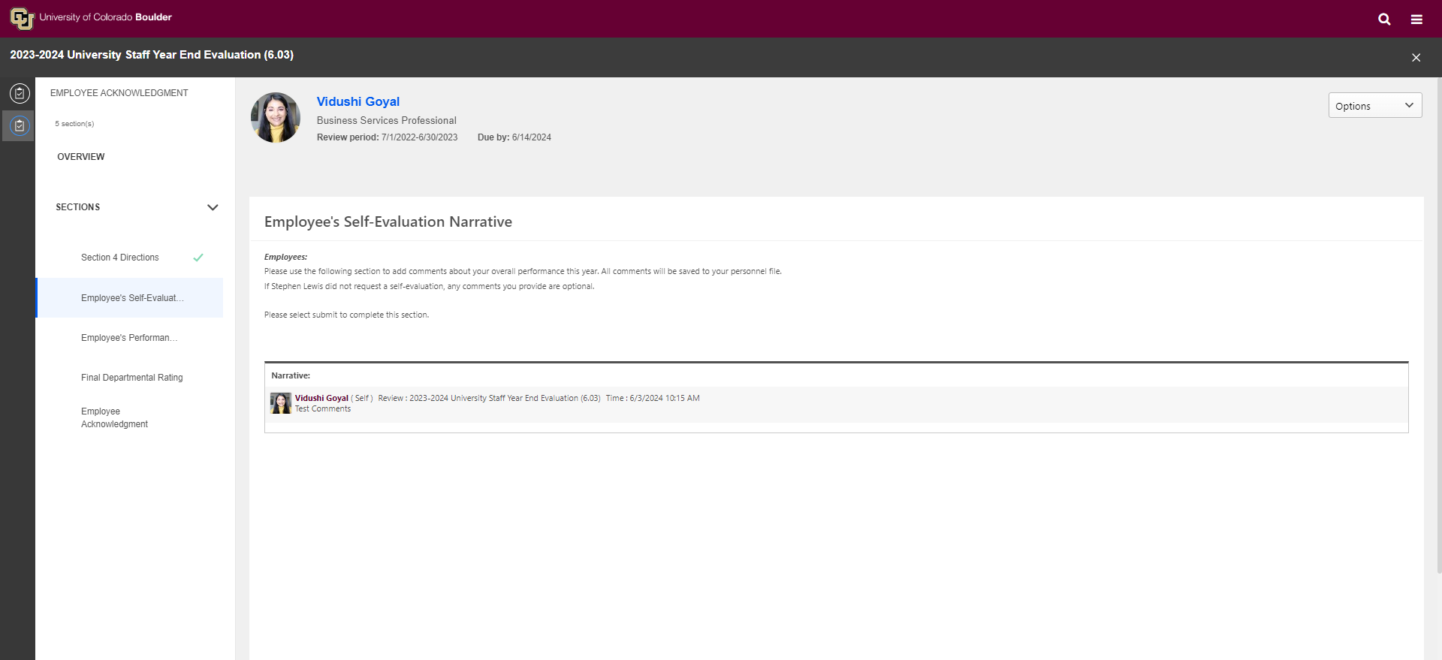
Employee 4.3

Slide 29
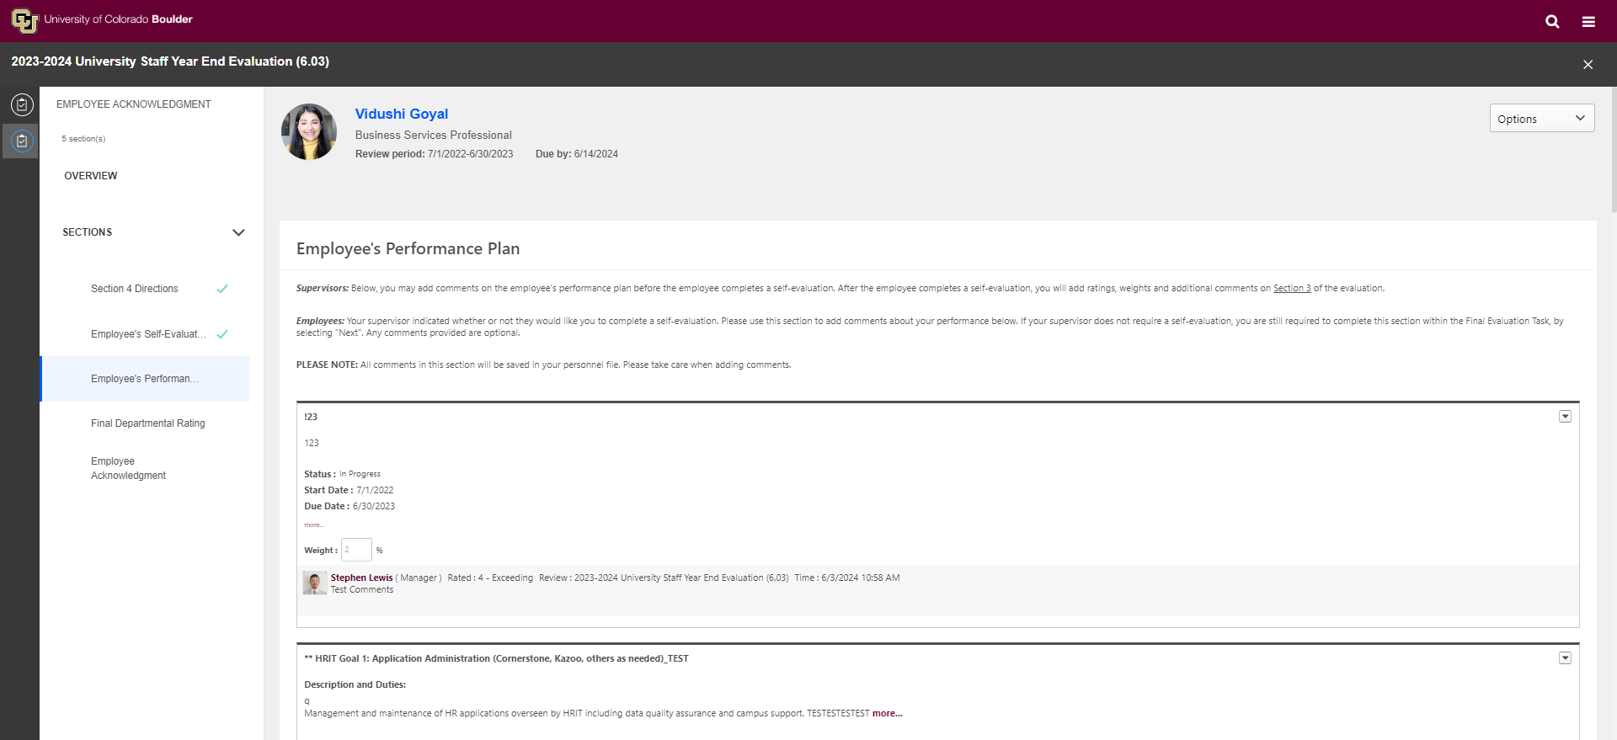
Employee 4.4

Slide 30
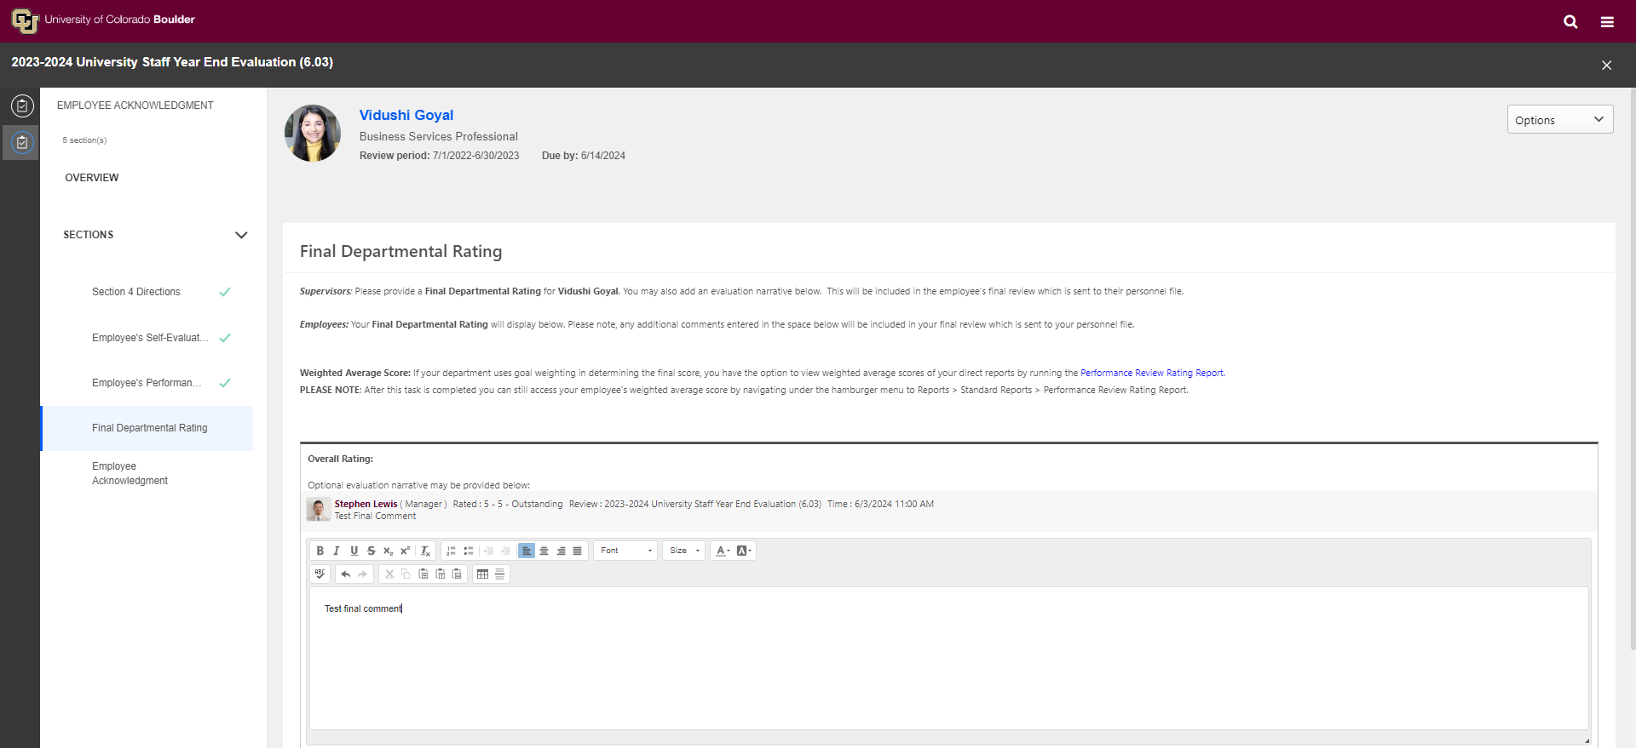
Employee 4.5

Slide 31
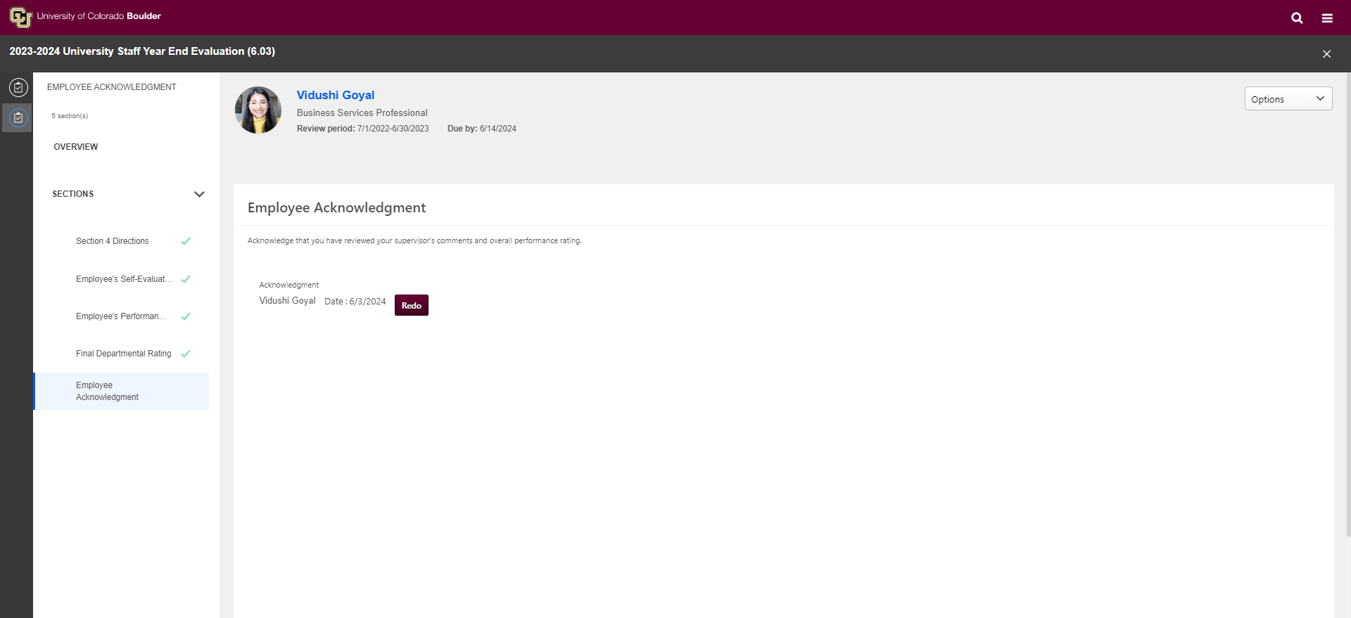
Employee 4.6

Slide 32
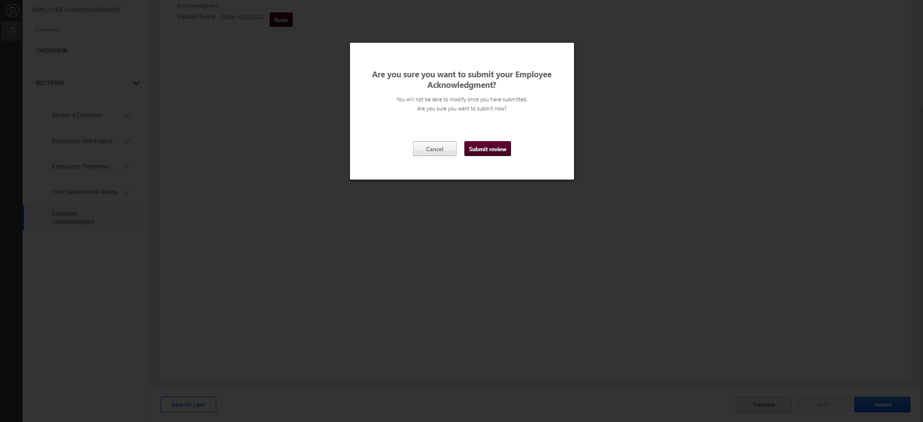
Employee 4.7

Slide 33
Employee 4.8

Slide 34
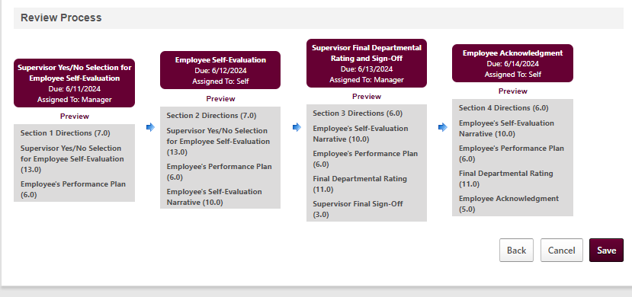
Review Workflow

Slide 35
University Staff Planning Task Changes
Goals will be pulled out of the Planning Task

Slide 36
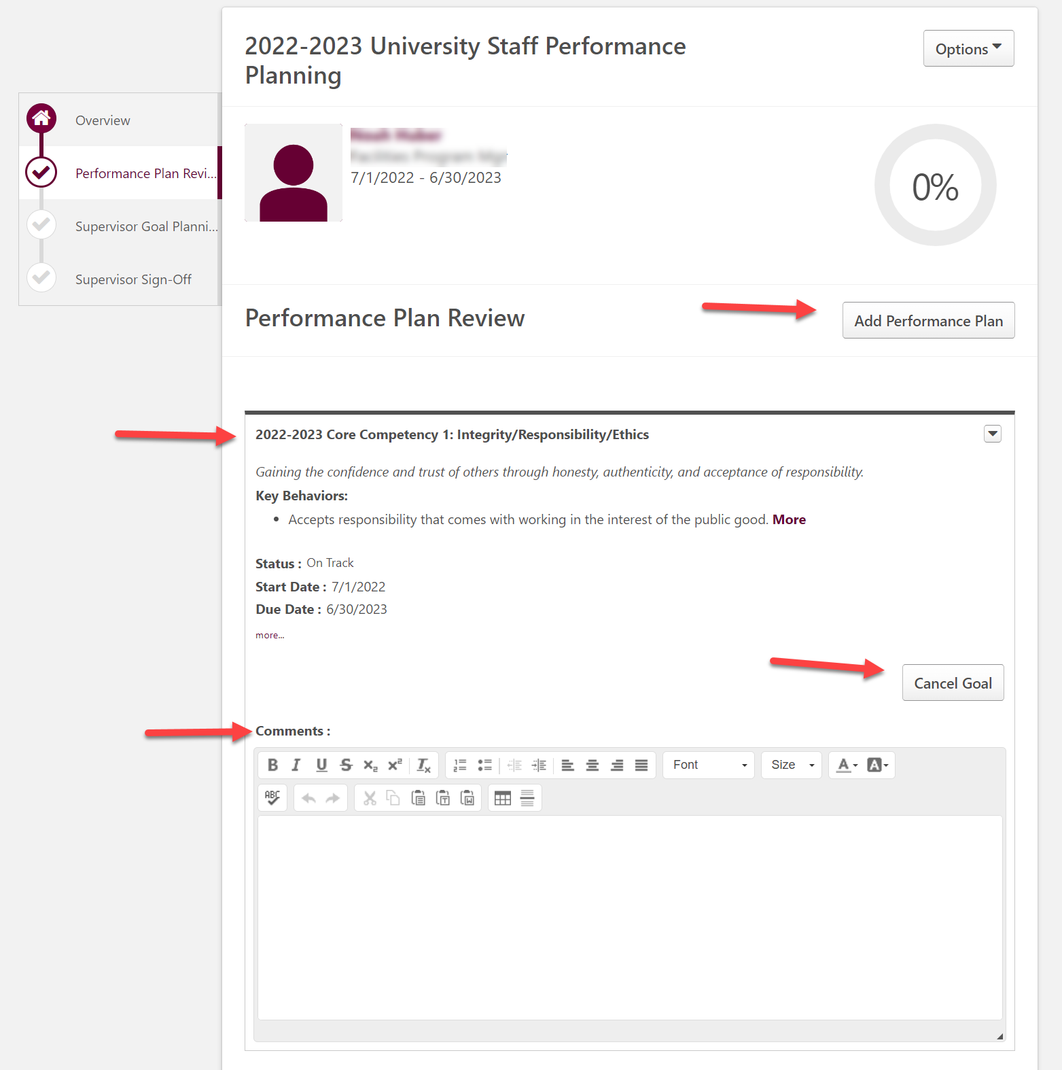
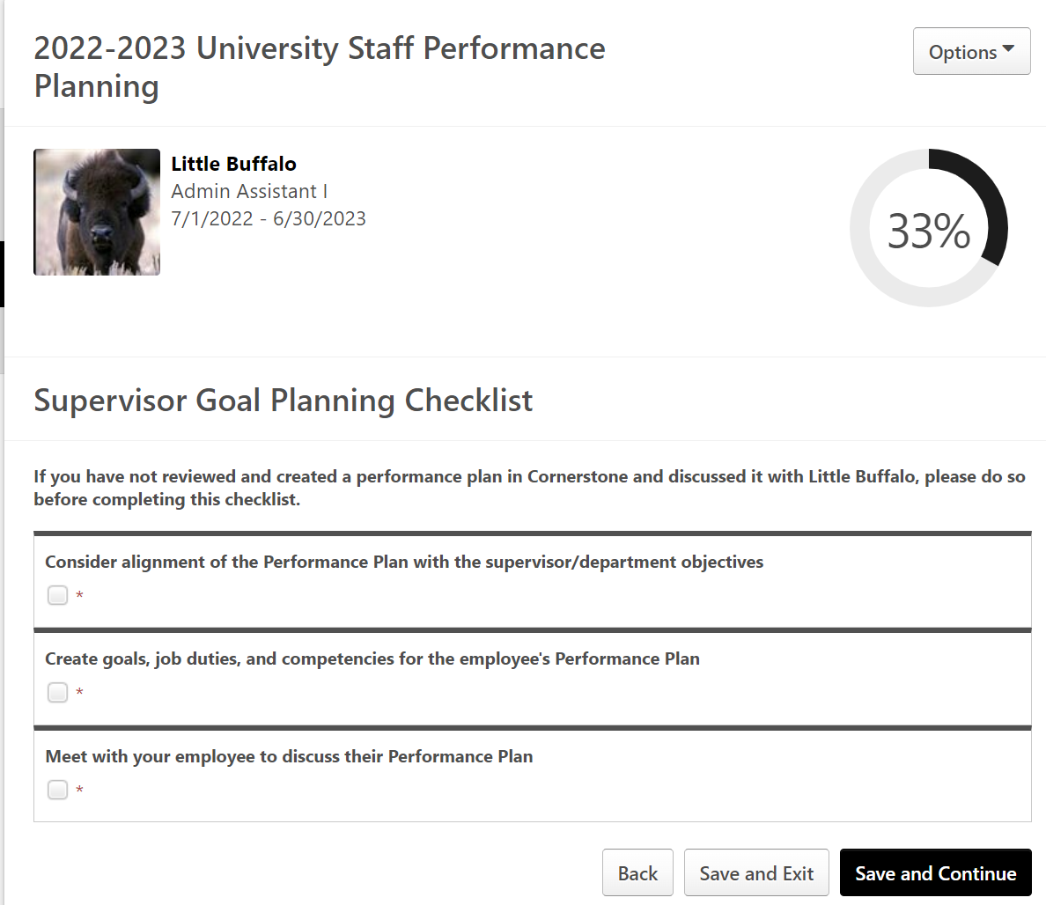
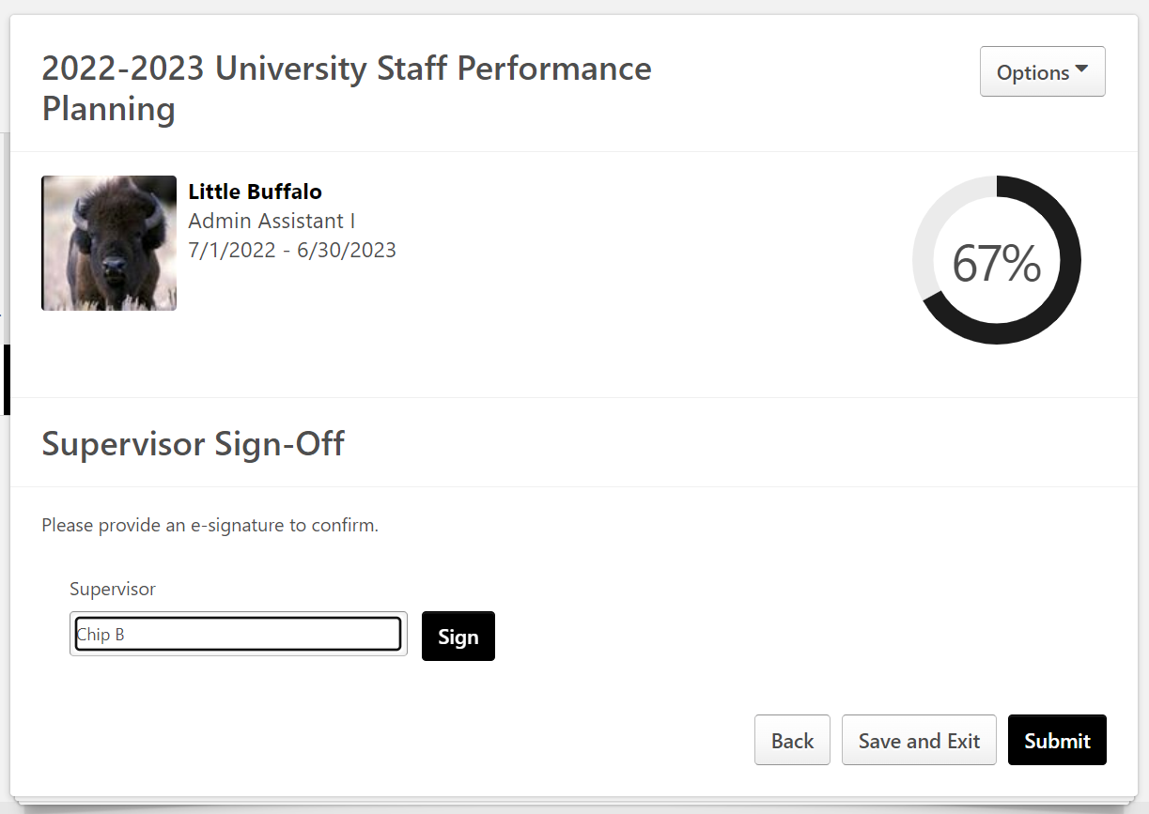
University Staff Planning Task Changes
Current state allows users to add goals within the review task, causing goals to get “suspended” in the review task
Updated Task will resemble coach task, showing confirmation checklist and signature page only
Checklist/Signature Workflow:

Slide 37
University Staff Planning Task Changes Cont…
Current state allows users to add goals within the review task, causing goals to get “suspended” in the review task
Updated Task will resemble coach task, showing confirmation checklist and signature page only
Checklist/Signature Workflow:

Slide 38
Contact us!
Cornerstone Help Request Form

