Slide 1
How to Complete the Required Immigration Check-In Form and Submit Your Confirmation of a Passing (70%) Immigration Essentials Score

Slide 2
Immigration Check-In Form
International students in F-1 or J-1 status are required by federal regulations to complete a SEVIS immigration check-in within 30 days of the start date indicated on their I-20 or DS-2019.
Transfer-in students must complete the check-in form within 15 days of the start date indicated on their CU Boulder I-20 or DS-2019
Failure to complete the immigration check-in process will result in the termination of one’s F-1 or J-1 status and the ability to legally pursue a degree in the United States.

Slide 3
When to Complete the Immigration Check-In Form
The Immigration check-in can only be completed after arriving in the U.S. as you must provide a copy of your U.S. arrival record (I-94)
Deadline for non-transfer students: 30 days after the program start date
Deadline for transfer students: Within 15 days of the program start date indicated on your Form I-20
The Immigration Check-In Form is available via MyISSS portal
Students in F-1 status: You must complete an Immigration Essentials Virtual Quiz within your orientation canvas course and upload the results in the Immigration Check-In Form
Exchange Students in J-1 status have access to the orientation canvas course, but will not complete a quiz and will instead have to attend an information session.
If you are a J-1 student who is not an exchange student, please reach out to ISSS about your check-in process. You will also be required to submit proof of insurance: Exchange Visitor Insurance Compliance Form (DocuSign)
Notes:
Will check in with Kim regarding the highlighted part

Slide 4
MyISSS Portal
How to Access MyISSS where you will find your Check-In Form
Open the portal at https://isss.cu.edu
Select the login button
Select your Campus
Login using your IdentiKey and IdentiKey password
If given an option, select Full Client Services (NOT Limited Client Services)
MyISSS Intro Video
Notes:
Portal Demo

Slide 5
How to Access your I-94 Record
F-1 and J-1 students must submit their I-94 arrival record when completing the Immigration Check-In Form
Go to https://i94.cbp.dhs.gov/I94/#/home
Select "Get Most Recent I-94"
Click on "Consent & Continue"
Enter your information as it appears on your F-1 or J-1 visa
If you are a Canadian citizen, please use your passport

Slide 6
Most Recent I-94

Slide 7
Responsibilities Contract for Students in F-1 or J-1 Status
International students are required to abide by U.S. federal immigration regulations for the duration of their stay in the U.S.
The Responsibilities Contract outlines several rules international students must follow to maintain F-1 or J-1 status
Students are responsible for knowing and abiding by all U.S. federal immigration rules
Abiding by the U.S. federal immigration regulations is required to maintain F-1 or J-1 status and to remain in the U.S. legally while you complete your academic program
ISSS advisors are here to help answer questions regarding your F-1 or J-1 status

Slide 8
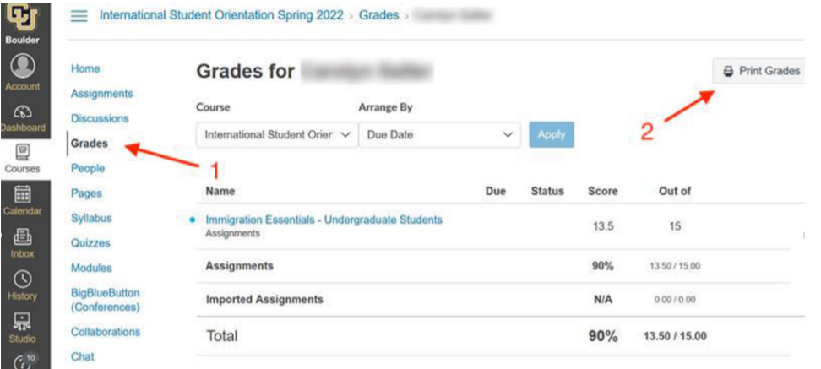
Submitting your Confirmation of a Passing (70%) Immigration Essentials Score
Only required for students in F-1 status
Take the Immigration Essentials Quiz in the canvas course
After completing the quiz with a 70% or higher, go to "Grades" and then select “Print Grades”

Slide 9
Immigration Essentials Course Grade
You will need to save a screenshot of your passing grade

Slide 10
Immigration Essentials Grade Submission
In MyISSS Portal select the "IES Quiz Grade Submission" Under "Arrival & Immigration Check-In"

Slide 11
Where to Find ISSS Forms
https://www.colorado.edu/isss/myisss

