Slide 1
Paul M. Rady Department of Mechanical Engineering
Graduate and Elective Courses
Please scroll through this document to view the department’s technical electives.
Slides two, three and four organize the ME technical electives by focus area. Click each link to find the course description and which semester the course is typically offered.
Information about potential emphasis options for MS Thesis or MS Professional students is available on the graduate program website.

Slide 2
Full List of Graduate and Elective Courses by Focus Area
Graduate Foundations
MCEN 5020: Methods of Engineering Analysis
MCEN 5021: Intro to Fluid Dynamics
MCEN 5022: Classical Thermodynamics
MCEN 5023: Solid Mechanics
MCEN 5024: Materials Chemistry and Structures
MCEN 5042: Heat Transfer
MCEN 5044: Mechanical Behavior of Materials
MCEN 5208: Intro to Research (PhD, MS Thesis)
MCEN 5000: Sociotechnical Industry Skills (MS Professional)
Materials
MCEN 5024: Materials Chemistry and Structures
MCEN 5044: Mechanical Behavior of Materials
MCEN 4194/5194: Energy Conversion/Storage
MCEN 4228/5228: Nano Science/Engineering
MCEN 4228/5228: Thin Film Materials
MCEN 4228/5228: Mechanics of Biological Materials
MCEN 4292/5292: Materials/Devices in Medicine
MCEN 4298/5298: Intro to Polymers
MCEN 6184: Structures/Properties of Polymers
MCEN 6228: Self-Assembling Materials
Mechanics of Materials
MCEN 5023: Solid Mechanics
MCEN 5044: Mechanical Behavior of Materials
MCEN 4133/5133: Intro to Tissue Biomechanics
MCEN 5147: Mechanobiology
MCEN 4173/5173: Finite Element Analysis
MCEN 4174/5174: Failure of Eng. Materials
MCEN 4183/5183: Mech of Composite Materials
MCEN 4113/5113: Mechanics of Cancer
MCEN 4228/5228: Mechanics of Snow
MCEN 5153: Fracture Mechanics
MCEN 4293/5293: Mechanics of Soft Matter
MCEN 6228: Continuum Mechanics

Slide 3
Full List of Graduate and Elective Courses by Focus Area
Thermo Fluid Sciences
MCEN 5021: Fluid Dynamics
MCEN 5022: Classical Thermo
MCEN 5042: Heat Transfer
MCEN 4151/5151: Flow Visualization
MCEN 4152/5152: Intro to Combustion
MCEN 4228/5228: Thermofluids Lab
MCEN 4228/5228: Biofluids
MCEN 4228/5228 Thermal Systems Innovation
MCEN 4231/5231: Computational Fluid Dynamics
MCEN 4012/5012: Renewable Fuels, Fuel Cells, & ICE
MCEN 4228/5228: Fluid Mech in the Human Body
MCEN 4111/5111: Intro to Microfluidics
MCEN 6001: Reacting Flows
Micro/Nanoscale
MCEN 4228/5228: Biofluids
MCEN 4111/5111: Intro to Microfluidics
MCEN 4228/5228: Thin Film Materials
MCEN 4228/5228 Membrane Technologies
MCEN 4298/5298: Intro to Polymers
MCEN 4228/5228: Intro to Nanoscale Transport
MCEN 5228: Flexible Electronics
MCEN 5636: Micro-Electro-Mechanical Systems
MCEN 6184: Structures/Properties of Polymers
MCEN 6228: Self-Assembling Materials
MCEN 6228: Wetting, Adhesion, Friction
Robotics and Systems Design
MCEN 4115/5115: Mechatronics/Robotics 1
MCEN 4125/5125: Optimal Design
MCEN 4138/5138: Feedback Control
MCEN 4155/5155: Automated Mechanical Design
MCEN 4228/5228: Industrial Automation
MCEN 4228/5228: Vibrations
MCEN 4228/5228 Machine Learning in ME
MCEN 4228/5228: Biohybrid Robitics
MCEN 4195/5195: Bioinspired Robotics
MCEN 4157/5157: Modeling of Human Movement
MCEN 4228/5228: Mechatronics/Robotics 2
MCEN 5228: Advanced Dynamics
MCEN 5448: Linear Systems
MCEN 5636: Micro-Electro-Mechanical Systems
MCEN 6228: Robust Multivariable Control

Slide 4
Full List of Graduate and Elective Courses by Focus Area
Air Quality, Energy and the Environment
MCEN 4032/5032: Sustainable Energy
MCEN 4131/5131: Air Pollution Control
MCEN 4135/5135: Wind Energy
MCEN 4141/5141: Indoor Air Pollution
MCEN 4152/5152: Intro to Combustion
MCEN 5161: Aerosols
MCEN 4194/5194: Energy Conversion/Storage
MCEN 4228/5228: Thermofluids Lab
MCEN 4231/5231: Computational Fluid Dynamics
MCEN 4012/5012: Renewable Fuels, Fuel Cells, and Internal Combustion Engines
MCEN 4228/5228: Climate Engineering
MCEN 4291/5291: PBL in Rural Schools
MCEN 4299/5299: Household Energy Systems
MCEN 6001: Reacting Flows
MCEN 6228: Kinetics of Chemical Systems
MCEN 7221: Turbulence
Biomedical
MCEN 4117/5117: Anatomy & Physiology
MCEN 4127/5127: Biomedical Ultrasound
MCEN 4133/5133: Intro to Tissue Biomechanics
MCEN 5147: Mechanobiology
MCEN 4171/5171: Biofluids on the Micro Scale
MCEN 4231/5231: Computational Fluid Dynamics
MCEN 4113/5113: Mechanics of Cancer
MCEN 4228/5228: Fluid Mech in the Human Body
MCEN 4228/5228: Surface Forces in Biology
MCEN 4228/5228: Advanced Biotransport
MCEN 4111/5111: Intro to Microfluidics
MCEN 4157/5157: Modeling of Human Movement
MCEN 4110/5110: Regenerative Bio/Tissue Repair
MCEN 4292/5292: Materials/Devices in Medicine
Product Design and Manufacturing
MCEN 5045: Design for Manufacturability
MCEN 5055: Advanced Product Design
MCEN 5065: Graduate Product Design 1
MCEN 5075: Graduate Product Design 2
MCEN 4115/5115: Mechatronics/Robotics 1
MCEN 4125/5125: Optimal Design
MCEN 4173/5173: Finite Element Analysis
MCEN 4155/5155: Automated Mechanical Design
MCEN 4215/5215: Design for Inclusion
MCEN 4228/5228: Industrial Automation
MCEN 4228/5228: Design of Beer
MCEN 4228/5228: Design Research Theory and Methods
MCEN 4036: Lean/Six Sigma Manufacturing
MCEN 4195/5195: Bioinspired Robotics
MCEN 4193/5193: Design of Coffee
MCEN 4238: Design for Community
MCEN 4279/5279: Aesthetics of Design

Slide 5
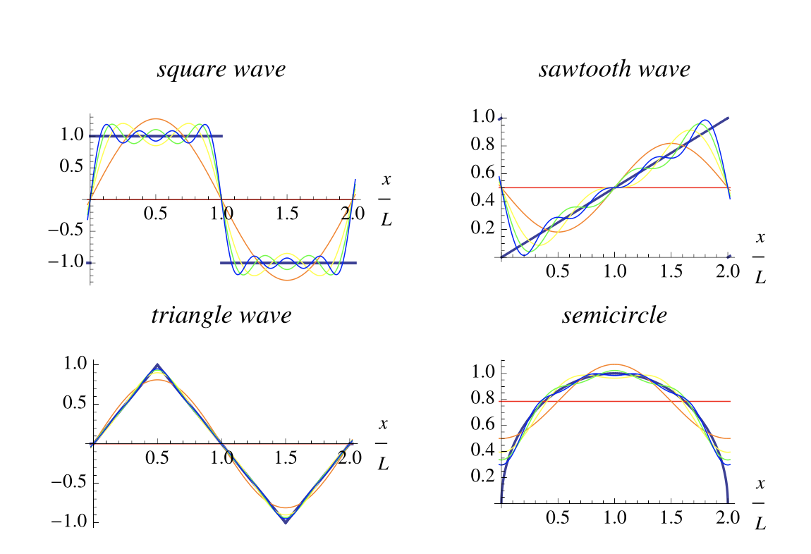
MCEN 5020: Methods of Engineering Analysis
Career Areas
Engineering Foundation
Specializations
None
Prerequisites
None
Pre or Corequisites
None
Studies selected topics from linear algebra, ordinary differential equations and Fourier series. Assigns computer exercises. Correlates with analysis topics in other mechanical engineering graduate courses and emphasizes applications.
mathworld.wolfram.com/FourierSeries.html
Peter Hamlington
Daven Henze
Teaching schedule: Offered every fall semester.

Slide 6
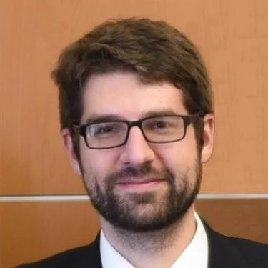
MCEN 5021: Introduction to Fluid Dynamics
Career Areas
Biomedical Engineering
Renewable Energy
Aviation/Space Exploration
Atmospheric Science
Specializations
None
Prerequisites
None
Pre or Corequisites
MCEN 5020: MEA
Focuses on physical properties of gases and liquids, and kinematics of flow fields. Analyzes stress; viscous, heat-conducting Newtonian fluids; and capillary effects and surface-tension-driven flow. Other topics include vorticity and circulation, ideal fluid flow theory in two and three dimensions, Schwartz-Christoffel transformations, free streamline theory, and internal and free-surface waves.
Hana Kieger
Xiaoyun Ding
Jean Hertzberg
Jeremy Koch
Teaching schedule: Offered every fall semester.

Slide 7
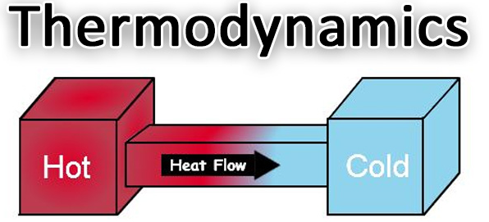
MCEN 5022: Classical Thermodynamics
Career Areas
Power Generation
Renewable Energy
Aviation/Space Exploration
Transportation
Biomedical Engineering
Manufacturing
Specializations
None
Prerequisites
None
Pre or Corequisites
None
First and second laws of thermodynamics. Entropy and availability. Cycle analysis. Thermodynamic properties of pure substances and mixtures. Property relations. Chemical reactions and chemical availability. Energy systems analysis.
Jeremy Koch
Nicole Labbe
Mike Walker
Teaching schedule: Offered every spring semester.

Slide 8
MCEN 5023: Solid Mechanics
Career Areas
Engineering Design
Structural Engineering
Failure Analysis
…and many more!
Specializations
None
Prerequisites
None
Pre or Corequisites
MCEN 5020: MEA
Introduces stress, strain and motion of a continuous system. Discusses material derivative; fundamental laws of mass, momentum, energy and entropy; constitutive equations and applications to elastic and plastic materials.
dnicolasespinoza.github.io/node16.html
Francois Barthelat
Jianliang Xiao
Teaching schedule: Offered every fall semester.

Slide 9
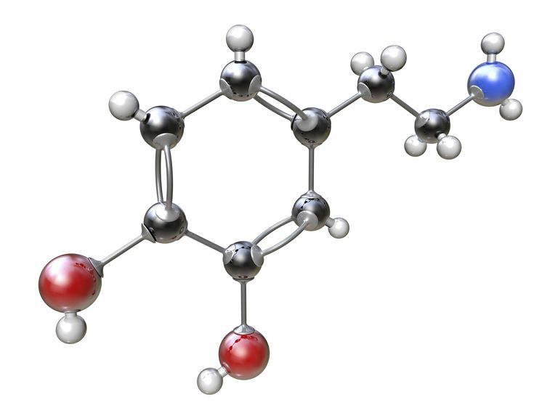
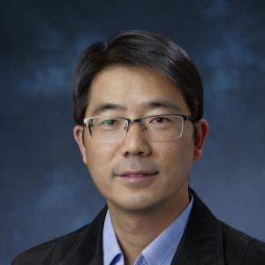
MCEN 5024: Materials Chemistry and Structures
Career Areas
Materials Science
Semiconductors
Energy Storage
Biomedical Applications
Manufacturing
Specializations
None
Prerequisites
None
Pre or Corequisites
None
Provides graduate level students with a comprehensive overview of the chemistry and structure of material systems, with a focus on chemical bonding, the resulting material structures and their properties. Course topics include: bonding in solids, crystalline and amorphous states, basic group theory, diffraction, metals and alloys, ceramics, and an intro to materials characterization.
www.thoughtco.com/definition-of-bonds-in-chemistry-604392
Yifu Ding
Se-Hee Lee
Teaching schedule: Offered every spring semester.

Slide 10
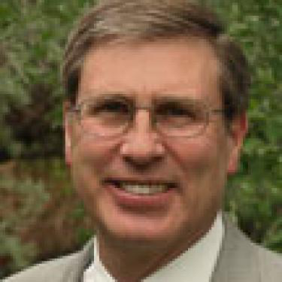
MCEN 4032/5032: Sustainable Energy
Career Areas
Energy Efficiency
Renewable Energy
Environmental Policy
Specializations
BS Environmental Option
BS Energy Minor
Prerequisites
MCEN 3012: Thermo
MCEN 3021: Fluids
Pre or Corequisites
MCEN 3022: Heat Transfer
Examines sustainability of our current energy systems, including transportation, using environmental and economic indicators. Uses systems analysis that addresses energy supply and demand. Explores the science and technology as well as environmental and economic feasibility of efficiency measures and renewable energy technologies. Additional emphasis is given to the global nature of the challenges and the potential for locally optimal solutions.
Mike Walker
Chuck Kutscher
Teaching schedule: Offered every fall semester.

Slide 11
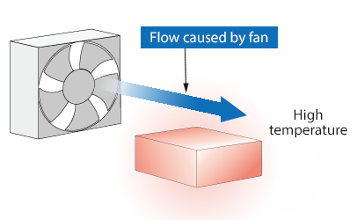
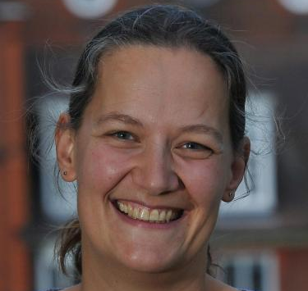
MCEN 5042: Heat Transfer
Career Areas
Power Generation
Aviation/Space Exploration
Transportation
Biomedical Engineering
Manufacturing
Specializations
None
Prerequisites
None
Pre or Corequisites
None
Studies development of equations governing transport of heat by conduction, convection, and radiation, and their solution. Includes analytical and numerical solution of initial and boundary value problems representative of heat conduction in solids. Describes heat transfer in free and forced convection, including laminar and turbulent flow. Also involves radiation properties of solids, liquids, and gases and transport of heat by radiation.
www.cradle-cfd.com/technology/glossary/ja_F/detail0053.html
Longji Cui
Jeff Knutsen
Nathalie Vriend
Teaching schedule: Offered every spring semester.

Slide 12
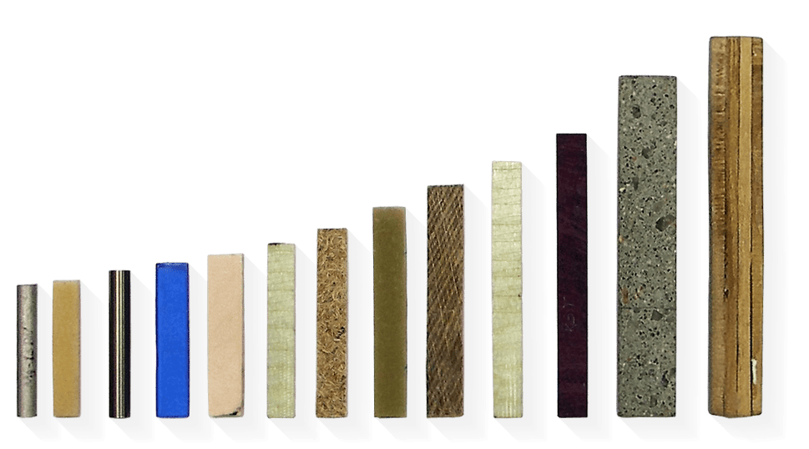
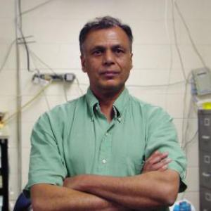
MCEN 5044: Mechanical Behavior of Materials
Career Areas
Materials Science
Mechanics of Materials
Specializations
None
Prerequisites
None
Pre or Corequisites
None
Models are derived that link fundamental properties of materials at these successive length scales into analytical expressions for guiding and interpreting laboratory data. The course is divided into four distinct sections: elastic properties, plasticity, fracture and high temperature phenomena. Each topic is separated by its own exam, with each contributing approximately equally to the final grade. The course will be useful to students, researchers and practitioners.
www.sonelastic.com/en/
Rishi Raj
Teaching schedule: Generally offered spring semester. Availability may vary based on instructor schedule.

Slide 13
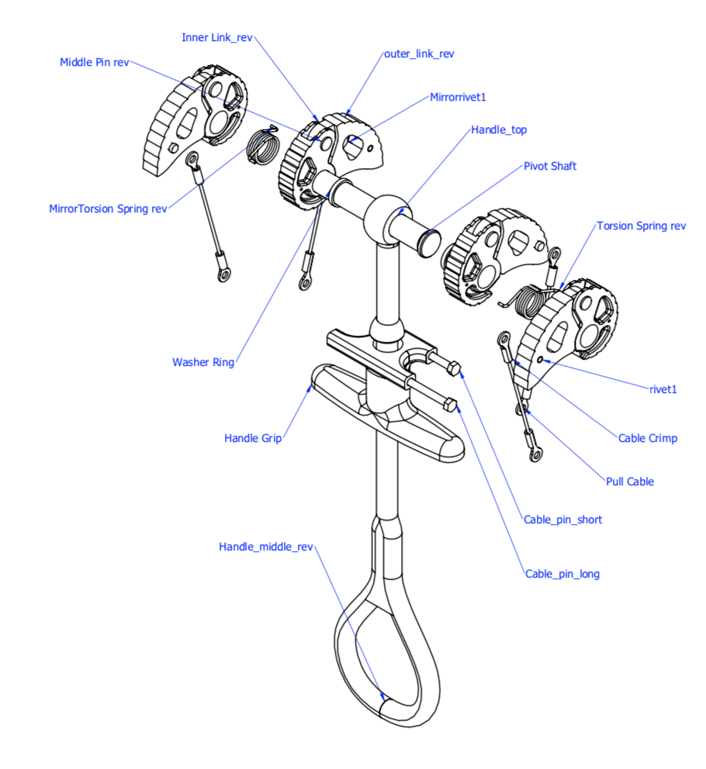
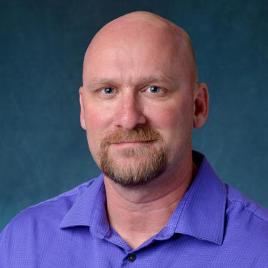
MCEN 5045: Design for Manufacturability
Career Areas
Product Design Manufacturing
Project Management
Specializations
Graduate Design Emphasis
Prerequisites
None
Pre or Corequisites
None
Topics include general design guidelines for manufacturability; aspects of manufacturing processes that affect design decisions; design rules to maximize manufacturability; economic considerations; value engineering and design for assembly. Presents case studies of successful products exhibiting DFMA principles.
Dan Riffell
Teaching schedule: Generally offered both fall and spring semester.

Slide 14
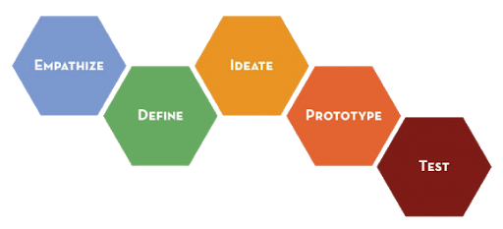
MCEN 5055: Advanced Product Design
Career Areas
Product Design
Specializations
Graduate Design Emphasis
Prerequisites
None
Pre or Corequisites
MCEN 4045: Senior Design
Application Process
Introduces the processes and methods for designing products. Course content includes: need finding and need specification, ideation and idea selection, design thinking, user-centered design, human factors, sketching, prototyping, user feedback, design communication, design for manufacturing, materials selection, and intellectual property. Teams of 3-4 students will design and build a novel product throughout the semester.
Janet Tsai
Greg Rieker
James Harper
Teaching schedule: Generally offered both fall and spring semester.

Slide 15
MCEN 5065: Graduate Product Design 1
Career Areas
Product Design
Specializations
Graduate Design Emphasis
Prerequisites
MCEN 5055: APD
Pre or Corequisites
None
First part of a two-course graduate product design experience in mechanical engineering. Covers problem definition and specifications, determining design requirements, user feedback, alternative design concepts, engineering analysis, concept prototypes and CAD drawings. Students make several oral design reviews, a final design presentation and prepare a written report. Entails a team product design, fabrication and testing cycle of sponsored project.
Gregory Whiting
Rebecca Komarek
Teaching schedule: Offered every fall semester.

Slide 16
MCEN 5075: Graduate Product Design 2
Career Areas
Product Design
Specializations
Graduate Design Emphasis
Prerequisites
MCEN 5065: GPD 1
Pre or Corequisites
None
Second part of two-course graduate product design experience in mechanical engineering. Includes refinement of prototype, design optimization, fabrication, testing, and evaluation. Students orally present the final design and prepare a written report and operation manual for the product. Entails a team product design, fabrication, and testing cycle of a sponsored project, leading to a fully-functional product.
Gregory Whiting
Rebecca Komarek
Teaching schedule: Offered every fall semester.
Tunable Oscillating and Rotational Kinematic Damper for Siemens Gamesa

Slide 17
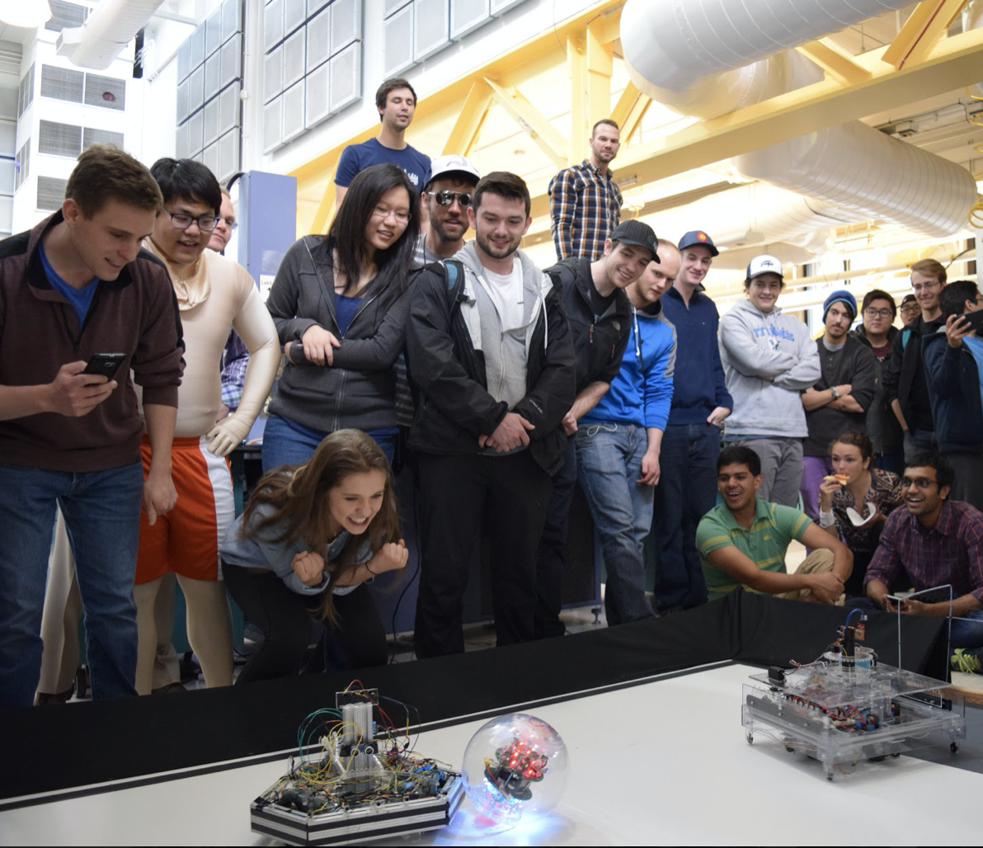
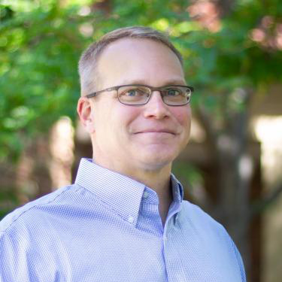
MCEN 4115/5115: Mechatronics and Robotics 1
Career Areas
Robotics
Controls
Automated Systems
Integrated Systems
Specializations
None
Prerequisites
ECEN 3010: Circuits*
CSCI 1300: Programming*
Pre or Corequisites
None
*Or equivalent.
Focuses on design and construction of microprocessor- controlled electro-mechanical systems. Lectures review critical circuit topics, discuss sensor and actuator component selection, microprocessor selection and programming, robotic systems, systems integration, and design strategies for complex, multi-system devices. Lab work reinforces lectures and allows hands-on experience with mechatronic design. Students must design and build an autonomous robotic device.
Derek Reamon
Teaching schedule: Generally offered fall semester. Availability may vary based on instructor schedule.

Slide 18
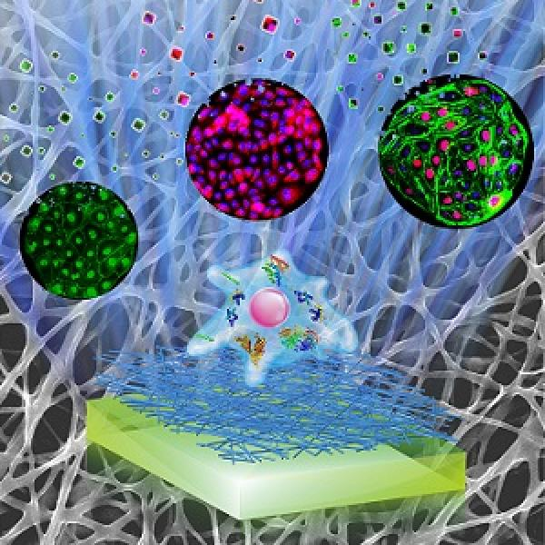
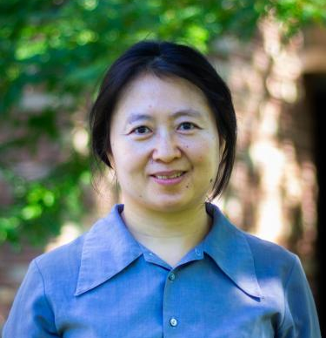
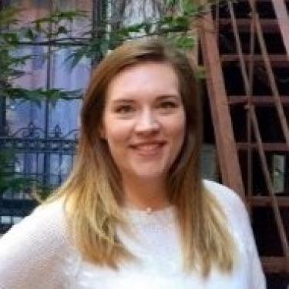
MCEN 4117/5117: Anatomy and Physiology for Engineers I
Career Areas
Biomedical Engineering
Medical Devices
Prosthetics
Specializations
BS Biomedical Option
BS Biomedical Minor
Prerequisites
None
Pre or Corequisites
None
Explores human physiological function from an engineering, specifically mechanical engineering, viewpoint. Provides an introduction to human anatomy and physiology with a focus on learning fundamental concepts and applying engineering (mass transfer, fluid dynamics, mechanics, modeling) analysis.
Wei Tan
Jessica Fitzgerald
Teaching schedule: Offered both fall and spring semester. Taught in alternating semesters with BMEN.

Slide 19
MCEN 4125/5125: Optimal Design
Career Areas
Engineering Design
Modelling/Optimization
Specializations
None
Prerequisites
MCEN 3030: Comp Methods*
Pre or Corequisites
None
*Or equivalent.
Learn how to formulate engineering optimization problems into mathematical forms that can be solved by standard software tools to find the "best" solution. Applications such as the minimum cost mechanical design, wind farm power maximization, minimum energy control, operations research, classification via support-vector machine, and even a Sudoku solver will be explored using the tools learned.
Shalom Ruben
Teaching schedule: Generally offered every second year in the spring semester.

Slide 20
MCEN 4127/5127: Biomedical Ultrasound
Career Areas
Imaging Technology Biomedical Engineering
Specializations
BS Biomedical Option
BS Biomedical Minor
Prerequisites
Senior standing (or above)
Pre or Corequisites
None
Covers the design of ultrasound systems for medical imaging and therapy, including the physics of wave propagation, transducers, acoustic lenses, pulse-echo imaging and cavitation dynamics, with an emphasis on current topics in biomedical ultrasound. Includes lectures on theory, practice and special topics; a laboratory on wave propagation; oral presentations on current literature; and a design project.
Nick Bottenus
Mark Borden
Teaching schedule: Generally offered Fall semester as instructor schedules allow.

Slide 21
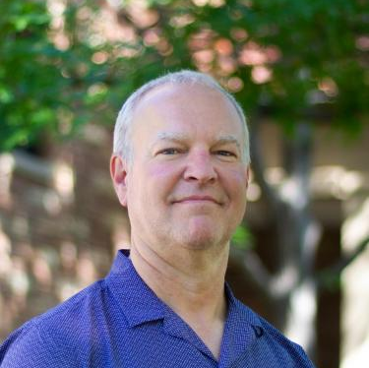
MCEN 4131/5131: Air Pollution Control Engineering
Career Areas
Environmental Engineering Environmental Consulting Policy Analysis
Specializations
BS Environmental Option
BS Energy Minor
Prerequisites
MCEN 3012: Thermo*
MCEN 3021: Fluids*
Pre or Corequisites
None
*Or equivalent.
Introduces air quality regulations, physics and chemistry in the atmosphere, meteorology, and exposure. Examines methods for controlling major classes of air pollutants, including particulate matter and oxides of sulfur and nitrogen, as well as control technologies for sources such as coal power plants and motor vehicles. Requires interdisciplinary design projects. Approved for the Environmental Option.
Shelly Miller
Nina Vance
Michael Hannigan
Teaching schedule: Offered every fall semester.

Slide 22
MCEN 4133/5133: Introduction to Tissue Biomechanics
Career Areas
Medical Device Design
Prosthetics Engineering Biomedical Engineering Biomaterials Design
Clinical Care
Specializations
BS Biomedical Option
BS Biomedical Minor
Prerequisites
MCEN 2024: Materials*
MCEN 2063: Solids*
MCEN 3021: Fluids*
Pre or Corequisites
None
*Or equivalent
Focuses on developing an understanding of the fundamental mechanical principles that govern the response of hard and soft biological tissue to mechanical loading. Specifically, covers mechanical behavior of biological materials/tissues, classical biomechanics problems in various tissues, the relationship between molecular, cellular and physiological processes and tissue biomechanics and critical analysis of related journal articles.
Virginia Ferguson
Corey Neu
Teaching schedule: Offered every spring semester.

Slide 23
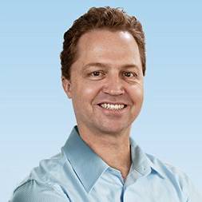
MCEN 4135/5135: Wind Energy
Career Areas
Renewable Energy
Specializations
BS Environmental Option
BS Energy Minor
Prerequisites
ECEN 3010: Circuits*
MCEN 3021: Fluids*
Pre or Corequisites
None
*Or equivalent.
Learn the evolution of a wind energy project from development to operations. Study practical techniques for getting a project constructed and generating revenue. Create an awareness around the current policies and events in the industry. Topics will include: technical analysis during development; general approach to engineering wind turbine components; and economic evaluation for wind turbine selection. Approved for and sponsored by the Energy Minor.
Roark Lanning
Teaching schedule: Offered every spring semester through the Energy Minor Program.

Slide 24
MCEN 4141/5141: Indoor Air Pollution
Career Areas
Environmental Engineering Environmental Consulting Policy Analysis
Specializations
BS Environmental Option
BS Energy Minor
Prerequisites
MCEN 3021: Fluids*
MCEN 3022: Heat Transfer*
Pre or Corequisites
None
*Or equivalent.
Describes the impact of indoor air pollutants on human health, including an introduction to key pollutants and their sources. Students will estimate emission factors, calculate generation/ventilation rates, quantify the impact of deposition and chemical reactions and explore relevant control technology. Current issues will also be addressed, including climate change, green building design, economic concerns, and relevance to the developing world.
Shelly Miller
Teaching schedule: Availability varies. Offered as instructor schedules allow.

Slide 25
MCEN 5147: Mechanobiology
Career Areas
Healthcare
Biomedical Engineering Exercise Sports Science
Physiology
Specializations
BS Biomedical Option
BS Biomedical Minor
Prerequisites
None
Pre or Corequisites
None
Current molecular mechanisms by which cells convert mechanical stimuli into chemical activity and the literature supporting them will be discussed. Students will acquire an understanding and expertise from the analysis of primary literature and completion of a synthesis project. This course will serve as the focal point of discourse for graduate students with research requiring an in-depth understanding of the interface of mechanics and molecular and cellular biology.
Corey Neu
Teaching schedule: Availability varies. Offered as instructor schedules allow.

Slide 26
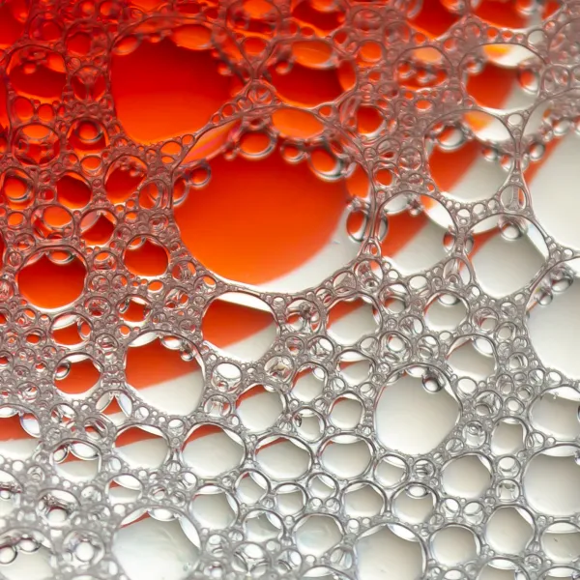
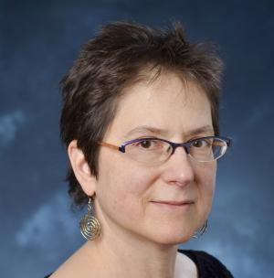
MCEN 4151/5151: Flow Visualization
Career Areas
Artistic Design
Fluid Mechanics
Specializations
None
Prerequisites
MCEN 3021: Fluids*
Pre or Corequisites
None
*Or equivalent.
Explores techniques for visualizing the physics of fluid flows including seeding with dyes, particles and bubbles, and shadowgraphy and schlieren. Reviews optics and fluid physics, especially atmospheric clouds. Assignments are student-driven, to individuals and mixed teams of graduates, undergraduates, engineering majors and photography/video majors.
Jillian Weber
Mohamed Adil
Jean Hertzberg
Teaching schedule: Generally offered once a year. Availability may vary based on instructor schedule.

Slide 27
MCEN 4152/5152: Introduction to Combustion
Career Areas
Energy Efficiency
Renewable Energy
Oil and Gas
Air Quality
Specializations
BS Environmental Option
BS Energy Minor
Prerequisites
MCEN 3012: Thermo*
MCEN 3021: Fluids**
MCEN 3022: Heat Transfer**
Pre or Corequisites
None
*Or equivalent.
**Recommended.
Focuses on the mechanisms by which fuel and oxidizers are converted into combustion products. Application to practical combustion devices such as Otto, Diesel, gas turbine, and power plant combustion systems. Consideration of combustion-generated air pollution, fire safety, and combustion efficiency.
Nicole Labbe
Teaching schedule: Generally offered fall semester. Availability may vary based on instructor schedule.

Slide 28
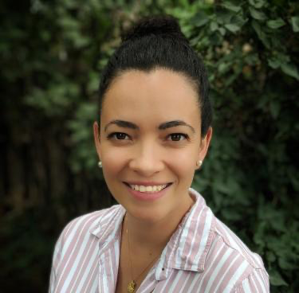
MCEN 5161: Aerosols
Career Areas
Air Pollution Control
Atmospheric Science
Production Engineering
Specializations
Environmental Option
Prerequisites
None
Pre or Corequisites
None
Introduces atmospheric aerosols and properties of their distributions, followed by fundamental descriptions of single particle dynamics, thermodynamics, nucleation, coagulation, mass transfer and populations dynamics. During the second half of the course, the focus will shift to sources and sinks of atmospheric aerosols, their impacts on atmospheric chemistry and radiation, and the impacts of these processes on air quality and climate.
Marina Vance
Daven Henze
Teaching schedule: Availability varies. Offered as instructor schedules allow.

Slide 29
MCEN 4173/5173: Finite Element Analysis
Career Areas
Structural Engineering
Heat Transfer
Renewable Energy Biomechanics
Advanced Materials
Specializations
None
Prerequisites
MCEN 2023: Statics*
MCEN 2063: Solids*
Pre or Corequisites
None
*Or equivalent.
The class is an introductory course of finite element analysis (FEA). It introduces the theory behind and applications of the finite element method as a general and powerful tool to model a variety of phenomena in mechanical engineering. It will cover the fundamental theory of FEA including FEA formulas for truss, beam, 2D and 3D elasticity problems, general theory and considerations of FEA. The lab session will give chances to apply the FEA tool to problems including structural mechanics, elasticity, and heat conduction. Approved for the Biomedical Option.
Jianliang Xiao
Jeff Knutsen
Teaching schedule: Offered every spring semester.

Slide 30
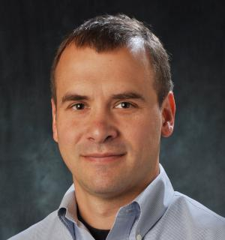
MCEN 4174/5174: Failure of Engineering Materials
Career Areas
Materials Engineering
Failure Analysis
Materials Selection
Specializations
None
Prerequisites
MCEN 2024: Materials*
MCEN 2063: Solids*
Pre or Corequisites
None
*Or equivalent.
Examines the fundamental concepts regarding the failure of engineering materials. Case studies are used to integrate a basic understanding of material failure mechanisms with analysis techniques and tools. Topics include the elastic properties (isotropic and anisotropic materials) and the origin of elastic behavior, viscoelasticity, plasticity (dislocation mechanisms, yielding criteria, strengthening mechanisms), creep, fracture and fatigue.
Todd Murray
Teaching schedule: Generally offered once a year. Availability may vary based on instructor schedule.

Slide 31
MCEN 4183/5183: Mechanics of Composite Materials
Career Areas
Aircraft Engineering
Automotive Engineering
Marine Engineering
Wind Energy
Infrastructure
Biomedical Applications
Specializations
None
Prerequisites
MCEN 2063: Solids*
Pre or Corequisites
None
*Or equivalent.
Composite materials offer advantageous material properties such as high strength, high stiffness, low density and long fatigue life. However, because composites consist of two or more material phases, the mechanics of composite materials is much more complex. This course will start with a brief review on the fundamentals of solid mechanics and then introduce the concepts required to analyze composite materials. Topics to be discussed include: elastic behavior and strength of composites, failure analysis, uni-directional and multi-directional lamina, and effects of temperature and humidity.
Rong Long
Teaching schedule: Availability varies. Offered as instructor schedules allow.

Slide 32
MCEN 4194/5194: Energy Conversion and Storage
Career Areas
Electric Vehicles
Energy Storage
Smart Grids
Portable Electronics
Fuel Cell Systems
Specializations
BS Energy Minor
Prerequisites
MCEN 2024: Materials*
Pre or Corequisites
MCEN 3032: Thermo 2*
*Or equivalent.
Presents the fundamentals, principles and experimental techniques of electrochemistry, the background of ionic or electronic conduction of metal, semiconductor, inorganic and polymer materials, and applications in the areas of batteries, fuel cells, electrochemical double layer capacitors, electrochemical photonics, sensors and semiconductor electrochemistry.
Se-Hee Lee
Teaching schedule: Availability varies. Offered as instructor schedules allow.

Slide 33
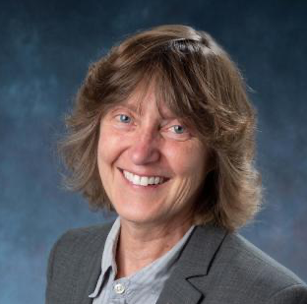
MCEN 5208: Introduction to Research
Career Areas
Research
Graduate Study
Specializations
None
Prerequisites
None
Pre or Corequisites
None
This course is meant to help students with major objectives of their first year of graduate school. These objectives include learning how to conduct research and communicate the results, developing an understanding of the ins and outs of getting a PhD and/or writing a Master’s thesis, and building a community of peers and network of friends.
Peter Hamlington
Maureen Lynch
Hope Michelsen
Teaching schedule: Offered every fall semester.

Slide 34
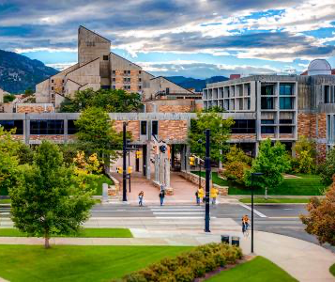
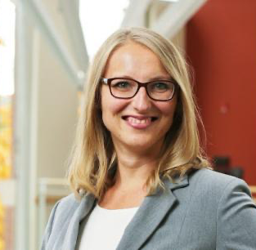
MCEN 5000 Sociotechnical Industry Skills
Career Areas
Industry
Specializations
None
Prerequisites
None
Pre or Corequisites
None
This course provides students with an introduction to professional skills as they relate to the practice of engineering. The primary focus areas are effective communication, ethics, leadership styles and philosophies, project management, and teamwork. Students will regularly engage with alumni and industry experts. This course is required for all professional master’s students who joined the program in summer 2021 or later.
Rebecca Komarek
Vera Sebulsky
Teaching schedule: Offered every spring semester.

Slide 35
MCEN 4228/5228: Thermofluids Lab
Career Areas
Energy Systems
Renewable Energy
Heating/Cooling
Specializations
BS Environmental Option
BS Energy Minor
Prerequisites
MCEN 3022: Heat Transfer*
MCEN 3032: Thermo 2*
Pre or Corequisites
None
*Or equivalent.
Strengthens understanding of how fundamental thermo-fluid concepts relate to real-world energy systems through hands-on laboratories with solar-thermal heaters, refrigeration cycles, cookstoves, combustors and more. Integrates concepts from thermodynamics, fluid mechanics, and heat transfer. Also emphasizes measurement practices and technical communication.
Julie Steinbrenner
Greg Rieker
Jeff Knutsen
Teaching schedule: Availability varies. Offered as instructor schedules allow.

Slide 36
4228/5228 Surface Forces in Biology
Career Areas
Biomedical
Specializations
None
Prerequisites
None
Pre or Corequisites
None
Most materials display only one or two types of intermolecular interactions, while biological systems typically involve four or more interactions, simultaneously or sequentially in space and time. This course will help you build a quantitative molecular-level understanding of the diverse nanoscale forces acting between biological surfaces, including van der Waals, electrostatic, hydration, hydrophobic and thermal fluctuation interactions. Knowledge of these forces will be used to analyze self-assembly, biomembranes and engineering for drug delivery and imaging.
Mark Borden
Teaching schedule: Availability varies. Offered as instructor schedule allows.

Slide 37
4228/5228 Machine Learning in Mechanical Engineering
Career Areas
Data Science
Robotics Engineering
ML-enhanced CAD
Predictive Maintenance
Specializations
None
Prerequisites
MCEN 3021: Fluid Mechanics
MCEN 3022: Heat Transfer
MCEN 4026: Manufacturing
Pre or Corequisites
None
This course explores the dynamic intersection of mechanical engineering and machine learning. We will delve into the state of the art integrating data science and machine learning algorithms with traditional mechanical engineering disciplines such as fluid and solid mechanics, heat transfer, control systems, materials, system design, and manufacturing.
Longji Cui
Teaching schedule: Availability varies. Offered as instructor schedule allows.

Slide 38
4228/5228 Thermal Systems Analysis and Innovation
Career Areas
Decarbonization Sustainability
Renewable Energy
Solar Thermal Energy
Power Generation
Propulsion & Transportation
Fuel Cell & Electrolysis Systems
Specializations
BS Energy Minor
Prerequisites
MCEN 3012: Thermodynamics
MCEN 3021: Fluid Dynamics
This course focuses on System Level Thinking, use of Requirements Flow Down and First-Principles Analysis as the backbone for Innovation and creative thinking in the domain of thermal system. It includes applying innovation methods so that students will have the experience and skills to engage in innovations in the rapidly changing world of renewable thermal energy and propulsion and power systems. Strengthens understanding of real-world energy systems. Also emphasizes technical communication for influence.
Greg Hampson
Teaching schedule: Availability varies. Offered as instructor schedule allows.

Slide 39
4228/5228 Membrane Technologies
Career Areas
None
Specializations
None
Prerequisites
None
Pre or Corequisites
None
Membrane technologies are critical for addressing global challenges from sustainability to public health. Covers fundamentals and applications of membrane technologies. Topics include (1) basics of different types of separation membranes, (2) membrane materials and manufacturing processes, (3) membrane characterizations, (4) fundamentals of different membrane processes, (5) applications of membrane technologies for liquid separations such as desalination and ultrafiltration (UF), (6) gas separation using membranes, (7) membranes for energy applications such as fuel cells and batteries.
Yifu Ding
Teaching schedule: Availability varies. Offered as instructor schedule allows.

Slide 40
4228/5228 Design of Beer
Career Areas
Process Engineering
Manufacturing
Quality Control
Systems Engineering
Brewing/Distilling
Food Engineering
Chemical Engineering
Mechanical Engineering
Specializations
None
Prerequisites
None
The Design of Beer is an excellent example of a product that encapsulates many scientific and engineering principles in all parts of the value chain – from raw materials production and selection through to manufacturing and brewhouse equipment design, quality control, marketing, packaging, and (of course) consumption. At the end of this course, students will understand the science underlying beer production, the engineering design of manufacturing and processing equipment, and quality control of the final product.
Dan Riffell
Teaching schedule: Availability varies. Offered as instructor schedule allows.

Slide 41
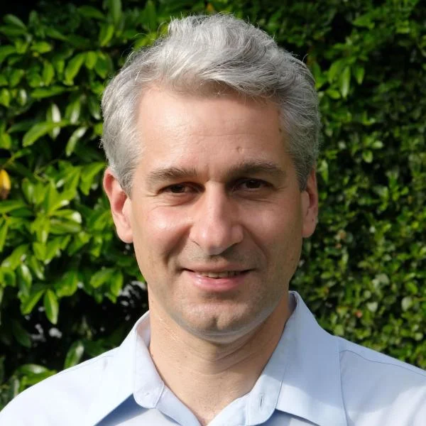
4228/5228 Mechanics of Biological/Bioinspired Materials
Career Areas
Mechanical Engineering
Bioinspiration
Bioengineering
Materials Science
Biology.
Prerequisites
MCEN 2063 Mechanics of Solids or
MCEN 5023 Solid Mechanics
Covers the composition, structure and mechanics of biological materials at the molecular scale (proteins, polysaccharides) and at larger scales (bone, skin, spider silk, seashells, cuticles, etc.). Reviews experiments and models (micromechanics, large deformations, fracture mechanics) applied to biological. Discusses implications in biomechanics, biology and medicine, with a stronger emphasis on engineering materials inspired by biological materials (biomimetics, bioinspiration). Assessment is largely based on in-class activities and a final project.
Francois Barthelat
Teaching schedule: Availability varies. Offered as instructor schedule allows.

Slide 42
MCEN 4155/5155: Automated Mechanical Design
Career Areas
Mechanical Design
Design Automation
Additive Manufacturing Robotics
Optimization
Mechanical Simulation
Specializations
None
Prerequisites
MCEN 3030: Comp Methods* (or)
MCEN 4043: System Dynamics*
Pre or Corequisites
None
*Or equivalent.
Multimaterial mechanical design is formulated as a constrained non-convex multi-objective optimization problem, and various algorithms to solve these optimization problems are discussed. Topics include: review of the expert-driven design process; computational analysis tools based on mechanical simulation (finite element methods, mesh-free methods); topological optimization; compositional design; multi-objective optimization; evolutionary design; design for manufacturing with additive manufacturing (FDM, SLA, Inkjet).
Rob MacCurdy
Teaching schedule: Generally offered spring semester. Availability may vary based on instructor schedule.

Slide 43
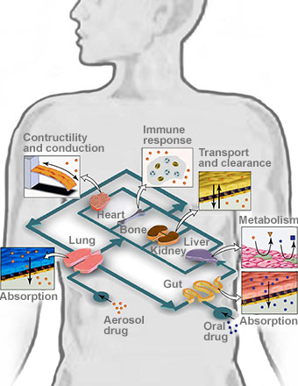
MCEN 4171/5171: Biofluids on the Micro Scale
Career Areas
Biomedical Devices
Lab on a Chip
Biomedical Engineering
Specializations
BS Biomedical Option
BS Biomedical Minor
Prerequisites
None
Pre or Corequisites
None
Fluid (water or air) is everywhere, surrounding or inside any living creature. The needs for engineers with integrated multidisciplinary knowledge are growing along with the rapid advances in biomedical science and engineering. This course is designed to introduce fundamental physical concepts and basic mechanisms of biological fluids. This course elaborates the application of fluid mechanics principles to major biological systems, including human organ systems, organ on a chip, and some animal locomotion.
Xiaoyun Ding
Teaching schedule: Availability varies. Offered as instructor schedules allow.

Slide 44
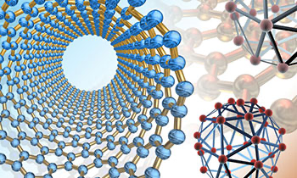
MCEN 4228/5228: Nano Science and Engineering
Career Areas
Materials Science
Energy
Electronics
Specializations
None
Prerequisites
None
Pre or Corequisites
None
This course is based on a book, "Introduction to NanoScience". It contains chapters on basic science (chemistry, physics, mechanical properties, spectroscopy and electrochemistry). Subsequent chapters address coalescence of the science and engineering (thin films, nanocrystals, nanocarbon, thermal conductivity of nanocomposites, lithium-ion batteries, molecular spectroscopy). The course focuses on applications. The unique feature is learning to build models that explain engineering data. This cross-disciplinary course is relevant to the fields of science, applied-science and engineering.
Rishi Raj
Teaching schedule: Generally offered fall semester. Availability may vary based on instructor schedule.

Slide 45
MCEN 4231/5231: Computational Fluid Dynamics
Career Areas
Biomedical Engineering Energy Engineering
Transportation
Defense Industry
Manufacturing
Environmental Applications
Specializations
None
Prerequisites
MCEN 3021: Fluids*
MCEN 3030: Comp Methods*
Pre or Corequisites
None
*Or equivalent.
This course will provide a broad introduction to the basic principles and applications of Computational Fluid Dynamics (CFD). The core focus will be on computational solutions of flow and transport problems using the finite element method. Students will learn about the mathematical fundamentals of the finite element method, as well as techniques for geometry handling, mesh generation, assembly and solution of matrix systems derived from the governing equations, and post-processing of the resultant numerical solution.
Debanjan Mukherjee
Teaching schedule: Generally offered spring semester. Availability may vary based on instructor schedule.

Slide 46
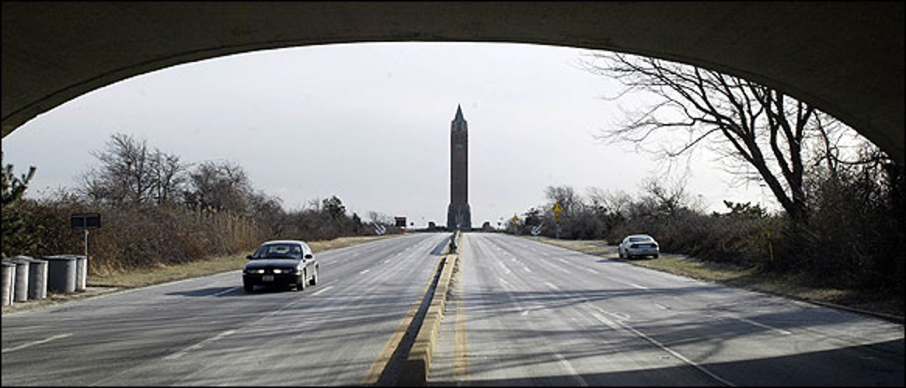
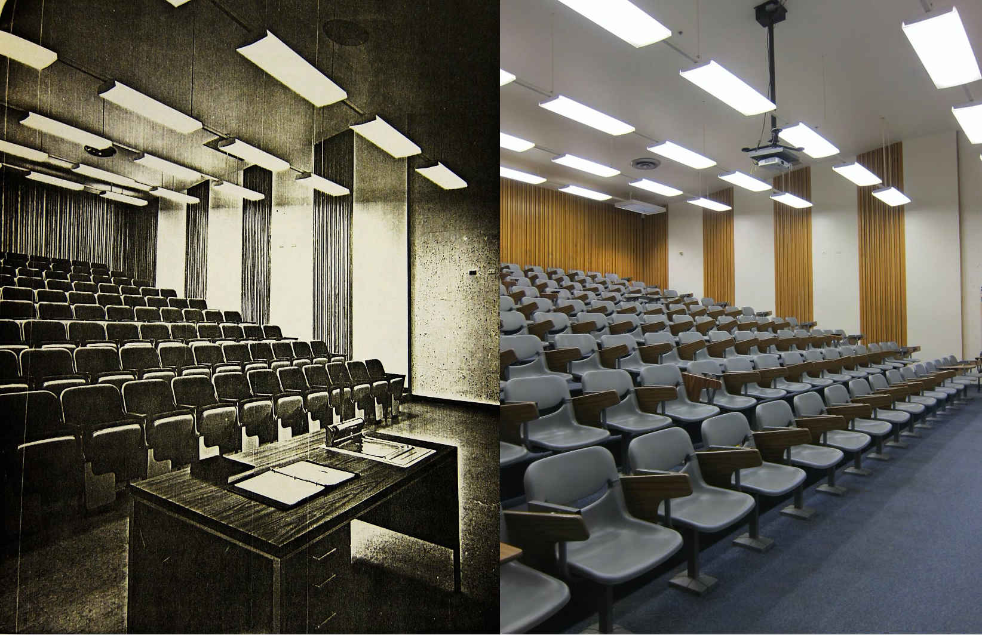
MCEN 4215/5215: Design for Inclusion
Career Areas
Product Design
Social Justice
Critical Analysis
Specializations
None
Prerequisites
None
Pre or Corequisites
None
Are robots racist? Are algorithms oppressive? How do we end up with technologies that are optimized for some users, but scarcely meet the needs of others? In this era of upheaval and inequity, how should we be thinking about who benefits or who is harmed by a product? How can we as engineers even begin to answer these questions? The Design For Inclusion (DFI) course will examine the ways modern inventions like apps, products, public infrastructures and educational systems are biased, and what we as socially conscious engineers and designers can and should do about it.
Janet Tsai
Teaching schedule: Generally offered spring semester. Availability may vary based on instructor schedule.

Slide 47
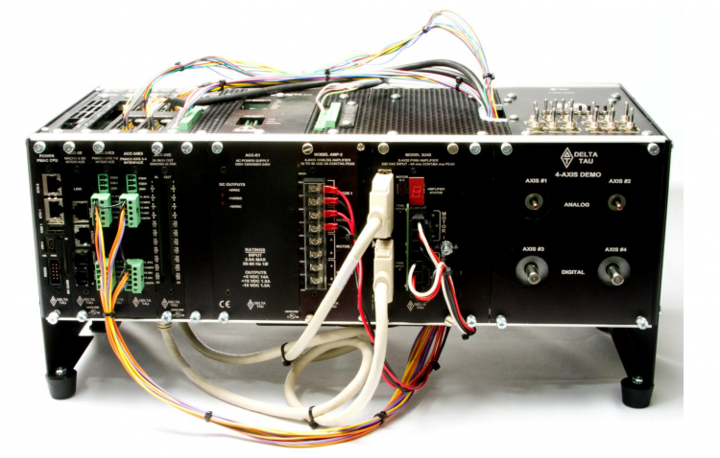
MCEN 4228/5228: Industrial Automation
Career Areas
Controls
Robotics
Industrial Systems
Specializations
None
Prerequisites
MCEN 4043: System Dynamics*
Pre or Corequisites
None
*Or equivalent.
Industrial applications of control are presented in this course including experimentation on a magnetic bearing system, where an unstable rotor is actively positioned at the shaft ends by electro-magnets using hall-affect sensors as feedback. All algorithms will be implemented on industrially used real-time control hardware. Methods for system identification of dynamical systems from input/output data, digital signal processing, and digital control of mechatronic systems will be learned.
Shalom Ruben
Teaching schedule: Generally offered every second year in the spring semester.

Slide 48
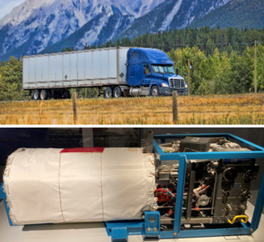
MCEN 4012/5012: Renewable Fuels, Fuel Cells, and
Internal Combustion Engines
Career Areas
Combustion Engines
Combustion Devices
Specializations
None
Prerequisites
MCEN 3032: Thermo 2*
MCEN 4152/5152: Combustion
Pre or Corequisites
None
*Or equivalent.
With the accelerated availability of Carbon Free and Renewable Fuels, we will explore high efficiency, low emissions Fuel Cell and Internal Combustion Engine energy conversion technologies, preparing students to enter the rapidly changing fields of power and propulsion on the path to Net-Zero Greenhouse Gas Emissions. Through Thermodynamics Modeling, Systems Engineering, and Requirements Flow Down, students will apply the fundamentals of thermodynamics, fluids and heat transfer, combustion and electro-chemistry to fuel cells and IC Engines.
Greg Hampson
Teaching schedule: Availability varies. Offered as instructor schedules allow.

Slide 49
MCEN 4228/5228: Inverse Methods
Career Areas
Environmental Engineering
Imaging
Geophysical Engineering
Statistics
Optimization
Specializations
None
Prerequisites
Linear Algebra
Pre or Corequisites
None
What is an inverse problem? "Using a physical theory for predicting the results of observations corresponds to solving the ‘forward modelling problem’. The reciprocal situation, using the result of measurements to infer the values of the parameters representing a system, corresponds to the ‘inverse modelling problem’.” This course will address fundamental aspects of inverse problems that arise in an array of engineering and geophysical applications, such as tomography, remote sensing, flux inversions, seismology, image reconstruction, and signal processing.
Daven Henze
Teaching schedule: Availability varies. Offered as instructor schedules allow.

Slide 50
MCEN 4228/5228: Biohybrid Robotics
Career Areas
Animal Kinematics
Bioengineering
Biology
Electrical Engineering
Fluid Dynamics
Mechanical Engineering
Robotics
Specializations
Biomedical
Robotics
Prerequisites
None
Biohybrid robotics is a growing interdisciplinary field in which live components are integrated into engineered systems to address both biological questions and bottlenecks in traditional robotics, such as power constraints and dexterity. Such methods include using bacteria and other microorganisms, tissue engineering of cardiac and skeletal muscles, and cyborg techniques to direct the locomotion of live animals. Students will engage in lectures and laboratory components that incorporate microelectronics, additive manufacturing, and image processing to build and study biohybrid systems with live plants, insects, and jellyfish.
Nicole Xu
Teaching schedule: Availability varies. Offered as instructor schedules allow.

Slide 51
MCEN 4036: Lean Six Sigma Manufacturing
Career Areas
Manufacturing
Quality Control Management
Specializations
None
Prerequisites
None
Pre or Corequisites
None
This course focuses on Lean principles and Six-sigma methodologies for defining, measuring, analyzing, improving and controlling (DMAIC) processes in order to create more efficient processes. Skillsets that will be learned include; value stream maps, SIPOCS, statistical process control, GR&R studies, statistics, graphical representation, and Minitab. This course has shown to be successful in training your brain to think differently about processes through identifying wastes and improving processes to be more efficient.
Jenifer Blacklock
Teaching schedule: Availability varies. Offered as instructor schedules allow.

Slide 52
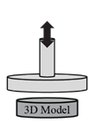
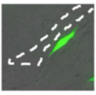
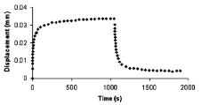
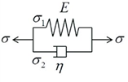
MCEN 4113/5113: Mechanics of Cancer
Career Areas
Biomedical Engineering Clinical Care
Tissue Engineering Biomechanics for Cancer
Specializations
BS Biomedical Option
BS Biomedical Minor
Prerequisites
MCEN 2063: Solids*
MCEN 3021: Fluids*
Pre or Corequisites
None
*Or equivalent.
This course will cover the role of mechanics (emphasis on solid and fluid mechanics) in cancer and cancer-related processes. Course content includes experimental systems used to model and test these processes. No prior knowledge of biology is required to take this course. A limited overview of relevant biological processes will be covered as necessary.
Systems
Mechanical Inputs
Insights/
Knowledge
Tumor tissue
Tumor cell behavior
Mechanical Behavior
Engineered models of tumor
Experiments
Idealizations
Simulations
Metastasis
Maureen Lynch
Teaching schedule: Generally offered spring semester. Availability may vary based on instructor schedule.

Slide 53
MCEN 4228/5228: Thin Film Materials
Career Areas
Text
Specializations
None
Prerequisites
MCEN 2063: Solids*
Pre or Corequisites
None
*Or equivalent.
This class is to give an introductory course to thin film materials. The topics include: (1) Deposition and processing of thin film materials, (2) Theory of elastic beams, plates and 3D solids, (2) Film stress and substrate curvature, (3) Thin film on stiff substrates and applications to coatings, (4) Thin film on compliant substrates, and applications on flexible/stretchable electronics, (5) Modeling of adhesives, (6) Other applications.
Jianliang Xiao
Teaching schedule: Availability varies. Offered as instructor schedules allow.

Slide 54
MCEN 4228/5228: Vibrations
Career Areas
Structural Engineering Modeling/Simulation Product Testing Engineering Design
Specializations
None
Prerequisites
None
Pre or Corequisites
None
The course will provide an introduction to the dynamics of discrete and continuous mechanical systems, and will focus on the description of their response to a variety of excitation sources, including impulsive, harmonic and periodic. The dynamic response will be described in terms of modal properties, which include natural frequencies, mode shapes and damping ratios. The concept of resonance will be introduced in the context of forced response and will be illustrated through practical examples and numerical simulations. Application case studies will be presented to describe the vibrations of structural components, and basic concepts for vibration.
Massimo Ruzzene
Teaching schedule: Availability varies. Offered as instructor schedules allow.

Slide 55
MCEN 4228/5228: Mechanics of Snow
Career Areas
Avalanche Mechanics
Winter Sports
Land Management
Specializations
None
Prerequisites
MCEN 2063: Solids*
Pre or Corequisites
None
*Or equivalent.
This course will introduce key concepts in the mechanics of snow over a wide range of time and length scales. Several concepts in solid mechanics will be covered in this process, including elasticity, viscoelasticity, micromechanics, failure criteria, damage mechanics, fracture mechanics, instabilities and cellular solids. Using these concepts we will describe the crystallographic structure of ice and snow, and how to connect this microstructure and its evolution over time to its mechanical properties.
Francois Barthelat
Franck Vernerey
Teaching schedule: Availability varies. Offered as instructor schedules allow.

Slide 56
MCEN 4228/5228: Climate Engineering
Career Areas
Air Quality Engineering
Specializations
None
Prerequisites
None
Pre or Corequisites
None
Introduces the technical aspects of climate intervention, with particular focus on carbon dioxide removal (CDR) and solar radiation management (SRM) techniques. Discusses the destruction of the ozone layer and implementation of the Montreal Protocol as a framework for understanding the potential trajectory of climate intervention. Addresses the governance, ethics, and justice implications of CDR and SRM approaches.
Kelvin Bates
Teaching schedule: Availability varies. Offered as instructor schedules allow.

Slide 57
MCEN 4228/5228: Advanced Biotransport
Career Areas
Biomedical
Specializations
None
Prerequisites
None
Pre or Corequisites
None
Builds on fundamentals of biological fluid mechanics, mass transfer and biochemical reaction kinetics to analyze physiological biotransport processes, including fluid transport in the circulation and tissues, transport in porous media, transvascular transport, oxygen transport, cell adhesion, immunogenicity, toxicity, transport of drugs in tumors, and pharmacokinetic modeling. Special emphasis will be placed on engineering solutions for delivery and removal of molecules in the human body.
Mark Borden
Teaching schedule: Availability varies. Offered as instructor schedules allow.

Slide 58
MCEN 4195/5195: Bioinspired Robotics
Career Areas
Engineering Design
Robotics
Biomedical Engineer
Art/Architecture
Specializations
None
Prerequisites
None
Pre or Corequisites
None
In this course, you will learn how to build robots by leveraging principles of bioinspired design. Specifically, bioinspired design views the process of how we learn from nature as an innovation strategy translating principles of function, performance and aesthetics from biology to human technology. Lectures will address the biomimicry design process from original scientific breakthroughs to entrepreneurial start-ups using cases studies that include gecko-inspired adhesives, robots that run, fly and swim, artificial muscles, computer animation and more.
Kaushik Jayaram
Teaching schedule: Generally offered spring semester. Availability may vary based on instructor schedule.

Slide 59
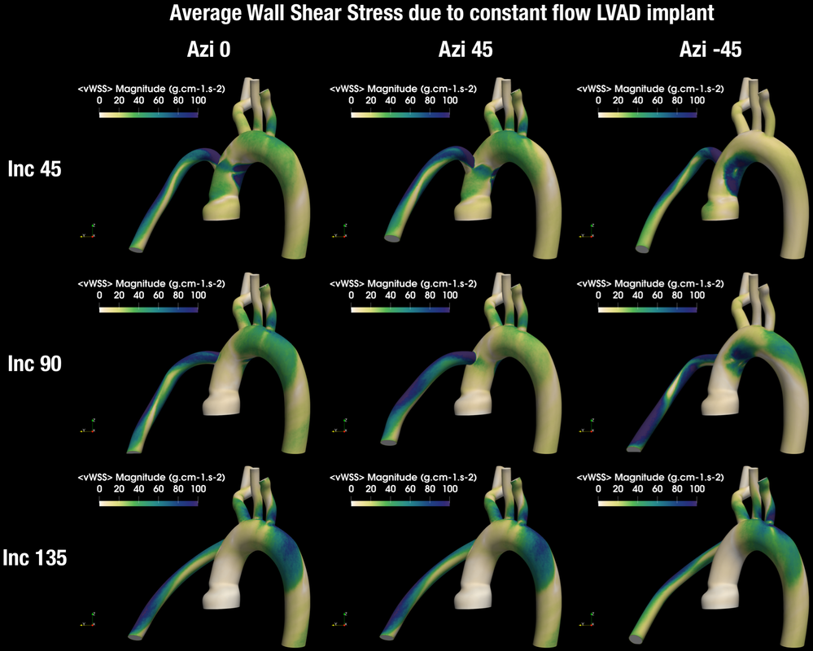
MCEN 4228/5228: Fluid Mechanics in the Human Body
Career Areas
Biomedical Engineering
Healthcare
Medical Devices
Medical Imaging
Precision Biomedicine
Specializations
BS Biomedical Option
BS Biomedical Minor
Prerequisites
MCEN 3021: Fluids**
Pre or Corequisites
None
**Recommended.
This course will provide a formal introduction to principles of biofluid mechanics at the macroscopic physiological scales. The average living human body is filled with fluids of over two dozen varieties – each performing key functions essential for life and well-being. Developing a core understanding of macroscale physiological flows is essential for key advances in healthcare and medical technology. We will explore the use of engineering principles of fluid flows and fluid-solid interactions to study physiological flow phenomena. This will include discussions of physiological processes in healthy and diseased states. The course will also explore latest advances in medical imaging and image-based flow analysis.
Debanjan Mukherjee
Teaching schedule: Generally offered once a year. Availability may vary based on instructor schedule.

Slide 60
MCEN 4193/5193: Design of Coffee
Career Areas
Food Engineering
Sustainable Agriculture
Specializations
BS Biomedical Minor
BS Global Eng. Minor
Prerequisites
None
Pre or Corequisites
None
This class will serve as an introduction to how engineers use their training to approach and solve problems outside of their discipline, as illustrated by the roasting and brewing of coffee. In addition to focusing on the science and craftsmanship of making a cup of coffee from bean to cup, we will also study the global sourcing of coffee beans. The course will offer weekly hands-on experimental laboratories to demonstrate key engineering principles in subject areas such as heat transfer, mass transfer, thermodynamics, materials science, sustainability, water quality, biomedical engineering and device design evaluation. This class culminates in a design competition where students compete to make the best coffee using the least energy.
Carmen Pacheco-Borden
Teaching schedule: Generally offered fall semester. Availability may vary based on instructor schedule.

Slide 61
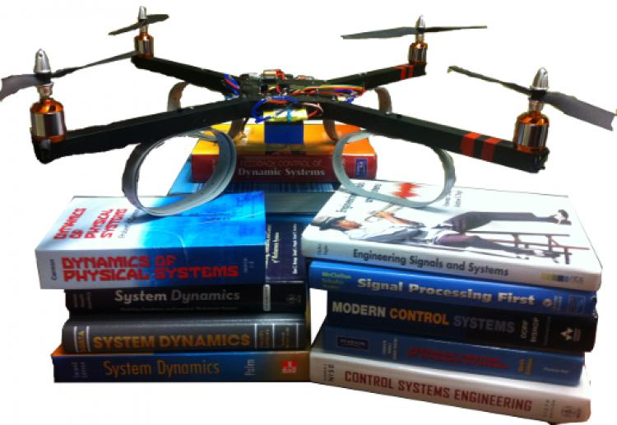
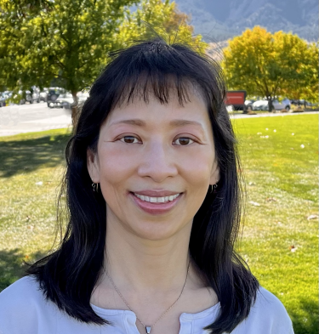
MCEN 4138/5138: Feedback Control
Career Areas
Controls
Robotics
Specializations
None
Prerequisites
MCEN 4043: System Dynamics*
Pre or Corequisites
None
*Or equivalent.
Introduction to fundamental principles and techniques for analysis and synthesis of feedback control systems in the time and frequency domains. Linearization, review of linear system response, frequency response, transfer functions and Bode diagrams. Closed loop system analysis including root locus, Nyquist criterion, gain and phase margins. Compensation design with lead, lag and PID controllers. Translation of closed loop performance requirements into open loop constraints. Model uncertainty and robustness. Introduction to state space representations and state feedback control.
Shalom Ruben
Lucy Pao
Teaching schedule: Offered both fall and spring semester. Taught in alternating semesters with ECEN.

Slide 62
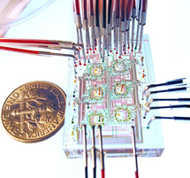
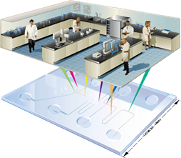
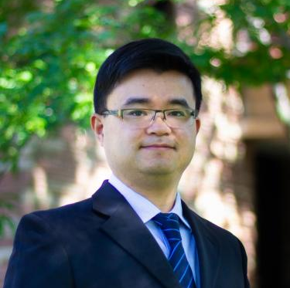
MCEN 4111/5111: Introduction to Microfluidics
Career Areas
Lab on a Chip
Biomedical Microdevices
Micro/Nanotechnology
Specializations
BS Biomedical Option
BS Biomedical Minor
Prerequisites
MCEN 3021: Fluids*
Pre or Corequisites
None
*Or equivalent.
Microfluidics deals with the behavior of fluids in small scale. It is a highly multidisciplinary field at the intersection of engineering, physics, chemistry, biology, medicine, nanotechnology, and biotechnology. This course is designed for a wide audience in engineering and science. It covers the fundamentals and fabrication of microfluidic devices, and their applications, particularly in lab on a chip. It includes lectures, team presentations, and possibly one laboratory on microfluidic devices. Mastery will enhance your understanding of microfluidic technologies and their broad applications.
Xiaoyun Ding
Teaching schedule: Generally offered once a year. Availability may vary based on instructor schedule.

Slide 63
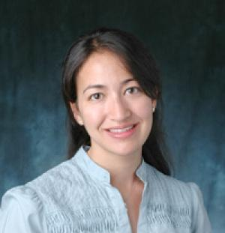
MCEN 4157/5157: Modeling of Human Movement
Career Areas
Biomechanics
Movement Rehabilitation
Robotics
Neuroscience
Specializations
BS Biomedical Option
BS Biomedical Minor
Prerequisites
None
Pre or Corequisites
None
Human movement analysis is used in a wide range of applications, from physical rehabilitation to sport training, human-robot interaction and animation. The course will provide a systematic overview of human movement on multiple levels of analysis, with an emphasis on the phenomenology amenable to computational modeling. Topics will include muscle physiology, movement-related brain areas, musculoskeletal mechanics, forward and inverse dynamics, optimal control and Bayesian inference, learning and adaptation. The focus will be on reaching and locomotion as representative human movements.
Alaa Ahmed
Teaching schedule: Generally offered once a year. Availability may vary based on instructor schedule.

Slide 64
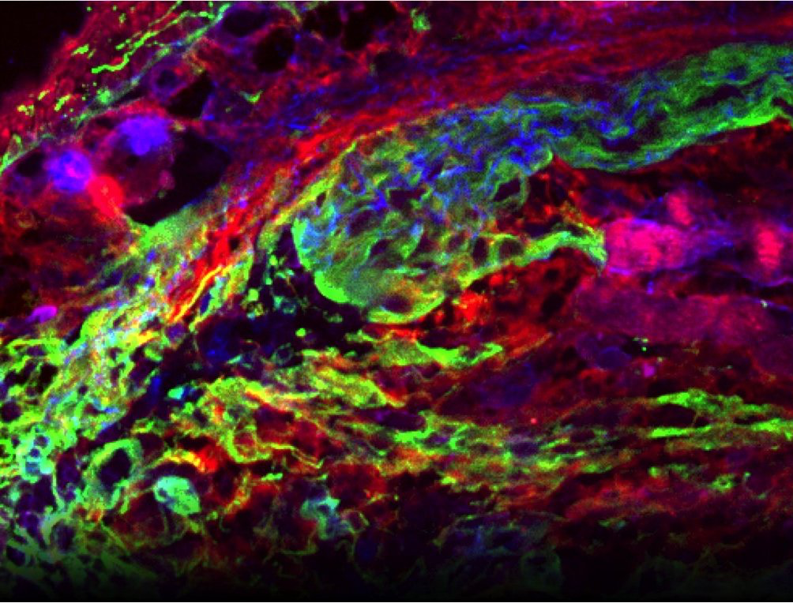
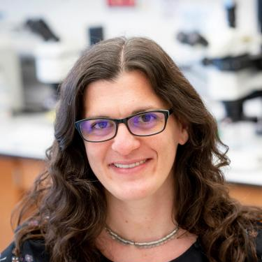
MCEN 4110/5110: Regenerative Biology and Tissue Repair
Career Areas
Healthcare
Biomedical Engineering
Specializations
None
Prerequisites
None
Pre or Corequisites
None
This course will cover the biological aspects behind the regeneration/repair and the utilization of engineering strategies to restore functionality of tissues compromised by injury and disease. A range of tissues, including epidermal, neural, digestive, respiratory, digestive, musculoskeletal and cardiovascular, will be discussed based on student interest. Key topics critical for understanding the biological underpinnings of tissue regeneration (e.g. immune response, cell-matrix interactions) will be emphasized. Students will be required to read and present on the primary literature and over the course of the semester will develop a mini-proposal that will address an unsolved problem in regenerative medicine/engineering.
Sarah Calve
Teaching schedule: Generally offered once a year. Availability may vary based on instructor schedule.

Slide 65
MCEN 4228/5228: Introduction to Nanoscale Transport
Career Areas
System Test/Diagnosis
Nanotech Manufacturing
Microelectronics
Nano-Optics
Quantum Technologies
Specializations
None
Prerequisites
None
Pre or Corequisites
None
This course covers the basic concepts and methods to understand nanoscale transport phenomena that are ubiquitous in microelectronics, nano-enabled renewable energy technology, heat transfer, nano-optics, Micro/Nano-Electro-Mechanical- Systems (MEMS/NEMS), as well as emerging quantum technologies. Relevant laboratory and real-world applications and examples will be discussed.Topics include basics of solid-state physics and quantum mechanics, nano-electronic transport, nanoscale heat transfer, and more.
Longji Cui
Teaching schedule: Availability varies. Offered as instructor schedules allow.

Slide 66
MCEN 4228/5228: Design Research Theory and Methods
Career Areas
Design
Specializations
None
Prerequisites
None
Pre or Corequisites
None
Provides an in-depth introduction to design science research, focusing on the scientific study of how people develop new products, systems, and services. Students will explore design practices, methodologies, and techniques that enhance design outcomes. The course emphasizes a comprehensive understanding of the artifacts, people, and institutions involved in design, while also covering the evaluation of design practices and the assessment of the broader societal impacts of engineered solutions. Students will develop skills to systematically and critically analyze and improve the processes of innovation and creation.
Grace Burleson
Teaching schedule: Availability varies. Offered as instructor schedules allow.

Slide 67
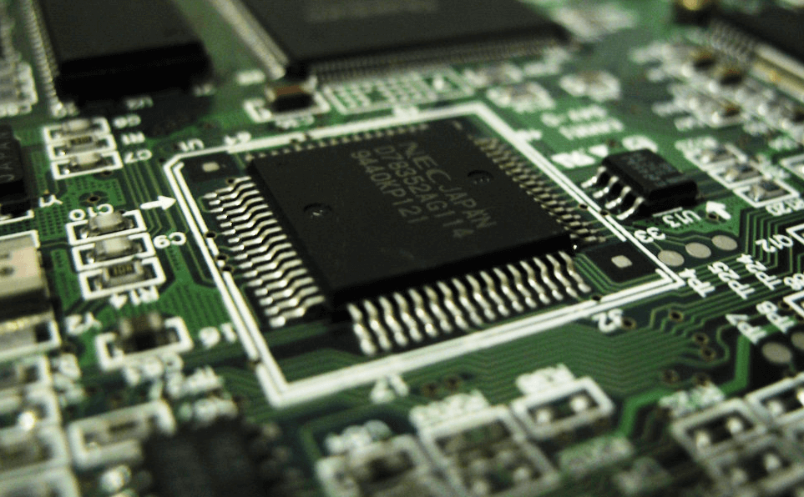
MCEN 4228/5228: Mechatronics and Robotics 2
Career Areas
Robotics
Controls
Automated Systems
Integrated Systems
Specializations
None
Prerequisites
MCEN 4115/5115: Mechatronics 1 (or)
Instructor Permission
Pre or Corequisites
None
Continuation of MCEN 4115/5115. Focuses on design and construction of advanced microprocessor-controlled electro-mechanical systems. Lectures explore computer vision, machine learning, feedback control, multi-processor coordination and other advanced topics in mechatronics and robotics. Lab work reinforces lectures and allows hands-on experience with mechatronic design. Team-based design project integrates content into class-chosen design challenge. Robots from Mechatronics 1 can be adapted or refined for use in the new design challenge. Mechatronics 1 and 2 do not have to be taken in the same year.
Derek Reamon
Teaching schedule: Availability varies. Offered as instructor schedules allow.

Slide 68
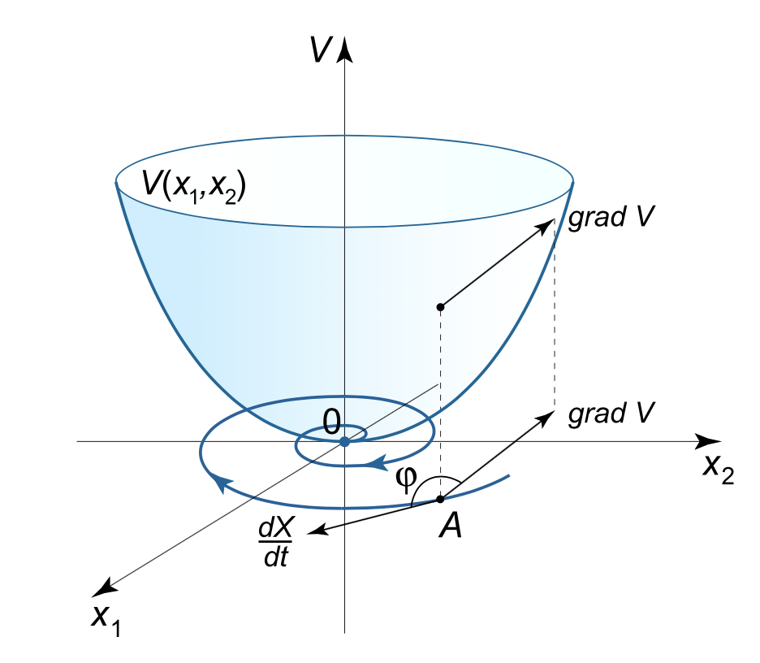
MCEN 5228: Advanced Dynamics
Career Areas
Robotics
Controls
Modeling
Dynamic Systems
Specializations
None
Prerequisites
None
Pre or Corequisites
None
This course covers advanced theory for formulating and analyzing dynamical systems, including Newtonian, Lagrangian and Hamiltonian methods. Additional topics include equilibria, stability, Lyapunov functions, limit cycles, conservation laws and basic bifurcation theory.
https://math24.net/method-lyapunov-functions.html
Sean Humbert
Teaching schedule: Availability varies. Offered as instructor schedules allow.

Slide 69
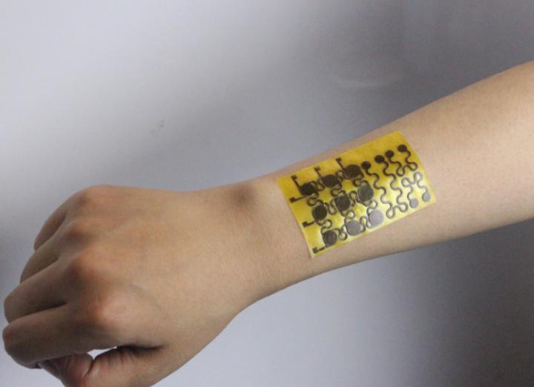
MCEN 5228: Flexible Electronics
Career Areas
Smart Electronics
Materials Science
Engineering Design
Specializations
None
Prerequisites
MCEN 2063: Solids*
Pre or Corequisites
None
*Or equivalent.
This course provides an introduction to flexible/stretchable electronics. It will cover almost all aspects of flexible electronics, including design, fabrication and application. Specifically, we will discuss: (1) Deposition and processing of thin film materials for flexible electronics, (2) Design and mechanics of flexible/stretchable electronics, (3) Transfer printing for flexible electronics fabrication, (4) Application of flexible/stretchable electronics, and (5) Recent advances in smart electronics, transient electronics and self-healable electronics.
Jianliang Xiao
Teaching schedule: Availability varies. Offered as instructor schedules allow.

Slide 70
MCEN 5228: Fracture Mechanics
Career Areas
Product Design
Failure Analysis
Specializations
None
Prerequisites
None
Pre or Corequisites
None
This course will introduce fundamental concepts, analytical approaches, and experimental methods to characterize the fracture of solid materials. Topics to be discussed include: linear elastic analysis of 2D cracks, energy flows and criteria for elastic fracture, experimental methods for elastic fracture, application of fracture mechanics in adhesion, introduction to elastic plastic fracture, and nonlinear fracture mechanics of soft materials.
Rong Long
Teaching schedule: Availability varies. Offered as instructor schedules allow.

Slide 71
MCEN 5228: Optical Sensing
Career Areas
Laser Diagnostics
Energy/Environment
Specializations
None
Prerequisites
TBD
Pre or Corequisites
TBD
Introduces the fundamentals of optical sensing derived from principles of quantum mechanics and presents practical optical sensing techniques and their applications. Topics include quantized energy levels of molecules, molecular absorption and emission processes, spectral lineshapes, laser-absorption spectroscopy, laser-induced fluorescence, emission spectroscopy, and imaging. Includes practical optical sensing applications from laboratory laser experiments to satellite remote sensing in atmospheric, environmental, and combustion science. The course will include laboratory demonstrations and students will analyze experimental data.
Greg Rieker
Teaching schedule: Availability varies. Offered as instructor schedules allow.

Slide 72
MCEN 4238: Design for Community
Career Areas
Product Design
Project Management
Engineering Consulting
Specializations
None
Prerequisites
None
Pre or Corequisites
None
Design for Community (D4C) will provide engineering students with practical experience in consulting while offering valuable engineering services to University and industry clients. Focuses on preparing students for the practice of engineering by acting as a consultancy for clients' engineering-related design and fabrication needs. Students may be expected to work in teams or individually under the supervision of project directors, depending on project scope. Each student or team will assist several clients during the semester.
Dan Riffell
Teaching schedule: Offered both fall and spring semester.

Slide 73
MCEN 4279/5279: Aesthetics of Design
Career Areas
Industrial Design
Design for the Arts
Upcycling
Specializations
None
Prerequisites
None
Pre or Corequisites
None
Focuses on aesthetic aspects of design via hands-on design-build experiences. Students individually create dynamic artifacts of their own choice with the assistance of teammates. Content includes major design movements since 1900, constructive critique practice, hand sketching techniques and other selected industrial design topics. Students publish their design work on an archival public blog which provides a professional portfolio element.
Maya Rudd
Stephen Chamot
Jean Hertzberg
Teaching schedule: Generally offered once a year. Availability may vary based on instructor schedule.

Slide 74
MCEN 4291/5291: Project Based Learning in Rural Schools
Career Areas
Education
Environmental Monitoring
Specializations
BS Environmental Option
Prerequisites
None
Pre or Corequisites
None
Focuses on the use of low cost air quality monitoring tools, dubbed Pods, to implement PBL curriculum in high school environmental science classes in rural communities in Colorado. Each student will be paired with a high school class and will serve as curriculum and technology advisors as well as science experts. During the fall semester, students will be trained to effectively work in those roles and will also travel to their schools to be introduced. During the spring semester, students will support high school teachers in implementing an existing PBL air quality curriculum with the Pods. This will include monthly visits to schools in the spring and reporting back to the class.
Daniel Knight
Michael Hannigan
Teaching schedule: Full year course starting in the fall semester. Offered every year.

Slide 75
MCEN 4292/5292: Materials and Devices in Medicine
Career Areas
Biomedical Engineering
Materials Science
Medical Device Design
Specializations
BS Biomedical Option
BS Biomedical Minor
Prerequisites
MCEN 2024: Materials*
MCEN 4117/5117: A&P
Pre or Corequisites
None
*Or equivalent.
The main objective of this course is to provide a broad survey of biomaterials and their use in medical devices for restoring or replacing the functions of injured, diseased, or aged human tissues and organs. The topics to be covered include: evolution in the medical device industry, an introduction to the materials used in medicine, discovery of medical problems, potential impacts of treatment innovations, existing devices and design considerations, materials interaction with the human body, basic mechanisms of wound healing, biocompatibility issues, testing methods, biofunctionalities for specific applications, as well as state-of-the-art approaches for the development of new regenerative materials targeting cellular mechanisms.
Wei Tan
Teaching schedule: Generally offered once a year. Availability may vary based on instructor schedule.

Slide 76
MCEN 4293/5293: Mechanics of Soft Matter
Career Areas
Biomaterials
Biomedical Engineering
Smart Materials
Specializations
BS Biomedical Option
BS Biomedical Minor
Prerequisites
MCEN 2063: Solids*
Pre or Corequisites
None
*Or equivalent.
This class will provide a general overview of fundamental concepts behind the mechanical behavior of soft matter. The term soft matter (which includes polymers, colloids, liquid crystals and surfactants, to name a few) is typically used to describe classes of materials whose structural unit is much larger than atoms, making their response more complex and often richer that of traditional solids. The objective of this class is to understand how chemical and mechanical forces between these small units yield macroscopic behaviors that one can observe in everyday life. Key engineering applications will also be discussed.
Franck Vernerey
Teaching schedule: Generally offered once a year. Availability may vary based on instructor schedule.

Slide 77
MCEN 4298/5298: Introduction to Polymers
Career Areas
Design and Manufacturing Plastic Industry
Chemical Industry
Energy Engineering
Specializations
None
Prerequisites
MCEN 2024: Materials*
Pre or Corequisites
None
*Or equivalent.
Polymers represent a major class of engineering materials that are used by mechanical engineers. Yet, very little is covered in current ME curriculum. In this class, we will discuss the most fundamental concepts regarding polymeric materials. Topics include synthesis/ manufacturing and chemical properties of polymers, statistical properties of polymer chains, multiphase polymers including polymer solutions and polymer blends, crystallization and glass transition of polymers, and viscoelastic properties of polymers.
Yifu Ding
Teaching schedule: Generally offered once every two years.

Slide 78
MCEN 4299/5299: Household Energy Systems
Career Areas
Global Engineering
Air Quality
Biofuels
Energy Efficiency
Specializations
BS Environmental Option
BS Energy Minor
Prerequisites
None
Pre or Corequisites
MCEN 3022: Heat Transfer*
*Or equivalent.
Cooking, heating and lighting in the developing world often involves inefficient and incomplete combustion of solid or liquid fuels. The Global Burden of Disease Study in 2010, ranked this combustion as the 4th largest risk factor, causing 4 million premature deaths per year. There is a strong societal need to tackle this problem. Students leaving this course will be able to meet this need as they will have the skills to assess existing and new technology used in the developing world for cooking, heating and lighting.
Mike Hannigan
Teaching schedule: Availability varies. Offered as instructor schedules allow.

Slide 79
MCEN 5448: Linear Systems
Career Areas
Robotics
Controls
Modeling
Dynamic Systems
Specializations
None
Prerequisites
APPM 2360: Diff Eq*
Pre or Corequisites
None
*Or equivalent.
Introduces the theory of linear systems, including vector spaces, linear mappings, structure of linear operators, state space descriptions of dynamic systems, stability, controllability, observability, state variable estimation and feedback control methods.
Sean Humbert
Xudong Chen
Teaching schedule: Offered every fall semester. Taught in alternating years with ECEN.

Slide 80
MCEN 5636: Micro-Electro-Mechanical Systems
Career Areas
Software Development Electronics Manufacturing Biomedical Engineering
Robotics/Sensors
Communication Systems
Specializations
None
Prerequisites
ECEN 3010: Circuits*
MCEN 4043: System Dynamics*
Pre or Corequisites
None
*Or equivalent.
Addresses micro-electro-mechanical systems (MEMS) modeling, design, and fabrication. Focus is on MEMS sensors and actuators due to significance of these devices in optics, medical instruments, navigation components, communications, and robotics.
Victor Bright
Teaching schedule: Generally offered fall semester. Availability may vary based on instructor schedule.

Slide 81
MCEN 6001: Reacting Flows
Career Areas
Combustion Engines
Gas Turbine Engines Aerospace Propulsion
Fire Safety
Wildland Fire Modeling
Clean Combustion Biofuels
Emissions Mitigation
Specializations
None
Prerequisites
MCEN 5021: Fluids
Pre or Corequisites
None
Provides an introduction to reacting flows and combustion. Covers chemical kinetics, including global and detailed mechanisms and the variable density flow equations are derived. Relevant non-dimensional parameters and limiting behaviors are discussed. The Rankine-Hugoniot relations are presented and various aspects of diffusion, kinetically dominated and balanced combustion are outlined. Flame structures are discussed, including laminar and turbulent flames, and the Burke-Schumann solution is outlined.
Peter Hamlington
Teaching schedule: Availability varies. Offered as instructor schedules allow.

Slide 82
MCEN 6184: Structures and Properties of Polymers
Career Areas
Materials Science
Specializations
None
Prerequisites
None
Pre or Corequisites
None
Emphasizes the relationship between molecular structure and macroscopic properties. Structural aspects include chain conformation, configuration, and the crystalline and amorphous states. Discusses physical and mechanical properties with a focus on solution and phase behavior, transitions of bulk polymers, and rubber and viscoelastic behavior.
Yifu Ding
Teaching schedule: Generally offered once every two years.

Slide 83
MCEN 6228: Continuum Mechanics
Career Areas
Advanced Mechanics
Specializations
None
Prerequisites
MCEN 5023: Solids
Pre or Corequisites
None
This class will treat of the nonlinear mechanical response of a variety of engineering, biological and bio-inspired materials. We will start by redefining key concepts of solid mechanics in the context of finite deformation and further explore the response of elastic and inelastic solids. In this context, we will discuss the relationship between the micromechanics occurring at the level of a material’s structure and the emerging mechanical response during elasticity, viscoelasticity, plasticity, damage and fracture.
Francois Barthelat
Franck Vernerey
Teaching schedule: Availability varies. Offered as instructor schedules allow.

Slide 84
MCEN 6228: Kinetics of Chemical Systems
Career Areas
Combustion
Pollution Control
Aviation
Chemistry
Specializations
None
Prerequisites
MCEN 5022: Classical Thermo
Pre or Corequisites
None
Develop an advanced understanding of chemical kinetics in relation to applications for combustion, atmospheric sciences, and catalysis. Understand concepts of molecular bonding as it pertains to chemical reactivity and properties. Learn kinetic theory (transition state theory, master equation theory) and the dependence of reactions on pressure and temperature. Model reacting systems using chemical mechanisms to explore the chemistry of low pressure oxidation, high pressure flame propagation, and molecular growth pathways.
Nicole Labbe
Teaching schedule: Availability varies. Offered as instructor schedules allow.

Slide 85
MCEN 6228: Robust Multivariable Control
Career Areas
Controls
Specializations
None
Prerequisites
Graduate Level Knowledge of Controls
Pre or Corequisites
None
Mathematical framework for analysis and synthesis of robust controllers for multivariate, uncertain systems. Singular values, matrix norms, signal and system norms in the time and frequency domain. Loopshaping and generalization of Bode design principles. Uncertainty modeling, linear fractional transformations (LFTs), and the structured singular value. Robust stability and performance, limitations on achievable performance due to uncertainty. Modern synthesis techniques including H- infinity mixed sensitivity and loopshaping design, and mu-synthesis.
Sean Humbert
Teaching schedule: Availability varies. Offered as instructor schedules allow.

Slide 86
MCEN 6228: Self-Assembling Materials
Career Areas
Materials Science Nanoscale/Microscale Project Management
Specializations
None
Prerequisites
None
Pre or Corequisites
None
The nano- and microtechnologies that underpin biology (proteins, organelles, and cells) build themselves through “bottom-up” processes of self-assembly and self-organization, in contrast with the “top-down” strategies that characterize engineered nano- and micro-technologies. This course examines both bio-inspired and synthetic approaches to building materials that self-assemble from the bottom up across length scales. Critical review of the current literature in this area will be explored through a combination of discussions, presentations, and proposals.
Carson Bruns
Teaching schedule: Availability varies. Offered as instructor schedules allow.

Slide 87
MCEN 6228: Wetting, Adhesion and Friction
Career Areas
Surface Engineering Thin-Film Processing Manufacturing
Specializations
None
Prerequisites
None
Pre or Corequisites
None
This course aims to discuss fundamentals of liquid wetting of a solid surface, adhesion and friction between two contacting surfaces. These interfacial interactions are critical across a broad spectrum of applications from traditional field of rubber tire to emerging areas of designing anti-icing surfaces. The course will examine theories and findings for both conventional materials such as metal and ceramics and more complex soft materials.
Rong Long
Yifu Ding
Teaching schedule: Availability varies. Offered as instructor schedules allow.

Slide 88
MCEN 7221: Turbulence
Career Areas
CFD
Renewable Energy
Combustion
Specializations
None
Prerequisites
None
Pre or Corequisites
None
The material covered in this class includes (i) the foundations of high Reynolds number flows and their implications for universal structure in turbulence, (ii) the motivations behind a statistical description of turbulent flows, (iii) statistical concepts relevant to turbulent flows, focusing on probability density functions, characteristic functions, and correlations, (iv) a description of the structure and dynamics of homogeneous, isotropic turbulence, focusing on multi-point statistics, energy-transfer concepts, and their application to the classical problems of turbulence decay and more.
Peter Hamlington
Teaching schedule: Availability varies. Offered as instructor schedules allow.

