Slide 1
Workshop 3
One-Axis Rotations
Notes:
Spatial Visualization lesson 3/workshop 3
Note: The slides are animated so a mouse or keyboard click brings up the next image, text or slide.

Slide 2
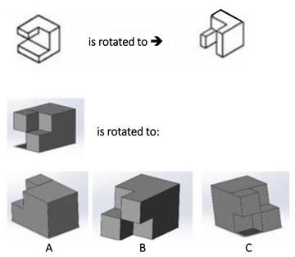
One-Axis Rotations
is rotated to ➔
Can you find the rotation of the gray object that is analogous to the rotation of the white object?
is rotated to:
Notes:
Answer = B:
The middle gray object in the last row is rotated 90 degrees about the z-axis—just like the white object in the top row.
///
Image source: 2015 Jacob L. Segil, College of Engineering and Applied Science, University of Colorado Boulder

Slide 3
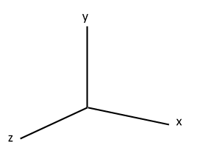
One-Axis Rotations
Three positive axes, x, y and z:
X = horizontal axis
Y = vertical axis
Z = axis coming towards us
vertical
horizontal axis
depth
Notes:
///
Image source: (x, y, z axes)
2016 Jacob L. Segil, College of Engineering and Applied Science, University of Colorado Boulder

Slide 4
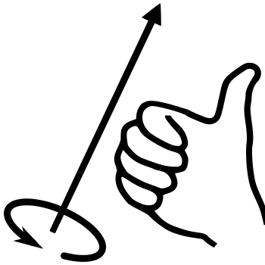
One-Axis Rotations
How to do the right-hand rule:
Point your thumb parallel to the axis you are rotating about and curve your fingers naturally towards the palm of your hand
Your fingers will move in the same way that the object will move
Notes:
The right-hand rule is a mnemonic—which is a learning tool that helps us remember something.
///
Image sources:
(x, y, z axes) 2016 Jacob L. Segil, College of Engineering and Applied Science, University of Colorado Boulder
(drawing with hand) 2009 Schorschi2 and 2011 Das steinerne Herz, Wikimedia Commons {PD} https://en.wikipedia.org/wiki/File:Right-hand_grip_rule.svg

Slide 5
One-Axis Rotations
Tips:
Right-hand rule!
Clockwise = negative rotation; counter-clockwise = positive rotation
90°, 180°, 270° rotations only
“Flag around a flagpole”

Slide 6
Workshop 3 Stations
Station 1: Block Relay
Build an object with 6 blocks
Define the axes and a one-axis rotation
Draw the isometric views before and after rotation
Then pass the object to a neighbor and repeat
Check drawings for accuracy with neighbor
Station 2: Workbook Drill
Individually, answer questions on ODD pages rot1-5 to rot1-17 on scrap paper
Check your answers with the answer key
Station 3: Frozen
In pairs, build an object of any size
Define the axes and a one-axis rotation
Switch objects with partner and draw the isometric view before and after rotation without moving the object – it’s frozen!
Compare drawings with partner and repeat
Station 4: Computer-Aided Visualization
Read Module 7 – Rotations about a Single Axis
Complete the rotations about a single axis exercises
Notes:
Leave this slide up so students know what to accomplish at each station

