Slide 1
Workshop 4
Two-Axis Rotations
Notes:
Spatial Visualization lesson 4/workshop 4
Note: The slides are animated so a mouse or keyboard click brings up the next image, text or slide.

Slide 2
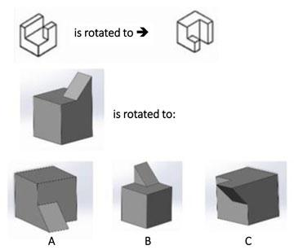
Two-Axis Rotations
Can you find the rotation of the gray object that is analogous to the rotation of the white object?
Notes:
Answer = A:
The far left gray object in the last row is rotated 90 degrees about the negative y-axis and 90 degrees about the negative z-axis—just like the white object in the top row.
///
Image source: 2015 Jacob L. Segil, College of Engineering and Applied Science, University of Colorado Boulder

Slide 3
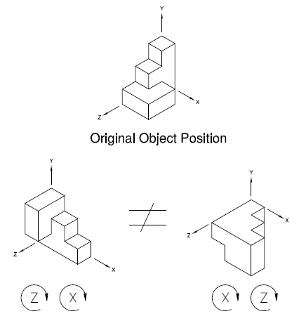
Two-Axis Rotations
Tips:
Right-hand rule!
Clockwise = negative rotation; counter-clockwise = positive rotation
Two-axis rotation is NOT commutative (order matters!)

Slide 4
Workshop 4 Stations
Station 1: Block Relay
Build an object with 6 blocks
Define the axes and a two-axis rotation
Draw the isometric views before and after rotations
Then pass the object to a neighbor and repeat
Check drawings for accuracy with neighbor
Station 2: Workbook Drill
Individually, answer questions on ODD pages rot2-5 to rot2-17 on scrap paper
Check your answers with the answer key
Station 3: Frozen
In pairs, build an object of any size
Define the axes and a two-axis rotation
Switch objects with partner and draw the isometric view before and after rotation without moving the object – it’s frozen!
Compare drawings with partner and repeat
Station 4: Computer-Aided Visualization
Read Module 8 – Rotations about Two Axes
Complete the rotations about two axes exercises
Notes:
Leave this slide up so students know what to accomplish at each station

